Slide 1
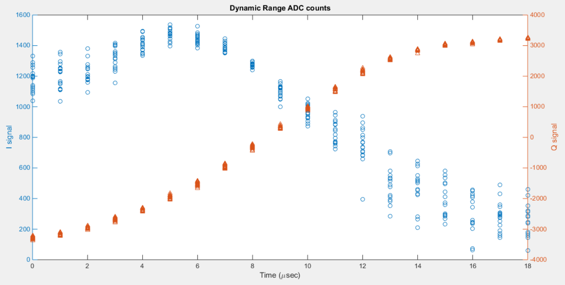
Sample 53
jitRun1_10dB
IPAyCal1_10dB
IPCyCal6_10dB
Folder: 160617_owl
Ref. sample: 50,
IQ sample: 53.

Slide 2
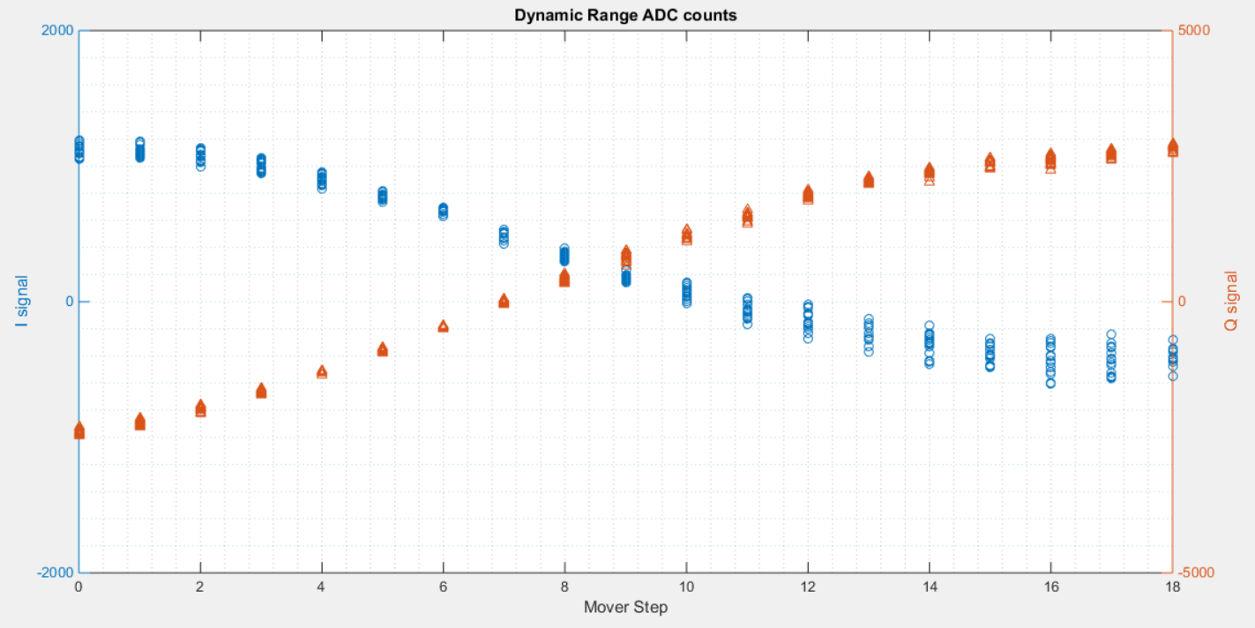
Sample 57
jitRun1_10dB
IPAyCal1_10dB
IPCyCal6_10dB
Folder: 160617_owl
Ref. sample: 50,
IQ sample: 57.

