Slide 1
Main Linac Basics
D. Schulte
10th Linear Collider School, December 2016

Slide 2

Introduction
D. Schulte, 10th Linear Collider School 2016, Main Linac Basics 1

Slide 3
Stepping Stones
Introduction
Accelerating structures
Power efficiency
Beam parameters
  single bunch longitudinal wakefield and energy spread
  beam transport and emittance
  transverse wakefields and beam break-up
  multi-bunch effects
Imperfections
Parameter optimisation
D. Schulte, 10th Linear Collider School 2016, Main Linac Basics 2

Slide 4
Generic Linear Collider Design
damping
main linac
detector
main linac
damping
ring
ring
e- source
RTML
BDS
BDS
RTML
e+ source
D. Schulte, 10th Linear Collider School 2016, Main Linac Basics 3

Slide 5
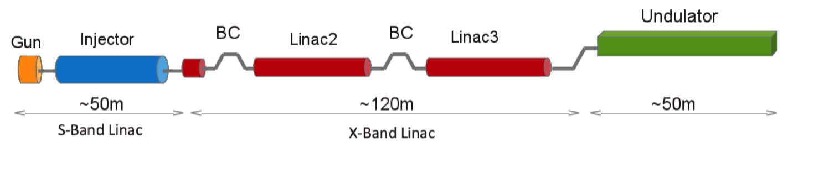
Generic FEL
Normal conducting FEL shown
But superconducting similar in concept
D. Schulte, 10th Linear Collider School 2016, Main Linac Basics 4

Slide 6
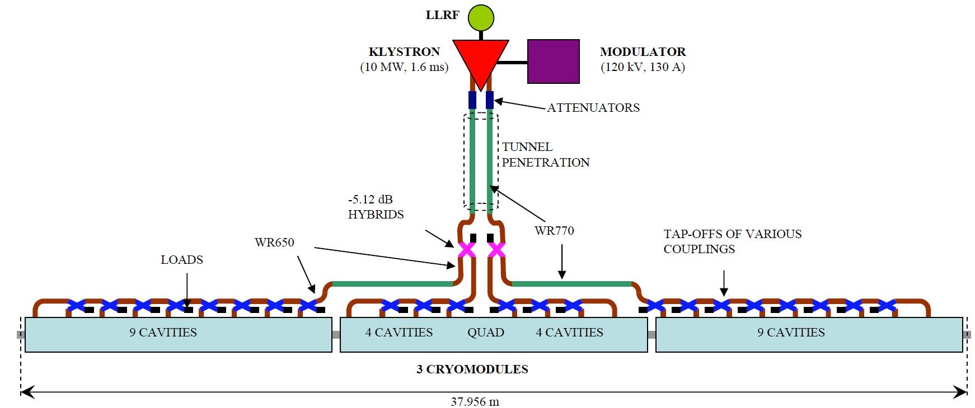
RF Unit Design Concept (old ILC, European FEL)
Most relevant components for the beam
  accelerating structures
  quadrupoles
  beam position monitors (BPMs) and correctors
D. Schulte, 10th Linear Collider School 2016, Main Linac Basics 5

Slide 7
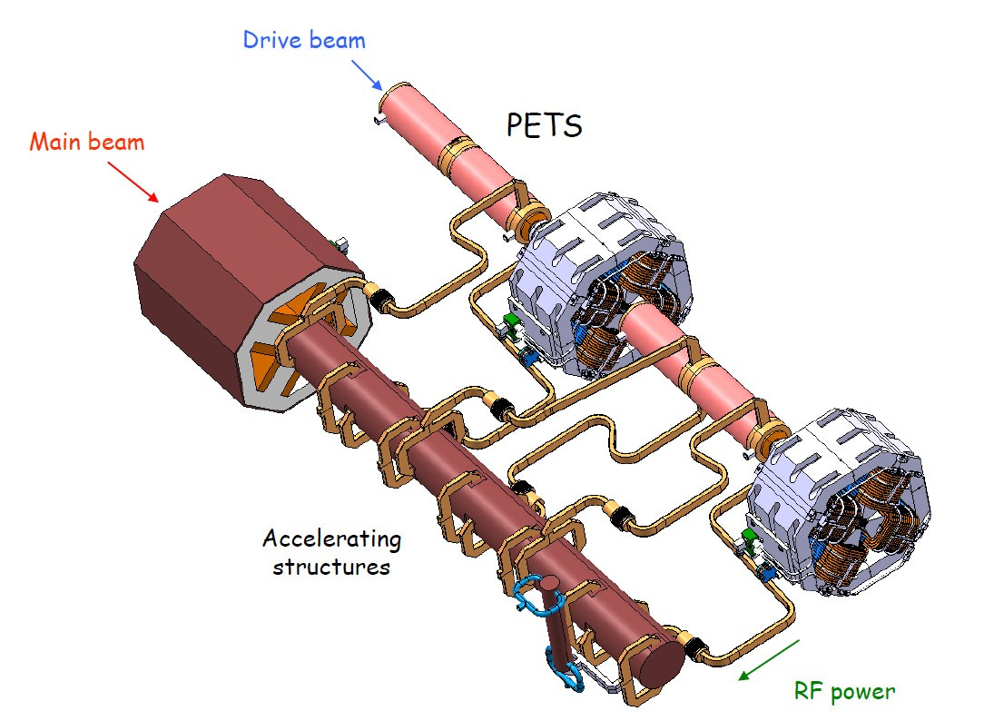
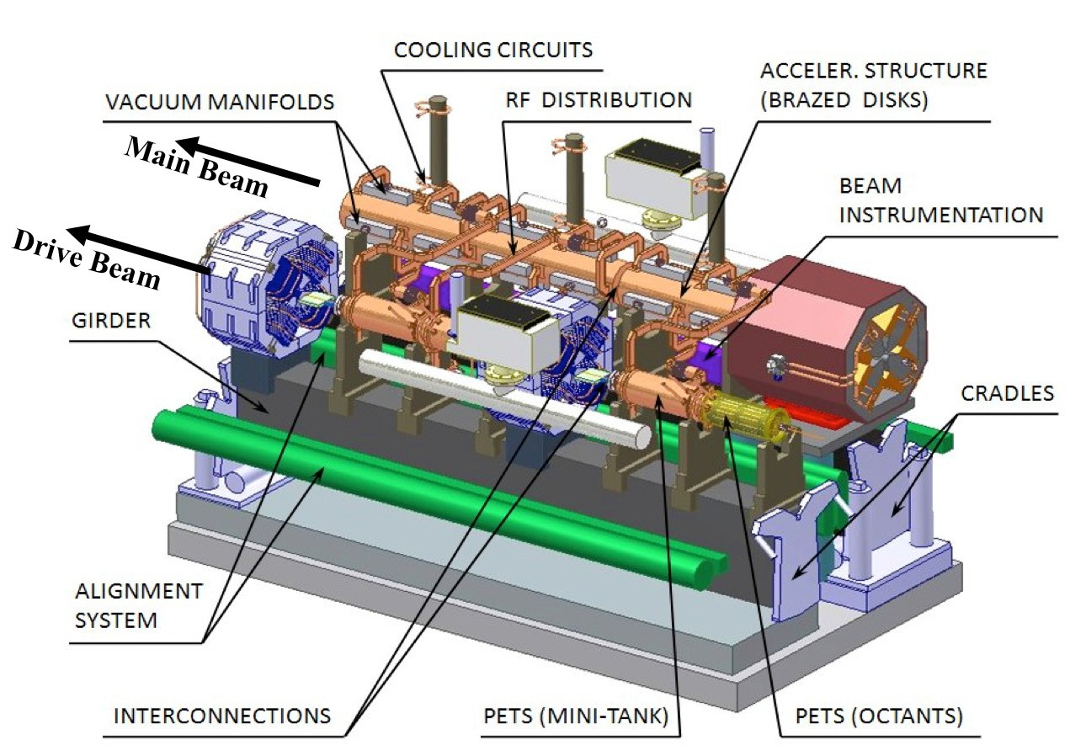
Module Design (CLIC)
Five types of main linac modules
Drive beam module is regular
Most relevant components for the beam
  accelerating structures
  quadrupoles
  beam position monitors (BPMs) and correctors
D. Schulte, 10th Linear Collider School 2016, Main Linac Basics 6

Slide 8
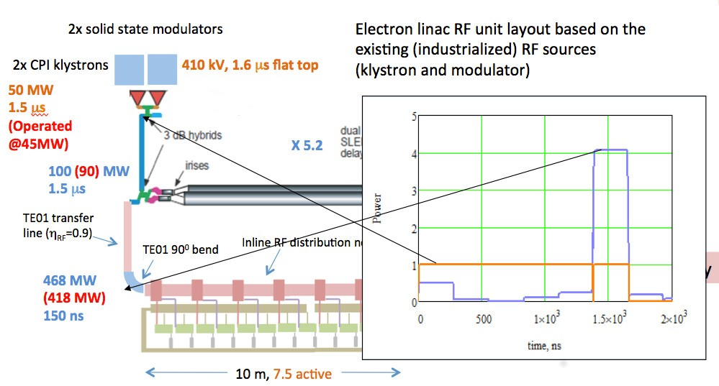
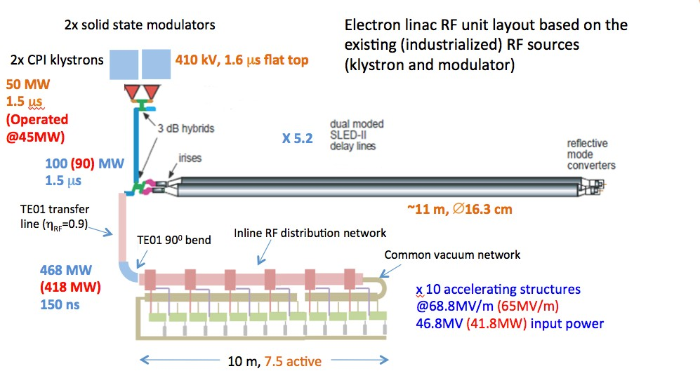
Klystron-based Normal Conducting Module
Klystron Module for CLIC at low energy
FEL module
  Could use single klystron per compressor
D. Schulte, 10th Linear Collider School 2016, Main Linac Basics 7

Slide 9
Why is the Main Linac Important?
In linear colliders two main parameters that are important for the physics experiments
  collision energy
  luminosity, a measure for the rate of events at the interaction point
The main linac is the main component to accelerate the beam
⇒ it is responsible for the beam energy
  the main relevant parameter is the accelerating gradient
The main linac is the main consumer of power
⇒ it is an important limitation for the beam current
  the luminosity depends on the beam current
The main linac is one of the main sources of emittance growth
⇒ the emittance is a parameter that affects the luminosity
There is a third parameter which the main linac affects very much, the cost
  is the society willing to pay for it?
D. Schulte, 10th Linear Collider School 2016, Main Linac Basics 9

Slide 10
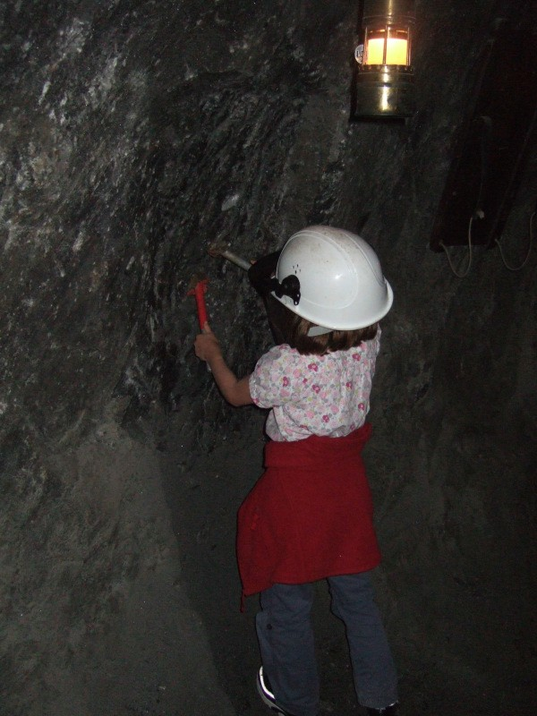
Cost Impact
In ILC 60% of the cost is in the ML
The long tunnel is expensive
  and important for the schedule (tunnel boring machines)
The installed components are expensive
The linac drives other machine compo- nents
  large damping rings in ILC to be able to store the full bunch train
  drive beam complex in CLIC
In FELs the linacs are also important cost items, e.g. 1/3 of the SWISSFEL
D. Schulte, 10th Linear Collider School 2016, Main Linac Basics 10

Slide 11
Luminosity and Parameter Drivers
Can re-write normal luminosity formula
H_{D} : pinch enhancement, typically 1-2
N : number of particles per bunch
n_{b} : number of bunches per train
f_{r} : number of trains per second
σ_{x,y} : transverse beamsizes
Beam power
Luminosity
spectrum
Beam Quality
(+bunch length)
D. Schulte, 10th Linear Collider School 2016, Main Linac Basics 11

Slide 12
Beam-beam Effect
Intense beams for luminosity
Strong electromagnetic fields
Particles travel on curved trajectories
They emit O(1) photons (beamstrahlung)
They can collide with less than nominal energy
D. Schulte, 10th Linear Collider School 2016, Main Linac Basics 11b

Slide 13
Beamstrahlung Optimisation
For CLIC at 3TeV (quantum regime)
I_{beam}
R=σ_{x}/σ_{y}
CLIC parameter choice n_{γ} ≈ 2
Or use very short bunches?
D. Schulte, 10th Linear Collider School 2016, Main Linac Basics 11c

Slide 14
Luminosity and Parameter Drivers
In the classical regime
In the quantum regime
D. Schulte, 10th Linear Collider School 2016, Main Linac Basics 11

Slide 15
Some Fundamental Parameters
Parameter | Symbol [unit] | SLC | ILC | CLIC | CLIC
Centre of mass energy | E_{cm} [GeV] | 92 | 500 | 380 | 3000
Luminosity | L [10³⁴cm⁻²s⁻¹] | 0.0003 | 1.8 | 1.5 | 6
Luminosity in peak | L_{0.01} [10³⁴cm⁻²s⁻¹] | 0.0003 | 1 | 0.9 | 2
Gradient | G [MV/m] | 20 | 31.5 | 72 | 100
Particles per bunch | N [10⁹] | 37 | 20 | 5.2 | 3.72
Bunch length | σ_{z} [μm] | 1000 | 300 | 70 | 44
Collision beam size | σ_{x,y} [nm/nm] | 1700/600 | 474/5.9 | 143/2.9 | 40/1
Vertical emittance | ε_{x,y} [nm] | 3000 | 35 | 30 | 20*
Bunches per pulse | n_{b} | 1 | 1312 | 352 | 312
Bunch distance | Δz [mm] | - | 554 | 0.5 | 0.5
Repetition rate | f_{r} [Hz] | 120 | 5 | 50 | 50
⇒ Beam Parameters are very different
We will see that this is driven by the main linac

Slide 16

Accelerating Structures

Slide 17
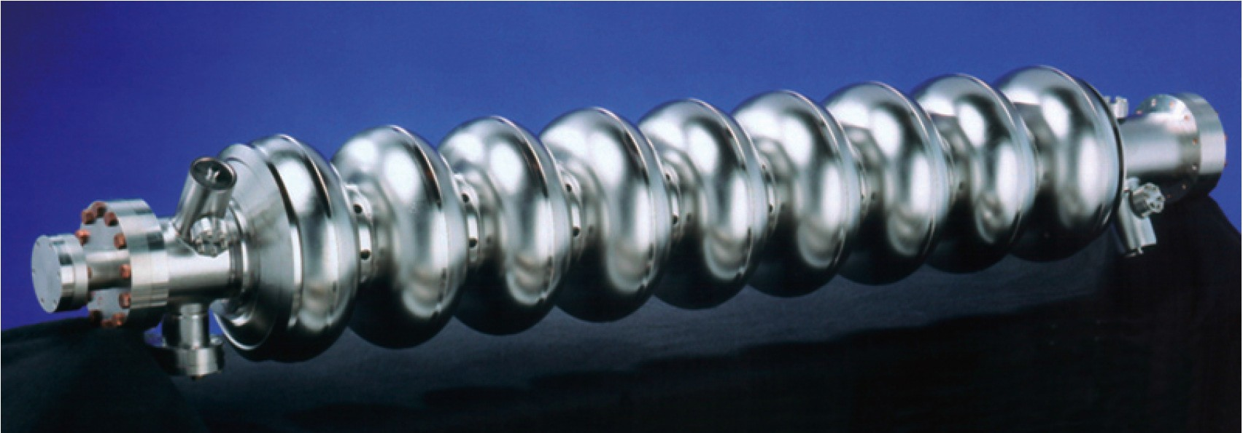
Accelerating Structure (ILC)
About 1 m long cavity with 31.5 MV/m,
  super-conducting
  1.3 GHz
  standing wave
  constant impedance

Slide 18
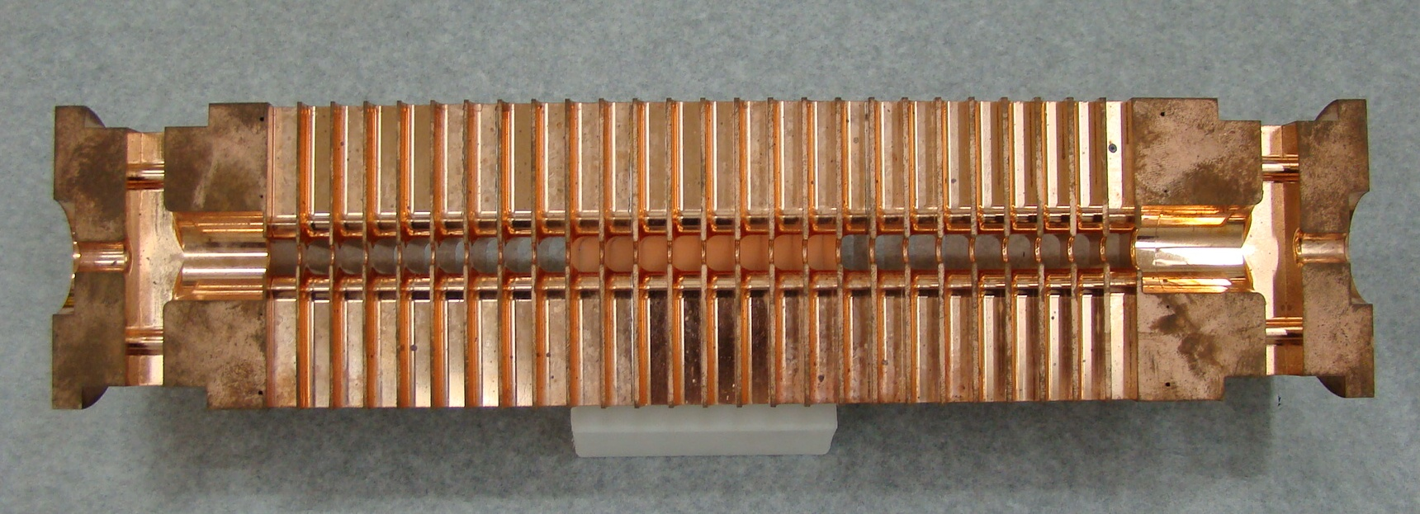
Accelerating Structure (CLIC)
About 23 cm long structure with G = 100 MV/m
  normal-conducting
  12 GHz
  travelling wave
  constant gradient (almost)

Slide 19
Types of Structures
Accelerating structures can be normal-conducting or superconducting
  in a superconducting structure very little power is lost in the walls
  In a normal-conducting structure a significant power is lost in the walls (in most cases)
They can be standing wave or travelling wave structures
  In standing wave the energy is trapped and the RF wave is reflected at the ends creating the standing wave
  In a travelling wave structure power is coupled into one end and extracted at the other
They can be constant impedance structures of constant gradient structures (or some- thing else)
  all cells can be the same design or the design differs along the structure

Slide 20
Choice of Material
The material is the most fundamental design choice
Super-conducting structures
  allow a small beam current
⇒ low background per unit time in IP
⇒ intra-pulse feedback is possible everywhere
Normal conducting structures
  allow for high gradient
⇒ high centre-of-mass energy
  need high beam current
⇒ significant wakefield effects
  use short pulses
⇒ smaller damping ring

Slide 21
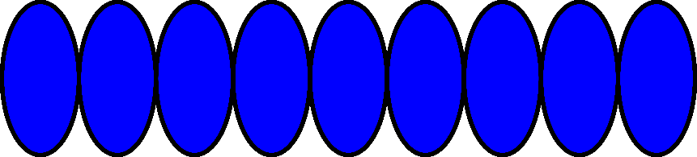
Standing Wave Structures
klystron
load
damping antenna
The power is feed into one end
  the power is reflected at the coupler
  as the power in the cavity is increasing, the reflection is reduced
there is a level when there is no reflection
⇒ now switch on the beam

Slide 22
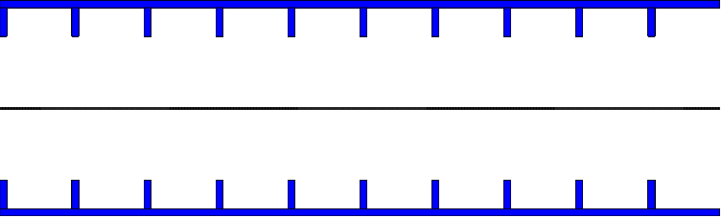
Standing Wave Structures
klystron
load
damping antenna

Slide 23
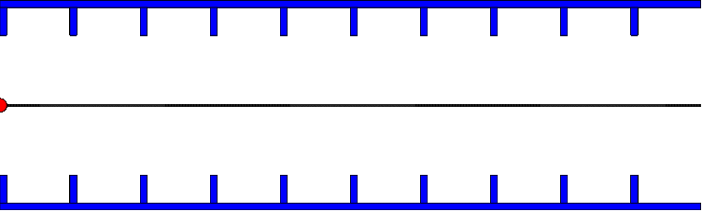
Standing Wave Structures
klystron
load
damping antenna

Slide 24
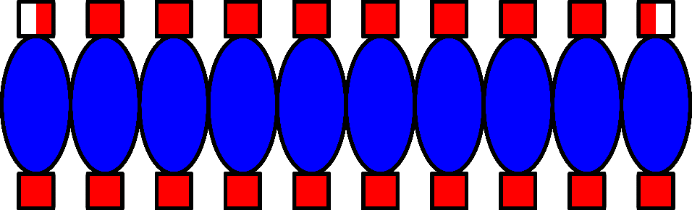
Travelling Wave Structures
klystron
damping waveguides
load
The power is feed into one end
  no reflection if designed properly
It slowly moves through the structure
  group velocity is typically a few percent of the speed of light

Slide 25
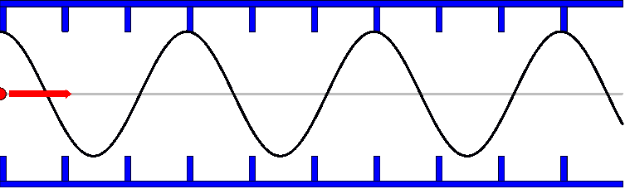
Travelling Wave Structures
klystron
damping waveguides
load

Slide 26
Choice of Structure Design
In a super-conducting structure little power is lost in the wall
  so can afford a small beam current
  little power is extracted but over long times
  natural choice is standing wave structures, to avoid all the power draining out at the end
  no need to compensate extraction of energy along the structure
For a normal conducting structure all four options (constant impedance/constant gradi- ent and standing/travelling wave) could be used
  for CLIC travelling wave, constant gradient structures have been chosen
  travelling wave structures avoid recirculators to keep the energy in the structures
  constant gradient allows to reach higher effective gradients
D. Schulte, 10th Linear Collider School 2016, Main Linac Basics 20

Slide 27
Choice of Frequency
Obviously the frequency choice differs
  CLIC: 12 GHz
  ILC: 1.3 GHz
So what drives the choice?
ILC uses super-conducting structures
  high frequencies lead to higher surface resistance
- high frequencies lead to higher wakefield amplitudes W_{L} ∝ f ², W ∝ f ³
⊥
- a very low frequency makes the structures expensive (dimension ∝ λ)
⇒ so a frequency with existing power sources has been picked
CLIC uses normal-conducting structures
  higher frequencies help in reaching high gradients
  but also lead to higher wakefields
⇒ full optimisation of the design has been performed to achieve the lowest cost for a fixed energy and luminosity target

Slide 28

RF Power Generation

Slide 29
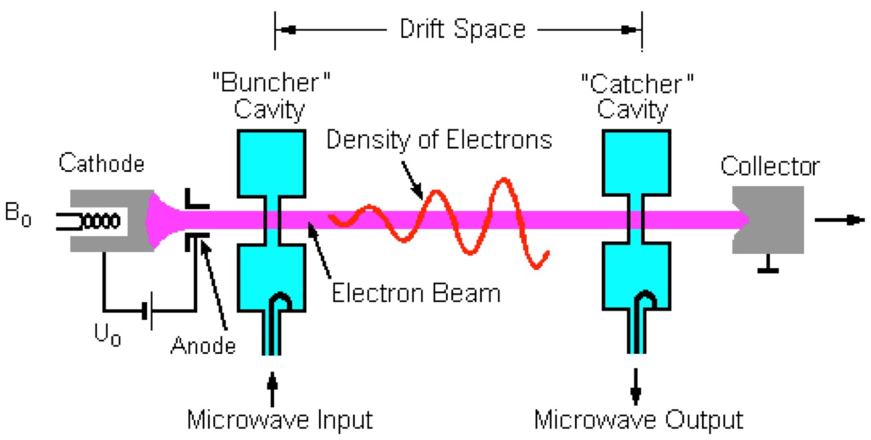
Klystron
Usually the input RF power for the accelerating structures is provided by klystrons
In ILC or superconducting FELs klystrons are used to directly power the main beam
In CLIC they power the drive beam accelerator
  only at low energy could use them in the main linac
In normal conducting FEL would use klystrons and pulse compressors
Klystrons tend to be more efficient at low frequencies and long pulses

Slide 30
Power Needs
 | ILC ML | CLIC ML | CLIC DB
Peak power/structure [MW ] | 0.2 | 61.3 | 20
Structures | 16,000 | 140,000 | 1100
Total peak power [GW ] | 3 | 8,600 | 22
Pulse length [µs] | 1,600 | 0.244 | 142
Note: Numbers are rounded, new CLIC drive beam numbers used
Main cost drivers are peak power, average power and energy per pulse
  the first make the klystron tough
  the second the modulators
Very short high peak power for CLIC main linac would be very expensive
⇒ hence the drive beam scheme with resonable klystron peak power
For ILC and CLIC drive beam average power is important for cost
  but there is nothing we can do to reduce it if we do not want to compromise luminosity
ILC klystrons: 1.3 GHz, 5 × 1.5 ms at 10 MW
CLIC drive beam klystrons: 1 GHz, 50 × 140 µs at 20 MW

Slide 31





Drive Beam (CLIC)
540 klystrons
20 MW, 142 µs
Drive Beam
circumferences delay loop 73 m CR1 293 m
CR2 439 m
540 klystrons
20 MW, 142 µs
drive beam accelerator
2.4 GeV, 1.0 GHz
drive beam accelerator
2.4 GeV, 1.0 GHz
2.5 km
delay loop
delay loop
2.5 km
CR2
CR2
CR1
CR1
decelerator, 25 sectors of 878 m
BC2
BDS
BDS
BC2
e– main linac, 12 GHz, 100 MV/m, 21 km
2.75 km
IP
2.75 km
e⁺ main linac
TA
TA
CR combiner ring TA turnaround DR damping ring
50 km
PDR predamping ring BC bunch compressor
BDS beam delivery system
booster linac
2.86 to 9 GeV
Main Beam
IP interaction point dump
e– injector
2.86 GeV
_{e}– DR
427 m
_{e}+ _{e}+
DR PDR
427 m 389 m
e⁺ injector
2.86 GeV
Can see the CLIC drive beam complex as a single huge klystron
- with a fancy pulse compression

Slide 32

Power Efficiency

Slide 33
Coordinate Systems
We use two frames, the laboratory frame and the beam frame
The nominal direction of motion of the beam is called s in the laboratory frame, the beam moves toward increasing s
The longitudinal direction is called z in the beam frame, with particles at smaller z moving ahead of particles with larger z
A particle preserves its longitudinal position within the beam
The transverse dimensions are x in the horizontal and y in the vertical plane, in both coordinate systems
People use different systems so find out what they talk about

Slide 34
Beam Power
Power consumption of the main linac is a prime consideration
  electricity cost
  equipment cost
Examples of total beam power
  ILC: P_{beam} = 2n_{b} f_{r} N E ≈ 11 MW
  CLIC: P_{beam} ≈ 28 MW
Wall plug power can be transformed into RF power with limited efficiency
The efficiency of transforming RF power into beam power depends on
  structure design
  the gradient
  the beam parameters
The structures need to be cooled (especially in a super-conducting machine)

Slide 35
RF to Beam Power Efficiency
The RF to beam efficiency can be calculated looking a single structure/cavity during the RF pulse
Efficiency is
Assuming constant RF pulse power we can calculate
P_{beam} is the power going into the beam during the beam pulse, P_{RF} is the RF power during the RF pulse
We simplify
Note: what I call τ_{f ill} contains several components of which the fill time is the most important; RF experts will learn more

Slide 36
RF to Beam Power Efficiency
In a super-conducting cavity
  little RF power is lost in the walls during the pulse
  but the cooling requires some significant overhead
  some cooling is also needed against heating from the environnement
In normal conducting structures
A significant fraction of the RF power is lost into the walls
some power will be draining out of the travelling wave structure (usually)
D. Schulte, 10th Linear Collider School 2016, Main Linac Basics 30

Slide 37
Shunt Impedance R and P_{loss}
Note: the concept of shunt impedance will be important for all efficiency effects The field in a structure induces losses in the walls
The loss is described by R, the shunt impedance, defined as
Note: the impedance is here given in “Linac Ohms” , in “Circuit Ohms” the number would be only 50%: 1”Linac Ohm”= 0.5”Circuit Ohm”
So one obtains easily the power
⇒ High R means little losses

Slide 38
Losses vs. Acceleration
Power loss per unit length in the wall
Power per unit length given to the beam
R' is shunt impedance per unit length
The ratio is
⇒ For high efficiency want
lower gradient G
higher current I
higher shunt impedance R^{t}
The average beam current is determined by the luminosity goal
The machines are pulsed to increase the beam current while the RF is on
So what limits the shunt impedance and the beam current?

Slide 39
Shunt Impedance
The shunt impedance R depends on three main factors
structure geometry
structure material
RF frequency
The energy stored in the structure is only a function of the geometry
all energy is in the vacuum
described by R/Q (and ω)
The rate of losses depends on the surface material, the shape and the RF frequency
material is most important
described by Q
Hence, the value of R can be written as

Slide 40
Stored Energy R/Q

Slide 41
Remark: Scaling of R/Q
The structure geometry defines
Energy in the structure (same gradient) scales with the volume
the energy gain GL scales with
and the frequency ω as
Hence
A typical value for superconducting cavities is 110Ω per cell

Slide 42
Quality Factor Q

Slide 43
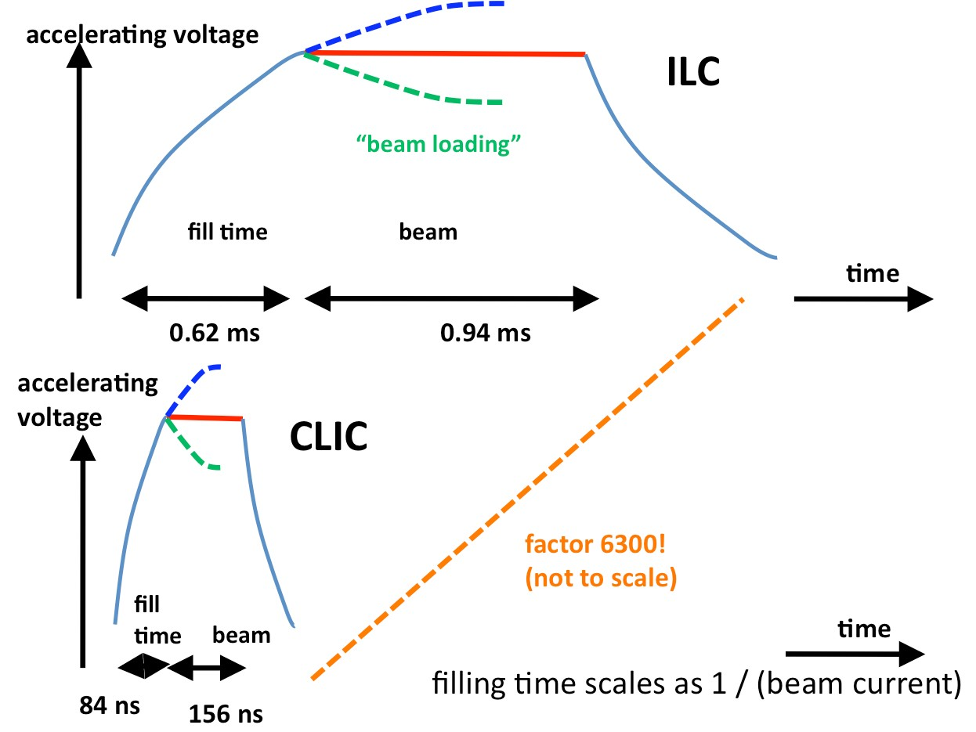
Required RF Pulse Length (Outdated Numbers)

Slide 44
Filling a Standing Wave Cavity

Slide 45
Filling a Standing Wave Cavity (cont.)

Slide 46
Filling a Standing Wave Cavity (cont.)
D. Schulte, 10th Linear Collider School 2016, Main Linac Basics 40

Slide 47
Filling A Travelling Wave Cavity
In a travelling wave, normal conducting structure the fill time is the time for an energy to flow from input coupler to output coupler
  in principle need to add rise time (but for RF experts)
⇒ get your number from the RF expert
We will discuss the wakefield view of the beam loading to understand
  reason for output power
  beam loading compensation

Slide 48
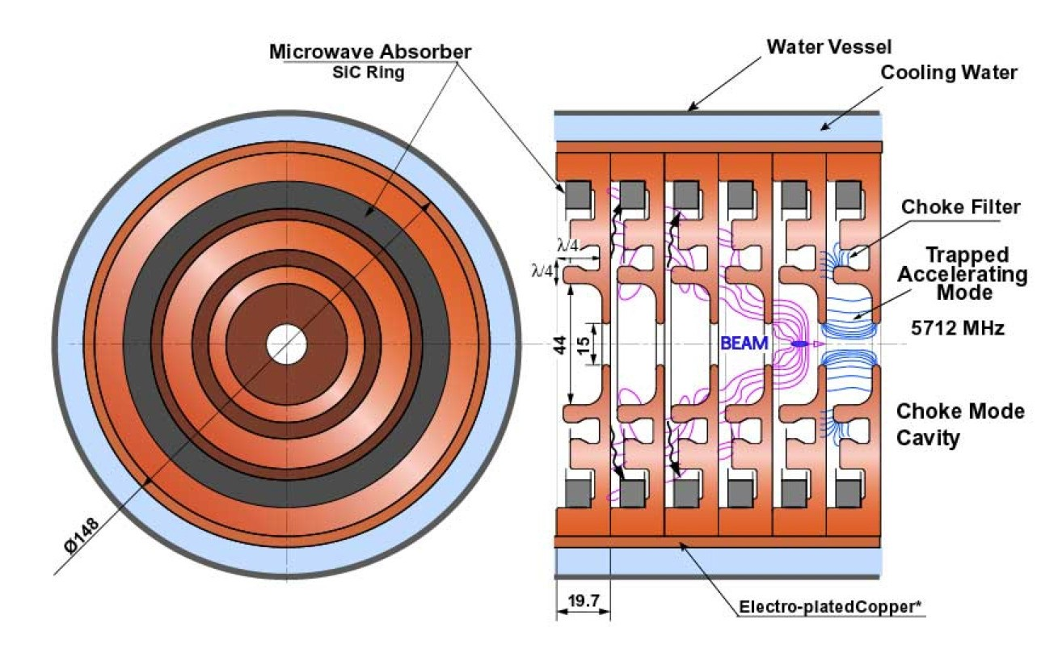
Passage of a Particle
A particle in the structure will
extract or leave energy (depending on energy in structure)
induce electromagnetic wakefields
  cosine-like Logitudinal (monopole) and sine-like transverse (dipole) modes for offset driving particles
  The wakefield does not depend on the energy in the structure
The longitudinal wakefield W_{L}(z) expresses the average acceleration of a particle at
time z along the structure [V/mC]
The transverse wakefield W⊥(z) expresses the average transverse deflection of a par- ticle at time z along the structure [V/m²C]

Slide 49
Wakefield

Slide 50
Wakefield and Power Extraction

Slide 51
Beam Loading in Travelling Wave Structure
1.5
RF gradient
beam loading
sum
1
G/G₀
0.5
0
-0.5
-1
0
0.2
0.4
0.6
0.8
1
s/L
1.5
1
0.5
G/G₀
0
-0.5
-1
RF gradient
beam loading
-1.5
sum
0
0.2
0.4
0.6
0.8
1
s/L

Slide 52

Beam Loading in Travelling Wave Structure
1.5
RF gradient
beam loading
sum
1
G/G₀
0.5
0
-0.5
-1
0
0.2
0.4
0.6
0.8
1
s/L

Slide 53
Beam Loading Compensation
1.5
RF gradient
beam loading
sum
1
G/G₀
0.5
0
-0.5
-1
0
0.2
0.4
0.6
0.8
1
s/L

Slide 54

Beam Loading Compensation

Slide 55
Structure Tapering
1.5
1
0.5
G/G₀
0
-0.5
-1
RF gradient
beam loading
sum
-1.5
0
0.2
0.4
0.6
0.8
1
s/L

Slide 56
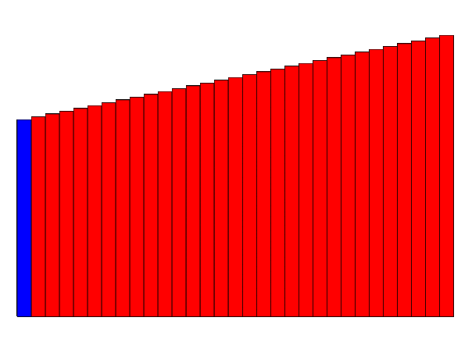
Structure Tapering
1.5
1
0.5
G/G₀
0
-0.5
-1
RF gradient
beam loading
sum
-1.5
0
0.2
0.4
0.6
0.8
1
s/L

Slide 57
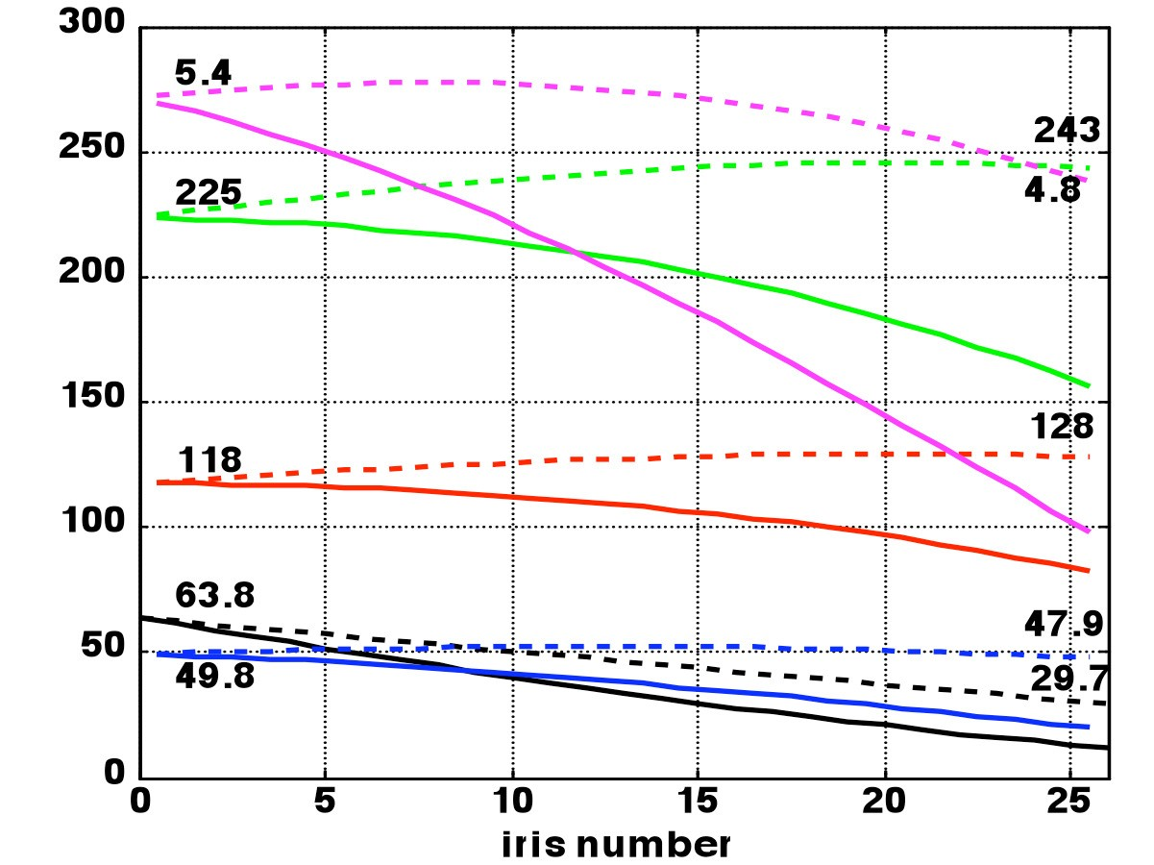
Constant Impedance vs. Constant Gradient
In a travelling wave structure, the beam extracts energy during its passage
⇒ the gradient will be lower at the end of the structure
This can be avoided by reducing the iris radius along the structure (tapering)
  the smaller irises produce more gradi- ent per power flowing through them
An additional difference exists for the long-range transverse wakefields
  in a constant impedance structure one strong wakefield mode exists
  in a tapered structure many small modes exist which reduces the effec- tive wakefield

Slide 58
RF to Beam Power Efficiency Summary

Slide 59
Remark: Drive Beam Accelerator
1.5
1
0.5
G/G₀
0
-0.5
-1
RF gradient
beam loading
sum
-1.5
0
0.2
0.4
0.6
0.8
1
s/L

Slide 60
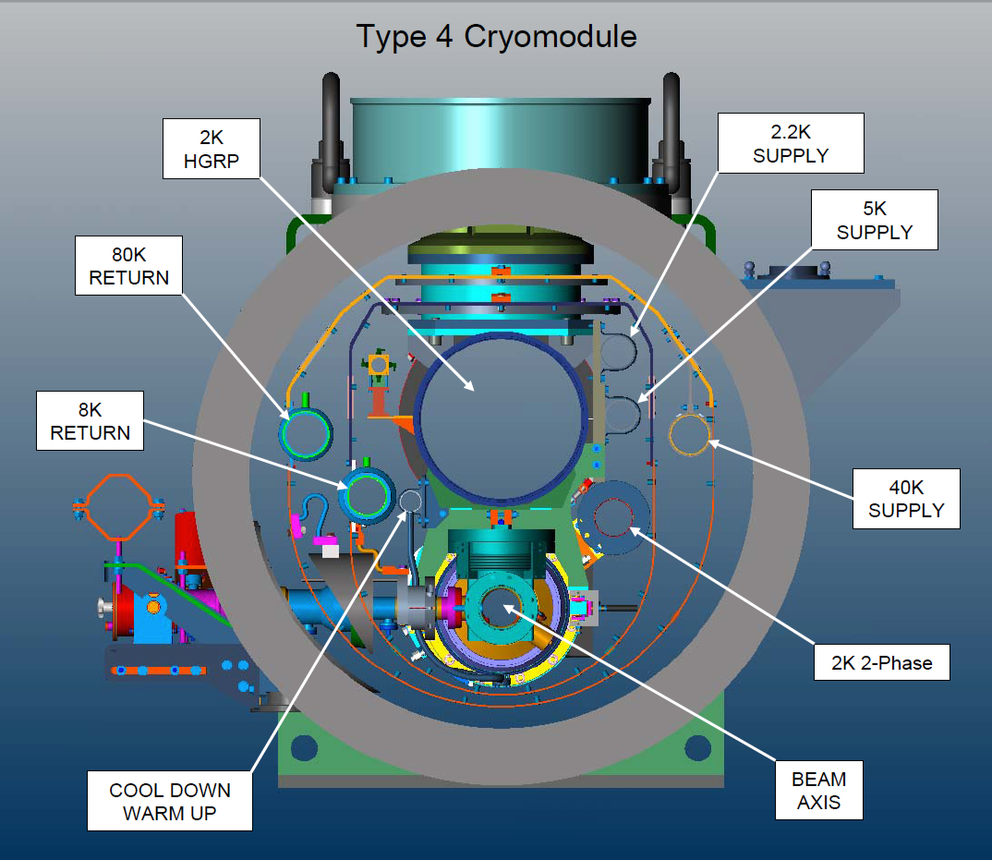
ILC Limiting Factors for Efficiency
Cavities have small losses
About 1W/m
But cooling costly at low temperatures
Remember Carnot:
The typical heat load of 1 W/m
about 1 kW/m for cryogenics
Average RF power: 1.6kW/m (3kW/m)
Power into beam about 0.7kW/m

Slide 61
Superconducting CW Operation
Can easily calculate for ILC that operating CW leads to a total heat load of 1.5 MW
  this requirs 1 GW of power to cool
⇒ need the pulsed operation
In an FEL need less final energy
  can afford a lower gradient
  which may also increase the Q
⇒ CW operation is interesting
- no losses due to the filling time

Slide 62
CLIC Limiting Factors for the Efficiency
A lower gradient G
  leads to a longer main linac hence to higher cost
  requires reducing the current
A higher shunt impedance R^{t}
  leads usually to larger wakefields also in the transverse hence to a less stable beam
A higher beam current I
  leads to a less stable beam
An optimisation can be performed of the whole machine
  varying G and R^{t} and adjusting the current to the highest possible value
  selecting the best combination taking into account luminosity and cost
This optimisation has indeed been performed for CLIC
⇒ let us see which is the highest current for a given structure and gradient

Slide 63

Beam Parameters:
Longitudinal Wake and Bunch Charge Limits
Correlating bunch length and charge

Slide 64
Wakefields and Bunch Length
Aim for shortest possible bunch to reduce transverse wakefield effects
Energy spread into the beam delivery system should be limited to about 1% full width or 0.35% rms
Multi-bunch beam loading compensated by RF
Single bunch longitudinal wakefield needs to be compensated
⇒ accelerate off-crest
E
z
Limit around average ∆Φ ≤ 12◦
⇒ σ_{z} = 44 µm for N = 3.72 × 10

Slide 65
Specific Wakefields
5000
4500
4000
3500
3000
2500
2000
W_{L} [V/pCm]
0 50 100 150 200 250
z [μm]

Slide 66
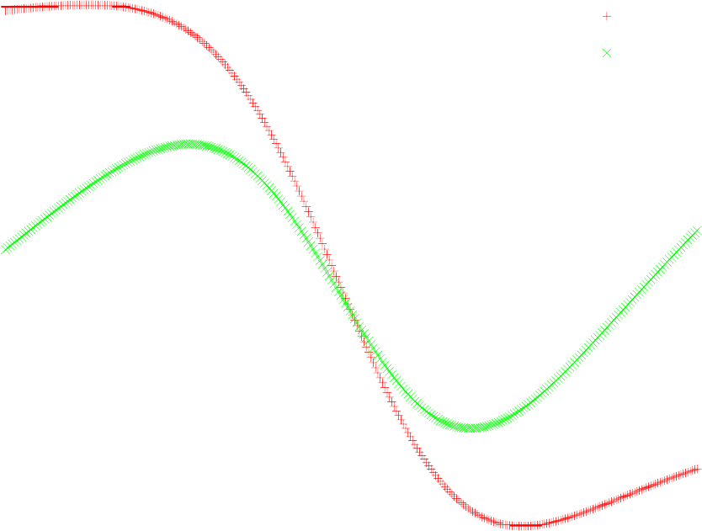
Energy Spread at End of Linac
Phi=0 Phi=12
-0.002
-0.004
-0.006
-0.008
-0.01
-0.012
-0.014
-0.016
-0.018
∆E/E₀
-150
-100 -50
0
z [∝m]
50 100 150
z [μm]

Slide 67
Recipe for Choosing the Bunch Parameters
Decide on the average RF phase
  OK, we fix 12◦
  smaller values give less bunch charge, larger values give more sensitivity to phase jitter
Decide on an acceptable energy spread at the end of the linac
  OK, we choose 0.35%
  mainly from BDS and physics requirements
Determine σ_{z}(N )
  choose a bunch charge
  vary the bunch length until the final energy spread is acceptable
  choose next charge
Determine which bunch charge (and corresponding bunch length) can be transported stably

Slide 68
Simplified Treatment

Slide 69
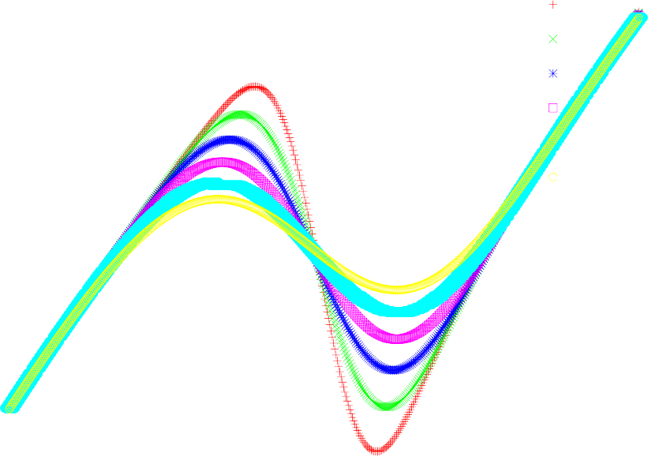
Dependence of Energy Spread on Bunch Length
For a given charge and phase the bunch length is varied
0
-0.0002
-0.0004
-0.0006
-0.0008
-0.001
-0.0012
-0.0014
-0.0016
-0.0018
σ =30∝m
z
σ_{z}=40∝m
σ_{z}=50∝m
σ_{z}=60∝m
∆E [GeV/m]
σ_{z}=70∝m
σ_{z}=80∝m
-250-200-150-100 -50
0 50 100 150 200 250
z [∝m]
D. Schulte, 10th Linear Collider School 2016, Main Linac Basics 60

Slide 70
Note: Energy Spread Along Linac

Slide 71

Beam Parameters: Beam Transport and Emittance
Know σ_{z}(N ) but current limit will depend on wakefields and lattice design, important problem

Slide 72
Emittance
The beam particles do not have identical coordinates
- they occupy some phase space
According to Liouville theorem (from the Liouville equation)
the density in phase space around a trajectory remains constant in an unperturbed system
For some reason particles are conventionally not described by (x, y, z, p_{x}, p_{y}, p_{z}) but by (x, y, z, x', y', E)
⇒ in this representation the “phase space” changes
We use the emittance to describe the phase space volume
  geometric emittance is the actual size in x x' and changes with acceleration
  the normalised emittance is size in x x^{t} for γ = 1 and is constant

Slide 73
Why is the Emittance Important?
The luminosity can be written as
And the beam size is given by
at the IP, a lattice property
ε at the IP, a beam property

Slide 74
Main Linac Emittance Growth
The vertical emittance is most important since it is much smaller than the horizontal one (10 nm vs. 600 nm, 24 nm vs. 8400 nm)
For a perfect implementation of the machine the main linac emittance growth would be negligible
Two main sources of emittance growth exist
  static imperfections
  dynamic imperfections
The emittance growth budget is 5 nm for static imperfections
  i.e. 90% of the machines must be better
For dynamic imperfections the budget is 5 nm
  but short term fluctuation must be smaller to avoid problems with luminosity tuning

Slide 75
Low Emittance Transport Challenges
Beam stability
incoming beam can jitter (have small offsets) and become unstable
lattice design, choice of beam parameters
Static imperfections
errors of reference line, elements to reference line, elements. . .
excellent pre-alignment, lattice design, beam-based alignment, beam-based tuning
Dynamic imperfections
element jitter, RF jitter, ground motion, beam jitter, electronic noise,. . .
lattice design, BNS damping, component stabilisation, feedback, re-tuning, re-alignment
Combination of dynamic and static imperfections can be severe
Lattice design needs to balance dynamic and static effects

Slide 76
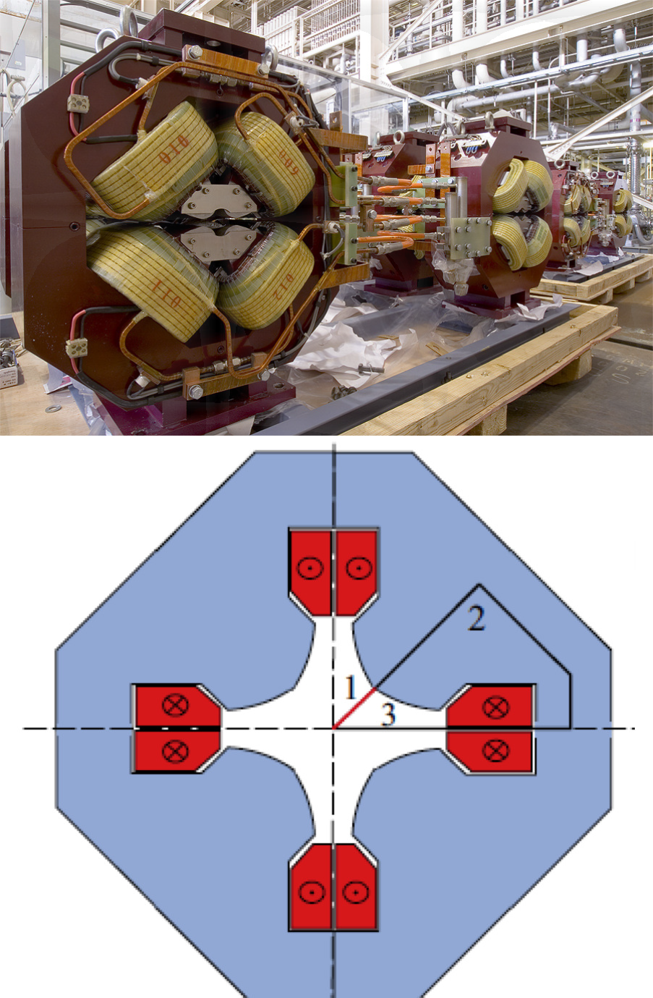
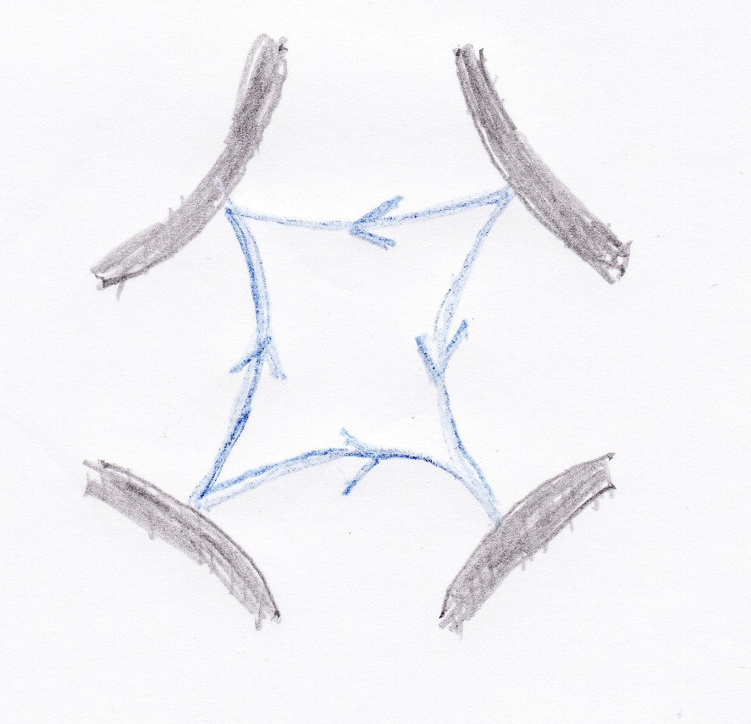
Guiding the Beams: Quadrupoles
The focusing is provided by quadrupoles
They focus in one plane but defocus in the other planes
  octopoles would focus in x and y but defocus in the planes at 45◦
  also their magnetic field is not linear

Slide 77
FODO Lattice
Focusing is achieved by alternating focusing and defocusing quadrupoles

Slide 78
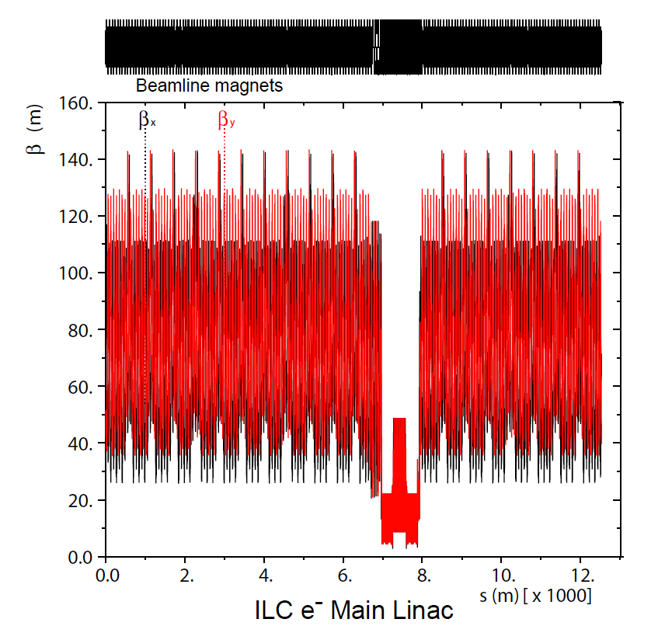
ILC Lattice
In the ILC constant quadrupole spacing is chosen
The phase advance per cell is constant
The phase advance is different in the two planes
- reduces some coupling effects between the two planes
130
120
110
100
90
80
70
60
50
40
30
20
β_{x} β_{y}
β [m]
0 200 400 600 800 1000
s [m]

Slide 79

CLIC Lattice Design
Use strong focusing (small β) to stabilise beam
  10% of linac are quadrupoles
Used β ∝ E^{1/2}, ∆Φ = const
  Quadrupole spacing and length scale as E^{1/2}
⇒ roughly constant fill fac- tor
  phase advance is chosen to balance between wakefield and ground motion effects
Total length 20867.6m
  fill factor 78.6%
70
60
50
β [m]
40
30
20
10
0
0
5000
10000
15000
20000
25000
s [m]
12 different sectors used
Matching between sectors using 7 quadrupoles to allow for some energy bandwidth
Note: fill factor = active length/total length
D. Schulte, 9th Linear Collider School 2015, Main Linac Basics 70

Slide 80
Hill’s Equation and Beta-Functions

Slide 81

Phase Space Representation
-α/βx
(ε/β)
1/2
0
-(ε/β)^{1/2}
-(εβ)^{1/2}
0
x
(εβ)^{1/2}

Slide 82

Beam Parameters:
Transverse Wakefields and Beam Break-up
Limit on the bunch charge

Slide 83
Example of Single Bunch Transverse Wakefield (CLIC)
Fit obtained by K. Bane
For short distances the wake- field rises linear
Summation of an infinite number of sine-like modes with different frequencies
160000
140000
120000
100000
80000
60000
40000
20000
0
W_{T} [V/pCm²]
0
50
100
150
200
250
m]
z [μ

Slide 84
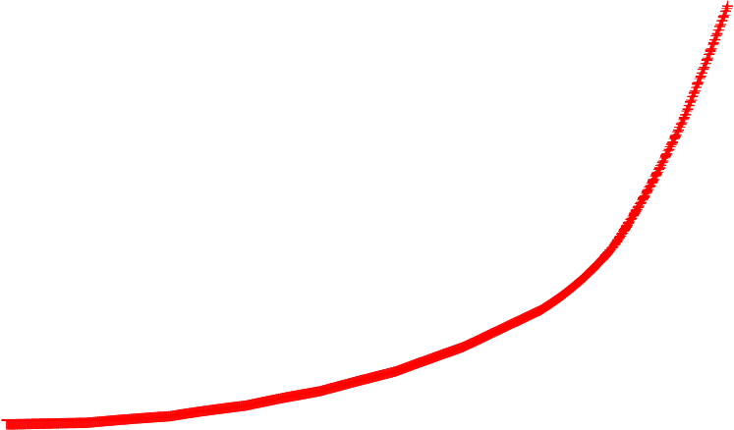
Beam Stability
Transverse stability of beam with initial offset σ_{y}
No energy spread
Emittance with respect to beam axis shown
Acceptable for ILC
Not acceptable for CLIC
9.3
9.2
9.1
9
8.9
8.8
8.7
8.6
8.5
8.4
8.3
8.2
∆ε [nm]
y
0
50 100 150 200
quadrupole #
250 300 350
300
250
200
150
100
50
0
∆ε [nm]
y
0
500
1000 1500
quadrupole #
2000
2500

Slide 85
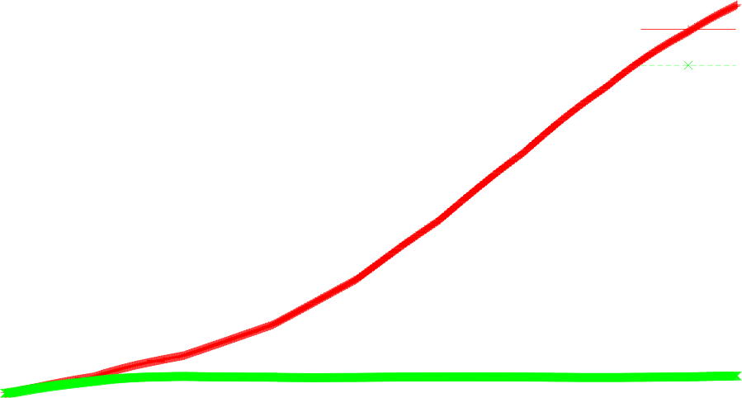
Achieving Beam Stability
Transverse wakes act as defocusing force on tail
⇒ beam jitter is exponentially amplified
BNS damping (Balakin, Novokhatsky and Smirnov) prevents this growth
  manipulate RF phases to have energy spread
  take spread out at end
structure
quad
120
100
80
60
40
20
0
no BNS
BNS
ε_{y} [nm]
0
200 400 600 800 1000
1200
1400
quadrupole #

Slide 86
Two-Particle Wakefield Model
Assume bunch can be represented by two particles and constant K(s) = 1/β²
  second particle is kicked by transverse wakefield
  initial oscillation
For the second particle
Solution is simple with an ansatz (and using P_{L}c = E)
⇒ Amplitude of second particle oscillation is growing linearly with s

Slide 87
Driving Parameters
Factors for the amplitude growth of the second particle
  β: small beta-function (strong focusing) helps
  1/E: high energy helps
  W⊥: small wakefield helps
  N : small bunch charge helps
  s: shorter linac helps (i.e. higher gradient)
The integral is very important for the linac

Slide 88
BNS Damping
For simplicity assume initial offset but no angle
First particle performs a harmonic oscillation
We want the second particle to perform the same oscillation, i.e.
Change unperturbed oscillation frequency of second particle (e.g. change energy)
Including the effect of the first particle yields

Slide 89
BNS Damping
Plugging in our wanted solution for x₂(s)
we find
which is fulfilled for
which requires E₂ < E₁
⇒ No more wakefield effect

Slide 90
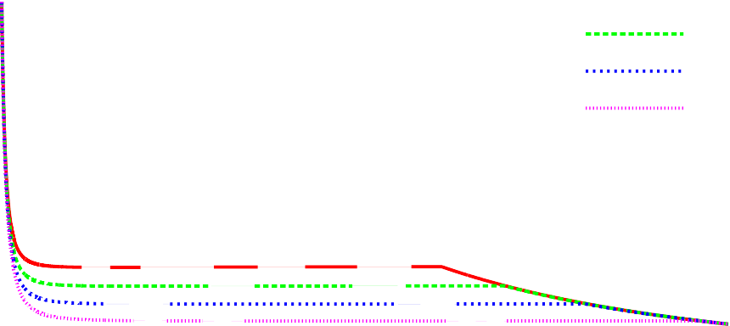
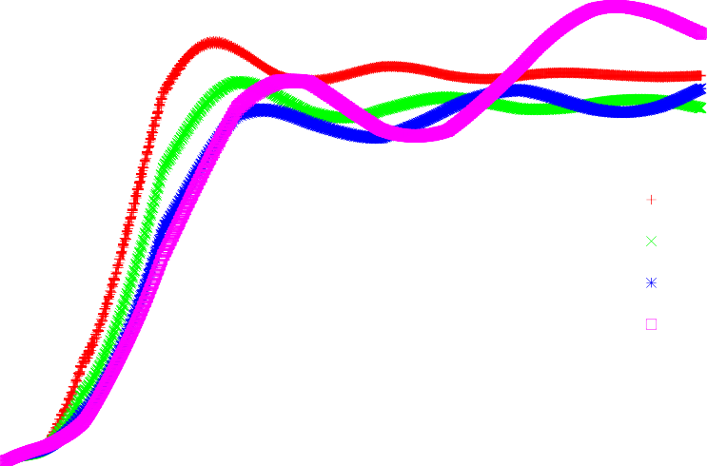
Energy Spread and Beam Stability
0.022
0.02
0.018
0.016
0.014
0.012
0.01
0.008
0.006
0.004
0.002
Φ₂=0º
Φ₂=4º
Trade-off in fixed lattice
  large energy spread is more stable
  small energy spread is better for alignment
Φ₂=8º
Φ₂=12º
σ_{E}/E
0 200 400 600 800 1000 1200 1400
E [GeV]
1.8
1.6
1.4
1.2
1
0.8
0.6
0.4
0.2
0
structure quad
⇒ Beam with N = 3.7 × 10⁹
will be stable
⇒ Beam with larger charge will not be stable (sorry, without plot)
∆ε [nm]
Φ_{RF}=0
o
Φ_{RF}=4
o
y
Φ_{RF}=8º
Φ =12º
RF
0
500
1000 1500
quadrupole number
2000
2500

Slide 91

Beam Parameters: Multi-bunch Effects
Final component of the beam current
D. Schulte, 10th Linear Collider School 2016, Main Linac Basics 82

Slide 92
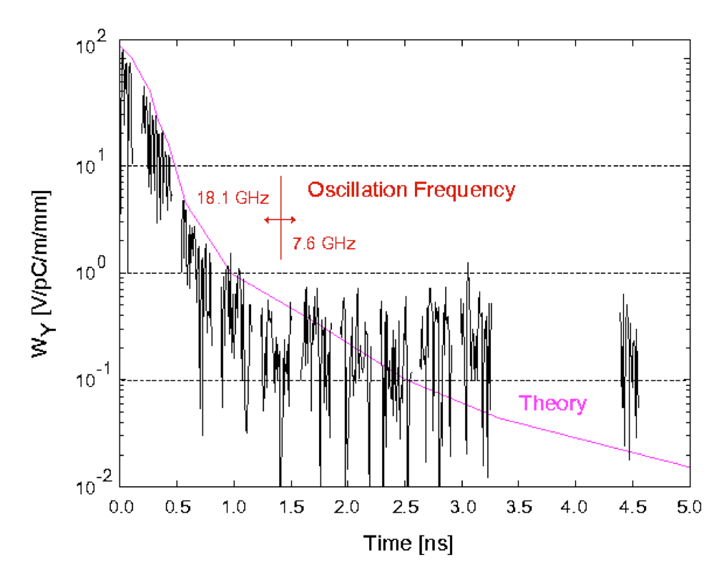
Multi-Bunch Wakefields
Long-range transverse wakefield determines how close one can put the bunches in the linac
Longrange transverse wakefields are sine-like
They can be reduced by
  Damping
  Detuning

Slide 93
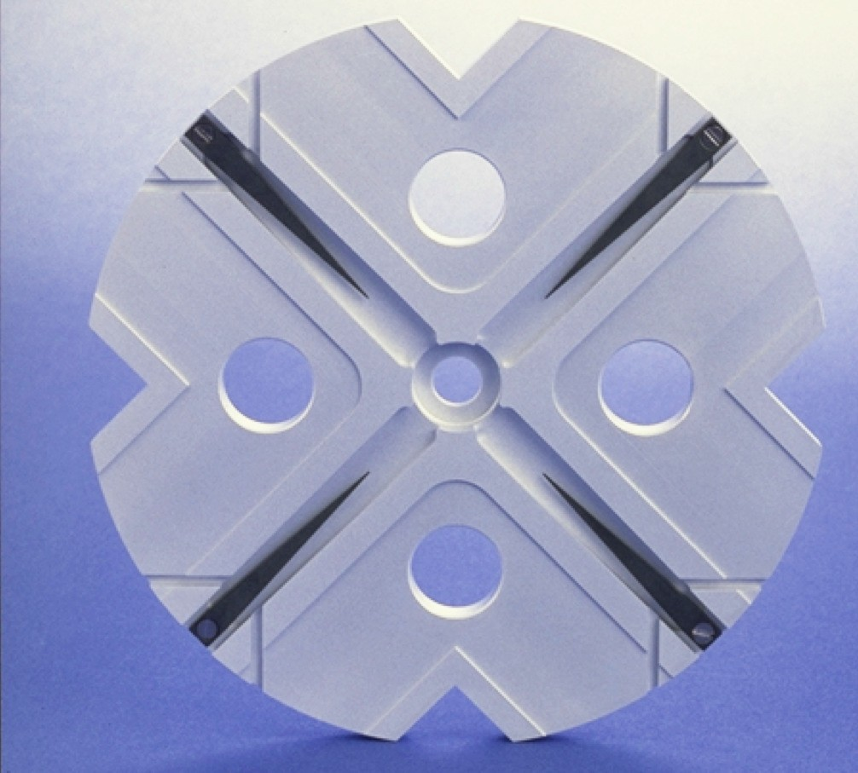
Damping
Damping can be achieved by extracting the power of transverse modes from the structure
In CLIC each cell has waveguides for this pur- pose
  the fundamental mode cannot escape
ILC has antennas at the end
  weaker damping but bunch distance is larger

Slide 94
Effect of Damping
1
0.5
W(t)/W₀
0
-0.5
-1
0
20
40 60
t [arb. units]
80
100

Slide 95
Detuning
To make our life simple we neglect damping
We split the wakefield W (z) = W₀ sin(kz) into two modes
the resulting amplitude is
Integrating over a Gaussian distribution yields
For a limited number of modes, recoherence can occur
⇒ damping is also needed
In ILC detuning is important

Slide 96
Effect of Detuning
1
0.5
W(t)/W₀
0
-0.5
-1
0
20
40 60
t [arb. units]
80
100

Slide 97

Effect of Both
1
det. damp both
0.5
W(t)/W₀
0
-0.5
-1
0
20
40 60
t [arb. units]
80
100

Slide 98

Multi-Bunch Jitter Emittance Growth (CLIC)
Multi-bunch effects can be calculated analytically for point-like bunches
  an energy spread leads to a more stable case
Simulations show
  point-like bunches
  Bunches with energy spread ue to their length
  Bunches also with initial energy spread
Point-like bunches is conservative model
Beam is stable enough
10
8
point length
y y,0
6
full
∆ε /∆ε
4
2
0
-3
-2
-1 0 1
W₁/6.6kVpC⁻¹m⁻²
2
3

Slide 99
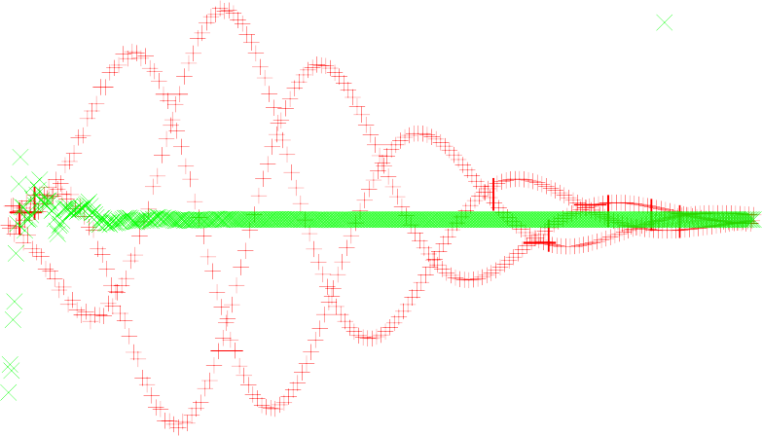
Static Multi-Bunch Effects (ILC)
5
4
3
2
1
0
-1
-2
-3
-4
-5
no det.
det.
Simulation of long-range transverse wakefield effects
With no detuning
With random detuning from cavity to cavity
Cavity detuning is essential
Need to ensure it is present
∆y/σ_{y}
All main linac cavities are scattered by 500 µm
Long-range wakefields are represented by a number of RF modes
0 50 100 150 200 250 300 350 400 450 500
bunch number
Note: results depend on exact frequency of transverse modes
  some uncertainty in the prediction
  but not a worry with detuning
D. Schulte, 10th Linear Collider School 2016, Main Linac Basics 90

Slide 100
Beam Jitter (ILC)
Perfect machines used
100 machines simulated
- TESLA wakefields with 0.1% RMS frequency spread
100
80
p(∆ε >∆ε ) [%]
y,0
60
- beam set to an offset
y,
40
5% bunch-to-bunch charge variations in uncorrected test beam
additional relative emit- tance growth due to multi-bunch is deter- mined
20
0
-4
-2
2
(∆ε -∆ε )/∆ε [%]
y y,0 y,0
0
4

Slide 101
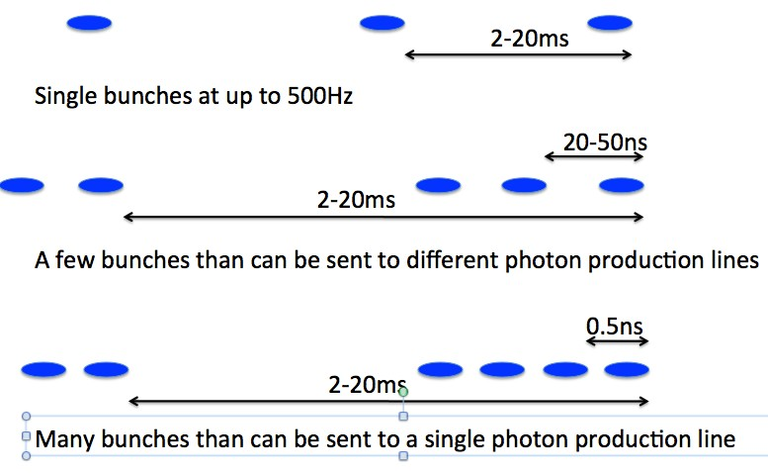
Normal Conducting FEL
The minimum bunch spacing in an FEL is given by the ability to use the beam
If bunches need to be separated into different lines need to have some nanoseconds spacing
- and need one station per bunch
Swiss FEL plans a couple of bunches per train
Room for improvement

Slide 102

Imperfections

Slide 103
Introduction
Have now been able to design a lattice that can transport the beam
Need to determine how the imperfections in the machine affect the emittance preser- vation
Will discuss the misalignment of elements
  most important source of static emittance growth
Have two ways to deal with tight tolerances for imperfections
  work on the lattice to loosen tolerances
  push R&D to satisfy tighter tolerances
  e.g. in CLIC strong effort is ongoing to push imperfections down by about an order of magnitude

Slide 104
Element Misalignments
Pre-Alignment imperfections can be roughly categorised into short-distance and long- distance errors
To first order, the imperfections can be treated as independent
  as long as a linear main linac model is sufficient
The short-distance misalignments give largest emittance contribution
  misalignment of elements is largely independent
  simulated by scattering elements around a straight line
  or slightly more complex local model
The long-distance misalignments are dominated by the wire system
⇒ ignore short-distance misalignments and simulate wire errors only
Combined studies are mainly for completeness

Slide 105
Simulation Rational
Script language used to steer the simulation
The art is in using minimum model
  as little as possible
  as much as necessary
One can understand the effects qualitatively
  some can be calculated analytically
  some can be approximated analytically
  but things soon become complex
⇒ Beam dynamics tracking code is used for studies (choose your favorite one)
Implemented models are usually very flexible
  e.g. linear and non-linear effects
⇒ Cannot say what is in the code but rather what is in each individual study

Slide 106
Main Linac Static Tolerances
Element | error | with respect to | tolerance
 |  |  | CLIC | ILC
Structure | offset | beam | 5.8 µm | ≈ 700 µm
Structure | tilt | beam | 220 µradian | ≈ 1000 µradian
Quadrupole | offset | straight line | — | —
Quadrupole | roll | axis | 240 µradian | 190 µradian
BPM | offset | straight line | 0.44 µm | 15 µm
BPM | resolution | BPM center | 0.44 µm | 15 µm
All tolerances for 1nm growth after one-to-one steering
Goal is to have 90% of the machines achieve an emittance growth due to static effects of less than 5 nm

Slide 107

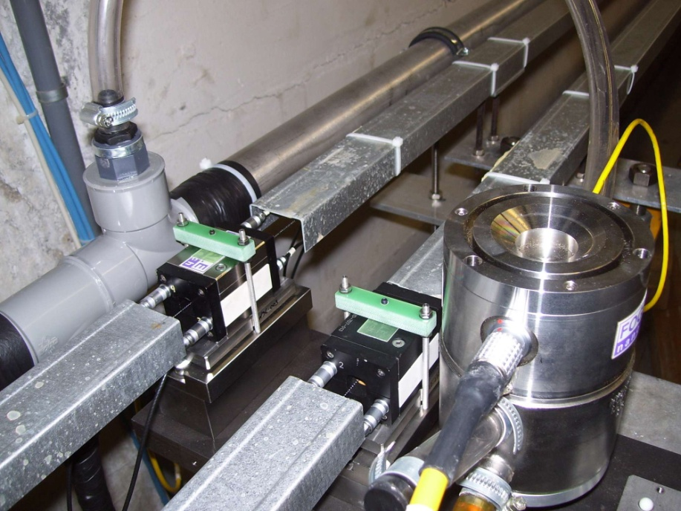
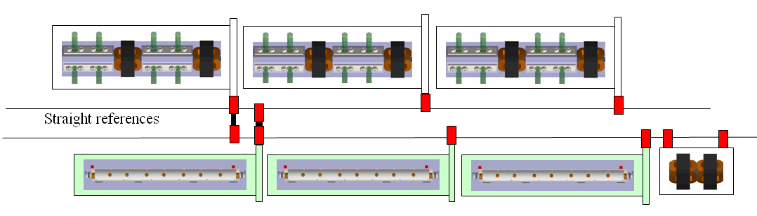
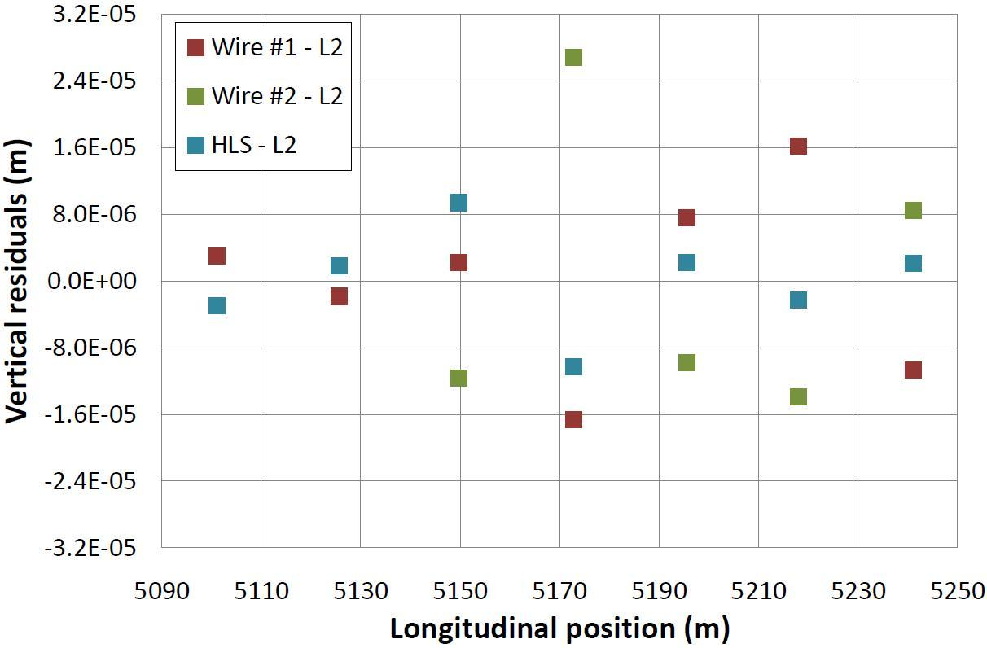
CLIC Survey Concept
Required accuracy of reference points is 10μm
Test of prototype shows
  vertical RMS error of 11μm
  i.e. accuracy is approx. 13.5μm
Improvement path identified

Slide 108
Assumed Survey Performance
Element | error | with respect to | alignment
 |  |  | ILC | CLIC
Structure Structure Girder Girder Quadrupole Quadrupole BPM BPM Wakefield mon. | offset tilts offset tilt offset roll offset resolution offset | girder girder survey line survey line girder/survey line survey line girder/survey line BPM center wake center | 300 µm 300 µradian 200 µm 20 µradian 300 µm 300 µradian 300 µm ≈ 1 µm — | 5 µm 200(∗) µm 9.4 µm 9.4 µradian 17 µm ≤ 100 µradian 14 µm 0.1 µm 5 µm
In ILC specifications have much larger values than in CLIC
  more difficult alignment in super-conducting environment
  dedicated effort for CLIC needed
Wakefield monitors are currently only foreseen in CLIC
  but could be an option also in ILC

Slide 109
Beam-Based Alignment and Tuning Strategy
Make beam pass linac
  one-to-one correction
Remove dispersion, align BPMs and quadrupoles
  dispersion free steering
  ballistic alignment
  kick minimisation
Remove residual wakefield and dispersive effects
  accelerating structure alignment (CLIC only)
  emittance tuning bumps
- Tune luminosity
- tuning knobs
D. Schulte, 10th Linear Collider School 2016, Main Linac Basics 100

Slide 110
Dispersion Free Correction
Basic idea: use different beam energies
NLC: switch on/off different accelerating structures
CLIC (ILC): accelerate beams with different gradient and initial energy
- try to do this in a single pulse (time resolution)
40
before after
30
20
10
0
-10
-20
-30
y [∝m]
-40
100
120
140 160
BPM number
180
200
Optimise trajectories for different energies together:
Last term is omitted
Idea is to mimic energy differences that exist in the bunch with different beams
D. Schulte, 10th Linear Collider School 2016, Main Linac Basics 101

Slide 111
Emittance Growth (ILC)
Error | with respect to | value | ∆ε_{y} [nm] | ∆ε_{y,121} [nm] | ∆ε_{y,df s} [nm]
Cavity offset | module | 300 µm | 3.5 | 0.2 | 0.2(0.2)
Cavity tilt | module | 300 µradian | 2600 | < 0.1 | 1.8(8)
BPM offset | module | 300 µm | 0 | 360 | 4(2)
Quadrupole offset | module | 300 µm | 700000 | 0 | 0(0)
Quadrupole roll | module | 300 µradian | 2.2 | 2.2 | 2.2(2.2)
Module offset | perfect line | 200 µm | 250000 | 155 | 2(1.2)
Module tilt | perfect line | 20 µradian | 880 | 1.7 | —
The results of the reference DFS method is quoted, results of a different implementation in brackets
Note in the simulations the correction the quadrupoles had been shifted, other wise some residual effect of the quadrupole misalignment would exist
D. Schulte, 10th Linear Collider School 2016, Main Linac Basics 102

Slide 112
Beam-Based Structure Alignment (CLIC)
Each structure is equipped with a wakefield monitor (RMS position error 5 µm)
Up to eight structures on one movable girders
⇒ Align structures to the beam
Assume identical wake fields
  the mean structure to wakefield monitor offset is most important
  in upper figure monitors are perfect, mean offset structure to beam is zero after alignment
  scatter around mean does not matter a lot
With scattered monitors
  final mean offset is
In the current simulation each structure is moved independently
A study has been performed to move the articulation points
For our tolerance σ_{wm}=5μm we find Δε_{y} ≈ 0.5 nm
Some dependence on alignment method

Slide 113
Emittance Tuning Bumps
Emittance (or luminosity) tuning bumps can further improve performance
  globally correct wake- field by moving some structures
  similar procedure for dispersion
Need to monitor beam size
Optimisation procedure
  measure beam size for different bump settings
  make a fit to determine optimum setting
  apply optimum
  iterate on next bump

Slide 114
Final Emittance Growth (CLIC)
imperfection | with respect to | symbol | value | emitt. growth
BPM offset | wire reference | σ_{BPM} | 14 µm | 0.367 nm
BPM resolution |  | σ_{res} | 0.1 µm | 0.04 nm
accelerating structure offset | girder axis | σ₄ | 10 µm | 0.03 nm
accelerating structure tilt | girder axis | σ_{t} | 200 µradian | 0.38 nm
articulation point offset | wire reference | σ₅ | 12 µm | 0.1 nm
girder end point | articulation point | σ₆ | 5 µm | 0.02 nm
wake monitor | structure centre | σ₇ | 5 µm | 0.54 nm
quadrupole roll | longitudinal axis | σ_{r} | 100 µradian | ≈ 0.12 nm
100
no bumps 1 bump
3 bumps
5 bumps
7 bumps
80
Multi-bunch wakefield misalignments of 10 µm lead to
∆ε_{y} ≈ 0.13 nm
Can reach emittance preservation goal
Would be worse with higher charge
p(ε_{y}>ε_{y,0}) [%]
60
40
20
0
10
12
14
16
18
20
ε_{y,0} [nm]

Slide 115
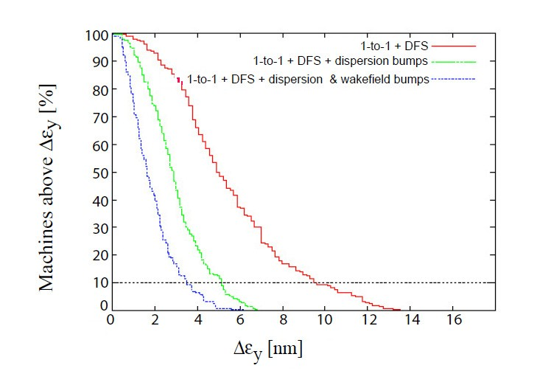
Results (ILC)
DFS brings us close to the required performance
Tuning of the dispersion helps a lot
Even wakefield tuning helps us
The remaining emittance growth is to a significanst extent due to quadrupole roll
  Should add corresponding tuning bump
D. Schulte, 10th Linear Collider School 2016, Main Linac Basics 106

Slide 116
Dependence on Weights (Old CLIC Parameters)
For TRC parameters set
One beam is used with different gradient and different incoming energy
BPM position errors are less important with larger w₁
BPM resolution less important for small w₁
Need a compromise
There is no such thing as the tolerance
1
σ_{BPM}=10∝m
σ_{res}=0.1∝m
σ_{cav}=10∝m
∆ε_{y} [nm]
σ’_{cav}=100∝rad
^{σ}realign^{=10∝m}
0.1
0.01
100
1000
10000 100000
w₁
1e+06
D. Schulte, 10th Linear Collider School 2016, Main Linac Basics 107

Slide 117
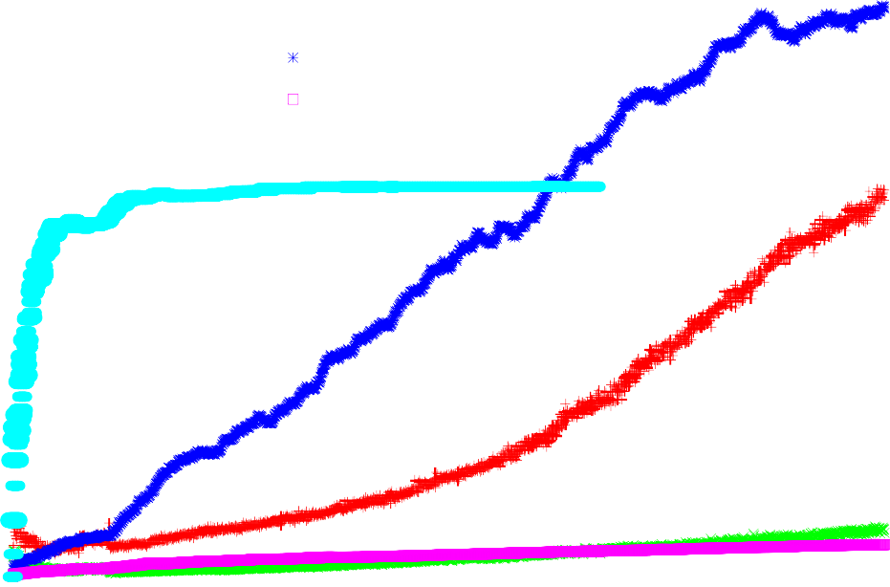

Growth Along Main Linac (CLIC)
Emittance growth along the main linac due to different imperfections
Growth is mainly constant per cell
  follows from first principles applied during lattice design
Exception is structure tilt
  due to uncorrelated energy spread
  flexible weight to be in- vestigated
Some difference for BPMs
  due to secondary emit- tance growth
0.6
bpm res real cav tilt art.
interc.
0.5
0.4
∆ε [nm]
0.3
y
0.2
0.1
0
0
500
1000
quadrupole #
1500
2000
D. Schulte, 10th Linear Collider School 2016, Main Linac Basics 108

Slide 118
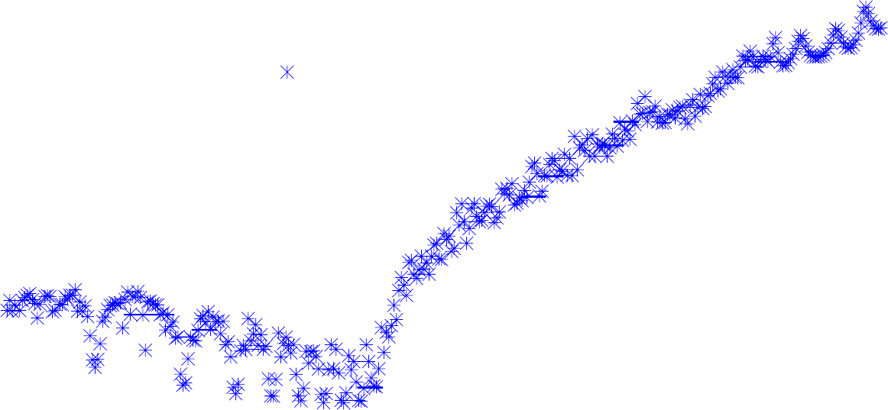
Sensitivity to Survey Line Errors (CLIC)
1e+07
1e+06
100000
10000
1000
100
10
1
0.1
0.01
0.001
tolerance for ∆ε_{y}=1nm [μm]
no
1-2-1
DFS+RF
10 100 1000
10000
wavelength [m]
Cosine-line misalignments, beta-functions clearly visible
D. Schulte, 10th Linear Collider School 2016, Main Linac Basics 109

Slide 119
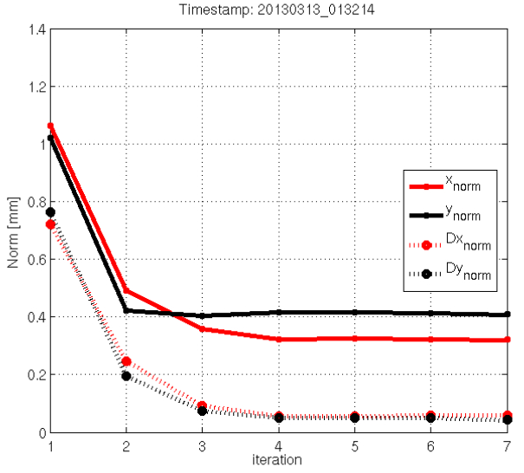
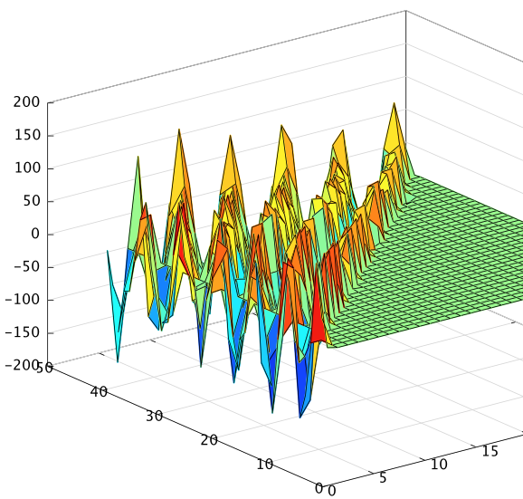
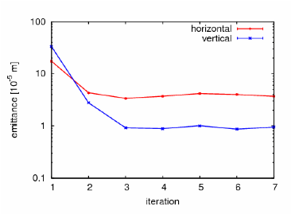
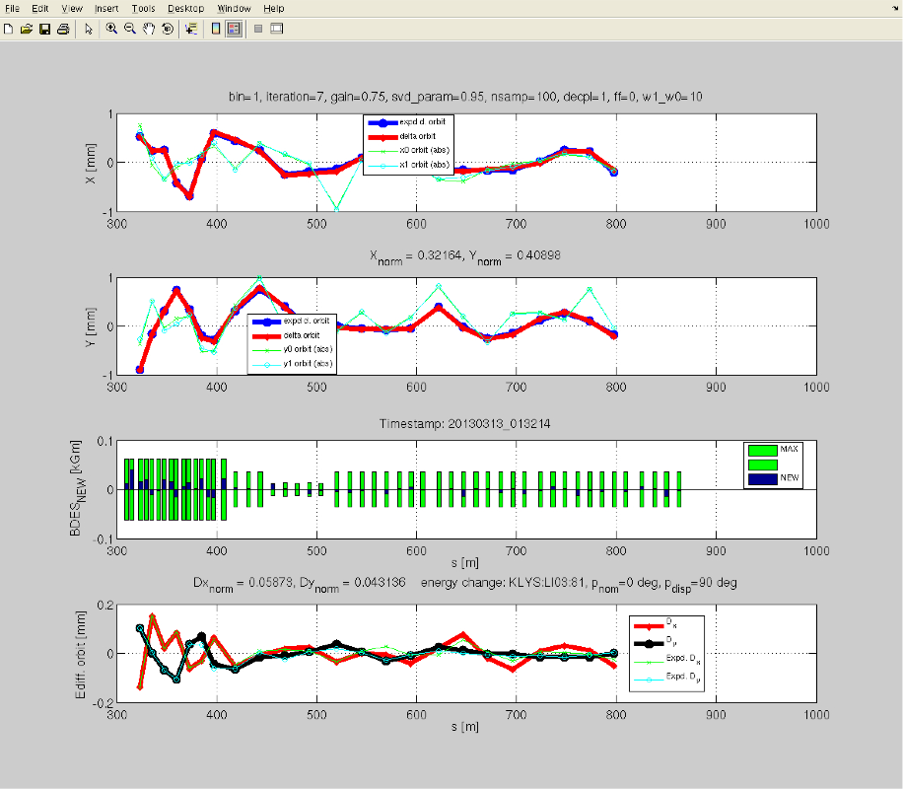
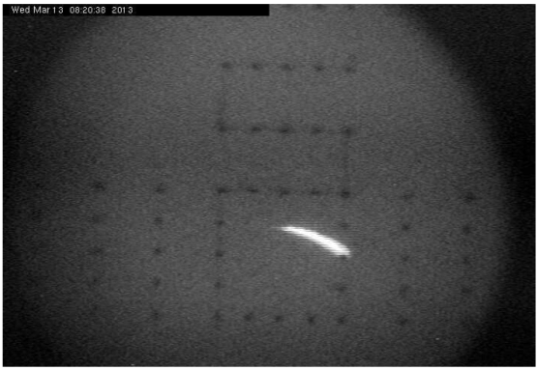
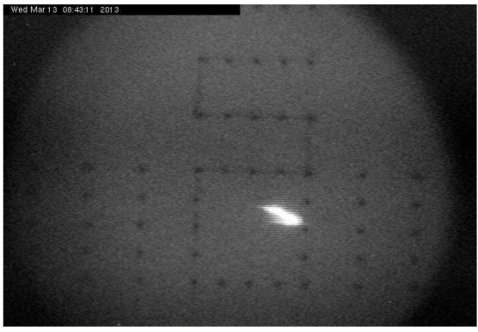
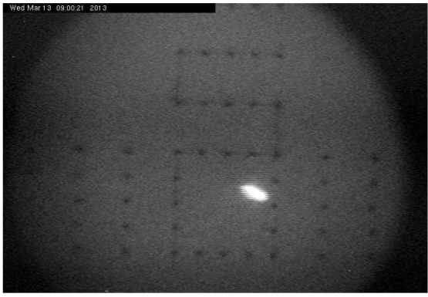
CLIC Beam-Based Alignment Tests at FACET)
A. Latina,
J. Pfingstner,
E. Adli,
D. Schulte
DFS correction applied to 500 meters of the SLC linac
SysID algorithms for model reconstruction
DFS correction with GUI
Emittance growth
is measured
Orbit/Dispersion
Graphic User Interface:
Emittance
Beam profile measurement
SysID
Incoming oscillation/dispersion is taken out and flattened; emittance in LI11 and emittance growth significantly reduced.
After 1 iteration
After 3 iterations
D. Schulte, 10th Linear Collider School 2016, Main Linac Basics 109

Slide 120

Energy Stability
Not to be forgotten
D. Schulte, 10th Linear Collider School 2016, Main Linac Basics 110

Slide 121
Requirements
The final energy needs to be accurately known for physics
  measurement
The final energy needs to be stable for physics
  large energy variations would also cause luminosity loss due to limited BDS band- width
  need to control final energy
The emittance needs to be preserved in presence of static imperfections
  differences between the actual and the assumed lattice can cause emittance growth
  need to control energy profile
The emittance needs to be preserved in presence dynamic of imperfections
  the energy profile needs to be stable
  kicks due to cavity tilts need to be controlled
Beam timing errors lead to luminosity loss
  need to control bunch compressor RF stability
D. Schulte, 10th Linear Collider School 2016, Main Linac Basics 111

Slide 122
Main Linac RF Noise Sources (ILC)
Lorentz force detuning
  systematic from pulse to pulse
  is largely corrected using piezo tuners in feed-forward
Microphonics
  unpredictable
  corrected by klystron-based (or piezo-based) feedback
Klystron amplitude and phase jitter
  corrected by klystron based feedback
Beam current variation
  measure beam current at damping ring and use feed-forward for klystrons
Feedback noise
  measurement noise
  feedback amplifies at some frequencies
Jitter of timing reference
  impacts feedback systems
D. Schulte, 10th Linear Collider School 2016, Main Linac Basics 112

Slide 123
Low Level RF Controls
The low level RF control ties the RF phase to a timing reference and adjusts the gradient
For each cavity one measures
  field amplitude and phase
  input power
  reflected power
As correctors are used
  piezo tuners in each cavity
  stepping motors
  klystron amplitude and phase
One needs a beam timing feedback
The klystron-based feedback acts on the vector sum of all cavity gradients in a unit
The sensors are calibrated measuring the field with and without beam
  the field induced by the beam can be calculated
Input and reflected power per cavity is measured
Beam current is measured at damping ring and used for feed-forward
D. Schulte, 10th Linear Collider School 2016, Main Linac Basics 113

Slide 124
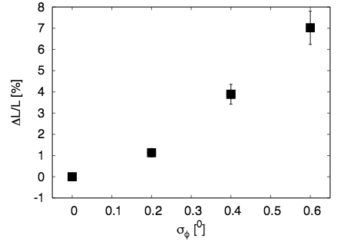
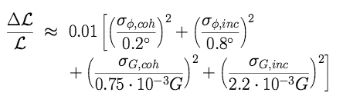
CLIC RF Jitter Tolerance
RF gradient and phase errors lead to final beam en- ergy errors
The BDS bandwidth is limited
⇒ Lose luminosity
RF tolerances translate directly into drive beam cur- rent and phase tolerances
D. Schulte, 10th Linear Collider School 2016, Main Linac Basics 114

Slide 125




CLIC Layout
540 klystrons
20 MW, 142 µs
Drive Beam
circumferences delay loop 73 m CR1 293 m
CR2 439 m
540 klystrons
20 MW, 142 µs
drive beam accelerator
2.4 GeV, 1.0 GHz
drive beam accelerator
2.4 GeV, 1.0 GHz
2.5 km
2.5 km
delay loop
CR2
CR2
delay loop
CR1
CR1
decelerator, 25 sectors of 878 m
BC2
BDS
BDS
BC2
e– main linac, 12 GHz, 100 MV/m, 21 km
2.75 km
IP
2.75 km
e⁺ main linac
TA
TA
CR combiner ring TA turnaround DR damping ring
PDR predamping ring BC bunch compressor
BDS beam delivery system IP interaction point
dump
50 km
booster linac
2.86 to 9 GeV
Main Beam
e– injector
2.86 GeV
_{e}– DR
427 m
_{e}+ _{e}+
DR PDR
427 m 389 m
e⁺ injector
2.86 GeV
D. Schulte, 10th Linear Collider School 2016, Main Linac Basics 115

Slide 126
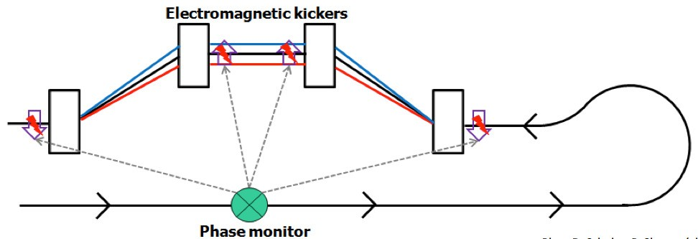
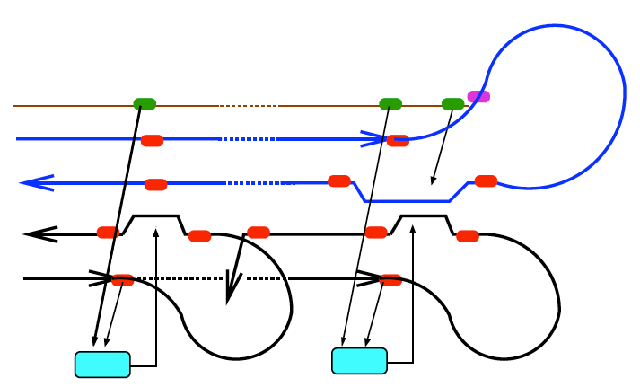
Phase Feed-forward
Design drive beam complex for current and phase stability
  Measured current stability is OK
  Phase stability needs a factor to improvement
⇒ Correct the phase of the drive beam at the final turn-around
  requires timing reference system
  but gives the missing factor
D. Schulte, 10th Linear Collider School 2016, Main Linac Basics 116

Slide 127
Conclusion
Introduced some basic physics of the main linac
For CLIC aim to maximise the beam current for best efficiency
  leads to short pulses
  requires drive beam scheme
For ILC can afford using longer pulses
  but still need pulsed operation
Superconducting FELs could be operated in CW mode
Normalconducting FELs need to find ways to use bunch trains
D. Schulte, 10th Linear Collider School 2016, Main Linac Basics 117

Slide 128

Thanks
Many thanks to you for listening and to the people who helped me to prepare this lecture
  with advice
  with plots
Erik Adli, Alexej Grudiev, Erk Jensen, Jochem Snuverink, Igor Syratchev, Rolf Wegner, Walter Wuensch, Riccardo Zennaro, Frank Zimmermann
D. Schulte, 10th Linear Collider School 2016, Main Linac Basics 118

Slide 129
Some Fundamental Parameters
parameter | symbol | SLC | ILC | CLIC
centre of mass energy | E_{cm} [GeV] | 92 | 500 | 3000
luminosity | L [10³⁴ cm⁻²s⁻¹] | 0.0003 | 1.8 | 5.9
luminosity in peak | L_{0.01} [10³⁴ cm⁻²s⁻¹] | 0.0003 | 1.1 | 2
gradient | G [MV/m] | 20 | 31.5 | 100
charge per bunch | N [10⁹] | 37 | 20 | 3.72
bunch length | σ_{z} [µm] | 1000 | 300 | 44
beam size | σ_{x,y} [nm] | 1700/600 | 474/5.9 | 40/1
vertical emittance | _{y} [nm] | 3000 | 35 | 20
bunches per pulse | n_{b} | 1 | 1312 | 312
distance between bunches | ∆_{b} [ns] | – | 554 | 0.5
repetition frequency | f_{r} [Hz] | 120 | 5 | 50
average beam power | [MW] |  | 10.5 | 28
peak beam power | [GW] |  | 2.9 | 3600
⇒ Beam Parameters are very different
We will see that this is driven by the main linac

