Slide 1


Course B: rf technology
Normal conducting rf
Part 3: High-Gradient Acceleration
Walter Wuensch, CERN
Tenth International Accelerator School for Linear Colliders
Teijin Academy at Mt. Fuji, Japan
8 to 19 December 2016

Slide 2
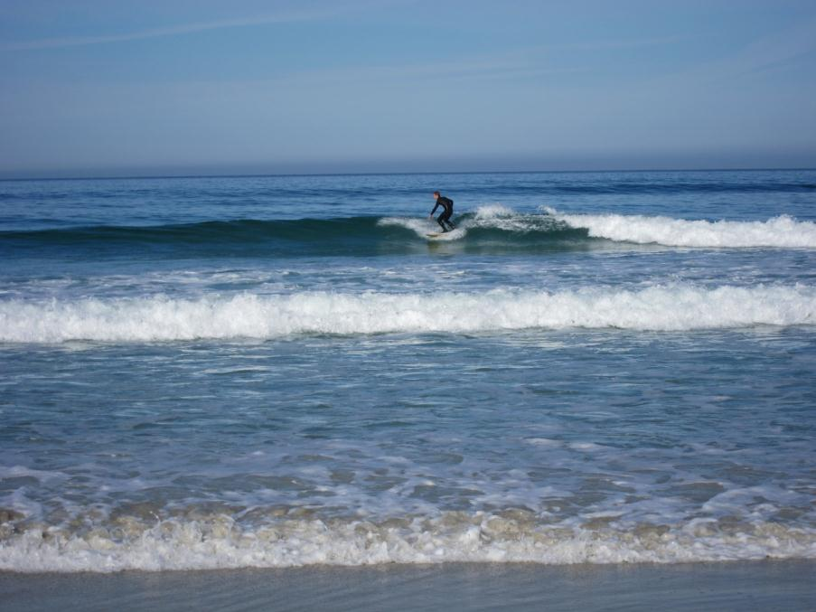
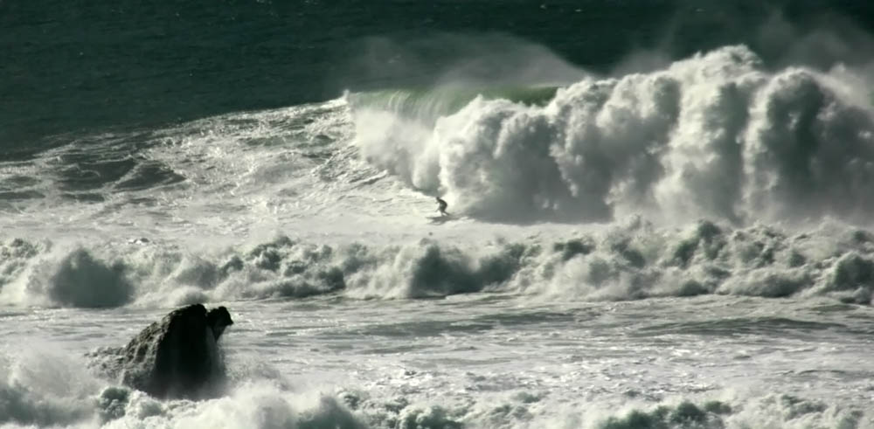
Now – acceleration with high gradient!
"Mavericks and surfer" by Brocken Inaglory. Licensed under CC BY-SA 3.0 via Commons - https://commons.wikimedia.org/wiki/File:Mavericks_and_surfer.jpg#/media/File:Mavericks_and_surfer.jpg

Slide 3
We have studied the properties of electromagnetic fields in rf structures and the interaction of a beam with those fields.
The underlying equations are Maxwell’s equations and the Lorentz force – linear equations!
When we raise the power we put in a structure, increasing the surface fields, we encounter a whole range of new phenomena.
These phenomena include field emission and vacuum arcing and pulsed surface heating which, in various combinations, affect the beam and can damage a structure.
They limit the high-gradient performance of CLIC structures!

Slide 4
Today we will study these high-power, and high-gradient, phenomena.
We need to approach the subject in a very different way than the earlier sections since it involves the interplay of many different areas of physics including:
Electromagnetism
Material science
Plasma physics
Field and photo emission
And much of our understanding is still phenomenological so you need to learn a lot about the experiments.

Slide 5
Outline
Introduction
rf system hardware
rf signals
Conditioning
Gradient and pulse length dependencies
Geometrical dependence
Dynamics of high-surface fields

Slide 6
Some (round) numbers to keep in mind:
Accelerating gradient - 100 MV/m
Input power - 50 MW
Pulse length - 180 ns
Pulse energy of 12 J.

Slide 7
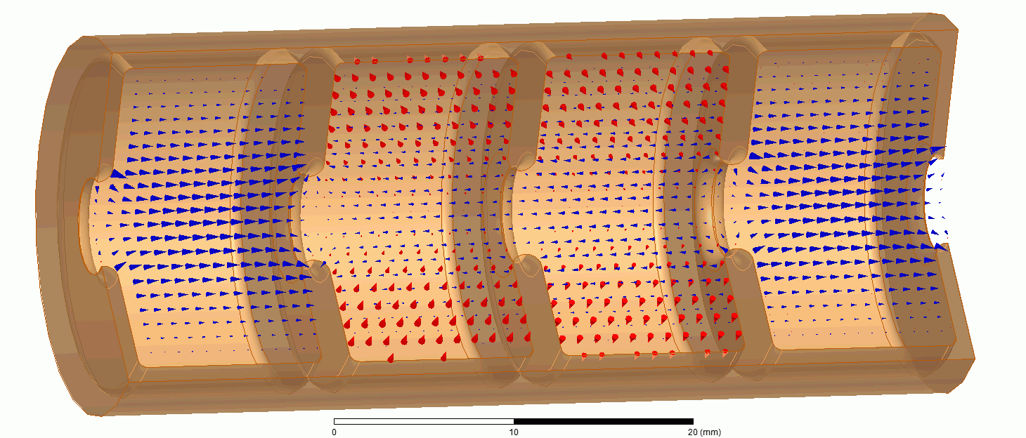
Vacuum arc, aka breakdown

Slide 8
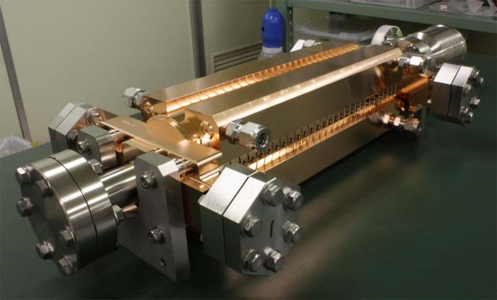
incident power
transmitted
power
reflected power
incident
transmitted
Envelope of rf pulse
reflected

Slide 9
incident power
transmitted
power
reflected power
Suppression of transmission and reflection due to breakdown
incident
transmitted
reflected

Slide 10
Testing experimental set-up
and infrastructure

Slide 11
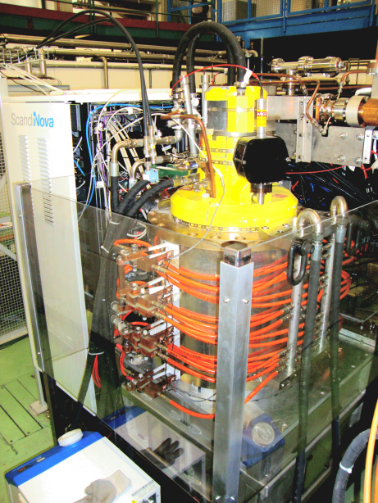
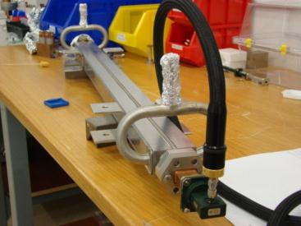
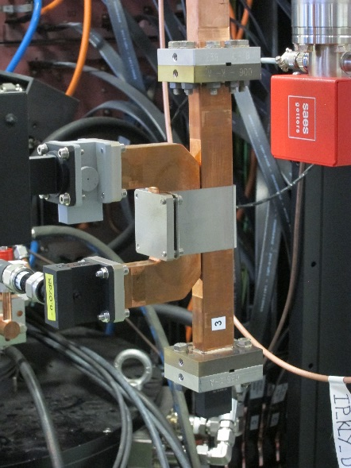
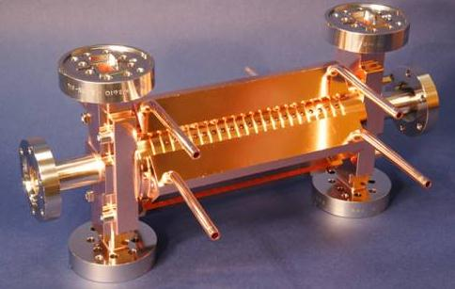
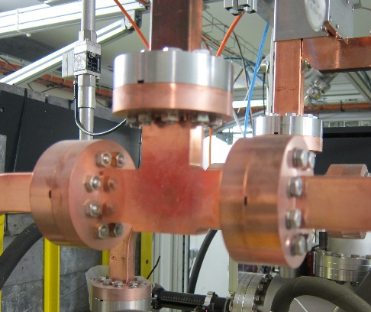
klystron
directional coupler
load
Transmitted
Reflected
Incident
splitter
accelerating structure
The basic layout of an rf system

Slide 12
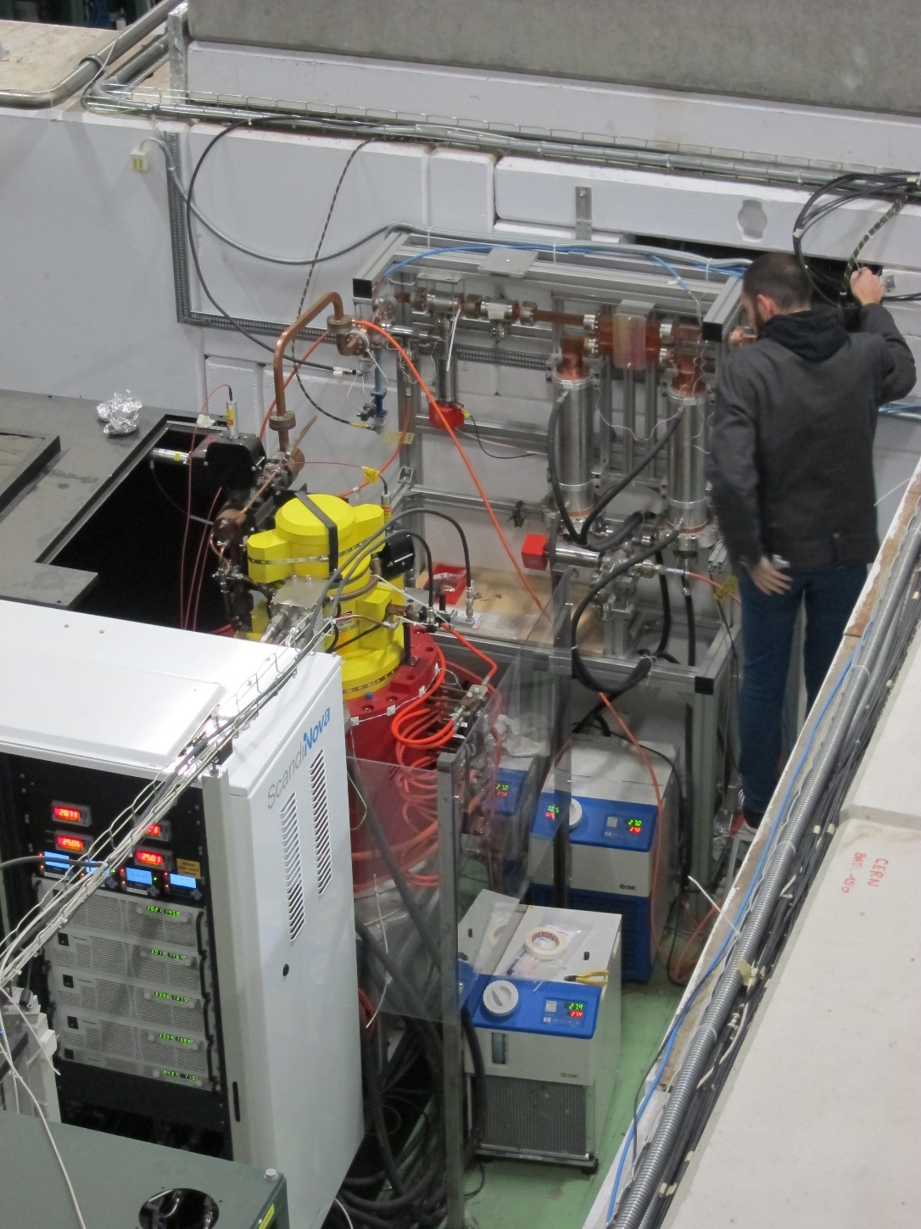
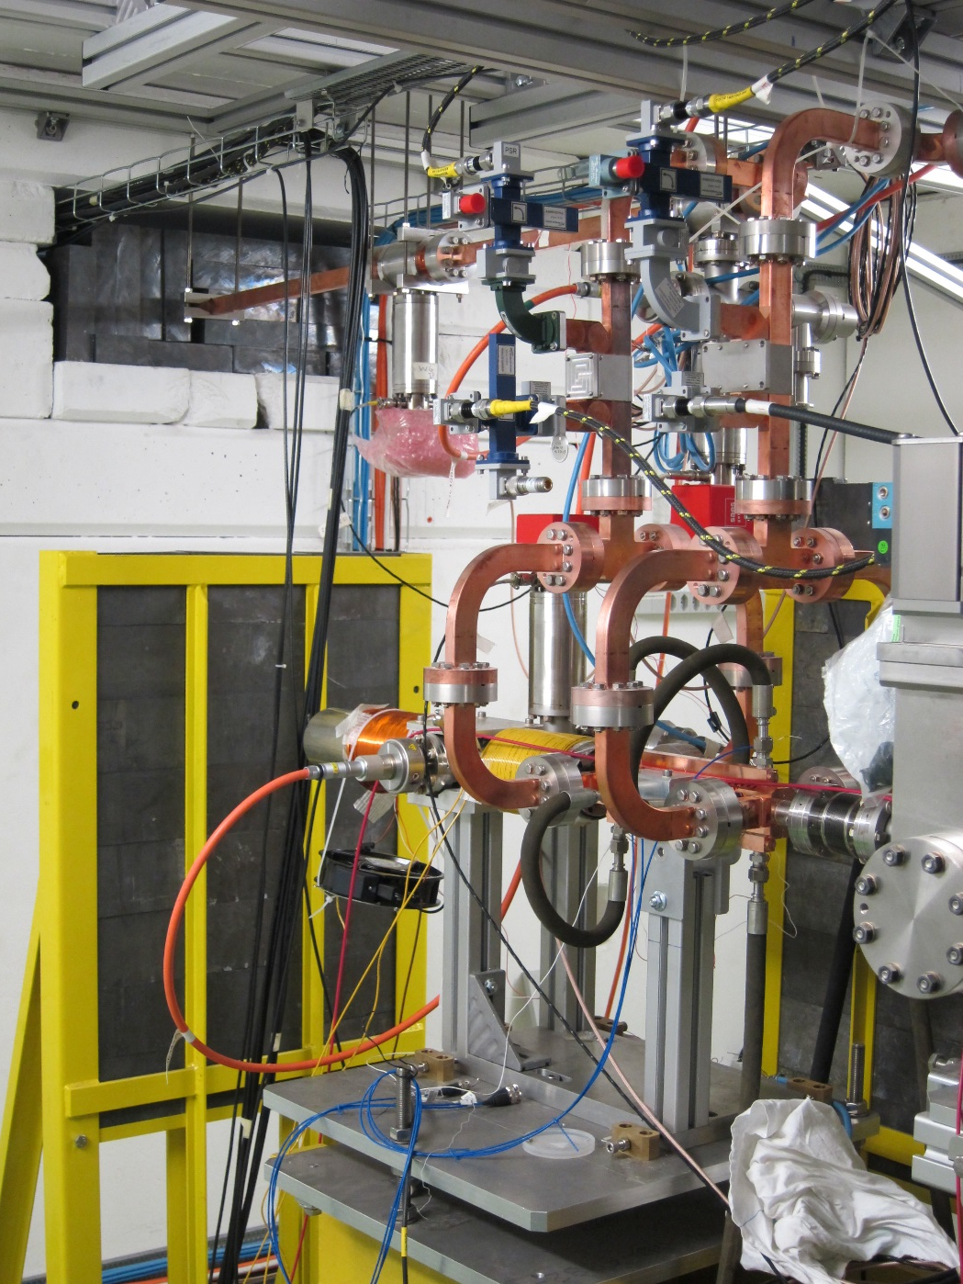
This klystron modulator unit feeds
this accelerating structure.

Slide 13
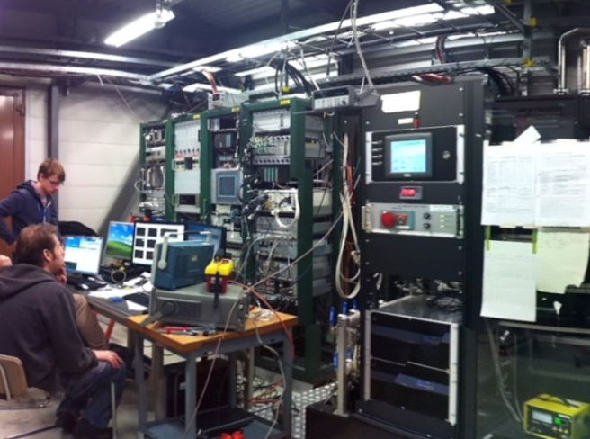
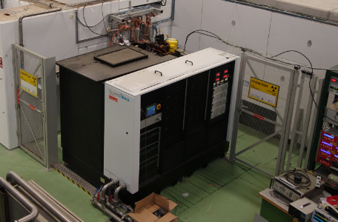
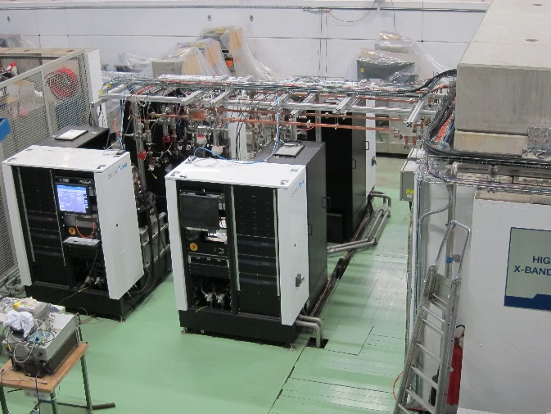
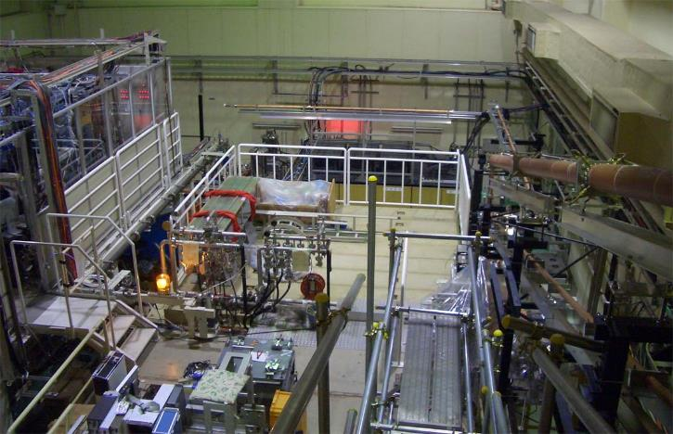
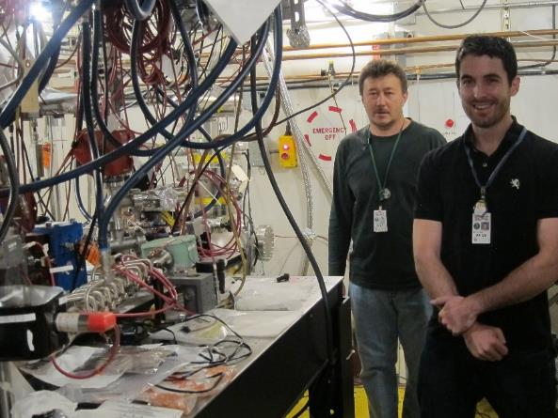
Klystron-based X-band test stands
around the world
XBox-1: 50 MW, 50 Hz
XBox-2: 50 MW, 50 Hz
XBox-3: 50 MW, 400 Hz!
NEXTEF
KEK
ASTA
SLAC

Slide 14
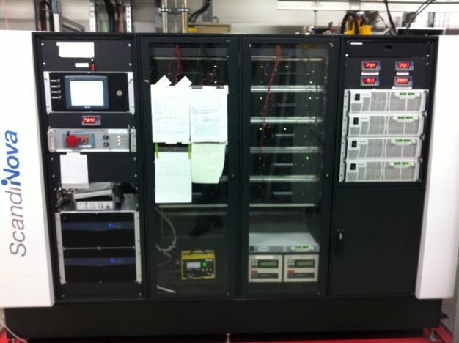
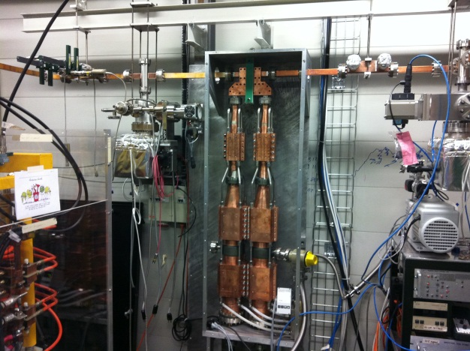
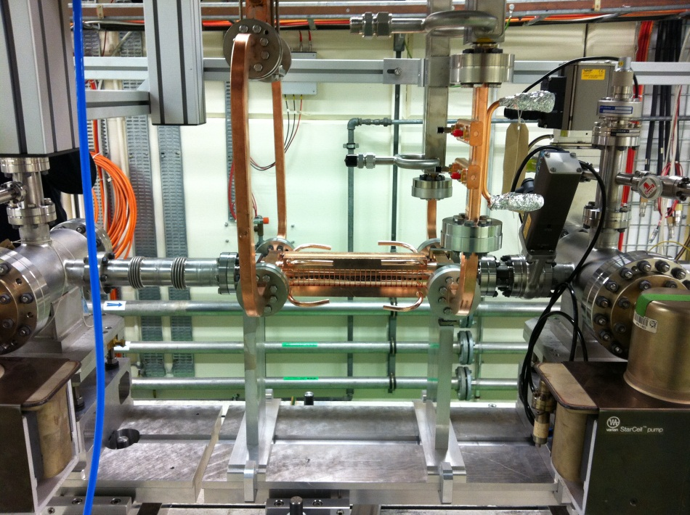
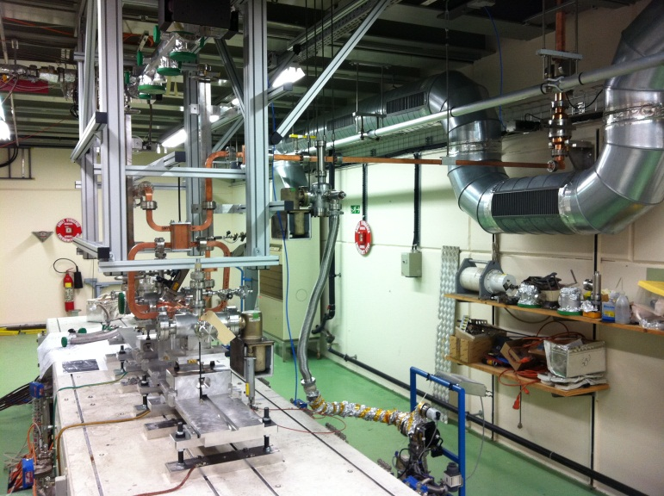
Typical test stand Layout
Clockwise from top-left:
Modulator/klystron (50MW, 1.5us pulse)
Pulse compressor (250ns, ratio 2.8)
DUT + connections
Acc. structure (TD26CC)
Gallery
Bunker

Slide 15
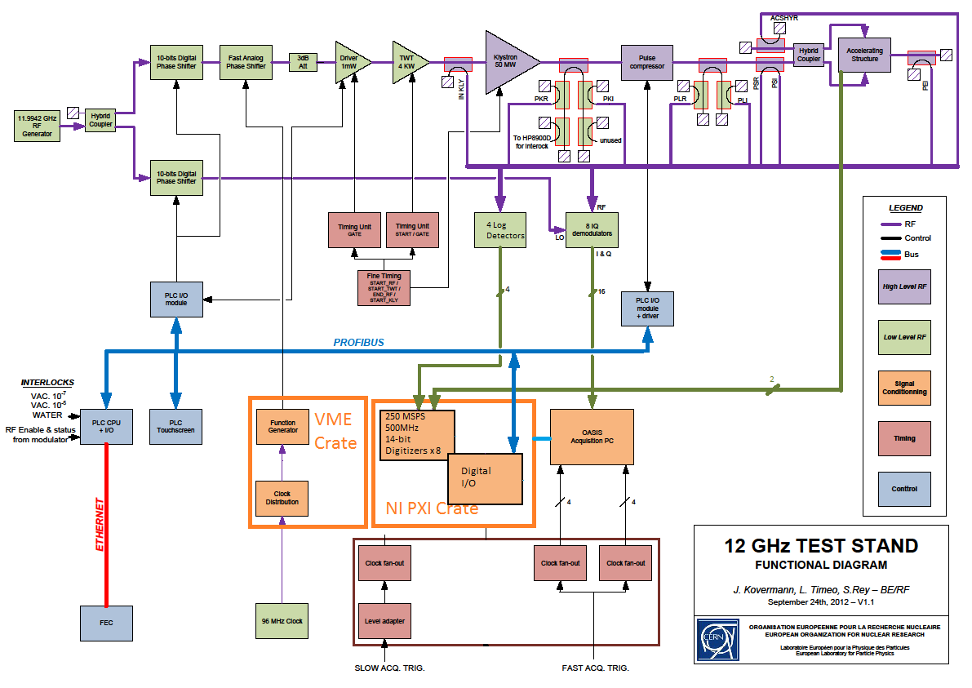
System Layout and diagnostics

Slide 16
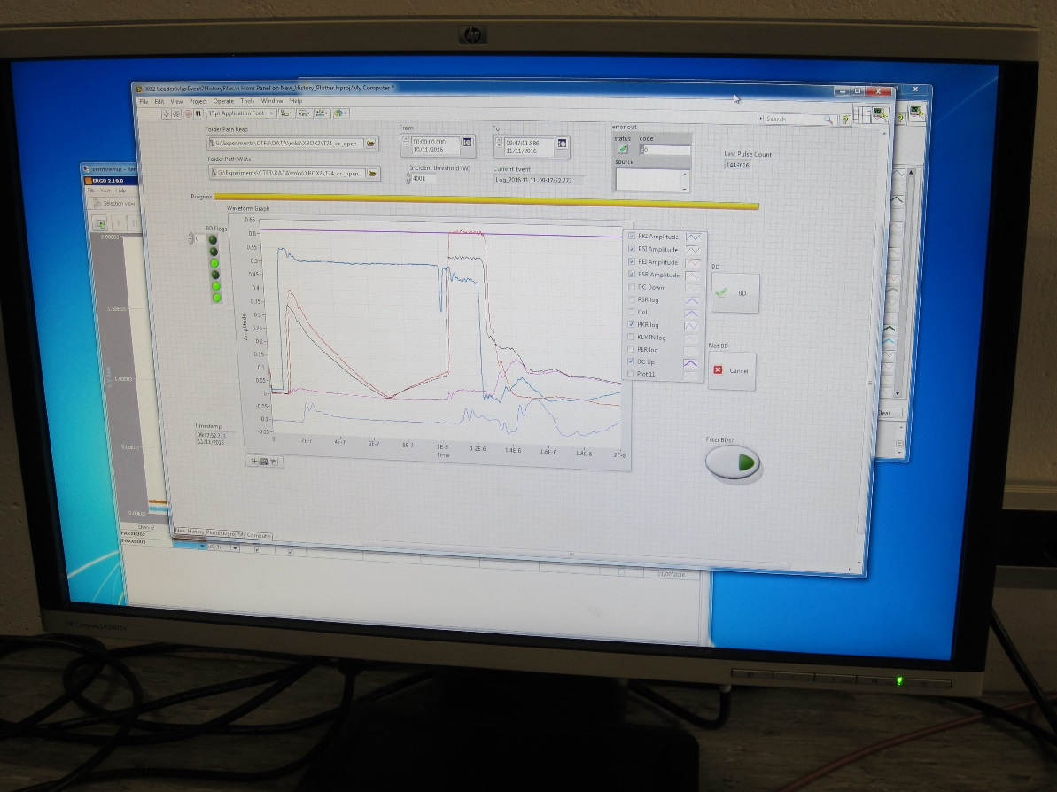
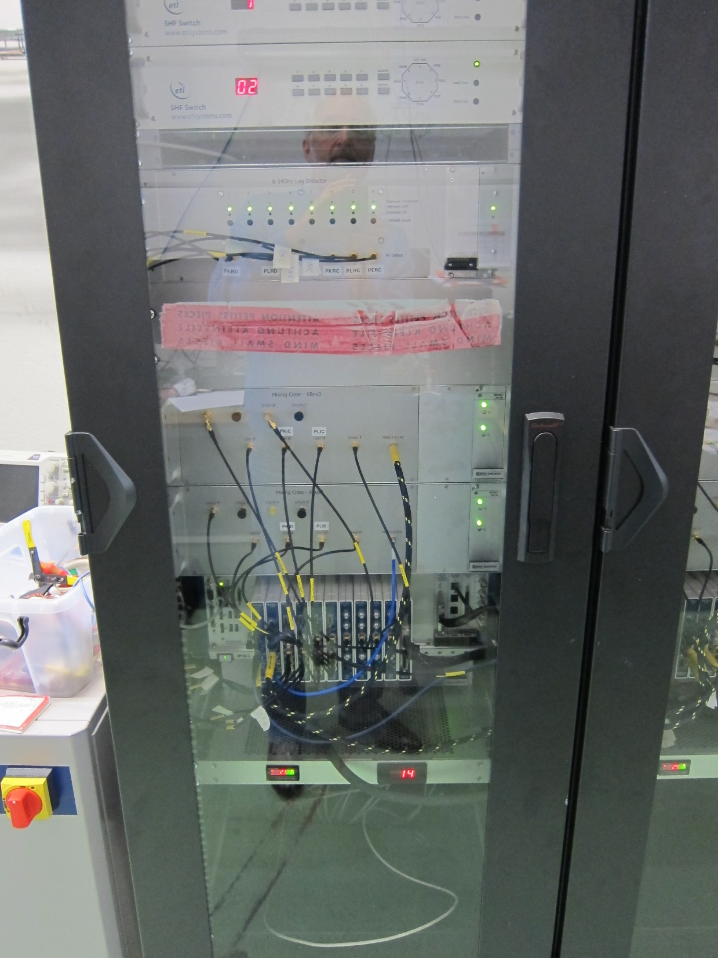

Slide 17
Accelerating Structure Diagnostics
Asymmetric Reflection
RF Load
RF Load
WR90 Waveguide
Ion gauge readout
Ion gauge readout
Input coupler
Output coupler
50 dB directional coupler
RF Hybrid
CLIC Accelerating Structure
Beam-pipe
Beam-pipe
Incident power
Reflected Power
Upstream Faraday cup signal
Downstream Faraday cup signal
Transmitted Power
RF Load
RF Power From Klystron

Slide 18
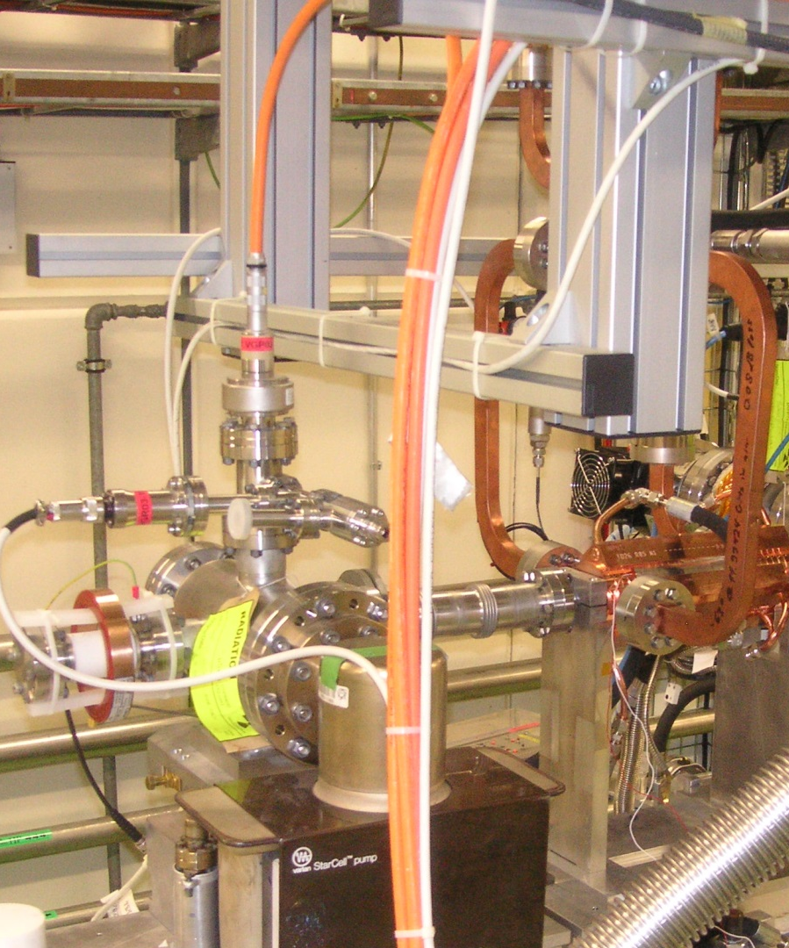
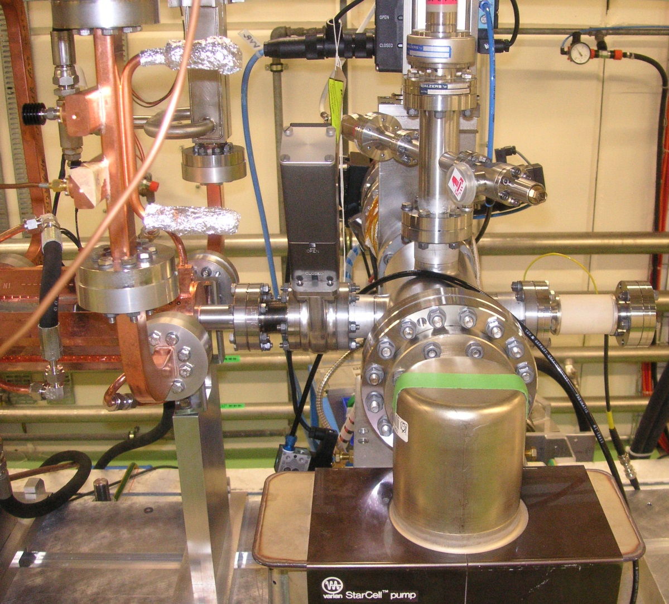
Accelerating Structure Diagnostics
RF hybrid splitter
(behind metal support)
Directional coupler
Vacuum valve
Ion Gauge
Faraday Cup
Ion Gauge
RF Load
Structure input couplers
Temperature probe
Structure output couplers
Ion Pump

Slide 19
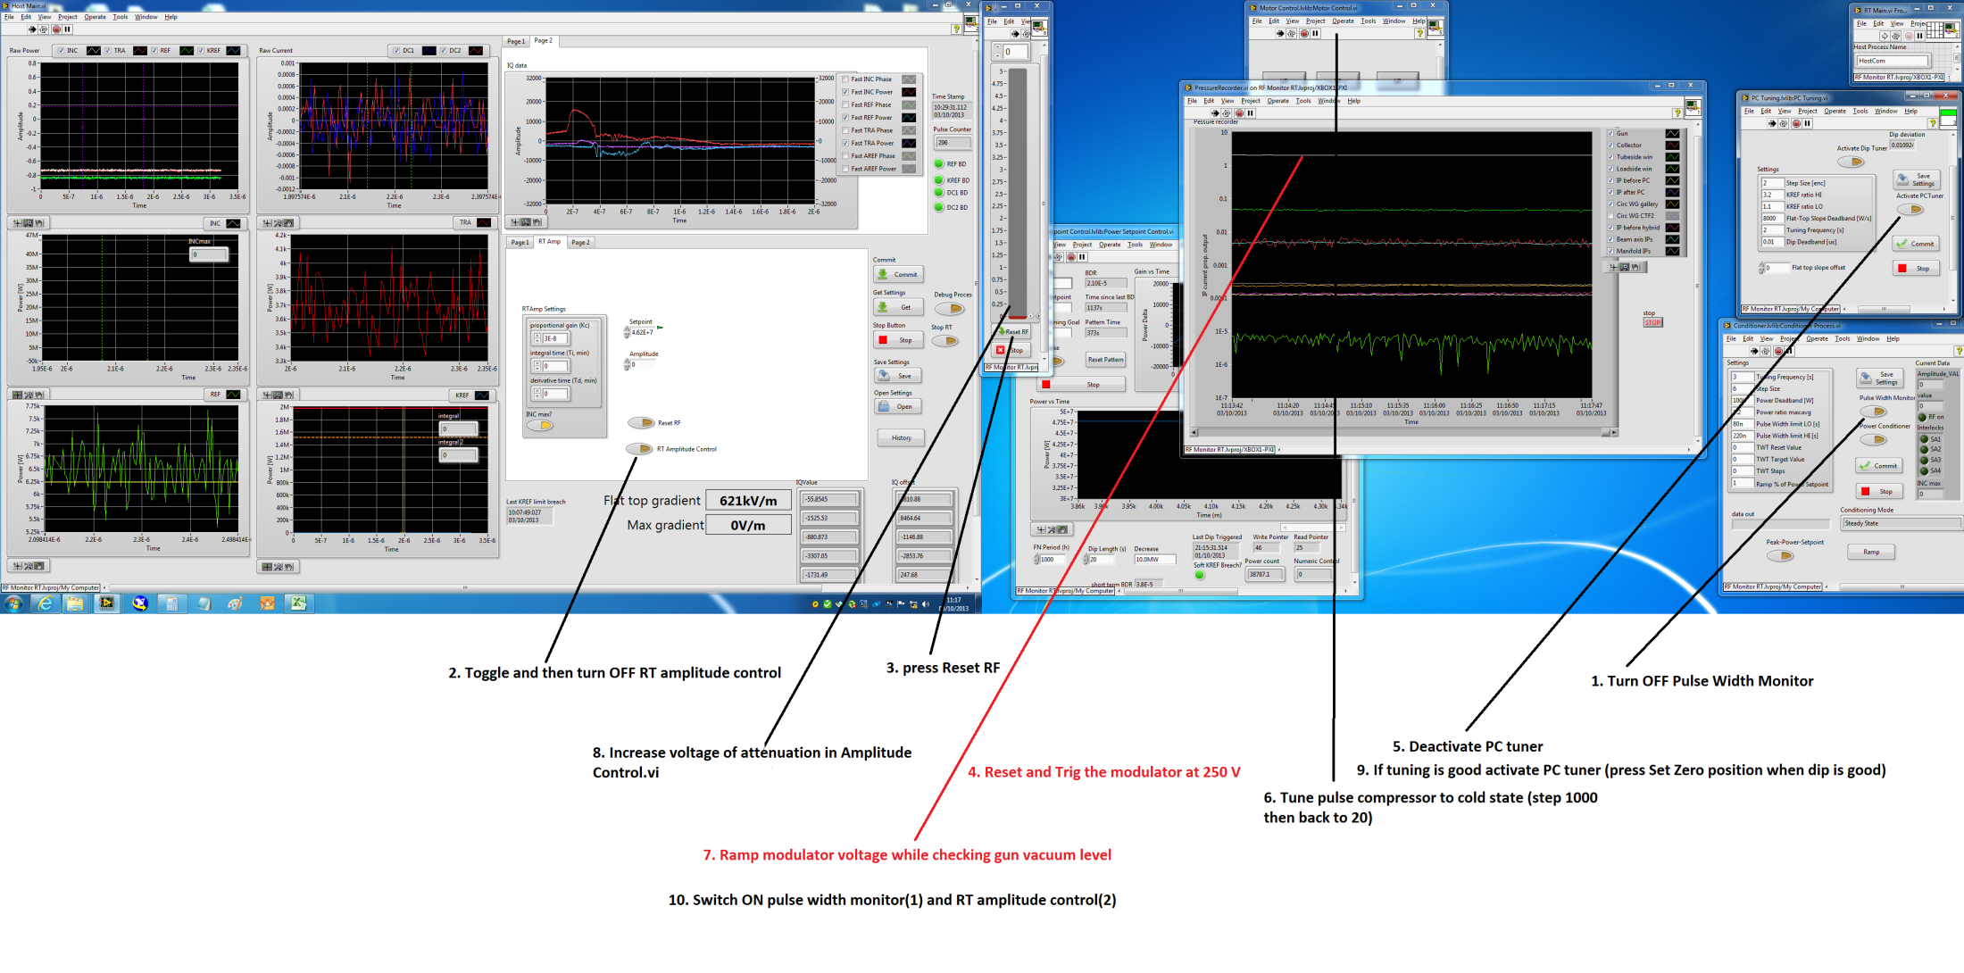
Operator display

Slide 20
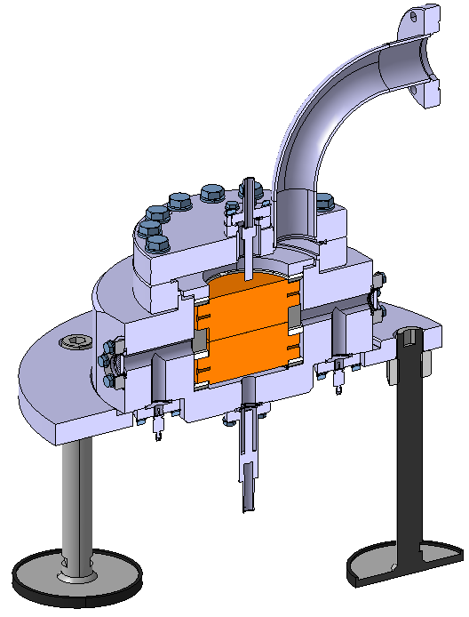
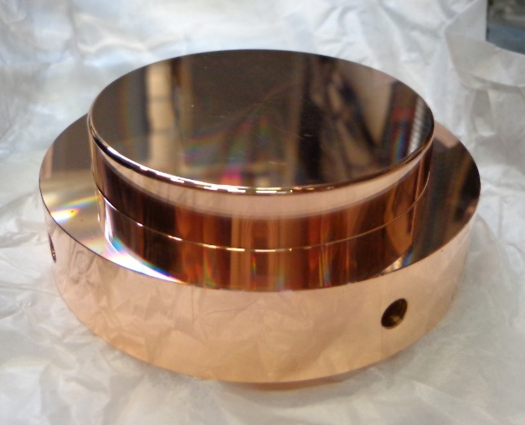
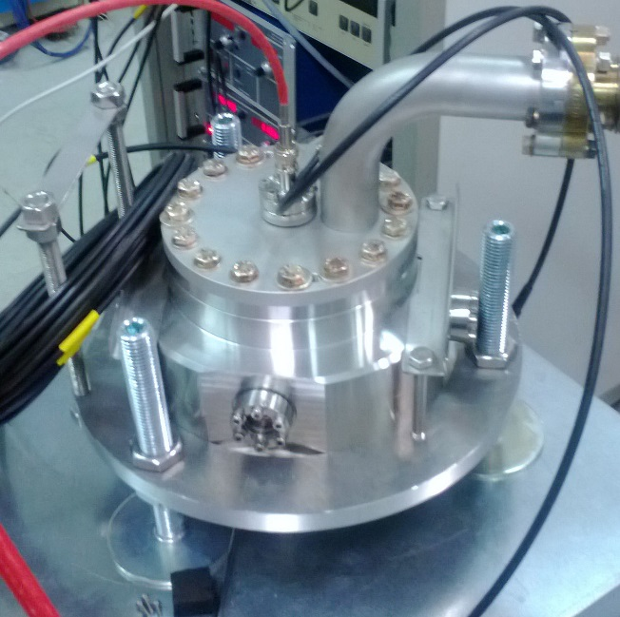
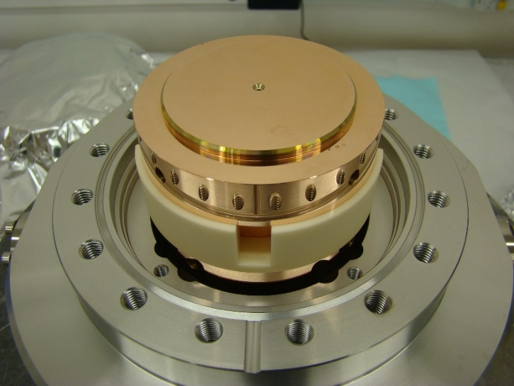
Pulsed dc system at CERN. Simple system which allows high-gradient test of electrodes using short dc pulses.
Reproduces very well pulsed rf behaviour.
I will refer to pulsed dc results a number of times in the coming slides.
vacuum chamber
copper electrode

Slide 21
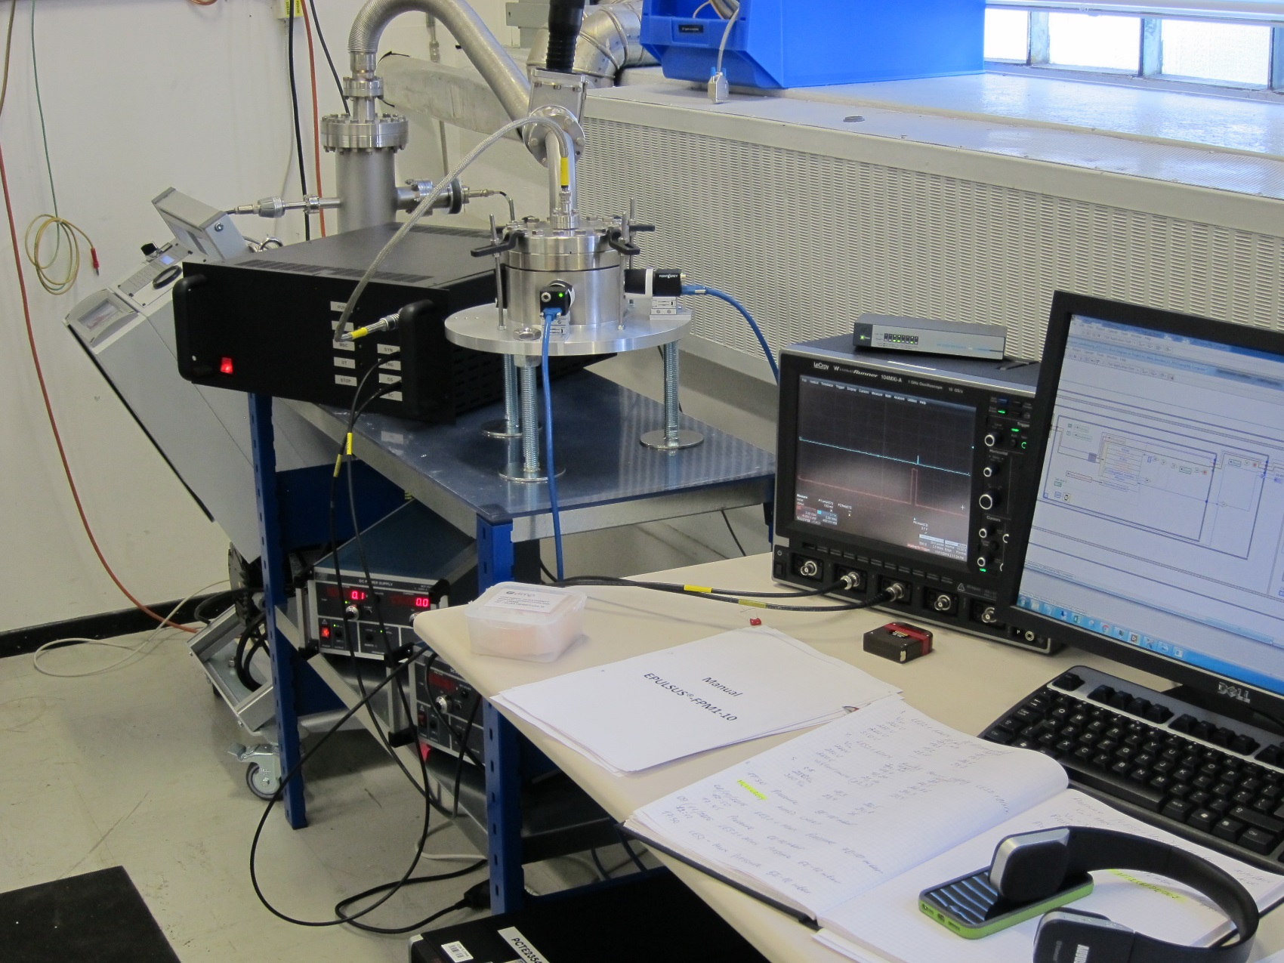
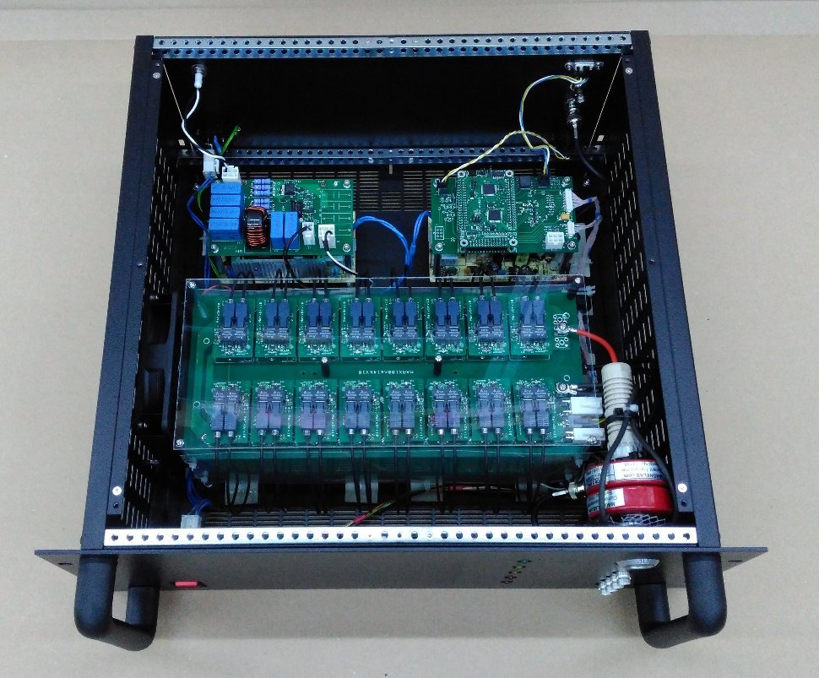
Pulsed dc system
Marx generator – up to 3 kHz!

Slide 22
Signals and detection of breakdown
aka vacuum arc

Slide 23
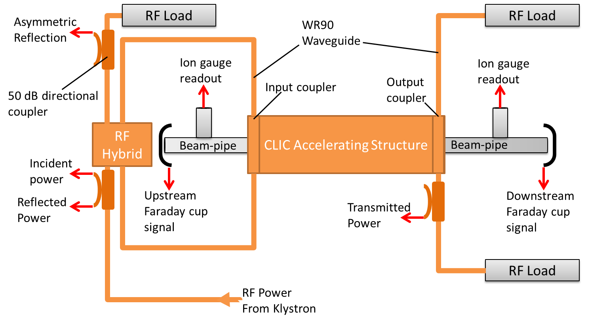
BD Detection: Normal Pulse
Transmitted pulse follows the incident pulse but with ~4dB of attenuation.
Reflected signal is ~20dB lower than incident pulse.
Only a few mV seen on the faraday cups. DC2-Upstream sees 1/10 of the signal compared to downstream.

Slide 24
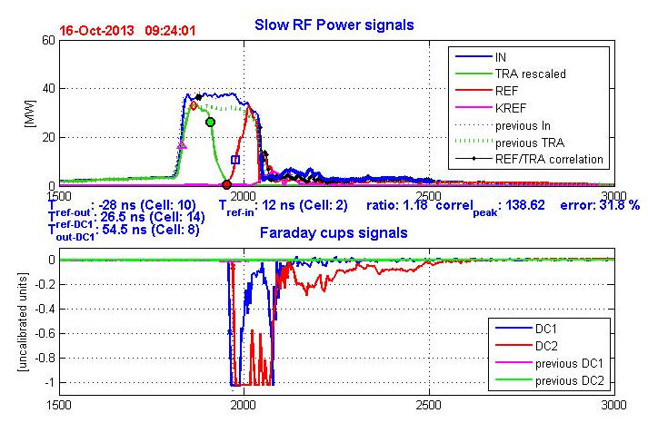
BD Detection: Breakdown
Transmitted pulse drops as the arc is established.
Reflected power increases to the same order as the incident pulse.
Faraday cup voltages are saturated: 100-1000x increase in charge emitted.
We can use the difference in time between the transmitted power falling and the reflected power increasing to find the BD cell location.
The phase of the reflected signal is used to pinpoint cell location.
Wilfrid Farabolini

Slide 25
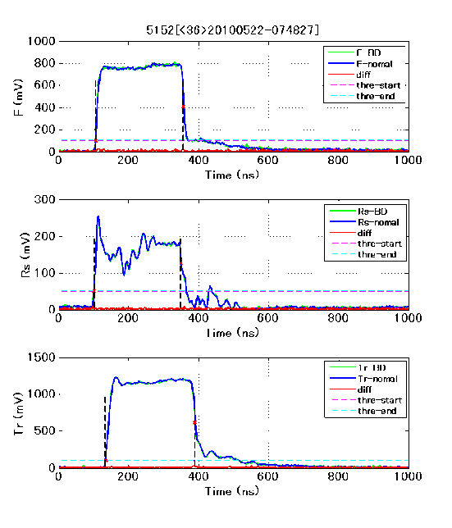
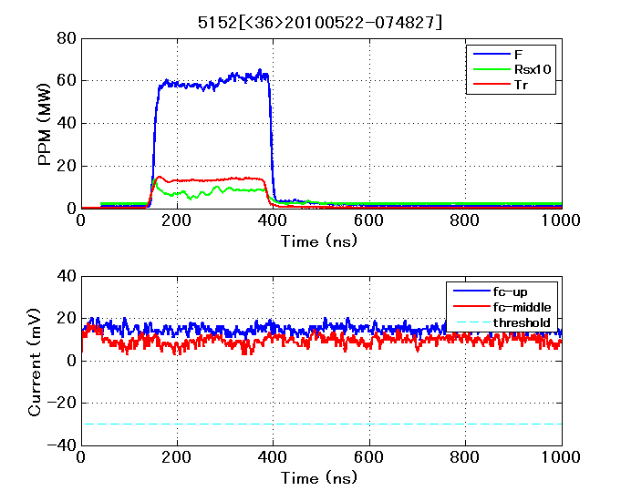
51+52 Normal pulse #36
F RsX10 Tr
Incident
(F)
Reflected
(Rs)
Transmitted
(Tr)
FC-UP FC-Mid Threshold
Last pulse
Last pulse but one
Difference between the two
Dashed lines = Analysis threshold
T. Higo, KEK
Test of TD18 structure

Slide 26
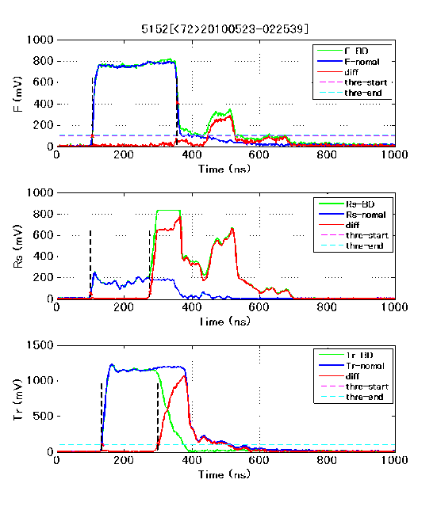
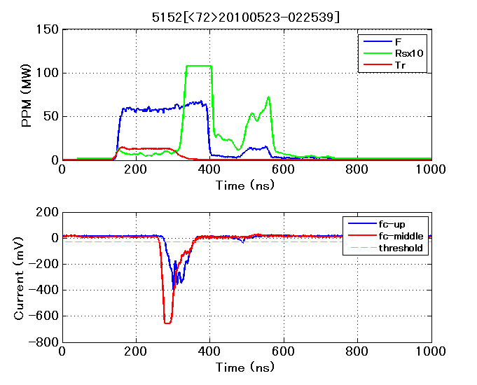
51+52 typical BD pulses
#72 Reflected RF back from klystron again
T. Higo, KEK
Test of TD18 structure

Slide 27
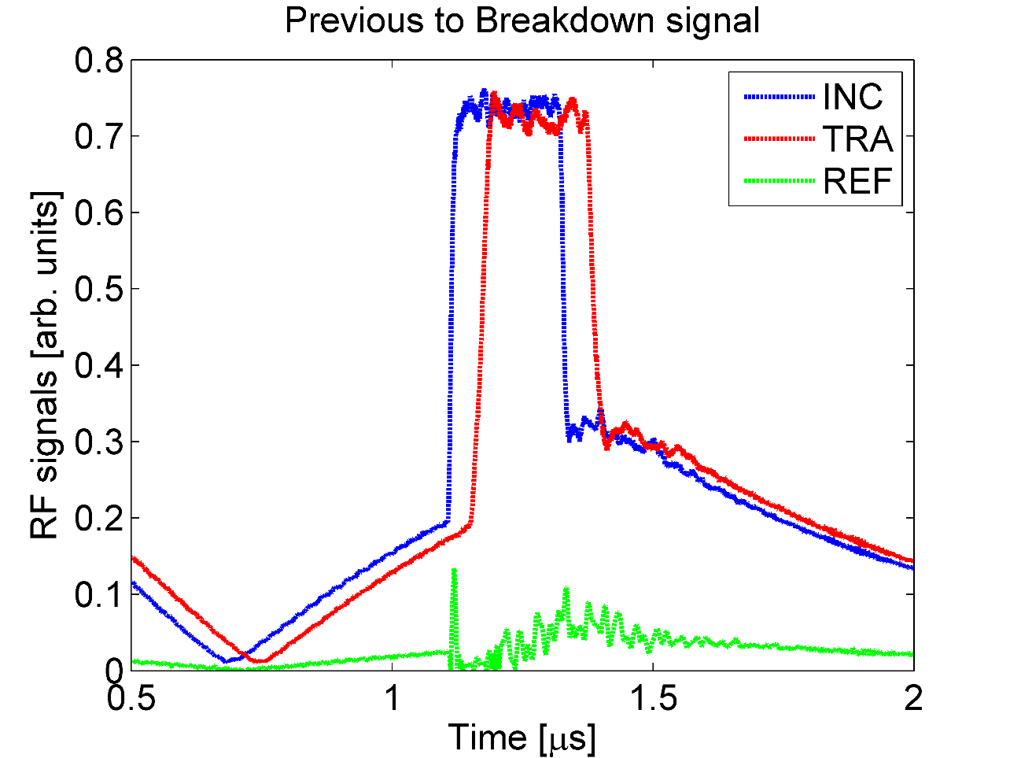
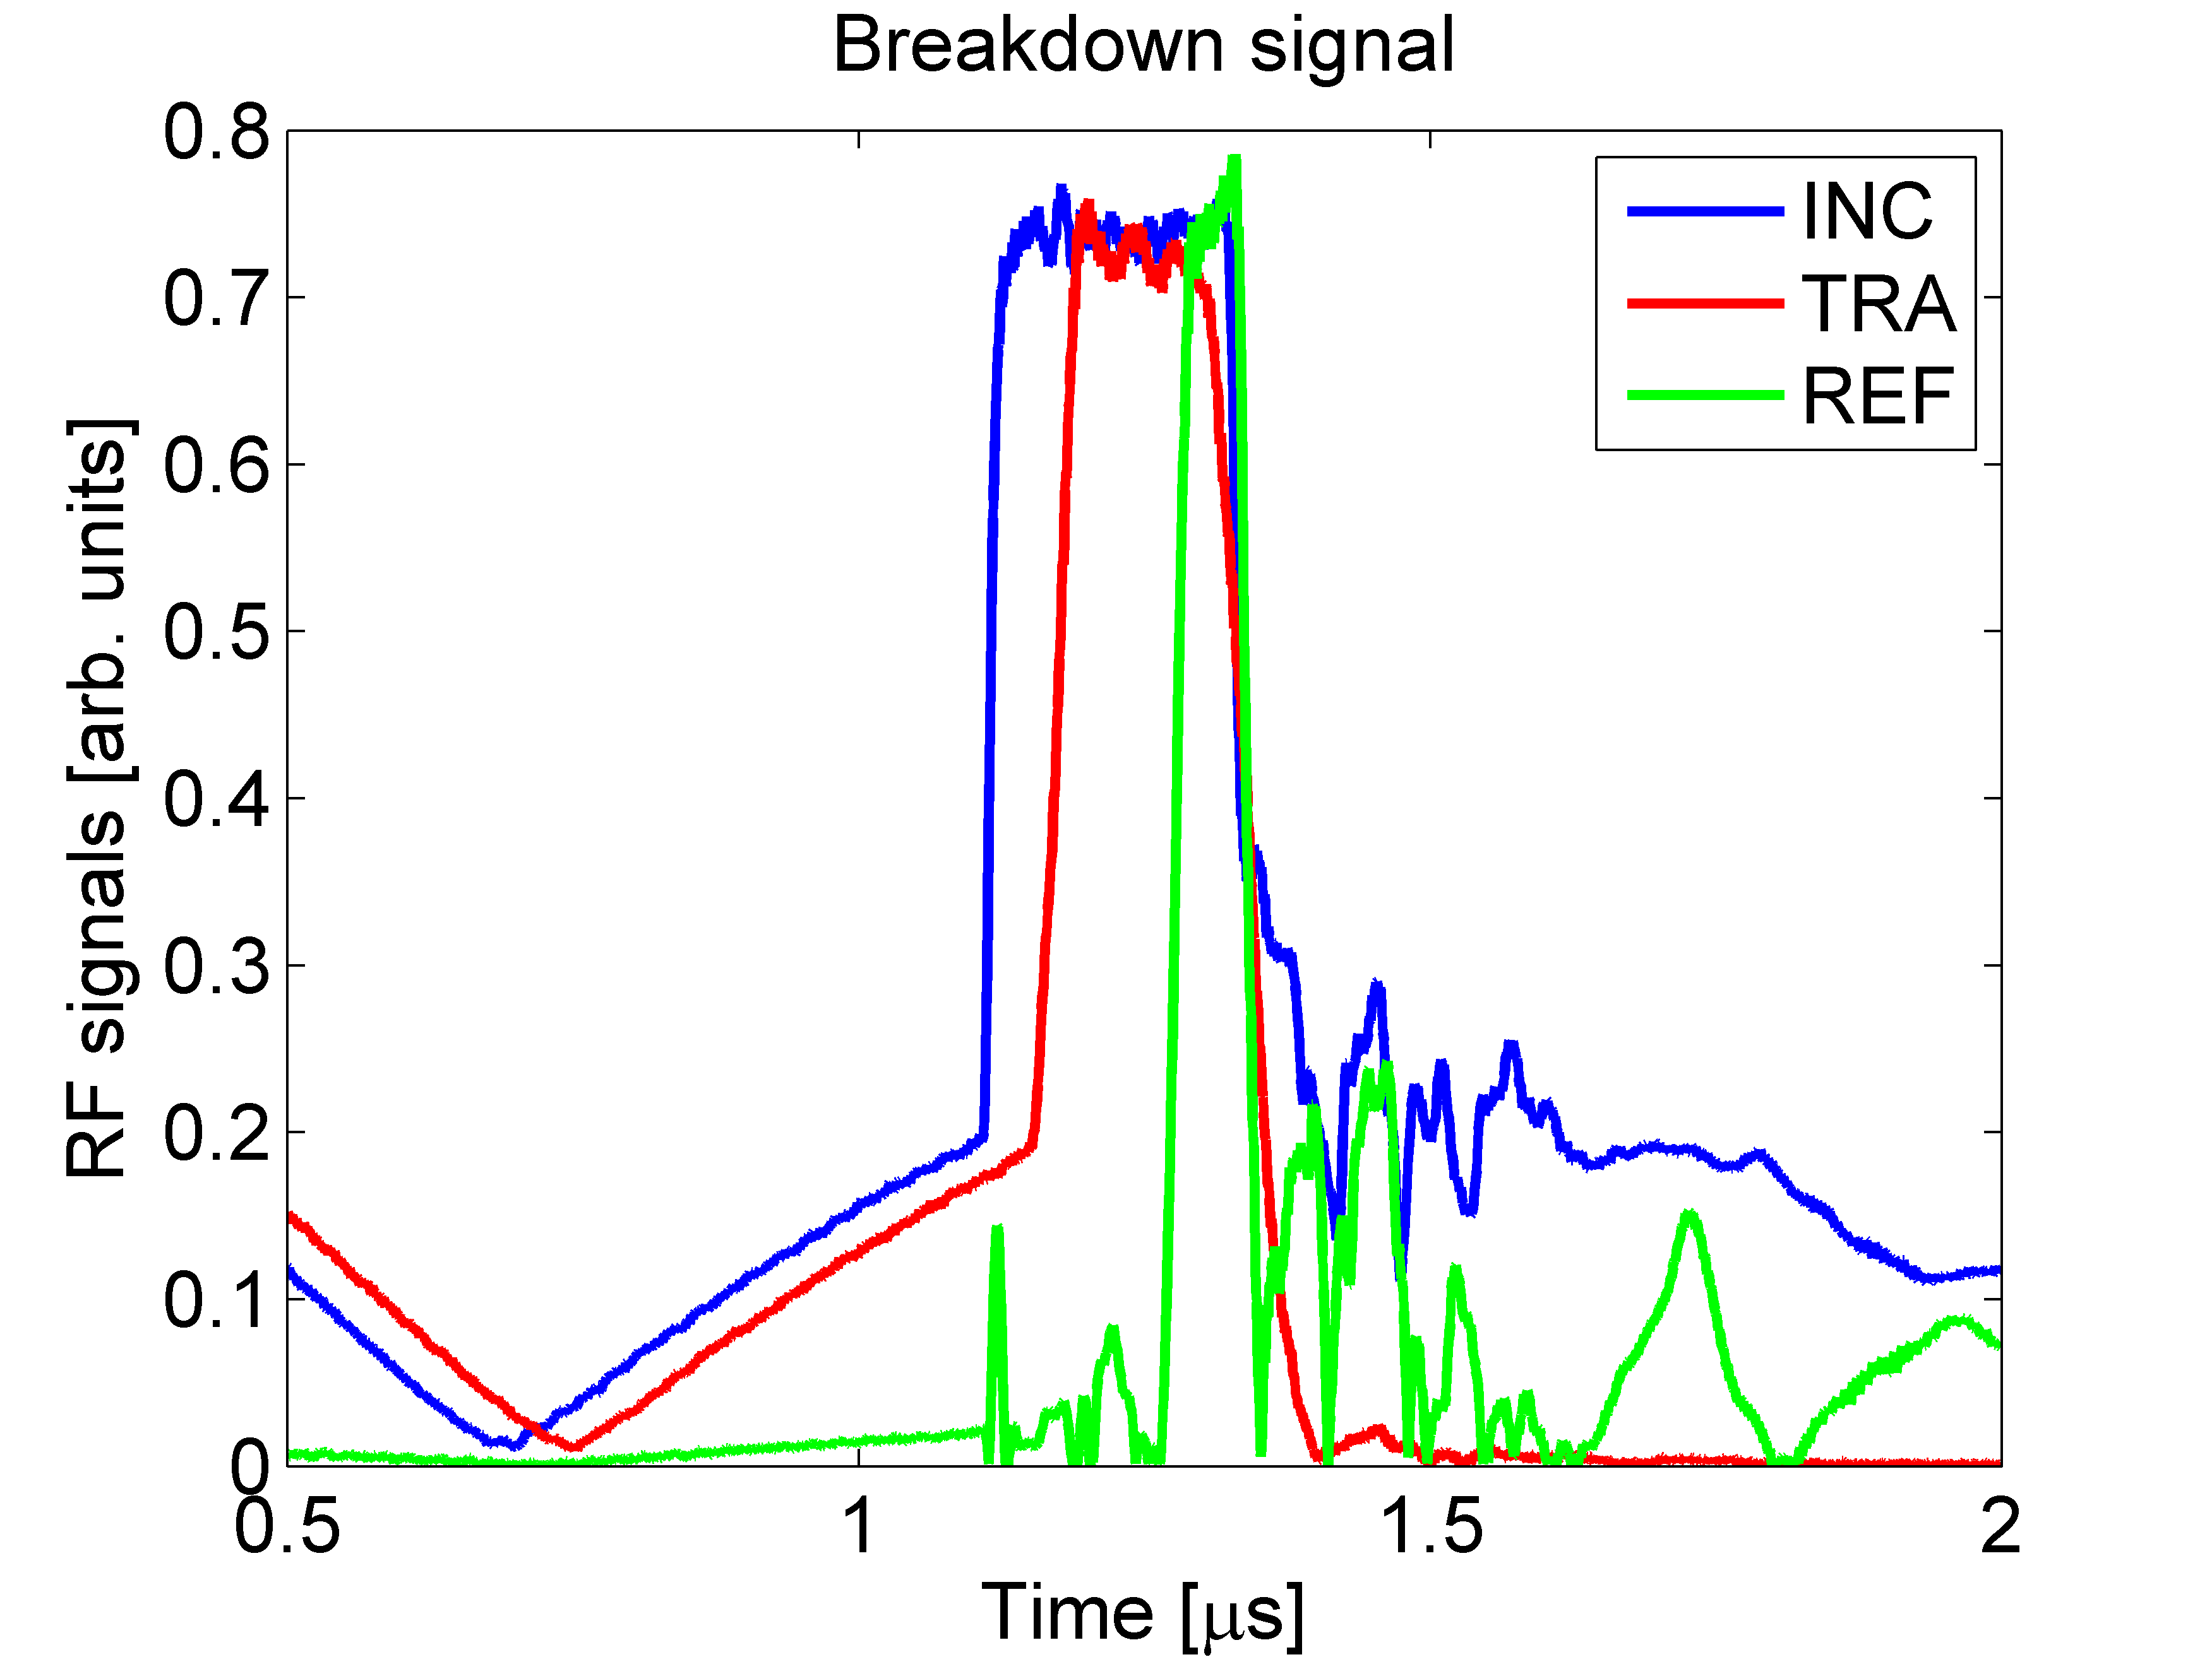
From CERN XBoxes

Slide 28
What is happening during breakdown and why does it interrupt power?
We’ll come back to this question but for now:
A field emission site, suddenly evolves and creates a local plasma. This plasma spot interacts with the fields and the copper surface and results in massively higher current emission. This current,
pico or nano amp for field emission
tens or hundreds of amps for arcing
creates something like a short circuit for the incoming rf.

Slide 29
I will now show an animation of a breakdown simulation by Kyrre Sjobaek, done for his PhD.
It is a simulation of the onset of breakdown, starting from field emission and going through the formation of a plasma, a plasma sheath and dramatically rising emitted current.
The code is ArcPIC and simulates a 20 micron wide dc gap.

Slide 30
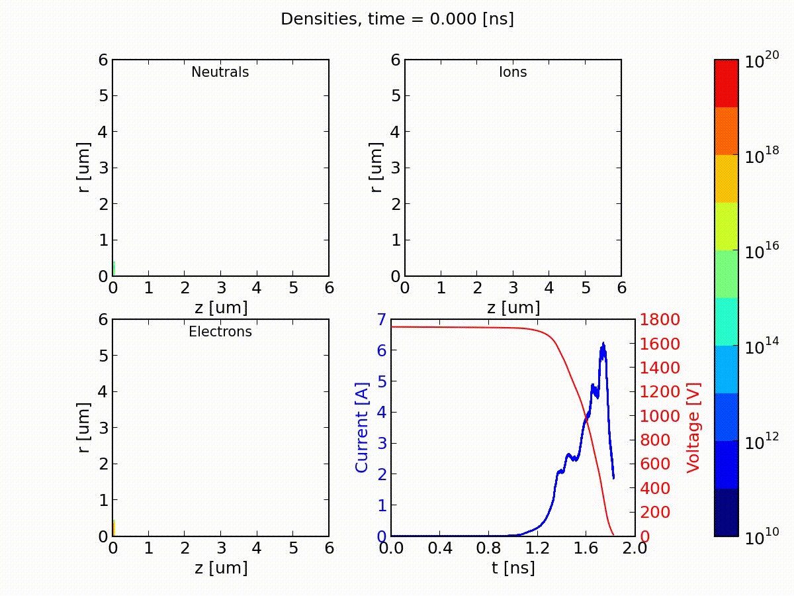

Slide 31
Breakdown rate
BDR (BreakDown Rate) is the fraction of pulses which have a vacuum arc. Arc currents and lost acceleration result in lost luminosity on that pulse.
CLIC specification:
3x10⁻⁷ 1/pulse/m
At 50 Hz, per structure:
1 BD every 3 days
Per facility:
1 BD someplace every 2 seconds

Slide 32
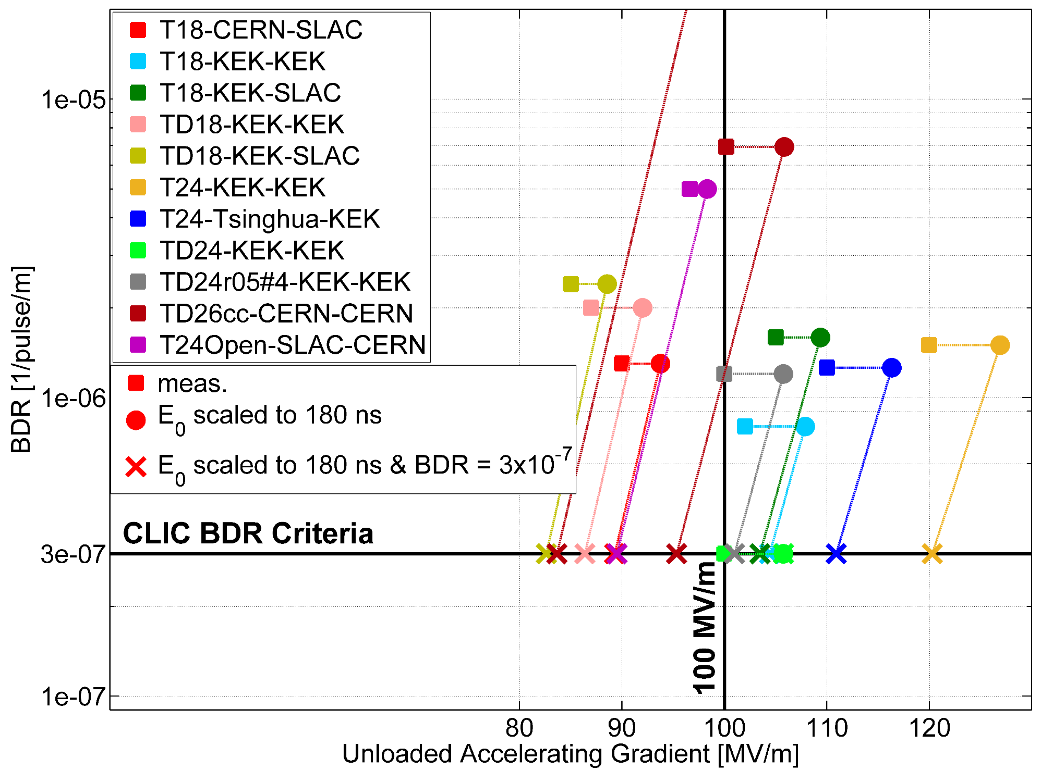

Performance summary at CLIC specifications
$$BDR∝E^{30}τ^{5}$$

Slide 33
Breakdowns in more detail

Slide 34
Breakdown position determination using timing and phase.

Slide 35
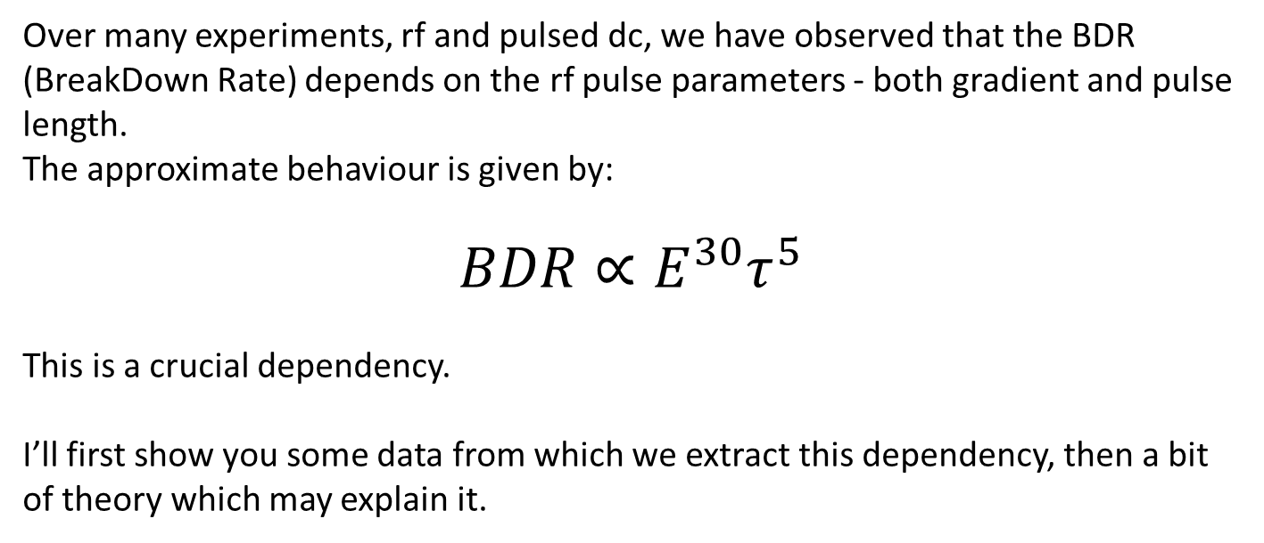
Important dependencies
Over many experiments, rf and pulsed dc, we have observed that the BDR (BreakDown Rate) depends on the rf pulse parameters - both gradient and pulse length.
The approximate behaviour is given by:
$$BDR∝E^{30}τ^{5}$$
This is a crucial dependency.
I’ll first show you some data from which we extract this dependency, then a bit of theory which may explain it.

Slide 36
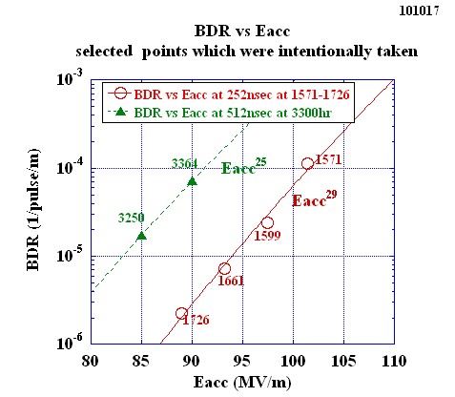
Relevant data points of BDR vs Eacc
TD18
Steep rise as Eacc, 10 times per 10 MV/m, less steep than T18
T. Higo, KEK

Slide 37
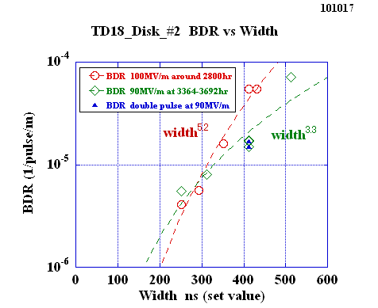
TD18_#2 BDR versus width at 100MV/m around 2800hr and at 90MV/m around 3500hr
TD18
Similar dependence at 90 and 100 if take usual single pulse?
T. Higo, KEK

Slide 39
soft Cu
hard Cu
From master’s thesis of Laura Mercade Morales

Slide 40
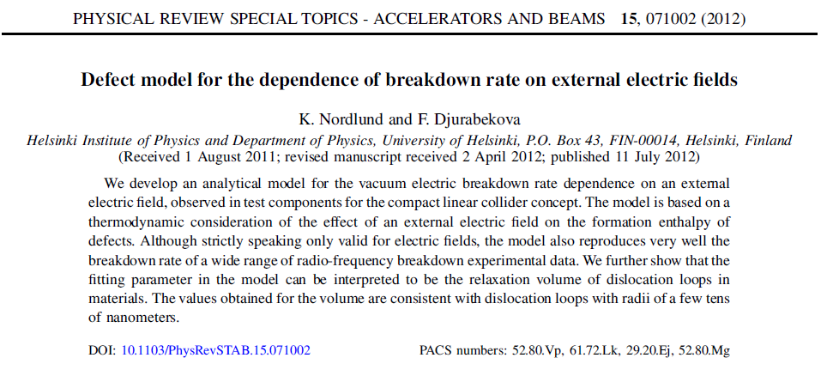
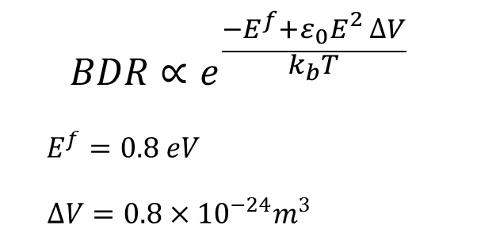
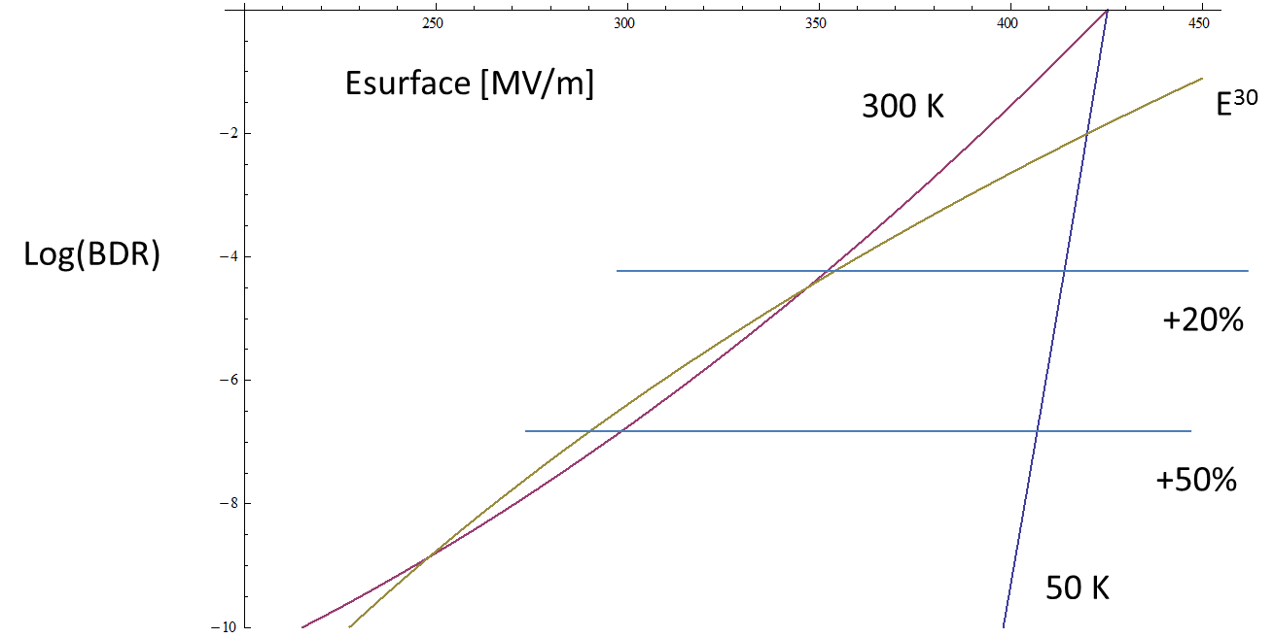

Slide 41
V. Dolgashev, EAAC2015

Slide 42
Long term operation and conditioning

Slide 43
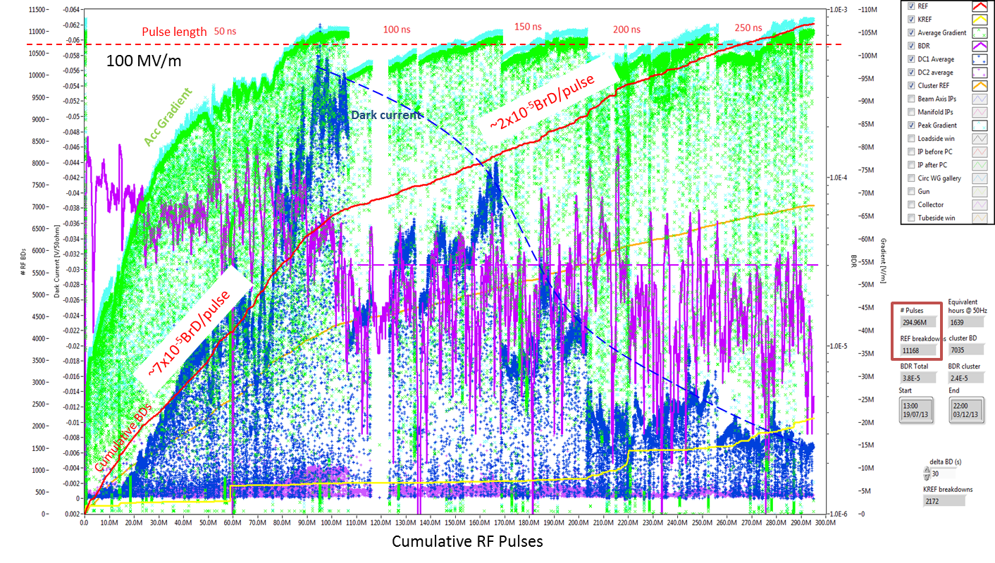
Conditioning data
Xbox-1: TD26CC#1 full conditioning history
An automatic conditioning algorithm was enable to keep a constant BDR while increasing the power.
Measurement
BDR = 2e-6 bpp at 100MV/m 250ns

Slide 44
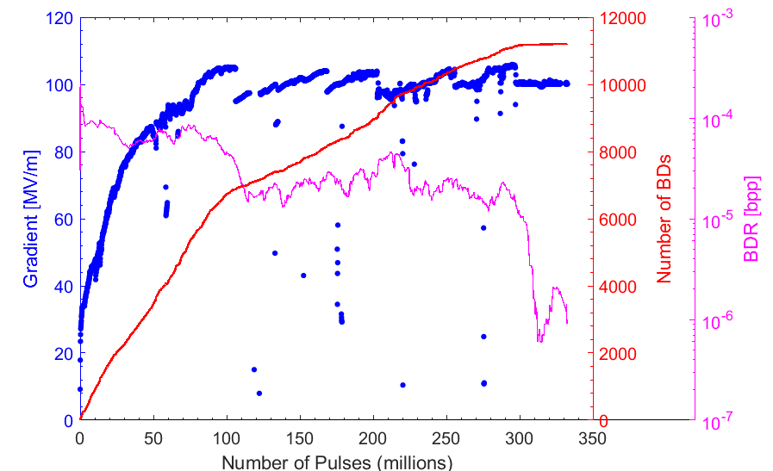
Conditioning
Accelerating structures do not run right away at full specification – pulse length and gradient need to be gradually increased while pulsing. Typical behaviour looks like this:
Pulse length steps
BDR falls during flat E run
4 million pulses per day at 50 Hz

Slide 45

Cavity Conditioning Algorithm
Automatically controls incident power to structure.
Short term: +10kW steps every 6 min and -10kW per BD event.
Long Term: Measures BDR (1MPulse moving avg.) and will stop power increase if BDR too high.

Slide 46
Conditioning data
Xbox-1: TD26CC#1 full conditioning history
An automatic conditioning algorithm was enable to keep a constant BDR while increasing the power.
Measurement
BDR = 2e-6 bpp at 100MV/m 250ns

Slide 47






Scaling: description of conditioning state
TD26CC#1 scaled gradient
BDR measure
CONDITIONING
BDR= 7e-5 bpp
2e-5 bpp
2e-6 bpp
Raw data full history
Equivalent gradient curve with constant pulse length of 250ns since the beginning
$$E_{0}^{scaled}=E_{0}{\left(\frac{t_{p}^{}}{250ns}\right)}^{−1/6}$$
Equivalent gradient curve with constant pulse length of 250ns and constant BDR of 2e-5 bpp since the beginning
$$E_{0}^{scaled}=E_{0}{\left(\frac{t_{p}^{}}{250ns}\right)}^{−1/6}{\left(\frac{BDR}{2·{10}^{−5}bpp}\right)}^{1/30}$$

Slide 48




Collection of conditioning histories
CLIC damped (TD) structures
TD26CC (XBOX-1)
TD24R05 (XBOX-1)
TD24R05#4 (NEXTEF)
TD24R05#2 (NEXTEF)

Slide 49



Comparing conditioning
Scaled gradient vs cumulative number of PULSES
Pulses
$$BDR∝E^{30}τ^{5}$$
Scaled gradient vs cumulative number of BREAKDOWNS
Breakdowns
Alberto Degiovanni, Walter Wuensch, and Jorge Giner Navarro, Comparison of the conditioning of high gradient accelerating structures, Phys. Rev. Accel. Beams 19, 032001 (2016) - Published 4 March 2016

Slide 50

Important question:
What is happening during conditioning?
Hope is the surface getting better?
Those really long runs you saw effectively cost a lot of money!
hard copper
heat treated copper
Pulsed dc system electrode

Slide 51




High-Gradient and Breakdown rate limits
TD26CC
Limiting quantities must be studied: gradient, Sc, peak E and H field, pulsed surface heating…
The trend at higher number of pulses might reach a limit in BDR
New CLIC TD structure upcoming tests will confirm these results
High repetition DC systems provide considerable new data to study conditioning phenomenology and operation dependencies.
Scaled BDR
$${BDR∝n}_{pulses}^{−9.2}$$
TD24R05#4
$${BDR∝n}_{pulses}^{−6.8}$$
TD24R05#2
$${BDR∝n}_{pulses}^{−8.0}$$

Slide 52


Breakdown statistics
rf
KEK
dc

Slide 53
soft Cu
hard Cu
From master’s thesis of Laura Mercade Morales

Slide 54

KEK
Processed for 1744 hours.

Slide 55

    Quantifying geometrical dependence of high-power performance

Slide 56
Importance of geometric dependence
There is a strong interplay between the rf design of accelerating structures and the overall performance of the collider for example:
Group velocity, beam loading and all that affect rf-to-beam efficiency
Another important dependency comes through wakefields, which affect emittance growth. We will look into wakefields tomorrow.
But rf geometry has an extremely strong influence on accelerating gradient and BDR.
In fact the three areas – rf-to-beam efficiency, wakefields and high-gradient performance – interact in a complex way overall accelerator optimization.
A crucial question becomes can we quantify the dependence of achievable gradient on rf geometry?

Slide 57


Performance summary at CLIC specifications
$$BDR∝E^{30}τ^{5}$$

Slide 58
The big questions
Can we quantify the dependence of achievable accelerating gradient on the geometry?
Where does such a geometrical dependency come from?
Trying to understand, derive and quantify geometrical dependence has been a significant effort because an essential element of the overall design and optimization of the collider.
We are now going to focus on the limit coming from breakdown. There is another limit from pulsed surface heating which I will come back to later.

Slide 59
The basic approach
The basic element is to express our high-power limits as a function of the unperturbed fields inside our structures – like the electric field limit in dc spark.
So first we are going to make sure that we have a feel for how those fields vary as a function of geometry.
We use a specific example of iris variation for a fixed phase advance in a travelling wave structure.

Slide 60



Field distribution
Electric field (V/m)
Magnetic field (A/m)
Poynting vector (W/m²)
Simulation in HFSS12
Field values are normalized to accelerating gradient, E_{acc}=100MV/m
Frequency: 11.424GHz
Phase advance per cell: 120 degree
Iris radius: 3mm
v_{g} /c= 1.35%

Slide 61
Parameters v.s. iris
Simulation in HFSS12
Iris thickness: 1.66mm
Frequency: 11.424GHz
Phase _adv/cell: 120 degree
R/Q = V²_{acc}/(ωU)

Slide 62
Trying to achieve these specifications has resulted over the years in the test of many structures of diverse rf design.
The preparation and testing conditions of the test structures which were built were not always the same – these processes also evolved over the period the structures were being developed.
But the wide variety of structure geometries were tested under reasonably similar conditions.
So we have used this unique set of data to try to understand and then quantify the geometrical dependency of gradient.

Slide 63


Maximum surface electric and magnetic fields
Waveguide
damped
Es = 250 MV/m or higher has been achieved in several cases: very low or zero group velocity

Slide 64
What do can make out of this mess?
My personal conclusion from looking at data like this, was that a something else is important, beyond E and B surface fields.
This something felt like it had to be related to the power flowing through the structure. In particular some kind of power density, since larger apertures generally support larger powers.
This is reasonable when you think about what we know about breakdown.
Field emission is pico or nano amps. Breakdowns in rf and dc produce 10’s, 100’s even kA of current.
A lot of power is needed to accelerate so much current. The breakdown must need to be “fed” with the necessary power so power density is crucial.

Slide 65
W. Wuensch
Observations about RF Breakdown from the CLIC High Gradient Testing Program
CERN-AB-2006-085; CLIC-Note-700.- Geneva : CERN, 2006 - 8 p. - Published in : AIP Conf. Proc.: 877 (2006) , pp. 15-21
global power flow

Slide 66
A. Grudiev, S. Calatroni, and W. Wuensch,
New local field quantity describing the high gradient limit of accelerating structures,
Phys. Rev. ST Accel. Beams 12, 102001 (2009)

Slide 67



This has resulted in the development of two power-density based design criteria:
E_{s}/E_{a}
global power flow
H_{s}/E_{a}
local complex power flow
S_{c}/E_{a}²
There is no proof (yet) but rather the general set of physical arguments plus reasonably good consistency with measurements.

Slide 68


Power flow related quantities: Sc and P/C
Sc = 4 - 5 MW/mm²
P/C = 2.3 – 2.9 MW/mm

Slide 69
Summary on the high-power RF constraints
RF breakdown and pulsed surface heating constraints used for CLIC_G design (2007):
E_{s}^{max} < 250 MV/m
P_{in}/C_{in}·(t_{p}^{P})^{1/3} = 18 MW·ns^{1/3}/mm
ΔT^{max}(H_{s}^{max}, t_{p}) < 56 K
Optimistic RF breakdown and pulsed surface heating constraints for BDR=10⁻⁶ bpp/m:
E_{s}^{max} ·(t_{p}^{P})^{1/6} < 250 MV/m · (200ns)^{1/6}
P_{in}/C_{in}·(t_{p}^{P})^{1/3} < 2.8 MW/mm · (200ns)^{1/3} = 17 [Wu]
S_{c}^{max} ·(t_{p}^{P})^{1/3} < 5 MW/mm² · (200ns)^{1/3}
and
ΔT^{max}(H_{s}^{max}, t_{p}) < 50 K
Depending on degree of our optimism a safety margin has to be applied.
Varying RF constraints in the optimization how much money one can save by being optimistic.
A. Grudiev

Slide 70

Optimization procedure
<E_{a}>, f, ∆φ, <a>, da, d₁, d₂
Beam
dynamics
Bunch population
Cell parameters
N
Q, R/Q, v_{g}, E_{s}/E_{a}, H_{s}/E_{a}
Q₁, A₁, f₁
Structure
parameters
Bunch
separation
Beam
dynamics
N_{s}
L_{s}, N_{b}
η, P_{in}, E_{s}^{max}, ∆T^{max}
rf
constraints
YES
Cost function
minimization
NO

Slide 71
Simplified Parameter Diagram
Parameter Routine
Luminosity, …
Variable | Meaning | Current value
I_{drive} | Drive beam current | 101A
E_{drive} | Drive beam energy | 2.37GeV
τ_{RF} | Main linac RF pulse length | 244ns
N_{sector} | Number of drive beam sectors per linac | 4
N_{combine} | Combination number | 24
f_{r} | Repetition rate | 50Hz
N | Main beam bunch charge in linac | 3.72e9
n_{b} | MB bunches per pulse | 312
n_{cycle} | Spacing between MB bunches | 6 cycles
E₀ | MB energy at linac entrance | 9GeV
E_{cms} | Centre-of-mass energy | 500GeV
G | Main linac gradient | 100MV/m
I_{drive}
E_{drive}
τ_{RF}
N_{sector}
N_{combine}
f_{r}
N
n_{b}
n_{cycle}
E₀
f_{r}
E_{cms,} G, L_{structure}
Two-Beam Acceleration Complex
L_{module}, Δ_{structure}, …
Drive Beam Generation Complex
P_{klystron}, N_{klystron}, L_{DBA}, …
Main Beam Generation Complex
P_{klystron}, …

Slide 72
A few more words of background.
A number of effects which emerge at high-power and high-gradient.
These include:
Breakdown or vacuum arc – This is essentially the same phenomenon you all know from daily life, sparking and arcing, but in vacuum. This is the main effect limiting gradient in CLIC.
Pulsed surface heating – Surface currents cause pulsed temperature rises, consequently cyclical stress which breaks up the surface and induces breakdown.
Electromigration – This is a new area of investigation in which rf currents directly affect the crystal structure of the copper surface.
Dark currents – Field emission currents are captured by the rf and can be accelerated over longer distances.
Dynamic vacuum – Field emission currents desorbs gasses which cause pressure rises during the rf pulse.
Multipactor – not really a problem at the highest gradients.

Slide 73
A closer look at the dynamics of Breakdown!
From pA to kA and from Angstroms to 100s of μm to mms.

Slide 74
An overview of the breakdown process
Vacuum
Copper

Slide 75
Actually real surfaces are imperfect
Vacuum
Copper

Slide 76
And the material below the surface isn’t perfect either
Vacuum
Copper
voids and inclusions
slip planes
vacancies
dislocations

Slide 77
Add an external electric field, around 200 MV/m. Surface charges re-arrange themselves in fs. Surface experiences εE² tensile force.
εE² tensile force
Vacuum
Copper
voids and inclusions
slip planes
vacancies
dislocations

Slide 78
Field emission current flows from metal into vacuum (Fowler-Nordheim) from local areas (O[10 nm]) of geometrical field enhancement and low local work function. There is a local field enhancement β of around 50-100. The total current from something like 0.1 mm² is a nanoAmp.
εE² tensile force
Vacuum
Copper
voids and inclusions
slip planes
vacancies
dislocations

Slide 79
The external electric field causes the tensile stress and field emission current causes thermal induces stresses so the material imperfections and surface features evolve – plastic deformation.
εE² tensile force
Vacuum
Copper
voids and inclusions
evolve
slip planes move
vacancies move
dislocations move

Slide 80
The external electric field causes the tensile stress and field emission current causes thermal induces stresses so the material imperfections and surface features evolve – plastic deformation.
εE² tensile force
Vacuum
Copper
voids and inclusions
evolve
slip planes move
vacancies move
dislocations move

Slide 81
All the while, neutral copper atoms are coming off the surface field assisted evaporation.
The details of this process is process is a fundamental open question.
εE² tensile force
Cu
Cu
Cu
Vacuum
Cu
Cu
Cu
Cu
Cu
Copper
voids and inclusions
evolve
slip planes move
vacancies move
dislocations move

Slide 82
The copper atoms are ionized by the field emission current. the positively charged ions head to the surface and the electrons add to the emission current.
εE² tensile force
Cu+
Cu+
Vacuum
Cu+
Cu+
Cu+
Cu+
Cu+
Cu+
Copper
voids and inclusions
evolve
slip planes move
vacancies move
dislocations move

Slide 83
The copper ions hit the surface and sputter more copper in addition to that produced at by the original emission process.
εE² tensile force
Cu
Cu
Cu
Cu+
Cu+
Cu
Vacuum
Cu+
Cu+
Cu+
Cu+
Cu+
Cu+
Copper
voids and inclusions
evolve
slip planes move
vacancies move
dislocations move

Slide 84
One of these emission points, on some rf or dc pulse, at some point passes a threshold and the process runs away. We will now switch to a computer simulation of the run-away process.
εE² tensile force
Cu
Cu
Cu
Cu+
Cu+
Cu
Vacuum
Cu+
Cu+
Cu+
Cu+
Cu+
Cu+
Copper
voids and inclusions
evolve
slip planes move
vacancies move
dislocations move

Slide 86
It all starts with field emission

Slide 87

The surface potential used for solving the Fowler-Nordheim equation
{
-W_{a} for z<0
-eEz-e²/4z for z>0
V(z)=

Slide 88
The Fowler-Nordheim equation
(approximate, practical form)
Units: [I]=A, [E]=MV/m, [A_{e}]=m², [ϕ]=eV and [β]=dimensionless
Values: ϕ = 4.5 eV for copper

Slide 89
The Fowler-Nordheim equation
Analyzing real data
-γ
You will have the opportunity to analyze a real set of data tonight for homework!

Slide 90

Field emitter observed in Chamonix, France. MeVArc mini-school on rf acceleration.

Slide 91

Electron emission
Fowler Nordheim Law (RF fields):
I_{FN}
(β, φ₀, A_{e}, E₀)
High field enhancements (β) can field emission.
Low work function (φ₀) in small areas can cause field emission.
typical picture ➔
geometric perturbations (β)
alternate picture ➔
material perturbations (φ₀)
grain
boundaries
peaks
oxides
cracks
Copper surface
inclusions
(suggested by Wuensch and colleagues)

Slide 92
Schottky Enabled Photo-electron Emission Measurements
ICT
Data 2010-10-04
First results
from Tsinghua
e-
γ
Should not get
photoemission
Experimental parameters
  work function of copper = φ₀ = 4.65 eV
  energy of λ=400nm photon = hν= 3.1 eV
  Laser pulse length
    Long = 3 ps
    Short = 0.1 ps
  Laser energy ~1 mJ (measured before laser input window)
  Field (55 – 70 MV/m)

Slide 93
→Long Laser Pulse (~ 3ps)
→E=55 MV/m@ injection phase=80 ➔ 55sin(80)=54
First results
from Tsinghua
Data 2010-10-04
Q I
single photon emission
Q(pC)
laser energy (mJ)
photocathode input window

Slide 94


Slide 95
Identification of a nanometer-sized field emitter.
Laser-induced asymmetric faceting and growth of nano-protrusion on a tungsten tip
Hirofumi Yanagisawa, Vahur Zadin, Karsten Kunze, Christian Hafner, Alvo Aabloo, Dong Eon Kim, Matthias F. Kling, Flyura Djurabekova,Q1 5 Jürg Osterwalder and Walter Wuensch
Accepted for publication in APL Photonics
arXiv1605.05393

Slide 96



Hardware status and evolution:
plane cathode, tip anode
Plane cathode, typically 12 mm diameter disk sample. Tip anode, 1 mm radius hemispherical tip. Moveable anode with capacitive gap-height control. Gaps typically 10-50 μm.

Slide 97

What are the field emitters?
Why do we look for dislocations?
The dislocation motion is strongly bound to the atomic structure of metals. In FCC (face-centered cubic) the dislocation are the most mobile and HCP (hexagonal close-packed) are the hardest for dislocation mobility.
A. Descoeudres, F. Djurabekova, and K. Nordlund, DC Breakdown experiments with
cobalt electrodes, CLIC-Note XXX, 1 (2010).

Slide 98
Pulsed surface heating.
Fatigue process driven by pulsed resistive wall losses

Slide 99
Pulsed surface heating limit
TD24
Last
regular
cell: 19
Cell # (cell #1 is a input matching cell):
4
?16?
5
6
7
8
9
10
11
12
13
14
15
17
18
It seems that cell #10 (regular cell #9 ~ middle cell) exhibits the level of damage which could be considered as a limit.
A. Grudiev
Images courtesy of M. Aicheler: http://indico.cern.ch/getFile.py/access?contribId=0&resId=1&materialId=slides&confId=106251

Slide 100



Fundamental physics of high fields on metal surfaces
Fabrication of prototypes and technology optimization
High-gradient rf design
High-gradient testing
High-power test stands

