Slide 1
Profile Measurements
Hermann Schmickler, CERN
With slides from:
Kay Wittenburg (DESY)

Slide 2
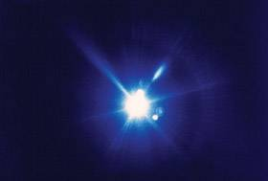
Synchrotron Light Profile Monitor
Introduction
Resolution limits
Small Emittance Measurements
(Proton Synchrotron Radiation Diagnostics)

Slide 3
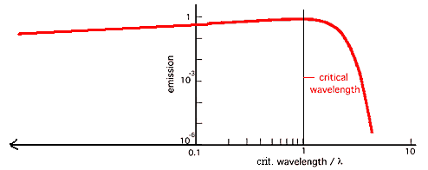
Synchrotron light profile monitor
In electron accelerators the effect of synchrotron radiation (SR) can be used for beam size measurements. In this course we will focus on profile determination, but SR can also be used for bunch length measurements with e.g. streak cameras with a resolution of < 1 ps. From classical electrodynamics the radiated power is given for a momentum change dp/dt and a particle with mass m₀ and charge e:
For linear accelerators dp/dt = dW/dx. For typical values of dW/dx = 10 - 20 MeV/m the SR is negligible. In bending magnets an acceleration perpendicular to the velocity exists mainly in the dipole magnets (field B) with a bending radius ρ = βγm₀c/(eB). The total power of N circulating particles with γ = E/m₀c² is than
This expression is also valid for a ring having all magnets of the same strength and field-free sections in between.
The critical wavelength
λ_{c} divides the Spectrum
of SR in two parts of
equal power:

Slide 4
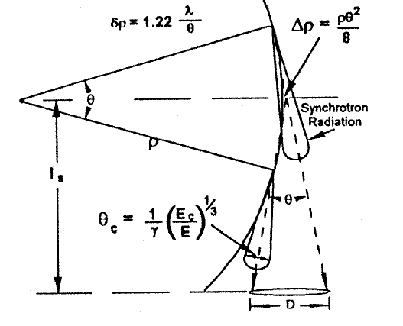
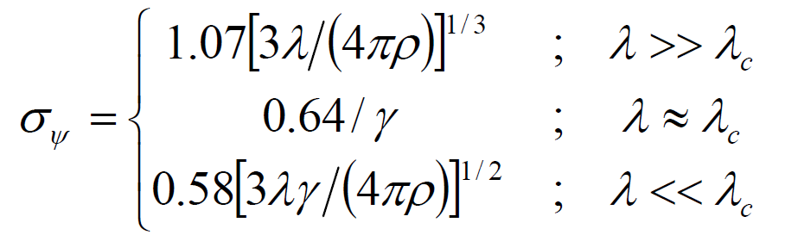
Opening angle Ψ of SR (1/2 of cone!) for λ>>λ_{c}(!!!):
with
= E/m₀c² = E [MeV]/0.511
= 23483 at 12 GeV and
= 52838 at 27 GeV
Path length s:
s = ρθ
ρ = Bending radius of Dipole
Ψ
J. Flanagan (IPAC2011)

Slide 5
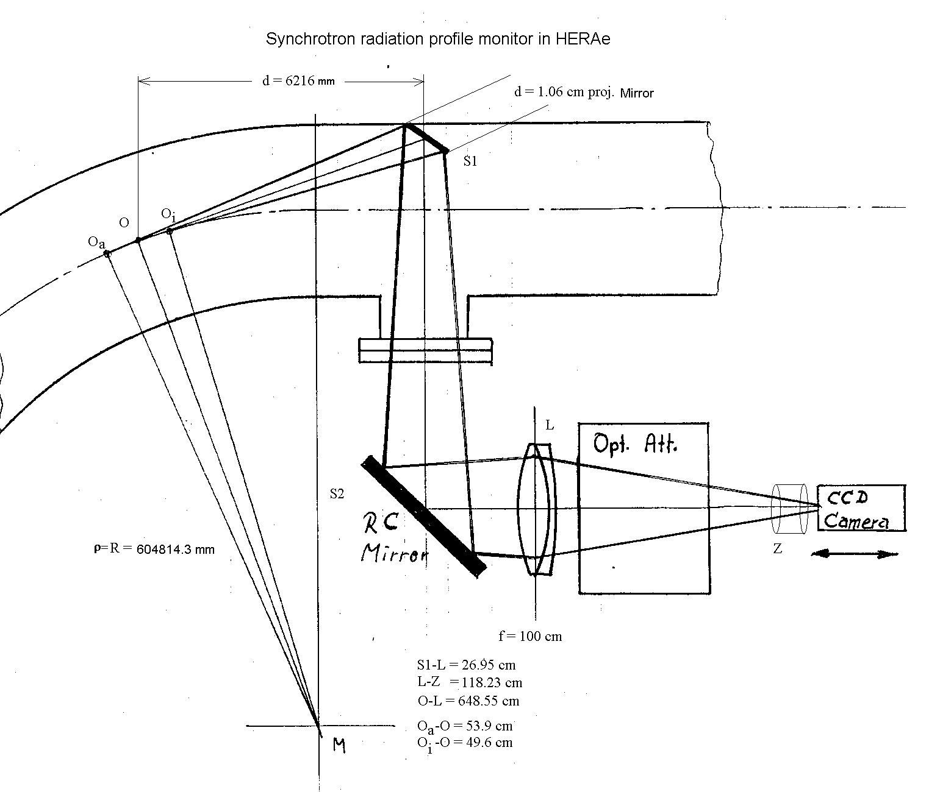
Example HERAe (46 mA circulating electrons at 27 GeV)
R = ρ = 604814.3 mm
G = O-L = 6485.5 mm
B = L-Z = 1182.3 mm
O-S1 = 6216 mm
L = O_{a}-O_{i} = 1035 mm
opening angle (horizontal): tanθ/2 = d/2/6216 => θ/2 = arc tan d/2/6216 = 0.85 mrad
opening angle (vertikal):
Ψ(λ) = 1/γ (λ/λ_{c})^{1/3}
Discussion: Potential problems?

Slide 6
Heating of mirror:
total emitted Power per electron:
total Power of 46 mA circulating electrons at 27 GeV (Number of electrons N_{e} = 6 · 10¹²)
P_{tot} = 6 · 10⁶ W
The mirror will get P_{tot} * Θ / (2 π) = 1600 W (Integral over all wavelength!!!)
Solutions?
=> mirror is moveable, mirror has to be cooled
Material with low Z is nearly not visible for short wavelength => Beryllium
Still 100 W on mirror in HERAe
not sufficient to prevent image distortion

Slide 7
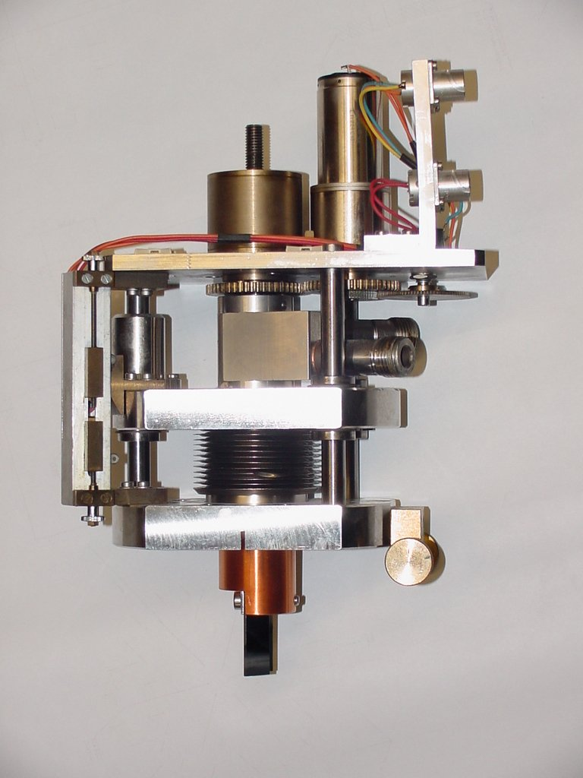
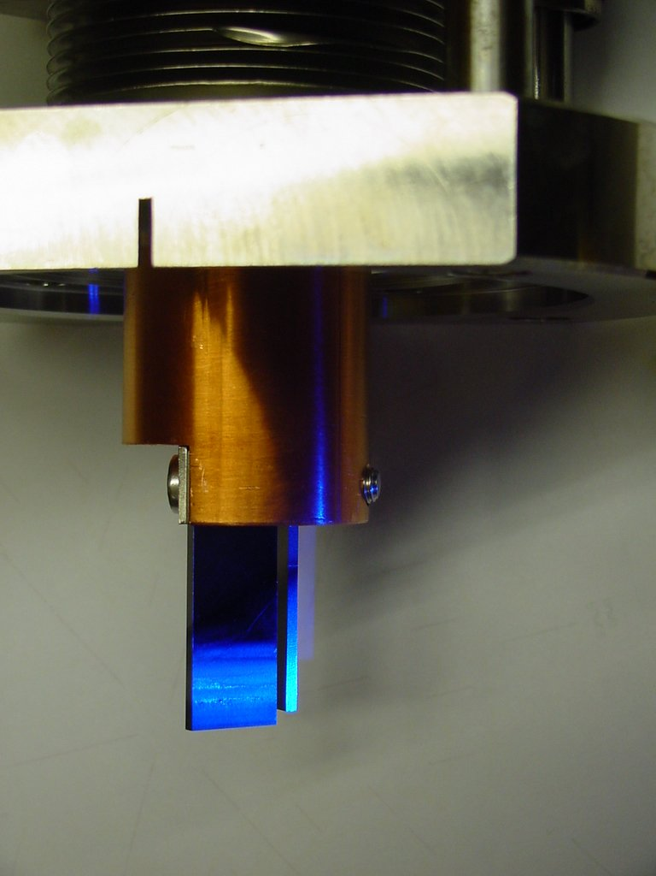

Slide 8
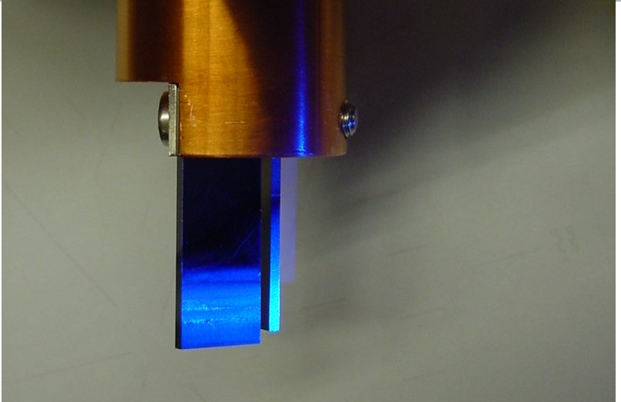
Proposals to solve the problem?

Slide 9
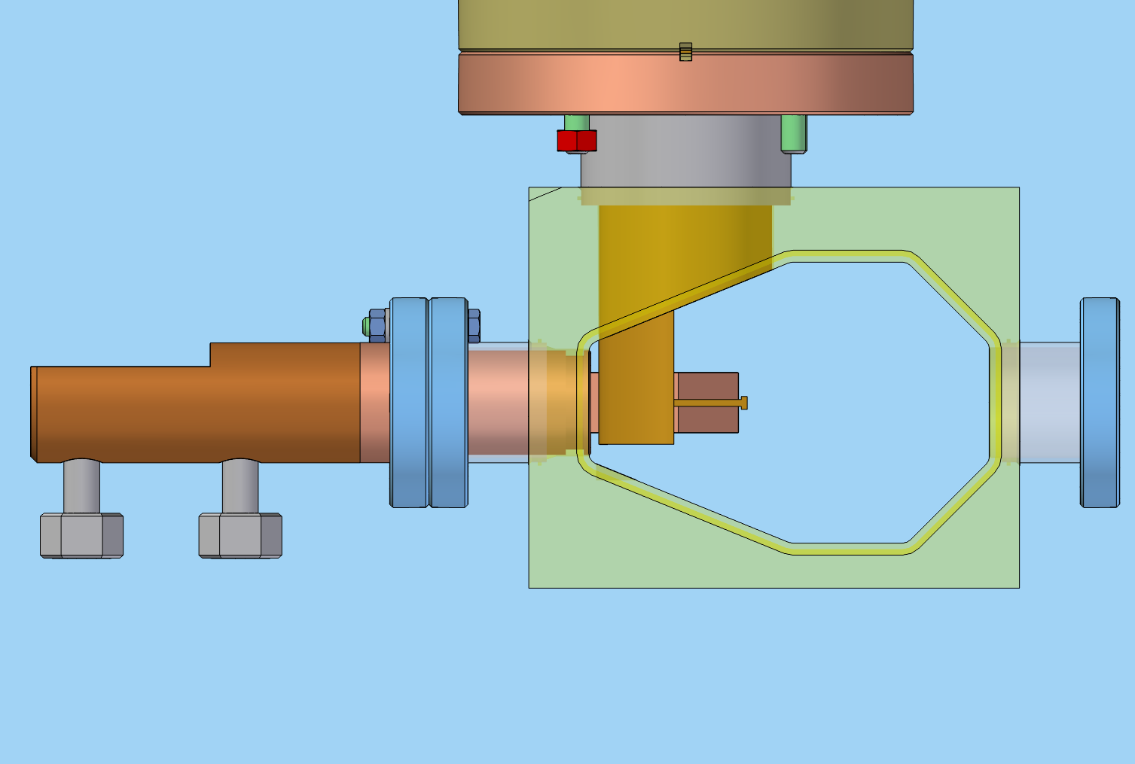
1. (water cooled) Absorber
2. Do not move the whole mirror into the beam, stop before center

Slide 10
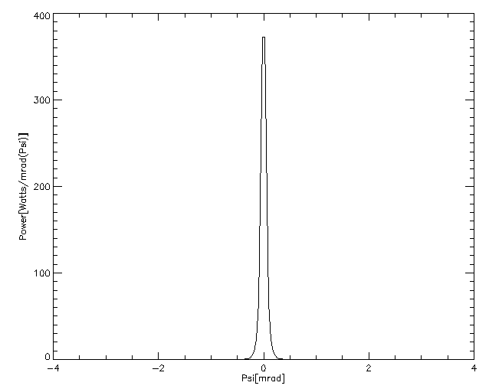
+/- 2 / γ = +/- 0,17 mrad
„Total“ power within +/- 0,6 mrad

Slide 11
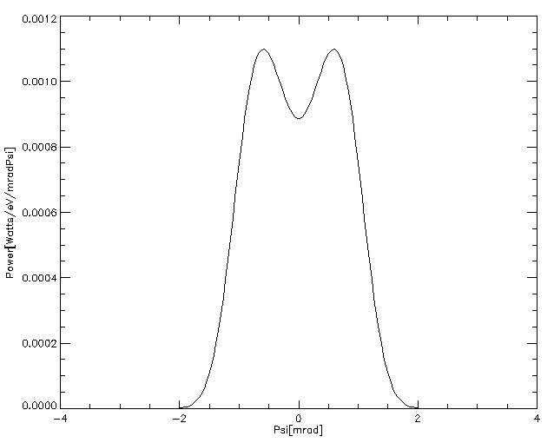
Visible part
Fade out ± 2/ γ by
Absorber
Mirrorsize

Slide 12
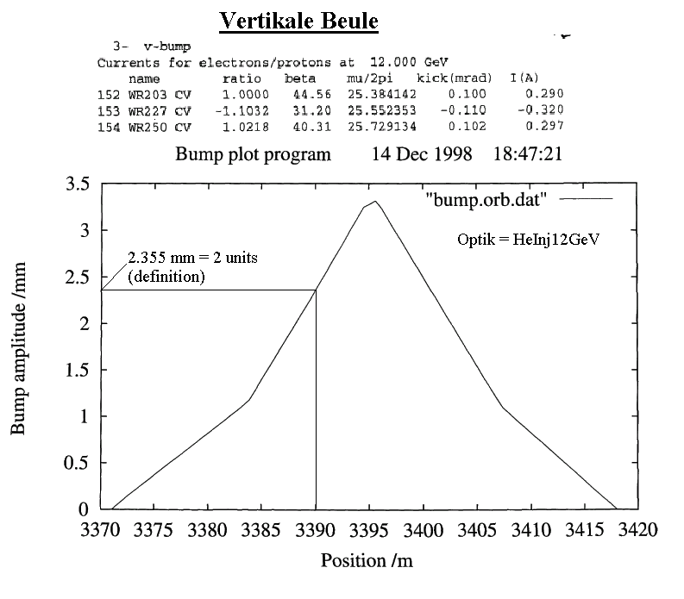
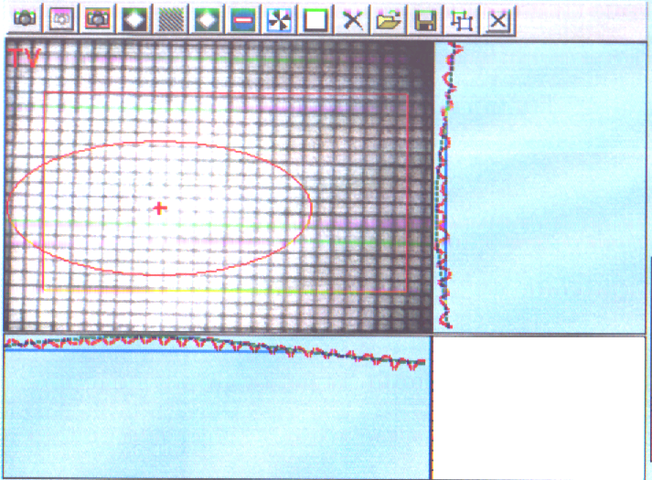
Discussion: What limits the spatial resolution?
Diffraction, depth of field, arc, camera => physical
Alignment, lenses, mirrors, vibrations => technical
How to calibrate the optics?
Grid (yardstick) at point of emission, orbit bumps, …

Slide 13
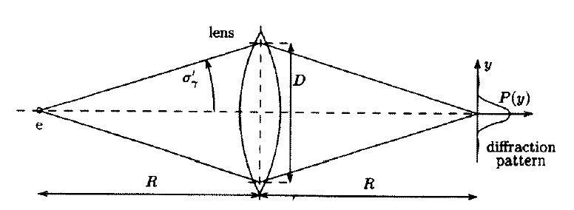
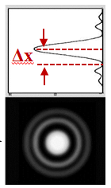
Diffraction:
Ψ
EQ 1:
Diffraction limit (for Object):
For normal slit:
σ_{Diff} = 0.47 ∗ λ/θ/2 (horizontal, mirror defines opening angle θ)
σ_{Diff} ≈ 0.47 ∗ λ/Ψ (vertikal)

Slide 14
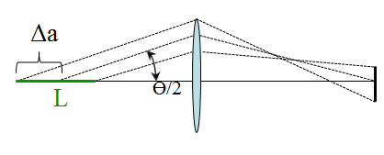
Depth of field:
Ψ
EQ 2:
depth of field:
Vertical: Δ_{depth} ≈ L/2 * Ψ = σ _{depth}
Horizontal: Δ_{depth} ≈ L/2 * θ/2 = σ _{depth} (mirror defines opening angle θ)
L ≈ ρ tanθ or 2ρ (θ/2 + Ψ)

Slide 15
Arc:
EQ 3:
Arc (horizontal):
Observation of the beam in the horizontal plane is complicated by the fact that the light is emitted by all points along the arc. The horizontal width of the apparent source is related to the observation angle as:
Δx_{arc} = ρ θ ²/8 = σ_{arc} (mirror defines opening angle θ)

Slide 16
Camera (finite pixel size)
EQ 4:
Camera:
image gain = G/B = 5.485
typical resolution of camera CCD chip: σ_{chip} = 6.7 μm
σ_{camera} = σ_{chip} * G/B = 37 μm
Resolution:
λ not monochromatic !
σ_{Diff} = 0.47 ∗ λ/θ (horizontal) = ??? Depends on wavelength
σ_{Diff} = 0.47 ∗ λ/Ψ (vertikal) = ??? Depends on wavelength
σ_{depth} = L/2 * θ/2 = 440 μm
σ_{arc} = ρ θ ²/8 = 219 μm (horizontal)
σ_{camera}= σ_{chip} * G/B = 37 μm

Slide 17
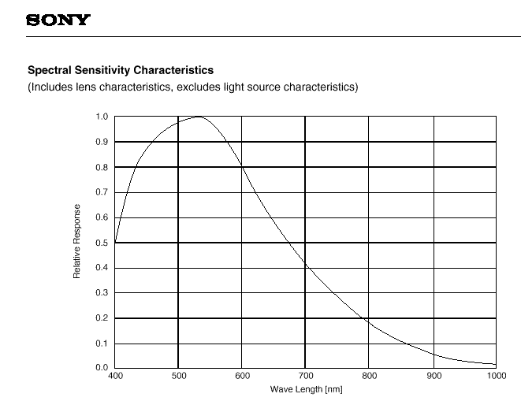
Assume: λ = 550 nm;
(γ = E/m₀c²)
γ₁₂ = 2.35 * 10⁴ (E = 12 GeV)
γ₃₅ = 6.85 * 10⁴ (E = 35 GeV)
λ_{c,12} = (4πρ)/(3γ³) = 0.195 nm at 12 GeV
λ_{c,35} = (4πρ)/(3γ³) = 0.008 nm at 35 GeV
opening angle (horizontal): tanθ/2 = d/2/6216 => θ/2 = arc tan d/2/6216 = 0.85 mrad
opening angle (vertikal):
Ψ(λ) = 1/γ (λ/λ_{c})^{1/3} = [(3λ)/(4πρ)]^{1/3} = 0.6 mrad
(mirror has to be larger than spot size on mirror) =>
σ_{diff} = 0.47 ∗ λ/θ/2 = 304 μm (horizontal)
σ_{diff} = 0.47 ∗ λ/Ψ = 431 μm (vertical)
σ_{depth} = L/2 * θ/2 = 440 μm
σ_{arc} = ρ θ ²/8 = 219 μm (horizontal)
σ_{camera} = σ_{chip} * G/B = 37 μm
typical spectral sensitivities from CCD Sensors:

Slide 18
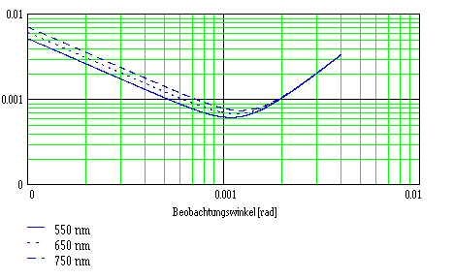
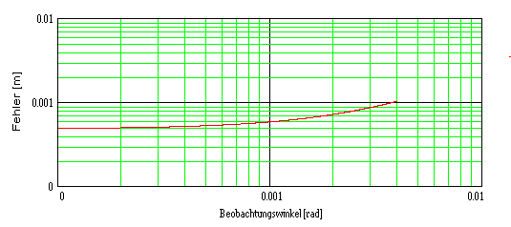
σ_{cor} = (σ_{diff} ² + σ_{depth} ² + σ_{arc}² + σ_{camera} ²)^{1/2} = 579 μm ; (horizontal)
σ_{cor} = (σ_{diff} ² + σ_{depth} ² + σ_{camera} ²)^{1/2} = 617 μm ; (vertical)
Horizontal:
σ_{cor} = [(ρ θ ²/8)² + (L/2 * θ/2)² + (0.47 ∗ λ/θ/2)²]^{1/2} with L ≈ ρ tan θ ≈ ρ θ
Vertical:
σ_{cor} = [(L/2 * Ψ)² + (0.47 ∗ λ/Ψ)²]^{1/2} with L ≈ ρ tan θ ≈ ρ θ

Slide 19
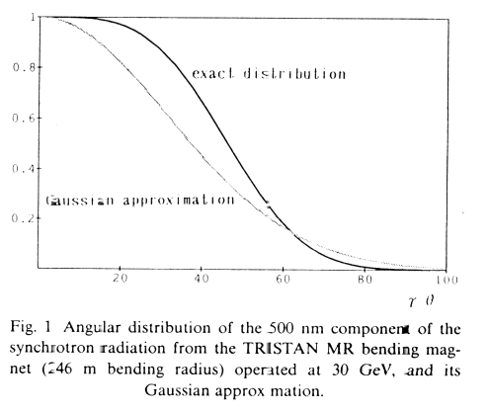
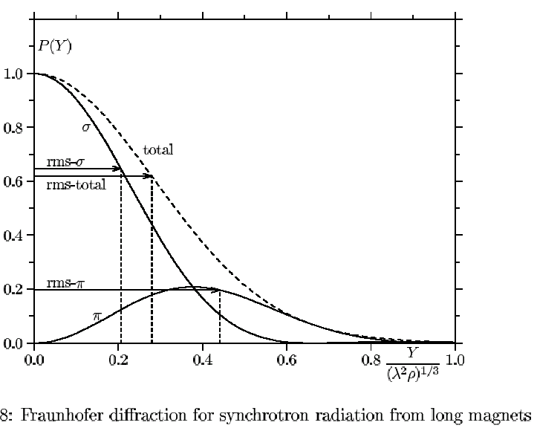
Discussion: So found correction terms too large!!!
1) Diffraction:
Ψ_{exact} is larger than the Gauss approximation (e.g. 0.79 → 1.08 mrad at Tristan)
b) For a gaussian beam the diffraction width is σ_{diff} ≈ 1/π ∗ λ/Ψ
(Ref: ON OPTICAL RESOLUTION OF BEAM SIZE MEASUREMENTS BY MEANS OF SYNCHROTRON RADIATION. By A. Ogata (KEK, Tsukuba). 1991. Published in Nucl.Instrum.Meth.A301:596-598,1991)
=> σ_{diff} ≈ 1/π ∗ λ/Ψ_{exact} = 218 μm (Ψ_{exact} = 0.8 mrad, λ = 550 nm) vertical

Slide 20
2) Depth of field:
The formula R_{depth} = L/2 * θ/2 describes the radius of the distribution due to the depth of field effect. It is not gaussian and has long tails. The resolution of an image is probably much better than the formula above. A gaussian approximation with the same integral is shown in the figure below resulting in a width of σ_{depth} = 61 μm.

Slide 21
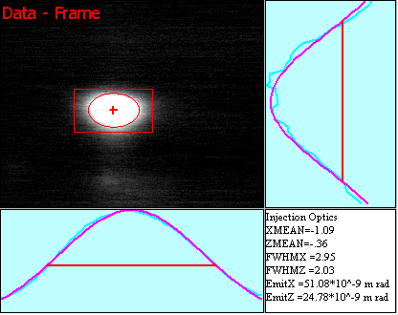
σ_{diff} = 0.47 ∗ λ/θ/2 = 304 μm (horizontal) before:
σ_{diff} = 1/π ∗ λ/Ψ = 218 μm (vertical) (431 μm)
σ_{depth} = L/2 * θ/2 = 61 μm (440 μm)
σ_{arc} = ρ θ ²/8 = 219 μm (horizontal)
σ_{camera} = σ_{chip} * G/B = 37 μm
σ_{cor} = (σ_{diff} ² + σ_{depth} ² + σ_{arc}² + σ_{camera} ²)^{1/2} = 381 μm ; (horizontal) (579 μm)
σ_{cor} = (σ_{diff} ² + σ_{depth} ² + σ_{camera} ²)^{1/2} = 229 μm ; (vertical) (617 μm)
Beam width σ_{beam} = (σ_{fit_measured} ² - σ_{cor} ²)^{1/2}
σ_{vert} = 860 μm

Slide 22


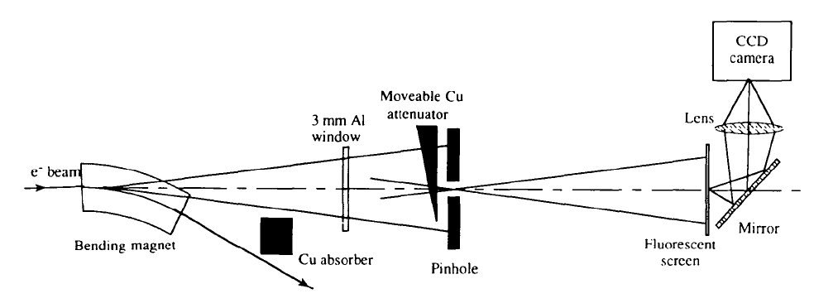
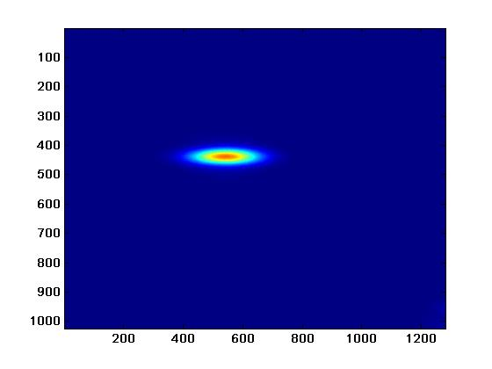
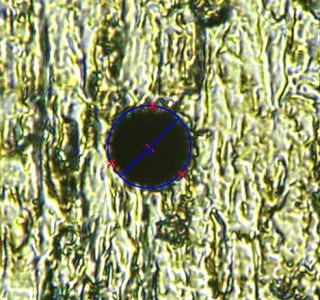
X-ray Pinhole Camera
„camera obscura“
description of phenomenon already by Aristoteles (384-322 b.C.) in „Problemata“
most common emittance monitor
simple setup
limited resolution
example: ESRF
P.Elleaume, C.Fortgang, C.Penel and E.Tarazona, J.Synchrotron Rad. 2 (1995) , 209
ID-25 X-ray pinhole camera:
PETRA III pinhole camera:
Ø 18 μm hole in 500 μm thick W plate
courtesy of K.Scheidt, ESRF
Gero Kube, DESY / MDI

Slide 23
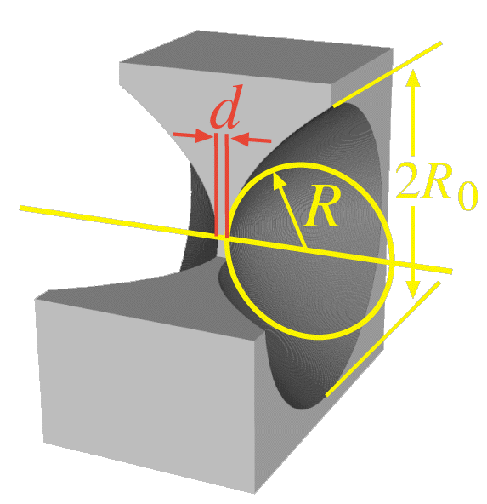
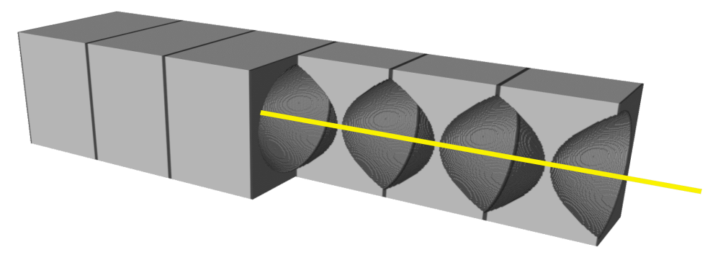
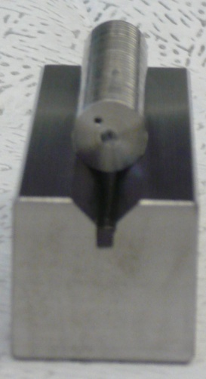
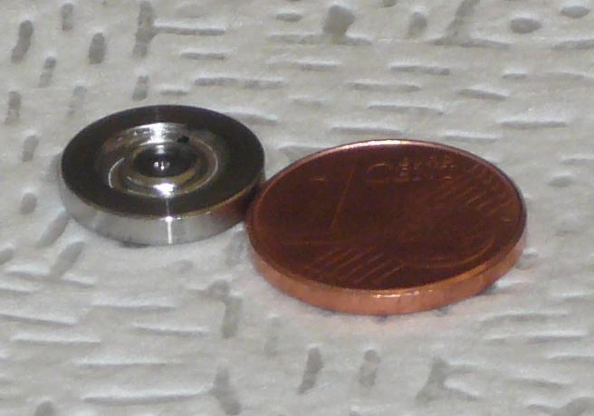
Compound Refractive Lens
lens-maker formula:
1/f = 2(n-1) / R
concave lens shape
strong surface bending R
X-ray refraction index :
small Z (Be, Al, …)
small d
D_{eff}
N
many lenses (N=10…300)
l
Ü
PETRA III @ 20 keV:
R = 200 μm, R₀ = 500 μm, d = 10 μm, l = 1mm
N = 31
material: beryllium
Gero Kube, DESY / MDI

Slide 24
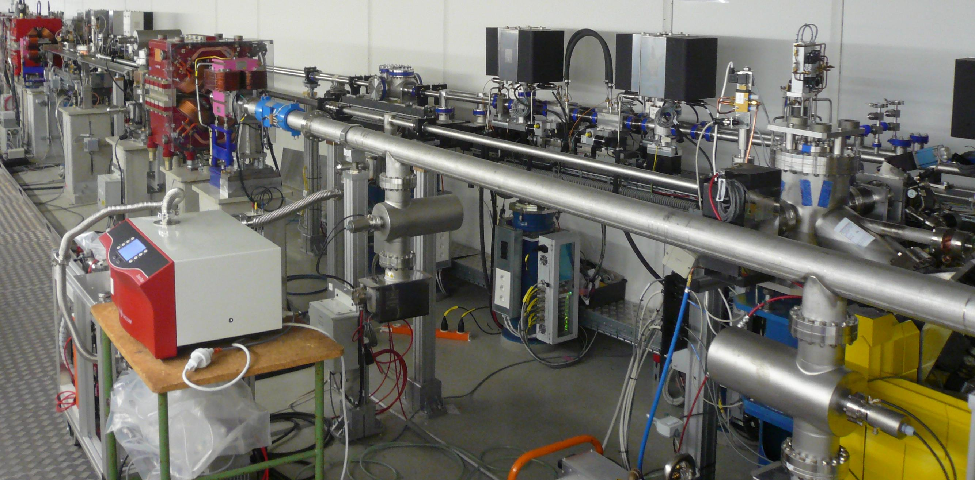
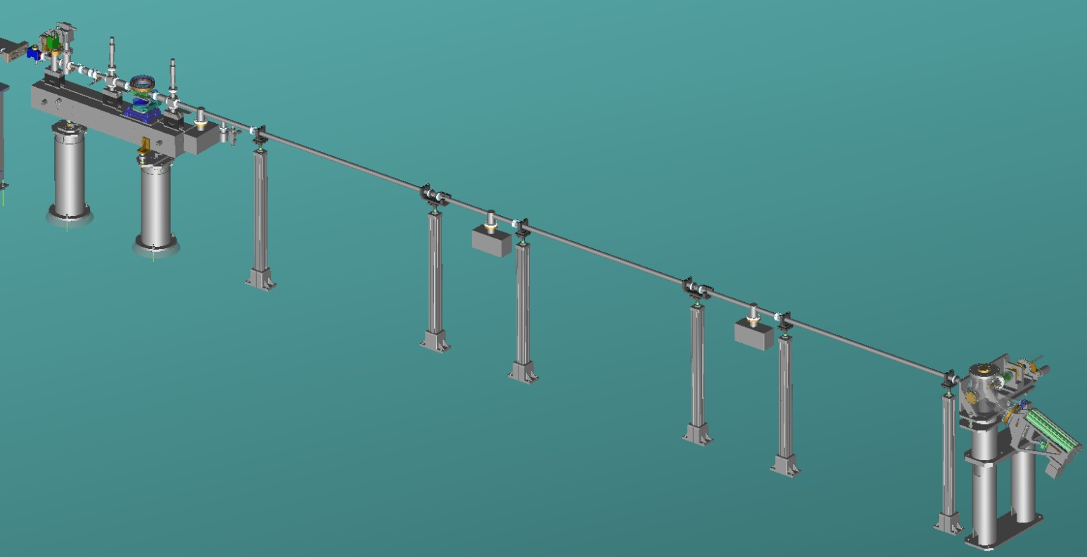
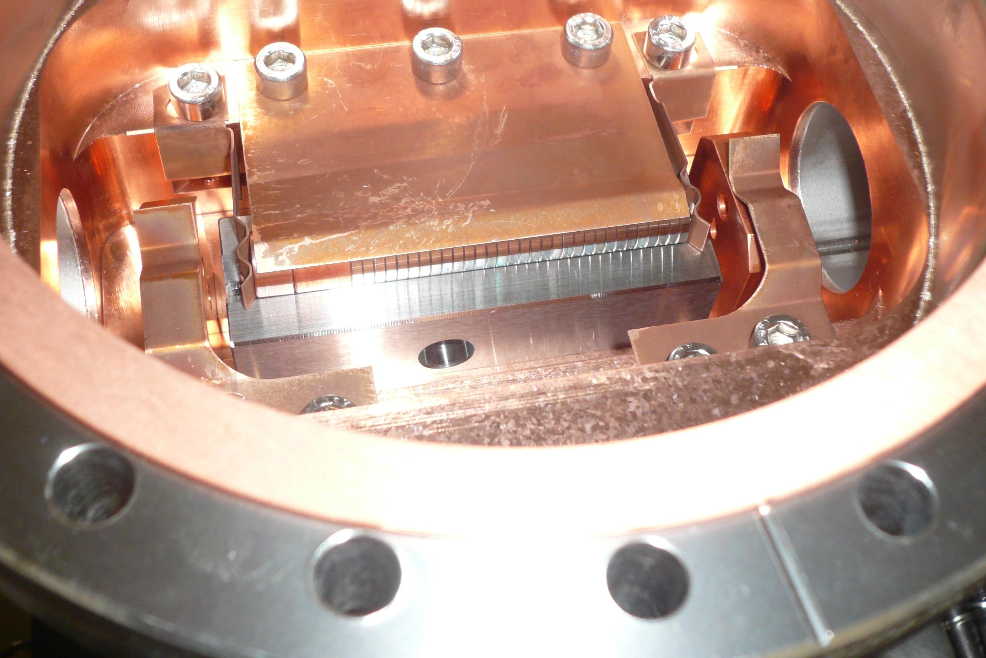
CRL Monitor @ PETRA III (DESY)
PETRA III diagnostics beamline
entrance absorber
pinhole optic
CCD
X-ray optics
CCD
X-ray optics
γ
Monochromator
Si (311)
Monochromator
Si (311)
CR lens stack
Gero Kube, DESY / MDI

Slide 25
Resolution Improvements
2.) interferometric approach
T. Mitsuhashi , Proc. Joint US-CERN-Japan-Russia School of Particle Accelerators, Montreux, 11-20 May 1998 (World Scientific), pp. 399-427.
probing spatial coherence of synchrotron radiation
visibility:
extended source
point source
T. Mitsuhashi, Proc. BIW04, AIP Conf. Proc. 732, pp. 3-18
Δn: photon number
resolution limit: uncertainty principle
ΔΦ: photon phase

Slide 26


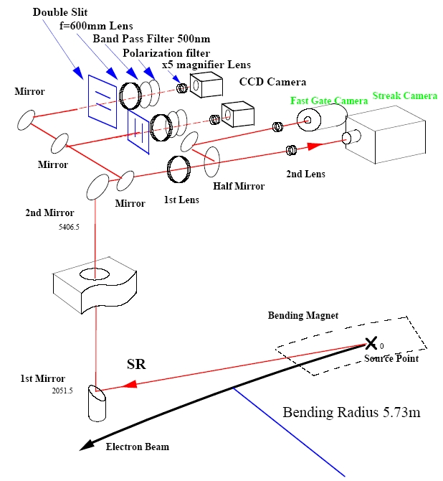
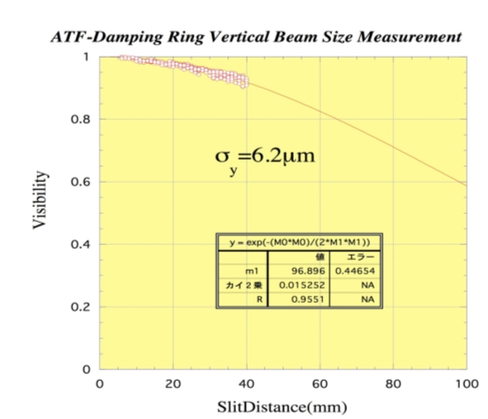
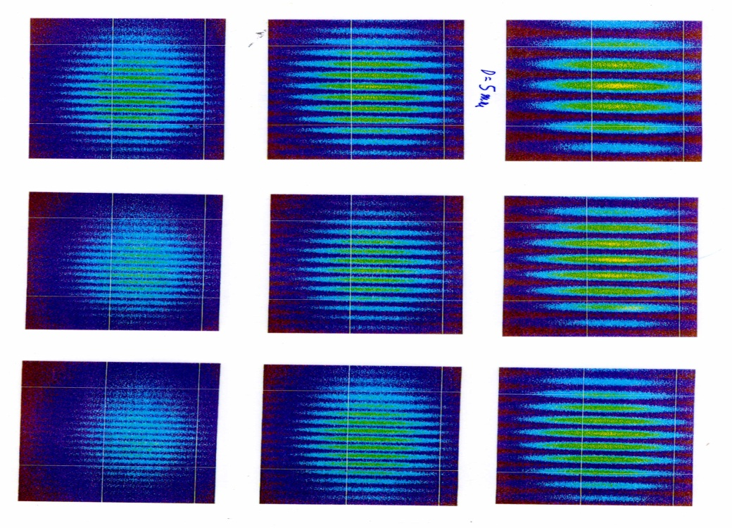
Interference: ATF (KEK)
vertical beam size:
courtesy of T.Mitsuhashi, KEK
H.Hanyo et al., Proc. of PAC99 (1999), 2143
smallest result: 4.7 μm with 400nm @ ATF, KEK
accuracy ~ 1 μm

Slide 27
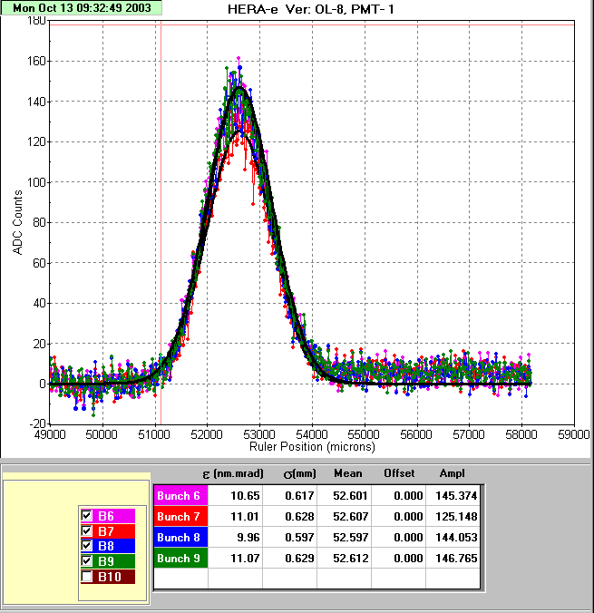
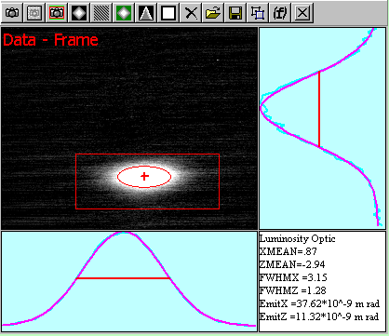
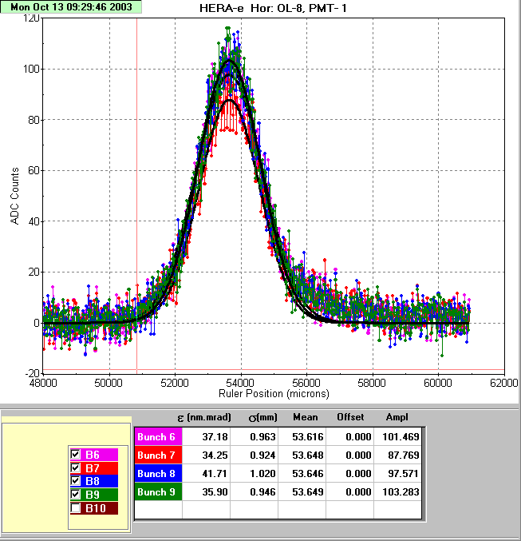
Comparison
SR-monitor vs Wire scanner
σ_{v} = 542 μm

Slide 28
End of Synchrotron Radiation Monitor

Slide 29
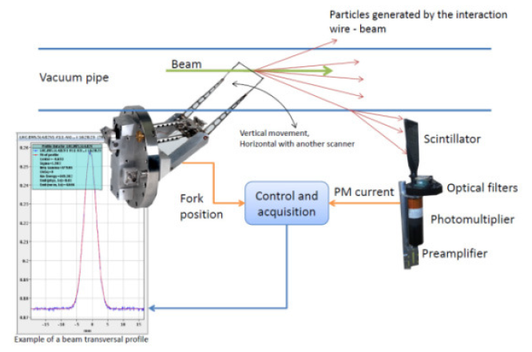
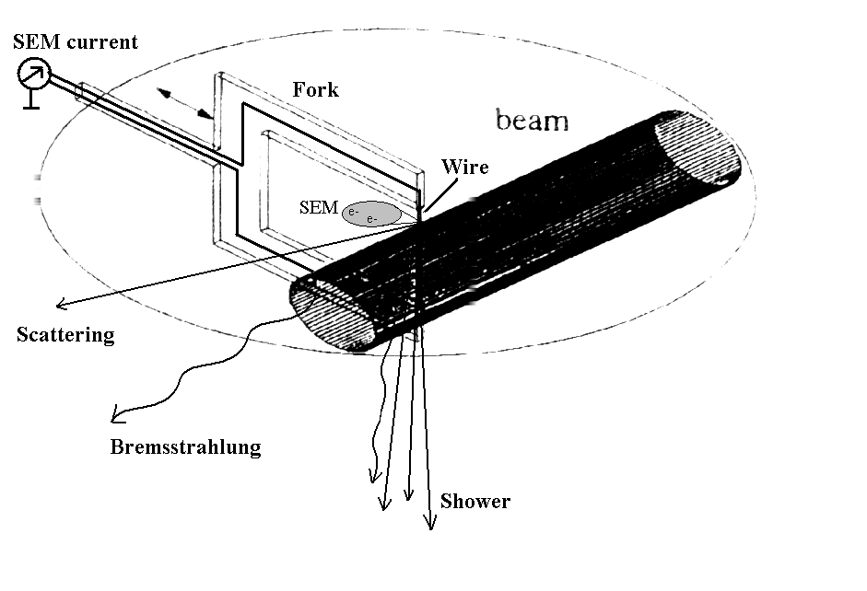
Wire Scanners
Introduction
Conventional wire scanners with thin solid wires (conventional compared with new techniques using, for example, Lasers) are widely used for beam size measurements in particle accelerators.
Their advantages:
Resolution of down to 1 μm
Trusty, reliable
Direct
CERN-SPS Wire Scanner Impedence and Wire Heating Studies
E.Piselli, et al. IBIC 2014, Monterey, California, USA September 14-18, 2014.

Slide 30
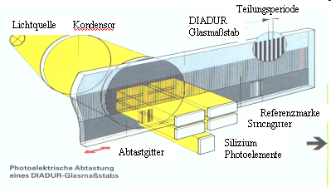
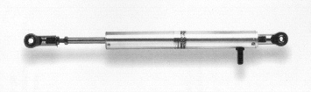
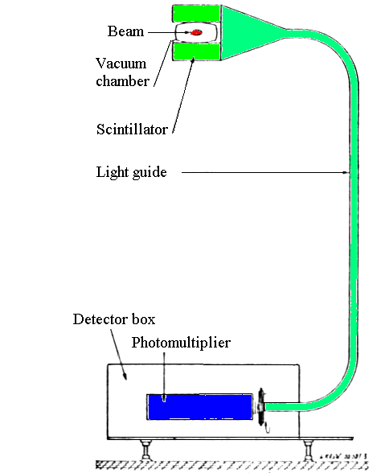
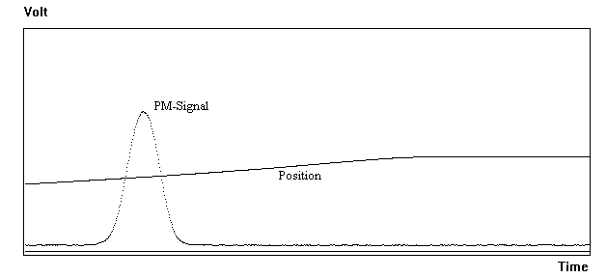
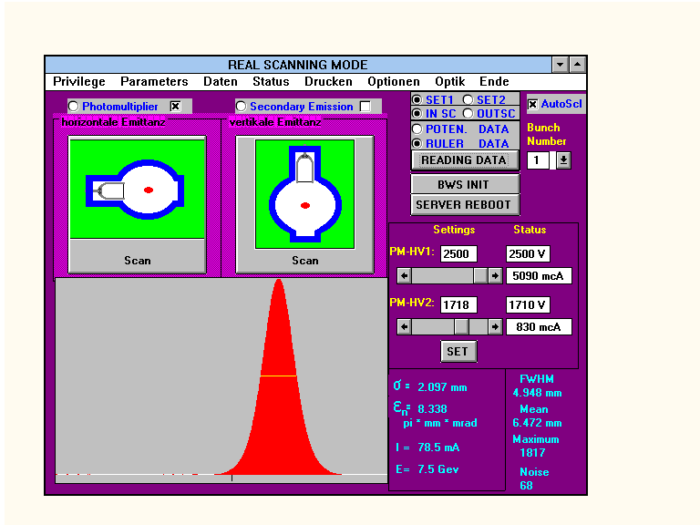
0.1 micron position resolution is possible
Potentiometer

Slide 31
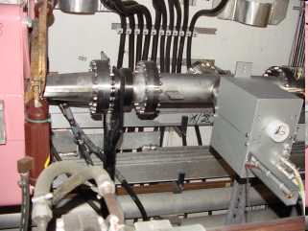
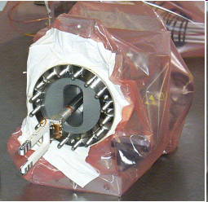
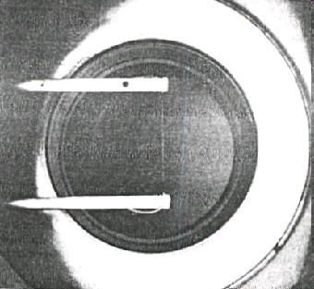
CERN/DESY 1990-2007
FLASH: 2002 - now
Speed: 0 - 1 m/s
Scanning area: approx. 10 cm
Wire material: Carbon/Quartz
Wire diameter: 7 microns
50 μm at Flash
Signal: shower
1 micron resolution

Slide 32
Where one should locate the Scintillator?
Projected angular distribution could be approximated by Gaussian with a width given by
d’ = 1.5×10⁻³ cm – the thickness of the target, X₀=12.3 cm – quartz-wire radiation length, x/X₀ = 1.22×10⁻⁴
It is corresponding to:
Θ_{mean} ≈ 3.0×10-6 rad
for electron momentum of 30GeV/c.
Scattered particles will arrive vacuum chamber of radius R = 2 cm at:
Sounds far away…but…

Slide 33
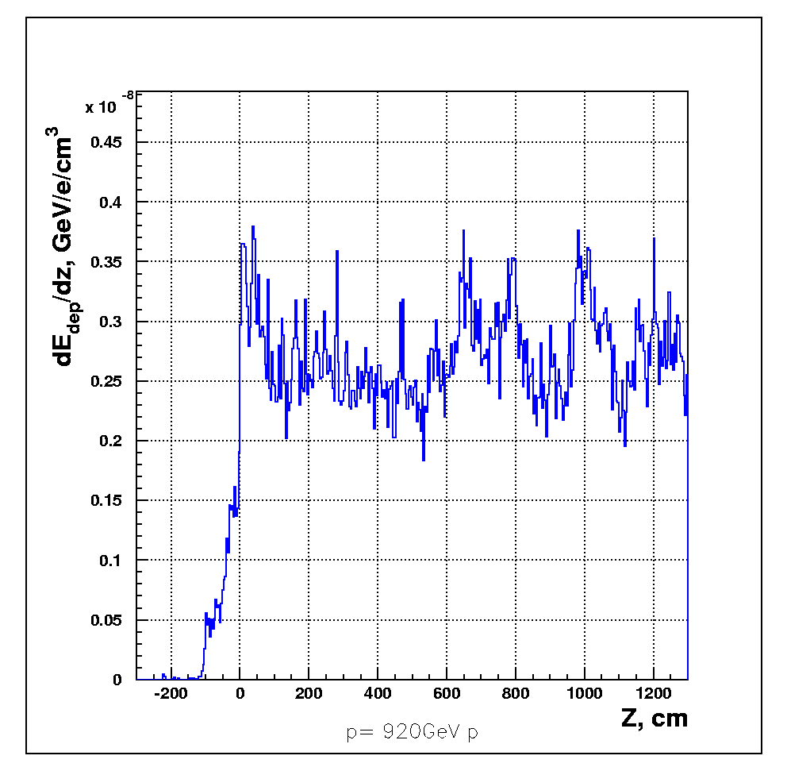
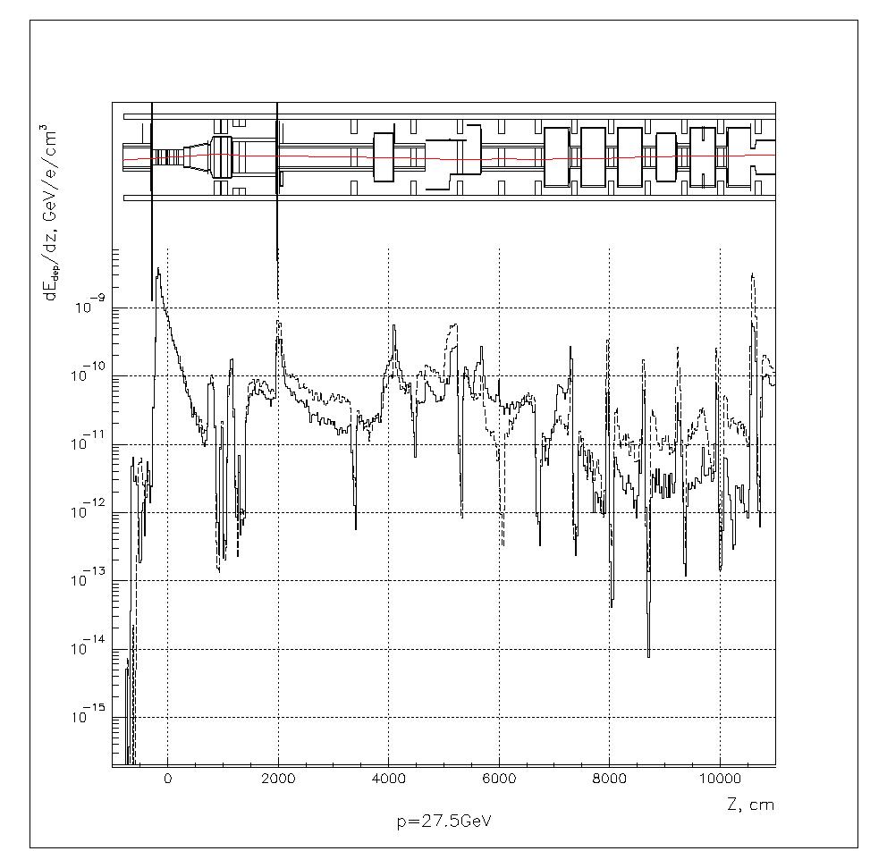

Monte Carlo simulations for finding best location of scintillators
Protons at 920 GeV/c
Electrons at 30 GeV/c
Wire position:
-100cm
Wire scanner: -8.1 m
Counter: 29 cm
Counter: 20 m
Simulation includes all magnetic fields
as well as all elastic and inelastic scattering cross sections

Slide 34

Wire Scanner at low energies
Wire scanners in low energy accelerators
P. Elmfos ar. Al.; NIM A 396

Slide 35


Wire Scanner at low energies
2) Secondary electron emission (SEM) .
This method is often used at low energy beams where the scattered particles cannot penetrate the vacuum pipe wall (below pion threshold).
Avoid cross talk of wires
In this low energy regime the hadron beam particles stop in the wire, so that the signal is a composition of the stopped charge (in case of H⁻: proton and electrons) and the secondary emission coefficient. Therefore the polarity of the signal may change, depending on the beam energy and particle type (true also for grids!).
(stripping)
M. A. Plum, et al, SNS LINAC WIRE SCANNER SYSTEM, Signal Levels and Accuracy; LINAC2002
Notes:
H- ions are accelerated in J-PARC linac. There are three
sources of the signal generated in a wire by collision of Hbeam.
(1) negative current by the electrons flowing into a wire
(2) positive current by the protons flowing into a wire
(3) positive current by secondary electron emission when
electrons and protons impact a wire. For thin wire, the both of electrons and protons in Hpenetrate
the wire and the signals are generated by only
above (3). For middle-thick wire, protons penetrate the
wire and electrons stop in the wire and the signals are
generated by above (1) and (3). For much thin wire, the
both of electrons and protons stop in a wire and the
signals are generated by above (1), (2), and (3).

Slide 36
Wire scanner’s limitations are?
1. The smallest measurable beam size is limited by the finite wire diameter of a few microns,
2. Higher Order Modes may couple to conductive wires and can destroy them,
3. High beam intensities combined with small beam sizes will destroy the wire due to the high heat load.
4. Emittance blow up

Slide 37



Limitations:
1. Wire size
The smallest achievable wires have a diameter of about 5-6 μm.
An example of the error in the beam width determination is shown for a 36 μm wire.
Influence of the wire diameter on the measured beam width.
(All figures from: Q. King; Analysis of the Influence of Fibre Diameter on Wirescanner Beam Profile Measurements, SPS-ABM-TM/Note/8802 (1988))

Slide 38

Limitations:
2. Higher Order modes
An early observation (1972 DORIS) with wire scanners in electron accelerators was, that the wire was always broken, even without moving the scanner into the beam. An explanation was that Higher Order Modes (HOM) were coupled into the cavity of the vacuum chamber extension housing the wire scanner fork. The wire absorbs part of the RF which led to strong RF heating.
Discuss methods of proving this
assumption.
Methods:
Measurement of thermo-ionic emission
Measurement of wire resistivity
Optical observation of glowing wire
Measurement of RF coupling in
Laboratory with spectrum analyzer

Slide 39

1a. Measurement of thermo-ionic emission, during scan
CERN SPS 2012
Normal profiles
Broken wire
CERN-SPS Wire Scanner Impedance and Wire Heating Studies
E.Piselli, et al. IBIC 2014, Monterey, California, USA September 14-18, 2014.

Slide 40

1b. Measurement of thermo-ionic emission, no scan
Wire heating due to the LHC beam injection in the SPS (No scan, wire in parking position).
The beam energy ramp/bunch length decreasing begin t=11 s.
A constant current was supplied to the wire and the voltage drop across it was fed to a digital scope together with the difference between the input and output currents. The differential current (I_{out}-I_{in}) grow up is due to the wire heating and consequent emission of electrons for thermionic effect. Fig. WIRE5 shows such voltage and differential current evolutions during the SPS cycle with LHC type beam. No scans were performed along this cycle. It is thus evident that the wire heating does not depend on the direct wire-beam interaction only.
(From CAVITY MODE RELATED WIRE BREAKING OF THE SPS WIRE SCANNERS AND LOSS MEASUREMENTS OF WIRE MATERIALS
F. Caspers, B. Dehning, E.Jensen, J. Koopman, J.F. Malo, CERN, Geneva, Switzerland
F. Roncarolo, CERN/University of Lausanne, Switzerland; DIPAC03)

Slide 41

2. Measurement of wire resistivity
The wire resistivity will change depending on the temperature of the wire, even without scanning.
Here: 8 μm Carbon wire
(from OBSERVATION OF THERMAL EFFECTS ON THE LEP WIRE SCANNERS. By J. Camas, C. Fischer, J.J. Gras, R. Jung, J. Koopman (CERN). CERN-SL-95-20-BI, May 1995. 4pp. Presented at the 16th Particle Accelerator Conference - PAC 95, Dallas, TX, USA, 1 - 5 May 1995. Published in IEEE PAC 1995:2649-2651)

Slide 42

3. Optical observation of glowing wire
Light intensity
time
Wire length
beam
Digitized video recording of an 8 μm carbon wire scanning a 0.8 mA beam. The wire is parallel to the horizontal axis, and the light intensity is plotted along the vertical axis (arbitrary units). Successive profiles are separated by 20 ms. The central spot corresponds to the passage of the wire through the beam. Thus, RF heating led to (huge) thermal glowing before the beam interacts with the wire.
(from: QUARTZ WIRES VERSUS CARBON FIBERS FOR IMPROVED BEAM HANDLING CAPACITY OF THE LEP WIRE SCANNERS.
By C. Fischer, R. Jung, J. Koopman (CERN). CERN-SL-96-09-BI, May 1996. 8pp. Talk given at 7th Beam Instrumentation Workshop (BIW 96), Argonne, IL, 6-9 May 1996.

Slide 43


4. Measurement of RF coupling with spectrum analyzer
Resonant cavity signal in presence of Carbon (36 μm), Silicon Carbide and Quartz wires
The plot qualitatively proves the RF power absorption of Carbon, and the non-absorption of Silicon Carbide and Quartz. Absorbed energy is mainly converted into heat.
Resonant cavity signal in presence of Carbon (36 μm), Silicon Carbide and Quartz wires
The plot qualitatively proves the RF power absorption of Carbon. The Absorbed energy is mainly converted into heat.
What are solutions for the problems 1-4?
Damping of Higher Order Modes with Ferrites etc.
Non conducting wires

Slide 44




Lab. Measurements
CST Simulations
Zoom
CERN-SPS Wire Scanner Impedance and Wire Heating Studies
E.Piselli, et al. IBIC 2014, Monterey, California, USA September 14-18, 2014.

Slide 45

Limitations:
3. Wire heat load
According to Bethe-Blochs formula, a fraction of energy dE/dx of high energy particles crossing the wire is deposit in the wire. Each beam particle which crosses the wire deposits energy inside the wire. The energy loss is defined by dE/dx (minimum ionization loss) and is taken to be that for a minimum ionizing particle.
dE/dx (Landau distr.)
Knock on electrons do not contribute to E-deposition
Inelastic (Gauss)
Geant Simulation: Distribution of 7 TeV proton energy deposit in 33 micron carbon fiber.
Beam Interaction with Thin Materials: Heat Deposition, Cooling Phenomena and Damage Limits
M. Sapinski, 2012 Beam Instrumentation Workshop (BIW12), April 15-19, 2012, Newport News, USA

Slide 46
Limitations:
3. Wire heat load
According to Bethe-Blochs formula, a fraction of energy dE/dx of high energy particles crossing the wire is deposit in the wire. Each beam particle which crosses the wire deposits energy inside the wire. The energy loss is defined by dE/dx (minimum ionization loss) and is taken to be that for a minimum ionizing particle. In this case the temperature increase of the wire can be calculated by:
where N is the number of particles hitting the wire during one scan, d' is the thickness of a quadratic wire with the same area as a round one and G [g] is the mass of the part of the wire interacting with the beam. The mass G is defined by the beam dimension in the direction of the wire (perpendicular to the measuring direction):
Estimation of the wire temperature after one scan with speed v (assume no cooling mechanisms):
unknown

Slide 47

Solving G: G [g] is the mass of the part of the wire interacting with the beam. The mass G is defined by the beam dimension in the direction of the wire (perpendicular to the measuring direction) and by the wire diameter d':
Solving N:
The number of particles N hitting the wire during one scan depends on the speed of the scan (~1/v), the revolution frequency (~f_{rev}), the wire diameter (~d') and the beam current (~NB · n_{bunch}):
.
The figure shows the a graphical representation of the parameters. The quotient d·f/v is the ratio of the scanned beam area or, in other words, like a grid seen by one bunch, assuming that all bunches are equal. However, the ratio can exceed the value 1 (a foil) if the scanning distance between two bunches is smaller than the wire diameter. Note that N does not depend on the beam widths σ.
Geometrical meaning of the parameters v/f and d'

Slide 48
Therefore, the temperature increase of the wire after one scan becomes:
In MeV/cm
Where h, denotes the horizontal (h) scanning direction. The cooling factor 'α' is described in the next section. Note that the temperature does not depend on the wire diameter and that it depends on the beam dimension perpendicular to the measuring direction. The temperature increase is inverse proportional to the scanning speed, therefore a faster scanner has a correspondingly smaller temperature increase.

Slide 49

Discussion: Which kind of wire Material you will prefer for a wire scanner in this accelerator?
Parameter table
The wire parameters dE/dx / cp and the Quotient Th/Tm should be minimal for a choice of the material (α = 1):
Material
dE/dx / c_{p}
T_{h} [⁰C]
T_{h}/T_{m}
AL
7.7
1.1 ⋅ 10⁴
16.9
W
50.6
7.1 ⋅ 10⁴
20.9
C
5.4
0.77 ⋅ 10⁴
2.2
Be
4.1
0.58 ⋅ 10⁴
4.8
SiO2
12.9
1.8 ⋅ 10⁴
10.6
TableWire3: calculated Temperatures
From Table WIRE3 follows, that even the best material (Carbon) will be a Factor 2.2 above its melting temperature.

Slide 50




Burned by the e-beam at SLC

Slide 51

Discuss cooling mechanisms which will cool the wire.
1) Secondaries emitted from the wire
2) Heat transport along the wire
3) Black body radiation
4) Change of c_{p} with temperature
5) Thermionic emission
6) Sublimation
1) Secondaries:
Some energy is lost from the wire by secondary particles. In the work in (J. Bosser et al.; The micron wire scanner at the SPS, CERN SPS/86-26 (MS) (1986)) about 70% is assumed. In DESY III (example above) no carbon wire was broken during more than 10 years of operation. At HERA, the theoretical temperature of the carbon wire (without secondaries) exceeds the melting temperature after a scan by far (T = 12800 ⁰C). Considering the loss by secondaries of 70%, the temperature reaches nearly the melting point. In practice, the wire breaks about once in 2 months. The observation is that the wire becomes thinner at the beam center. This may indicate, that during a scan some material of the wire is emitted because of nuclear interactions or is vaporized because it is very close to the melting temperature. This supports the estimate of the 70% loss and one has to multiply the factor α = 0.3 in the equation above
Thermal Load on Wirescanners
Lars Fröhlich
37th ICFA Advanced Beam Dynamics Workshop on Future Light Sources; May 15-19, 2006 in Hamburg, Germany

Slide 52


2) Heat transport:
The transport of heat along the wire does not contribute to short time cooling of the wire (P. Lefevre; CERN PS/DL/Note 78-8). However, frequent use of the scanner heats up also the ends of the wire and its connection to the wire holders (fork).
For small temperatures (low repetition rates (LINACs)) this is the major cooling mechanism.
with λ = thermal cond. , A = Surface
10 μm graphite wire bombarded with 800 bunches at 1 MHz; simulated with various combinations
of cooling mechanisms, 5 Hz rep. rate.
Thermal Load on Wirescanners; Lars Fröhlich; 37th ICFA Advanced Beam Dynamics Workshop on Future Light Sources; May 15-19, 2006 in Hamburg, Germany

Slide 53
3) Black body radiation: The temperature T_{bb} at which the radiated power is equal to the deposited power in the wire during one scan P_{dep} [MeV/s] can be calculated from the Stefan-Bolzmann-law:
where s = 35.4 MeV / (s¹ cm² ⁰K⁴) is the Stefan-Bolzmann-constant and A is the area of radiating surface. The surface of the heated wire portion A is 2 ⋅ σ_{v} ⋅ d ⋅ π [cm²]. The power can be calculated by:
where t_{scan} = 2 ⋅ σ_{h,v} / v is the time for a scan (in the assumpion of 2 σ it is neglected that only about 70% of the power is concentrated within 2 σ). α is the expected loss from secondaries.
For the example above: T_{bb} = 3900 ⁰C.

Slide 54

4) c_{p}(T): The heat capacitance is a function of the temperature. The figure shows the increase of c_{p} for Carbon with T. The expected temperature after a scan is inversely proportional to c_{p}. Therefore one can expect a slightly smaller resulting temperature because of this dependence.

Slide 55

5) Thermionic emission
The thermionic emission is a dominant cooling process for temperatures above 3200 K. It determines the wire temperature for scans of the high intensity beams. The electric current emitted by the hot body is described by Richardson-Dushman Equation:
where A_{R} is Richardson constant and Φ is the material work function. The power dissipated by the thermionic current is proportional to the surface of the wire and depends exponentially on the temperature. The thermionic emission removes electrons which are replaced by a current flowing from the fork supporting the wire. This current has a negligible contribution as an additional source of heating.
Relative contribution of cooling processes to the
total temperature change as a function of temperature. Blue points are for radiative cooling, red for thermionic emission and green are for the heat transfer.
Operational Limits of Wire Scanners on LHC Beam
Mariusz Sapinski, Tom Kroyer (CERN, Geneva)
2008 Beam Instrumentation Workshop (BIW08) held on May 4-8, 2008 at the
Granlibakken Conference Center and Lodge in Tahoe City, CA, USA, pp.383-388

Slide 56

5) Sublimation Cooling
The material behavior in high temperatures and in a vacuum can be read from a phase diagram. Materials which sublimate under these conditions have an advantage because the sublimation temperature and sublimation heat are higher than melting temperature and heat. Sublimation removes the hottest fraction of the material from the surface, what is equivalent to a cooling, which is weak in comparison to other cooling processes.
Evolution of the wire temparature during a scan of the beam is shown together
with decrease of the wire diameter due to sublimation.
With:
H_{sub}= Entalpie of Sublimation,
Δn = amount of material sublimated
Beam Interaction with Thin Materials: Heat Deposition, Cooling Phenomena and Damage Limits
M. Sapinski, 2012 Beam Instrumentation Workshop (BIW12), April 15-19, 2012, Newport News, USA

Slide 57

Temperature of the wire (v=1m/s)
Melting temperature = 3500 ºC for Carbon
= 1700 ºC for Quartz
The wire in DESY III existed with 200 mA = 1.25·10¹² p for all times.
In HERAp we exchanged the wires every 2 month after “normal” use. Unusual frequent use destroyed the wires much earlier.
Reason: Sublimation of material:
Fiber fracture at three distances from the beam impact location: 1 mm (upper plot), 0.5 mm (middle plot) and at beam center location (bottom plot).
CERN-BE-2009-028
Carbon Fiber Damage in Accelerator Beam
Sapinski, M ; Dehning, B ; Guerrero, A ; Koopman, J ; Métral, E ; DIPAC09, Basel

Slide 58

New concept to reach v=20 m/s and a resolution of 5 microns
Design of a High-precision Fast Wire Scanner for the SPS at CERN
R. Veness, N. Chritin, B. Dehning, J. Emery, J.F. Herranz Alvarez, M. Koujili, S. Samuelsson, J.L. Sirvent Blasco; CERN, Geneva, Switzerland IBIC2012, Tsukuba, Japan, Oct 1-4, 2012,

Slide 59


Limitations
4: Emittance blow up
Parameter table
Exercise WIRE3: Calculate the emittance blowup of the proton beam after one scan at a position with β = 11.8 m for p =0.3 and 7 GeV/c (Carbon wire):
Assume a measurement position close to a Quadrupole (α=0)
For small deflection angles a good approximation for average root mean square scattering angle is given by:
Remember:
A fraction Ψ of the circulating beam
particles will hit the wire:
(see exercise WIRE2) | mean deflection angle
The resulting emittance blowup is than (7 GeV/c):
δε/ε [%/scan]
=> Θ = Ψ ▪ δΘ ≈ y’
Gas: emittance growth due to
residual gas per hour (P=10⁻⁹ mbar)
Momentum [GeV/c]

Slide 60
D. Möhl, Sources of emittance growth (also P. Bryant;
CAS, Beam transfer lines):
Averaging over all Betatron-phases
Unit of phase space emittance
M. Giovannozzi (CAS 2005)
D. Möhl, Sources of emittance growth, 2007:

Slide 61

The End of Wire Scanner Session

Slide 62
Reserve Slides

Slide 63



XFEL-Screens (ca. 50 Stations)
63
Idea 1: 90⁰ /45⁰ Geometrie for removing (C)OTR
Idea 2: “Scheimpflug” Prinziple from Large-Picture-Photography to remove depth-of-field
“Get a sharp image of an entire plane, if focus, image, and object plane cut in a single line.“
D. Nölle,
G. Kube, Ch. Wiebers, M. Holz

Slide 64



Unfortunately for the moment there is no clear recommendation for “the best” material for the use in high current applications and further studies are still needed and ongoing. Lot of details at: http://www-bd.gsi.de/ssabd/
4.8 MeV/u
4.3*10¹⁰ ppp
5ms
← Same pulse energy →
(~similar flux [ions/(cm² s)])
Ion beam: Ca¹⁰⁺,
11.4 MeV/u
1.8*10¹⁰ ppp
1,2 ms

Slide 65

Measurement with –Harps-
Each individual wire is connected to an electrical vacuum feedthough and an amplifier.
Beam particles hitting a wire create secondary electrons of 20 – 100 eV from its surface.
The secondary electron yield Y varies between about 300% for low energy ions (e.g. 40 keV) to about 2% for minimum ionizing particles for most common metals.
The SEM current is linear over many orders of magnitude.
The spacing and the diameter of the wire defines the resolution of the instrument. Typical values of both are between 20 μm to about 2 mm.
Materials are tungsten and titanium due to their good mechanical and thermal properties but also carbon and aluminum.
Low-Z materials have the advantage of lower beam losses
Harps in high radiation environments
11th ICFA International Mini-Workshop on Diagnostics for High-Intensity Hadron Machines, 2002, by Mike Plum

Slide 66



Measurement with –Harps-
A negative bias voltage on the wires or positive collection electrodes avoids recollection of the secondary electrons by the same or another wire.
=> Avoid signal coupling (also electrical).
The dynamic range of a SEM harp is limited the electronic noise on the low beam current end and by thermal electron emission due to heating of the wire at the high beam current end.
Beside thermal electron emission the wire itself or its support (e.g. soldering) may melt and the elongation of the wires changes with heat.
A SEM Harp (or a thin screen) is quite transparent for not too low energetic beams and successive harps are possible.
two signal
planes (#1), the bias plane (#2),
U. Raich CERN Accelerator School 2005 LANSCE Harp Upgrade, J. Douglas et. al, BIW2010

Slide 67



Scheme of the pepperpot plate in a cross
sectional view and relevant dimensions
Light spots observed on the viewing screen of a Pepperpot device. Top left: Spots generated for calibration using a laser beam. Top right: Spots from an oxygen beam.
Bottom: Intensity distribution along one line.
By P. Forck
Juas 2009

