Slide 1
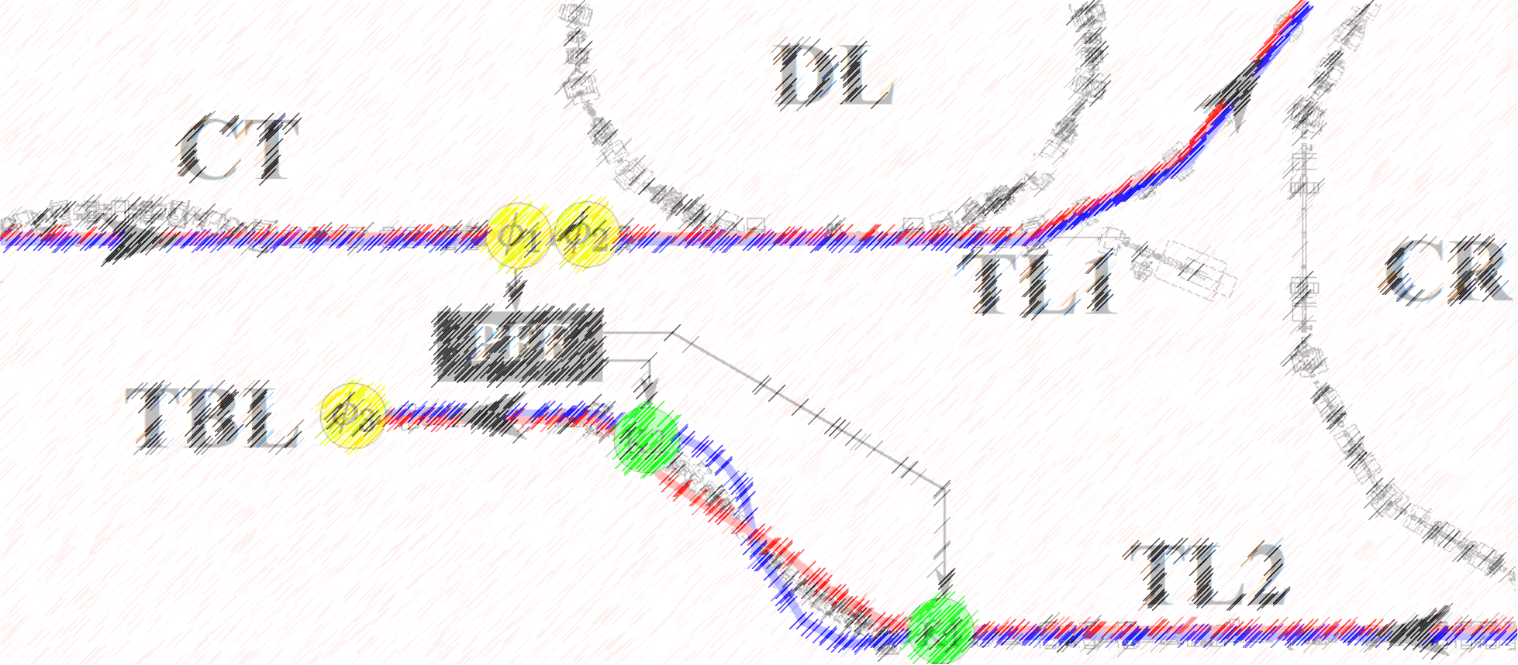
Phase Feedforward: Update & Plans
Jack Roberts

Slide 2
Overview
Quite a few different things but loosely:
Phase monitor status.
PFF setup/acquisition developments.
Phase propagation status.
New PFF results.
Plans.
In many places I will point to work Elizabeth (and Lawrence, but his work was mostly non-PFF related) has done, but leaving most of the details for her to present at a future meeting.

Slide 3
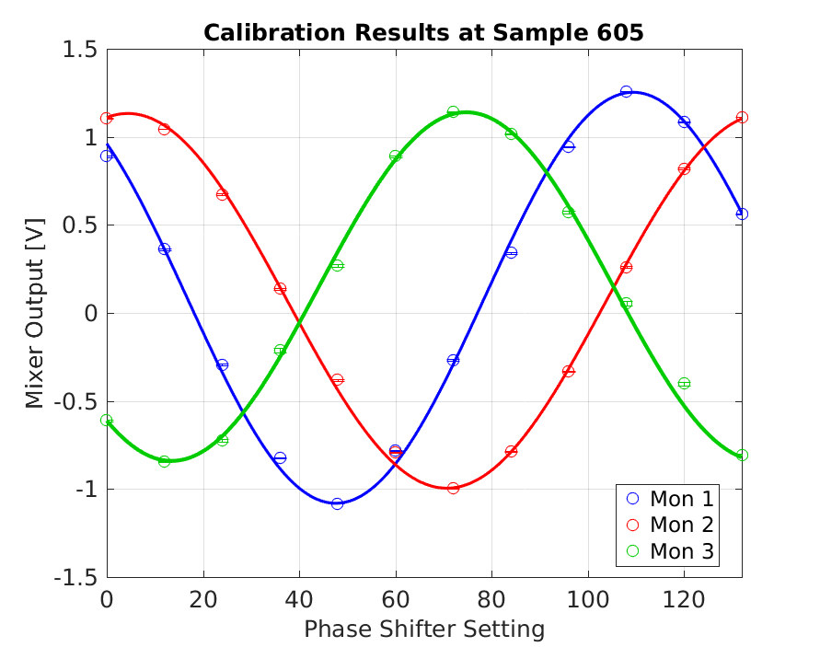
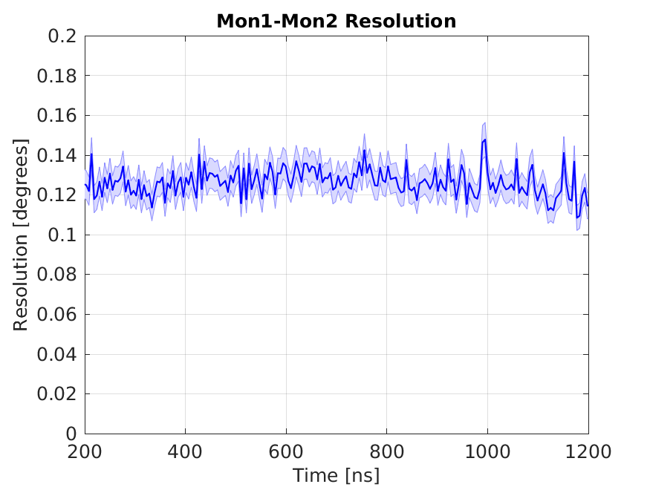
Phase Mons – November 2015
Mon1, Mon2 similar output levels (calibration amplitudes).
Best measured resolution ~0.13 degrees.

Slide 4
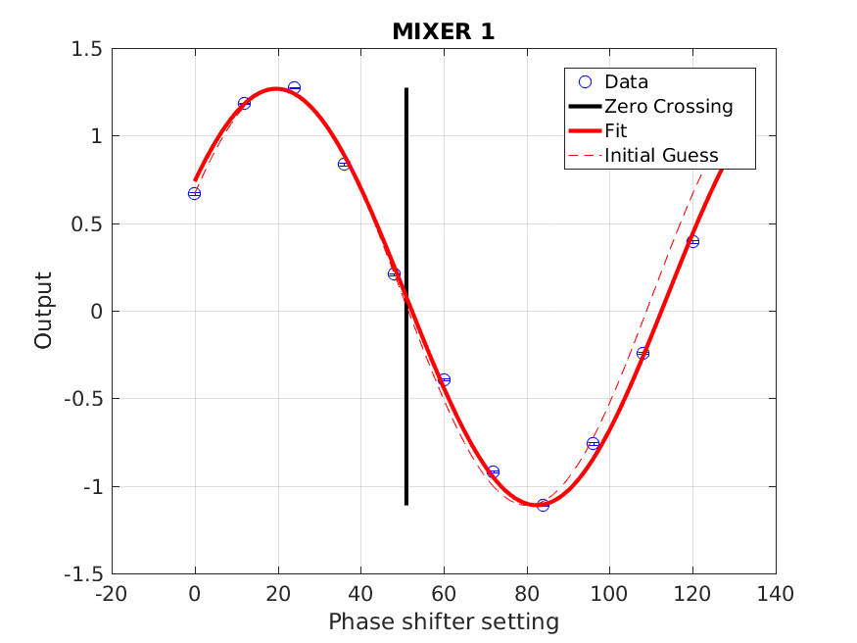
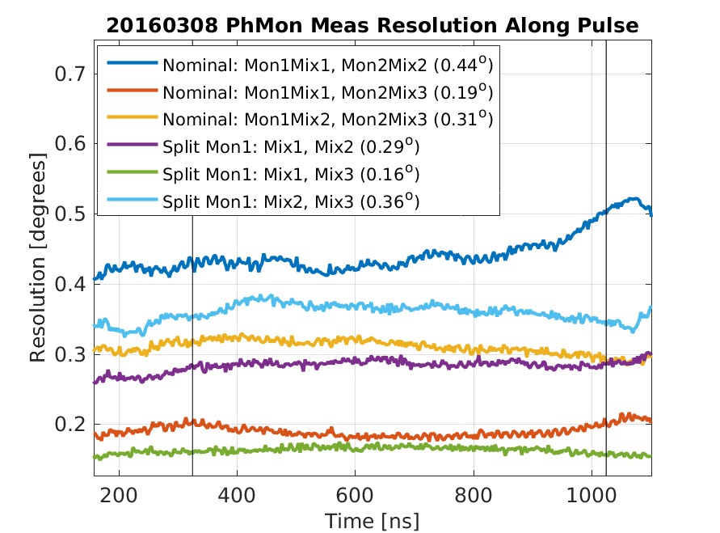
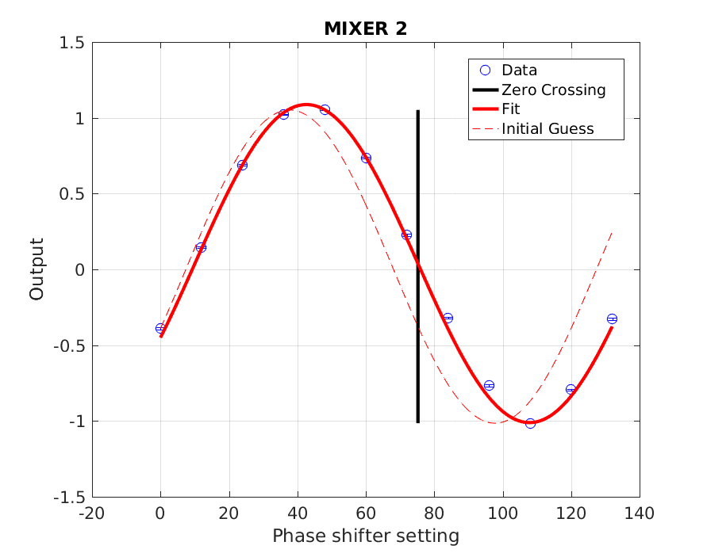
Phase Mons Dec 2015 – July 2016
Resolution measurements including second mixer >0.3 degrees.
Mon1, Mon2 calibration amplitudes as before.

Slide 5
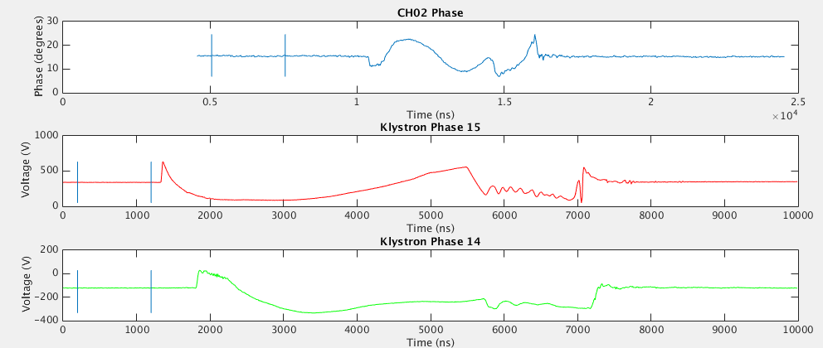
Phase Mons – LO Issues
Elizabeth/Lawrence Took
More Measurements of This
Top (CH02 Phase): Mixer output with two LOs connected (rather than LO + beam) – expect constant output.
Instead see shape dependent on power/phase of two nearest klystrons (14 and 15).
Red arrows mark approx. region where beam would usually arrive.

Slide 6
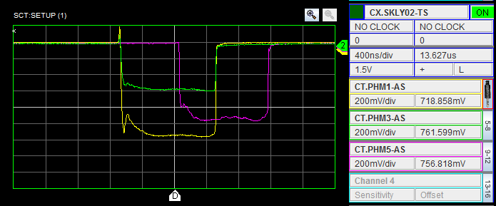
Phase Mons – Now (or at least last time I looked…)
Plots show 3 mixer outputs with shifters set to give minimum output.
Mon/LO/Mixer 2 (green) now giving much lower output than Mon/LO/Mixer 1 (yellow).

Slide 7
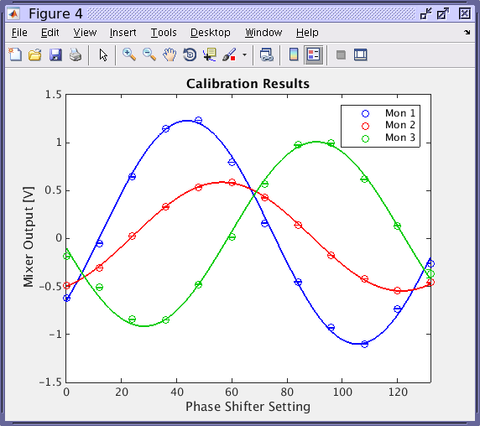
Phase Mons - Now
Same result but a full calibration.

Slide 8
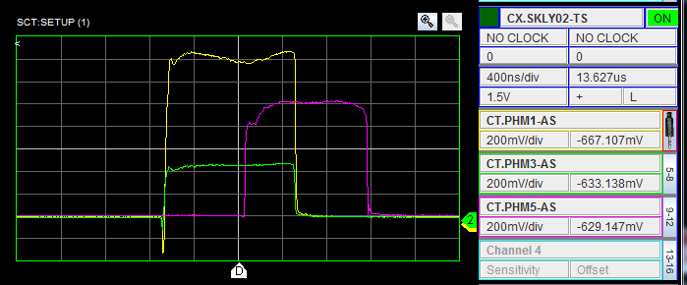
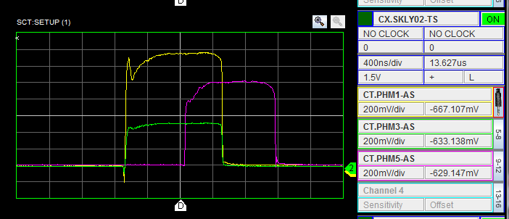
Mixer Outputs with Monitor/LO swapped
Phase Mon swapped:
Yellow: Mixer1, LO1, Monitor2.
Green: Mixer2, LO2, Monitor1.
Low output stays with the second mixer.
Multiple mixers inside each box – maybe one of them has broken/was giving noise before whilst slowly failing?
LO swapped:
Yellow: Mixer1, LO2, Monitor2.
Green: Mixer2, LO1, Monitor1.

Slide 9
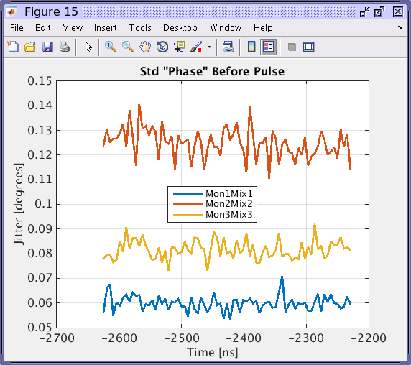
Effect on baseline noise
This for the SiS digitisers (better on FONT5a)
ADC noise contribution for second mixer ~double first mixer due to lower output.
On SiS should be able to adjust amplification/attenuation after mixer to recover same level on ADC.
FONT5a could do something as well, but ADC noise probably still insignificant there even with lower output.

Slide 10
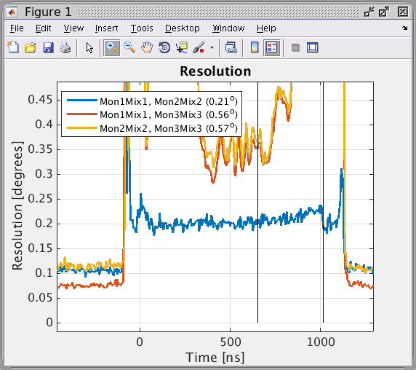
Resolution – Mix1, Mix2
Resolution across Mixer1 and Mixer2 now ~0.2 degrees.
Despite lower output from Mixer2 (or because iffy component inside is now dead?)
ONLY BLUE LINE
IS RELEVANT
Elizabeth has taken resolution measurements on the FONT5a board.

Slide 11
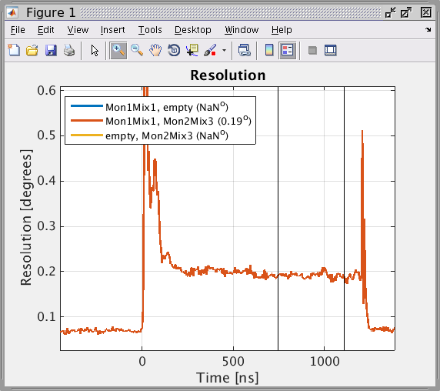
Resolution – Mix1, Mix3
Resolution across Mix1 and Mix3 also ~0.2 degrees.

Slide 12
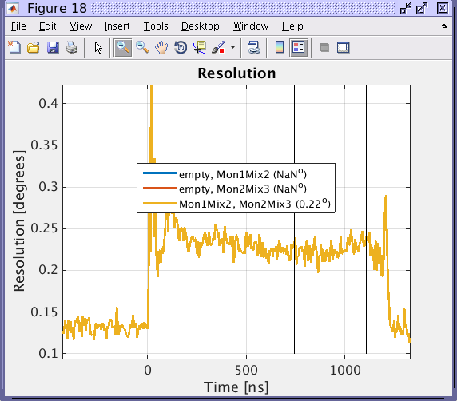
Resolution Mix2, Mix3
And for Mix2, Mix3 (bit worse maybe).
0.2 degrees much better than 0.4, but not enough for a point-by-point 0.2 degrees correction
But resolution on mean is more like 0.1 degrees 0.2 degrees correction on mean at least theoretically achievable.

Slide 13
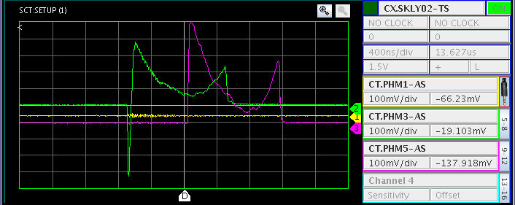
More LO Issues…
Always set shifters so middle of pulse is ~zero output on mixer at start of shifts.
This some time later – already see the outputs have drifted up, and then one hour later >>>

Slide 14
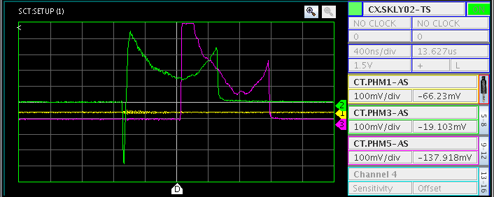
More LO Issues…
Elizabeth took data to investigate this in more detail.
Keeps drifting like this during the day. Can adjust offset in DAQ but eventually have to go to the gallery to change shifters again. Theory: temperature related drift on LO source.

Slide 15
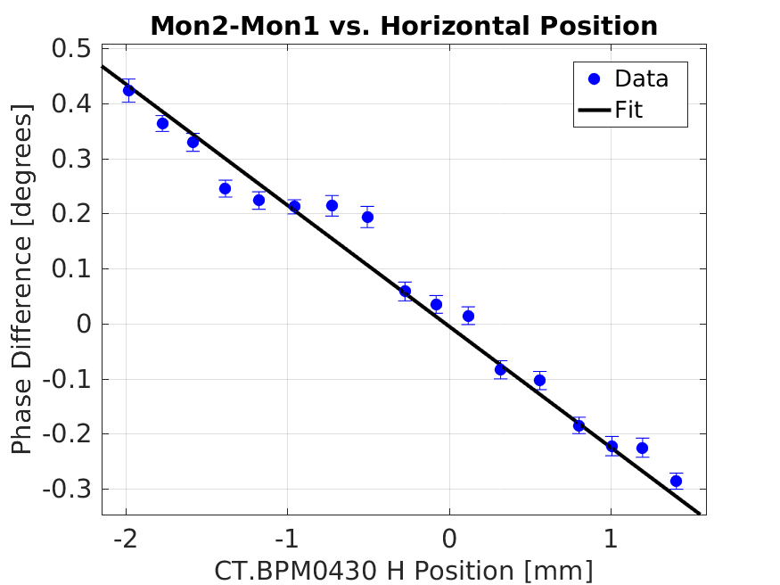
Upstream: Dependence of Measured Phase on Position
Around -1.8 degrees phase shift per mm offset in monitor.
Expected contribution to measured phase jitter: 0.04 degrees.

Slide 16
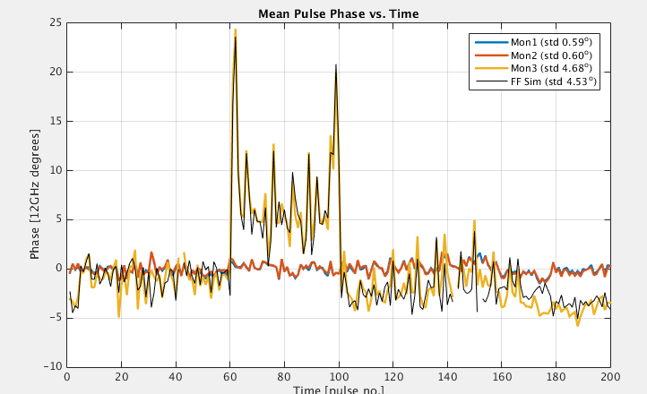
Downstream Phase Position Dependence
Less stable
Move beam
pos in Mon3
More stable
Varying a corrector to move horizontal position in the downstream monitor.
Seems to have an effect on both mean phase and phase stability.

Slide 17
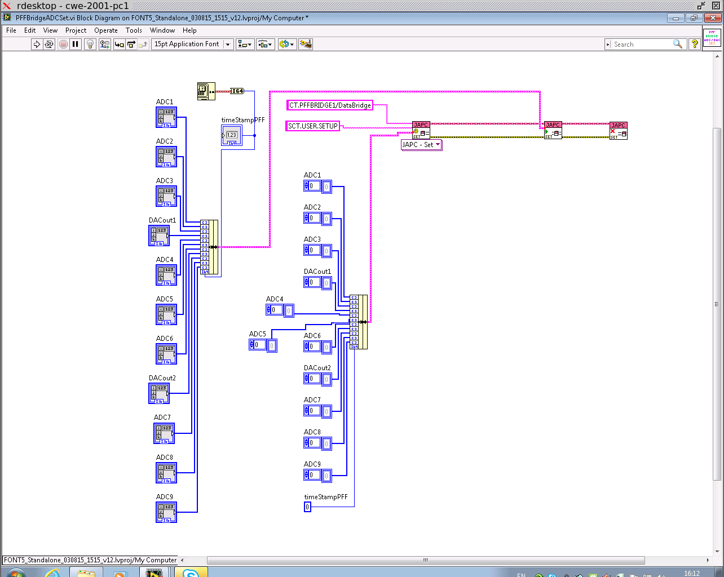
Acquisition
All Elizabeth!
Begun to develop acquisition from FONT DAQ over the CERN control system.

Slide 18
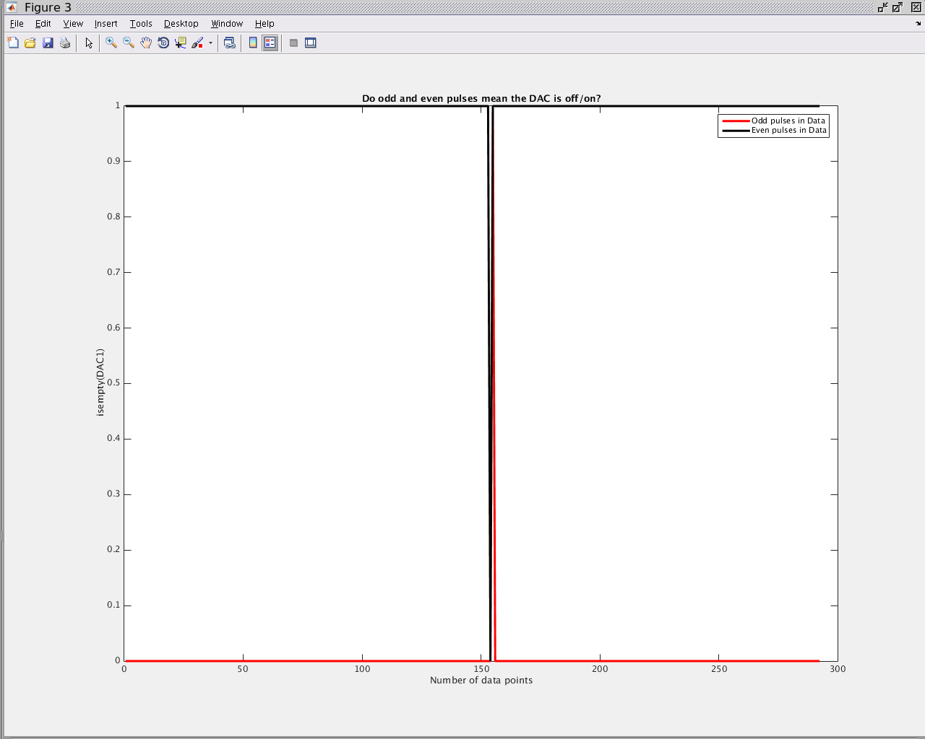
Acquisition
More or less working but some timing/synchronisation issues to sort out. Will leave the details to Elizabeth.

Slide 19
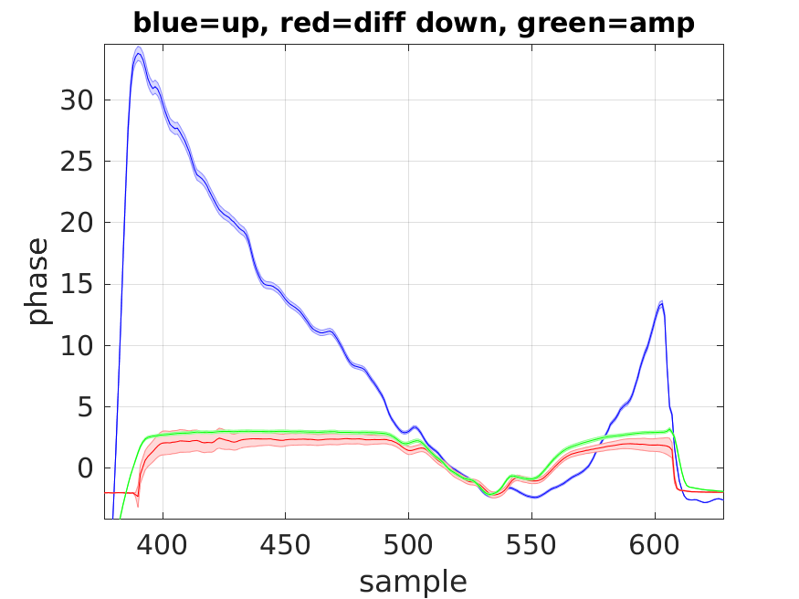
Shape of Applied Correction
Blue: Upstream phase in Mon2.
Green: amplifier monitoring output (~voltage sent to kickers)
Red: Downstream phase shift resulting from applied kick.
All 3 should have same shape, but shape of upstream phase in Mon2 clearly different.

Slide 20
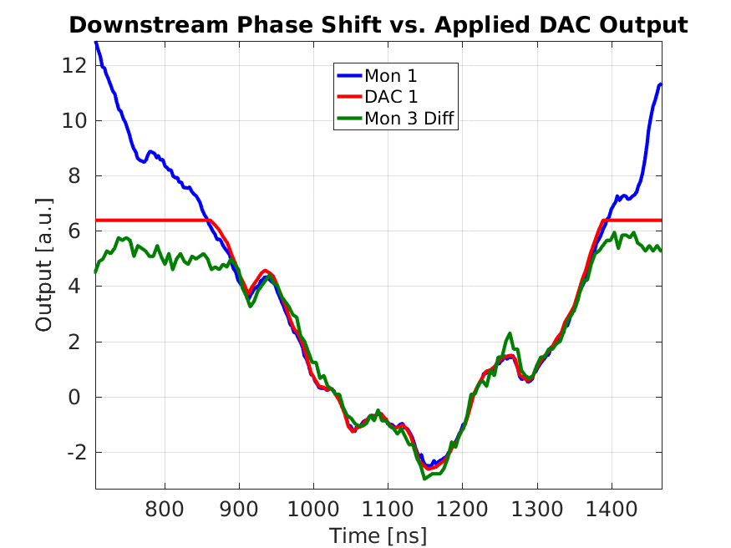
Shape of Applied Correction
Elizabeth
Blue: Upstream phase in Mon1.
Red: DAC1 output (~voltage sent to 1st kicker)
Green: Downstream phase shift resulting from applied kick.
Now all the same shape (Mon1 is correction input, Mon2 should have same shape but doesn’t, probably due to LO issues).
Downstream phase shift saturates before DAC as amplifier saturates before max DAC (expected).

Slide 21
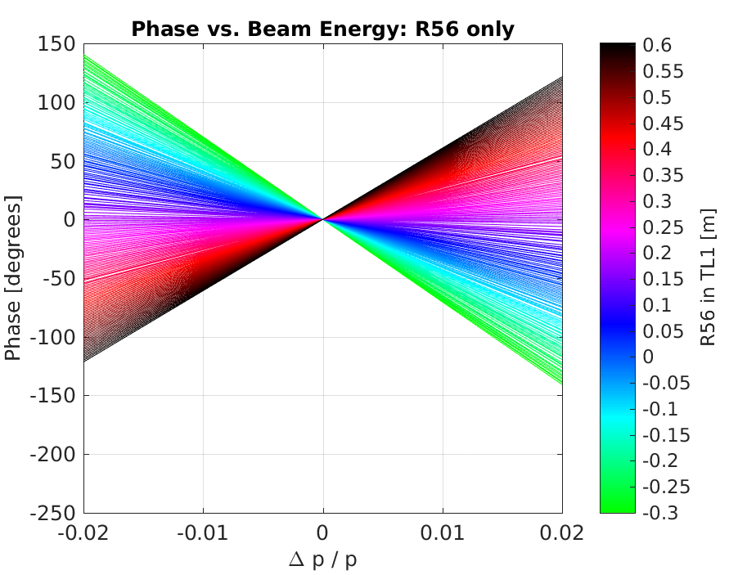
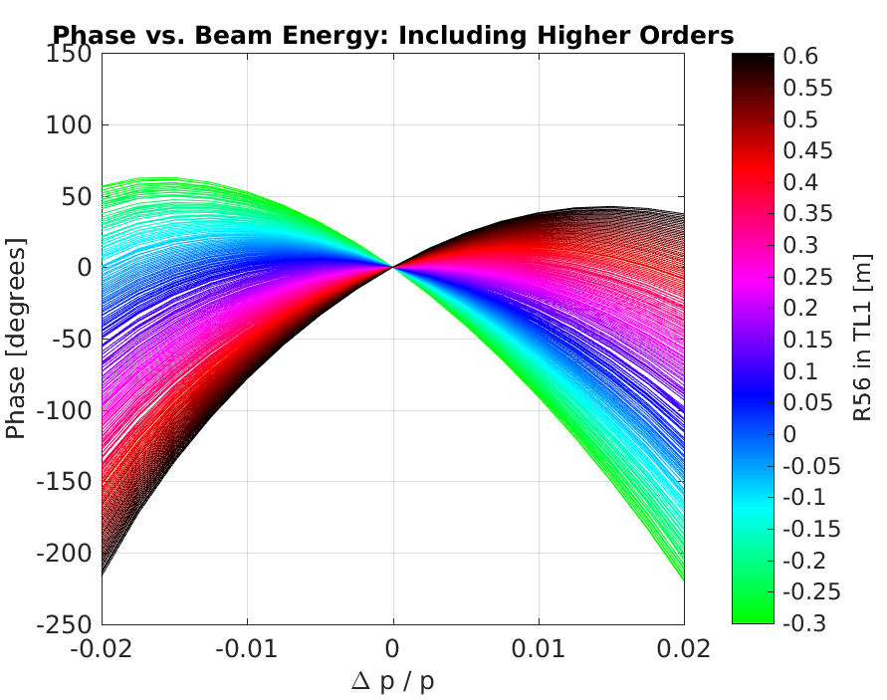
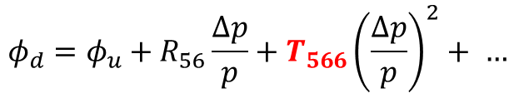

Phase Propagation
But all the optics have large higher order terms…
R56 ~0.2m optics in TL1 optics removes all energy dependence.
So can’t remove energy dependence for all energy offsets.
Only 1st order phase-energy dependence:
With higher orders:
$$φ_{d}=φ_{u}+R_{56}\frac{Δp}{p}$$
$$φ_{d}=φ_{u}+R_{56}\frac{Δp}{p}+T_{566}{\left(\frac{Δp}{p}\right)}^{2}+ …$$

Slide 22
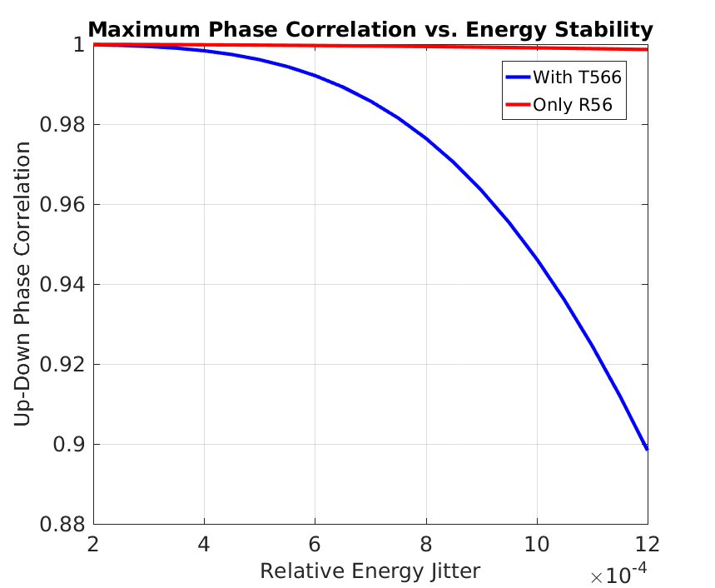
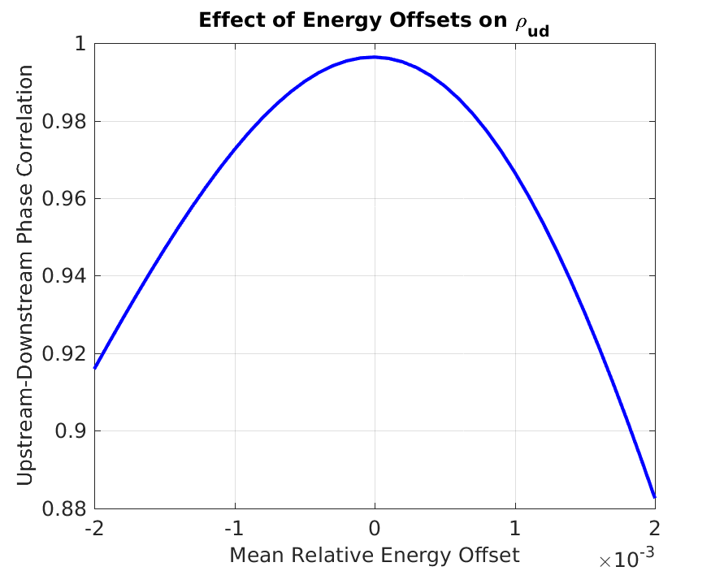
Effect of T566
2016
2015
feedbacks
With the optimal R56 optics in TL1 set and assuming typical phase jitters etc.
Higher orders make us very sensitive to energy stability, but should still be possible to achieve high correlations with an optimised CTF3/feedbacks.

Slide 23
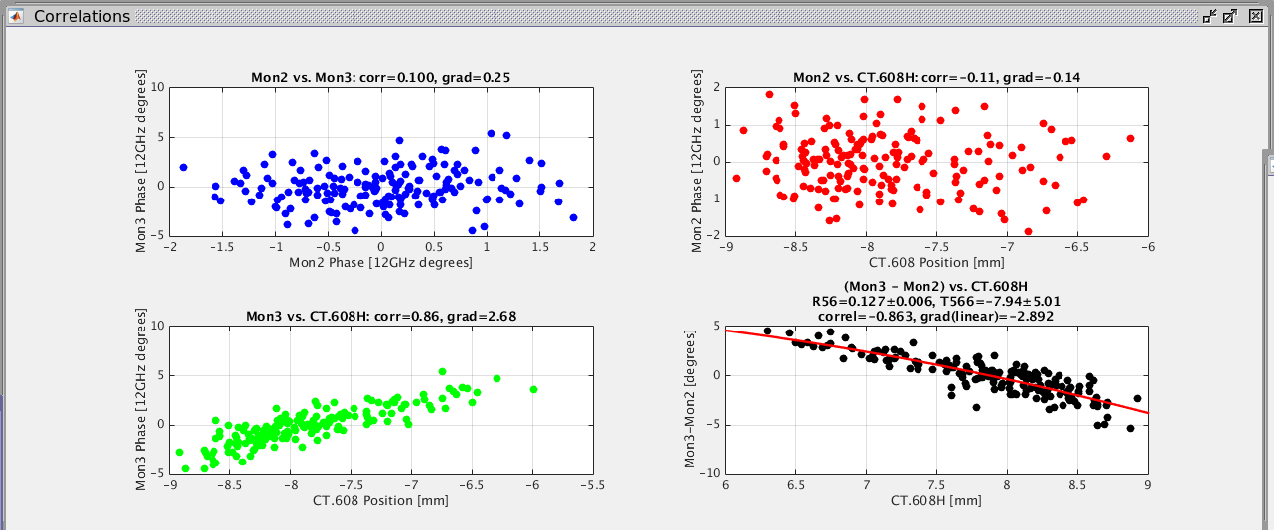
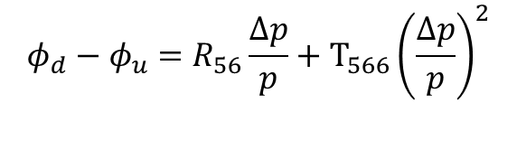

Online Monitoring of Energy Dependence
$$φ_{d}−φ_{u}=R_{56}\frac{Δp}{p}+T_{566}{\left(\frac{Δp}{p}\right)}^{2}$$
Fit R56, T566
$$D_{x}\left(CT.608\right)=−0.6 \text{m}$$

Slide 24
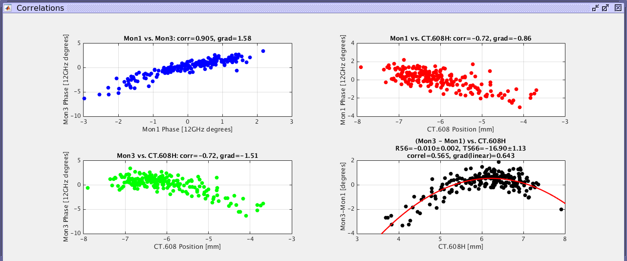
High Energy Correlation Up and Downstream

Slide 25
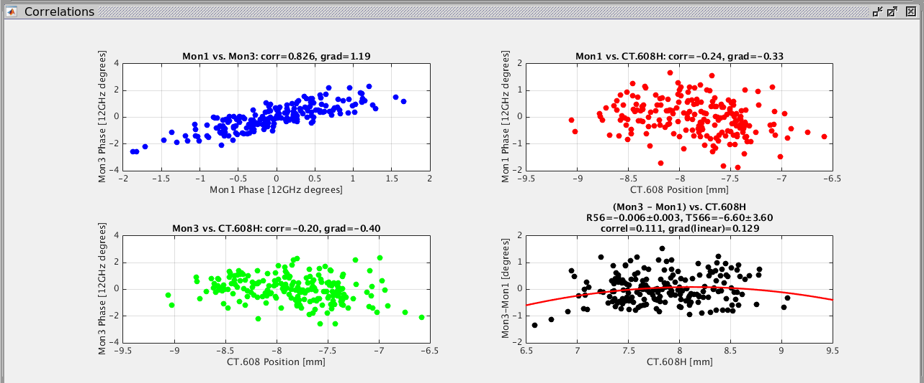
Close to Optimal Conditions
Achieving upstream/downstream phase correlation (top left) above this is where things start to get tricky and we don’t always manage.

Slide 26
Steps in Achieving Good Phase Propagation
Set up beam to the downstream monitor (TBL).
Normally quite quick to recover using settings from previous PFF run.
Find approximate set point for R56 in TL1 using online monitoring.
Not so quick to take R56 scans now as changing TL1 optics also changes the orbit (alignment issues) and leads to losses -> have to move correctors each time R56 is changed.
Energy and other feedbacks to create most stable beam possible upstream.
Further optimisation of phase-energy dependence via:
Changing beam energy.
Scaling CR dipoles (or the whole CR optics).
Effects other than energy – difficult to pin down
Maximise beam transmission to downstream monitor.
Position scan in downstream monitor.
Focusing around downstream monitor.
Possible other jitter sources between the two (e.g. dipole/septa power supplies).
Phase monitor resolution/other limitations.
Starting Point
In 2015
Moving in
to 2016

Slide 27
Examples of New PFF Results
Had a lot of PFF shifts in August.
Usually most the time on shift spent trying to achieve and maintain good phase propagation – not always successful but successful much more often than before.
When good conditions achieved, PFF attempts:
System setup quick using all derived timings etc. from last year.
Trying to improve results from last year in terms of either absolute jitter, jitter reduction factor, or dataset length.

Slide 28
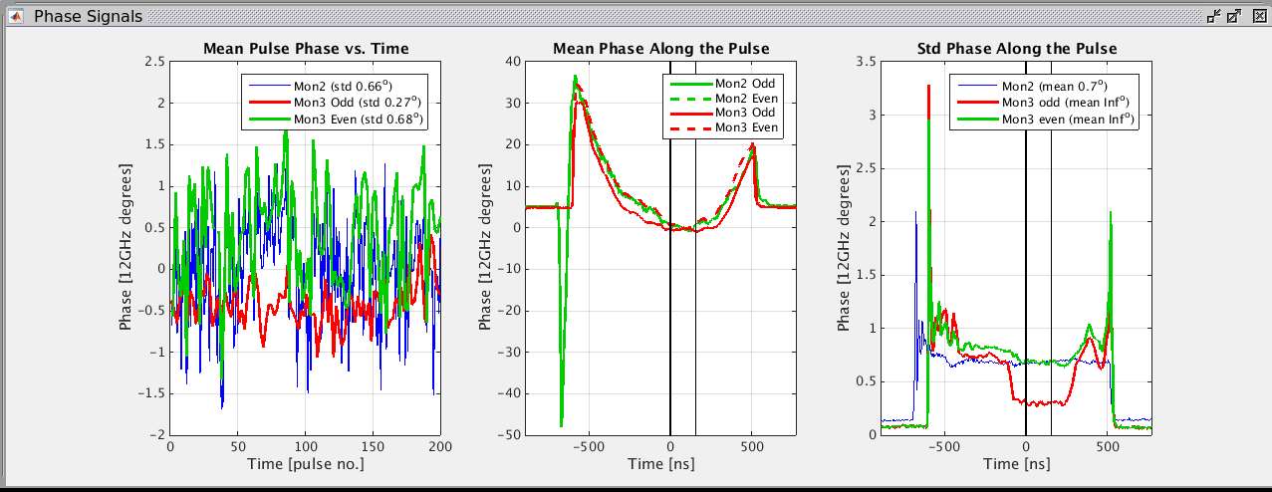
“Natural” Beam Conditions
0.27 degrees downstream jitter matches record from last year – but this across 200 pulses rather than 150.
More stable initial conditions (<0.7 degrees jitter up and downstream) helps a lot.

Slide 29
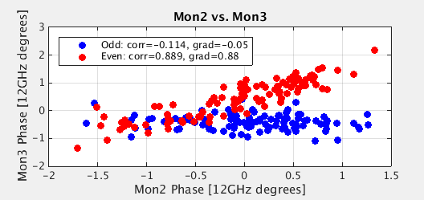
“Natural” Beam Conditions
Correlation plot for PFF Off and PFF On pulses in the previous dataset.
Only 89% correlation (last year record was with 93%), but lower initial jitter.

Slide 30
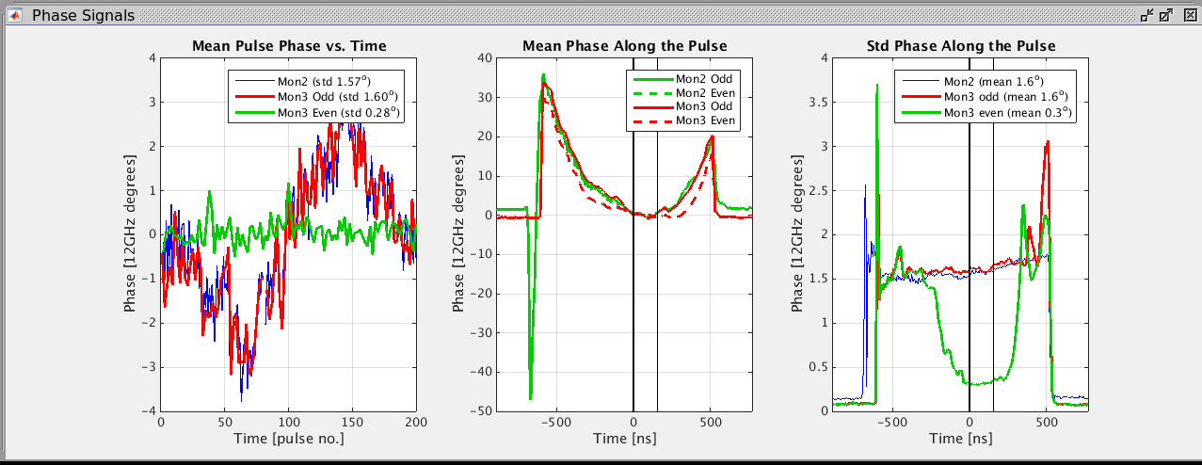
With Klystron Wiggling
Saw tooth variation implemented on phase of all klystrons (hoping to achieve higher correlation to demonstrate larger factor reduction in jitter).
Factor 5.7 reduction from 1.6 to 0.28 degrees here.

Slide 31
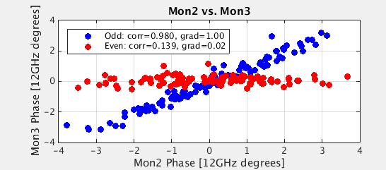
With Klystron Wiggling
Correlation boosted to 98% with wiggling.
All of it removed (or slightly over-corrected) with the PFF system.

Slide 32
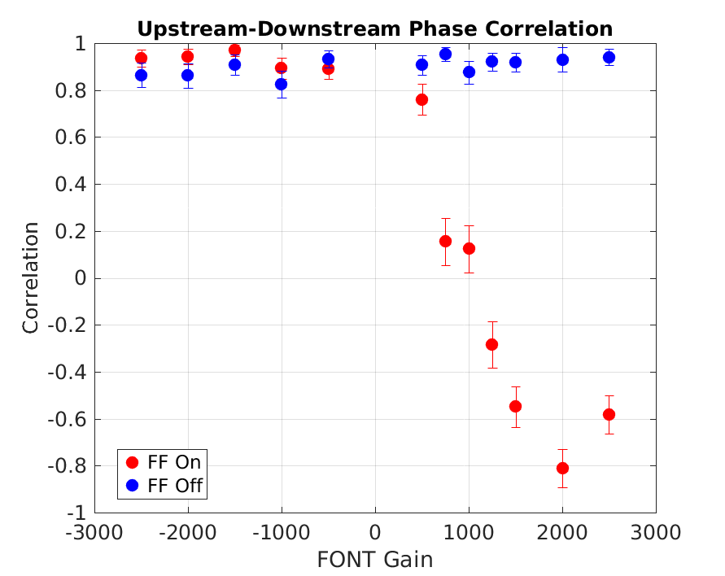
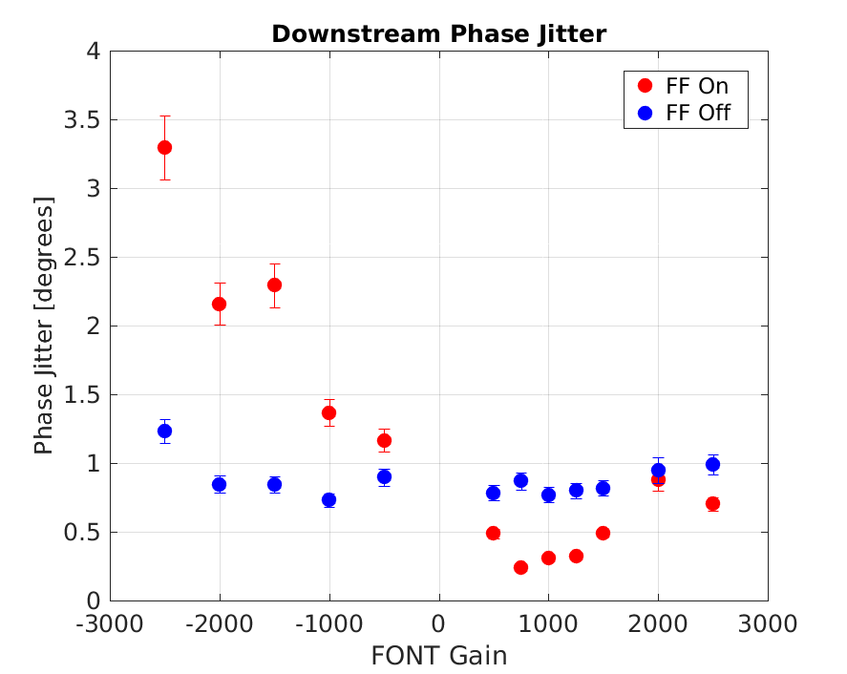
Gain Scan
0.24 degrees!
Looks like a new record dataset during the scan – haven’t analysed it separately yet.

Slide 33
Non-PFF Optics!
For the previous results turns out we were using the non-PFF optics for TL2, i.e. the optics without the constraints on:
R52 between kickers -> Gives the phase shifting behaviour in the chicane.
Orbit closure independent of applied kick.
That we could do any correction (and with similar range) is pretty much a fluke – probably means R52 is by chance similar in the PFF and non-PFF optics (can check in MADX later).
But do lose the orbit closure (though that’s not critical for our purposes).
May actually be worth pursuing further tests like this – non-PFF optics has ~factor 2 smaller dispersion and beta functions, so may help to get a “cleaner” beam to the downstream monitor.

Slide 34

Gain scale factor
Scale factor C that gives optimal gain to set in the PFF firmware given the current beam conditions:
C Depends on: phase monitor calibrations, constants in firmware, phase shift per DAC count.
Initial calculation assumed 6 degrees = 4096 DAC counts, so 1 degree = 4096/6 DAC counts
Not valid as phase shift not linearly dependent on DAC for high DAC outputs as the amplifier enters saturation.
Gives C ~= 710.
Corrected calculation uses 3.5 degrees = 2048 DAC counts -> in linear range.
Gives C ~= 620
But measured optimal gains (seem to) give closer agreement with the old C value…
Possibly because many pulses end up using non-linear range of amplifier, so the “correct” value of C is in reality somewhere in-between the two above, but not sure.
$$g= \frac{1}{C}\left(ρ\frac{σ_{d}}{σ_{u}}\right)$$

Slide 35
Plans
Phase monitor issues – probably a live with it unless it gets worse situation now. Still many mysteries, though.
Lower corrected jitter:
CLIC target is 0.2 degrees (averaged across ~30ns).
CTF3: 0.2 degrees on the mean across several hundred ns may be in reach (got to 0.24).
Larger factor reduction in jitter:
CLIC target is factor 10.
CTF3: Achieved 5.7, maybe could get 6.x – limited by correction range/ph mon resolution.
Longer datasets:
CLIC target is continuous.
CTF3: Mostly few-10 mins so far. Long runs difficult due to LO drifts.
Orbit closure, emittance corrected downstream beam.
Adjusted/new setups?
Combined beam? Maybe at least a correlation study.
2 input correction? Would require beam in Frascati chicane for energy measurement.
(Semi-)Automatic gain/offset adjustment.

Slide 36
Summary
The phase monitor resolution now appears to be 0.2 degrees on all 3 mixers. Drifts/features on the LO are a nuisance.
Acquisition of FONT ADCs/DACs etc. over CERN control system (almost) working thanks to Elizabeth/Davide.
Phase propagation trend is still to get better and better, but there are days we can’t get high correlation and don’t understand why.
Set new records for lowest jitter and largest jitter reduction factor.

