Slide 1
AIR COOLING & PROFILOMETRY
AIR COOLING & PROFILOMETRY
OXFORD SYSTEM IMPLEMENTATION
P.A. Coe – OXFORD
THURS 08 Sept 2016

Slide 2
AIR COOLING & PROFILOMETRY:
OVERVIEW
Air Cooling
  System target parameters
  Schematic overview
  [Hardware]
  Detailed choices
Profilometry
  System functional requirements
  Schematic overview
  Options under consideration
Timeline
THURS 08 Sept 2016

Slide 3
AIR COOLING TARGET PARAMETERS
Laminar flow of cooling air over test items
Temperature and flow rate measured and kept steady
Air humidity controlled
Target temperature range 10°c to 50°c
Typical airflow rates:
  Initial plan 1 to 2 litres / sec [in test volume]
  Up to 50 litres / sec expected to be possible
THURS 08 Sept 2016

Slide 4
AIR COOLING system OVERVIEW
Flow direction
By-pass flow
Axial fan
Warm air
Heat
Exchanger
Fan Control
Laminar flow
By-pass
Control
Chilled
Water
Airflow
Test
Cooled air
Condensation
Trap
Water
THURS 08 Sept 2016

Slide 5
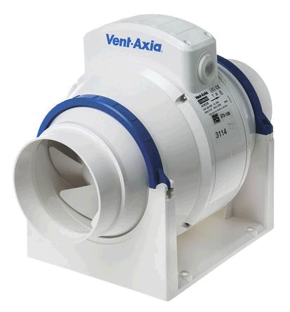
AIR COOLING - AXIAL FAN
  Max flow rate 71 litres / second
  Flow rate continuously adjustable
  Feeds into 100 mm diameter pipe
    Exhaust speed up to 9 m/s
THURS 08 Sept 2016

Slide 6
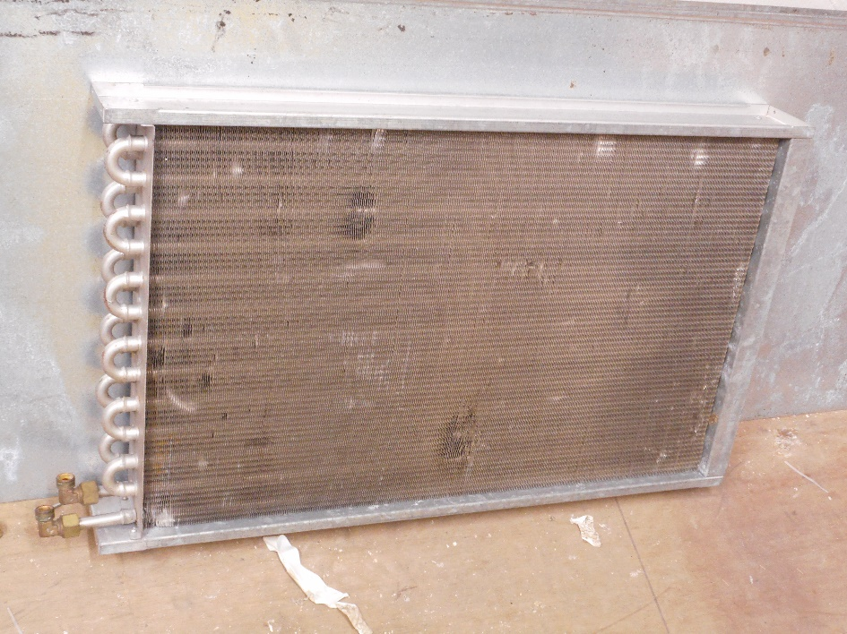
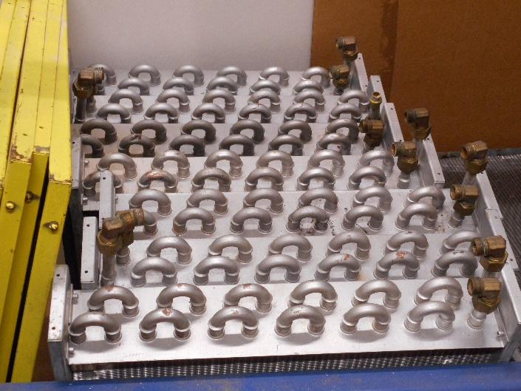
AIR COOLING - HEAT EXCHANGERS
  10 existing exchanger units
  Individual unit leak testing this / next week
  Water chilling provided by existing chiller
  Planned assembly into sealed 300 L volume
    One input for warmer air
    Two exits:
      One for chilled air
      One for potential moisture
  Condensation trap and exchanger chamber to be designed / built
THURS 08 Sept 2016

Slide 7
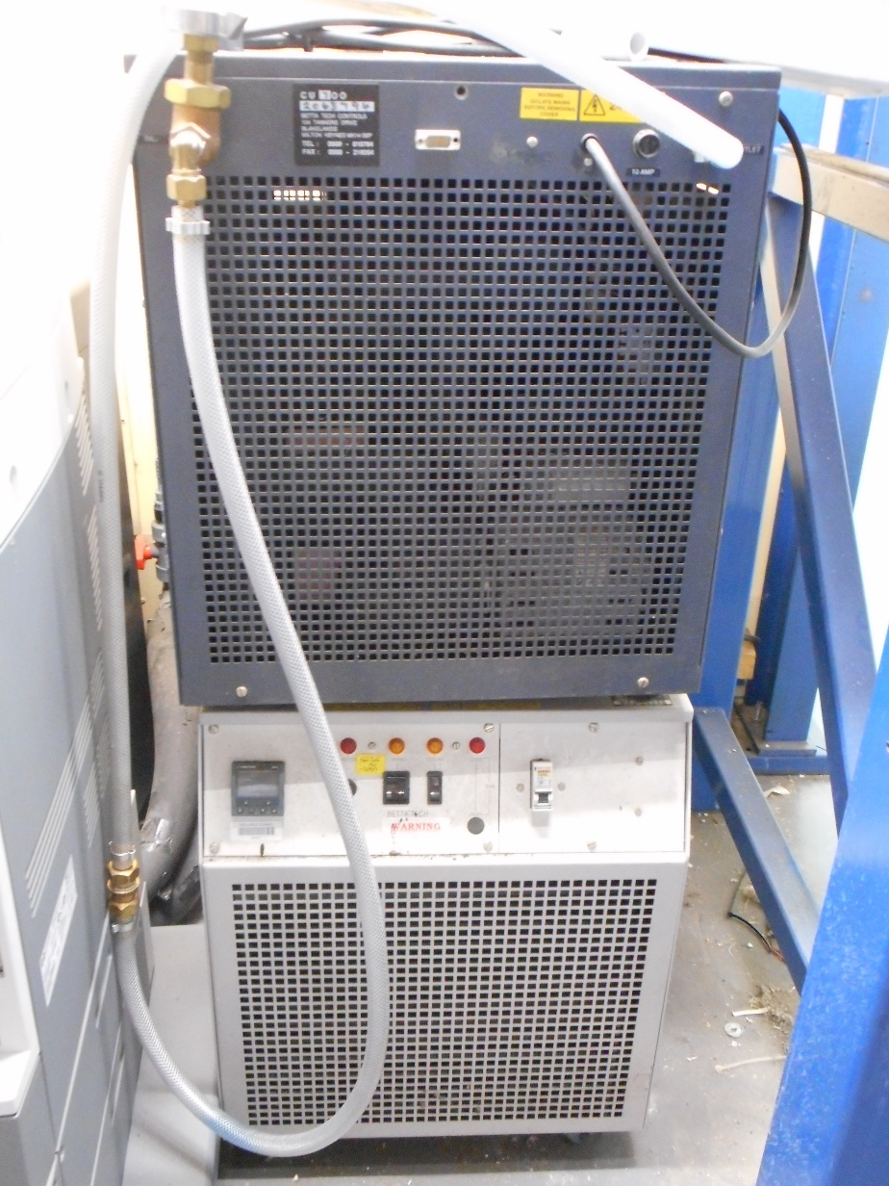
AIR COOLING - Water Chiller
  Existing unit
  Work needed
    Cleaning
    Replacing seals
    Testing in loop with heat exchanger
THURS 08 Sept 2016

Slide 8
AIR COOLING – TEST VOLUME
  Chamber to house items under cooling test
    Couples mechanically to test item
    Couples into laminar air flow from air cooling system
    Vents back into air cooling circulation
  Example input adapter (on next slide)
  Initial measurements to use capacitive sensor system (see later slide)
  Future upgrade to allow optical measurement profilometry system
THURS 08 Sept 2016

Slide 9
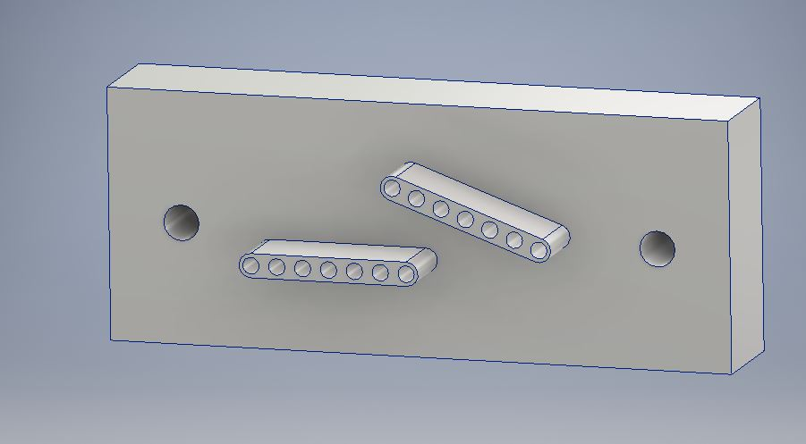
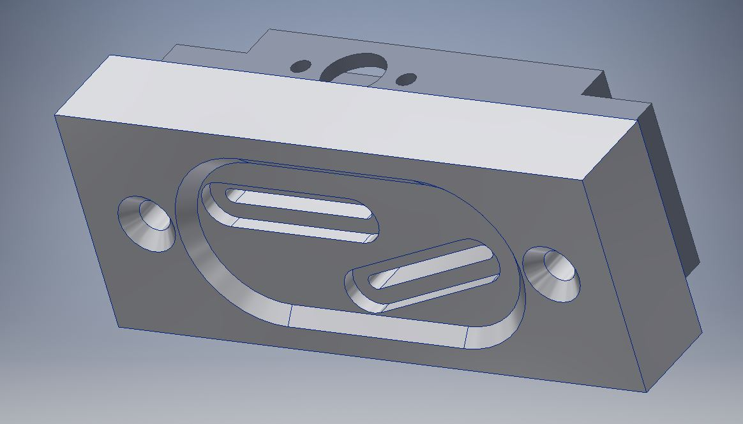
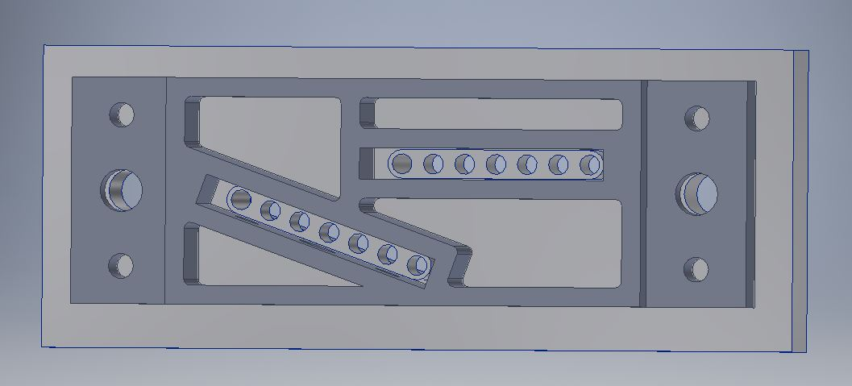
AIR COOLING – ADAPTER EXAMPLE
  Funnels airflow into Bristol design mounting box
    Provides laminar flow with hole array
    Prototype to be sent to Bristol for compatibility check
  Similar coupler at exhaust end
    Positional details differ at each end
Air inflow
Air injection adapter
View seen by incoming airflow
View from inside Bristol transport box
THURS 08 Sept 2016

Slide 10
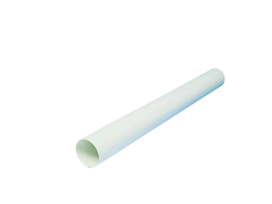
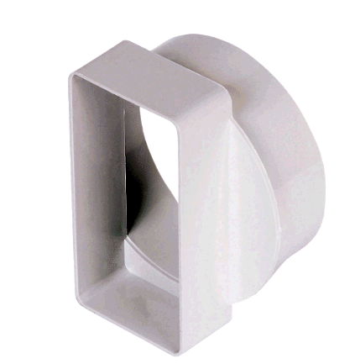
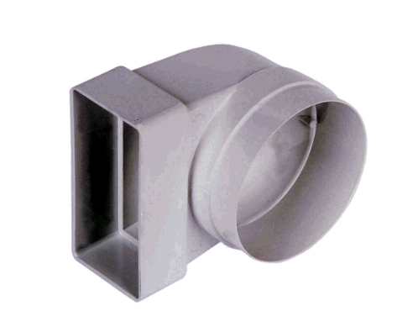
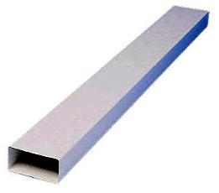
AIR COOLING – ducting
  Inexpensive 100 mm diameter cylindrical ducting
    Matches fan ports
    Matching rectangular ducting in same family
  Different options for system sealing
    Loose mechanical clip
      no airtight guarantee
    Sealant
      May outgas aggressive chemicals – e.g. acetic acid
      Might need to be run many times and emptied to exhaust fumes
    Custom machined interconnects
      Initially more expensive
      Can provide ports for anemometers
      No significant chemical gases
      Allows for easy re-opening / reassembly
THURS 08 Sept 2016

Slide 11

AIR COOLING – Instrumentation
  Anemometer
    Measures air speed up to 30 m/s
      Resolution 0.01 m/s
    Measures air temperature -20°c to +60°c
      Resolution 0.1 K
THURS 08 Sept 2016

Slide 12
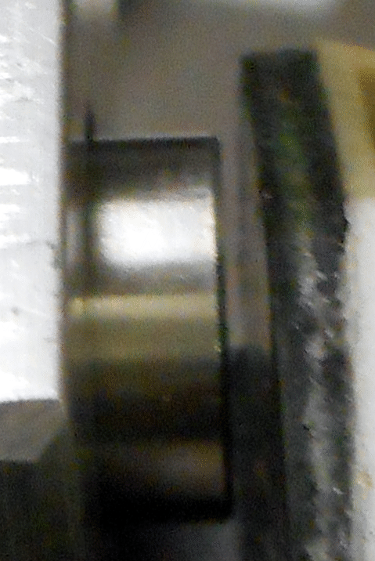
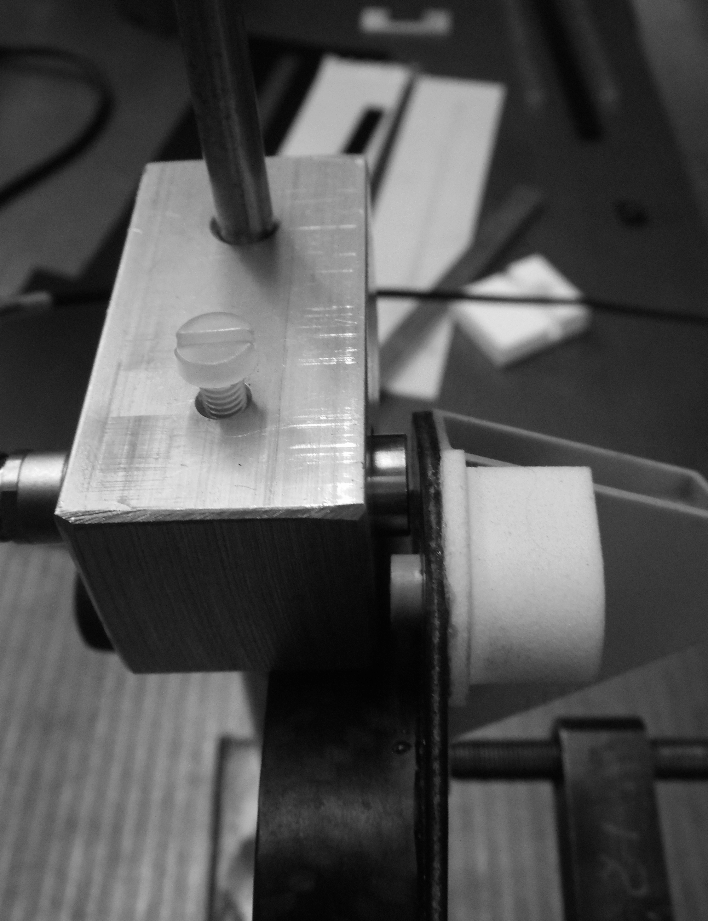
SAMPLE MEASUREMENT: Capacitive sensors
  Existing sensor system
    At least 8 channels of sensor
  Displacement measurements
    1 mm range
    Resolution ~ 1 micron
  Read out mechanical frequencies
    Frequency range
      sub 1 Hz to
      multi-100 Hz
THURS 08 Sept 2016

Slide 13
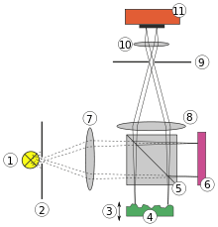
Profilometry: Concept
Camera / sensor
Light source
Reference
Reflector
Surface profile

Slide 14
timeline
2016
VIEWED BRISTOL WORK
JUN
PREPARED IDEAS: AIR COOLING AND OPTICAL
JUL-AUG
ORDERING AIR COOLING PARTS
SEP
CONSTRUCTION AIR COOLING LOOP
SEP-OCT
AIR COOLING COMMISSIONING
OCT
FIRST COOLING/ capacitive sensor TESTS
NOV
DESIGN OPTICAL PROFILING SYSTEM
SEP - NOV
ORDERING OPTICAL PARTS
OCT-NOV
CONSTRUCTION OPTICAL SYSTEM
DEC - JAN
2017
OPTICAL SYSTEM COMMISSIONING
JAN-FEB
FIRST COMBINED AIR COOLING / OPTICAL TESTS
MAR
THURS 08 Sept 2016

