Slide 1
Joint TB/CRWG Meeting
How best to proceed with the design activities in view of the recent KEK/Fermilab R&D proposal and the impending disappearance of the US.
Mike Harrison

Slide 2
Impact of the proposed Cost reduction R&D
At this point we do not know the accelerating gradient and won’t for a few years (at least)
XFEL cavities are consistent with TDR specs (>28MV/m)
N-infusion might give 35 MV/m -> ~40 MV/m.
XFEL cryomodule degradation ~0% not 10% as assumed in the TDR

Slide 3
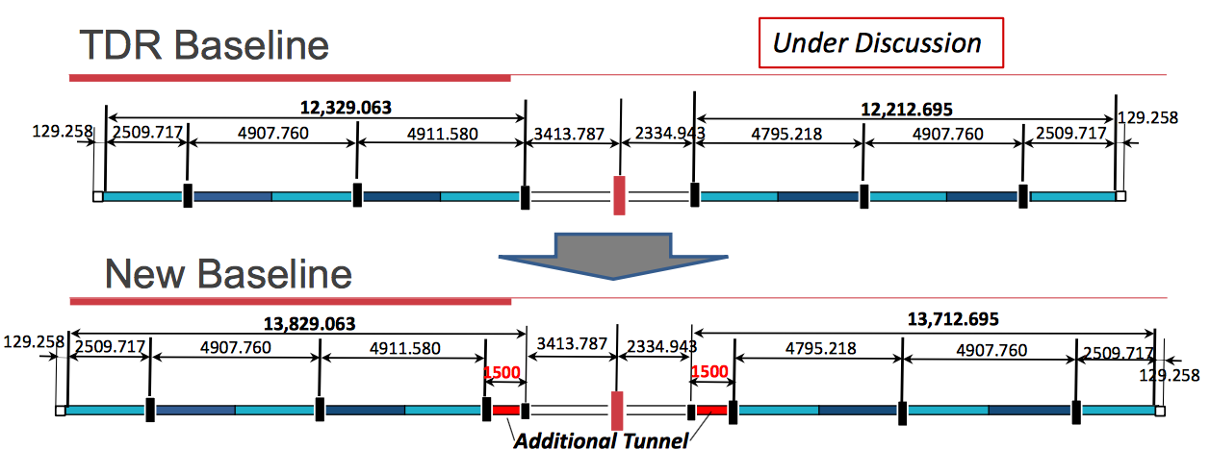
Machine Geometry
If we don’t know the gradient then we don’t know the geometry
Cryoloop spacing changes, access point spacing changes, collision point timing changes. None of this can be finalised until the accelerating gradient is defined. “Additional Tunnel” unlikely to survive but allows for an aggressive gradient goal.

Slide 4
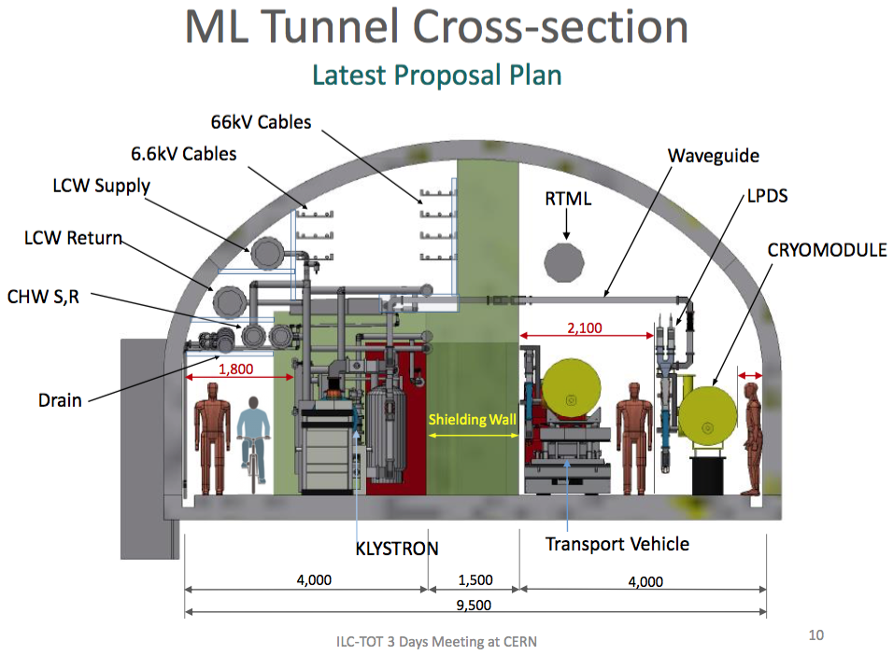
Value Engineering
Most cost reducing activities that come under the general rubric of value engineering are relatively benign from a design perspective: tuners, couplers, HLRF, niobium stock, cavity & cryomodule process & production, etc… Thus most beneficial changes can be incorporated at any time within reason.
CR-012

Slide 5
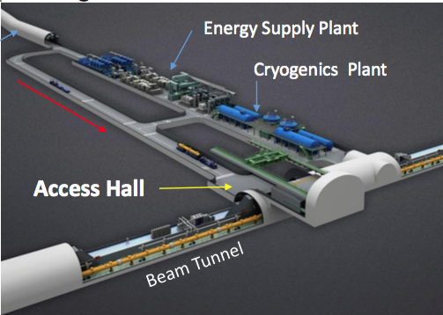
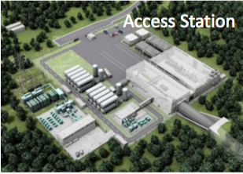
Utility Penetrations
The actual design is more or less the same but the spacing changes

Slide 6
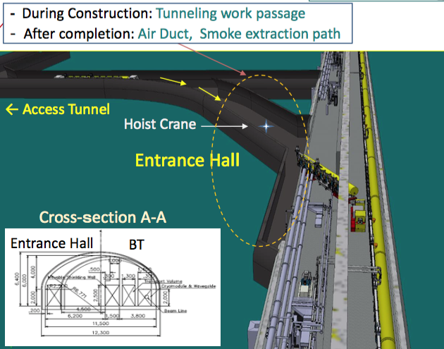
Tunnel Access

Slide 7
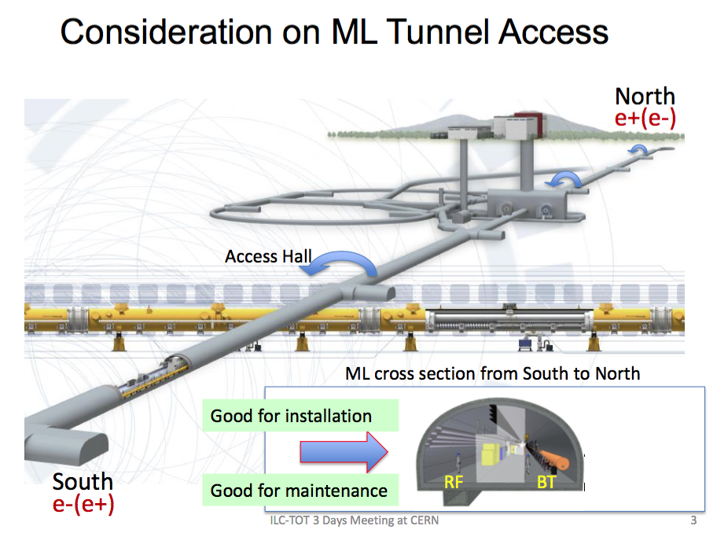
Central Region

Slide 8
How to proceed ?
Many cavities (GDE used 87) are needed to define the actual operating gradient distribution.
In the absence of a fully fledged multi-year cavity R&D program then one could fix the geometry and let the energy float ? Since the cavity gradient is a distribution not a delta function then there is an element of this approach in any case. Unlike a circular machine the energy is not defined by the worst “magnet”.
How do we incorporate the XFEL cryomodule degradation results ?
R&D programs by definition can last for ever. How do you define “good enough” ?

Slide 9
How to proceed ?
What design elements does it make sense to pursue or should the process be put on hold why the R&D program advances ?
How best to adapt to the US situation
Are there any changes that could continue to reduce costs ?

