Slide 1
CRWG
Status and Future
K. Yokoya
2016.9.08.CRWG+TB mtg

Slide 2
Charge (abridged)
To develop a conceptual design for the central region of the ILC
  at a level of detail consistent with a change request and
  sufficient to define the CFS features of this area of the machine.
Should assume
  Detector Hall layout as specified in CR-003.
  Tunnel geometry as specified in CR-004 (2x1.5km extension) and lattice ILC2015b.
  ML tunnel cross-section as outlined for a 1.5 m central shielding wall (CR12 --- note the number changed 13→12).
Avoid the temptation of trying to produce an engineering level of detail.
  We are not scoped for such a task at this time
  It is important to develop the central region concept in a timely way since changes have been made since the TDR and we need to progress towards a Kitakami site specific CFS footprint.
The Working Group should attempt to derive a cost-neutral (or cost reducing) approach
  though I appreciate that the TDR baseline was estimated in a somewhat generic fashion for this part of the machine thus cost comparisons might prove difficult.
You should plan towards having a working concept for the ECFA workshop in Santander, in June 2016 (May 30 – Jun 5).

Slide 3
Issues Discussed
Positron-related
  10Hz operation
  Auxiliary positron source (APS)
  Positron target region
MPS,PPS
Beam dumps
  Main dumps
  Tune-up dumps
BDS-related
  Muon wall
Tunnel of the Central Region

Slide 4
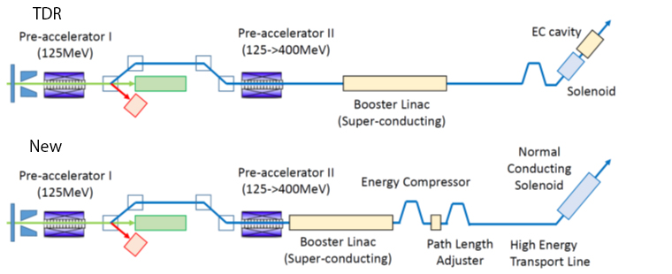
These are already accepted?
Relocation of positron booster linac
  Positron spin rotator
    2 parallel line for up and down polarization
    (strong request from physics and positron groups)
    Superconducting or normal-conducting solenoid?
  Location of Global timing chicane
DR
400MeV
5GeV
  Location of 1.5km ML tunnel extention

Slide 5
10Hz Operation
TDR mentions 10Hz operation for E_{CM} < 250GeV
  Gives parameter sets for 200 and 230GeV
  Damping ring with stronger wigglers
  But detail of linac operation, additional beam line, beam dynamics are not given
Is 10Hz operation really needed?
  200-250GeV: sweep the region above LEP
  But most important is Z-pole (92GeV) and W-pair (160GeV)
Conclusion in CRWG
  Prepare spaces for beamlines that guarantee down to E_{CM}=200GeV
    Preliminary beamline optics to tune-up dump by Okugi
  This does not guarantee E_{CM}<200GeV.
    Beam dynamics complex
    Will think of 92GeV and 160GeV later, if turn out to be necessary

Slide 6
Tune-up Dumps
Change of the commissioning strategy
  Tuning by weak beam using local tune-up dumps
  Use main dumps for all-system tuning
Reduced power scale of all the tune-up dumps
  Maximum ~400kW
  Except main dumps (E-5,E+5) and photon dump E+7
  Proposal of a new dump E+8 for spent electron after positron generation in 5+5 Hz operation
Will soon come to a change request

Slide 7
Main Dumps
Two 14 MW main dumps (plus 6.3MW spent electron dump)
  Detailed check of the dump system is not CRWG expertise
Need specialist team
  Beam dump specialists
  CFS
Issues
  Robot work
  Safety in particular window breakdown
  Required human access
I do not know yet about formation of such team

Slide 8
10atm water beam dump layout
B. Smith, CCLRC:
0-TB-0067-404-00-A
D00000000945405

Slide 9
Water beam dump surface site scheme
B. Smith, CCLRC:
0-TB-0067-410-00-A
D00000000945465
Shows surface facilities that service the dump, including cooling and exhaust for gases (tritium!)

Slide 10
Positron (target region)
Main issues needed as inputs to CRWG
  Design of photon dump
    A problem (radiation damage of the window by photon beam) of TDR design pointed out at Santander
  Required shielding of the target region including the thoughts on
    Target replacement
    Where/how waste targets to be stored
    Path to take waste target to the surface
Will be discussed in POSIPOL@LAL next week
This would take some more time

Slide 11
Consensus among ILC positron team
  No human access to the accelerator and service tunnels needed during high-energy beam on (normal operation and commissioning) as in main linac region
  Special shield wall needed for target+FC+solenoid+a few cavities
  Photon/electron dumps must also be shielded
This figure is for illustration only. To be discussed in the WS

Slide 12
BDS Tunnel (electron)
Okugi’s proposal
  Single (kamaboko) tunnel from ML end to e+ ECS
  Twin tunnel to muon wall
    Penetration for cables only (no waveguides)
    Small tunnel cross-section possible after collimators
Must come to final conclusion
  Info from positron team needed
e-linac end
IP

Slide 13
BDS Tunnel (positron)
Okugi’s proposal
  Move electron source upstream
Must come to final conclusion
  Required size of the components
  Then, send to CFS team for tunnel layout
TDR
Okugi

Slide 14
Muon Wall
TDR: 5m long magnetized spoiler, filling the tunnel crosssection.
Background to the detector was re-estimated with different conditions
 | #/200 bunches R=6.5m detector | #/200 bunches R=2.5m TPC
No spoilers | 138 | 9648
2x 5m mag.spoilers | 25 | 1008
5x 5m toroid | 3.3 | 273
both | 0.5 | 17
Can we remove 5m magnetized iron?

Slide 15
Auxiliary Positron Source
Our conclusion has been to retain it for DR and BDS commissioning
  Weak intensity but can still useful for DR emittance tuning if stacking possible
  Does it require a wider tunnel?
Now, under new commissioning strategy, is it still useful?

Slide 16
New Members to CRWG
Reorganization of CFS team in Japan
  Lead by Hayano & Terunuma
Shinichiro Michizono
Hitoshi Hayano
Nobuhiro Terunuma

Slide 17
Future Plan
Expect change of organization in December
Some items may come to conclusion by that time
  Positron BDS tunnel
  Auxiliary positron source
Some items require more inputs
  Electron BDS tunnel including positron target region
  Main dump-related issues
Whole system must be reviewed
  Installation
  Commissioning
  Accidents
Problem
  Expand the expertise?

