Slide 1
CR-0009 status
H. Hayano(KEK), B. Petersen(DESY), T. Peterson(FNAL),
02 June 2016, Santander

Slide 2
ILC-CR-0009
Cryogenic Layout Change: movement of the main helium compressors
and cryogen storage tank from cavern underground to the surface.
Change Review Panel Members:
Bernd Petersen (DESY),
Tom Peterson (FNAL),
Hitoshi Hayano (KEK) (chair).
The rationale is as follows:
(1) Mechanical vibration and noise from helium compressors
may interfere in accelerator beam operation.
(2) Large amount of cryogens underground should be avoided
for the safety reason.
(3) Accessibility to cryogen supply and daily check will greatly
improved if the main cryogenics components are in the surface.
(4) Natural environment conservation must be cared by choosing
the optimum locations of the cryogenics components in the surface
as a point of view of mechanical noise and vibration interfere on the residents.

Slide 3
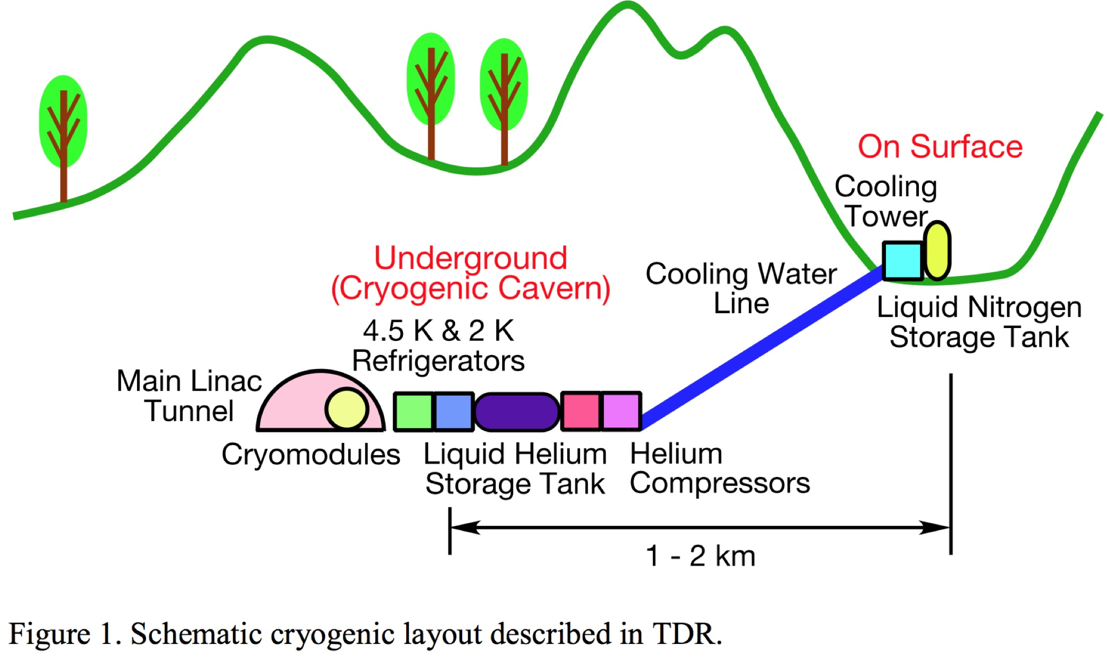
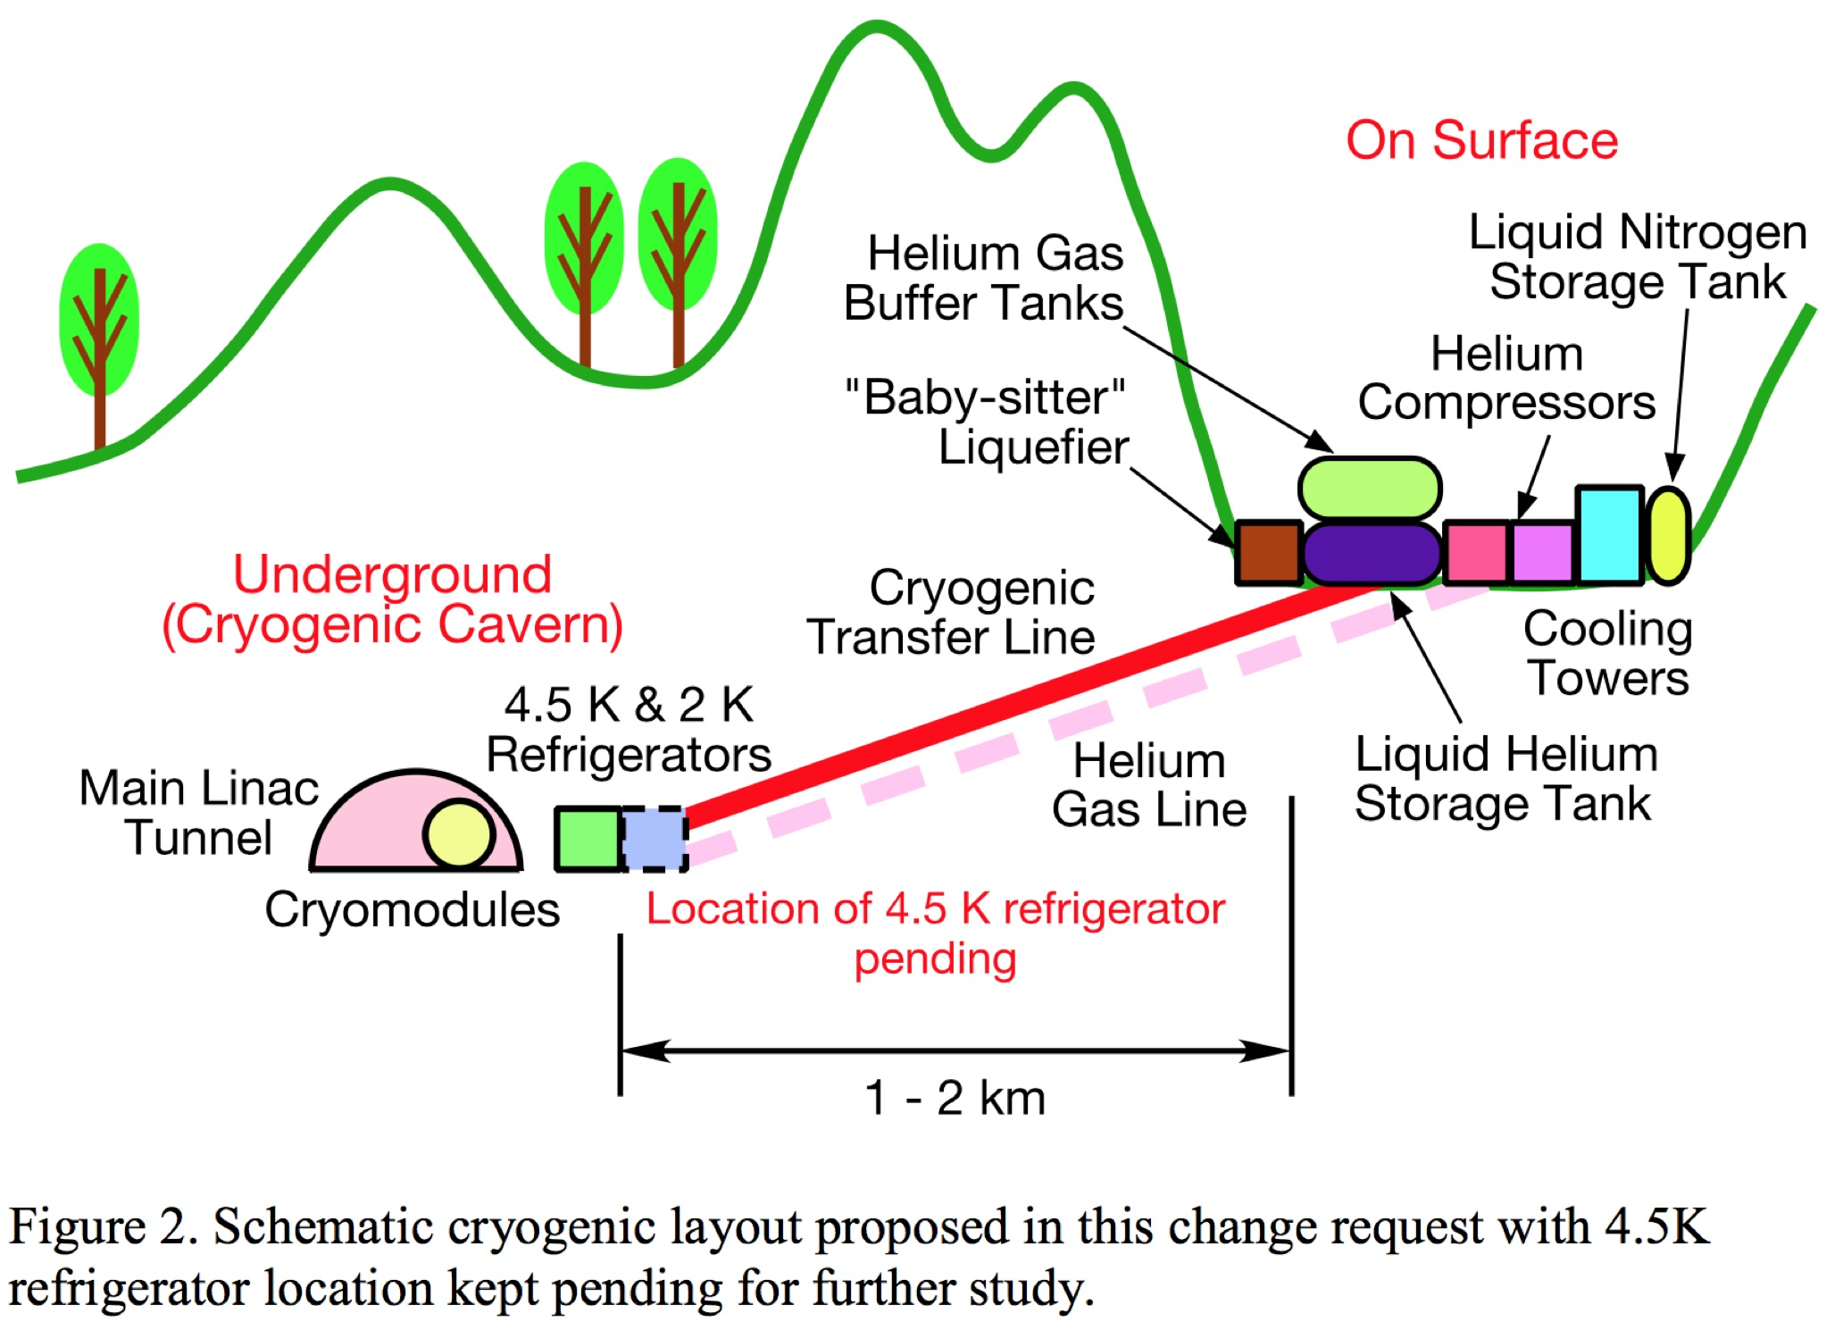

Slide 4
Discussions
“ILC cryogenics for Mountainous Topography” H. Nakai,
AWLC14(FNAL), 13 May, 2014
“Current Status of Japanese Cryo Design” H. Nakai, D. Delikaris, T. Peterson,
LCWS15(Whistler), 05 Nov., 2015
“Architecture on ML Cryogenics” T. Okamura,
LCWS15(Whistler), 05 Nov., 2015
*panel members participated in the discussion.
Conclusion
Review panel members are all agreed to this change.
For the further design of ILC cryogenics,
the following comments and recommendations are noted.

Slide 5
Comments and Recommendations (so far)
Cryogenic layout
There will be an efficiency study and a cost study about the location of 4.5K refrigerator in KEK.
It will be presented in the coming LC meeting. However, it is not the scope of this review.
Rationale
1) Mechanical vibration and noise from helium compressors
(BP) I agree. There may be even more reasons to place the helium compressors outside:
logistics for repair and maintenance, primary power & cooling water supply etc..
(HH): I agree. The quadrupole magnets inside of Main Linac cryomodule have to reduce
mechanical vibration down to less than several 10 nm. Any possible source of vibration
should be kept far away from the cryomodule.
2) Large amount of cryogens underground
(BP) Liquid helium stored in in the cryomodules in the tunnel cannot be avoided by the nature
of the system. For the accelerator tunnel the access can be restricted. If the liquid helium is
stored in caverns underground but outside the tunnel, full access to the cryo facilities
(cold boxes, cold compressor boxes) is required at any time and restrictions should be avoided.
If large amounts of cryogens shall be stored underground outside the accelerator tunnel,
adequate ventilation measures must be applied (additional channels to outside etc.).
(HH): The safety regulation will not be relaxed, since large amount of liquid helium is stored
still in the tunnel during accelerator operation.

Slide 6
3) Accessibility to cryogen supply and daily check
(BP) Transfer of large amounts of liquid helium or cold helium at high densities to
the cryomodules in the tunnel will take place anyway. All safety valves of the helium
process system should vent into a closed header. The header should vent to atmosphere
only at the surface not underground. (Only the safety flaps of the vacuum vessel could
vent into underground areas.)
4) Natural environment conservation
(BP) The noise from the screw compressors can be attenuated. At DESY the HERA/XFEL/FLASH
cryogenic facilities are situated close to a ‘living area’ (not industrial area), as a consequence,
the emitted extra noise must not exceed 35 dbA outside DESY in the living area.
(HH): The tunnel access points will be in the deep forest with living very few people
who like a quietness. The emitted noise is the most concern for the living people,
so that the maximum noise reduction should be considered in the cryogenics design.
Also, emission of ultra-low frequency vibration must be pay attention to make it minimum.

Slide 7
Scope/Value/Schedule Impact
(BP) In general, I can agree to the change request and proposal as shown in figure 2.
As mentioned earlier, there are good reasons to install the screw compressors outside
the caverns at the surface. Any warm gas helium storage should also be placed
at the surface. Liquid storage will be needed only during long term shut downs,
to store the inventory. I’d like to question, if the large ILC cold boxes should be used to feed
the liquid storage vessels. May be, extra smaller liquefier plants should be installed
at the surface to fill the liquid storage vessels. In any way, long additional transfer lines
should be avoided, if these will only be used to fill the storage vessels.

Slide 8
The 2K refrigerator part (cold compressor box) and the low temperature part of the 4.5 K
cold box should be placed in the underground cavern. If the 4.5 K refrigerator part should
be splitted in underground and surface boxes is part of a cost optimization:
i)if the distance from surface to underground cavern is quite long, all cold refrigerator parts
(2K & 4.5K cold boxes) should be placed in the cavern. Only warm gas piping will be
required to connect to the screw compressors. ( In case of a ‘mixed-cycle’ 2K operation
the warm sub atmospheric gas return line to the warm ‘2K’ screw compressor may create
problems, because of the pressure drop.)
ii) if the distance cavern/surface is shorter, the splitted 4.5 refrigerator version may come
into play. Cryogenic transfer lines will add to the costs. (For the ‘mixed-cycle’ option the sub
atmospheric 2K return gas can be transferred at low temperatures, depending on the heat
exchanger configuration.)
iii) if the distance surface/cavern is short, the complete 4.5K refrigerator may be installed
at the surface.
All three versions should work from a technical point of view. It seems to be a matter of
optimization. It should be considered to apply different solutions at different sites, depending
on the particular distance cavern/surface. In addition, requirements for 2K ‘mixed-cycle’ options
should be respected.
Also for the versions ii) and iii) warm gas piping (HP,LP) from surface to caverns will be
required for cool down, warm-up, purging, helium guard supplies and gas header systems.
Don’t forget to consider costs of cryogenic transfer lines: in the order of 5 – 15 thousand
Euros/Dollars per meter, depending on size and number of process tubes !

Slide 9
(HH): I agree the movement of noisy cryogenic components and liquid helium storage tanks
to the surface from the cavern. The location of 4.5K cold box will require another cost
consideration of transfer line tube. The transfer operation of cold helium gas from
cryomodule to the surface “baby sitter” liquefier will also require cost consideration of
transfer line tube.
End of comments
The review panel report is now under preparation.

