Slide 1
ILC Cryogenics: Study of Emergency Action and Recovery
- in progress -
H. Nakai, T. Okamura, Y. Makida, and
A. Yamamoto (KEK)
2016-08-25

Slide 2
Basic Design Guideline to be taken
No loss of Helium resource even during a total power or cryogenics system failure
  Unfortunately, this important guideline was missing in the TDR study.
  Annual loss of helium may not be zero because of regular maintainance work, but it may be assumed to be smaller than 10%, based on the CERN-LHC experience (~ 15 %/year, in several year after starting the LHC operation.
It is very important to find a reasonable balance to conserve nature environment with helium resource conservation. Sudden large amount of helium resource would not be available specially in Japan.
Both accelerator and detector cryogenics systems should have the same guidelines above, and both parties should harmonize the design concept.

Slide 3
A Technical Guideline in emergency and total power failure
A target time for recovery from starting the total power failure to resuming the ordinal/steady-state operation in our model study
  A recovery time of ≤ 24 hours is proposed in the worst case scenario of the secondary power not switched on due to some reason.
    In principle, the secondary power line assumed to be switched on within 1 min, but
    the main compressors to be turned-off, and
    We need to assume a recovery time of ~ < 6 hours, to resume 10 cryogenics systems distributed with a distance of > 10 km.
    We assume the recovery time period of ≤ 2 x 2 x 6 = 24 hours including contingency.
A quick action against the Main Compressor stop
  A simple and robust GHe recovery action made by using a dedicated GHe compressor system, immediately after the Main Compressor stop,
  It requires an emergency power supply operated by using natural-gas/oil generators with a capacity of < 1 MW per cryo-system: meaning < 2 MW per access tunnel portal point.

Slide 4
He Resource Handling in Emergency
Cold GHe evaporated due to the CM static loss ( ≤ 30 g/s) is transferred to surface with vacuum insulated recovery pipe-line, and to be stored in GHe buffer tank at a pressure of < 2 MPa.
  A medium-pressure recovery compressor system to be operated by using Natural-gas/oil.
    A high-pressure recovery recovery is also to be studied and to be compared.
Part of cold helium gas should go through radiation shield and thermal intercept in order to keep the static load to be < 30 g/s.
  It is an efficient way to use the cold gas enthalpy and to keep the thermal load under control.
  We hope to keep necessary balance of GHe and LHe ratio in storage with a reasonable level
As soon as the electricty could be recovered, part of main compressor system should start to resume the ordinal cryogenic operation at least to resume thermal balance to the static load of the cryomoudle.
  We intend to keep LHe level in the CM as high as possible.

Slide 5
Questions for Tohoku Regional Group
How much time duration needs to be assumed to resume the ordinal power line operation.
How quickly power line may be resumed
  We assume a time duration of ≤ 1 min. in our model study,
  We assume the dedicated recover power line and compressor operation to be available immediately within 1 min. as well.

Slide 6
Homework for the KEK Cryogenics Group
Technical and cost estimate for Ghe recovery compressors for the load of 30 g/s.
Fraction of Lhe remain in the CM after 24 hours, under the boundary condition of part of cold gas helium going through the radiation shield and thermal intercept.
  A computer simulation to be carried out.
Estimate for the main cryogenics operation and the efficiency in the minimum capacity of cryogenics system.
Response to a sudden reduction of the dynamic thermal load due to an emergent beam abort.
Recovery time for the liquid helium to be resumed in the CM.
  It shall be acceptable to wait for a several days (< 1 week) for Ghe in the buffer tank to be transferred to the LHe dewar on surface to keep the balance of GHe and LHe storage on surface.
  A starting point for the ratio of storage to be 50/50% for GHe/Lhe, and to be
  Further optimized.

Slide 7
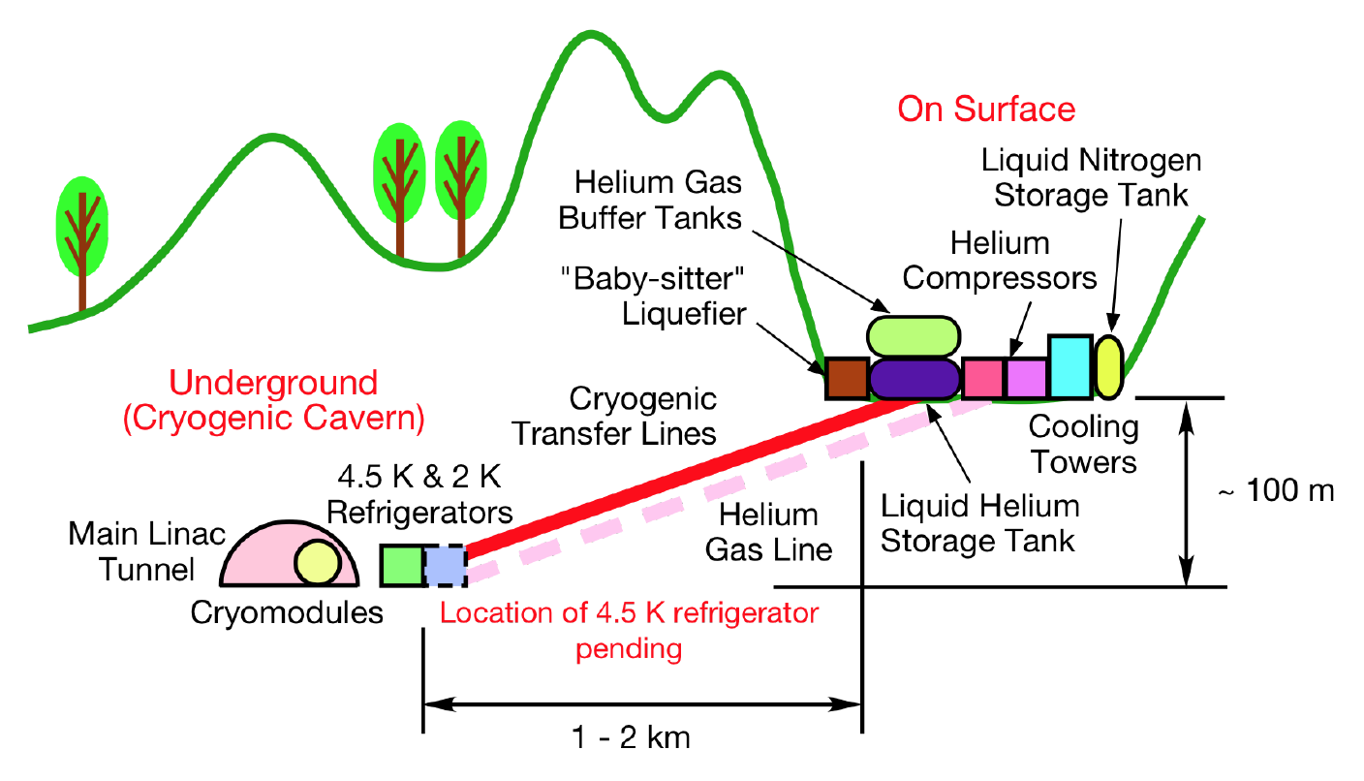
ILC Cryogenics Layout (in study)
Main & Rec. Compressors and LHe & Ghe storage --- surface
2K-4K Cold Box --- underground
Insulated
Recovery Line

Slide 8
He Flow Lines in Emergency to Recovery
-- under investigation --
LHe Storage
Small
Liquefier
GHe Storage
GHe Main Compressors
(Powered by Power-line)
GHe Recovery Compressor →
(powered by Generator,
switched in emergency)
RC
MC1
2
3 & …
Surface
Cold GHe recovery line→
(vac. insulated)
Underground
1.8 – 4.5 K, Main
Refrigerator Cold-Box (Main CB)
SRF-CM
Operation Sequence in emergency to resume steady state modes (under investigation):
GHe recovery using RC (powered by Generator for < 24 hrs, (electric capacity: < 1 MW / plant
Recovery of MC1 (and 2, 3, …) and Main CB, for LHe to be kept in CM after power-recovery
LHe to be produced in LHe storage for a period of 5 ~ 7 days, by using RC powered by power line
(Note: Balance of LHe and GHe storage capacity to be further investigated and globally discussed)

