Slide 1
And the simulations show…TBD
Some code edited from Edu Marin Lacoma
Some Code Original
Ryan Bodenstein
FONT Meeting
2016/16/9

Slide 2
What am I talking about?
First off, give a review over the Traditional Lattice tuning progress (ha!) and plans.
Then I’ll discuss a bit about LinSim itself.
  Not too detailed, but a general overview.
Finally, I’ll describe what’s happening with the ILC LinSim simulations.

Slide 3
Part I: Tuning Simulations

Slide 4
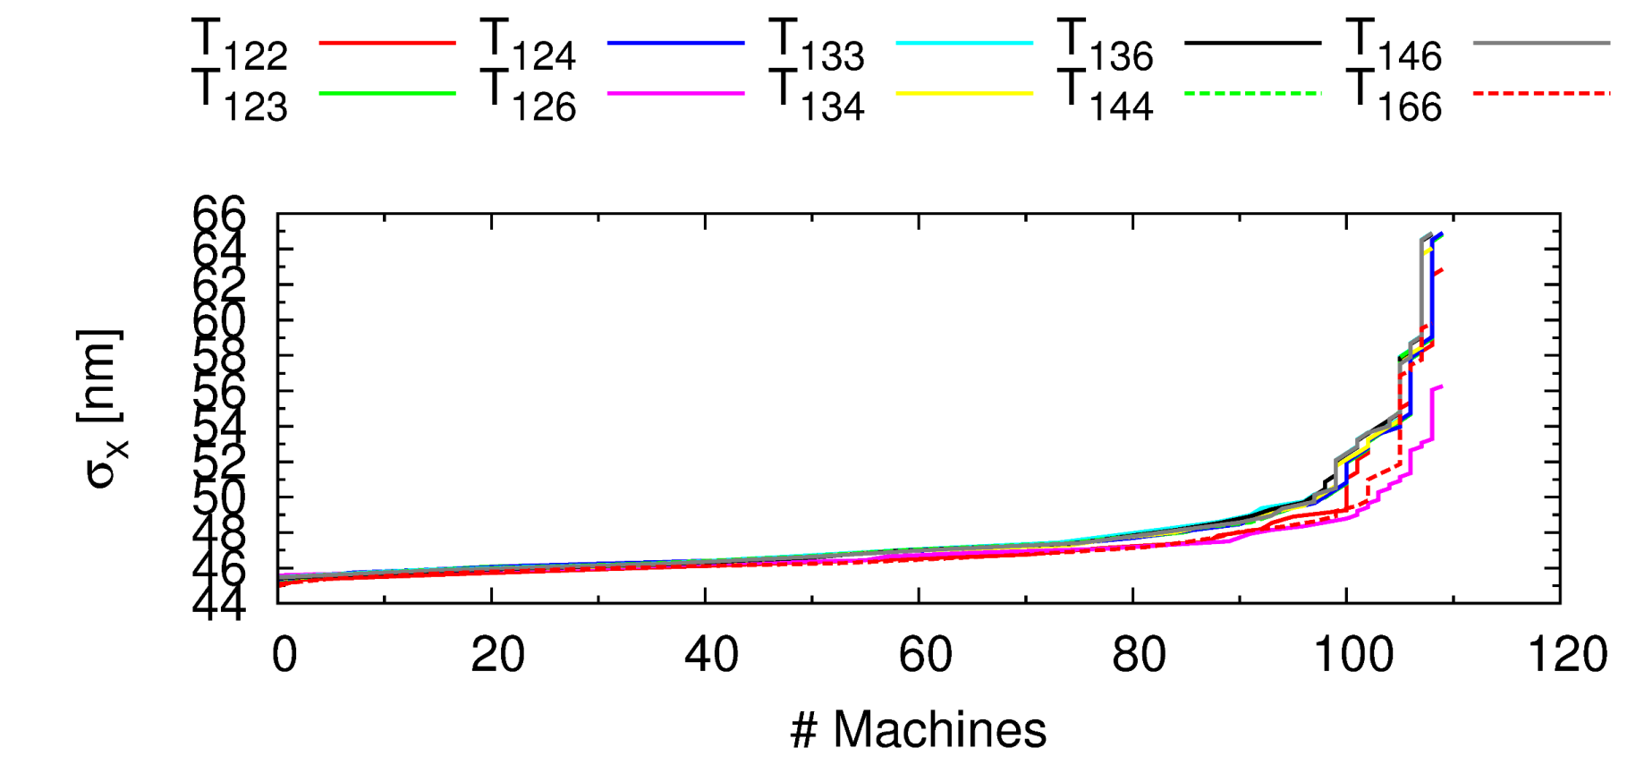
Just to reiterate, we target aberrations:

Slide 5
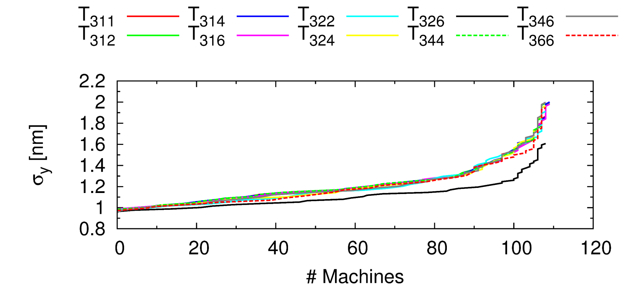
Also these:

Slide 6
Also, as a reminder:
Basically, you use a bit of mathematical wizardry on the response matrix to find various vectors that are orthogonal to each other
Three methods used, primarily
  Least Squares (LSQ)
  Matrix Inversion (INV)
  Singular Value Decomposition (SVD)
Each method ends up with different results, so all three have to be investigated and a method selected

Slide 7
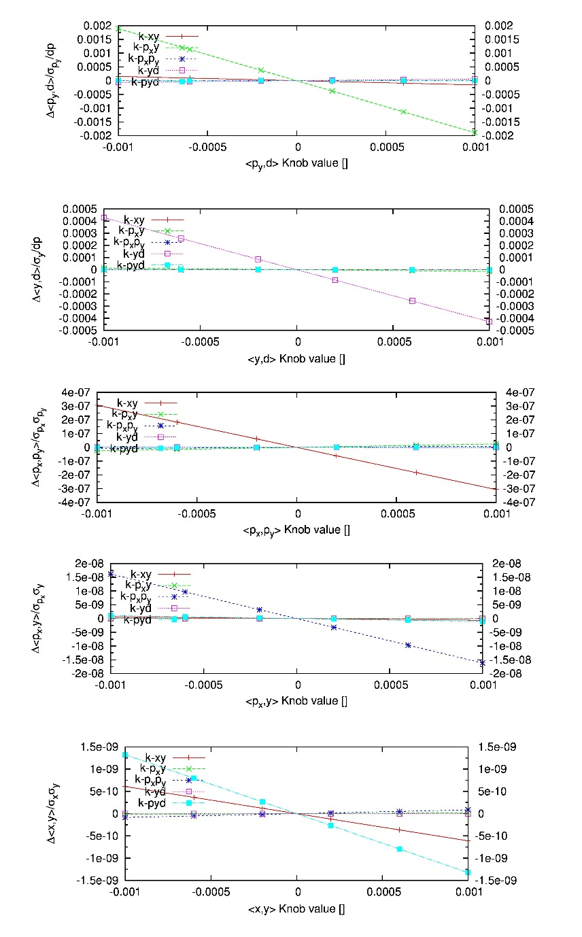
Y-Plane Linear Knobs
AKA
Edu Knobs
These are for the Y plane, did similar for X. These are the SVD-based knobs.
Singular Value 1
Singular Value 2
Singular Value 3
Singular Value 4
Singular Value 5

Slide 8
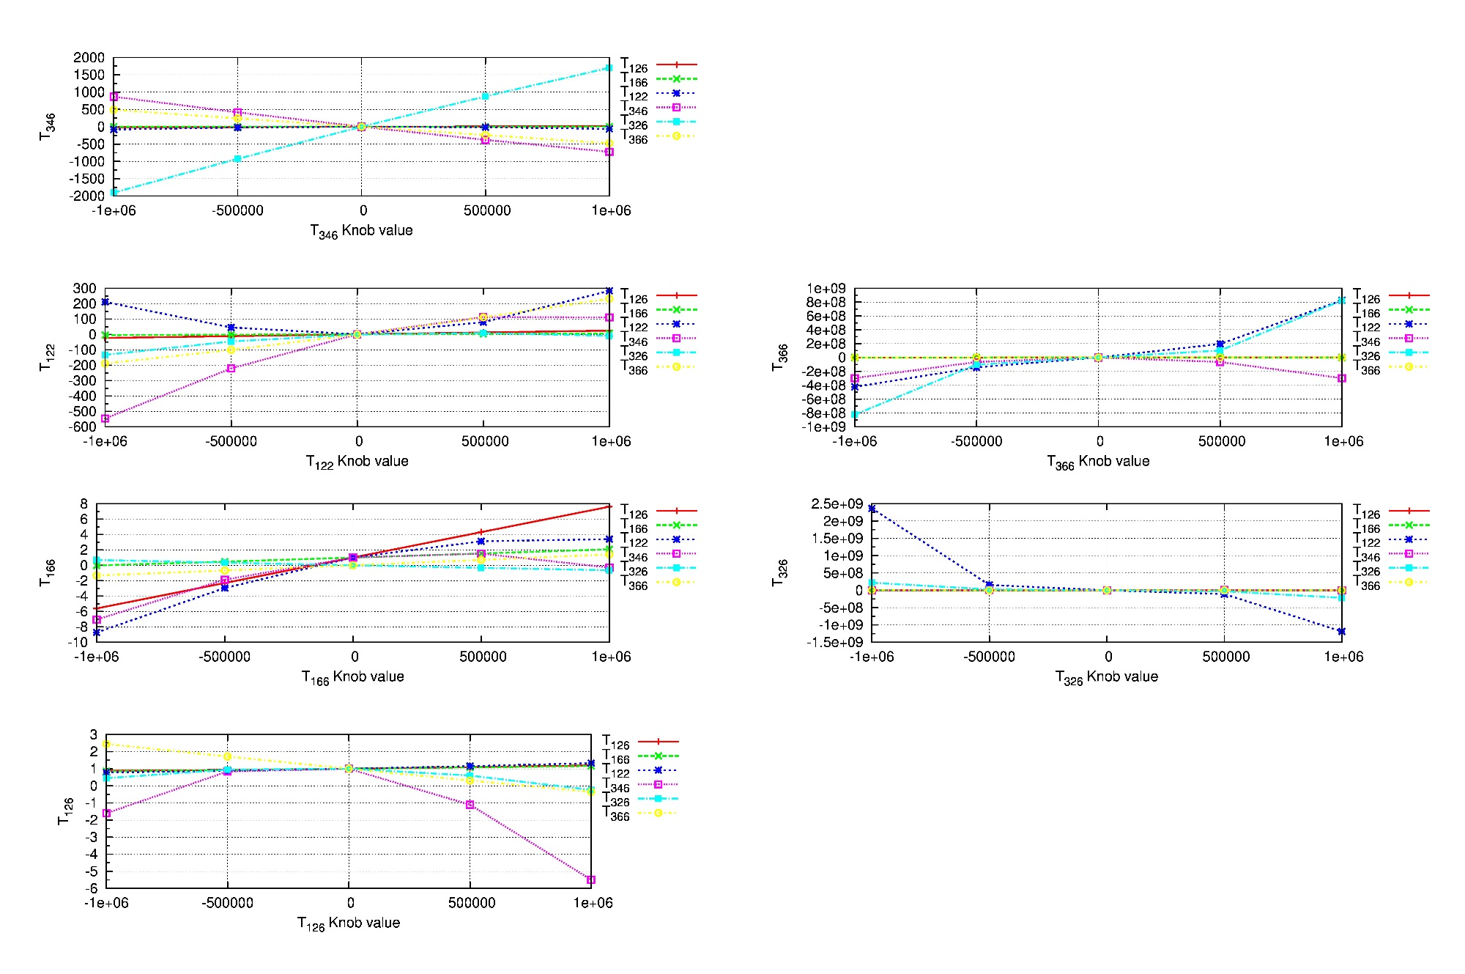
Nonlinear (2nd Order) Knobs
AKA
DKNS Knobs
Skew Sextupoles

Slide 9
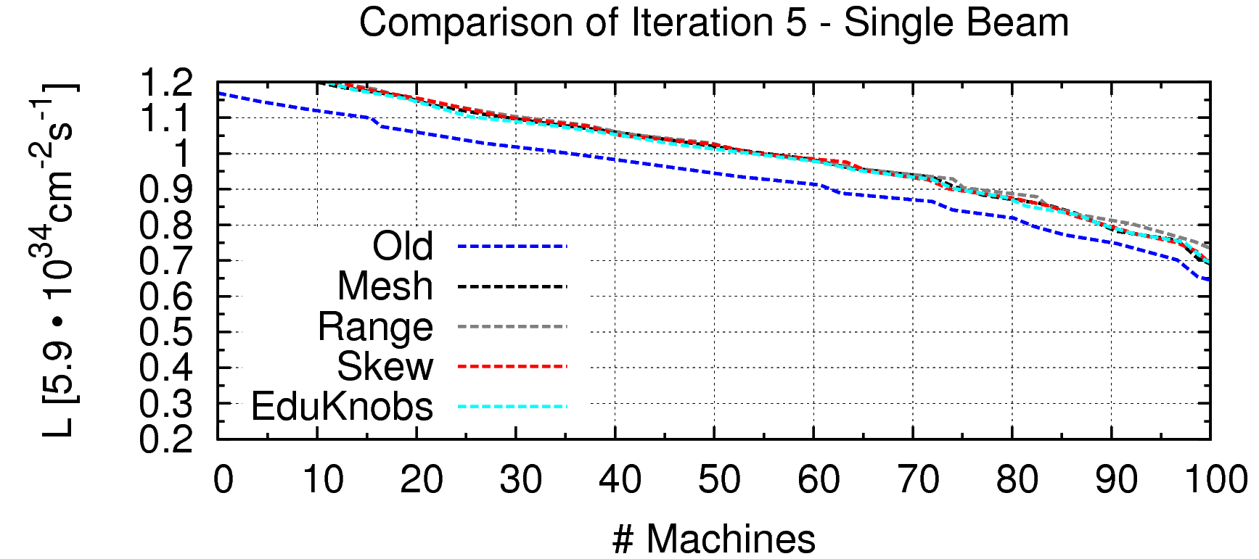
All that work, for no improvement.
Various Iteration 6s – Single Beam
I5
I5 Mesh Change
I5 Grid Change
Turns out, we found a way to get small amounts of improvement.
By tuning the linear and DKNS knobs together, we found small but present improvements.
Should note that it took 22 iterations for the Local scheme to get to 102%.

Slide 10
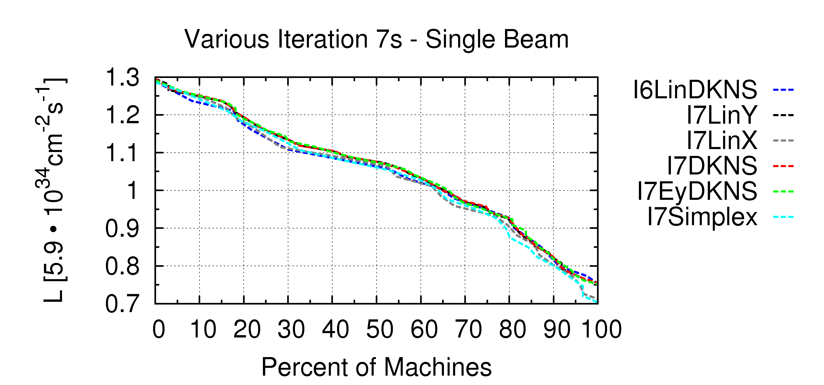
Experimenting for I7
Not only did we tune linear and nonlinear together, we changed the way the knobs work.
  Now they scan all of them simultaneously, instead of iteratively.

Slide 11
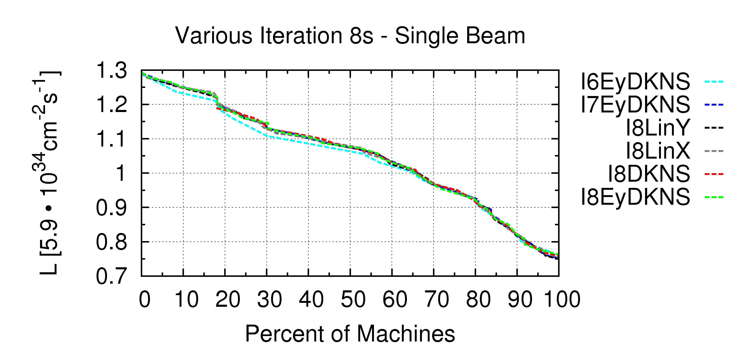
And again for I8…
The is a small improvement, but the number of machines reaching 110% has increased by over 10% in two iterations.
Next: looking into using the best results from each method.

Slide 12
Part II: Understanding LinSim…ish

Slide 13
Framework for PLACET and GUINEA-PIG
An obnoxious part of simulations is setting up the same thing repeatedly. (This part from the CLIC Note 1064)
  Setting up the model of the beamline and the beam
  Specifying and saving simulation parameters
  Implementing a simulation structure to simulate typical scenarios
  Implementing of correction techniques
  Implementing imperfections as ground motion and component imperfections
  Maintain scripts to ease parallel computing on a server farm
  Evaluating the results
  Performing backups and keeping track of changes
These parts are repeated for each simulation project.

Slide 14
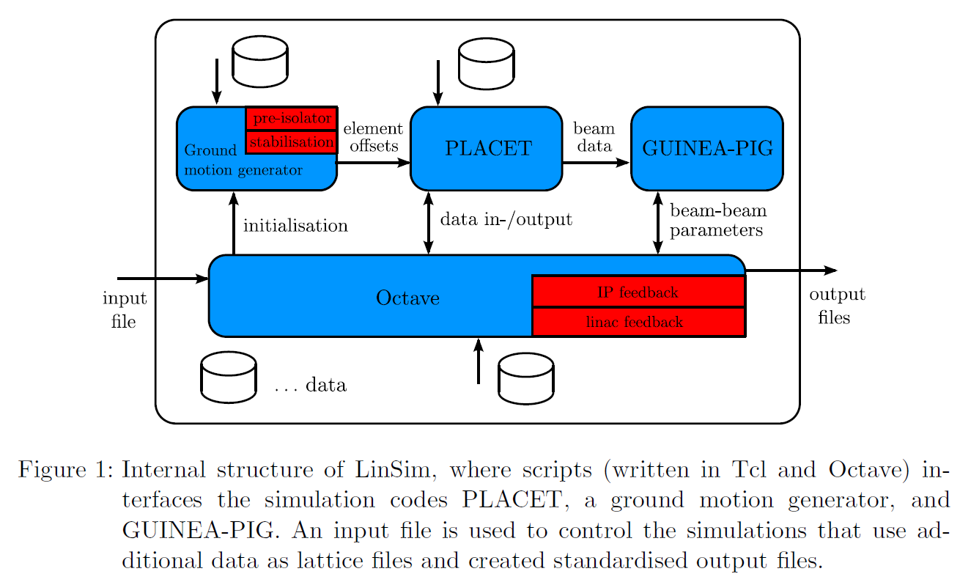
Framework for PLACET and GUINEA-PIG
(This part from the CLIC Note 1064)

Slide 15
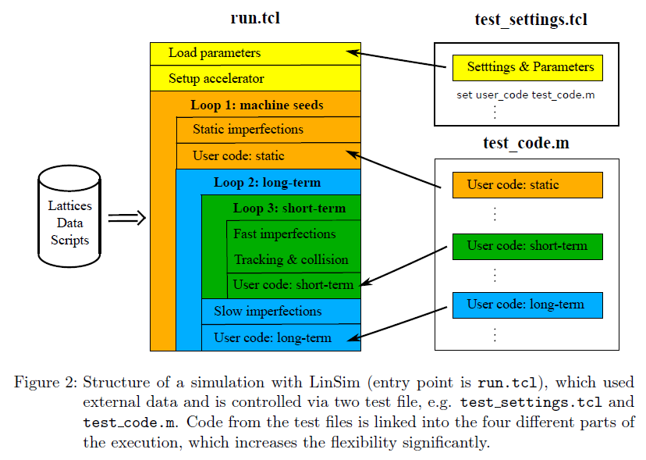
Framework for PLACET and GUINEA-PIG
Initial setup (yellow): sim mode = setup mode
Seed loop (orange): sim mode = static mode
Long-term loop (blue): sim mode = long term mode
Short-term loop (green): sim mode = short term mode
(This part from the CLIC Note 1064)

Slide 16
Part III: Where is it going wrong?

Slide 17
In short, here:
error: /afs/cern.ch/work/r/rbodenst/LINSIM/LinSim/scripts/ILC/create_element_indices.m: subscript indices must be either positive integers or logicals
error: called from:
error: /afs/cern.ch/work/r/rbodenst/LINSIM/LinSim/scripts/ILC/create_element_indices.m at line 27, column 9
error: /afs/cern.ch/work/r/rbodenst/LINSIM/LinSim/scripts/create_bpm_corr.m at line 20, column 1
error: /afs/cern.ch/work/r/rbodenst/LINSIM/LinSim/scripts/global_init.m at line 107, column 1
error: /tmp/rbodenst/placet-octave.tLvTOY at line 9, column -1
constant
while executing
"error constant "
(write trace on "emitt_axis")
invoked from within
"Octave {
%%%%%%%%%%%%%%%%%%%%%%%%%%
%% Global initialization %
%%%%%%%%%%%%%%%%%%%%%%%%%%
%%% load and calculate response matrices
%%% calculate no..."
(file "run.tcl" line 14)
INFO Thank you for using PLACET! Goodbye!

Slide 18
What am I doing to fix it?
Going through the “inner workings” of LinSim to find missing files, or create them if necessary.
Working with Jürgen Pfingstner when I get stuck…and I do.
Jürgen is extremely busy at CERN, so response time is slower than it was with Jochem.
Currently comparing lattice files from CLIC and ILC in order to try to correct the problem.
  Issue: the two IPFB systems appear to be set up differently.
    CLIC has one IPFB corrector for both planes
    ILC apparently has one for each plane.
Otherwise, I already have a working set of scripts!

