Slide 1
SC RF R&D Plans at DESY
Wolf –Dietrich Möller
International Workshop on Future Linear Colliders
4-9 December 2016
Aiina Center & MALIOS in Morioka

Slide 2
Outline
Introduction
Infrastructure
Project driven R&D
  Repair and restoring for XFEL modules
  FLASH CW and XFEL CW
Fundamental R&D
  N₂ infusion
Outlook

Slide 3
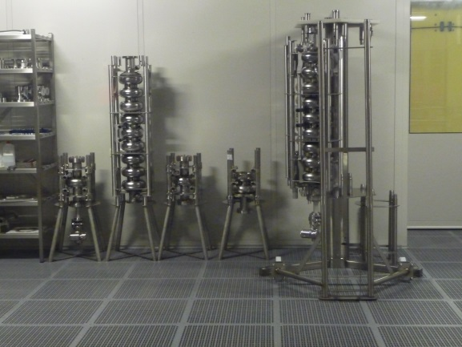
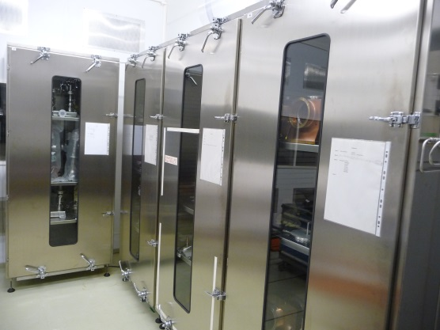
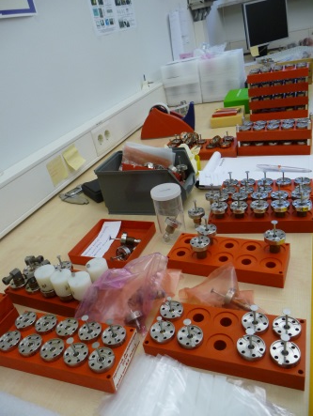
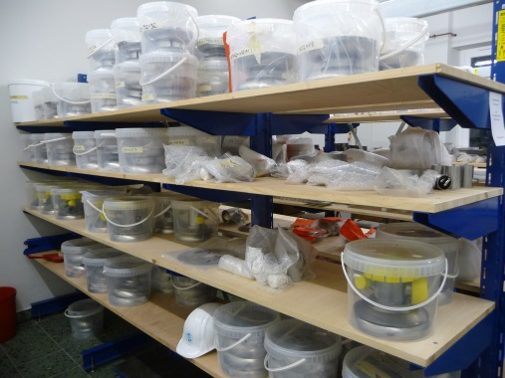
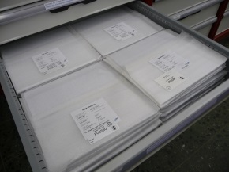
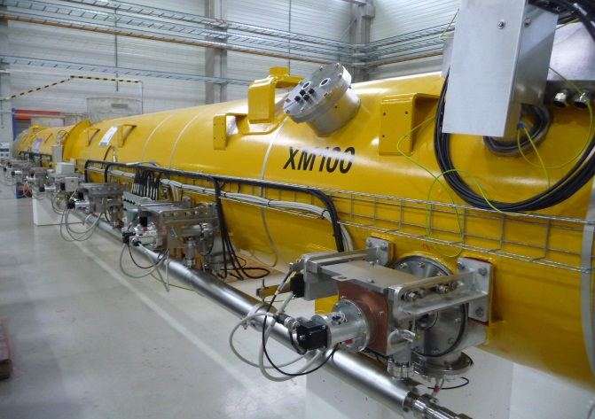
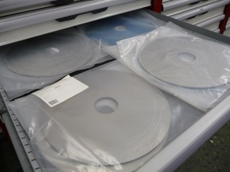
Introduction
XFEL installation is finished
Commissioning of XFEL is started, cool down of linac right now
Test infrastructure for series production (AMTF) is available
A number of cavities, couplers, modules and other components are available at DESY
R&D activities have been re-started this summer

Slide 4
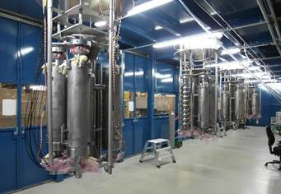
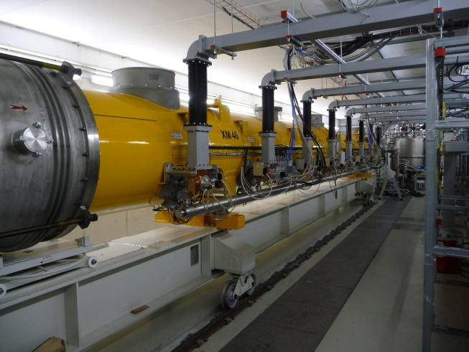
Infrastructure
Our former R&D test infrastructure from TESLA / TTF times is old and cannot be operated anymore
TESLA / TTF preparation infrastructure is maintained and ready for use: clean room, HPR, EP, BCP, CO2, etc.
Large test infrastructure AMTF was installed for the XFEL series production
The AMTF was designed for fast and efficient series measurements
  R&D instrumentation to be installed
  Measurement
  software to be modified

Slide 5
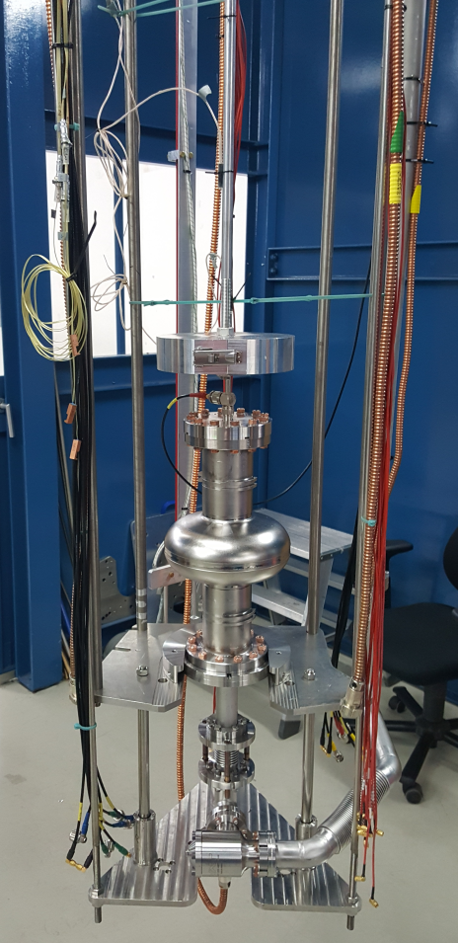
Infrastructure, new
We are now in the process to change over the AMTF test stands to meet the R&D requirements:
Vertical test stands:
  adaptive for different cavity types (single cell, 9-cell, gun)
  variable antenna,
  different frequencies
  T-map, field emission-map
  second sound,
  magnetometers,
  in situ RRR measurement,

Slide 6
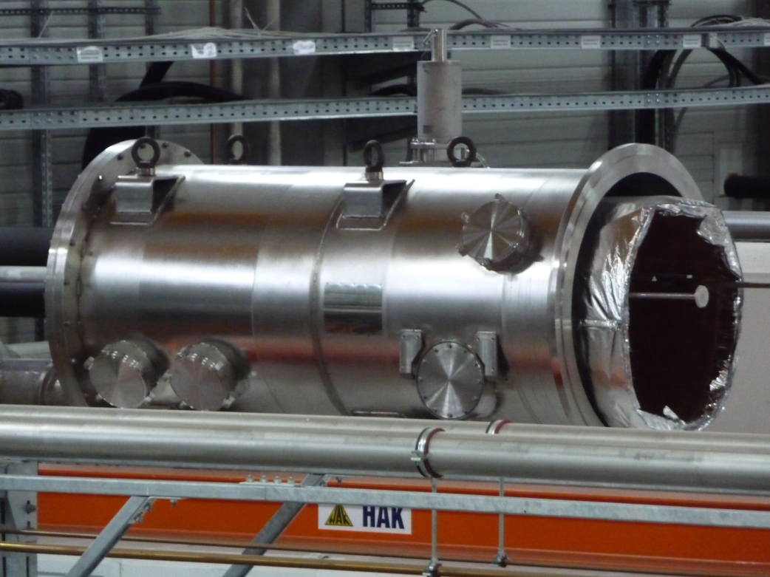
Infrastructure, new
Modification of module test stands:
  single cavity measurements (1.3GHz and 3.9GHz),
  3.9GHz modules
  SRF gun,
  New coupler test and conditioning stand
Remark: no change in the 1.3 GHz standard module testing capabilities (XFEL, FLASH)
CMTB module test stand is modified for pulse and CW measurements (IOT)
Cryostat adapter to be used for horizontal single cavity tests at AMTF

Slide 7
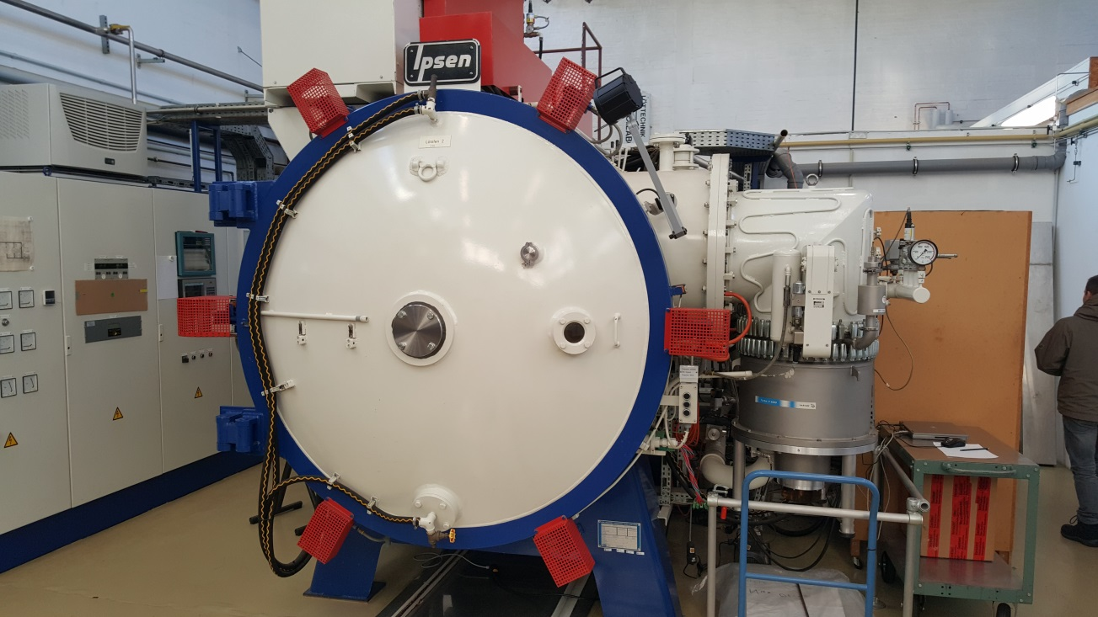
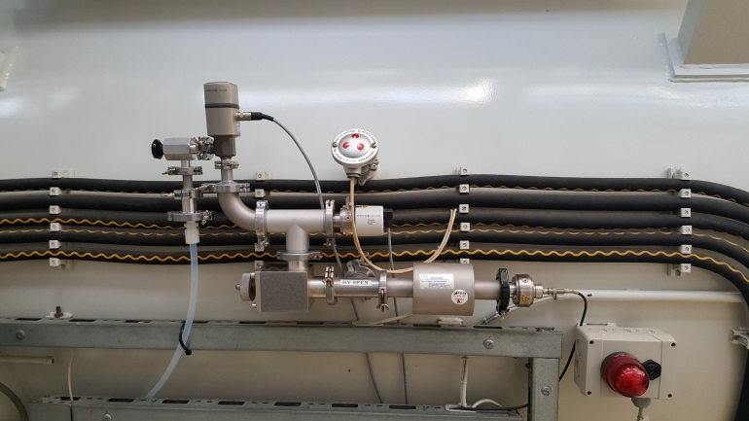
Infrastructure, new
Existing 800 ºC oven is now prepared for N₂ infusion
N2 doping is also possible although not favorable; DESY projects require high gradients

Slide 8
Repair and restoring for XFEL
Defect XFEL modules:
  XM8: leak at 2K circuit
  XM46 and 50: not acceptable cavity performance
  XM99: leak in beam vacuum
  XM100: in XFEL replaced by XM-2, now used as spare module
Modules have to be repaired and re-tested; some require complete disassembly
Re-test RF power coupler showing poor performance
  Some RF PC warm parts showed high dynamic thermal losses
  Parts are re-cleaned and baked and need to be retested
  Investigation of cause
Assembly and test of spare third-harmonic module for XFEL

Slide 9
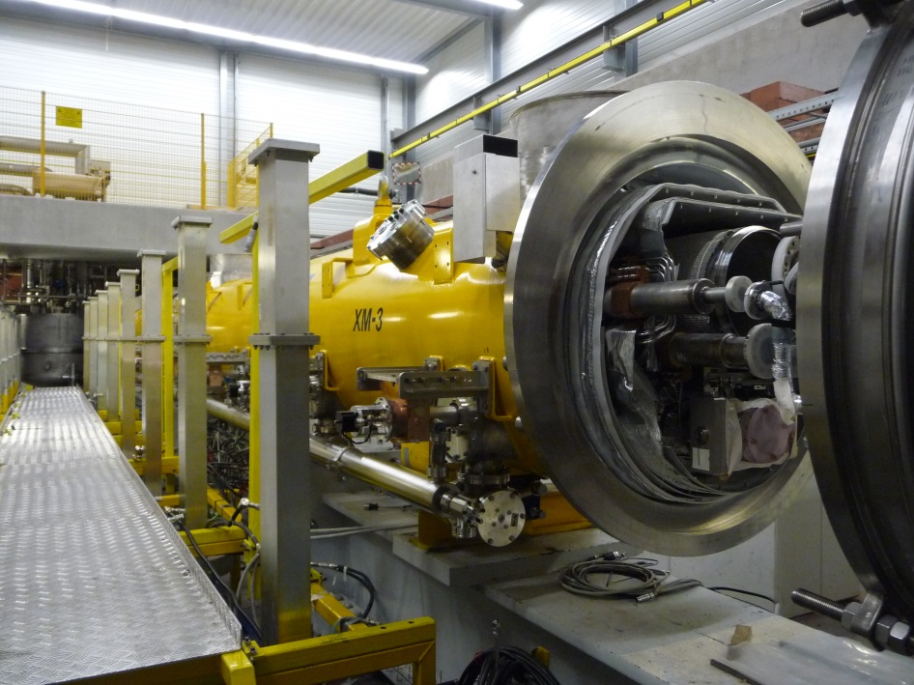
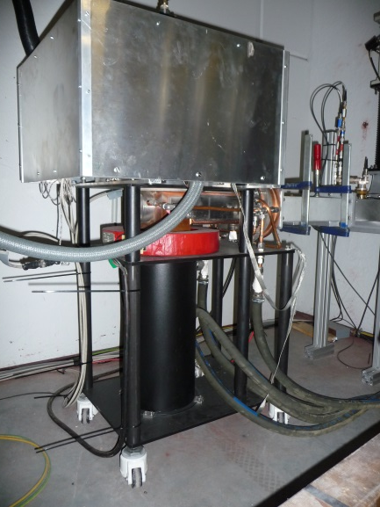
FLASH CW and XFEL CW, module tests
Module tests at CW have been performed (on CMBT):
Large grain prototype cryomodule (XM-3)
  Qo at 2K and 1.8K after the fast cool down (FCD) and slow cool down(SCD)
Fine grain production cryomodule (XM4)
  Qo at 2K, 1.8K and 1.56K after the FCD and SCD
  Mechanical vibrations and VS stability
To be continued: XM-3 large grain at CMTB with IOT
IOT:
Pmax = 105kW, CW

Slide 10
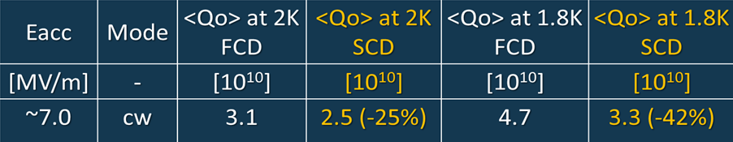
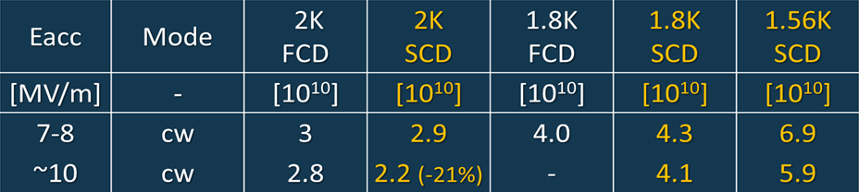
FLASH CW and XFEL CW, module tests
<Qo> summary for fast and slow cool down
On both modules and for different temperatures the slow cool down leads to lower Qo values
<Qo> summary for XM-3
<Qo> summary for XM4
FCD = fast cool down, SCD = slow cool down
Jacek Sekutowicz

Slide 11
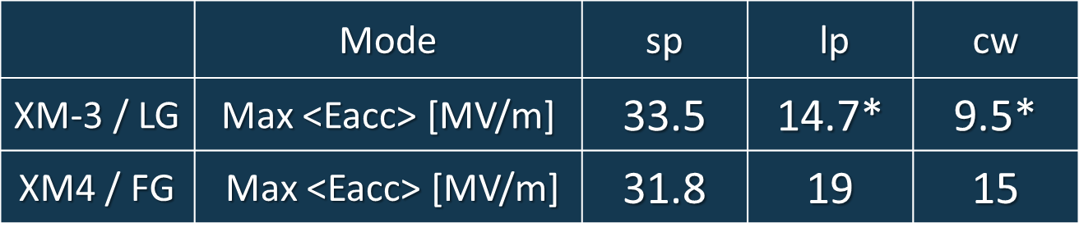
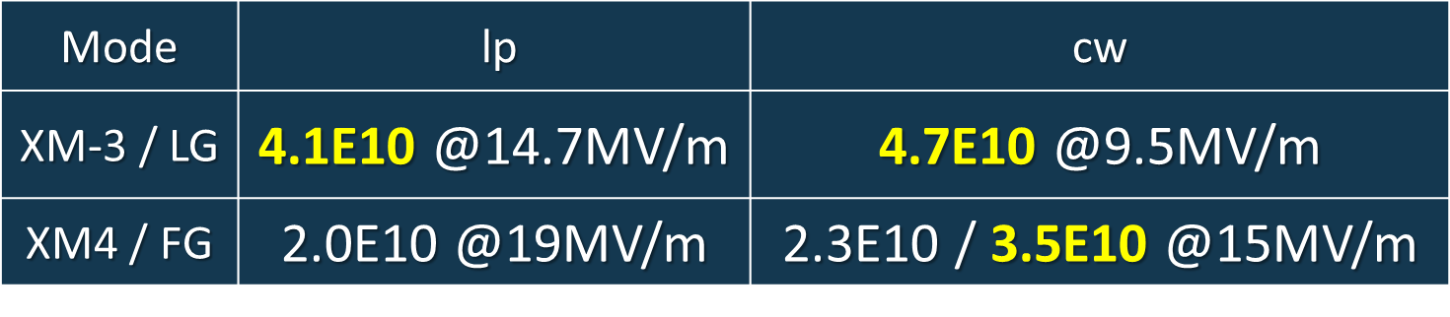
FLASH CW and XFEL CW, module tests
Summary of LG and FG cavities tests in all 3 operation modes
Demonstrated average Gradients
Jacek Sekutowicz
short pulse
long pulse
*limit was set at that time for dissipated heat load to 16W.
Demonstrated Qo in long pulse /cw operation at 2K and 1.8K
long pulse
LG = large grain, FG = fine grain

Slide 12
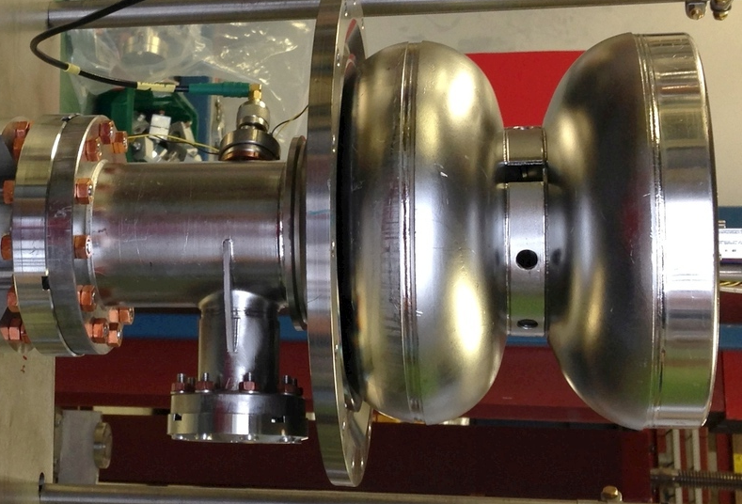
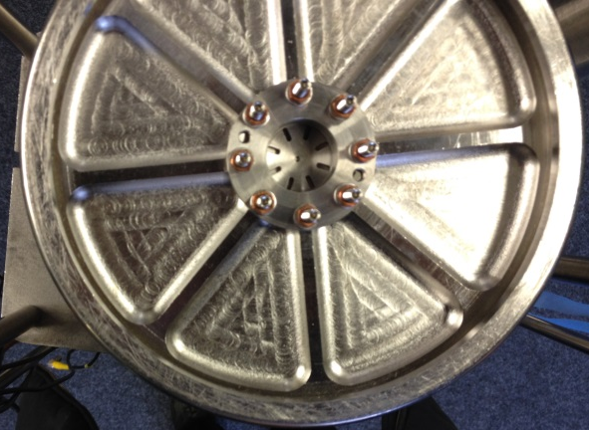
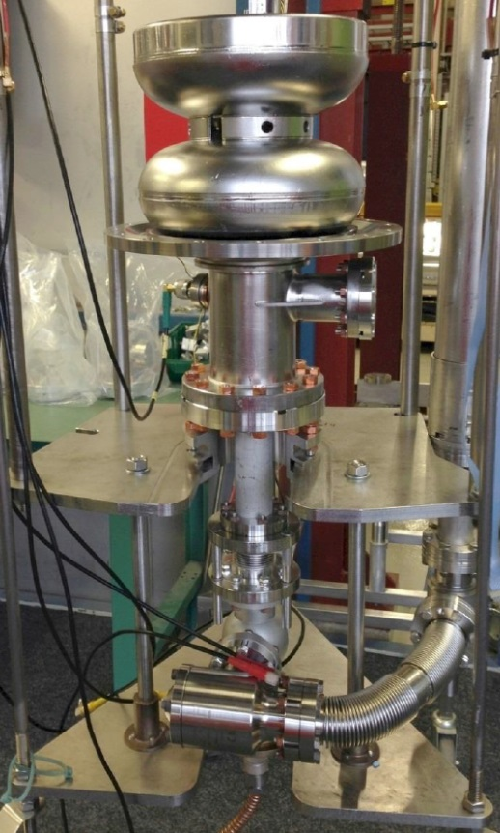
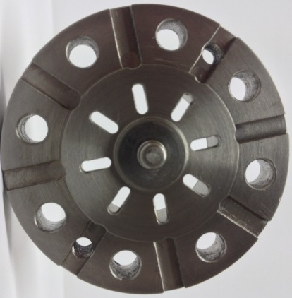
FLASH CW and XFEL CW, SRF Gun
The 1.5-cell gun cavity prototype was built at TJNAF. The present plug version has very effective cooling of the cathode.
Plug with LHe channels
1.5-cell , 1.3 GHz gun cavity
Next steps:
Build two new guns with improved plug design
Cathode: improve Pb-coating, Morphology and content of other elements
RF tests
Beam tests
Cathode Laser cleaning
Nb/Pb
cathode
Jacek Sekutowicz

Slide 13
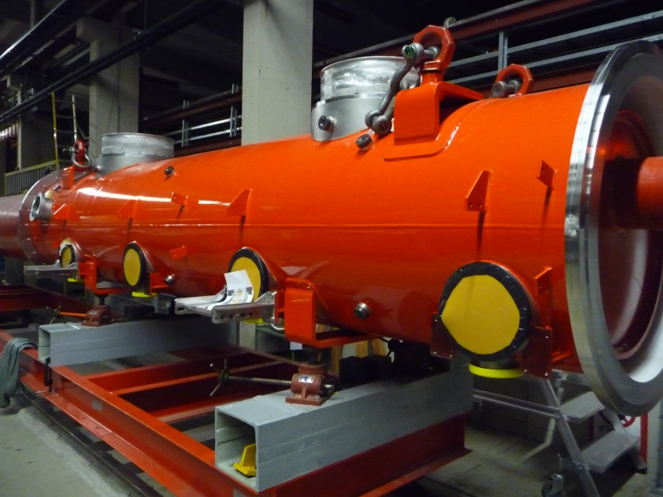
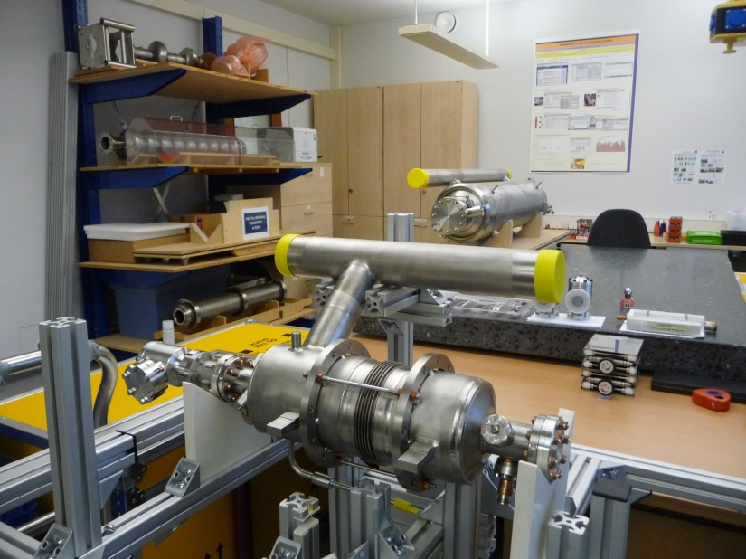
Project driven R&D, FLASH CW and XFEL CW
Other developments for CW operation
  Develop and build a third harmonic module for CW operation
  1.3 GHz 9-cell end-groups improvement for CW
  RF power coupler, P_{CW} > 5kW
  Modify module cryogenic design

Slide 14
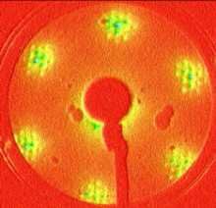
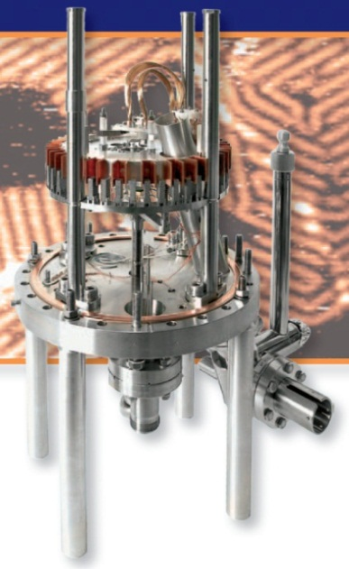
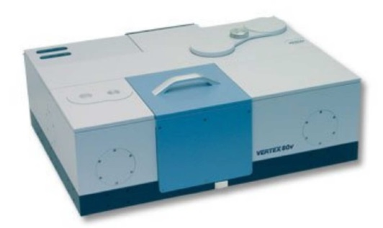
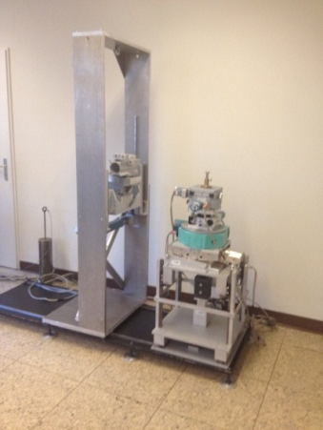
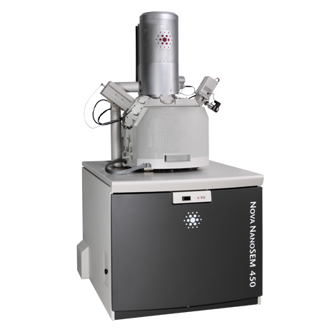
Fundamental R&D, Overview DESY NanoLab Techniques
Tools available to investigate N₂ infusion
Spectroscopy & Growth (H. Noei)
X-ray diffraction (V. Vonk)
Microscopy & Structuring (T. Keller)
Magnetic Characterization (R. Röhlsberger)
Andreas Stierle

Slide 15
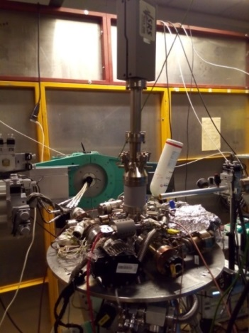
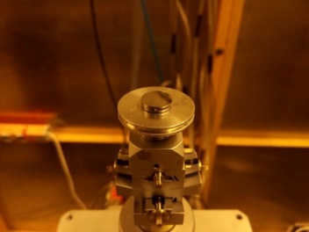
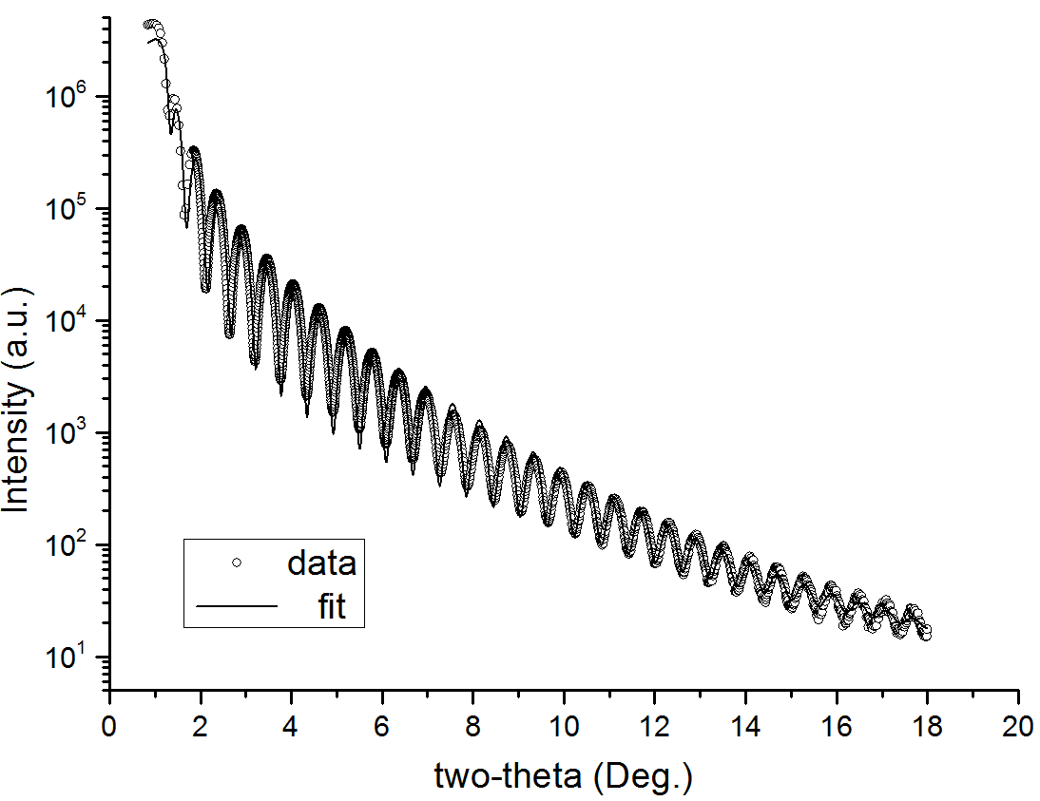
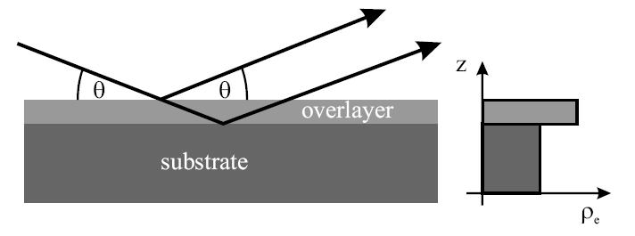
Fundamental R&D at DESY NanoLab
‘Nitrogen infusion’ experiment on a model sample
Nb (100) Single-Crystal
UHV Mobile Chamber
Cu Kα source
800°C annealing/2 hours
Cooldown to 120°C, insert 25mTorr of N₂
Hold for 23 hours
In-situ x-ray reflectivity (XRR) measurements
Ir film/ sapphire
Surface sensitive technique
Arti Dangwal Pandey,
Guilherme Semione

Slide 16
Fundamental R&D at DESY NanoLab
‘Nitrogen infusion’ experiment on Nb(100):
preliminary results, analysis will be published
Nb₂O₅
Room temperature
NbO₂
Natural oxide layers
Intensity (ct)
NbO
Nb
q_{z} (A⁻¹)
NbO
During/After 800°C anneal
Intensity (ct)
Intensity (ct)
Nb
q_{z} (A⁻¹)
q_{z} (A⁻¹)
Different nitride and oxide phases formed
During infusion
at 120°C
25mTorr N₂
Intensity (ct)
Nb
q_{z} (A⁻¹)
q_{z} (A⁻¹)
Arti Dangwal Pandey,
Guilherme Semione

Slide 17
Outlook
Preliminary SRF R&D goals at DESY:
Further development and tests on CW modules
Reproduce the N2 infusion and doping results (during 2017)
  On 1cell cavities, fine grain and large grain
  On 9 cell cavities
Work on fundamental understanding of N2 doping and infusion in collaboration with experts from the DESY Nanolab
Assemble and test a module with high Q / high gradient cavities (ca. 2018)

Slide 18
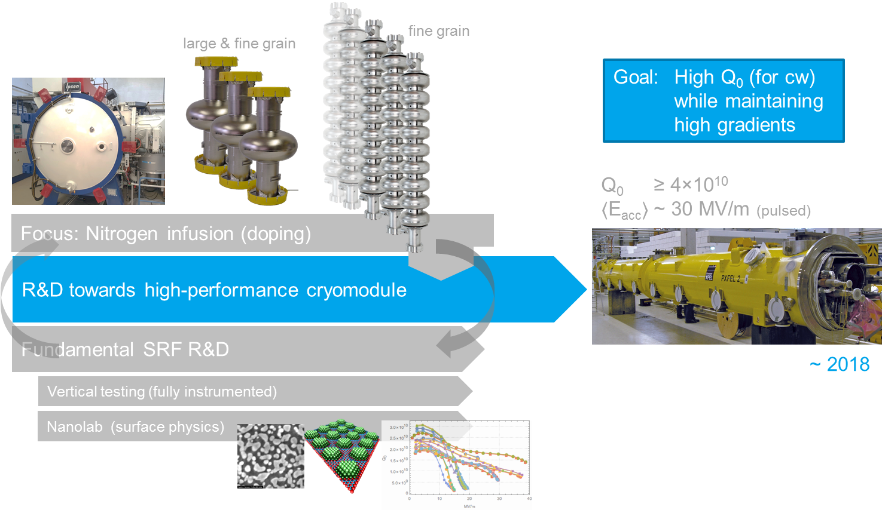
Overview, SC RF Cavity R&D at DESY
N. Walker

Slide 19
End
Thank You for Your attention

