Slide 1
Report of a Mini-Workshop on
Worldwide SRF R&D Plans
Akira Yamamoto
Dec. 6, 2016

Slide 2
Objectives of the Workshop
L. Evans
Superconducting Radio Frequency is an enabling technology for many future applications including linear and circular colliders, free electron lasers and radioactive isotope facilities.
Recently an initiative has been launched in the USA and Japan with the aim of reducing the cost of SCRF.
In view of the worldwide interest and the limited resources available for R&D on SCRF and its associated technologies, it is important to have a clear view of the priorities in each of the laboratories participating in SCRF R&D on a timescale of the next 2-3 years.
The Workshop will take place on Tuesday 6th December, during LCWS-2016. The subjects to be discuss include SCRF cavity design, processing and production, tuner and coupler design and progress in the design of high-efficiency klystrons and Marx modulators.

Slide 3
Agenda
SRF Mini-Workshop, 6 Dec. 2016
Introduction L. Evans
Plans at:
Fermilab N. Solyak
JLab B. Rimmer
DESY W-D. Moeller
INFN-LASA C. Pagani
CEA-CNRS O. Napoly
KEK S. Michizono
IHEP J. Zhai
CERN E. Jensen
TRIUMF B. Laxdal
(Cornell) (F. Furuta)
Plans for Associated Systems:
Input-coupler R&D Y. Yamamoto
Tuner R&D M. Yamanaka
(Y. Psichalnikov)
Crab-cavity R&D Y. Yamamoto
Marx-Modulator R&D M. Akemoto
Klystron R&D (I. Syratchev/
E. Jensen)
Discussions: All

Slide 4
R&D Plans at worldwide Labs
 | On-going | R&D: ML Cavity | Assoc. System | Cryomodule | RF
Fermilab | LCLS-II | N₂-infusion (HQ-HG) | Coupler
JLab | LCLS-II | Nb-LG/FG (Ingot-sliced/rolled) , N₂-infusion
DESY | EXFEL | N₂-infusion Nano-Lab study |  | High-performance CM
INFN-LASA | ESS | Nb-LG/FG systematic study for ESS
CEA/ CNRS-LAL | IFMIF ESS, SARAF | Vertical EP (VEP), N₂-Infusion | Magnetic shield Coupler | Assembly robotizing
KEK | STF | Nb-LG/FG N₂-infusion | Coupler, Tuner Crab. C. |  | Marx M.
IHEP | ADS | N₂-infusion, In dustrialization |  | Industrialization | Marx M. h.e. Klystron
CERN | HL-LHC Hi-Isolde | Thin-film (Nb on Cu) | Coupler |  | h.e. Klystron
TRIUMF | ISAS-II, ARIEL | VEP, muSR
(Cornell) |  | N₂-infusion, VEP

Slide 5
Discussions and Consensus for R&Ds in coming few years
Nb material: → reduction to total value cost: 1~ 2 %
  Disk sliced directly from ingot, to be compared w/ rolled Nb-sheet
Cavity fabrication/surface-process : → 6 ~ 10 %
  Vertical EP
  N2-infusion with sufficient statistics in three regions (target #: ~ 3 x 10)
Cryomodule
  Automating and robotizing for assembly
Associated systems
  Coupler: w/ new ceramic having low SE emission → ~ 1 %
  Tuner: lever-arm tuner, as a cost-effective option → keep TDR value cost
  High efficiency klystron → to be effective to operational cost
  Marx modulator

Slide 6
Some important comments given by C. Pagani
It is important to refer the EXFEL experiences
  Some discussion:
    the coupler w/ single window would result in the cost saving, but it will cause whole system engineering inevitably required, and it is not the time to seek for.
It is the time for industrialization effort and for seeking the cost-effective production, based on the EXFEL production experience

Slide 7
Appendix
Digested summary (by AY) of each presentation

Slide 8
R&D on ILC cost reduction
N.Solyak, A.Grassellino, S.Belomestnykh (from FNAL team)
Dec. 2016
LCWS’16, Morioka, Japan.

Slide 9
Recent progress in high gradient/ high Q at FNAL:
“standard” vs “N infused” cavity surface treatment
FNAL recently demonstrated (on single-cell cavities) a new treatment, which utilizes “nitrogen infusion”-120C bake.
Achieved so far:
    45.6 MV/m → 194 mT (10-30%)
    with Q ~ 2∙10¹⁰ ! (x2)
Systematic effect observed on several cavities.
R&D to focus on :
  Optimize the recipe;
  Implement and demonstrate improvement with statistics on nine cells cavities;
  Demonstrate preservation of performance in cryomodule;
  Transfer technology to industry.
Increase in Q by x2
Increase in gradient ~15%
Comparison of the same cavity performance after the standard ILC treatment (red circles) and the new nitrogen infusion treatment (black squares).

Slide 10
ILC cost reduction – proposed SRF R&D at FNAL
Working groups at FNAL and KEK identified several important R&D pathways for the ILC cost reduction, and grouped them under short (3 years), medium (5 years) and long (10 years) term efforts.
The table below presents the proposed R&D timeline for cost reduction on which FNAL will focus, while KEK will focus on cost reduction of cavity material, fabrication and chemical processing as well as on synergetic with FNAL efforts on improving cavity high Q / high gradient and input couplers.

Slide 11

Jlab status and plans
Bob Rimmer
for
JLab SRF R&D Department

Slide 12
What would Jlab like to do?
Promote optimized ingot Nb technology
  Apply for CEBAF cryomodule rework etc.
Understand low surface field (LSF) cavity optimization
  Surface fields, HOMs, material and processing
  Build ~8 optimized LSF, ingot Nb cavities for statistics
Understand and optimize doping effect
  Continue collaboration with FNAL, Cornell, etc.
Continue work on FE diagnostics and understanding
Develop HF-Free bipolar VEP technology
Develop alternative cavity fabrication technology
  Partner with US industry (SBIR?).
Continue long range R&D on new materials

Slide 13
SC RF R&D Plans at DESY
Wolf –Dietrich Möller
International Workshop on Future Linear Colliders
4-9 December 2016
Aiina Center & MALIOS in Morioka

Slide 14
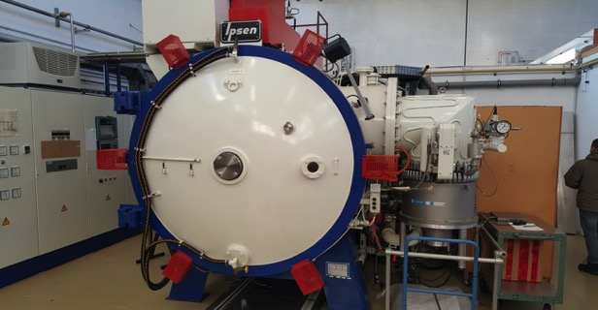
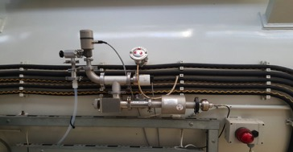
Infrastructure, new
Existing 800 ºC oven is now prepared for N₂ infusion
N2 doping is also possible although not favorable; DESY projects require high gradients

Slide 15
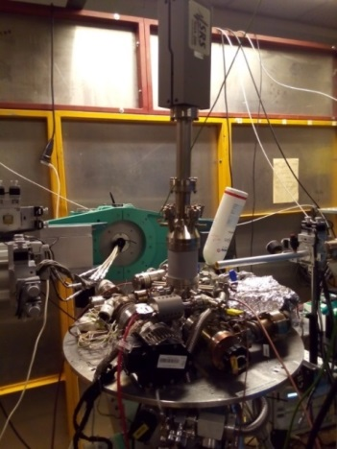
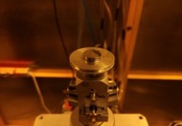
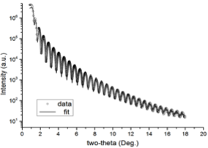

Fundamental R&D at DESY NanoLab
‘Nitrogen infusion’ experiment on a model sample
Nb (100) Single-Crystal
UHV Mobile Chamber
Cu Kα source
800°C annealing/2 hours
Cooldown to 120°C, insert 25mTorr of N₂
Hold for 23 hours
In-situ x-ray reflectivity (XRR) measurements
Ir film/ sapphire
Surface sensitive technique
Arti Dangwal Pandey,
Guilherme Semione

Slide 16
Fundamental R&D at DESY NanoLab
‘Nitrogen infusion’ experiment on Nb(100):
preliminary results, analysis will be published
Nb₂O₅
Room temperature
NbO₂
Natural oxide layers
Intensity (ct)
NbO
Nb
q_{z} (A⁻¹)
NbO
During/After 800°C anneal
Intensity (ct)
Intensity (ct)
Nb
q_{z} (A⁻¹)
q_{z} (A⁻¹)
Different nitride and oxide phases formed
During infusion
at 120°C
25mTorr N₂
Intensity (ct)
Nb
q_{z} (A⁻¹)
q_{z} (A⁻¹)
Arti Dangwal Pandey,
Guilherme Semione

Slide 17
Outlook
Preliminary SRF R&D goals at DESY:
Further development and tests on CW modules
Reproduce the N2 infusion and doping results (during 2017)
  On 1cell cavities, fine grain and large grain
  On 9 cell cavities
Work on fundamental understanding of N2 doping and infusion in collaboration with experts from the DESY Nanolab
Assemble and test a module with high Q / high gradient cavities (ca. 2018)

Slide 18
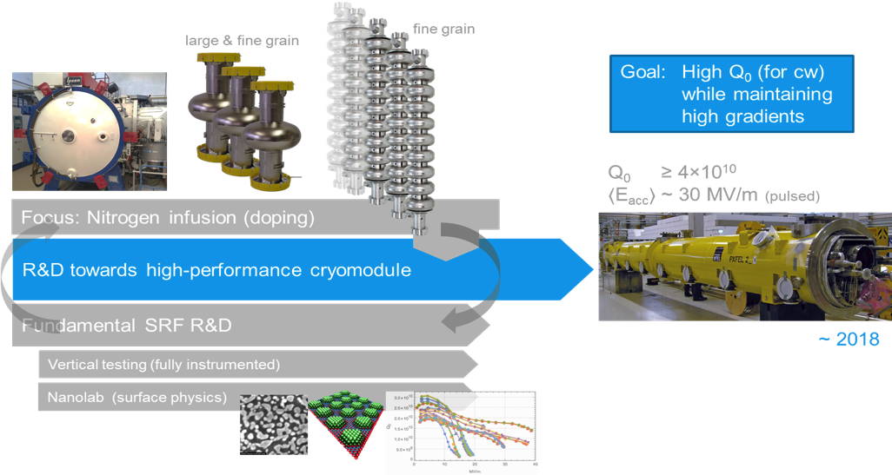
Overview, SC RF Cavity R&D at DESY
N. Walker

Slide 20
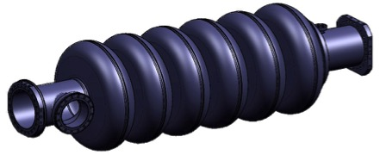
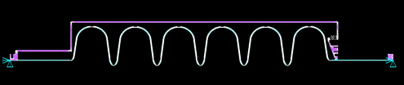
INFN LASA In-kind to the ESS
36 medium beta cavities
  Cavity fabrication of 36 medium beta cavities in the industry, including treatments, tuning, Helium tank integration. Full treatment at the vendor.
  Certification activities, documentation, ancillaries
  Cold test in a qualified infrastructure (DESY).
  Transportation in special boxes and delivery at CEA cryomodule assembling facility.
Prototypes to verify design and specs
  Built prototypes of both medium and high beta cavities.
  INFN design, using Large and Fine Grain Nb, plug compatible with ESS cryomodule.
  Full treatment in industry.
  Completion and vertical test at LASA.
MB cavity technical requirements
Frequency (MHz) | 704.42
Number of cells | 6
Geometric beta | 0.67
Nominal Acc. Gradient (MV/m) | 16.7
E_{peak} (MV/m) | < 45
RF peak power (kW) | 1100
Q external | 5.9-8 10⁵
Q₀ at nominal gradient | > 5 10⁹

Slide 21
High RRR Ingot from CBMM
Thinking to large elliptical cavities CBMM produced a high RRR niobium ingot with a new crucible: diameter = 530 mm.
Based on our request Ingot was machined to a diameter of 480 mm, for the production of ESS cavity prototypes.
In parallel INFN evaluated the different techniques for Ingot slicing: sawing, lathe cutting, EDM, multiple wire sawing.
Heraeus at Hanau was chosen for the slicing process: multiple wire sawing machine able to cut the 480 mm ingot.
CBMM delivered to INFN two 130 mm length cylinders from the original ingot to be converted in disk. This choice was driven by the high density of Nb with respect to silicon and quartz glass that are usually cut with the multiple wire sawing machine at Heraeus.

Slide 22
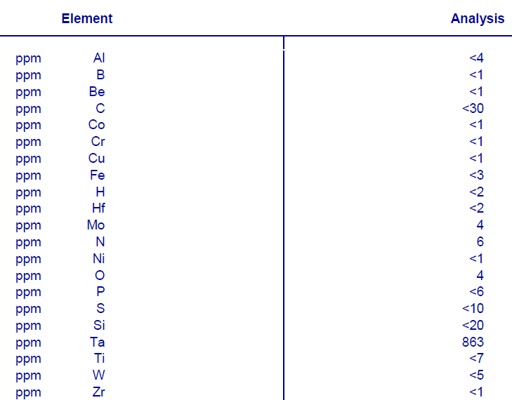
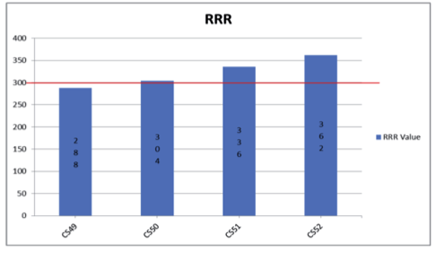

CBMM Ingots specs
Courtesy Rogerio Marques Ribas, CBMM

Slide 23
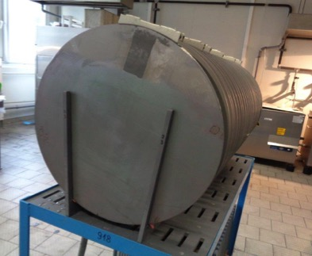
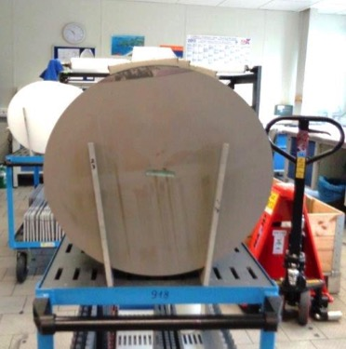
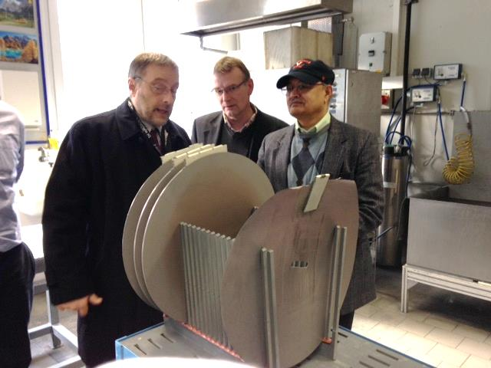
Some Photos of the sliced ingots
Witness of the
fastening system
Sample for
Interstitials
measurements
Photos: courtesy Ursula Weitzel-Hoefler, Heraeus

Slide 24
A few Comments to conclude
The realization and, in the near future, the operation experience of the European XFEL are setting a new reference for the ILC paramenters
Any R&D effort to modify those parts that will prove to be reliable and of a reasonable price should be avoided
The total RF system efficiency, from plug to beam, is the major cost driver and it should be strongly addressed
The Main Coupler is still the weakest component of the cold linac and its simplification and improvement should have the highest priority
R&D for High Qo is crucial for CW but cannot be driven by the ILC for which pros and cons seem to be balanced.

Slide 25
SCRF Cost Reduction R&D at CEA and IN2P3
Olivier Napoly (CEA)
Walid Kaabi (IN2P3)

Slide 26
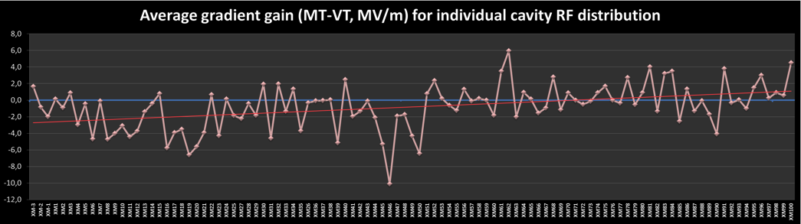
Cryomodule Performance: VT vs. MT
New clean
room procedure
CEA Audit
1st sample of 34 series CM
ΔE_{op} = -2.1 MV/m
2nd sample of 19 series CM
ΔE_{op} = -1.7 (-0.9) MV/m
last 47 series CM
ΔE_{op} =+0.5 MV/m
Significant gradient degradation from XM6 to XM23, while CEA and Alsyom put all their effort in achieving production goal of 1 CM/week: an audit of string and module assembly was conducted by CEA on XM26
A simplification of the clean room procedures was introduced at XM54: no degradation after

Slide 27
R&D Theme n°1
From E-XFEL experience, the cost of module assembly for ILC 500 GeV is in the ballpark of 200 M€, almost entirely in labour cost.
→ Automation and Robotization
Once the vacuum groups are connected to the cavities, vacuum operations (pumping, venting, flushing, leak checking) should be fully automated, to include slow pumping and venting, and valve opening.
Robotization could be implemented e.g.
  Ionized N2 cleaning
  Cold coupler assembly
  String assembly
  Warm coupler assembly

Slide 28
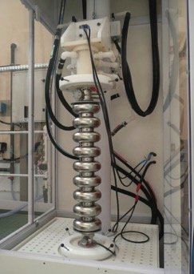
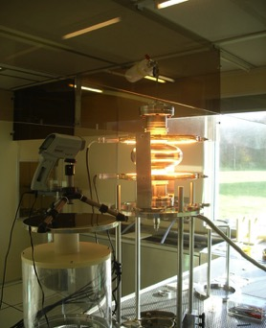
R&D Theme n°2
CEA will continue investigation on surface preparation:
  Electropolishing, and in particular Vertical EP
  120°C baking, and in particular N2-infusion recipe
CEA can join in an international collaboration on these topics.

Slide 29
Coupler R&D at LAL:
In-depth investigation on the lightening observed during the RF conditioning in some XFEL couplers: Origin, impact on coupler and how to supress it.
Test on a “new” multipactor suppressor thin layer on ceramic: Cr₂O₃.
Impact of different finishing processes (Brushing, glass bead blasting, burnishing…) on copper plated surface roughness, RRR and SEY.
Coupler cleaning-rinsing-drying procedure automatization: to avoid operator dependence, guarantee the process repeatability and save time and money.
Mechanical design, thermal and RF studies of coupler operating in CW mode.

Slide 30
KEK ILC activities
Shin MICHIZONO
(KEK ILC R&D project leader )
KEK LC facilities (ATF, STF, CFF)
Cost reduction R&D
LCWS2016 SRF Shin MICHIZONO
1

Slide 31
US-JAPAN cost reduction R&D
Short-term R&D (2–3 years)
A-1. Niobium material preparation
with new processing for sheeting and piping
A-2. SRF cavity fabrication for high gradient and high Q
with a new surface process recipe provided by Fermilab
A-3. Power input coupler fabrication
with new-ceramic window (w/o additional coating) A-4. Cavity chemical treatment
with vertical configuration and new chemical
LCWS2016 SRF Shin MICHIZONO

Slide 32

R&D plan for High-Q High-G
2016:
Single-cell KEK-cavity processing at FNAL
Q-measurement (with residual magnetic field dependence) at FNAL
Q measurement at KEK (to confirm the measurement system configuration)
2017:
New single-cell cavity production
Processing at small vacuum furnace
Procurement of new vacuum furnace for 9-cell cavity
2018:
High-Q High-G processing to 3 nine-cell cavity
Production of 8 nine-cell cavities 2019：
Performance test
Preparation of the installation to STF-2
2016 2017 2018 2019
KEK
Hitoshi HAYANO
LCWS2016 SRF Shin MICHI
ZONO
FNAL process
1 cell processing
Performaｎce test
Preparation for cyromodule
Preparation of vacuum furnace
3-9cell performance
8 - 9cell cavities fabrication
Performace test
18

Slide 33
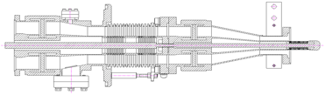
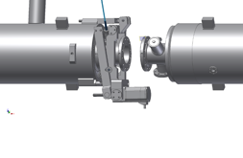
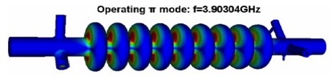
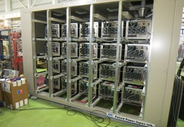
KEK plans for components study
Coupler: Cost reduction by no-coating ceramics
Tuner: Cost reduction by revised lever-arm tuner
Crab cavity: Concern item in Nomura-report
MARX modulator:
Concern item in Nomura-report

Slide 34


IHEP ILC SCRF R&D
Status & Plan
Jiyuan Zhai
IHEP, China
LCWS Workshop, Morioka, Japan
Dec. 6, 2016

Slide 35
IHEP ILC SCRF R&D Plan (2017-2019)
N-doping and N-infusion
  IHEP & MOST funded (apply for CAS fund)
  High Q and high gradient study (1.3 GHz and 650 MHz)
  Collaborate with FNAL on personal exchange, IHEP cavity processing and testing at FNAL (650 MHz single cell and 2-cell, 1.3 GHz single cell and 9-cell), FNAL doped/infused cavity testing at IHEP, OTIC RRR Nb material study (low Q problem for LCLS-II)
1.3 GHz 9-cell cavity
  Performance improvement of three cavities: IHEP01 low loss LG, IHEP03 TESLA-like FG, HERT001 TESLA FG)
  Four new cavities LG+FG (apply for CAS fund)
  N-infusion, cost reduction and industrialization study

Slide 36
IHEP ILC SCRF R&D Plan (2017-2019)
EP and T-mapping tool
  Beijing local government funded
  EP facility: design ongoing, construct at OTIC, Ningxia in 2017-2018,
  hope to collaborate with KEK on design and commissioning
  T-mapping: under development, use in cavity testing in 2018
1.3 GHz variable input coupler
  Variable two-window 70 kW coupler under fabrication (NSF funded)
  Two ILC-type variable couplers (apply for CAS fund)
1.3 GHz cryomodule IHEP-ILC-TC1 horizontal test

Slide 37
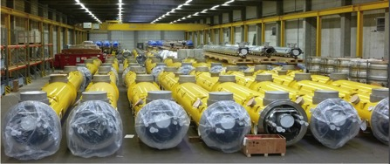
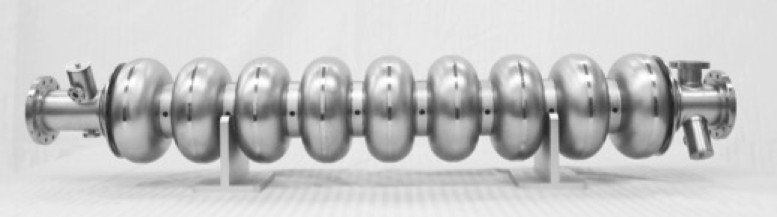
SCRF Industrialization
  Quality control and cost reduction:
  Niobium: OTIC (EXFEL 35% 7 t, FRIB 50% 5 t, LCLS-II 50% 5.6 t …)
  Cavity: OTIC, HERT, BIAM (ILC, CADS, FRIB, HEPS, CEPC …)
Coupler: HERT (ILC, CADS, RISP …), JNT
Cryomodule: WXCX (EXFEL 60, LCLS-II 33, FRIB), HFJN (CADS)
  LCLS-II cryomodule quality control (IHEP & SLAC-FNAL-JLAB collaboration)

Slide 38
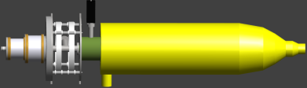
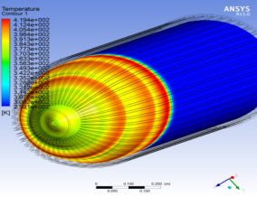

High Efficiency Klystron R&D
650 MHz 800 kW CW klystron R&D for CEPC
  Efficiency design goal > 80 %
  Prototype fabrication to be completed in 2018
  Beam tester (gun and collector) high power test in 2017

Slide 39
CERN Superconducting RF and
Higher Efficiency Klystron
R&D Plans
Erk Jensen, CERN
6-Dec-2016
LCWS16, Morioka, Japan

Slide 40
CERN priorities of SRF work
Highest priority: keep technology to fix problems in existing SRF installations!
  Have enough spares for LHC Cavities/CM/FPC, don’t forget how to fix them!
  HIE-ISOLDE (today operational up to 6.8 MeV/u, in 2018 to 10 MeV/u).
2nd priority: approved projects: HL-LHC
  Crab cavities (bulk Nb, compact geometry)
Ongoing studies (R&D preparing the future):
  High Gradient (704 MHz, bulk Nb, → ESS) – for CERN a reference point.
  FCC study – main challenge: CW RF power 100 MW through cavities!
The red thread:
  Complementary to SRF R&D elsewhere,
  Focus on CERN strengths,
  Collaborate!
The technology focus: thin films (Nb on Cu, A15 on Cu, A15 on Nb …)

Slide 41
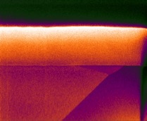
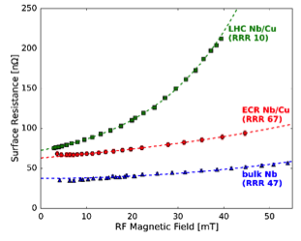

Nb on Cu thin films
Record $Q_{0}$ were measured – up to now only at low
fields – problem to address: strong $Q$-slope!
One would need much less Nb!
Cu is also a mechanical/thermal stabilizer.
Recent results at JLAB (A-M Valente) using a plasma
technique (ECR with energy condensation)
are very encouraging (much reduced Q-slope)
Pt
conventional
sputtering
Nb
ECR
Cu
2 μm
bulk Nb
FIB-SEM showing a cross-section through the Nb/Cu coating: smooth interface & no porosity. Courtesy R. Validadeh (STFC)

Slide 42

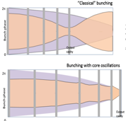
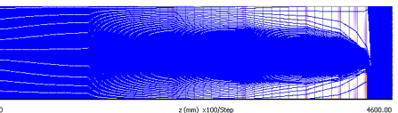



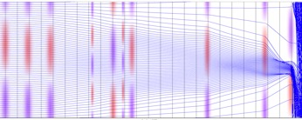

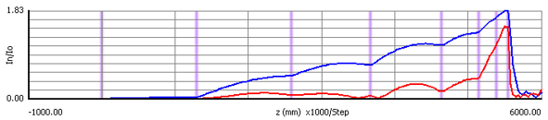


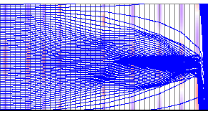
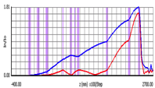


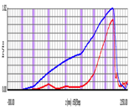
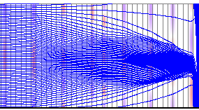
High efficiency klystrons: new bunching technology
COM: Core Oscillations Method (5.55 m)
133.8 kV, 12.55 A, 1.4 MW at 0.8 GHz, !
BAC: Bunching Alignment Collecting, 2.44 m
COM
Core Stabilization Method(s)
CSM_123, 1.96 m
BAC
High Efficiency International Klystron Activity
CSM
CSM_223, 1.88 m
igor.syratchev@cern.ch

Slide 43
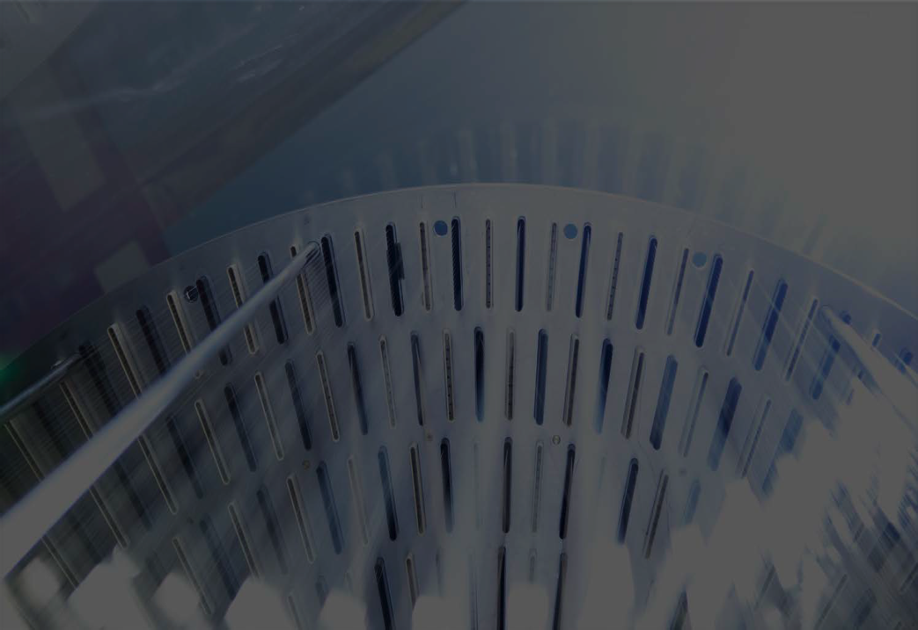

Report from TRIUMF
Canada’s national laboratory for particle and nuclear physics and accelerator-based science
Bob Laxdal, TRIUMF
LCWS2016, Dec. 6, 2016

Slide 44
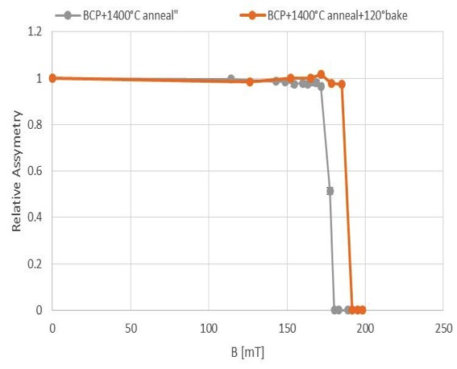
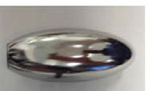





Fundamental studies - field of first flux entry with muSR
Findings: Baking at 120C in vacuum can enhance the field of first flux entry
Bake at 120C moved field of first flux entry in annealed sample from 174mT to 188mT
consistent with `dirty layer’ hypothesis
Dec 2016
Tobi Junginger, TRIUMF
Coating
µ
Bulk Nb
B

Slide 45
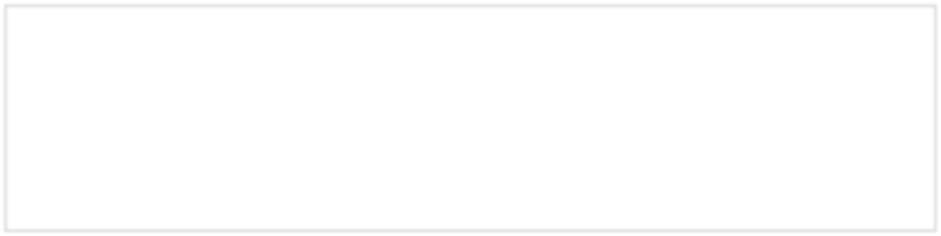

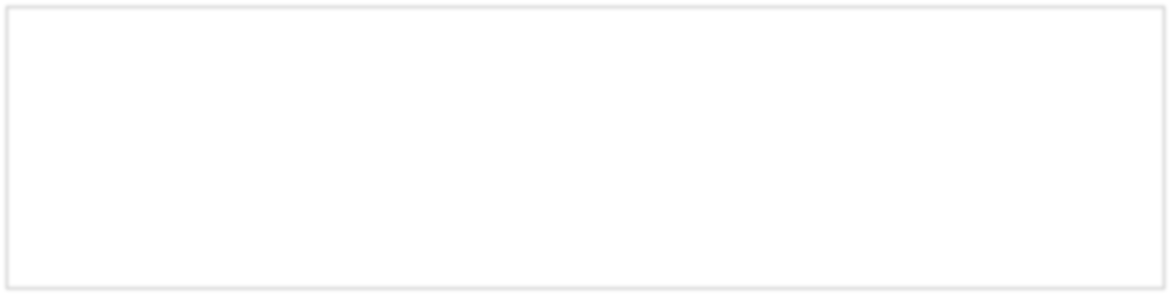

Proposed R&D Program
Investigate broad parameter sweep of doping and temperature using single cell 1.3GHz cavities, rf induction oven and cryogenic testing
Characterize near surface and bulk properties
of samples using beta-NMR and muSR
Continue to develop vertical EP to support single cell testing
Pursue low cost cavity development with rf deflecting mode cavity – reactor grade Nb and TIG welding

Slide 46
SC RF Plans at Cornell
Fumio Furuta
SRF group, Cornell University
SRF special session 6th Dec. 2016 International Workshop on Future Linear Collider (LCWS2016)
Aiina Center & MALIOS in Morioka, Japan

Slide 47
Summary
CBETA project will provide actual high-Q machine experiences,
studies, and future visions.
Cornell’s fundamental SRF R&D is focusing on new material and
understanding of physics behind high-Q.
  Nb₃Sn, Nb/Mo CVD (Chemical Vapor Deposition).
  R&Ds on Low temp. N₂ baking, flux control.
The outcomes of advanced VEP activities could be a significant
cost reduction and an environmentally-friendlier VEP for future.
HWR cavity collaboration between RAON heavy-ion accelerator in
Korea is on going.
More interest on high gradient, SRF-gun, etc.,,
CBB program will explore the future key accelerator technologies.
International collaborations are welcome!!

Slide 48

Coupler R&D Plan
Coupler R&D team: E. Kako, T. Matsumoto, S. Michizono, A. Yamamoto, Kirk (KEK)
E. Montesinos, C. Julie (CERN)
Courtesy of W.D. Möller, W. Kaabi, N. Solyak for E-XFEL and LCLS-II status report
Kirk
1
6/Dec/2016
LCWS2016 @Morioka

Slide 49
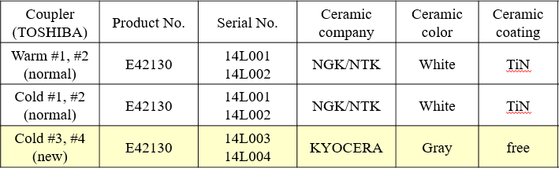
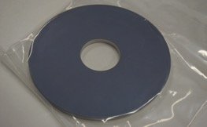
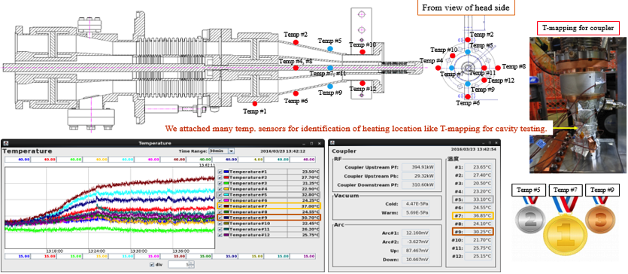
How about New Ceramic Coupler?

Slide 50
R&D Plan in F.Y. 2016-2019
Ultrasonic Rinsing Test for Coupler (with TOSHIBA)
SEE Measurement for Coating-free Ceramic (with KYOCERA)
Secondary Electron Simulation & RF Design by CST
Fabrication of Low Cost Coupler
High/Low Power Test at Bench
We’re here
We can get enough budget

Slide 51

ILC tuner development at KEK
LCWS2016, 5-9 December, 2016
Morioka, Japan
Mechanical Engineering Center, KEK
Masashi YAMANAKA

Slide 52
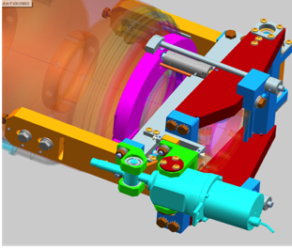
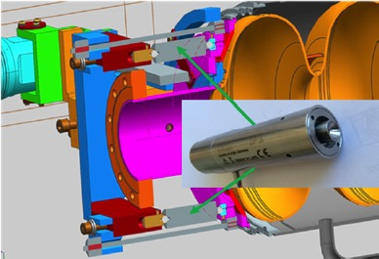
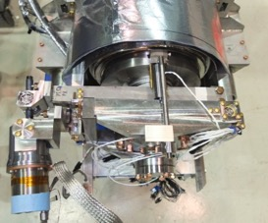
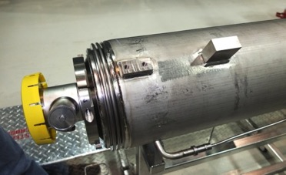
Modified SACLAY I tuner at FNAL
Figure 2: 3-D model of the Tuner, assembled on the cavity/helium vessel system.
Figure 3: 3-D model (Cross-section) of the SRF cavity/helium vessel/tuner system.
Short!
Y. Pischalnikov, et al.,
DESIGN AND TEST OF COMPACT TUNER FOR NARROW BANDWIDTH SRF CAVITIES
Proceedings of IPAC2015, Richmond, VA, USA, WEPTY035, pp. 3352-3354.

Slide 53


Tuner development plan at KEK
Prototyping a lever-type tuner for ILC-cavity based on Hayano’s conceptual design
Learn from foreign labs about lever-type tuners (Euro-XFEL form DESY, LCLS-II from FNAL)
Detail design of lever-type tuner and He vessel simultaneously for ILC-cavity (short beam tube) aiming high stiffness enough for high-gradient operation
Manufacture prototype tuner and He vessel
Assemble ILC-cavity, He vessel and tuner
Evaluation of the tuner performance including actual measurement of stiffness
Features of plan
Tuner design and prototyping will be collaborated with local company group near KEK site (Ibaraki Research & Development Association)
Prototype He vessel will be manufactured by Japanese company (collaborating partner of KEK)
Try to use and evaluate Japanese actuators (Stepper motor and piezo)

Slide 54
Schedule
 | FY2016 | FY2017 | FY2018
KEK
KEK + IRDA
IRDA
Learn from foreign
Labs.
We want to borrow
actual tuner and
He vessel for training
Design of He vessel
for ILC-cavity
Manufacture
He vessel by
Japanese company
TIG welding at MEC
(He vessel and cavity)
Understanding of tuner mechanism
Training of assembly and evaluation
Assemble, adjustment,
performance evaluation
Modify, improvement
Detail design of tuner
Part drawing
Manufacture prototype
tuner
2nd (modified)
prototype
Examination of Japanese actuators
(stepper motor, piezo)
54
54

Slide 55
Crab Cavity R&D Plan
Kirk
1
6/Dec/2016
LCWS2016 @Morioka

Slide 56
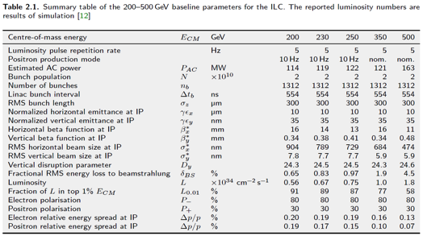
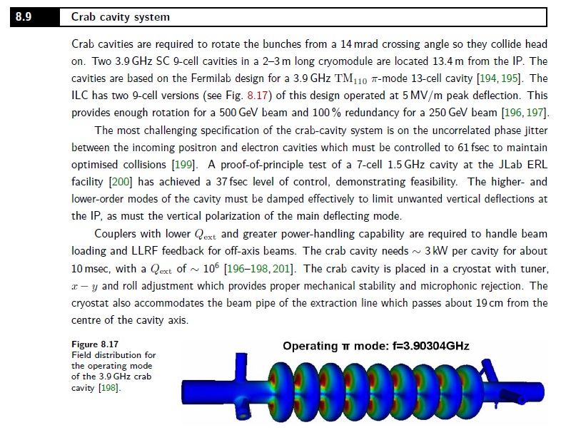
Technical Design Report
Description for Crab Cavity in only 1 page!
The most important thing is “in-phase operation” between electron and positron cavities.
We need more detailed specification table for ILC Crab cavity.

Slide 57
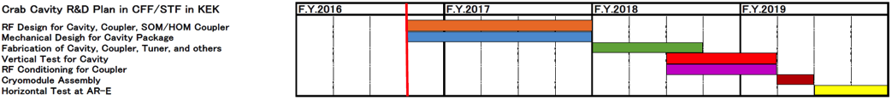
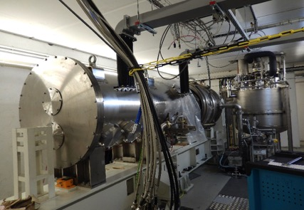

R&D Plan in F.Y. 2016-2019
Single cavity package w/ cavity, coupler, tuner will be (or maybe) tested in AR-E Lab in 2019.
Prototype CM test @AMTF in DESY
Horizontal Test Area @AR-E Lab. in KEK

Slide 58

KEK Marx-Modulator R&D
Accelerator Laboratory
Mitsuo Akemoto
KEK
LCWS2016
December 6, 2016

Slide 59


KEK Marx Modulator
Accelerator Laboratory
Marx Unit:
  6.4 kV output pulser with four Marx cells at -2 kV each
  Marx Cell has a step-down converter with a switching frequency of 50 kHz
  Flat pulse voltage is formed with a PWM modulation
Charging system:
  Independent unit charging through 20 kHz isolation step-up transformer
  Each unit is charged up to -2kV and the input voltage of the Marx unit is regulated.
System:
  N+1 redundancy
  Air insulatated, water cooled, No oil
10kW Inverter
Charging PS
Marx Unit #20
-120 k V
140 A
1.7 ms
5Hz
10kW Inverter
Charging PS
Marx Unit #19
Isolation
Step-up
Transformer
Klystron
10kW Inverter
Charging PS
Marx Unit #02
10kW Inverter
Charging PS
Marx Unit #01
-6.4 k V
140 A
1.7 ms
5Hz
620 V
20 kHz
2.0 k V
20kHz
-2.0 kV
DC
Inverter
Charging System
420 V
50 Hz
3φ
System Block Diagram
Simulated output voltage waveform

Slide 60
Future Plans
Accelerator Laboratory
2016(this fiscal year)
To check the modulator system at a charging voltage of 1.3kV, the high power tests at 80kV, 45A, 1.7ms, 5Hz with a klystron load will be performed.
2017
New unit using 3.3 kV devices will be tested at a charging voltage of 2 kV.
After confirming the performance of new unit, all units will be improved.
2018
Now, quarter of the modulator full charging power(5 charging power supplies, 50kW) is available. The remaining 15 charging power supplies will be added to complete the charging system.
Full power tests with a 10MW MBK klystron will be performed.

