Slide 1
New Low T Nitrogen Treatments Cavity Results with Record Gradients and Q
A. Grassellino, FNAL
International Workshop on Future Linear Colliders, Morioka
December 6th, 2016

Slide 2
Motivation behind experiments
Composition and mean free path in first nanometers of cavity surface have been shown to be crucial for both Q and gradient performance
N Doping at T> 800C proven to manipulate mean free path, but constantly throughout several microns, giving high Q
120C bake known to manipulate mean free path at very near surface on clean bulk, and produce the highest gradients
A. Grassellino et al, Proceedings of SRF 2015
A. Romanenko et al, Appl. Phys. Lett. 102, 232601 (2013)
120C bake, vacancies in first ~ 60 nanometers
N doping, nitrogen throughout several microns

Slide 3
Motivation behind experiments
Therefore, we decided to study how to better “engineer” a dirty layer on top a clean bulk, using low T nitrogen treatments → aim to create few to several nanometers of nitrogen enriched layer on top of clean EP bulk, to attempt to bring together the benefit of the Q and gradient
Nitrogen enriched nanometric layer to be created in the furnace post 800C treatment – when no oxide is present at the moment of injection of nitrogen at low T
Studies aim also at fundamental understanding of HFQS and 120C cure of high field Q slope
All Q vs E curves shown are for 1.3 GHz single cells, T=2K

Slide 4
The surface of 120C bake vs N doping vs EP, via LE-muSR
Produce same dirty layer profile as 120C bake, but with nitrogen (rather than vacancies)
Obtain benefit of BCS AND gradient
~15 nm - no screening
mfp ~ 2 nm at the surface, attempt substitute with N₂
mfp~70nm
mfp > 400 nm
Ba = 25 mT
Meissner screening profiles for differently treated cutouts (Ba magnetic field applied parallel to sample surface = 25 mT). Allows to directly extract surface mfp
M. Martinello et al, submitted to APL

Slide 5
Kubo and Checchin models on bi-layer potentially increasing achievable accelerating gradients
This idea is further strenghtened by Checchin (FNAL) and Kubo (KEK) models on bi-layer structure (eg dirty N doped layer on clean Nb) –claim that can enhance the achievable accelerating gradient
Ideal Depth of this layer ? Can this trick help push beyond the 200 mT or achieve 200 mT with higher yield? We are investigating this empirically via low T N infusion (different T and durations)
Kubo, TTC saclay 2016

Slide 6
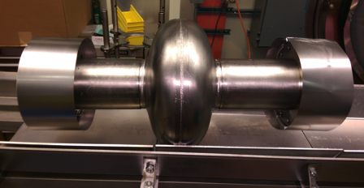
Example of new surface processing sequence
Bulk electro-polishing
High T furnace with caps to avoid furnace contamination:
  800C 3 hours HV
  120C 48 hours with N2 (25 mTorr)
NO chemistry post furnace
HPR, VT assembly
Protective caps and foils are BCP’d prior to every furnace cycle and assembled in clean room, prior to transporting cavity to furnace area
A. Grassellino et al, arXiv:1305.2182

Slide 7
Results comparison :
“standard” 120C bake vs “N infused” 120C bake
Same cavity, sequentially processed, no EP
in between
Achieved:
45.6 MV/m
→ 194 mT
With Q ~ 2e10!
Q at ~ 35 MV/m
~ 2.3e10
Increase in Q factor of two, increase in gradient ~15%

Slide 8
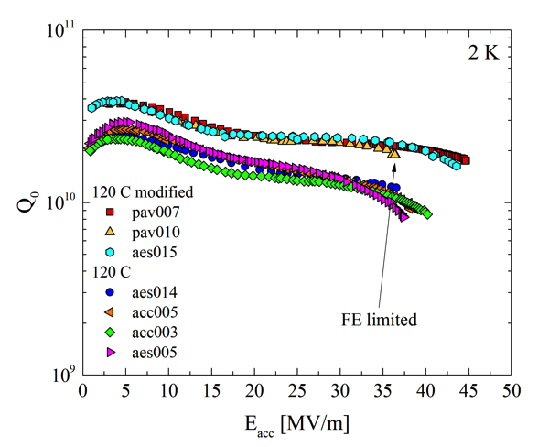
Reproducibility: repeatedly highest Q ever measured >2e10 at very high gradients > 40 MV/m!
So far three out of 4 cavities processed with this regime have reached 45 MV/m with high Q
Performed slow cooldown in 10mG and extracted very low sensitivity to B on order of 0.3 nOhm/mG
-> very robust for Q preservation

Slide 9
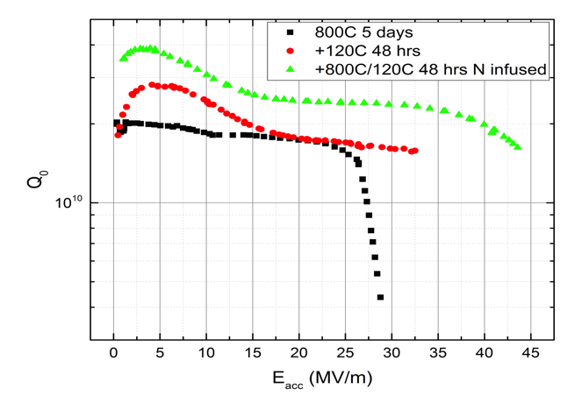
Sequence on same cavity:
EP + 800C→ 120C bake→ 800C+N-infused 120C bake
Clear evolution trend confirming improvement in Q and quench field
NO EP between furnace treatments: comparing same morphological surface, just different impurity content

Slide 10
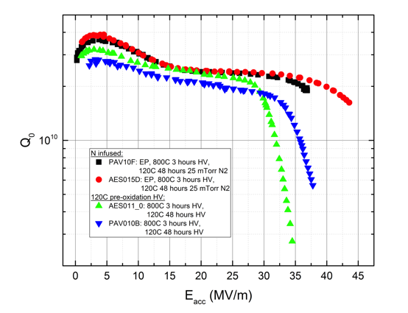
Is nitrogen really playing a role at 120C? YES
Repeated same procedure with and without nitrogen in furnace at 120C
Holding at 120C in furnace for 48 hours post 800C without the nitrogen does not completely remove the high field Q-slope
It pushes the onset of HFQS to higher fields ~ 30 MV/m
Nitrogen is needed to remove HFQS completely and achieve highest fields

Slide 11
But how deep is nitrogen to produce such an effect?
First SIMS measurements on samples baked with cavities in furnace with N at low T show ~ few-tens nm potential nitrogen enriched layer,
depending on T used

Slide 12
Exploration at other temperatures
Decided to explore other temperatures for N injection like 160C, 200C or same T 120C but longer time, to verify if diffusion of N deeper correlates with change in performance
Results in slides that follow show how incredible and dramatic the modification of BCS and residual resistance can be with just nanometer changes in surface impurity content
It does show how fortunate we were to stumble across the standard 120C bake which “miraculously” works well

Slide 13
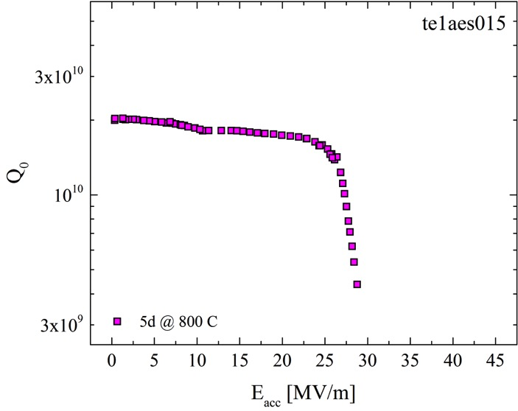
Cavity evolution

Slide 14
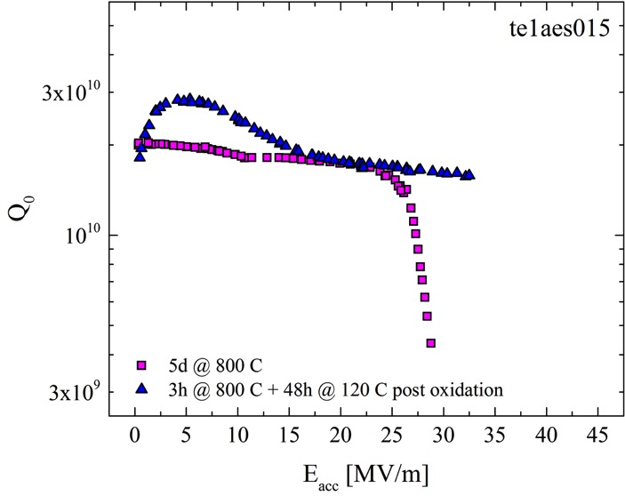
Cavity evolution

Slide 15
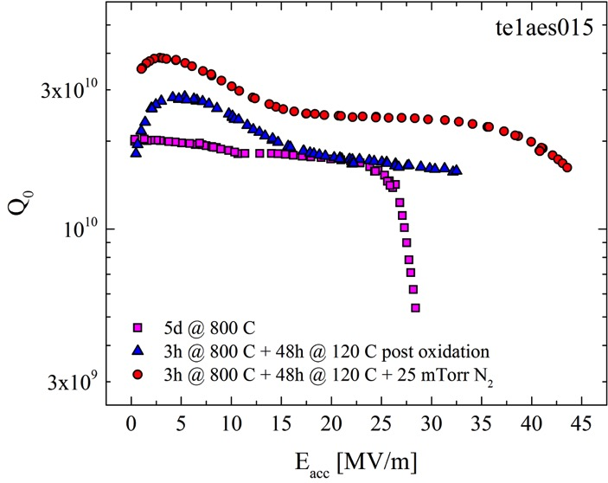
Cavity evolution

Slide 16
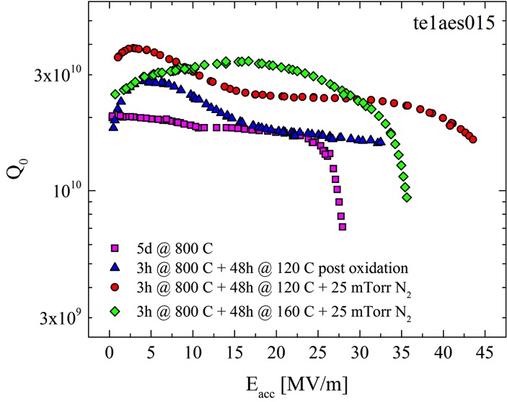
Cavity evolution
Increasing T ~40C turns cavity into “doped shape”!

Slide 17
Large parameter space – T and duration being explored
>3e10 at 31.5 MV/m!

Slide 18
Comments to results so far and path forward
We have found a powerful strategy to manipulate surface impurity content, and get higher Q > 2e10 at E_{acc} > 30 MV/m
Very High Q > 4e10 achievable with low T nitrogen treatment – first proof of N doping with no EP following N treatment
No lower quench limits observed, differently from high T doping

Slide 19
Comments to results so far and path forward
Path forward:
-continue exploration of T and duration parameters on single cell, in feedback with SIMs measurements to understand depths of dirty layer and effect on Q and resistance
-once optimal found, collect statistics on single cell
-then move to nine cells
-then, hopefully move to cryomodule to demostrate high Q/high grad CM

Slide 20
Conclusions (1/2)
Recipe that systematically improves Q (1.3 GHz, 2K)>2e10 at E_{acc}> 30 MV/m and leads to very high gradients has been found via introduction of nitrogen at 120Cx48 hours in the cavity surface
  Treatment also brings the advantage of processing
  cost cut/simplification by eliminating EP post bake, low T ovens bake etc
  The systematicity in 45 MV/m is very interesting – see Mattia Checchin talk for possible explanation

Slide 21
Conclusions (2/2)
Diffusing nitrogen deeper enhances Q >3e10, need to fine tune the duration and T to create right concentration and depth to reach highest fields with no Q-slope
Data and method are extremely powerful to gain fundamental understanding of high field Q-slope, mild baking mechanism and field dependence of surface resistance

Slide 22
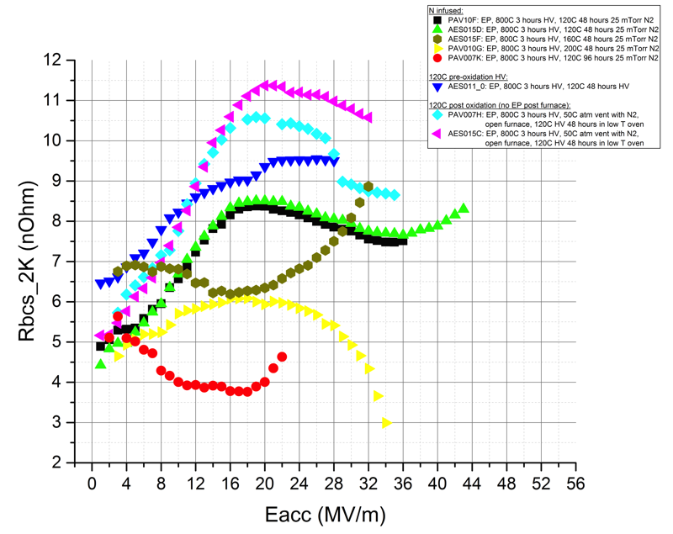
Decomposition – systematic changes in R_{BCS} (H)
120C 48 hrs with N2 in furnace vs standard 120C post oxidation reduces slightly the R_{BCS} (H) – but same shape
120C 96 hrs or 160C 48 hrs with N2 in furnace drive the R_{BCS} (H) to that of a doped cavity (inverse field dependence)…
…BUT, new finding, Q slope limiting Q>3e10 at high gradient emerging from BCS! Previously unseen
Perhaps indicates that N-infused layer is too thin?
200C changes shape – not understood

Slide 23
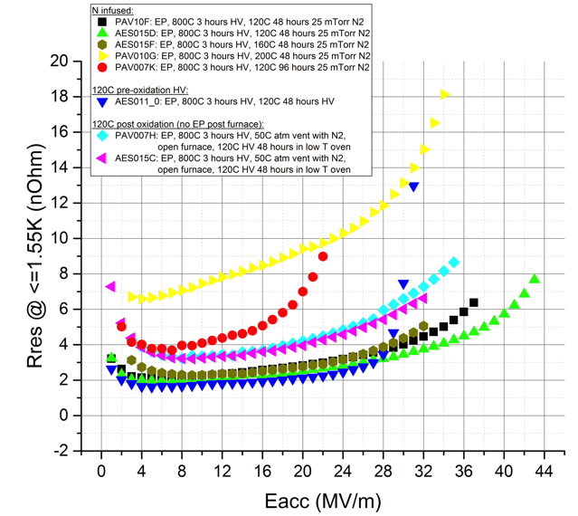
Decomposition – systematic changes in R₀ (H)
120C 48 hrs with N2 in furnace vs standard 120C post oxidation reduces clearly the residual resistance, especially at higher fields
Seems that improvement in Q at Eacc > 30 MV/m stems in larger portion from residual as a function of field
So nitrogen at 120C mainly plays role of eliminating HFQS, and perhaps improvement in residual comes from lack of suboxides post 120C bake?
HFQS visible in the residual of the cavity baked at 120C pre-oxidation and with no nitrogen

