Slide 1
LCWS2016 Industry session
Joint development of
Vertical electro-polishing (VEP) facility
for Nb accelerating cavity for ILC
by Iwate collaboration members
Iwate collaboration members
・Higashi Nihon Kidenkaihatsu Co., Ltd. （Morioka, Iwate）
・WING Co., Ltd. （Kitakami, Iwate）
・Marui Galvanizing Co., Ltd. （Hachinohe, Aomori）
・Iwate industrial research institute （Morioka, Iwate）
・Iwate industry promotion center（Morioka, Iwate）
・High energy accelerator research organization (KEK) （Tsukuba, Ibaraki）

Slide 2
Contents
1. Electro-polishing (EP) of a Nb accelerating cavity
2. Vertical electro-polishing（VEP）
vs. Horizontal electro-polishing（HEP）
3. VEP experiment facility
4. Our unique cathode: “Ninja Cathode”
5. Our achievements
6. Forthcoming challenges for industrialization
7. Activities and advantages of Iwate collaboration
8. Summary

Slide 3
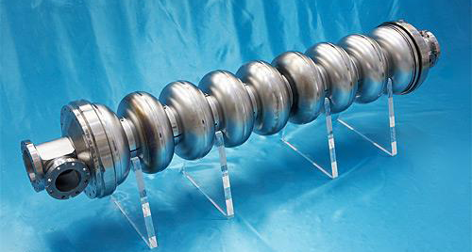
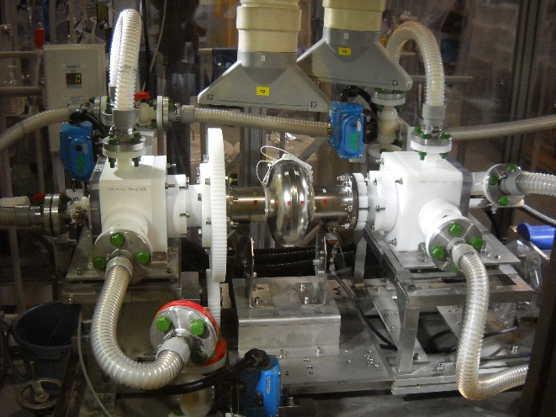
Electro-polishing (EP) of a Nb accelerating cavity
Nb SRF 9-cell cavity
Cavity EP
Inner surface after EP
・EP of the inner surface of a cavity is required to get ILC accelerating gradient.
・EP makes the inner surface shiny and smooth at nm level.

Slide 4
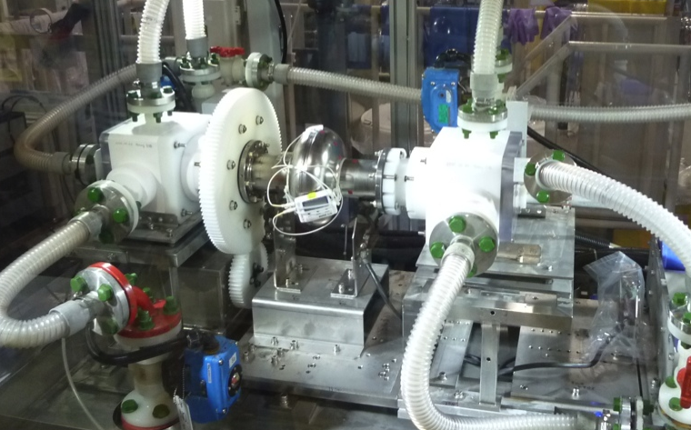
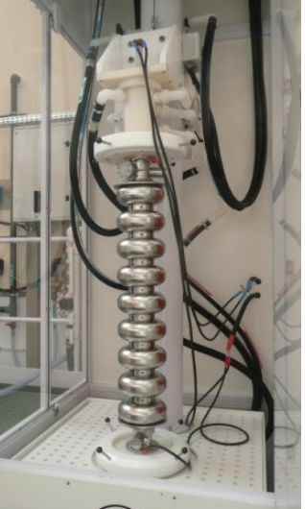
Vertical Electro-polishing（VEP） vs. Horizontal Electro-polishing（HEP）
HEP Setup at KEK
 | HEP | VEP
Setup | Complicated setup | ◎ Simple setup
Cavity rotation | Need rotation of a cavity | ◎ No cavity rotation
Sealing | Sealing of rotating bodies | ◎ No sealing as no rotating body
Cavity movement | Mechanism to make EP bed vertical for acid and water drainage | ◎ Already vertical
Facility space | Large space | ◎ Comparatively small space
Total cost | High Cost | ◎ Comparatively low cost
Technology | ◎ Well-established | Not-established (under R&D)
State | ◎ Many mass production experiences (EXFEL etc.) | No mass production experience
VEP Setup at Saclay
・Now HEP technology is well-established and being used
for mass production.
・If VEP technology is established, it would be beneficial in respect of simple setup, low cost etc.

Slide 5
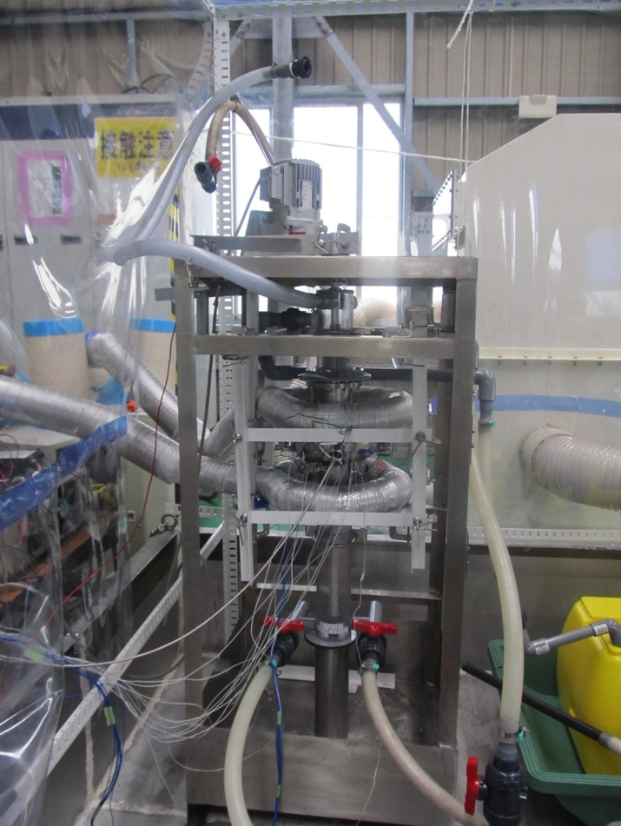
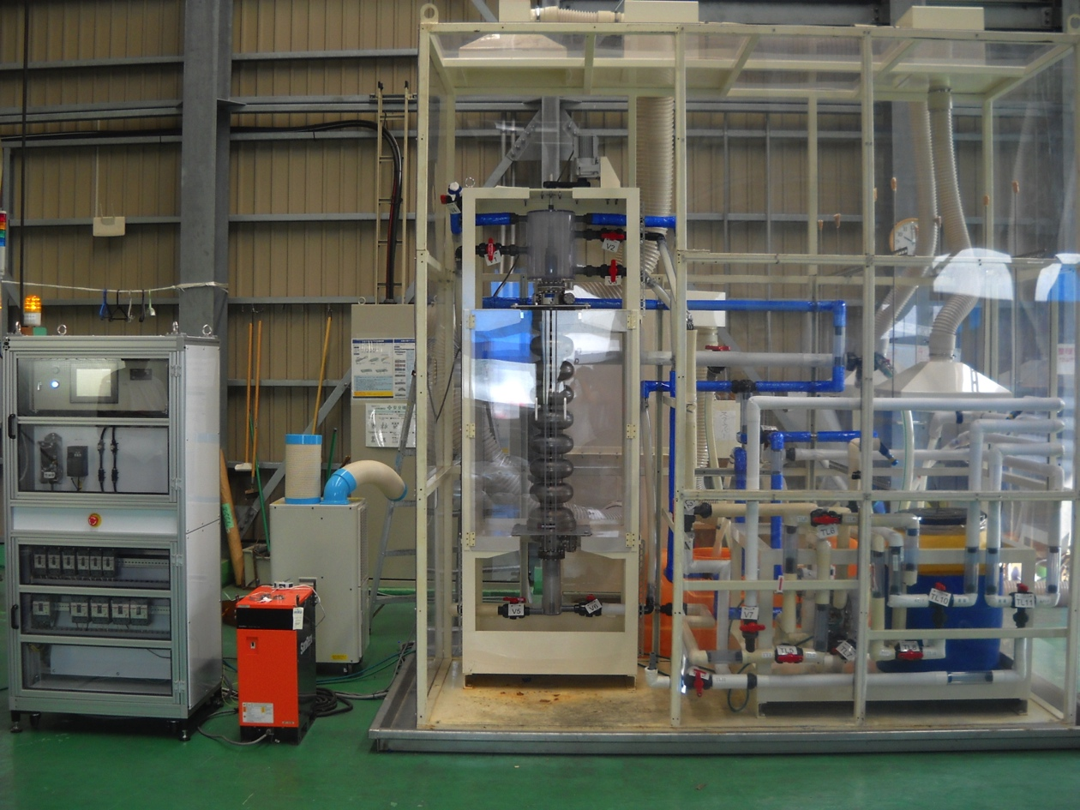
VEP experiment facility (under development)
For Single-cell Cavity
For 9-cell Cavity
We developed and constructed VEP facilities for single-cell and 9-cell cavities.
A VEP experiment facility is simple and easy to construct comparatively for small companies like us.

Slide 6

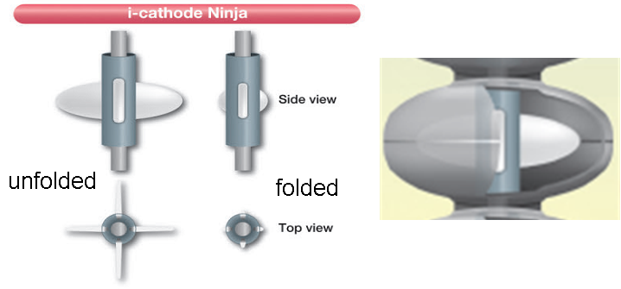
Unique Cathode “Ninja”
Our unique cathode which has
variable-geometry wings
was developed and constructed.
In comparison with conventional rod cathode,
・The Ninja cathode is effective
for better agitation of EP solution when it is
rotated at an adequate speed.
・It provides a uniform distance between
cathode and cavity surface when
the wings are made with cathode metal.
Moreover,
It can be easily inserted into a cavity due to its retractable wings.
Structure
Symbol
Our original cathode“Ninja”

Slide 7
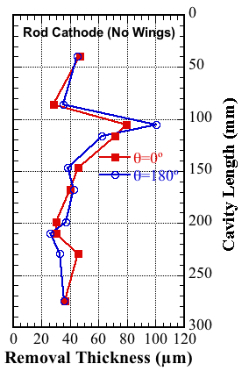
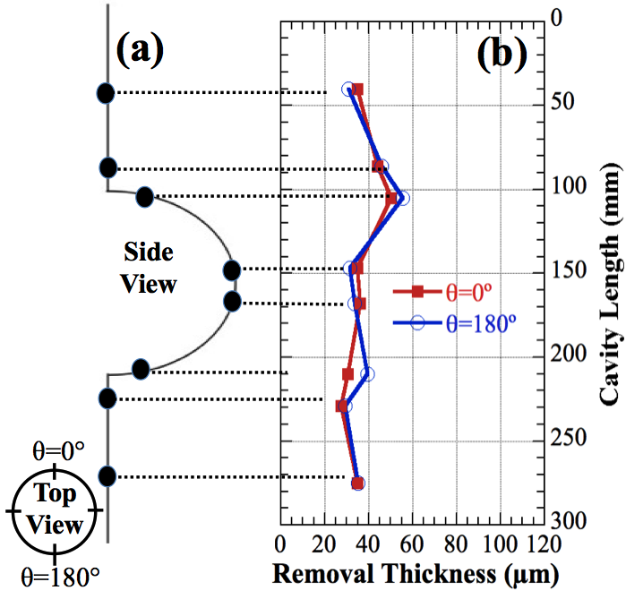
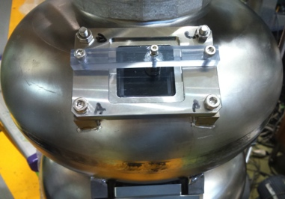
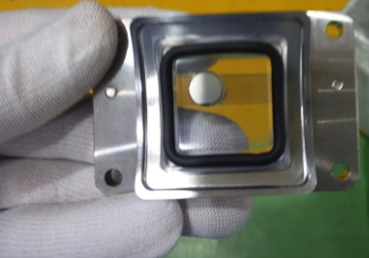
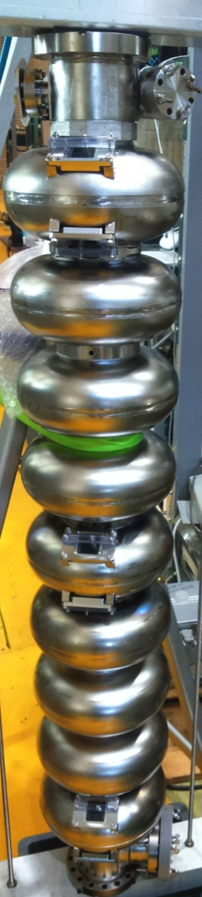
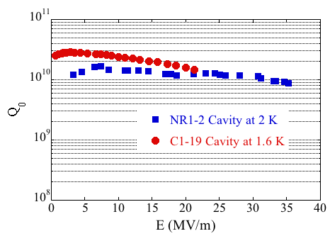
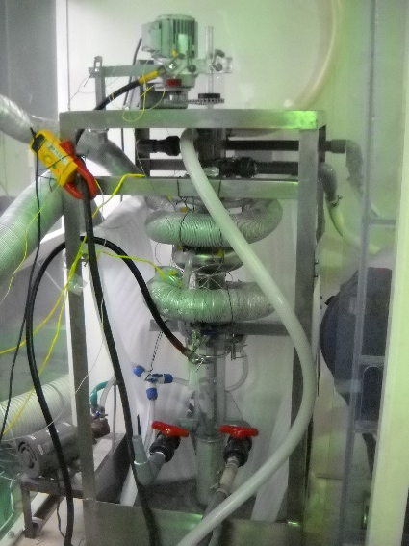
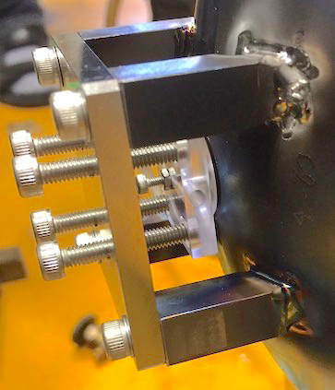
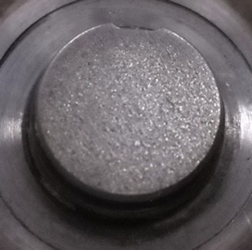
Our Achievements
Single-cell cavity VEP
9-cell cavity VEP
Removal thickness distribution measurement
9-cell coupon cavity
Rod Cathode
Ninja Cathode
Accelerating gradient measurement
（Interruption because of leak）
VEP setup
・Uniformity in a removal thickness along the cavity length was improved by using the Ninja cathode and optimized VEP parameters.
・After VEP with the Ninja cathode, a cavity achieved an accelerating
gradient of 35 MV/m in a vertical test.
・ A 9-cell coupon cavity was constructed for
optimization of VEP parameters.
・VEP experiment is being performed based on
experiences of single-cell cavity VEP.

Slide 8
Forthcoming Challenges for Industrialization
Removal of hydrogen bubbles from cavity during EP since bubbles disturb EP
  Modification in structure of Ninja cathode
  Improvement in VEP system
Control/optimization of VEP parameters
  Cavity and electrolyte temperatures
  Flow direction and rate of electrolyte
  Voltage & current
  Automatic control system
  Parameter control and feedback system by IoT
Facility cost reduction
  Searching for low cost and highly durable materials to replace expensive Teflon
  Simplification of VEP facility
Iwate collaboration which consists of several companies and institutes has been working to solve these problems.

Slide 9

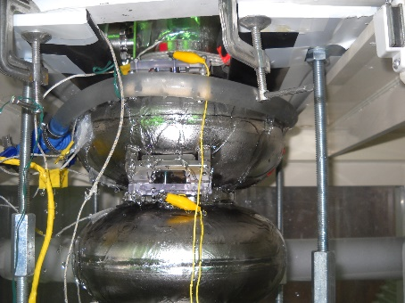
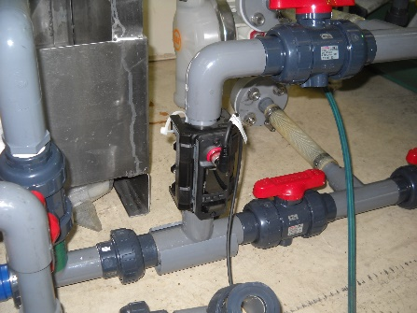


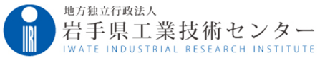
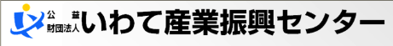

Activities and advantages of Iwate collaboration
Iwate collaboration members
Division of roles
Past activities
マルイ鍍金工業㈱
Basic plan preparation
Performing VEP experiment
Marui Galvanizing Co., Ltd.
Measurement and electrical
equipment preparation
Higashi Nihon Kidenkaihatsu Co., Ltd.
Resin parts processing
Making cavity cooling system
Flow meter preparation
WING Co., Ltd.
Various analysis
Resin durability test (tension test)
Iwate industrial research institute
Various activity
support
Iwate industry promotion center
High energy accelerator
research organization
Technical guidance
Making PVC parts
The advantages of Iwate collaboration
・Due to sharing work by specialized companies and institutes having experiences in
different fields, development can be performed smoothly.
・Small companies can enter into different fields easily with their strong points.
・Local companies can contribute to local projects and activation of local industry.

Slide 10
Summary
・Now Iwate collaboration is developing VEP technology and facility.
・A vertically electro-polished single cell cavity with our unique
“Ninja Cathode” and optimized VEP parameters
achieved an accelerating gradient of 35 MV/m.
・Currently, we are working to optimize VEP parameters for 9-cell cavities, improve the facility to control these parameters and reduce cost of the VEP facility so as to realize the industrialization.
In order to participate and support for construction of ILC in Iwate, local companies and institutes have collaborated.
Our Iwate collaboration will contribute to provide surface treatment of Nb SRF cavities with low cost mass production.

Slide 11
Thank you for your attention !!
We have presentation at company booth. Please visit us.
・WING Co., Ltd. （Introduction of Iwate collaboration）
・Higashi Nihon Kidenkaihatsu Co., Ltd. (Green ILC)
・Marui Galvanizing Co., Ltd. (Nb items)
Company booth photo

