Slide 1

Coupler R&D Plan
Coupler R&D team: E. Kako, T. Matsumoto, S. Michizono, A. Yamamoto, Kirk (KEK)
E. Montesinos, C. Julie (CERN)
Courtesy of W.D. Möller, W. Kaabi, N. Solyak for E-XFEL and LCLS-II status report
Kirk
1
6/Dec/2016
LCWS2016 @Morioka

Slide 2
Outline
World-wide coupler status
Coupler specification in TDR
40mm STF-type coupler for plug-compatibility
R&D for cost reduction
R&D plan in F.Y. 2016-2019
Summary

Slide 3
Outline
World-wide coupler status
Coupler specification in TDR
40mm STF-type coupler for plug-compatibility
R&D for cost reduction
R&D plan in F.Y. 2016-2019
Summary

Slide 4
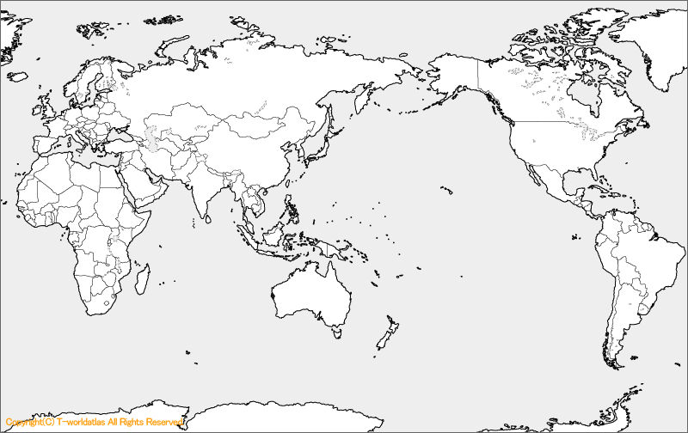
World-wide Coupler Status
E-XFEL @DESY, CEA-Saclay, LAL-Orsay
LCLS-II @FNAL/J-Lab
STF @KEK

Slide 5
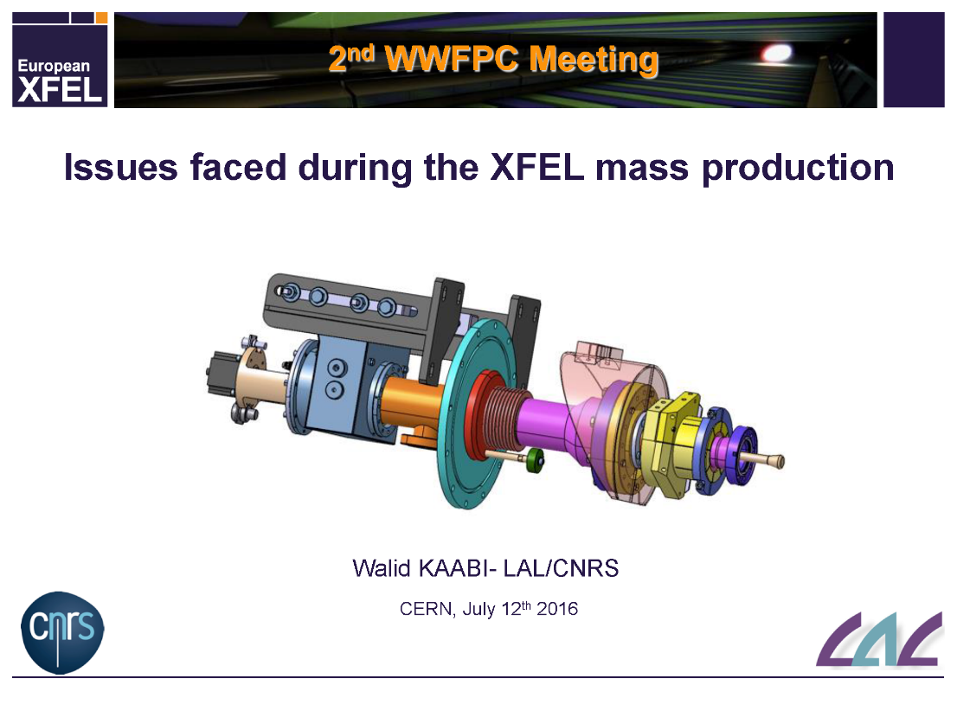
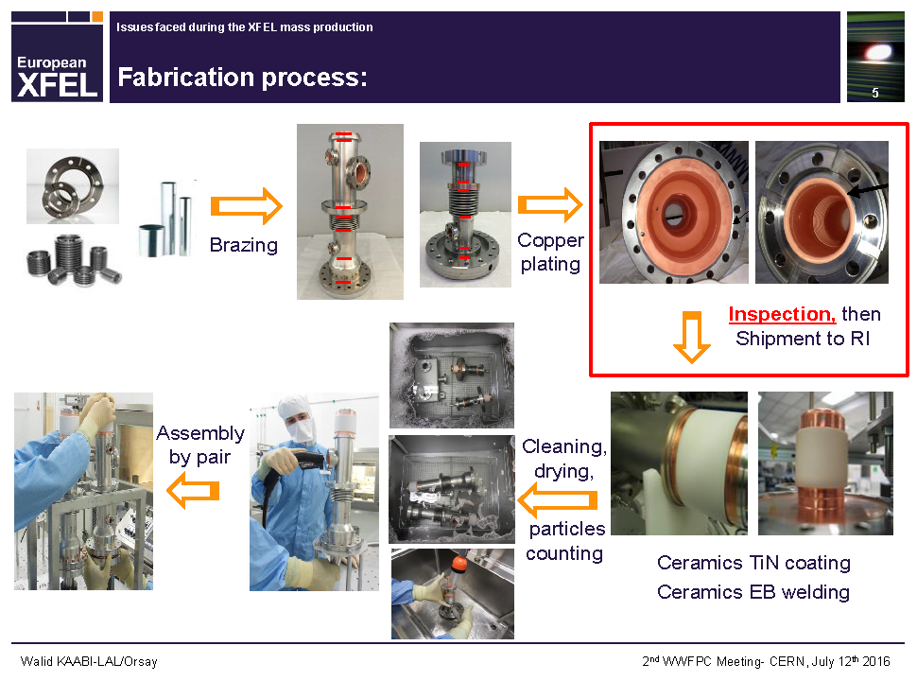
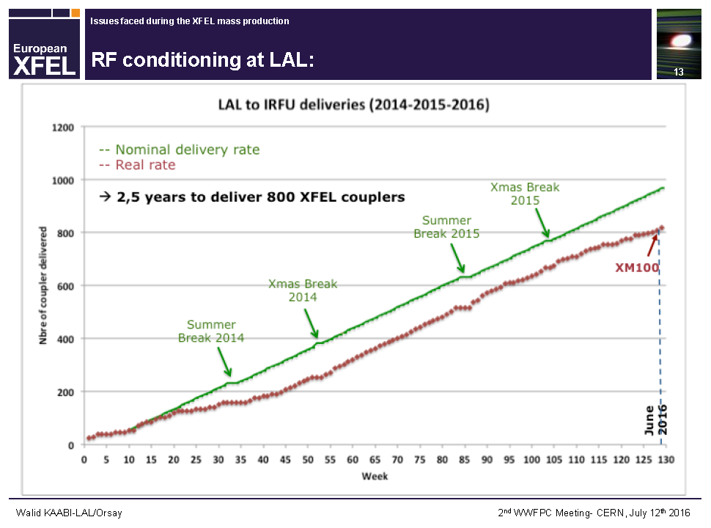
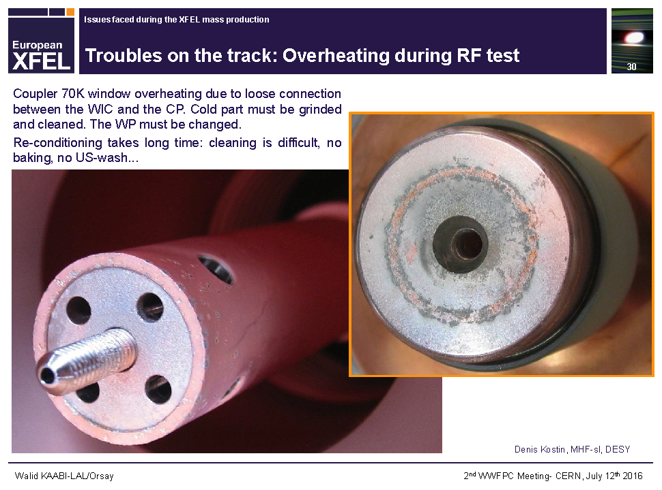
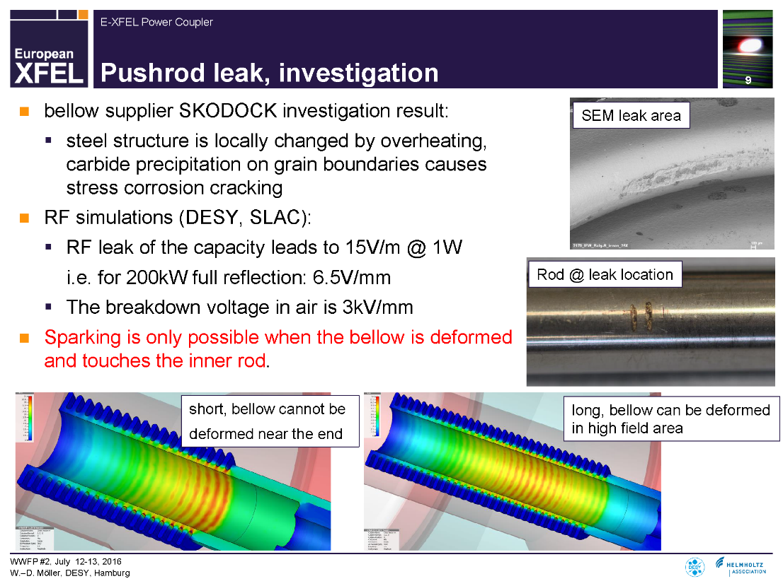
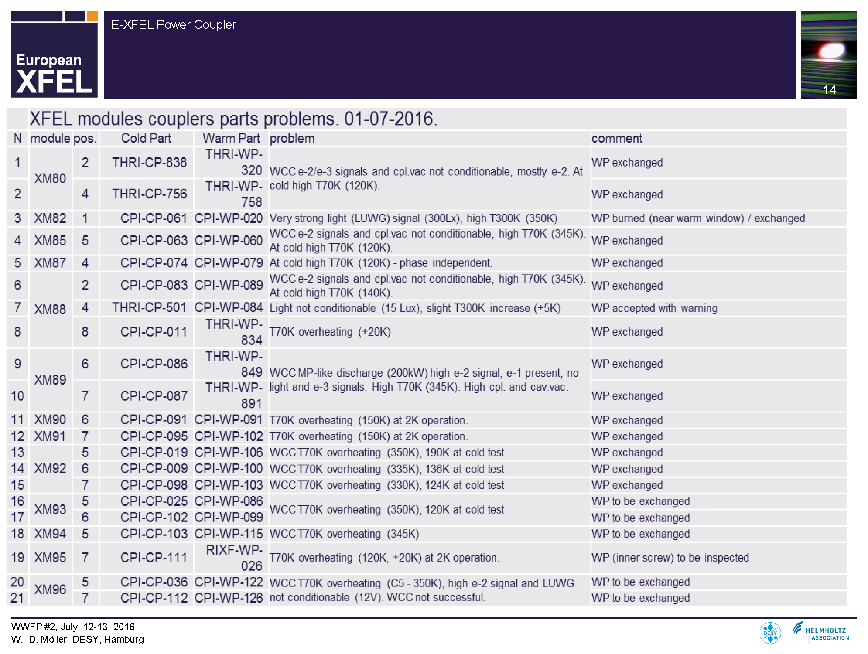
Coupler Status in E-XFEL
During the mass production of coupler for E-XFEL, they encountered many troubles,
but, everything was clear in the last stage.
Courtesy of W.D. Moeller and W. Kaabi

Slide 6
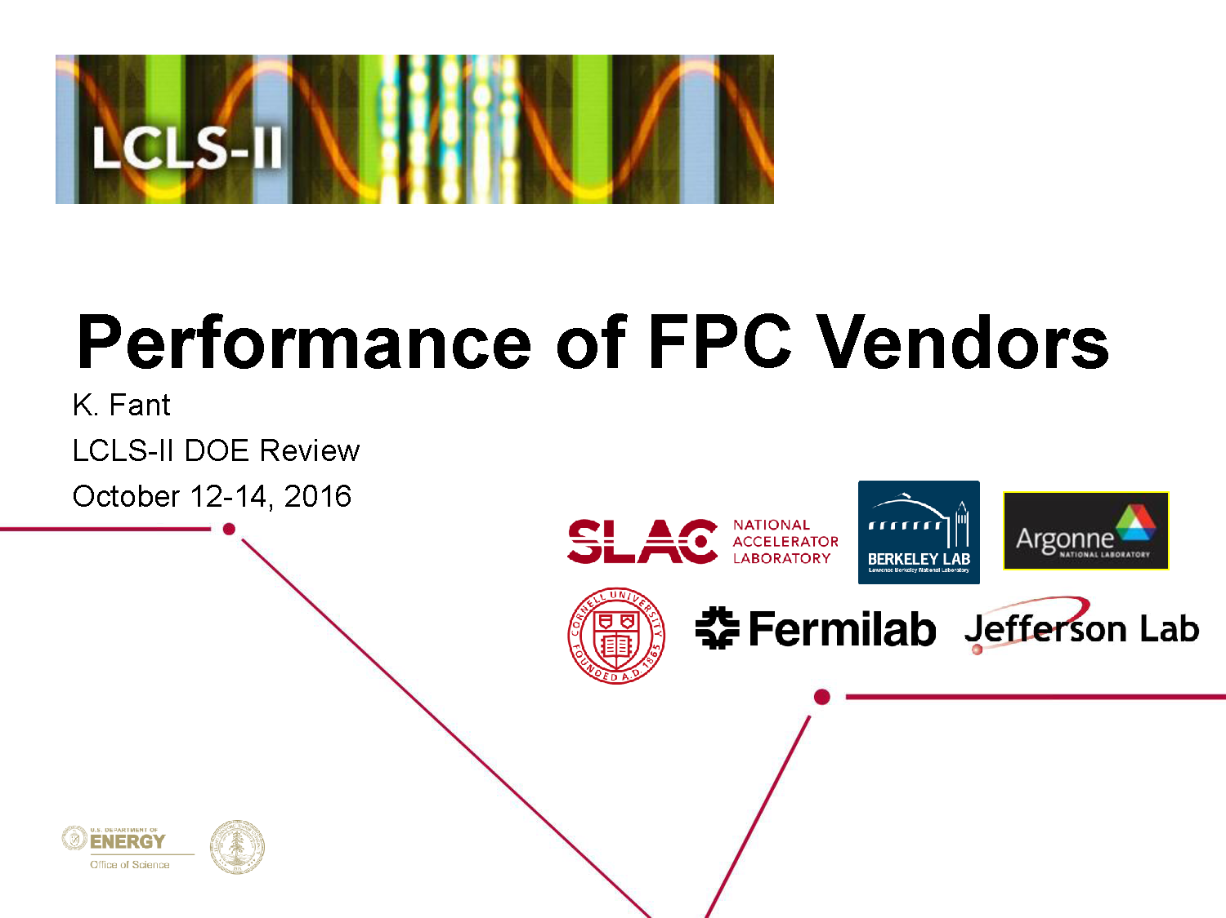
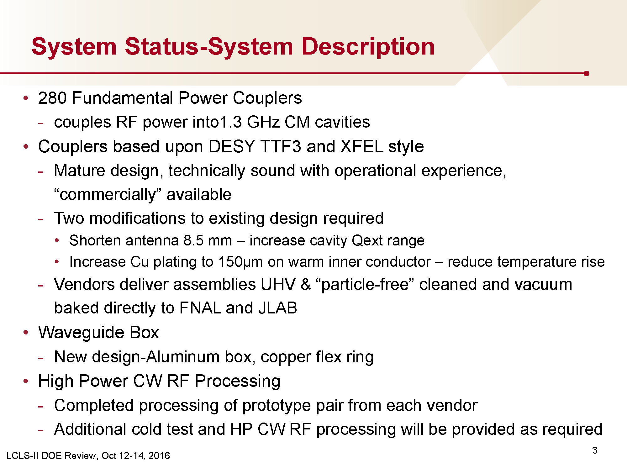
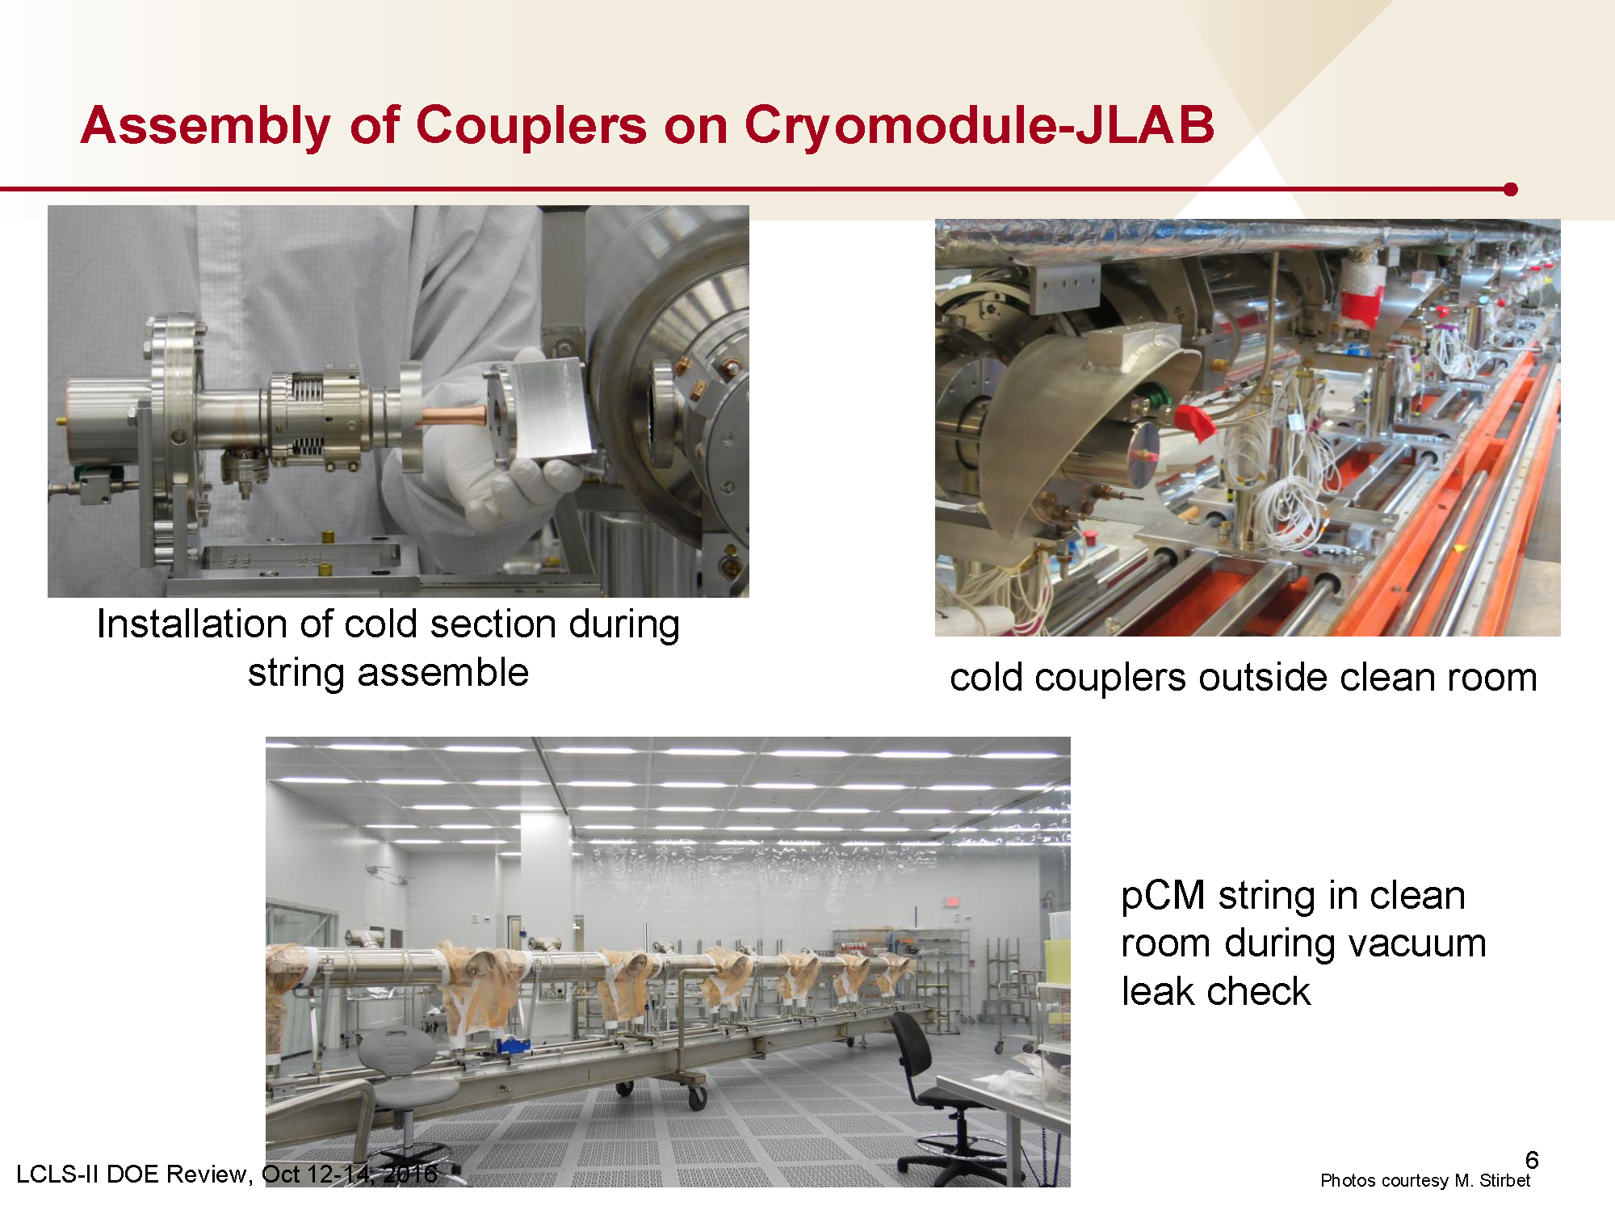
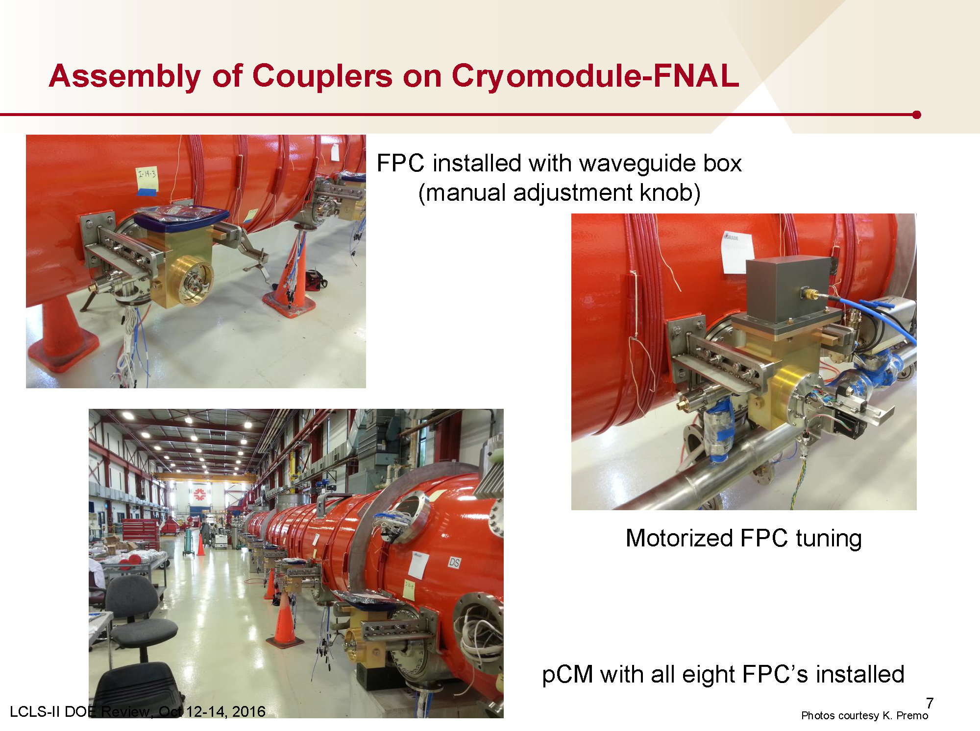
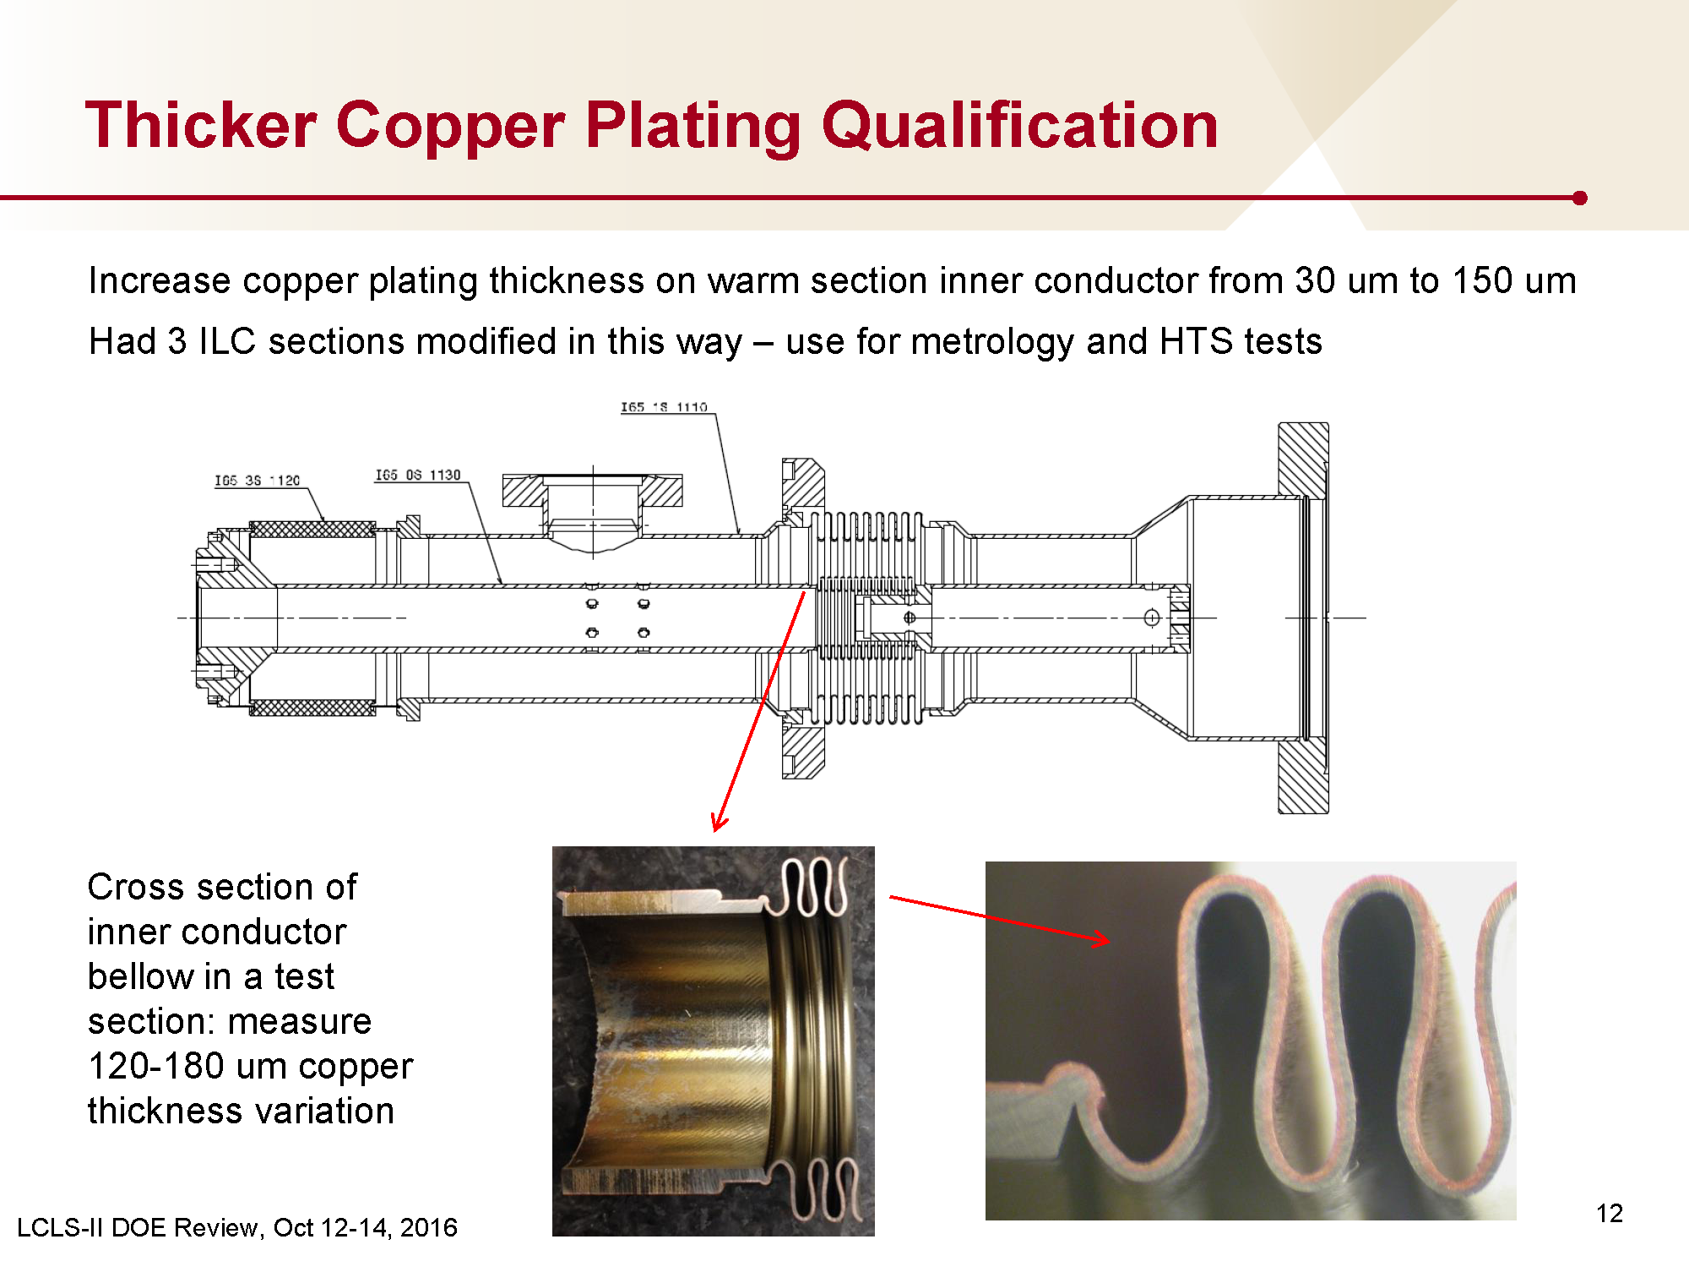
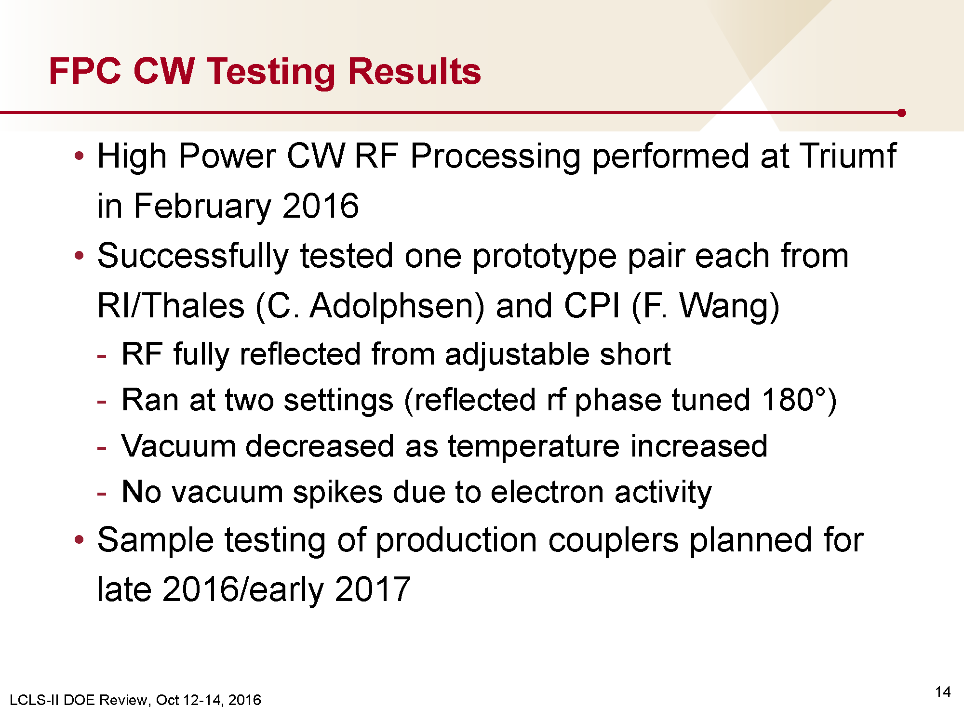
Coupler Status in LCLS-II
Copper plating of 150µm looks very good in first production,
and CW RF processing was also successfully performed at TRIUMF.
Courtesy of N. Solyak

Slide 7
Outline
World-wide coupler status
Coupler specification in TDR
40mm STF-type coupler for plug-compatibility
R&D for cost reduction
R&D plan in F.Y. 2016-2019
Summary

Slide 8
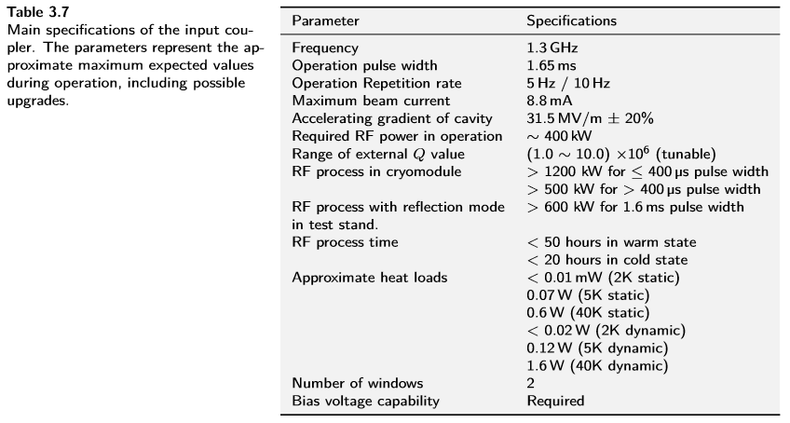
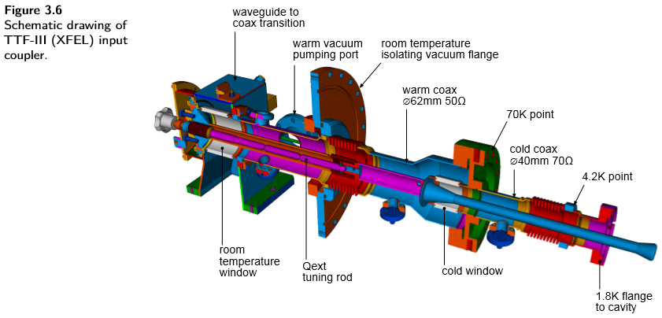
ILC-TDR (for Power coupler specification)
These figures are shown on Page 35 in ILC-TDR Vol.3 Part-II.
Not consistent in these parameters!
This table should be modified, according to recent coupler status used in pulsed operation!

Slide 9
Outline
World-wide coupler status
Coupler specification in TDR
40mm STF-type coupler for plug-compatibility
R&D for cost reduction
R&D plan in F.Y. 2016-2019
Summary

Slide 10
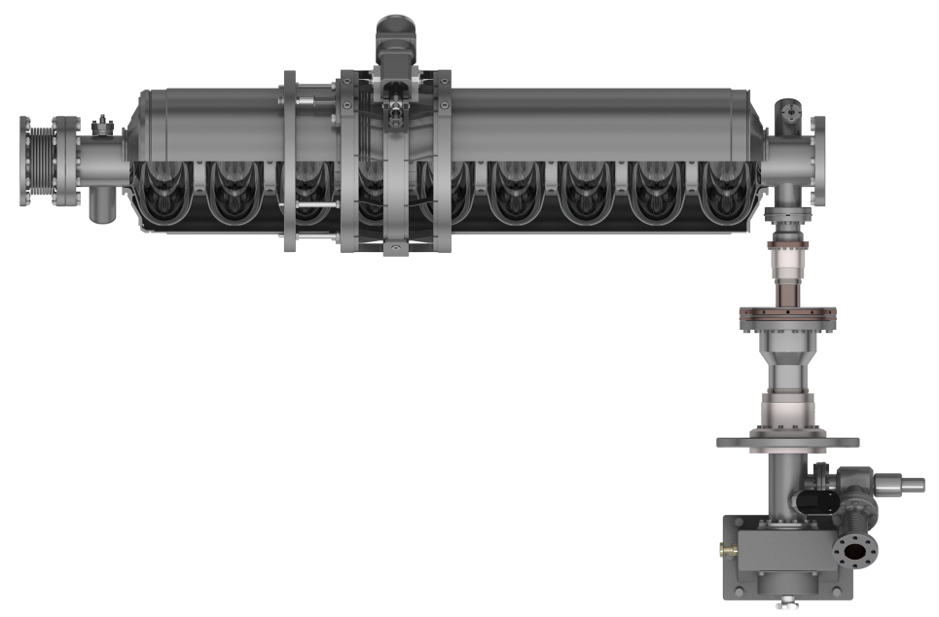
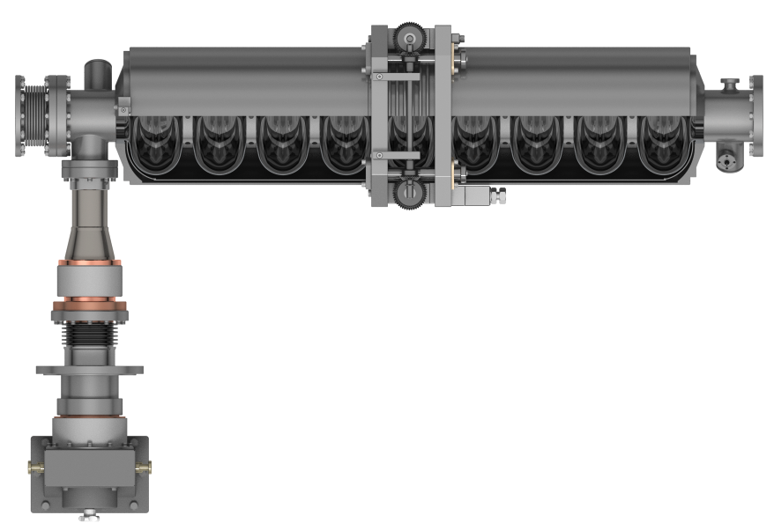
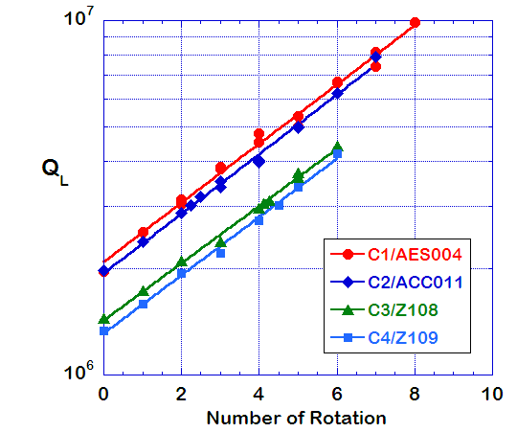
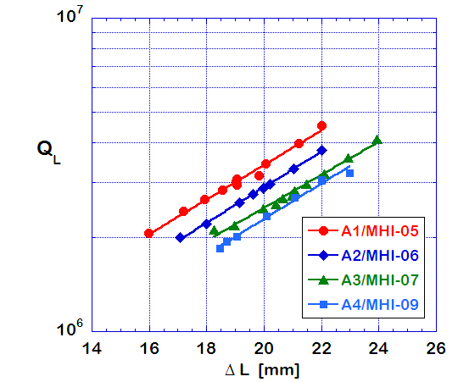
Motivation
DESY/FNAL Cavity Package
KEK Cavity Package
TTF-III Coupler
40mm
60mm
STF-II Coupler
Q_{L}=2~10 x10⁶
Q_{L}=2~4 x10⁶
TDR specification
Port dia. : 40mm
Range of Q_{L} : 10⁶⁻⁷

Slide 11
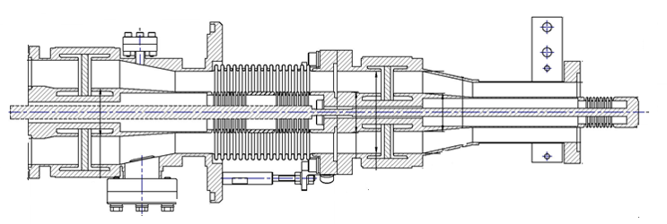
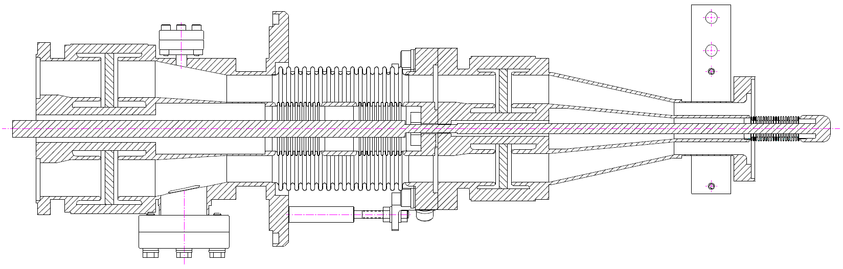
Brief History
Date | Content
Nov/2013 | Recommendation for plug-compatible design from LCC
Feb/2014 | Completion of mechanical design
Jun/2014 | Completion of RF design by simulation
Nov/2014 | Completion of Test Coupler Fabrication
Mar/2015 | Incoming inspection in KEK
Dec/2015 | Low power test at test bench
Feb/2016 – May/2016 | High power test at test bench
Nov/2016 ~ | R&D with TOSHIBA just started
60mm STF coupler
40mm STF coupler

Slide 12
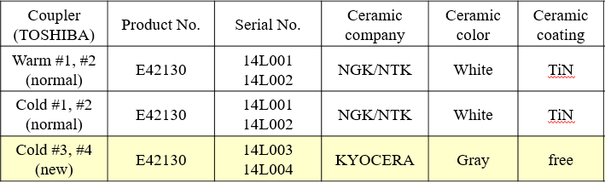
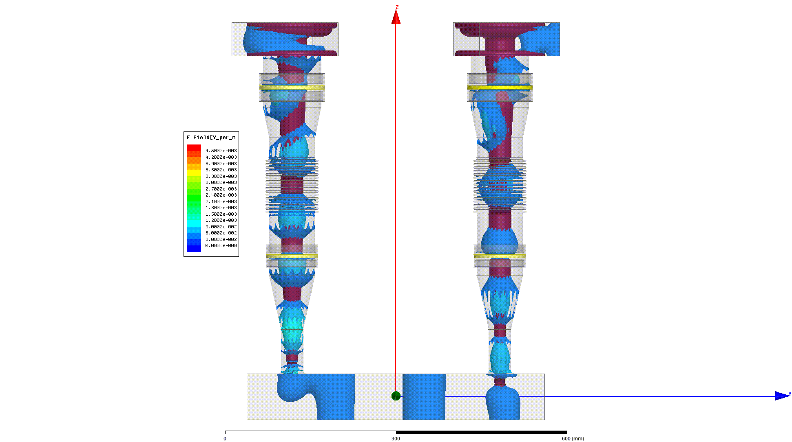
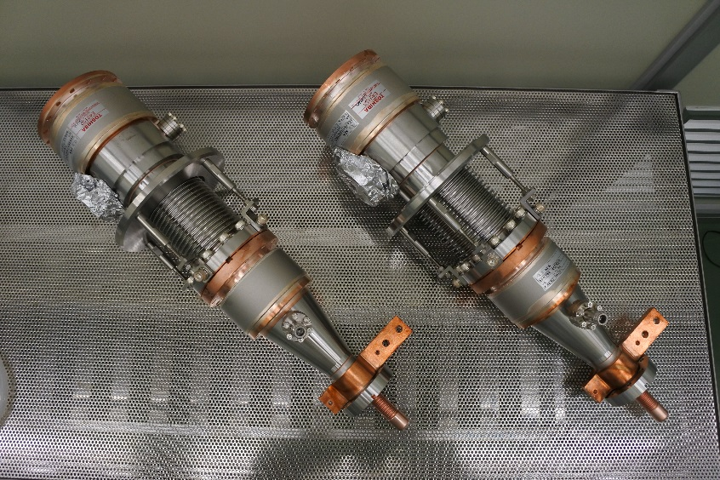
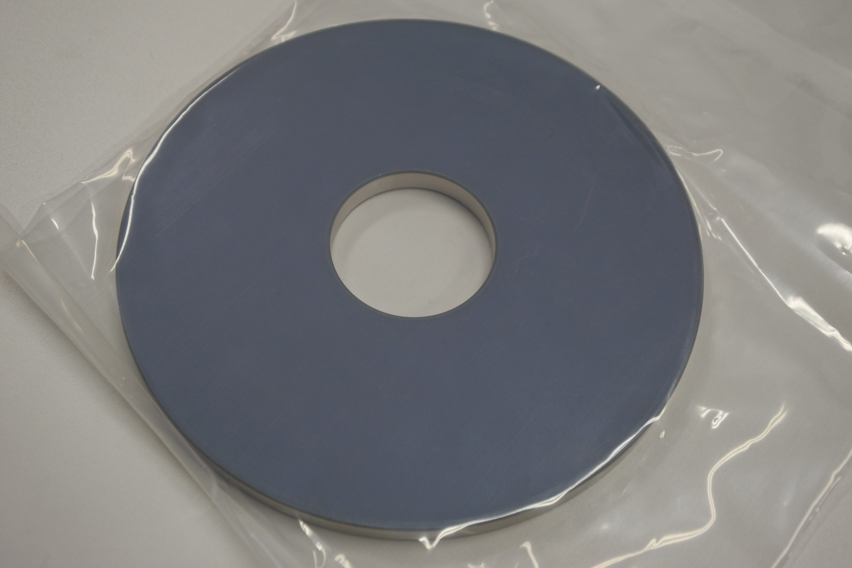
RF Design & Fabrication
Warm part is common
View point of plug-compatibility
  Longer tapered pipe for 40mm port
  Longer bellows for wider range of Q_{L}
View point of lower cost study
  Coating-free ceramic
    Coating process is dominant in cost

Slide 13
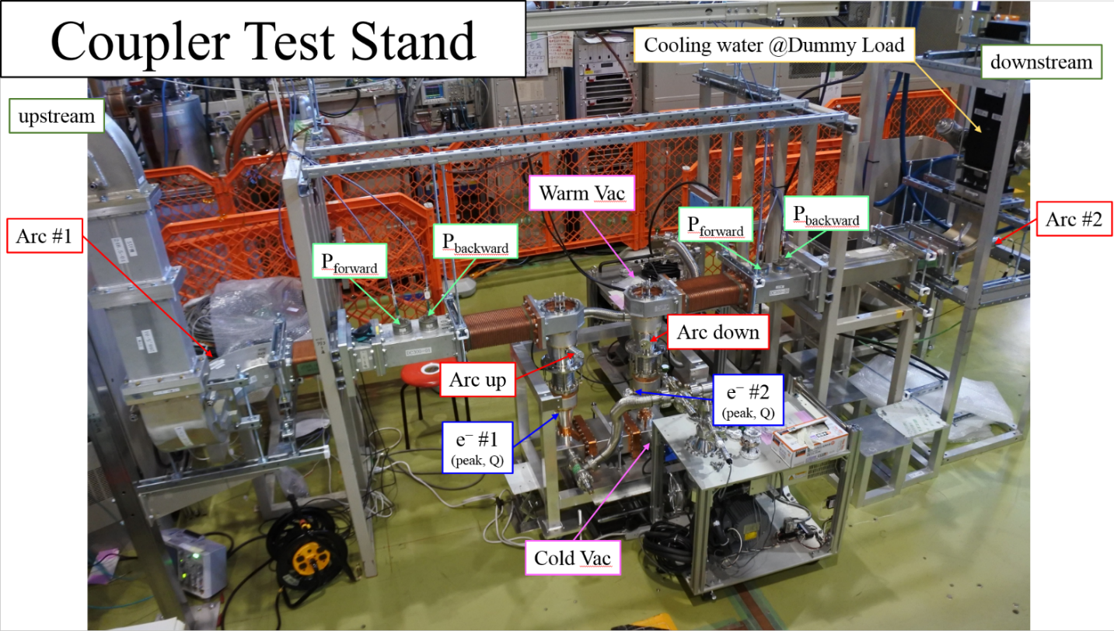
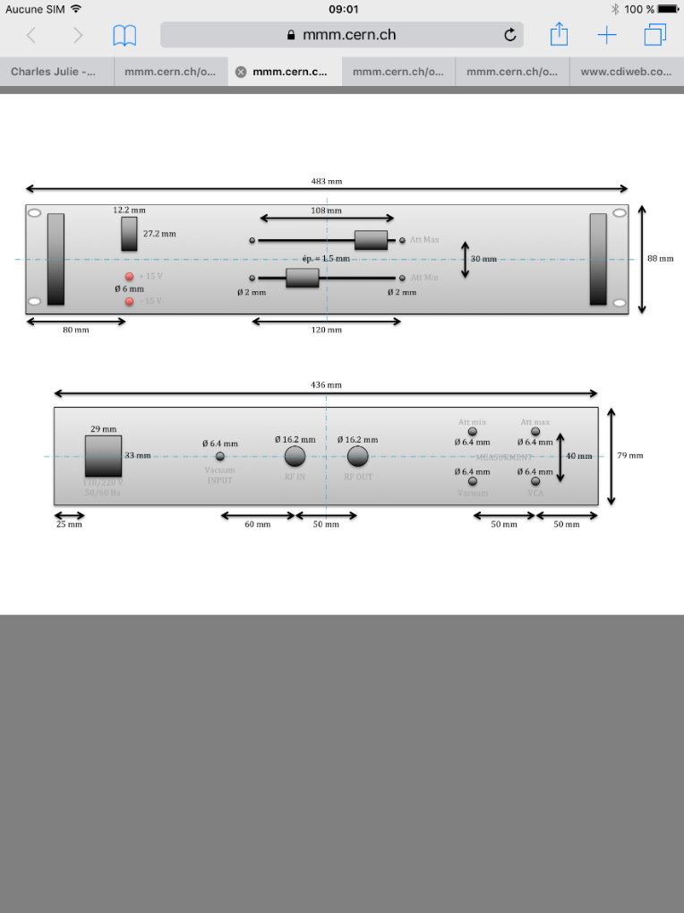
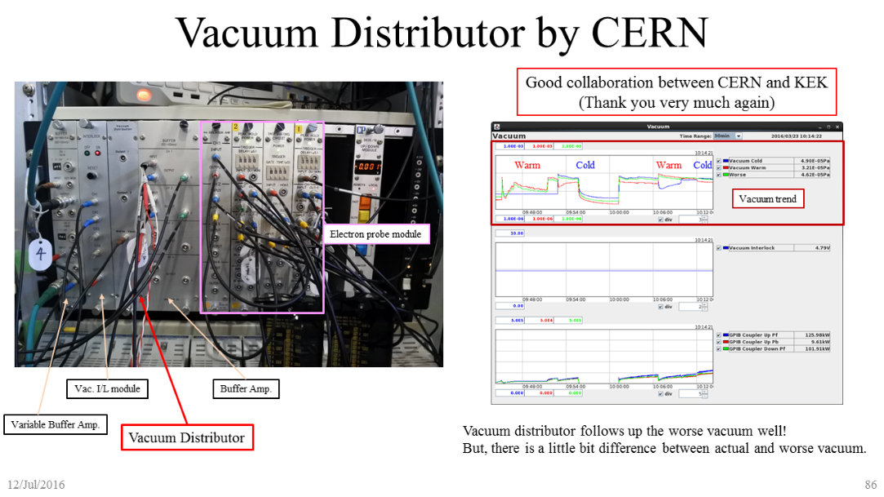
High power test at bench
Auto-conditioning module
Warm part is common
Two kinds of cold parts (TiN coating/free)
Goal: 1200 kW for <500μs
Goal: 800 kW for >500μs
Monitor: Vacuum, Electron, Arc, VSWR
Devices: Auto-conditioning & Vacuum distributor modules
Good collaboration between CERN and KEK
(Thank you very much)

Slide 14
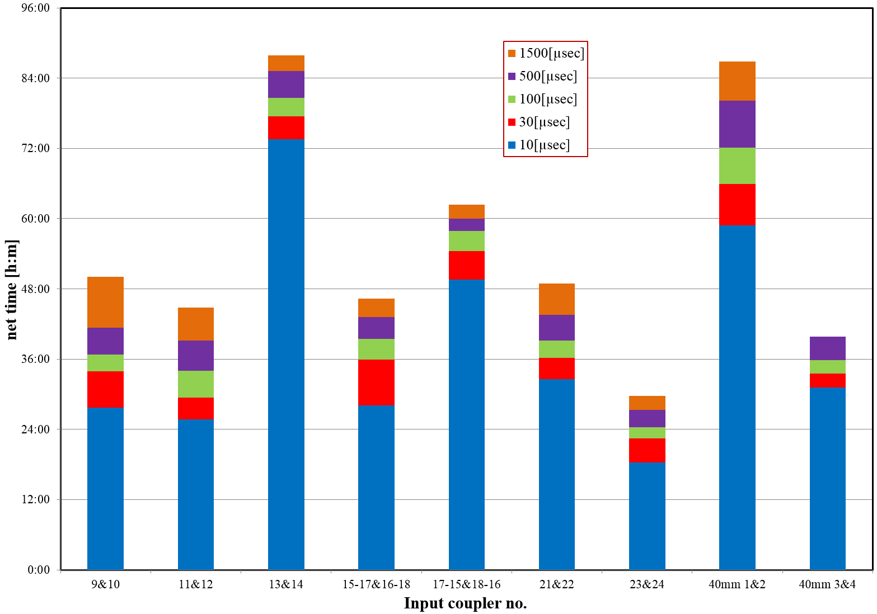
Comparison of RF conditioning time
60mm STF coupler
40mm STF coupler
40mm STF coupler had
typical conditioning time
New ceramic coupler had
unusual heating at higher RF duty
Plug-compatible STF coupler showed typical performance.

Slide 15
Outline
World-wide coupler status
Coupler specification in TDR
40mm STF-type coupler for plug-compatibility
R&D for cost reduction
R&D plan in F.Y. 2016-2019
Summary

Slide 16
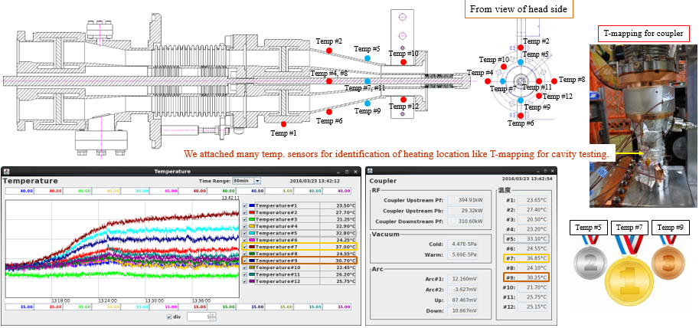
How about New Ceramic Coupler?

Slide 17
Outline
World-wide coupler status
Coupler specification in TDR
40mm STF-type coupler for plug-compatibility
R&D for cost reduction
R&D plan in F.Y. 2016-2019
Summary

Slide 18
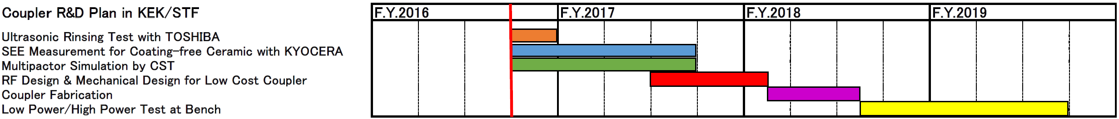
R&D Plan in F.Y. 2016-2019
Ultrasonic Rinsing Test for Coupler (with TOSHIBA)
SEE Measurement for Coating-free Ceramic (with KYOCERA)
Secondary Electron Simulation & RF Design by CST
Fabrication of Low Cost Coupler
High/Low Power Test at Bench
We’re here
We can get enough budget

Slide 19
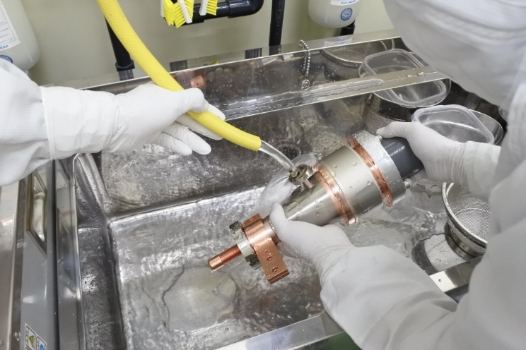
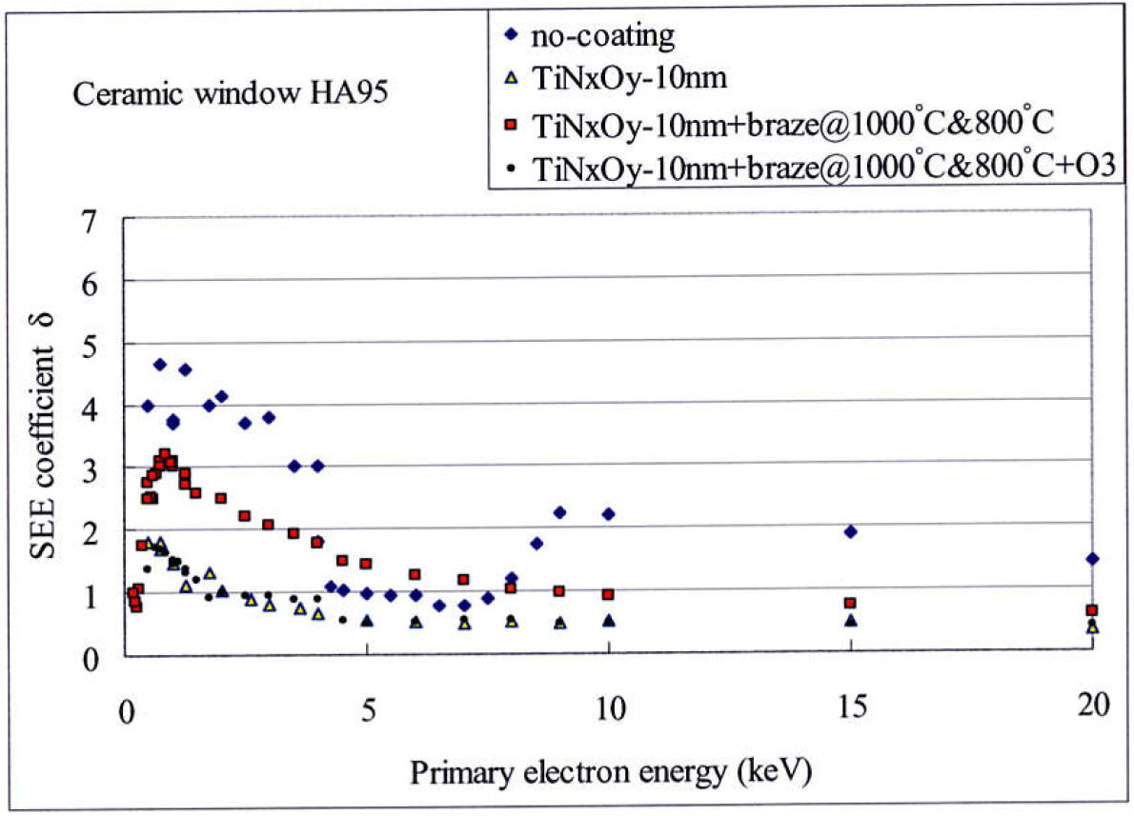
R&D for Rinsing Process
Collaboration with TOSHIBA
Ultrasonic Rinsing w/ detergent has been used for E-XFEL
TOSHIBA tried Ultrasonic Rinsing for FRIB
It will be done for STF-type coupler in F.Y. 2016 with TOSHIBA
Comparison among difference rinsing processes
    Ultra-pure water rinsing @STF, Ultrasonic rinsing w/ detergent @E-XFEL, O₃ water rinsing @KEKB
Kijima et al.
W. Kaabi

Slide 20
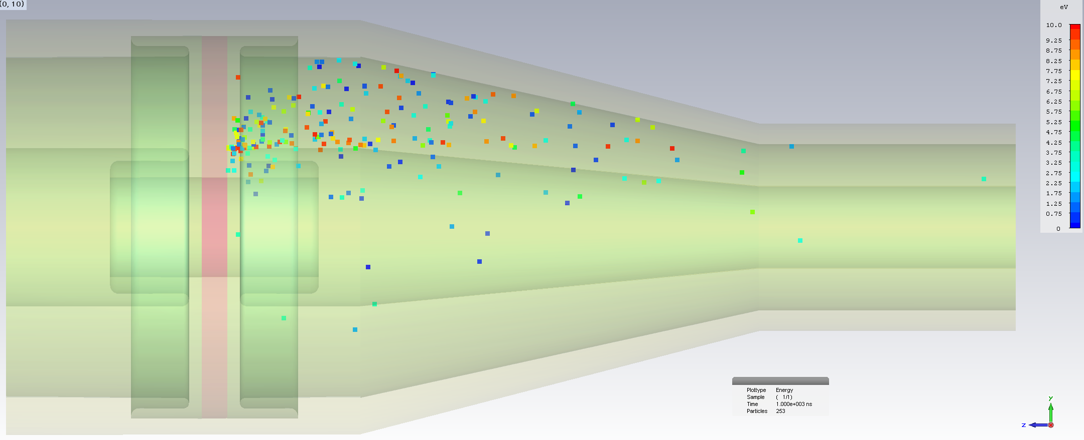
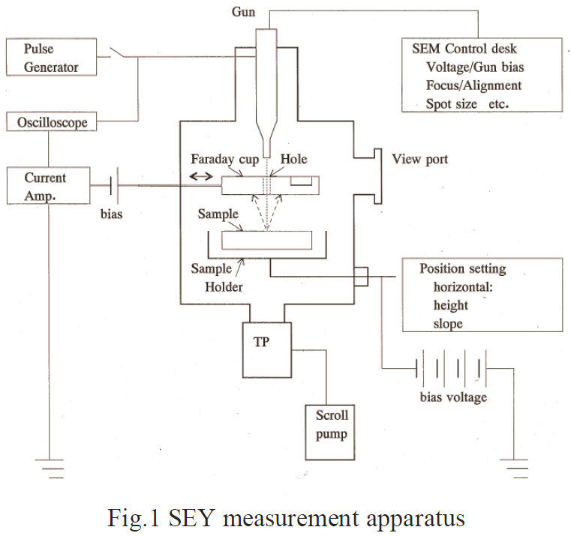
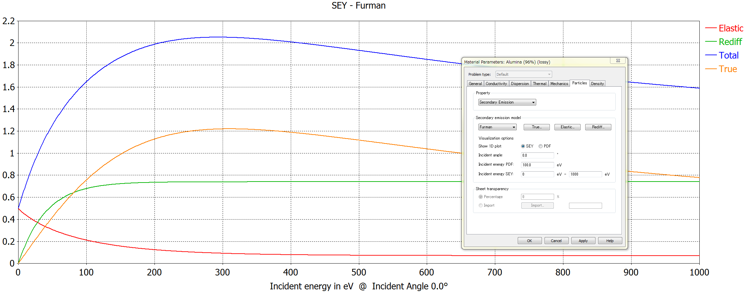
R&D for Coating-free Ceramic
Fabrication of Test Sample for Coating-free Ceramic
SEY Measurement for Test Sample
Secondary Electron Propagation Simulation by CST
Fabrication of New Coating-free Coupler
Test for New Coating-free Coupler
Collaboration with KYOCERA
Metalize process changed?
We can change SEY parameters, according to measured data

Slide 21
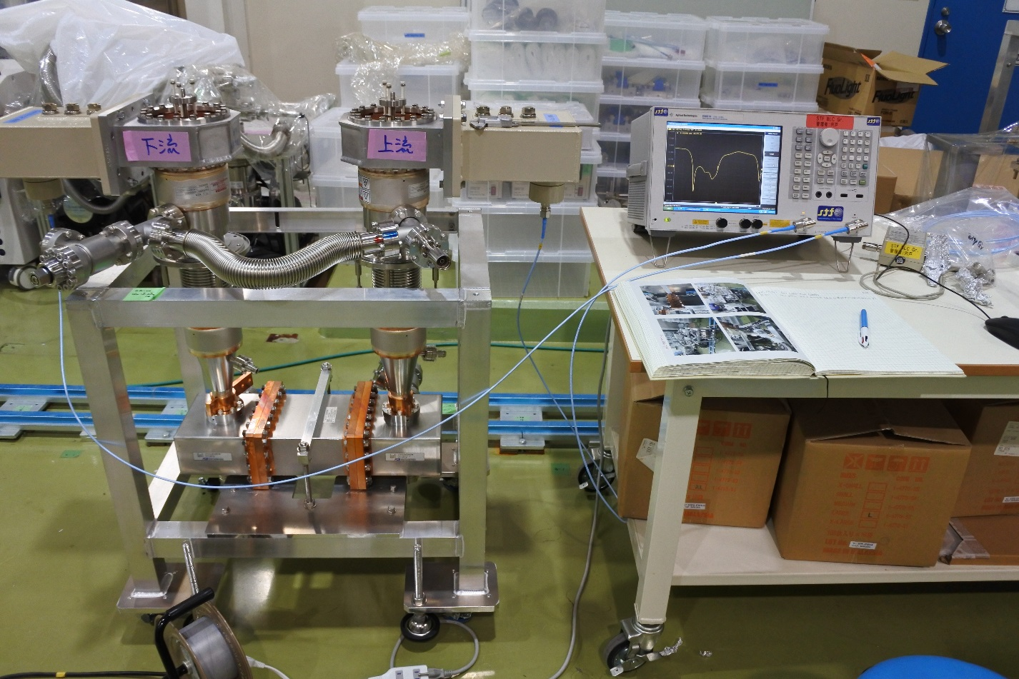
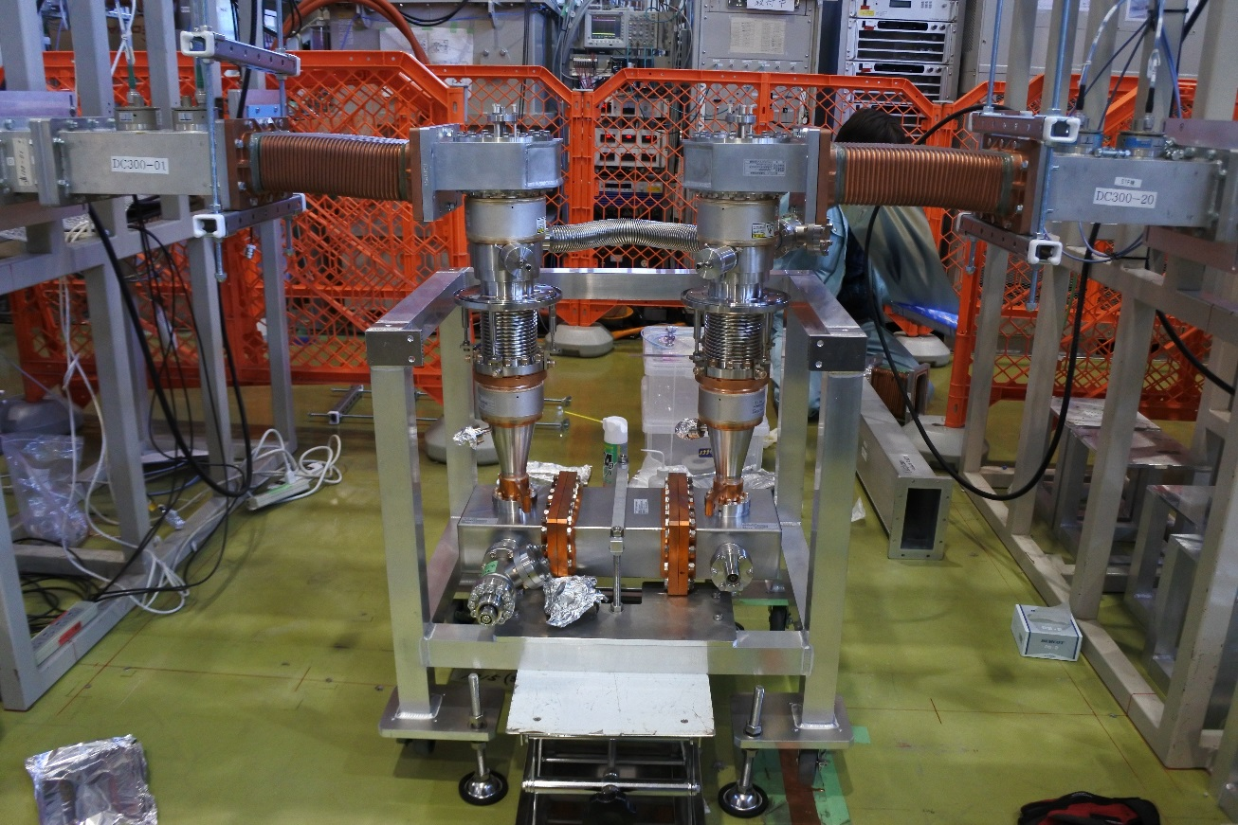
Low/High Power Test
Low cost coupler will be fabricated,
and tested in 2018-2019
If successful, new coupler will be
used and tested in STF Cryomodule

Slide 22
Summary
Mass-production for coupler looks very good for E-XFEL and LCLS-II
ILC-TDR should be modified
Plug-compatible STF coupler is available for ILC
Coating-free ceramic coupler needs more R&D
Rinsing test for coupler will be done in F.Y. 2016

Slide 23
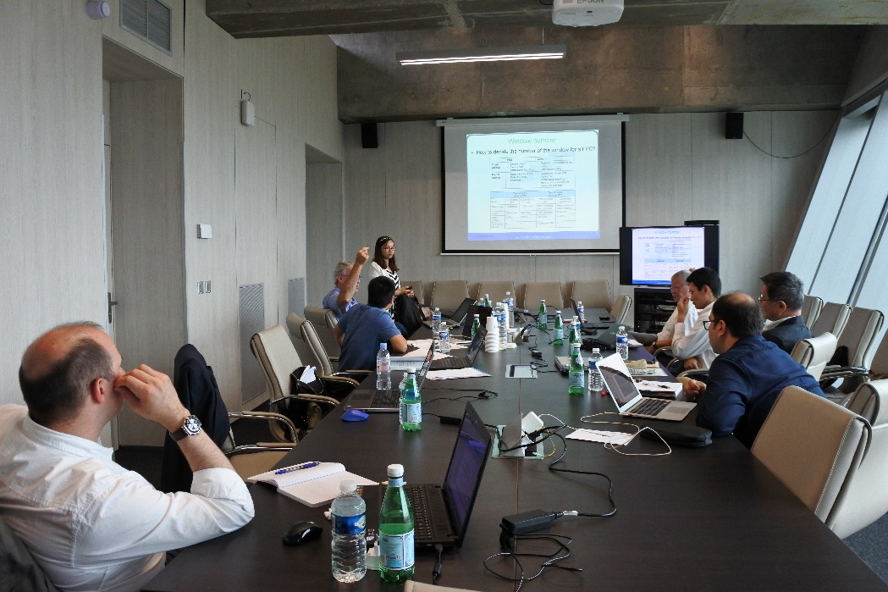
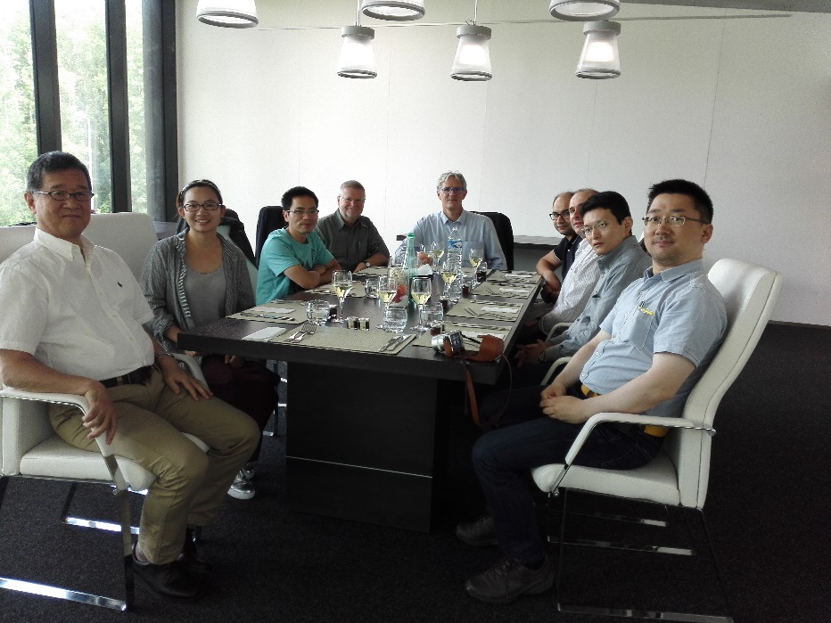
Thank you very much for your attention
If you are interested in coupler R&D, please check the following site!
World-Wide Fundamental Power Coupler Meeting in CERN Organized by E. Montesinos
https://indico.cern.ch/event/548549/timetable/#20160712

