Slide 1
Procurement, Measurement and Installation of 2 Octupoles for ATF
Linear Collider Workshop 2016, 5-9 December 2016, Morioka, Japan
Michele Modena
CERN – European Organization for Nuclear Research

Slide 2
Outline:
Octupoles proposal and specification
Components procurement
Assembly and measurements
Shipment and installation at ATF

Slide 3
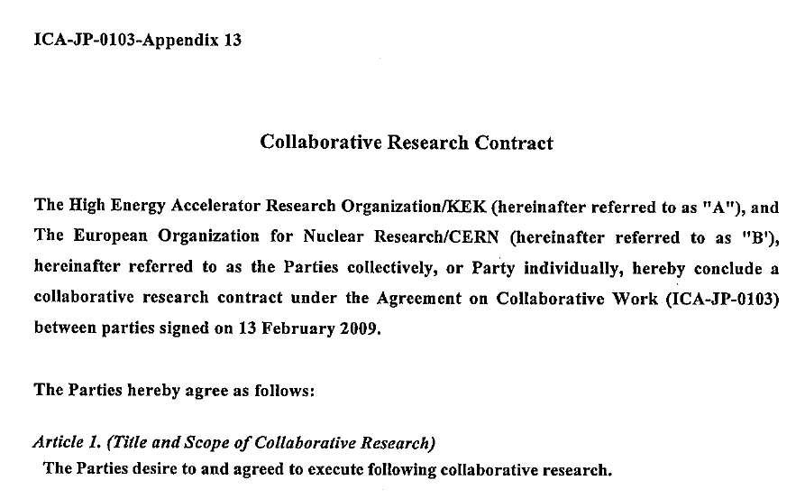
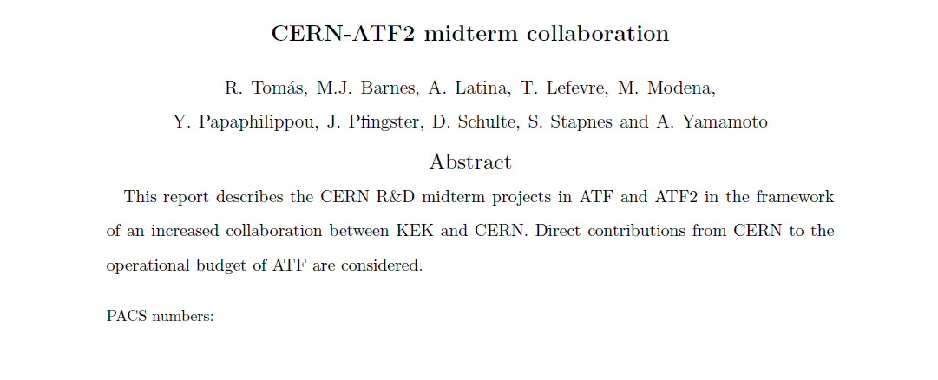
Octupole for ATF: Octupole proposal and specification
The CERN procurement of 2 Octupoles for further exploration of nanometre beam size was officialised in 2014 after a first proposal was presented at the CERN-Midterm collaboration meeting.
The 2 octupoles would be one of the several contribution in hardware from CERN for the prosecution of the ATF2 program in the next phase.

Slide 4
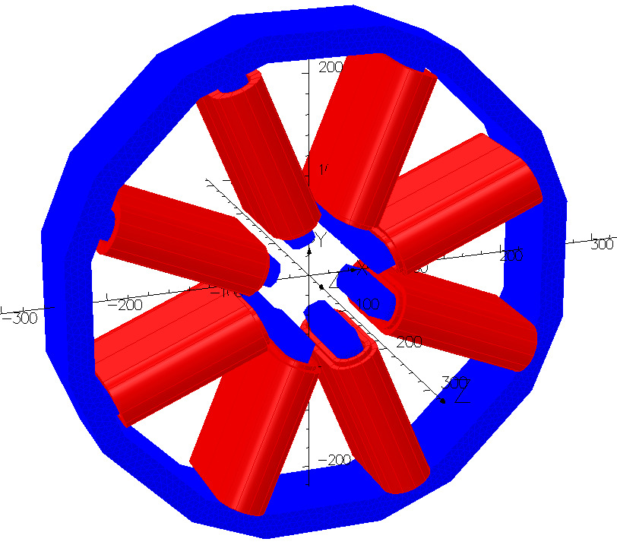
Octupoles for ATF: Octupole Specification
A first specification was requiring 2 identical octupoles with an integrated strength of 560 T/m².
A conceptual design was started based on this strength requirements but layout in ATF and manufacturing boundary conditions were mainly driving the design:
Mechanical design simpler as possible concerning the installation aspects in ATF. This in order to have an easy mounting and without perturbing the existing equipment.
Air cooled coils were chosen to simplify the design, service requirements, and installation.
Magnet bore was chosen: to be compatible with the existing vacuum chambers/BPM, to provide an iron saturation above a minimum level (for operation at very low gradients). A better field quality will also follow.
PARAMETER | UNITS | VALUE
Gradient, | T/m³ | 5284
Integrated gradient | T/m² | 560
Aperture radius | mm | 50
Iron length | m | 0.100
Magnetic length | m | 0.106
Coil number of turns |  | 61
Conductor size | mm x mm | 5 x 5
Ampere-turns | A | 1200
Current | A | 19.7
Resistance (per coil) | mΩ | 14
Conductor length (per coil) | m | 19.9
Conductor mass (per coil) | kg | 4.5
Yoke mass | kg | 56
Total mass | kg | 92

Slide 5

Octupoles for ATF: Octupole Specification
Then the requirements evolved and two different octupoles strengths and integrated gradients were defined (see: SLAC-TN-14-019).
Following a change in the installation position the required values varied again.

Slide 6
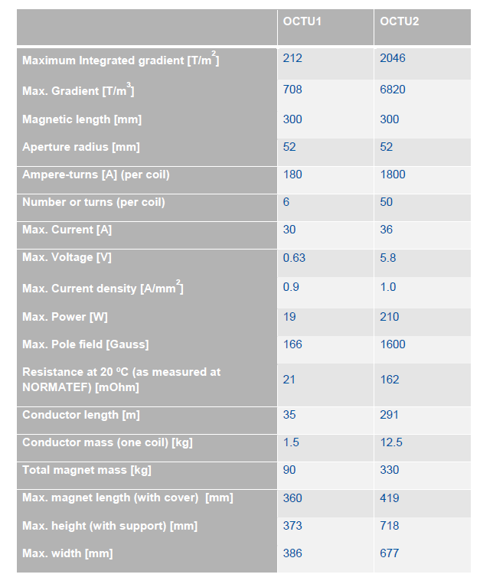
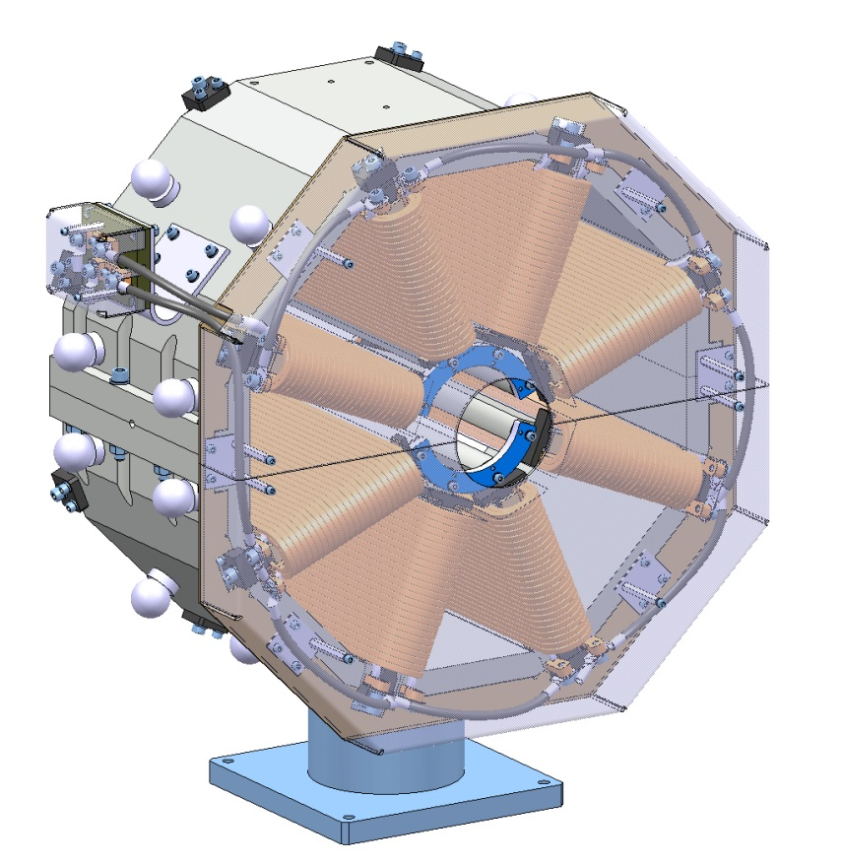
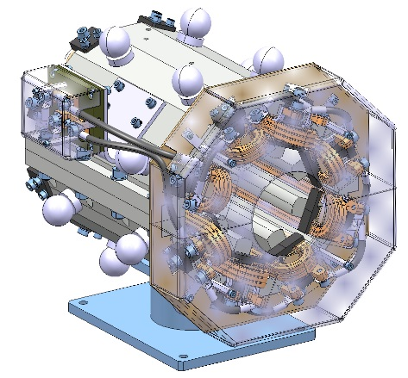
Octupoles for ATF: Octupole Specification
Finally, the designs converged to the following parameter sets. The final required integrated gradient were:
212 and 2046 T/m²
OCTU2
OCTU1

Slide 7
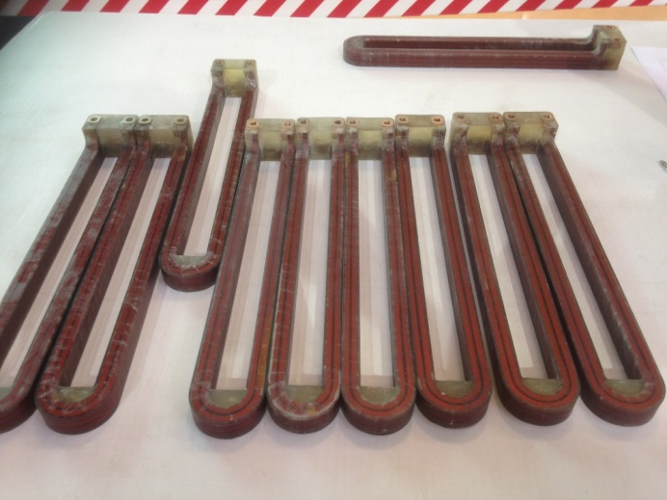
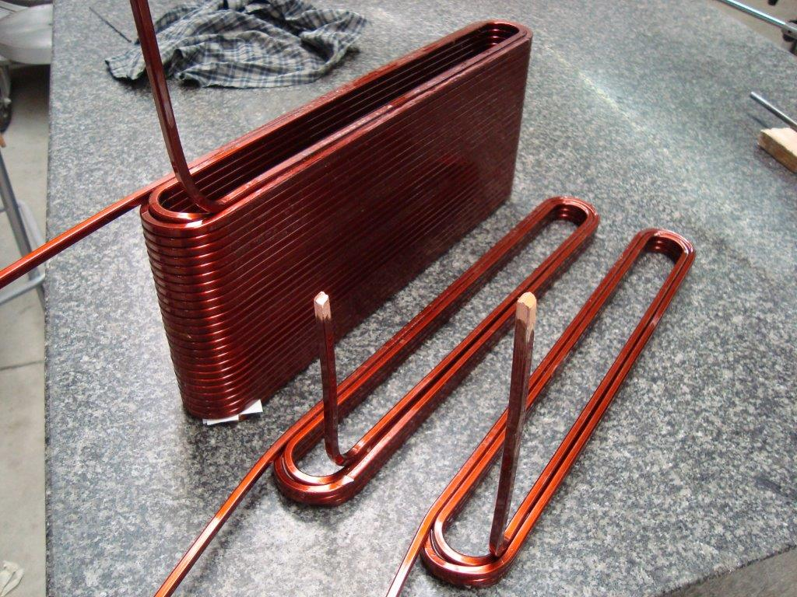
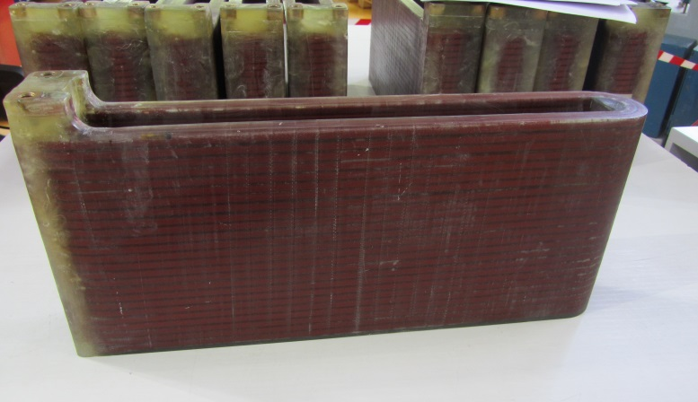
Octupoles for ATF: Components procurement
Procurement of main components was done in industry:
Coils were procured with S.E.F. Sarl, Labège - F
20 coils were procured (8 + 8 + 4 spares)

Slide 8
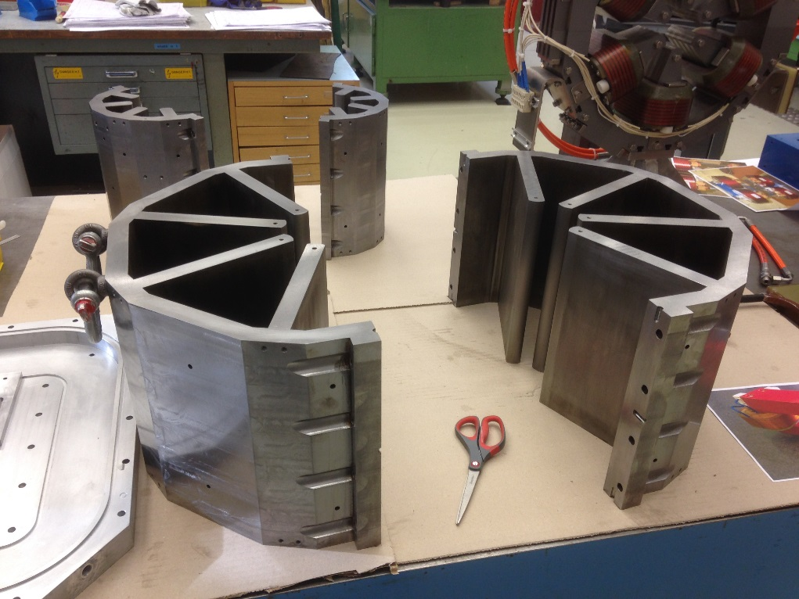
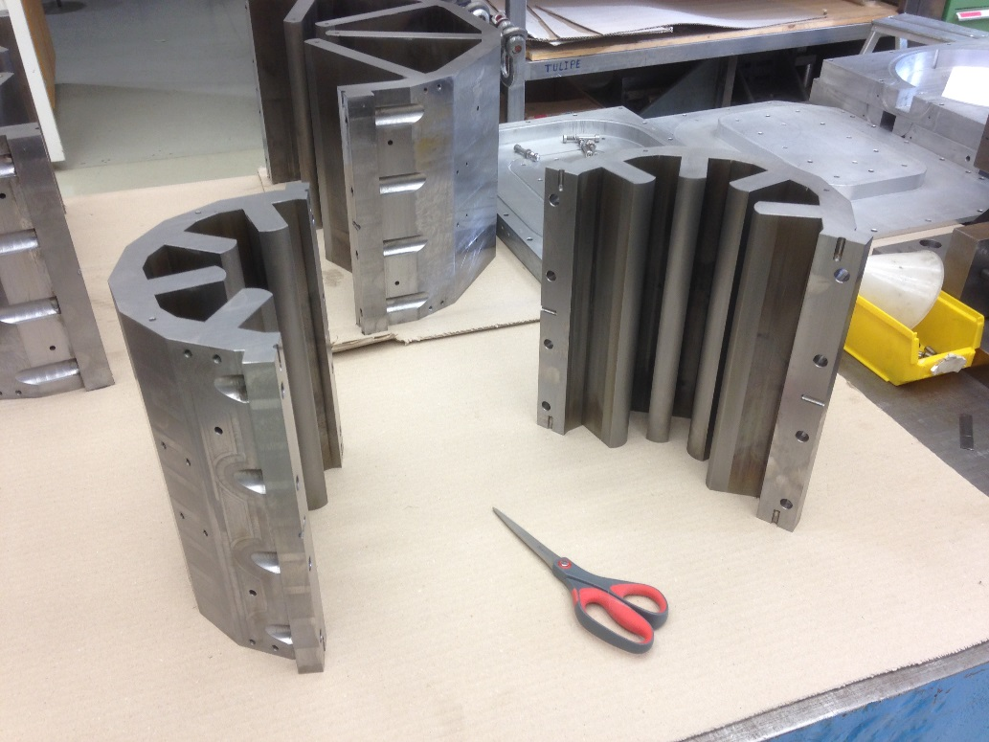
Octupoles for ATF: Components procurement
Iron yokes, made in ARMCO Iron, were machined by EDM (Electro Discharge Machining) with: Röttgers Værktøj A/S Odense - DK

Slide 9
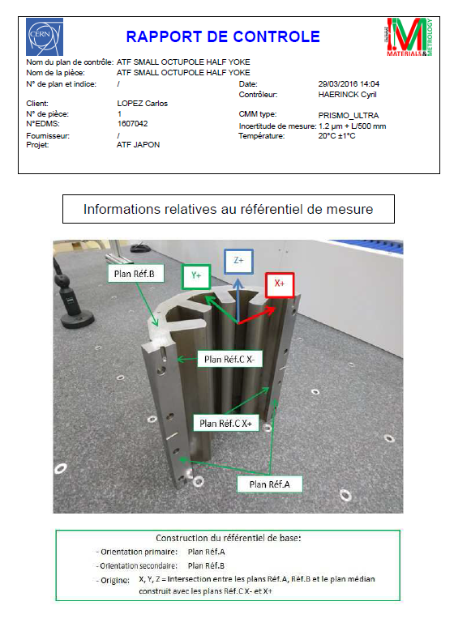
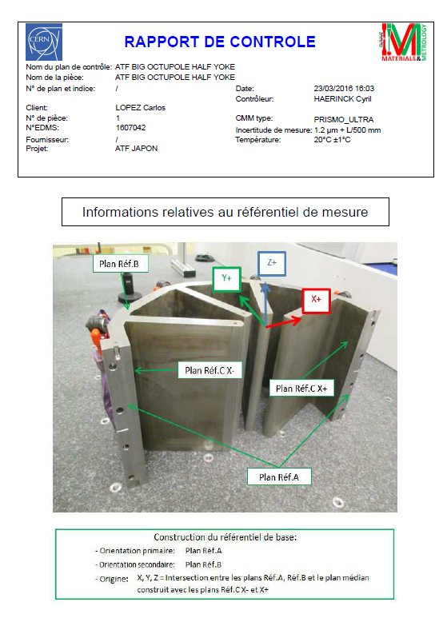
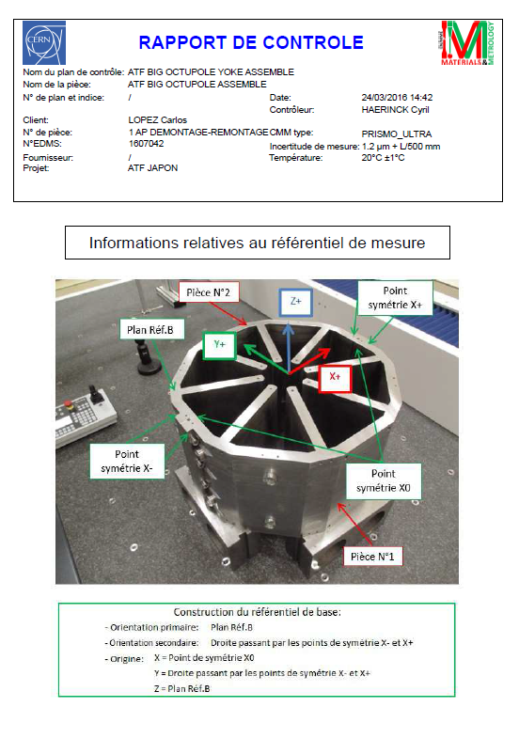
Octupoles for ATF: Components procurement
Iron yokes were measured at CERN Metrology Lab and accepted even if with some out of tolerance respect to the design (specified tolerance were know to be quite difficult to be realized on this relatively big pieces). Final tolerance of the critical parts (e.g. poles profiles) are in the range of 150 µm (referred to the nominal mechanical axis). As expected, the OCTU1 iron yokes are more precise respect to OCTU2.

Slide 10
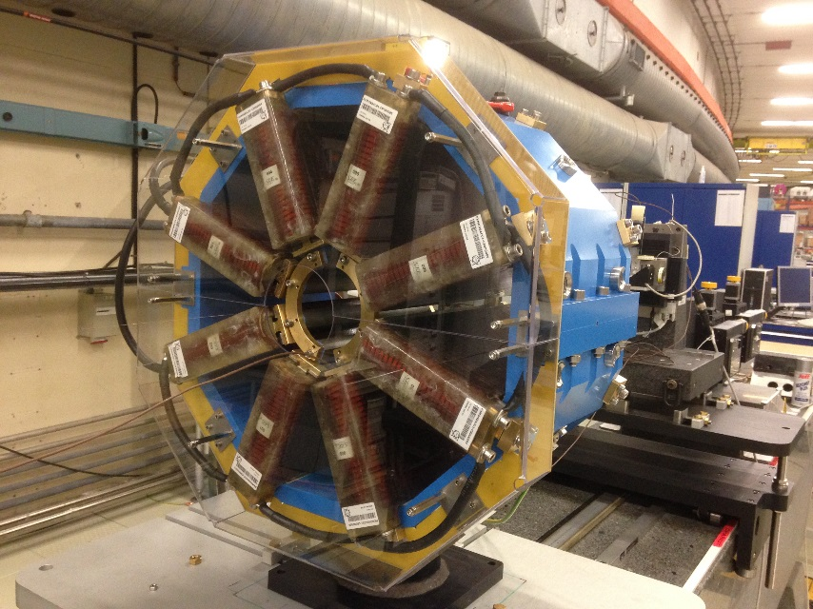
Octupoles for ATF: CERN Measurements
The 2 magnets were assembled in June-July 2016 and tested in August.
Magnetic measurement reports are available in CERN-EDMS (Nr: 1725782 and 1725791).
The transfer function was measured in details up to the maximum (nominal) design integrated gradient and beyond.
In fact, it was also asked to check the “ultimate” working points at which the magnets could be operated.
As “ultimate” current, 50 A were found acceptable (as a value compatible with the thermo-switches of the magnets coils (air cooled).
 | (Nominal) Design Integrated Gradient (T/m²) | (Nominal) Measured Integrated Gradient(T/m²) | Ultimate Measured Integrated Gradient (T/m²)
OCTU1 | 212 (30 A) | 218 (28.0 A) | 390.66 (50A)
OCTU2 | 2046 (36 A) | 2060.6 (32 A) | 3166.9 (50 A)

Slide 11
Octupoles for ATF: CERN Measurements
OCTU1:
OCTU2:
Comp. Units
(average)
b5 -0.93
a5 -0.53
b6 0.37
a6 -0.41
b7 -0.17
a7 0.04
b8 -0.02
a8 -0.12
b9 -0.01
a9 0.01
b10 0.01
a10 0.01
b11 0.02
a11 -0.06
b12 -0.27
Comp. Units
(average)
b5 2.20
a5 -1.11
b6 1.06
a6 -0.35
b7 -0.15
a7 0.01
b8 -0.04
a8 -0.02
b9 0.02
a9 -0.03
b10 0.02
a10 0.00
b11 0.00
a11 0.01
b12 -0.27
The field quality is here indicated in terms of magnetic multipoles in 10⁻⁴ with respect to the main field at a reference radius of 20 mm. The values are the ones measured at the “ultimate” current of 50 A.
Measurements were done with a rotating coils system. The measurement calibration was checked with a stretched wire system measurement.

Slide 12
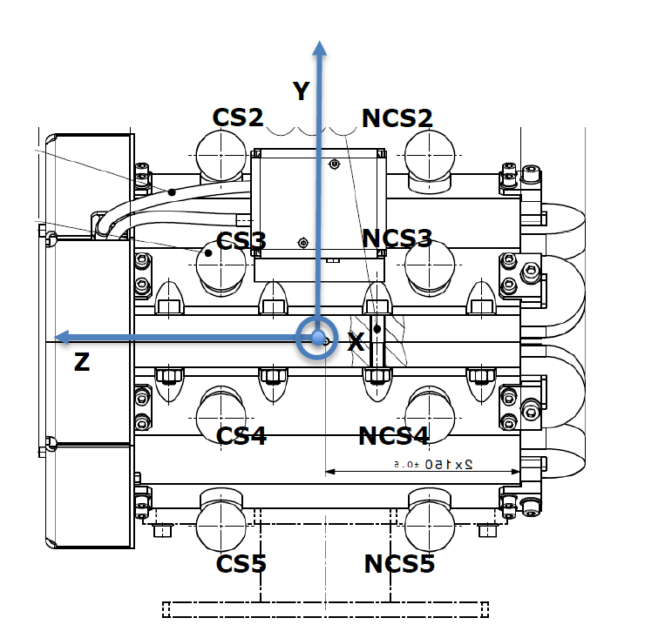
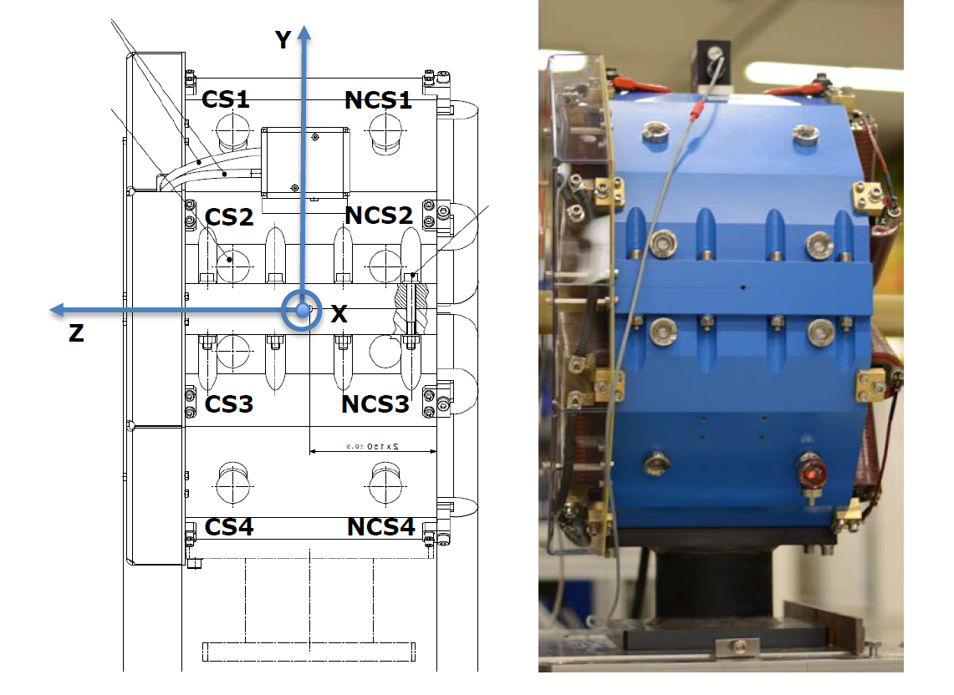
Octupoles for ATF: CERN Measurements: magnetic axis
OCTU1:
OCTU2:
During the measurement the OCTU2 has been opened, reclosed and re-measured afterword. The magnetic center moved of +0.002 mm in x direction and -0.003 mm in y direction which are in the range of the magnetic measurement uncertainty. Multipoles variation changed less than 0.1 unit. This test demonstrates the very good mechanical repositioning of the two magnet half-yokes.
Magnetic centres coordinates are provided respect to the reference systems (sphere supports)

Slide 13
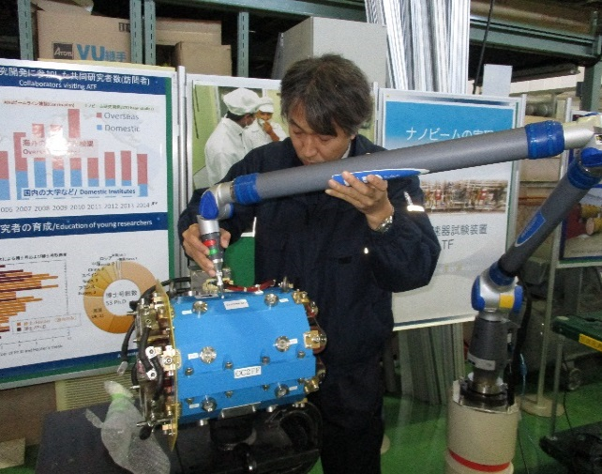
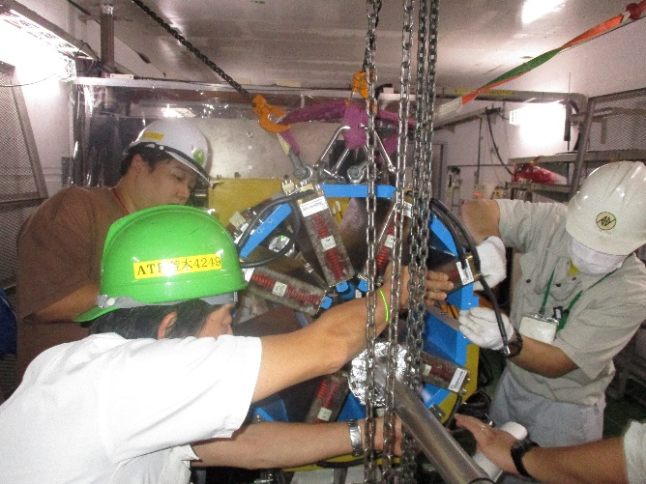
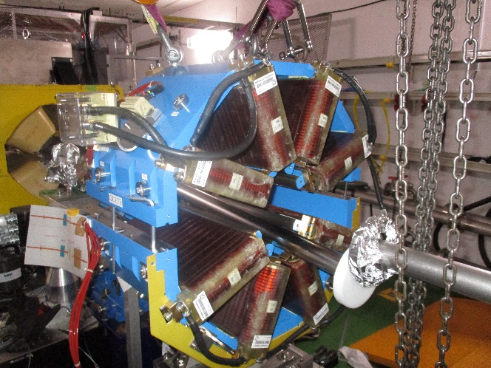
Octupoles for ATF: Installation
The magnets were sent to ATF in August. A long term temporary transfer was agreed. A tax of 8% on the value was paid by CERN, to avoid staying limitation in Japan (if magnets will be reimported after end 2018, an EU tax will need to be paid. Point to be decided in due time).
The alignment reference system (network of external spheres) was checked by ATF and results were found in very good agreement with CERN measurements. The magnets were then installed in ATF on the 9-11 Nov. 2016.

Slide 14
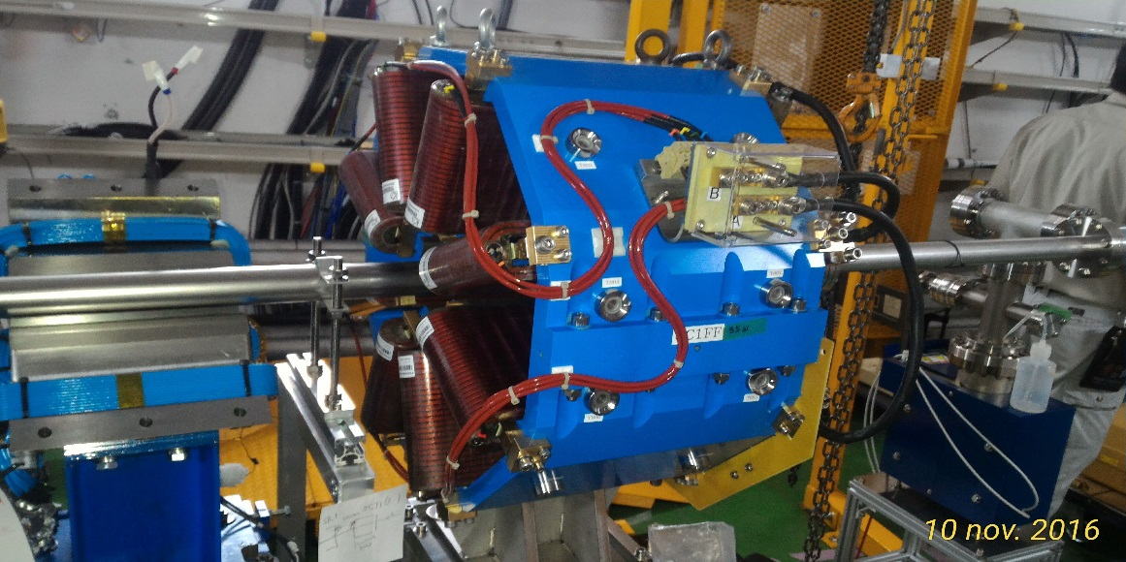
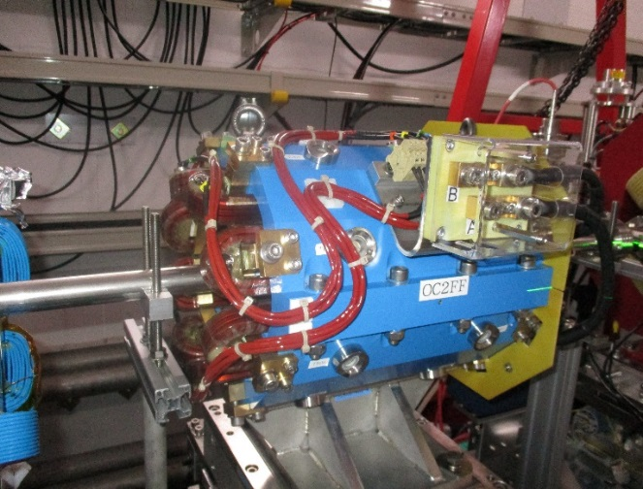
Octupoles for ATF: Installation
Installation is completed. As planned, the OCTU2 is mounted on a micrometric table, while OCTU1 is pre-equipped for that.
Electrical checks were done with not-definitive power supplies (final ones under procurement) and they were positive. Operation of the two octupoles just started (2017 year plan operation will be presented in the next talk. by F. Plassard)
OCTU1 installed in ATF
OCTU2 installed in ATF

Slide 15
Acknowledgment:
A. Aloev, C. Lopez, E. Solodko:
(for magnet design, components procurement and magnet assembly)
M. Duquenne:
(for magnet fiducialization)
C. Petrone:
(for magnetic measurements)
Thank you for the attention

