Slide 1
Status of Cryogenics Facilities Design
M. Miyahara (KEK)
7th December,2016 at Aiina Center, Morioka

Slide 2


Contents
Design change for Cryogenics Facilities
Underground Cavern
Surface Facilities
Outline of Construction Cost Impact
Summary

Slide 3
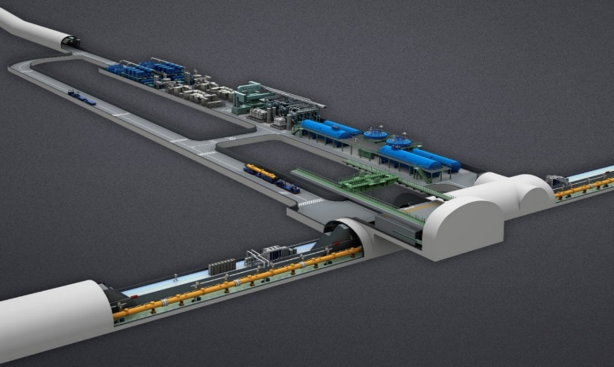
Design Change of Underground Cavern
Cryogenics Cavern
Service gallery
Beam tunnel
TDR Design
Energy Service Hall
Compressor
Electric & Mechanical
Cryogenics
To Access portal
To Surface
Entrance Hall
Shield wall
Access Hall Cavern (TDR)
Alternative Design
Compressors
Electric & Mechanical
Cryogenics
Cryogenics Hall
Electric & Mechanical
Cryogenics
To the portal
Entrance Hall
Beam Tunnel
Entrance Hall
LCWS2016 at Morioka

Slide 4
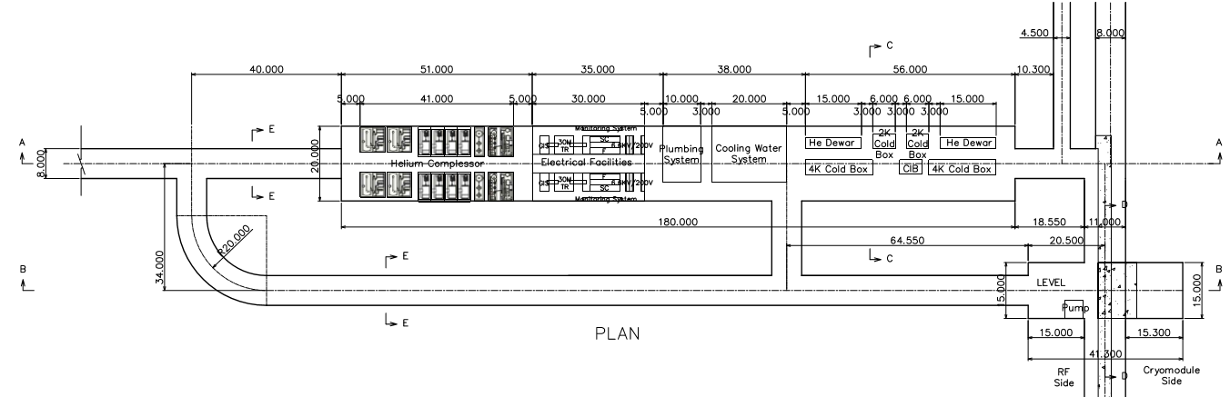
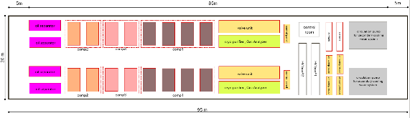
Cryogenics Cavern in the underground
TDR Baseline | Cavern area/Volume:
TDR Scheme
Compressor Cavern
Cold Box Cavern
Revised scheme
TDR Modified | Cavern area/Volume:
100,000

Slide 5
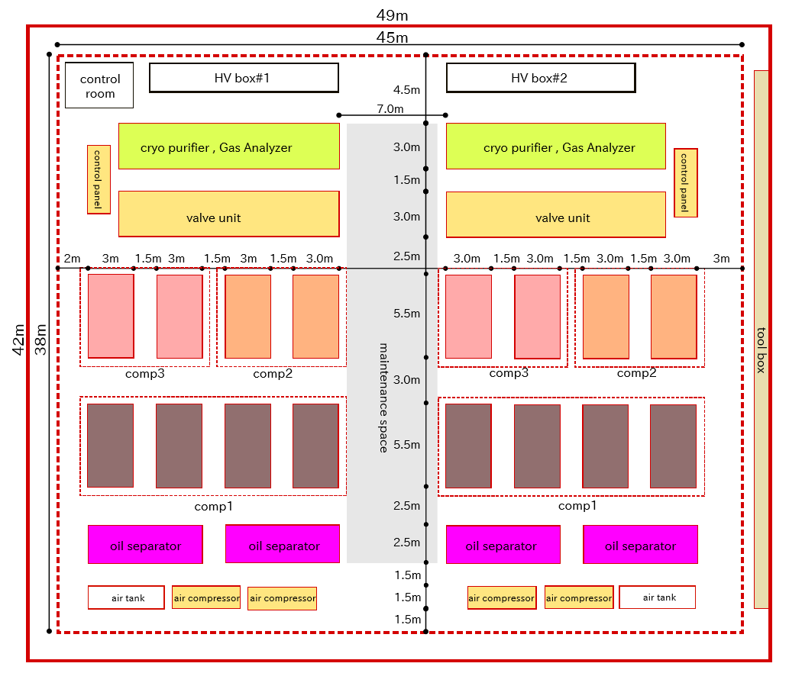
Surface Building
Compressor House on surface
Schematic Layout of Cryogenics Compressor
Compressor House :
Approx. 2,000㎡
L=49 m, w=42 m, H=15m
(for 2 Cryo. units)
Crane equipment:
20 t crane
Crane effective area;
45m x 38m
Ventilation facility
Ventilation capacity :
120000 m³/hour

Slide 6
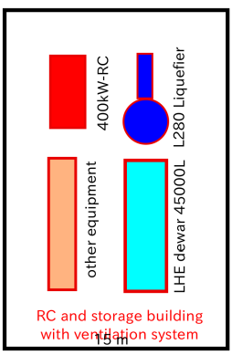

Surface Building
LHe Storage House on surface
Schematic Layout of Storage House
He Storage House :
Approx. 700㎡
L=23 m, w=15 m, H=8 m
2 buildings
23m
15m
15m

Slide 7

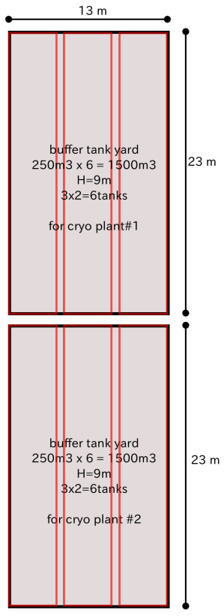
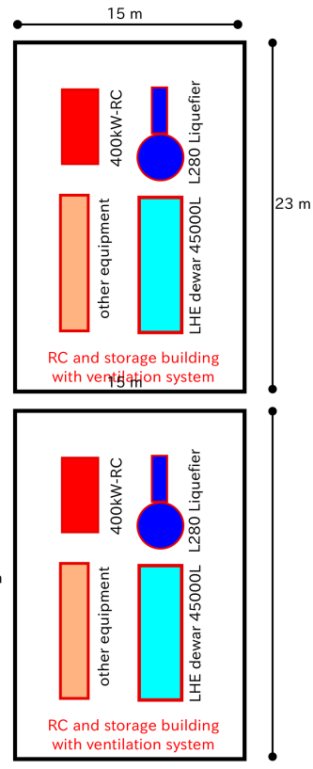
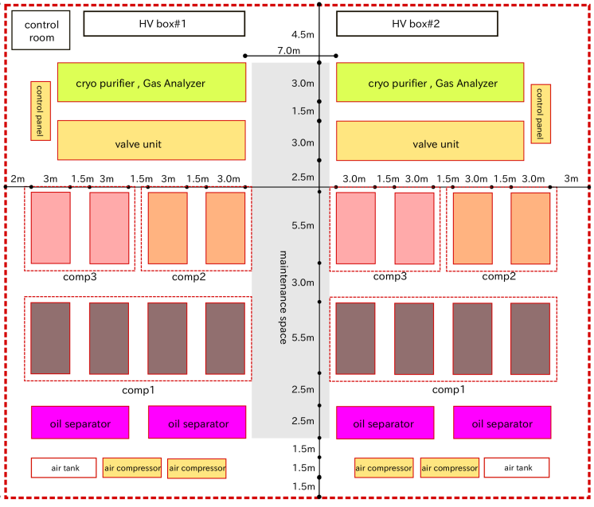
Surface Yard
Cryogenics Plant area on surface
Site area:
14,000㎡
LN2 Tank yard
5m×5m
Buffer Tank yard
Lhe Storage House
Compressor House
Control room
Compressor
Cryo purifier
Valve unit
Ｏｉｌ separator
Air compressor
HV box
2,000㎡

Slide 8
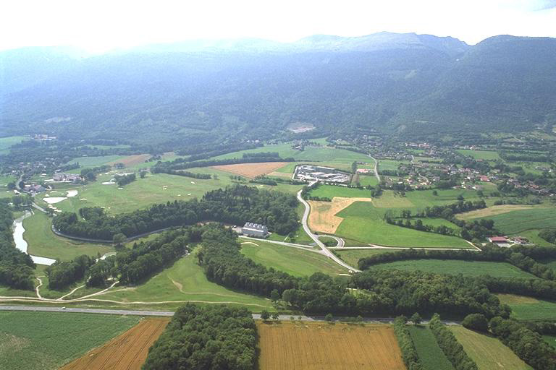
LHC Point 4 Site
LHC Point 4 Echenevex Main Site, France
Jura Mountains
LHC Point 4 Cooling Towers
LHC Tunnel

Slide 9
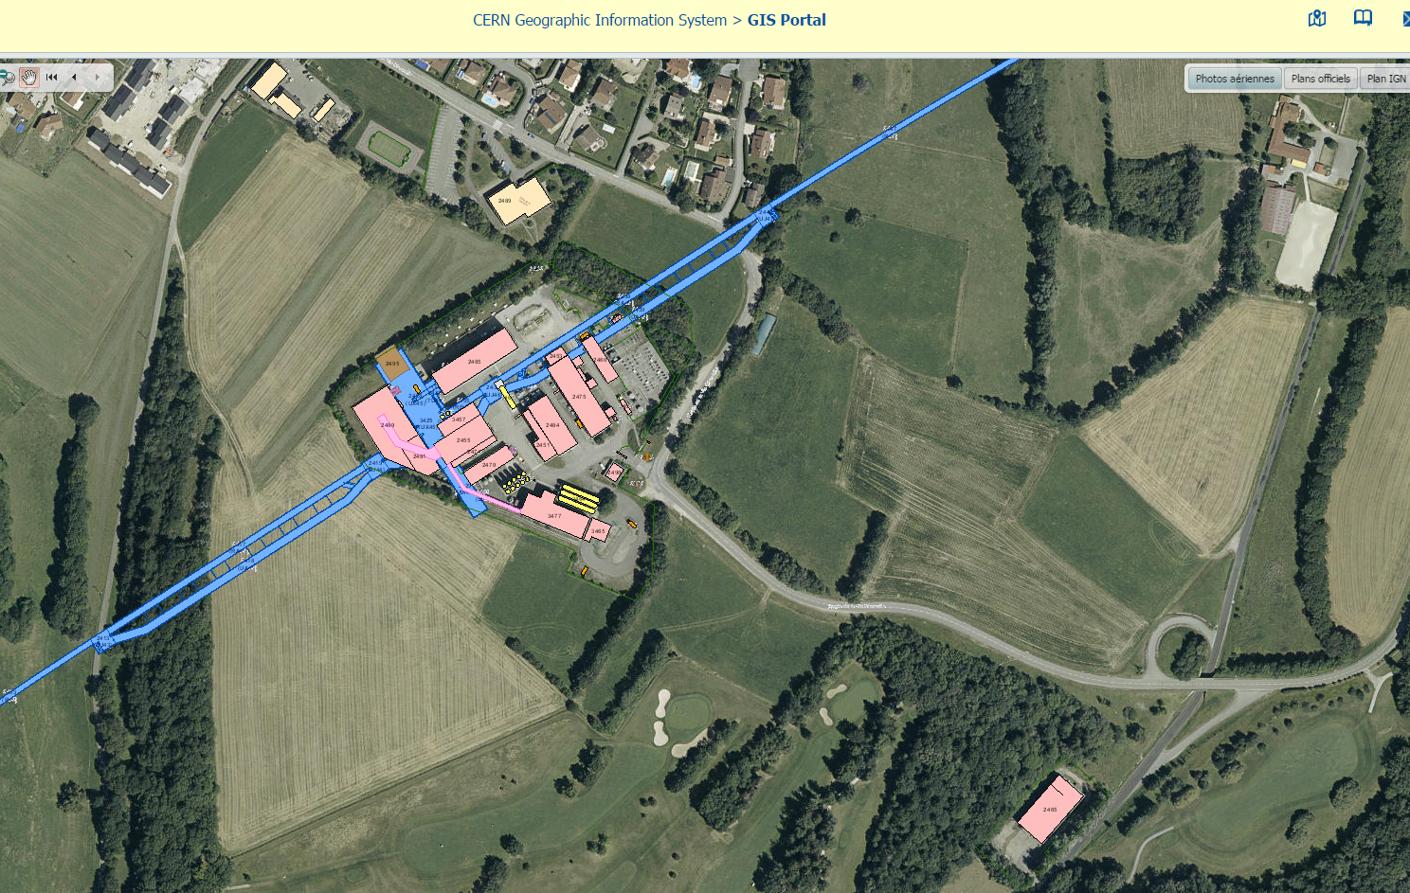
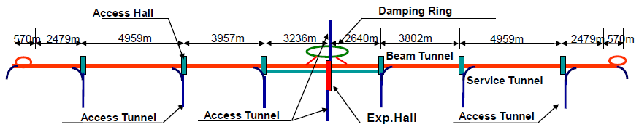


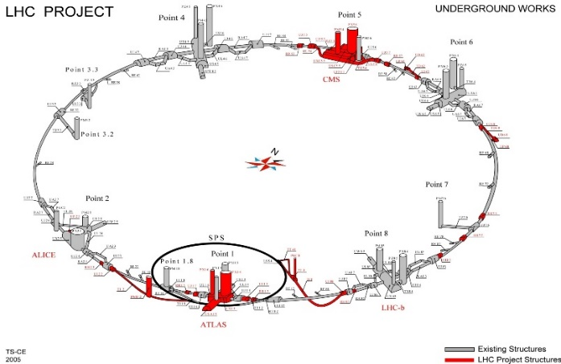
LHC Point 4 Site & ILC Virtual site
Main LINAC
LHC Point 4 Echenevex Main Site, Approx level = 590m ASL
Scale image in ILC site
LHC Point 4
ILC Cryogenics Plant
Surface Yard:
Area = 14,000 ㎡
Point 4
Point 5
Horizontal: 500m
Vertical: 40m
Point 3
Point 6
LHC Tunnel:
Point 7
Point 8
Point 2
LHC Point Cooling Towers, Approx level = 550m ASL
Point 1

Slide 10
Construction Cost Impact
Comparison to TDR scheme
Facilities Scale: Floor area
 | TDR Scheme |  |  |  | Revised Scheme
Item | Facility | Quantity m² |  |  | Facility | Quantity m² |  | Difference to TDR
 |  | 1 Place |  | 6 Places |  | 1 Place | 6 Places
Underground Cavern | Cold Box | 1,120 | 5,600 |  | Cold Box | 1,120 | 5,600 | 0
 | Compressor | 2,000 | 10,000 |  | - | - | - | - 600
Sub Total |  | 3,120 | 15,600 |  |  | 1,120 | 5,600 | -10,000
Surface Building | - | - | - |  | Compressor | 2,000 | 10,000 | 10,000
 | - | - | - |  | Storage House | 700 | 3,500 | 3,500
Sub Total |  | 0 | 0 |  |  | 2700 | 13,500 | 13,500
Construction Cost Impact |  |  | 100 % |  |  |  | 93 % | ▼7 %

Slide 11
Summary
Facilities Design
Reduction of underground cavern space (volume)
Increase of Surface building space
Eliminate the vibration issue by the compressor
Cost & Schedule
The total construction cost of the underground cavern and surface buildings are reduced slightly.
Shortening the Construction period at underground

Slide 12
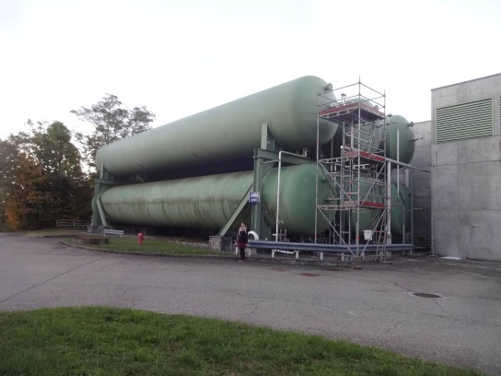
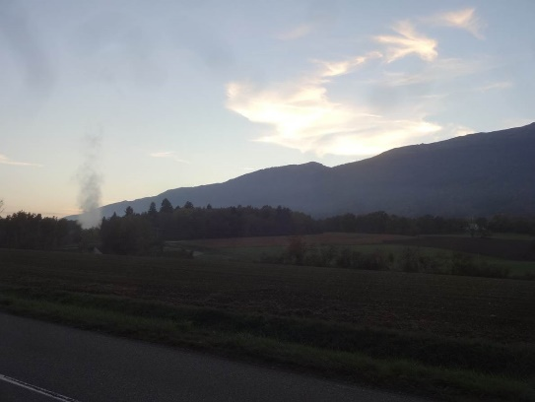
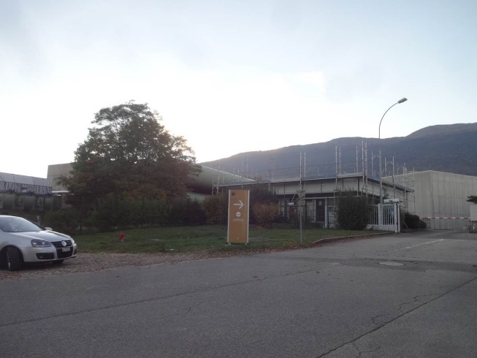
Appendix
LHC Point 4 Site

