Slide 1
State of the optimization group address
Jan strube

Slide 2
Overview
The state of the optimization group is strong
Accomplishments this year
  Beam background
  kpix buffer depth
  Vertex detector occupancy
  Muon spoilers
  Progress on new detector simulation
Status of the group and readiness for next year
Plans and outlook

Slide 3
Review
LCWS last year: “group meets frequently, but not regularly”
This year: bi-weekly meetings moved to weekly meetings
  Regular attendance > 10 people
  Optimization workshop @ PNNL: > 20 people attended
Goals for 2016 (as stated in January):
  Forward region layout (multiple items)
  KPIX buffer depth in ECAL endcap
  ECAL dynamic range (or cell size?)
  Vtx time stamping (granularity and buffer depth)
  New Simulation model
  Tracker Layout

Slide 4
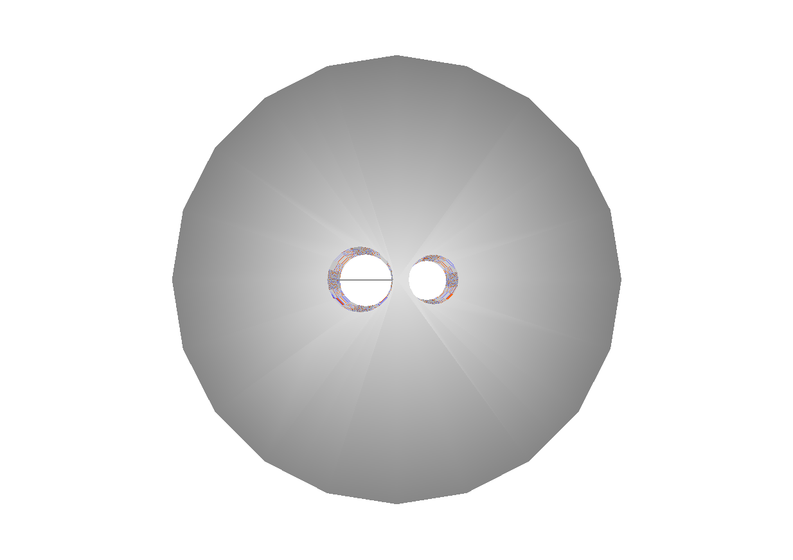
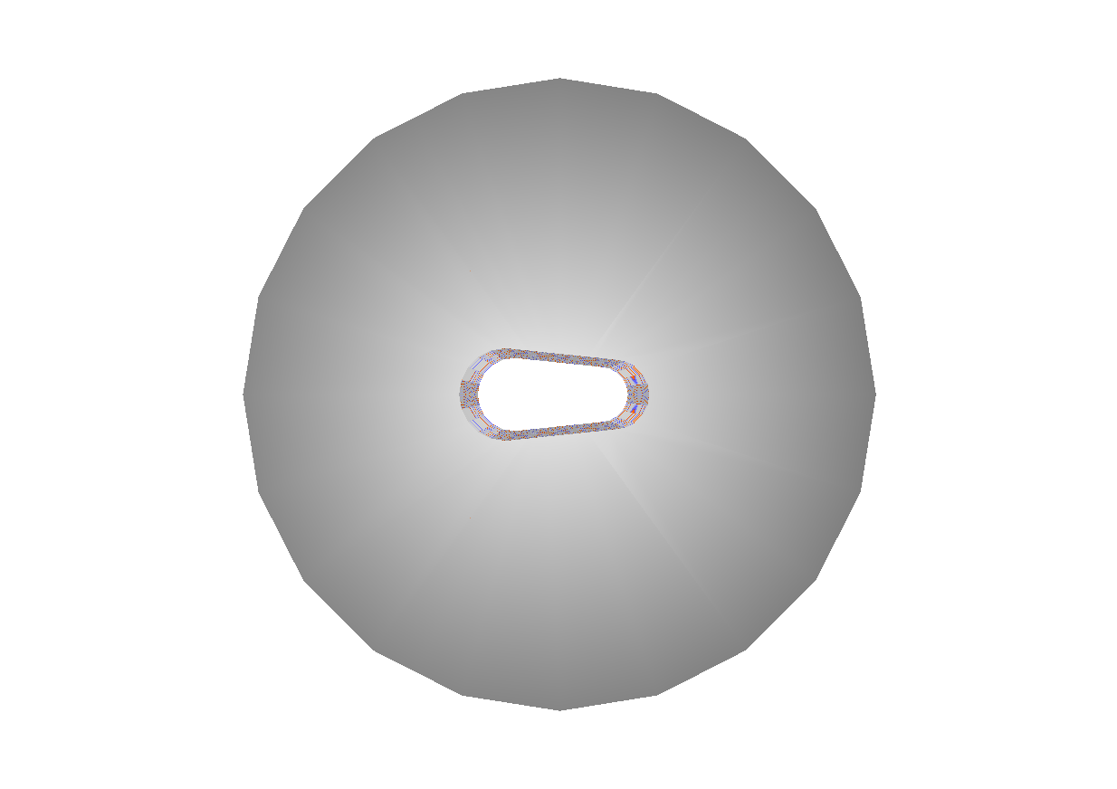
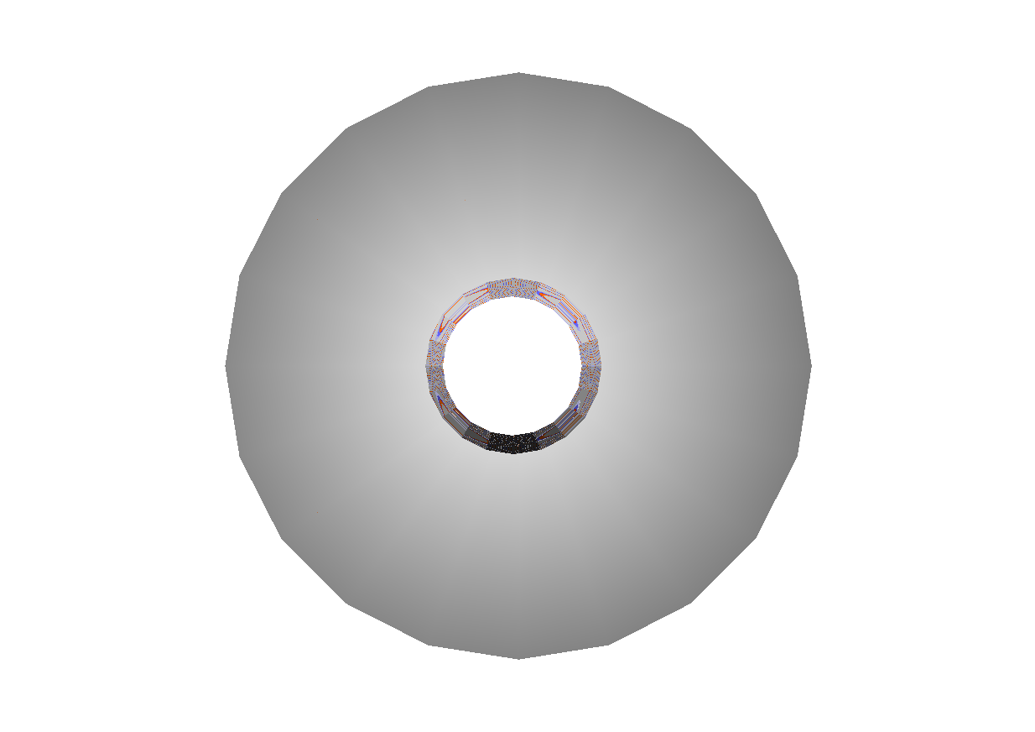
Forward region layout
sidloi3 w/ modifications – models are checked in
Put the beam cal at the crossing angle – done UCSC
Implement the L* change – done UCSC
Anti-DiD study
  Study multiple cutout options
  Impact on physics – still outstanding
  Impact on back scatter into detector w / w/o anti-DID – done UCSC

Slide 5
Anti-DID follow-on study
Looked at impact of back-scatter from forward calorimeters into the vertex detector
Using 30x30 µm² pixels and 5 BX time stamping
Fixed L*, otherwise nominal sidloi3
Barrel
Endcap

Slide 6
KPIX buffer depth in ECAL endcap
https://arxiv.org/abs/1609.07816
Dedicated simulation study
Full detector simulation of
a large number of
background processes with
high cross section
Using the sidloi3 model

Slide 7
ECAL Studies
Moved into the optimization group
Physics motivation: H → tau tau
Work on detailed ECAL simulation
Calibration (thin vs. thick layers)
Two-photon shower separation
More details in this session

Slide 8
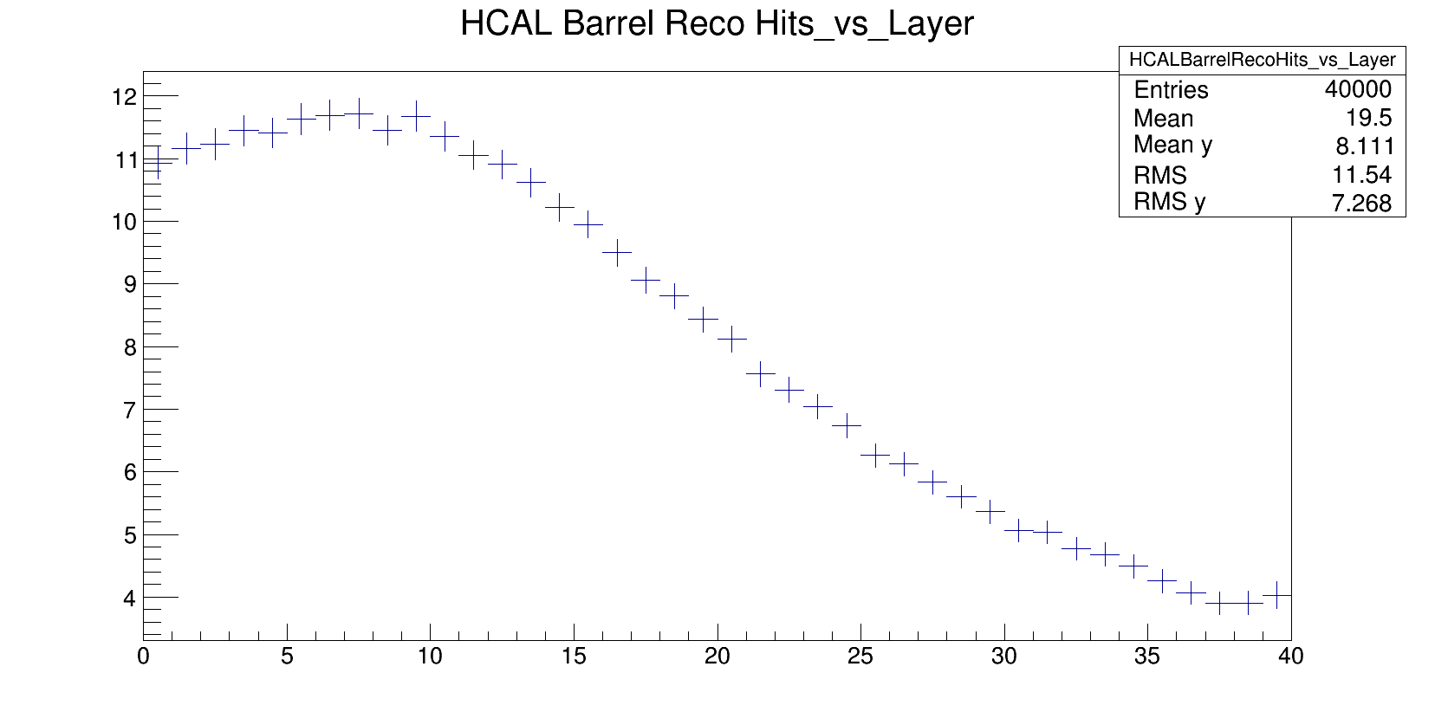
HCAL studies
Lots of work still ongoing to bring the simulation model up to par.
UTA started to look at the calibration
Working to disperse CALICE expertise with Scintillator within SiD

Slide 9
Vtx time stamping
Guinea pig pairs
500 GeV lumi-up scenario
Looking at the time
distribution of hits in the
vertex detector
sidloi3 study

Slide 10
Muon spoiler studies
Study of the region upstream of the detector
Muons produced in the BDS reach the detector
More details after the break

Slide 11
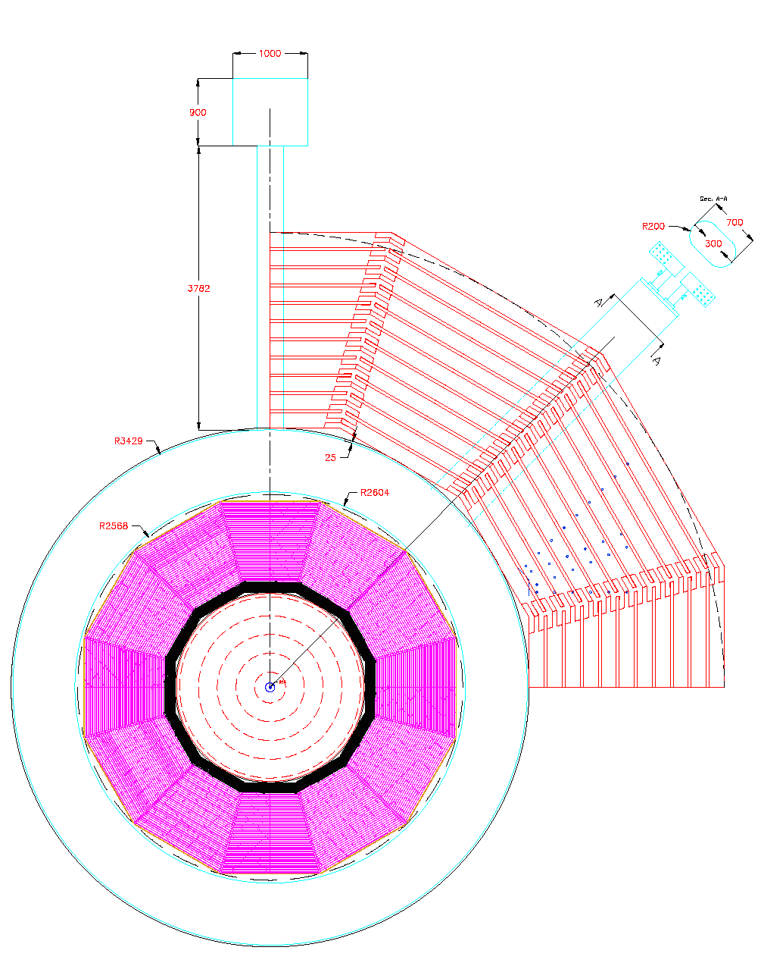
Simulation updates
sidloi3 had many
differences with the
engineering drawing
First round of fixes
by UCSC
  Beamcal to the out
  going beam pipe
  Updates to L*
  Updates to other parameters

Slide 12
New Simulation model
Decided to move to new infrastructure due to lack of support for LOI/DBD code
Led by Glasgow
Sim/Reco software:
  Require SL6 and /cvmfs instead – talk to your admin
  DD4HEP readiness remains a sore point
  Hopefully, SiD will be in a position to contribute back
Goal: complete SiD2016 by Santander, production version by LCWS
  Slipped by ~6 months
  However, the team working on this is growing, lots of support from students at UTA and Oregon for the HCAL and ECAL, respectively
  Going to AHCal allows UTA to tap into CALICE fundus of knowledge
Status: pretty complete, except the Muon geometry

Slide 13
State of the infrastructure
Communication: silicondetector.slack.com
Code: github.com/silicondetector
Bug tracker: github.com/silicondetector
Online Agenda: https://agenda.linearcollider.org/category/219/
Software: /cvmfs/ilc.desy.de/sw/ilcsoft
Documentation: confluence.slac.stanford.edu and wikis.bris.ac.uk and twiki.glasgow.ac.uk
  Situation at SLAC wrt accounts improved
  Situation at Bristol slightly worse
  Glasgow Twiki only maintained by Glasgow group
  DESY?
  Attempts to resolve this split at the PNNL workshop have not been successful
  This needs an executive decision – preferably from the spokespeople
  This is holding up progress now

Slide 14
State of the Collaboration
Good support through the SLAC meeting in June
  Most systems covered by more than one person
Several students move on to new projects before the summer
  Key staff remains, but continuity is a concern
New students / postdocs now would join a solid team effort and could become productive fairly quickly

Slide 15
Plans
Currently, we have found no reason for a directed change
All studies are aimed at understanding the baseline better, rather than evaluating a design change
  AHCal only exception, with Scintillator model now nearing completion
    Now moving to calibration
  ECAL shower separation
  Vertex performance w/ different layers
  Tracking performance (MAPS)
Starting to think about physics studies
  H → tau tau
  Glasgow and DESY are looking at ideas
New contributions and ideas welcome

Slide 16
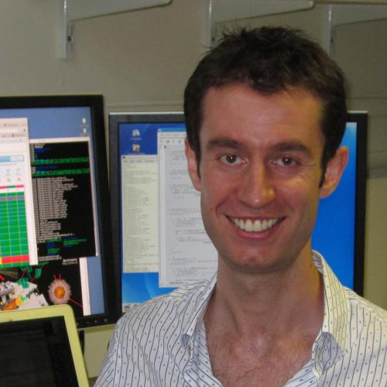
Summary
Very busy year comes to a close
Multiple studies were wrapped up
  SiD-only detector note was put on arXiv
Lots of activities are continuing
  With the new simulation model nearing completion, and lots of contributors, these are on strong footing
The optimization group has grown
to being the center for activity within SiD
  This has come to a point where
  it makes sense to have two people look
  after the group
  Thank you, Aidan for helping to
  keep this going

