Slide 1
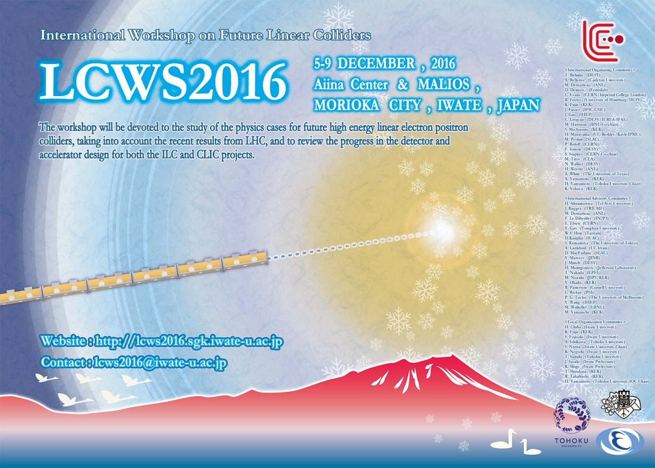
e+ target:
Cooling by thermal radiation
Felix Dietrich, Alexander Ignatenko, Sabine Riemann (DESY),
Andriy Ushakov (Hamburg U), Peter Sievers (CERN)
Outline
  Status
  Temperature distribution
  Mechanical issues
  To-Do

Slide 2
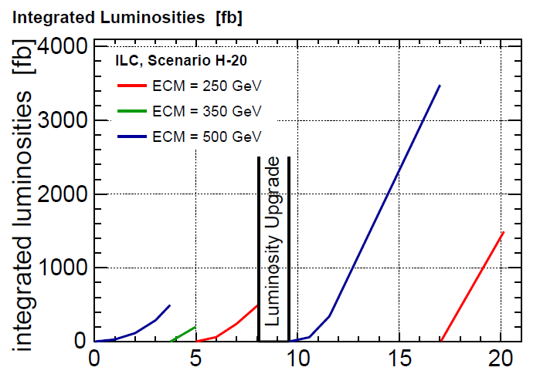
Expected target load in the first ILC years
Running scenario H-20
  1326 bunches per pulse during first years
    start with E_{cm}=500GeV (500fb⁻¹),
    followed by E_{cm}=350GeV (200fb⁻¹); and
    Followed by 250GeV (500fb⁻¹);
  Luminosity upgrade
    3.5 ab⁻¹ at E_{cm}=500GeV
    1.5 ab⁻¹ at E_{cm}=350GeV
  → During first 8 years E_{dep} ≤ 5kW
E_{dep} ≤ 5kW
E_{beam} [GeV] | E_{dep} [kW] | ΔT_{max}/pulse [K] |  | dpa | E_{dep} [kW] | ΔT_{max}/pulse [K]
 | Nominal luminosity |  |  |  | High luminosity
120 | 5.0 | 66 | 0.035 |  | - |  | -
175 (ILC EDMS) | 3.9 | 125 | 0.06 |  | - |  | -
250 (ILC EDMS) | 2.0 | 130 |  |  | 4.1 |  | 195
250 | 2.3 | 85 | 0.05 |  | 4.6 |  | 128
A. Ushakov, 2015
A. Ushakov,
Update 2015/16

Slide 3
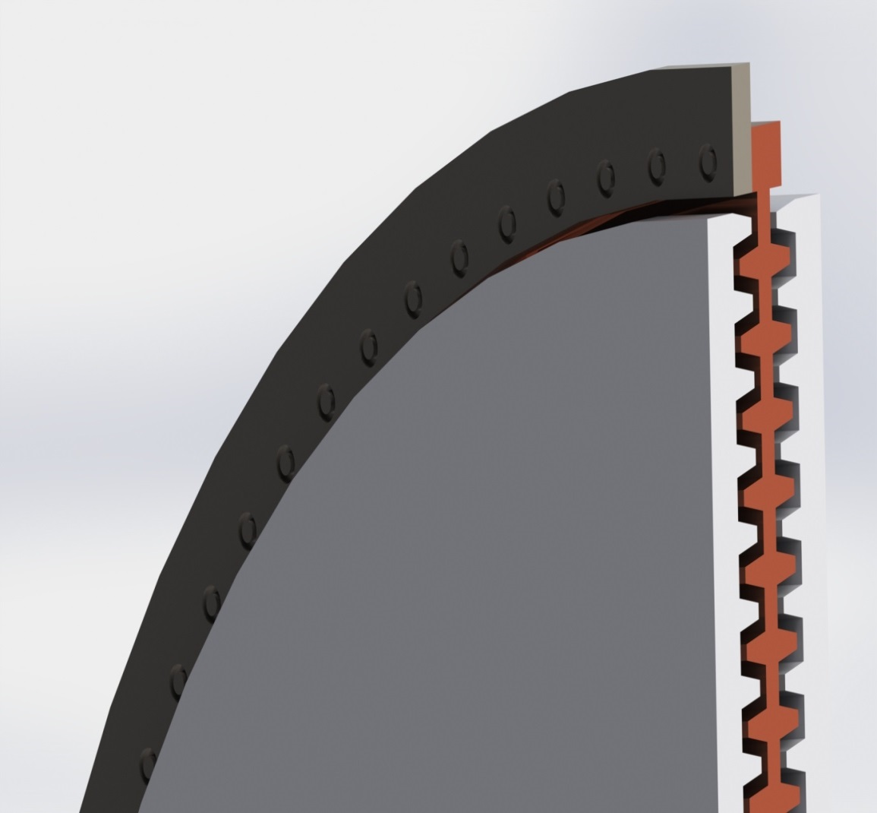
Radiative cooling model
e+ target located close to FC
Rotating wheel consists of Ti rim (e+ target) and Cu (radiator)
Heat path:
  thermal conduction Ti → Cu
  Thermal radiation from Ti and Cu to stationary water cooled coolers
Target, radiator and cooler are in vacuum
Radiating area can be adjusted by fins
Goal:
keep target temperature
below failure
of Ti6Al4V
vated temperatures?
photons
Ti6Al4V
Radiator
Cooler
Sketch, no technical drawing!
Felix Dietrich

Slide 4
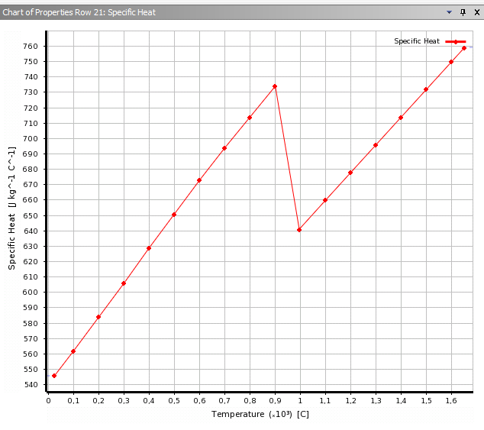
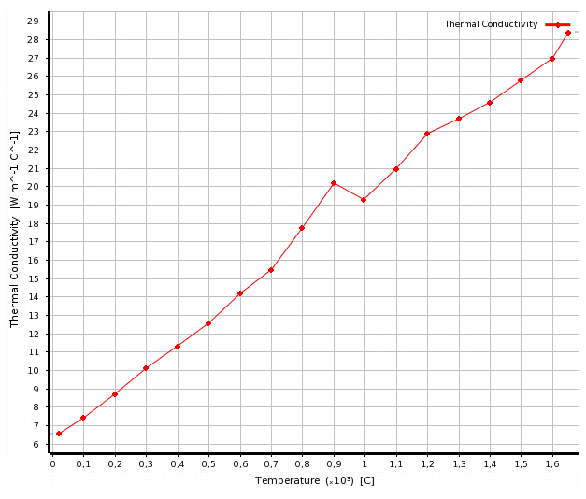
Temperature development in target +radiator
FEM to calculate temperature evolution in real model; here ‘estimation by hand’
Material parameters c, λ, ε depend on temperature and long-term load
E_{dep} from photons
(depends on E_{cm})
heating due to
energy deposition
Thermal conduction
through material
Radiation from
surfaces
Ti6Al4V
Specific heat [J/(kg K)]
Thermal conductivity [W/(m K)]
c( 20C) = 0.545J/(gK)
c(500C)= 0.650J/(gK)
K.C. Mills, 2002,
Recommended Values of
Thermophysical Properties
For Selected Commercial
Alloys, p. 217,
referenced by J. Yang
λ( 20C) = 0.065W/(m K)
λ(500C)= 0.126W/(m K)
200 400 600 800 1000 1400
T [C]
200 400 600 800 1000 1400
T [C]

Slide 5
Target wheel heating to equilibrium
Mass of target wheel
  Ti rim (assume height of 4cm) → ~11kg
  Radiator weight depends on # of fins, O(100kg)
      Energy stored in target wheel ~O(MJ)
Temperature evolution in rim and radiator
  Neglecting thermal radiation
    It takes ½ hour to heat 100kg Cu with 5kW to 200C
    It takes few minutes to heat 11kg Ti with 5kW to 300C
  Taking into account thermal radiation and time for heat transfer to radiator, few hours needed to achieve
Heat transfer Ti rim to radiator:
  slow due to low thermal conductivity → accumulation of heat load to T_{max} over many pulses
  heat dissipates only 5mm within 6s (after ~6-7seconds the beam hits the same rim area)
  → Ti rim remains hot

Slide 6
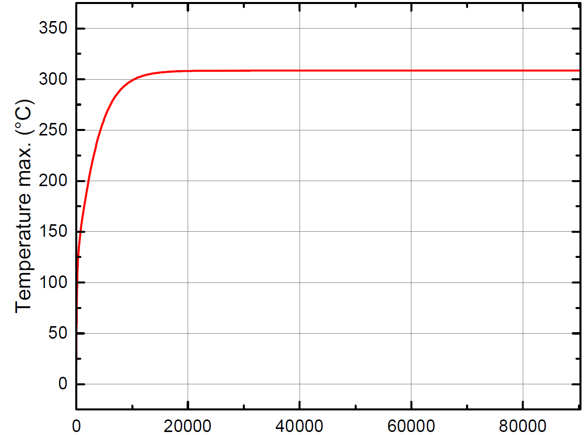
Equilibrium temperature in the target
Transient analysis of average temperature, ANSYS
E_{cm} = 500GeV;
E_{dep} = 2.3 kW
Radiator area ~2.3 m²
After ~3 hours equilibrium temperature distribution reached
Temperature in Cu (near Ti) ≈250°C
Felix Dietrich
Max average temperature in Ti
(area along beam path)
Time (s)

Slide 7
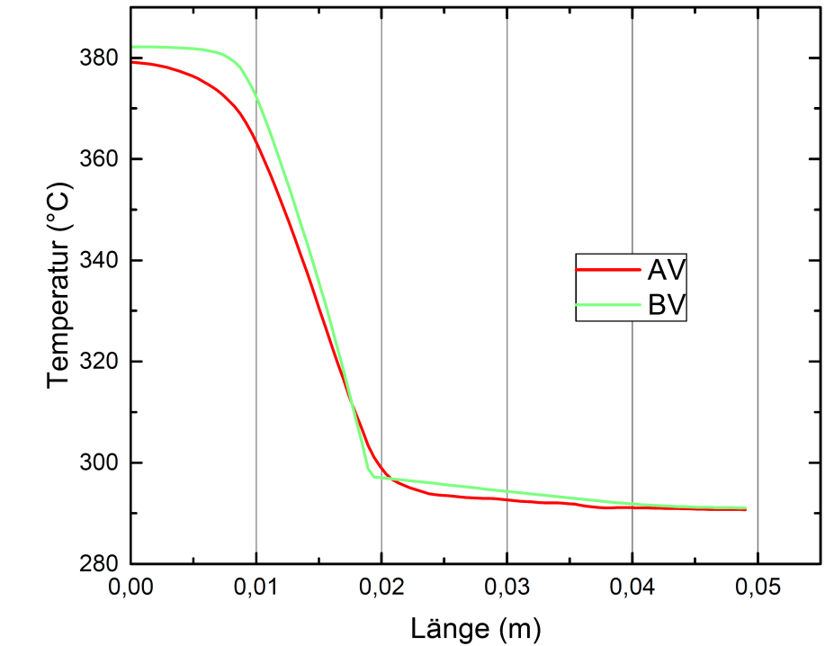
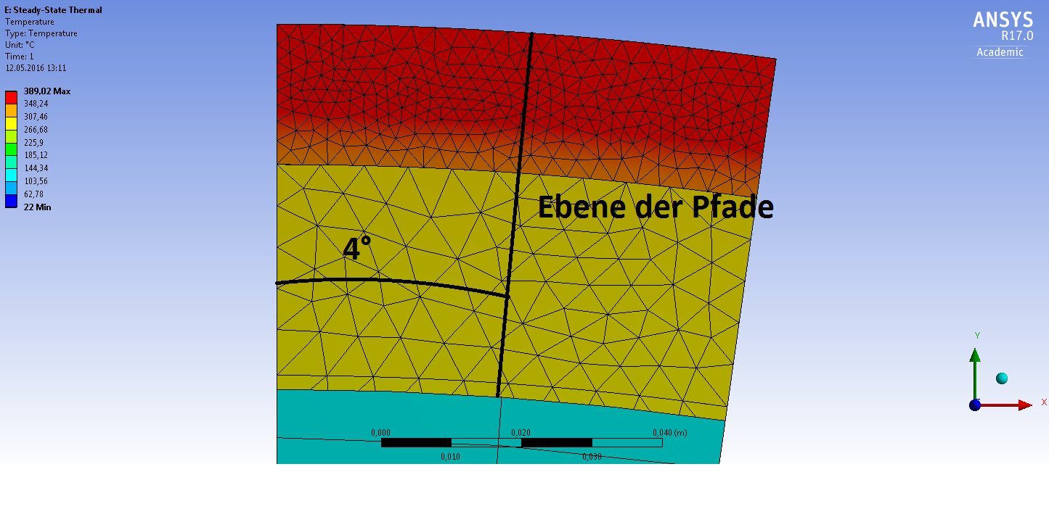
Radial temperature profile along Ti target to Cu radiator
Ti
Felix Dietrich (‘Fork model’)
Temparature
gradient
Photon beam
position
preliminary
Cu
Sketch,
no technical drawing!
Ti Cu
Distribution of bunch train

Slide 8
Estimated average temperature in T rim and Cu radiator
Consider thermal radiation from rim and radiator
  Case (1): rim 0.082m² + radiator 1m²
  Case (2): rim 0.082m² + radiator 2m²
  Emissivity ε=0.6
At relatively low Edep (~2kW) the radiator surface is less decisive
Real temperatures need simulations, they depend on radiator design and Ti-Cu contact
T_{ave}[C]
E_{dep}[kW]

Slide 9
Temperature distribution at the target rim
adjust revolution frequency to distribute energy deposition almost uniformly over rim
for example:
  bunch train occupies angular range θ_{pulse}
  f_{rev} = 1922rpm instead of 2000rpm
  → pattern: 1st second: 0, 144, 288, 72, 216,
  2nd second: 0 + θ_{pulse} ….,
  3rd second: 0 + 2θ_{pulse} ….
  after ~7s the rim is almost uniformly heated
  unbalances due to non-uniform heating are avoided

Slide 10
Stress due to heating
Instantaneous heating
  Pulse ⬄ ΔT = 80K … 200K
  Δσ ~ 100…260MPa
  ILC e+ target: ~3×10⁶ loads per year (5000h)
  fatigue stress limit for Ti alloy ~510MPa at room temperature but lower at elevated temperature
Average heating
  Heated rim:
    Hoop stress if expansion is prevented: σ_{H} = E α ΔT
    → Ti rim @ 500C → σ_{H} would be ~420MPa
    Expansion of rim not restricted → increase of rim circumference u,
    Δu = 1.3cm (Δr = 2mm)
  Spatial expansion V_{rim}(heated) = γ·V_{20˚C}·ΔT
    Ti: ΔV ~ 1.2% for ΔT=500K (~ 2% for 850K)
    Cu: ΔV ~ 6.6% for ΔT=200K (~ 11.5% for 350K)

Slide 11
→ Sliced target
  minimizes stress in (non-uniformly heated) target rim and radiator
  Main stress contribution from cyclic energy deposition by photon beam
Rotation ⬄ tangential and radial forces
  thin ring approximation for target rim: σ_{t} ~ ρr²ω² = 50MPa
  sliced target,
    ~40 pieces for nominal lumi),
    height ~3cm → F_{c}=mrω² ~ 3.3kN
    With connecting area A~10cm² → σ ~ 33MPa stress at Ti-Cu connection
→ Ti-Cu contact
  must work well for all temperatures
  Calculation of stress at the contact Ti to radiator needs FEM methods
  Possibilities considered
    bolts + plate springs
    bolts + plate springs + fire-tree connection

Slide 12
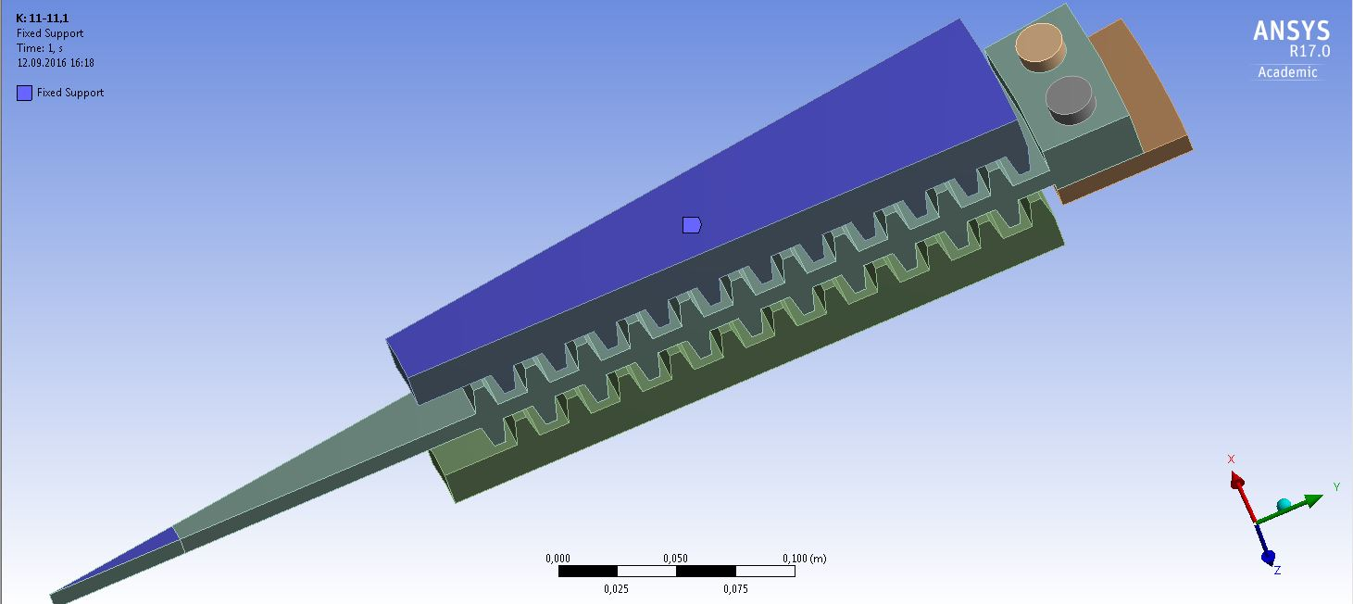
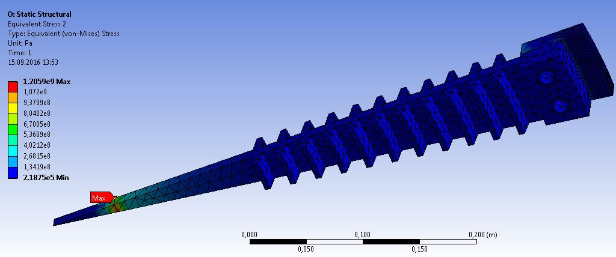
wheel sector considered for ANSYS simulations
target
bolts
radiator
cooler
model 1 target with radiator
F. Dietrich
Artificial peak stress due to implementation

Slide 13
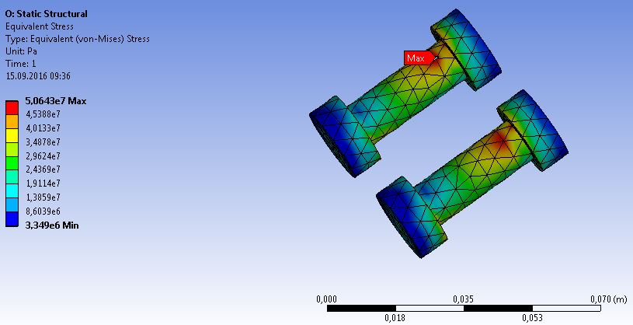
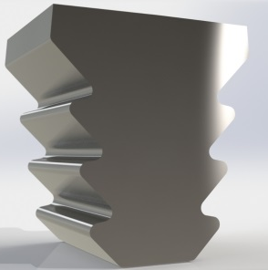
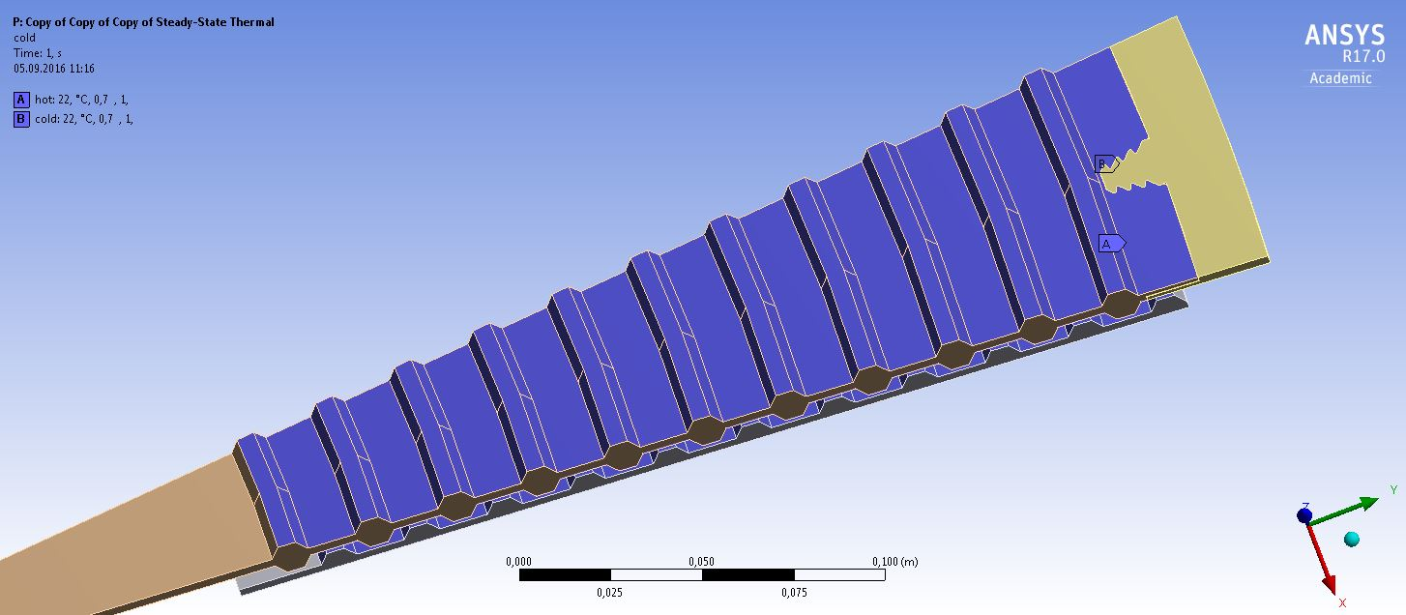
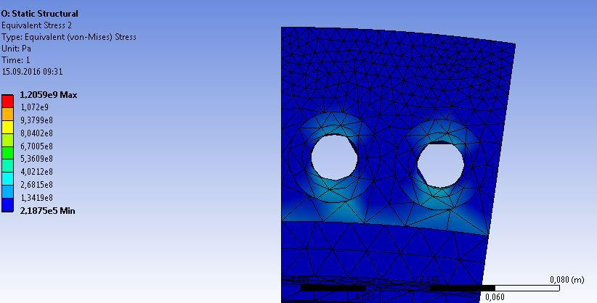
Target-radiator connection
Simulations: F. Dietrich
Artificial peak stress due to mesh
Fire-tree
bolts
h
preliminary
Model (E_{dep} = 2.3kW) | T_{ave}^{max}[C] in target | σ_{v.Mises} [MPa] at bolts | σ_{v.Mises} [MPa] at contact | σ_{v.Mises}[MPa] (static) | Height h [mm]
2 bolts M5 | 447 | 51 | 168 | <922 | 20
2 bolts M12 | 283 | 66 | 204 | <1170 | 30
Fire-tree | 301 |  |  | 66
High values
artificial

Slide 14
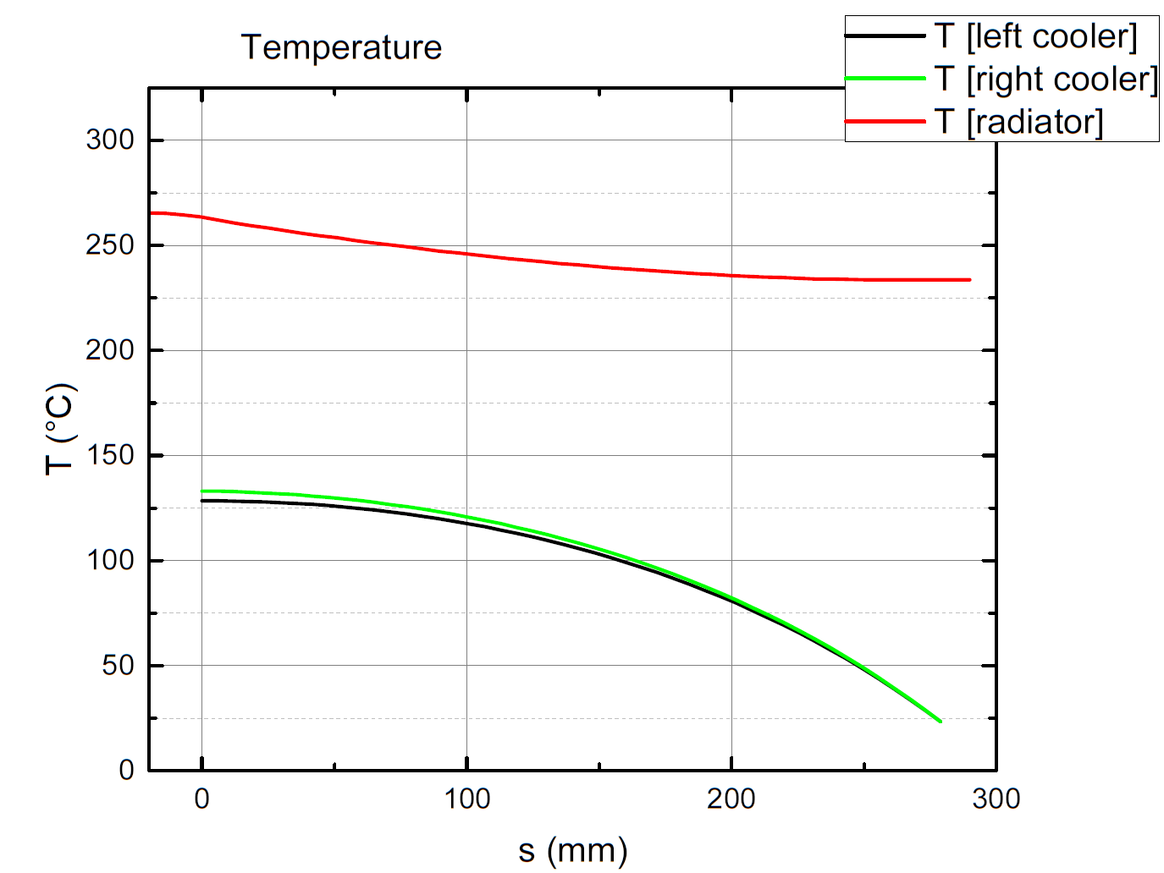
Temperature in radiator and cooler
Simulations: F. Dietrich
0cm
15cm
preliminary
28cm
E_{dep} = 2.3kW
Radiating area A=3.5m^2
Average temperature in radiator ~250C
Temperature in cooler is fixed at innermost area (s=28cm) to 20C
cooling efficiency is underestimated
But low radiator T is also less efficient

Slide 15
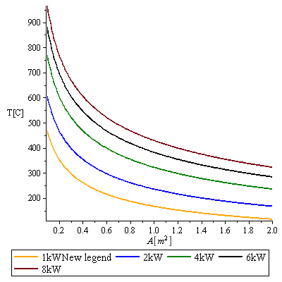
Thermal radiation – only rim, no radiator
Perfect solution for Ti-Cu connection has not yet been found
Result from target tests (see Alexandr’s talk): Ti6Al4V stands very high loads
Remember: first ~4 years max E_{dep} ~2.3kW (if no ‘staged ILC’)
→ what about simple rim with spokes (but no water cooling)?
Consider radiation off target rim only,
r = 0.5m, h=2cm, d=1.5cm
A ~ 0.17m², ε = 0.6
Average temperatures (nominal lumi)
E_{cm} = 500GeV
E_{dep}= 2.3kW ⬄ T_{target} (ave)~525C
E_{cm} = 350GeV : 5 kW ⬄ T_{target} (ave)~694C
250GeV: 7 kW ⬄ T_{target} (ave)~778C
T_{average}[°C]
ε=0.6

Slide 16
Consider: only rim with cooler (no radiator)
FC
FC
Sketch,
no technical drawing
No spokes (etc) shown
target
cooler
radiation area of rim: 0.14m^2 (⬄ rim height h = 2cm)
0.18m^2 (⬄ rim height h = 3cm)
0.47m^2 (⬄ rim height h = 10cm)

Slide 17
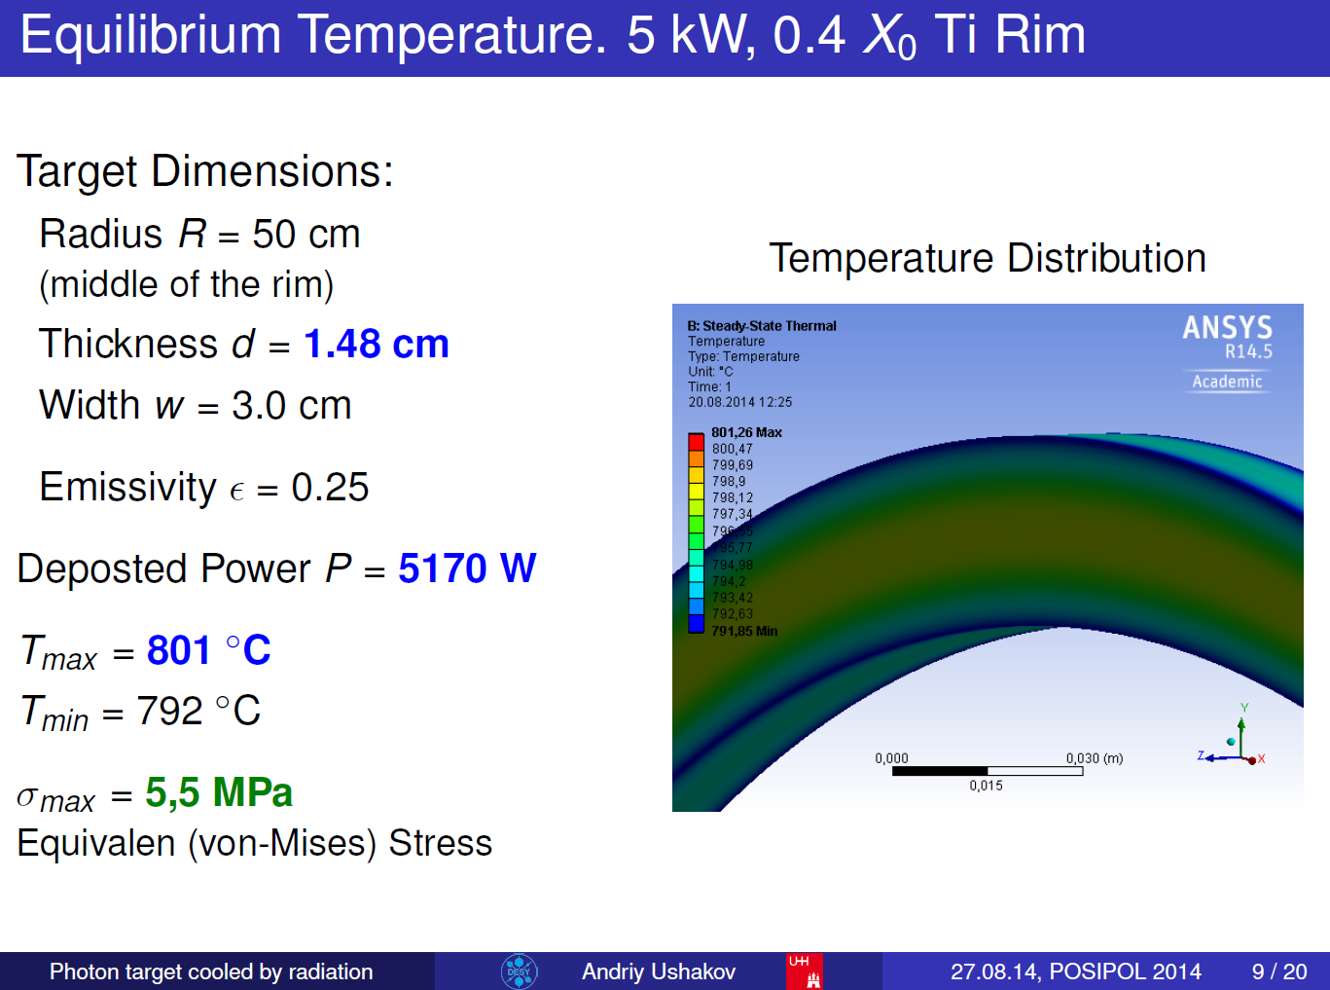
A. Ushakov, POSIPOL2014

Slide 18
Assumption: only rim with cooler, no radiator
T^4 cooling estimate (no simulation):
Ti6Al4V rim with h~10cm could work for E_{cm} = 500GeV, nominal lumi
T_{ave} ~ 350C; to be confirmed by realistic simulation
weight of rim + spokes ~50kg
Stress at spokes?
Deformation due to elevated temperatures and stress from rotation?
E_{cm} = 500GeV, E_{dep} = 2.3kW
E_{cm} = 350GeV, E_{dep} = 3.9kW
E_{cm} = 250GeV, E_{dep} = 5.0kW
T_{average} [°C]
ε=0.6
E_{dep} [kW]

Slide 19
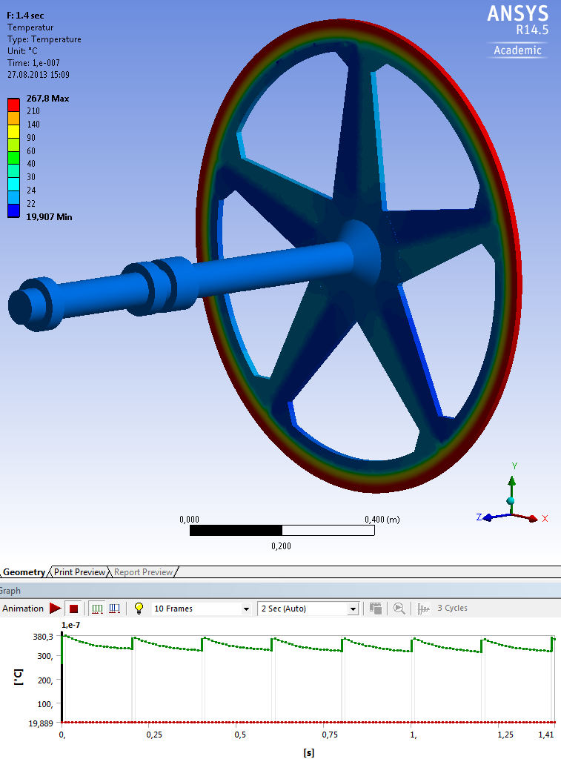
Assumption: only rim with cooler, no radiator
Ti6Al4V
Tensile Yield Strength
  = 830 MPa (RT)
  = 565 MPa (370C)
Fatigue Strength
  = 510 MPa (RT), corresponds to
  cyclic stress amplitude ~450 K
10cm high rim, no radiator:
  T_{ave} ~ 350C
F. Staufenbiel, POSIPOL2013:
Equilibrium temperature with cooling channels inside the wheel and a water flow of 0.1 l/s

Slide 20
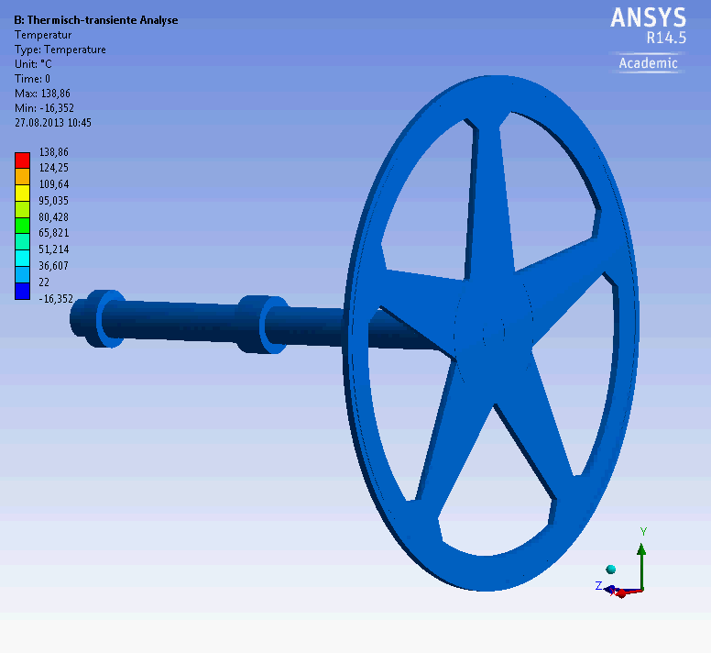
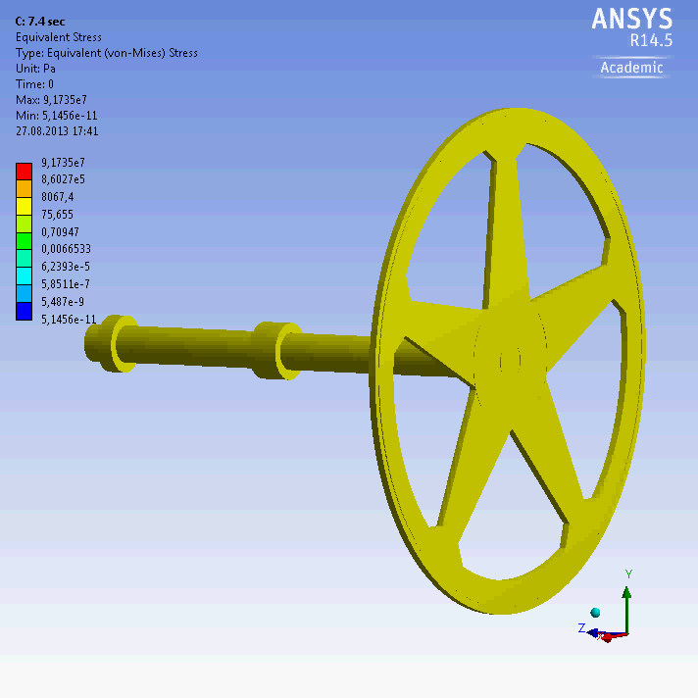
Dynamic stress and temperature evolution in the ILC target wheel (high lumi)
temperature
stress
2*10¹⁰ e⁻ / bunch
2625 bunch / train (0.97ms)
0.366μs bunch spacing
5 train / s
Friedrich Staufenbiel

Slide 21
To be done for the target
Operation temperature of target material?
  Our ‘old’ recommendation: max target temperature should be below 450C
  Material tests at MAMI (see Alexandr’s talk): Ti6Al4V can stand high cyclic load and very high temperatures
  Not included in the MAMI tests:
    Load from rotation
      plastic deformation due to lower stress limits at higher temperatures
    Stress from connection with other material which has different thermal expansion coefficient etc.
    Creep effects etc.
Test of T^4 cooling for thick samples
  Test targets at MAMI had thickness of 1-2mm. ILC target has 15mm. Heat diffusion from central part to surface ~15 seconds
  Does the T^4 cooling work as expected also for thick our temperature profiles in the target?

Slide 22
To be done for the target wheel
Connection of Ti target rim with radiator
  Optimum design
  Test of long-term stability under realistic conditions (elevated temperature distribution, mechanical load)
Weight of wheel
  Target rim + radiator with fins with current design ~ 120kg
  Weight reduction desired
    Safety reasons
    Design and operation of bearings
  Rim with spokes possible for Edep below ~2 kW ?
Mechanical driving system for the wheel
  Radiative cooling can use the system planned for the sliding contact cooling concept
  Tests up to prototype were planned for the sliding contact cooling concept – but now… ?
  Funding for R&D?

Slide 23
Summary
Although radiative cooling will work for the e+ target, design details are not so easy and need effort
  Principal design: wheel = target rim + radiator, stationary water-cooled cooler
  T in target mainly determined by heat transport in Ti alloy and radiator size
  May be, during first years simple target wheel with spokes is sufficient (to be checked and taking into account running scenario – H20 or staged approach)
Tests are necessary
  Test the material under irradiation
  Test of temperature distribution and T^4 behavior of ‘real-size’ target samples (thickness!)
  Design and test the contact between target and radiator
Mechanical design for the rotating wheel
  No DESY/Uni HH resources
Further issues:
  Shielding
  protection of source components (e.g. FC)
  Source exchange, target replacement, remote handling,…
e+ will be polarized. PhD thesis planned to study the realistic undulator spectrum
We would be very thankful for strengthened collaboration

Slide 24
Summary
Candidates for closer collaboration
  Test the material under irradiation
  Test of temperature distribution and T^4 behavior of ‘real-size’ target samples (thickness!)
  Design and test the contact between target and radiator
  Mechanical design for the rotating wheel
  Shielding
  protection of source components

