Slide 1
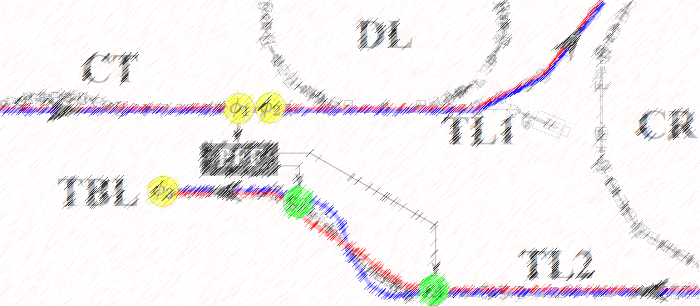
Phase Feedforward: Plans
Jack Roberts

Slide 2
Overview
This is mostly just text, quickly interspersed with a couple of relevant (previously shown) plots. Let me know if there are particular topics you would like to see more of.
Only ~2.5 months left of CTF3 drive beam operation. Last day in CLEX probably 16th December.
Most of the content is taken from a list I’m developing on the CTF3 wiki: https://wikis.cern.ch/pages/viewpage.action?pageId=91752618 (only accessable on CERN network unfortunately).

Slide 3
PFF Setup
Aim: Verify the system setup is completely optimal.
Priority: High
Difficulty: Medium
Beam Time Requirements: Low
Preparatory Time Requirements: Medium
Issues:
Difference between measured optimal timing with beam pickup and BPM based measurements.
Acquisition of FONT ADCs, DACs etc. over CERN control system.
Droop correction of DACs/amplifier?
Preparatory Work:
Need to create a beam with a clearly identifiable feature in the upstream and downstream phase.
Elizabeth created a class to acquire FONT signals over control system, plus associated changes to DAQ. But creates timing issues (missing pulses etc.)

Slide 4
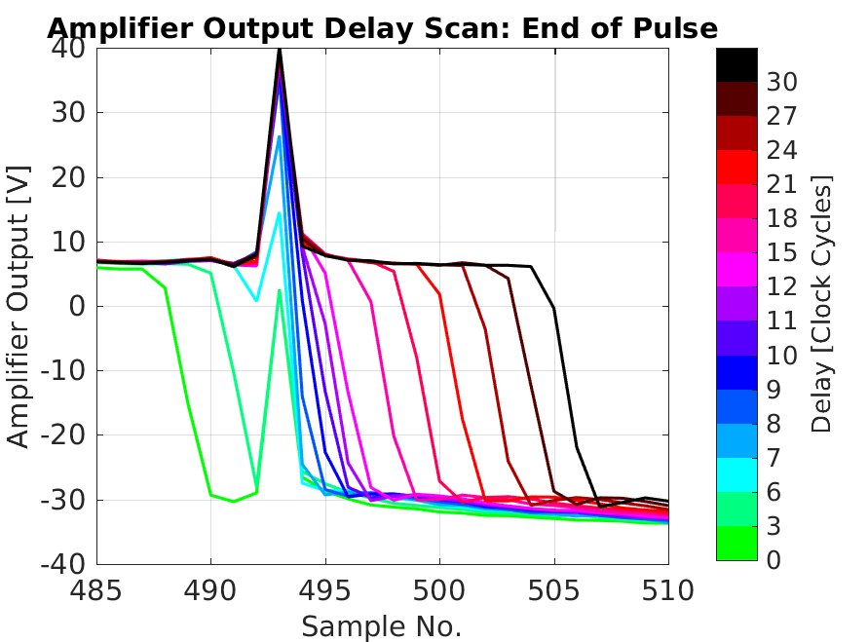
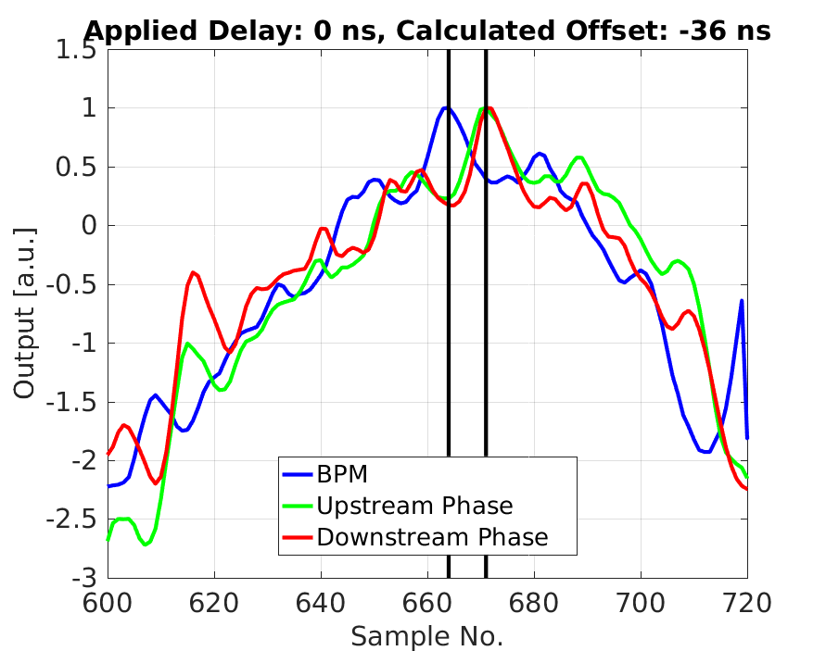
Timing check via beam pickup on kickers:
Timing check using BPM:

Slide 5
Phase Stability on Longer Timescales
Aim: Achieve close to 0.2 degrees phase stability on the timescale of ~1 hour rather than ~10 minutes.
Priority: High
Difficulty: Medium
Beam Time Requirements: High
Preparatory Time Requirements: High
Issues:
Stability of phase propagation - drifts in correlation, jitter and associated drifts in optimal gain.
Drifts on phase monitor LOs - quickly start to saturate correction range.
Drifts in optimal gain due to phase propagation changes - difficult to follow by hand.
Preparatory Work:
Automatic gain and offset adjustment.
To keep correction in range despite LO drifts and consistently correct with a close to optimal gain.
Develop new VI to do this in DAQ? Will try to ask Doug for advice before he goes to Japan.
Slow correction to remove slow phase drifts downstream.
Will no longer be removed by PFF system if offset is updated automatically.
Need to revisit and make improvements.

Slide 6
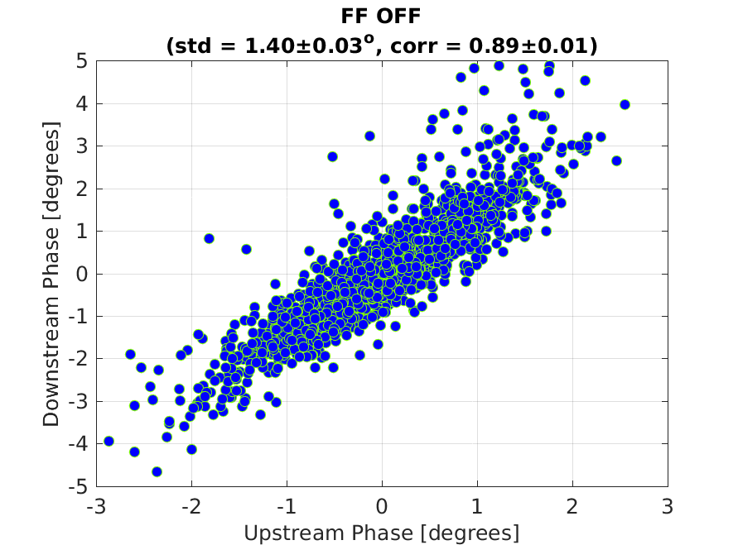
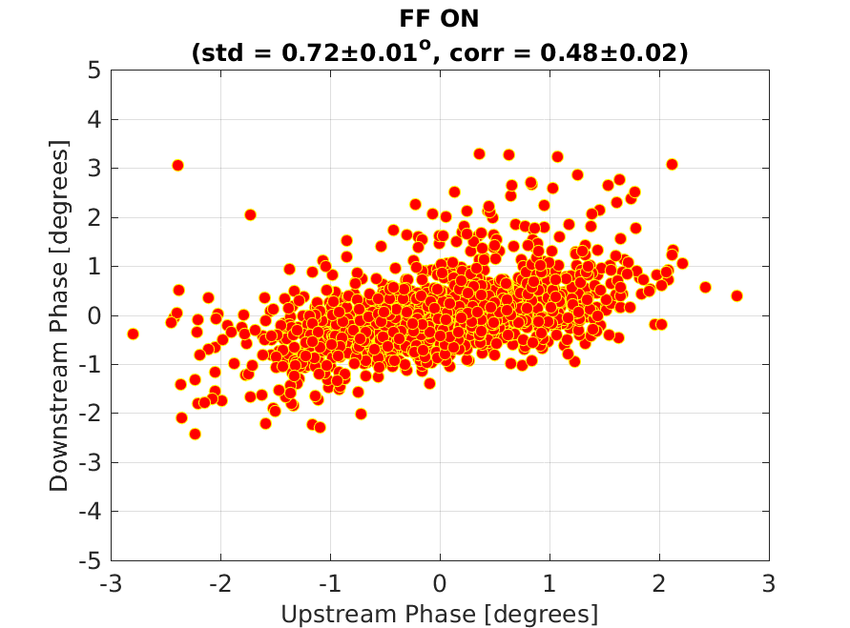
Combined results from many datasets on one afternoon:

Slide 7
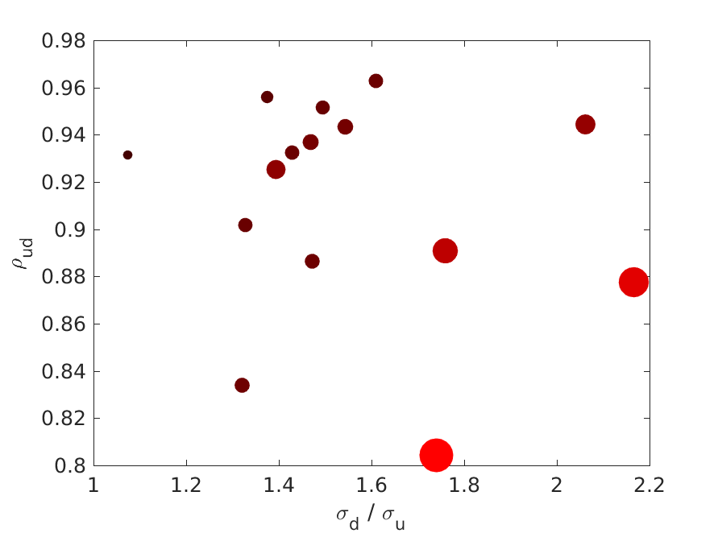
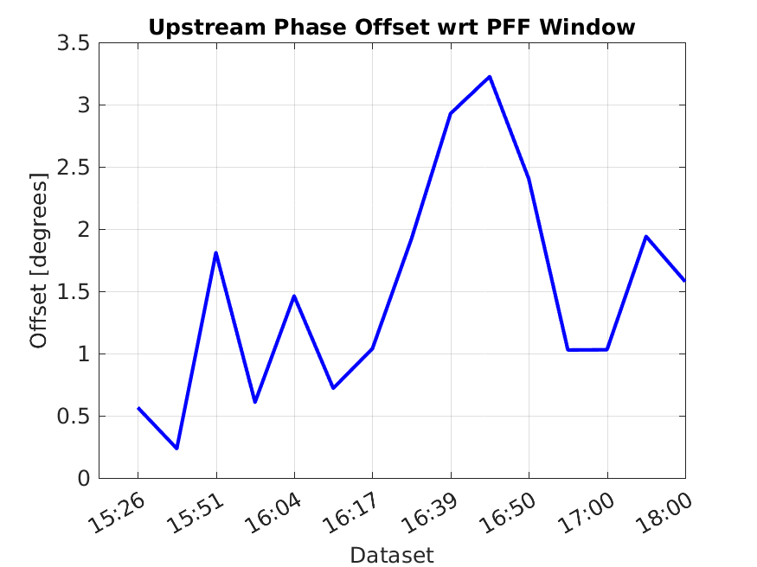
Drifts in phase propagation:
Non-optimal PFF setup:

Slide 8
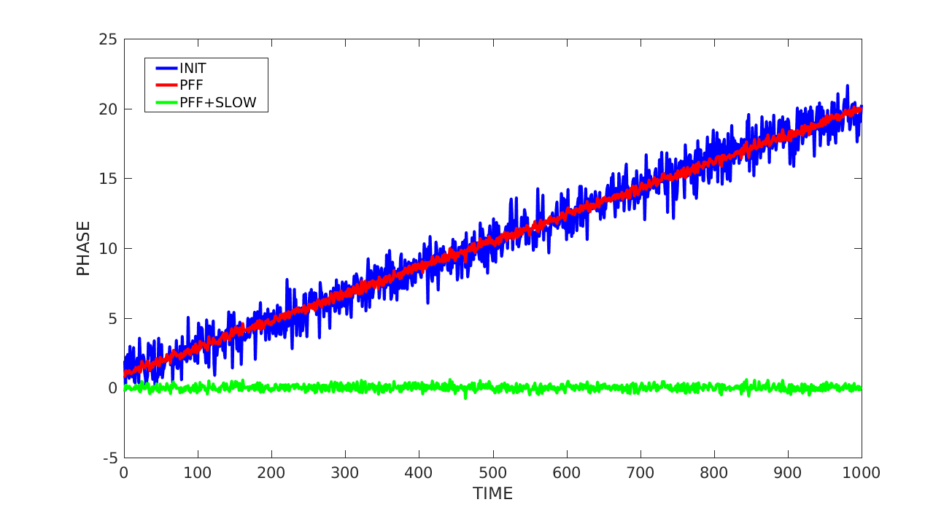
Hoping to achieve something like this (not real data!):

Slide 9
Non-Phase Stability in Presence of PFF System
Aim: Verify the PFF system can be run without degrading the orbit stability etc. downstream
Priority: High
Difficulty: Low
Beam Time Requirements: Medium
Preparatory Time Requirements: Low
Issues:
Orbit closure requires nominal PFF optics and maybe different gains for each kicker/amplifier output.
Measure emittance with/without PFF system.
Preparatory Work:
Maybe optics/amplifier checks, but nothing really needed.

Slide 10
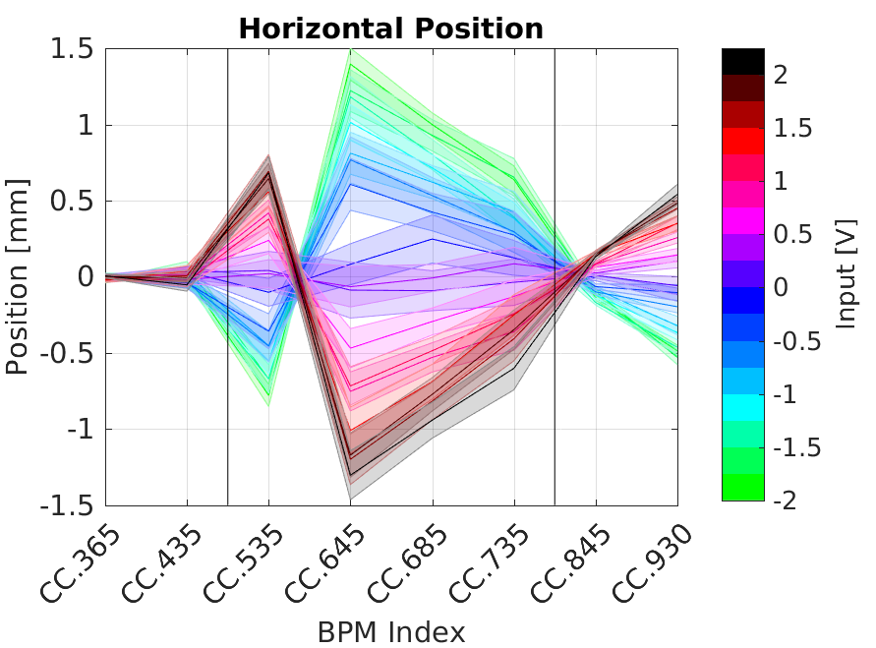
Typical orbit closure situation to date:

Slide 11
Combined Beam Correction
Aim: Reduce phase jitter of a factor 4 beam.
Priority: Medium
Difficulty: High
Beam Time Requirements: Medium
Preparatory Time Requirements: High
Issues:
Correlation of uncombined upstream phase with combined downstream phase.
Needs new firmware.
Preparatory Work:
Measurements and analysis of combined beam phase in TBL.
New firmware to develop.

Slide 12
Short Term Phase Stability
Aim: Achieve lowest possible jitter (0.20 degrees ideally!). And/or factor 10 reduction in initial jitter.
Priority: Medium
Difficulty: Low (to try, not achieve)
Beam Time Requirements: Medium
Preparatory Time Requirements: Low
Issues:
Upstream-downstream phase correlation, downstream jitter.
Phase monitor performance.
Preparatory Work:
Optics improvements?
Phase monitor measurements.

Slide 13
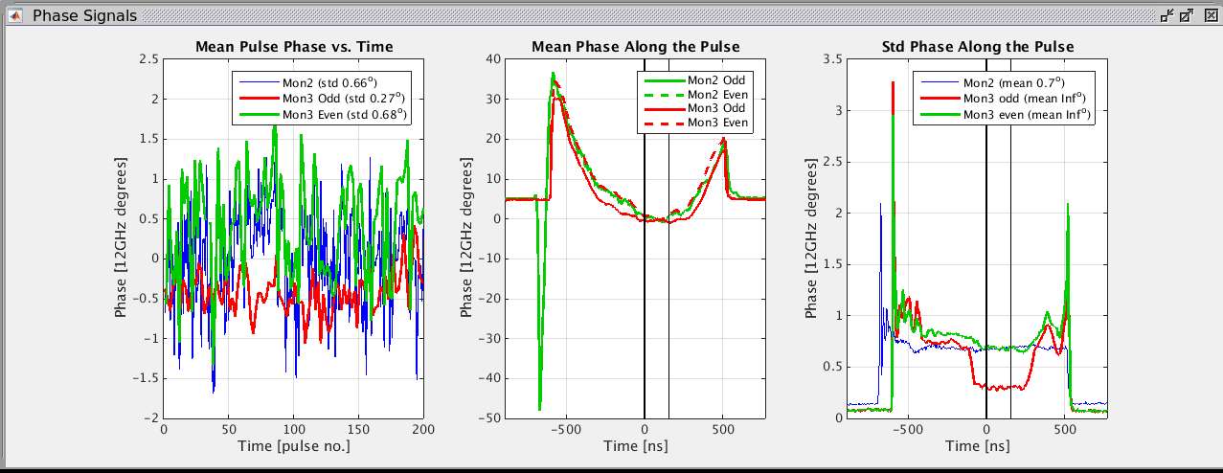
Example of one of the best results this year (not analysed fully yet):
Same jitter on mean as record from last year, but across 400 pulses instead of 150.

Slide 14
2-Input Correction
Aim: PFF with two inputs (phase-energy, phase-position or phase-phase)
Priority: Low
Difficulty: High
Beam Time Requirements: Medium
Preparatory Time Requirements: Medium
Issues:
Don't have high correlation with energy/position any more - would have to create it.
Available BPM signal is from Frascati chicane - not normally used, and would need new optics to avoid creating very large phase jitter.
Preparatory Work:
Setup - check firmware, how to optimally set each gain etc.
Optics/phase propagation changes

Slide 15
Phase Propagation
Aim: Higher/improved stability of upstream-downstream phase correlation. Larger correction range?
Priority: Medium
Difficulty: Medium
Beam Time Requirements: Medium
Preparatory Time Requirements: Medium
Issues:
Higher orders.
Ability to correct phase using nominal non-PFF optics in TL2.
Non-energy dependent effects (sensitivity to power supplies etc.)
Preparatory Work:
Verify R52 in nominal TL2 optics (in MADX).
Try to match optics with smaller T566 (in MADX).
Use sextupoles to try to reduce T566.
Consider creating an optics with larger R52 but sacrificing orbit closure/R56.

Slide 16
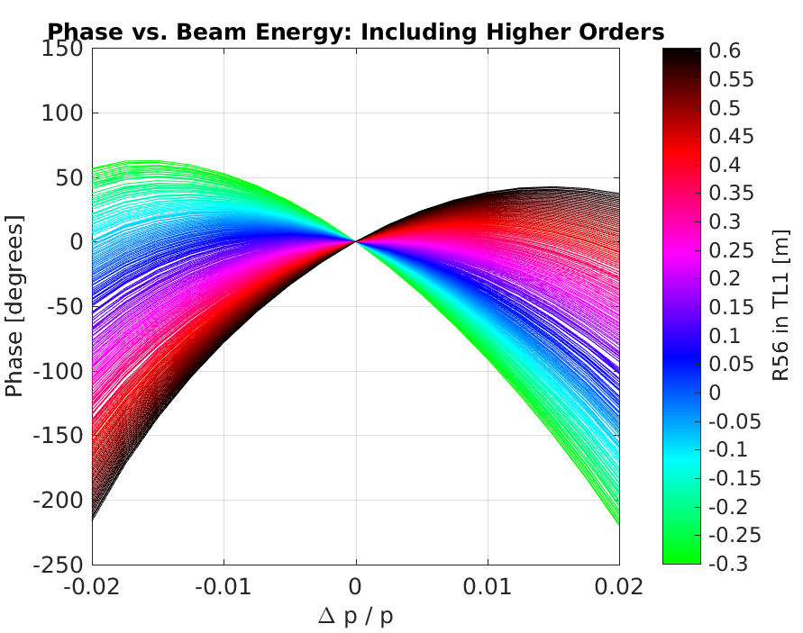
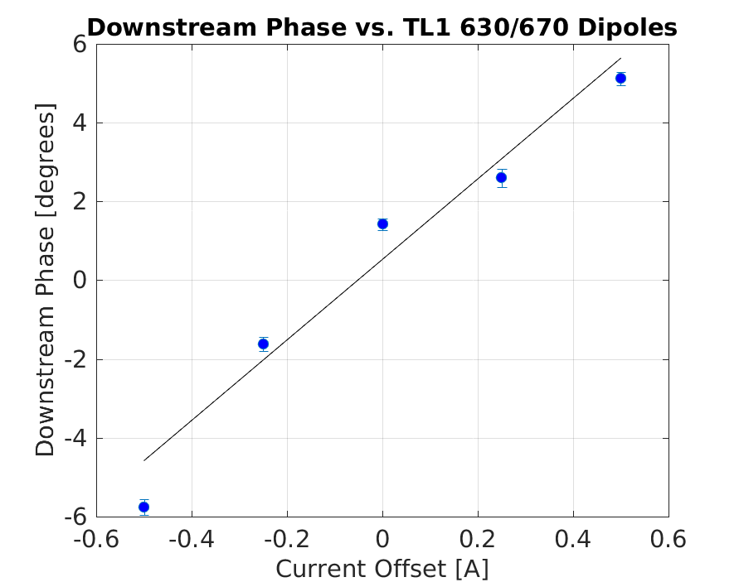
Higher order effects:
Effect of changing TL1 dipole field on the phase:

Slide 17
Phase Monitors
Aim: Better than 0.2 degrees resolution.
Priority: High
Difficulty: Low... hopefully.
Beam Time Requirements: Low
Preparatory Time Requirements: Medium
Issues:
Drifts on LO.
Noise on LO from klystrons.
Recent decrease in output level from second mixer.
Position dependence, variations in calibration constant etc. etc.
Preparatory Work:
My opinion: Monitor their performance and live with it unless it gets worse.

Slide 18
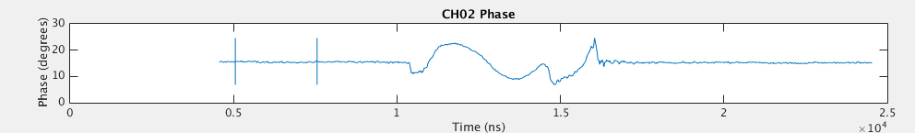
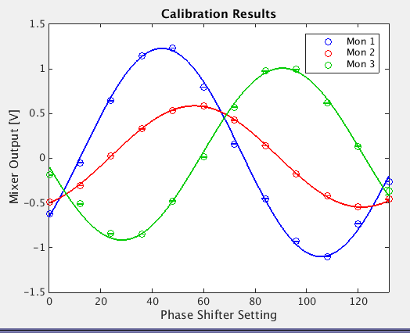
Noise from klystrons on LO
Lower output from Mixer 2

Slide 19
Beam Time Not Needed
Data Analysis of PFF runs July/August
Jitter record (0.23 degrees on mean?) as part of a gain scan.
Nice results with/without wiggling.
Paper
Start to prepare structure, placeholder figures etc.

Slide 20
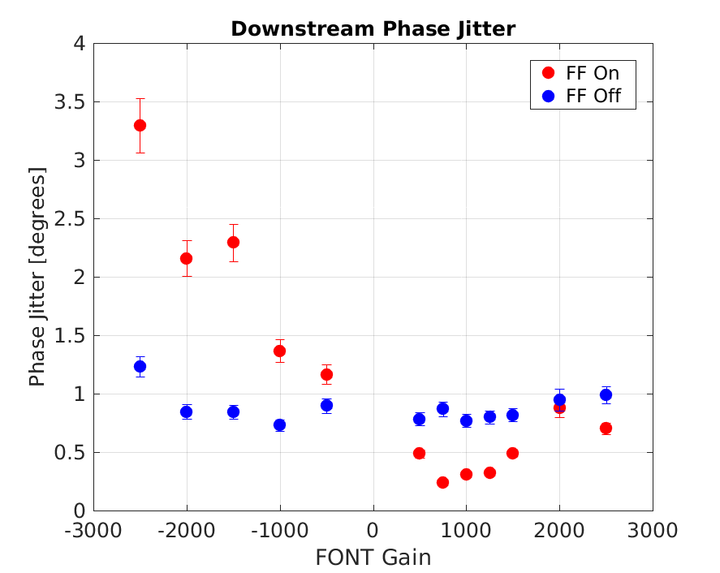
Lowest jitter achieved so far hidden in a gain scan:
0.24 degrees!
Can claim 0.2 degrees mean beam phase jitter achieved assuming a phase monitor resolution >0.14 degrees.

Slide 21
Summary
Still many things that can be done! Definitely more than 3 months work that could be done, so we need to prioritise.
My current priorities:
Try to develop automatic gain/offset adjustment.
Check current status of phase monitor resolution.
Acquire some data next time there is combined (factor 4) beam in TBL.
See if acquisition via CERN control system can be improved.
Next dedicated shifts I would initially prioritise:
Timing checks.
Demonstrate PFF system can be operated whilst maintaining orbit closure.
See if we can reduce higher order energy dependence with sextupoles.
Possibly slow correction as part of trying to get correction on long time scales..

