Slide 1
Dispersion and its application to the Quadscan

Slide 2
Current QuadScan Method
QuadScan => Measuring beta functions

Slide 3
Adding Dispersion contribution to beam size

Slide 4
Fitting Methods
‘Coregauss’ – Fits two gaussians, returns the taller/thinner one
‘Japanesegauss’ – Fits one gaussian, removes all points below a certain cutoff (15%), fits and returns another gaussian

Slide 5
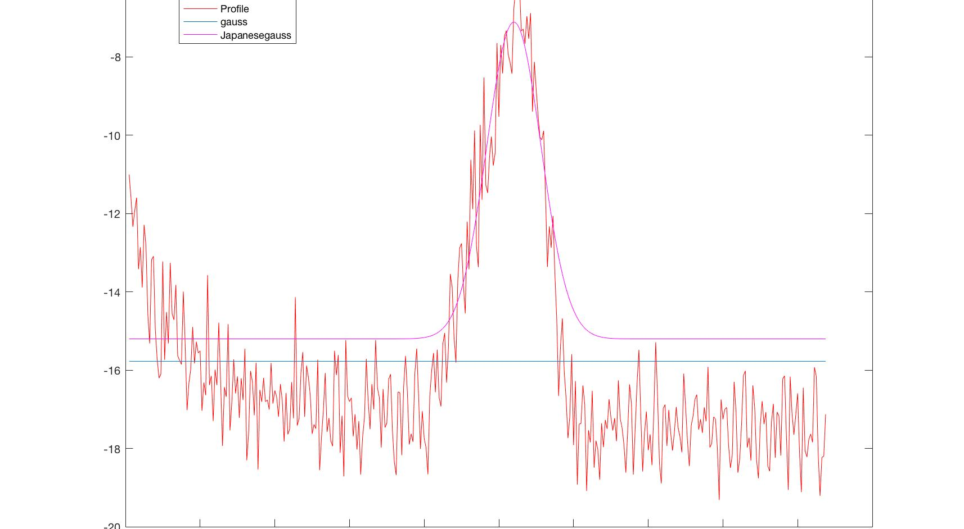
‘gauss’ vs. ‘Japanesegauss’

Slide 6
Dispersion Calculation
Change of 0.8% in gun current => -0.5% change in beam energy (nominally 135MeV)

Slide 7
Chromatic Aberration
Nominal
After Energy Change (-0.5%)

Slide 8
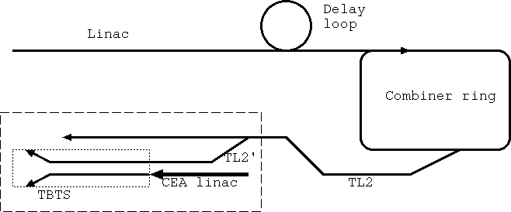
A & B Energy Dependence
Assumed so far that A and B depend only on quadrupole current, not beam energy.
Girder 20

Slide 9
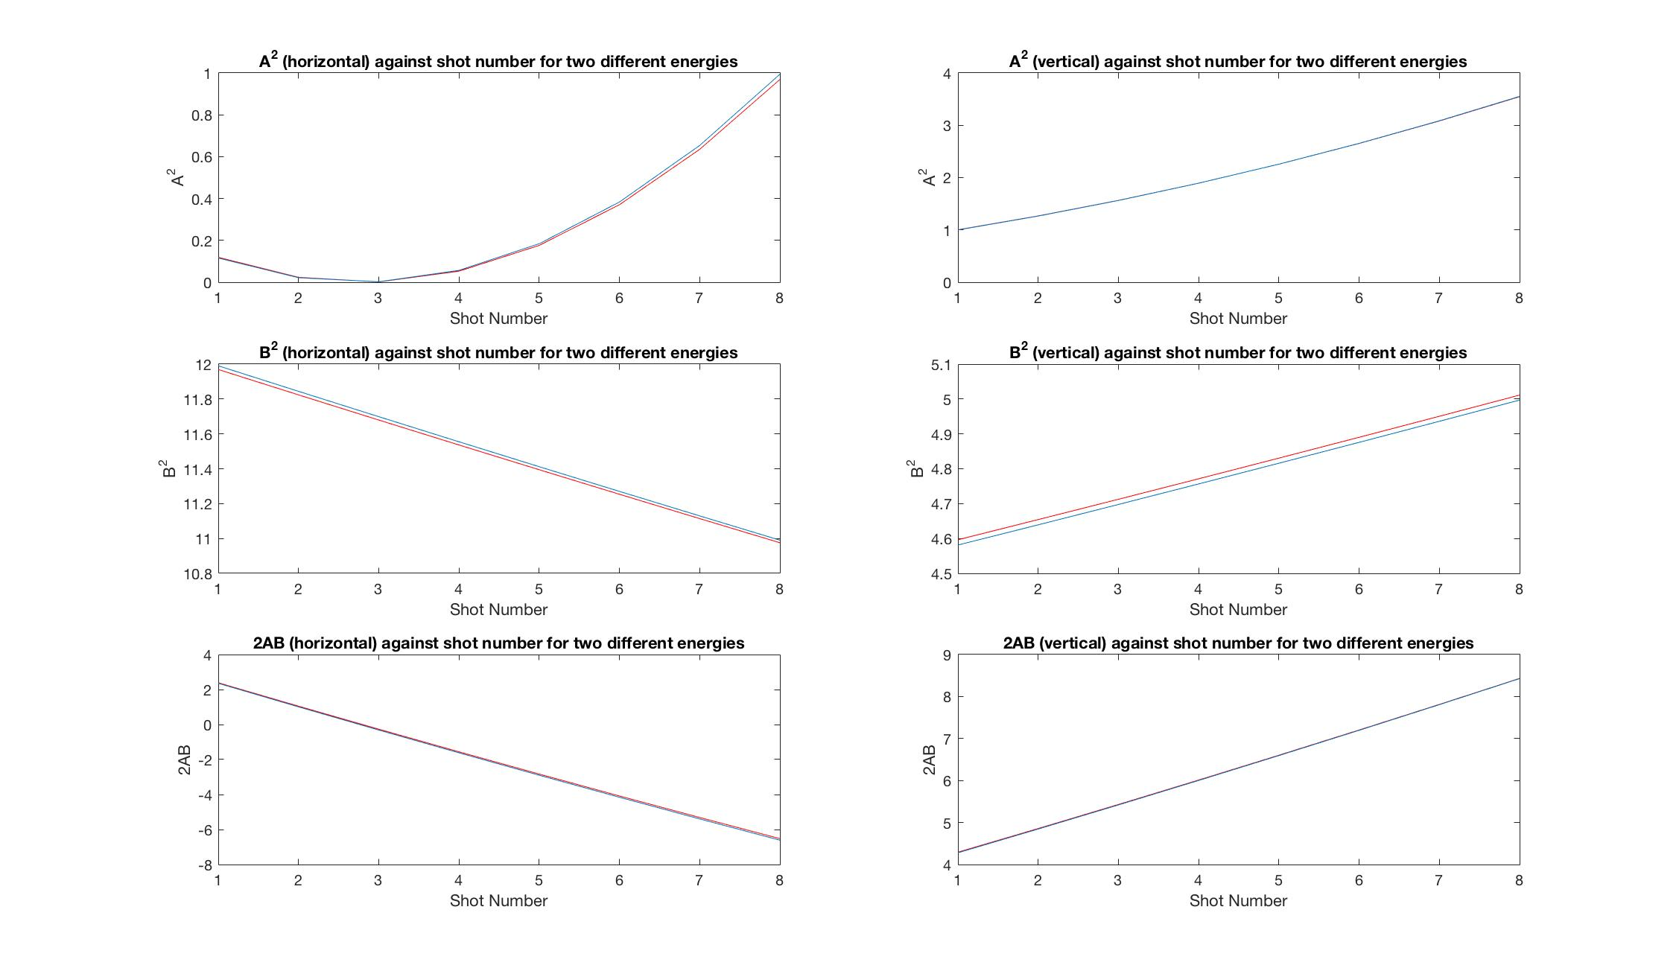

Slide 10
Results
A horizontal and a vertical scan for a straight beam (no delay loop) at girder 20
A horizontal and a vertical scan for a beam which has passed through the delay loop at girder 20
A horizontal scan for a beam which has passed through the delay loop at girder 20 (Large chromatic aberration in Y)

Slide 11
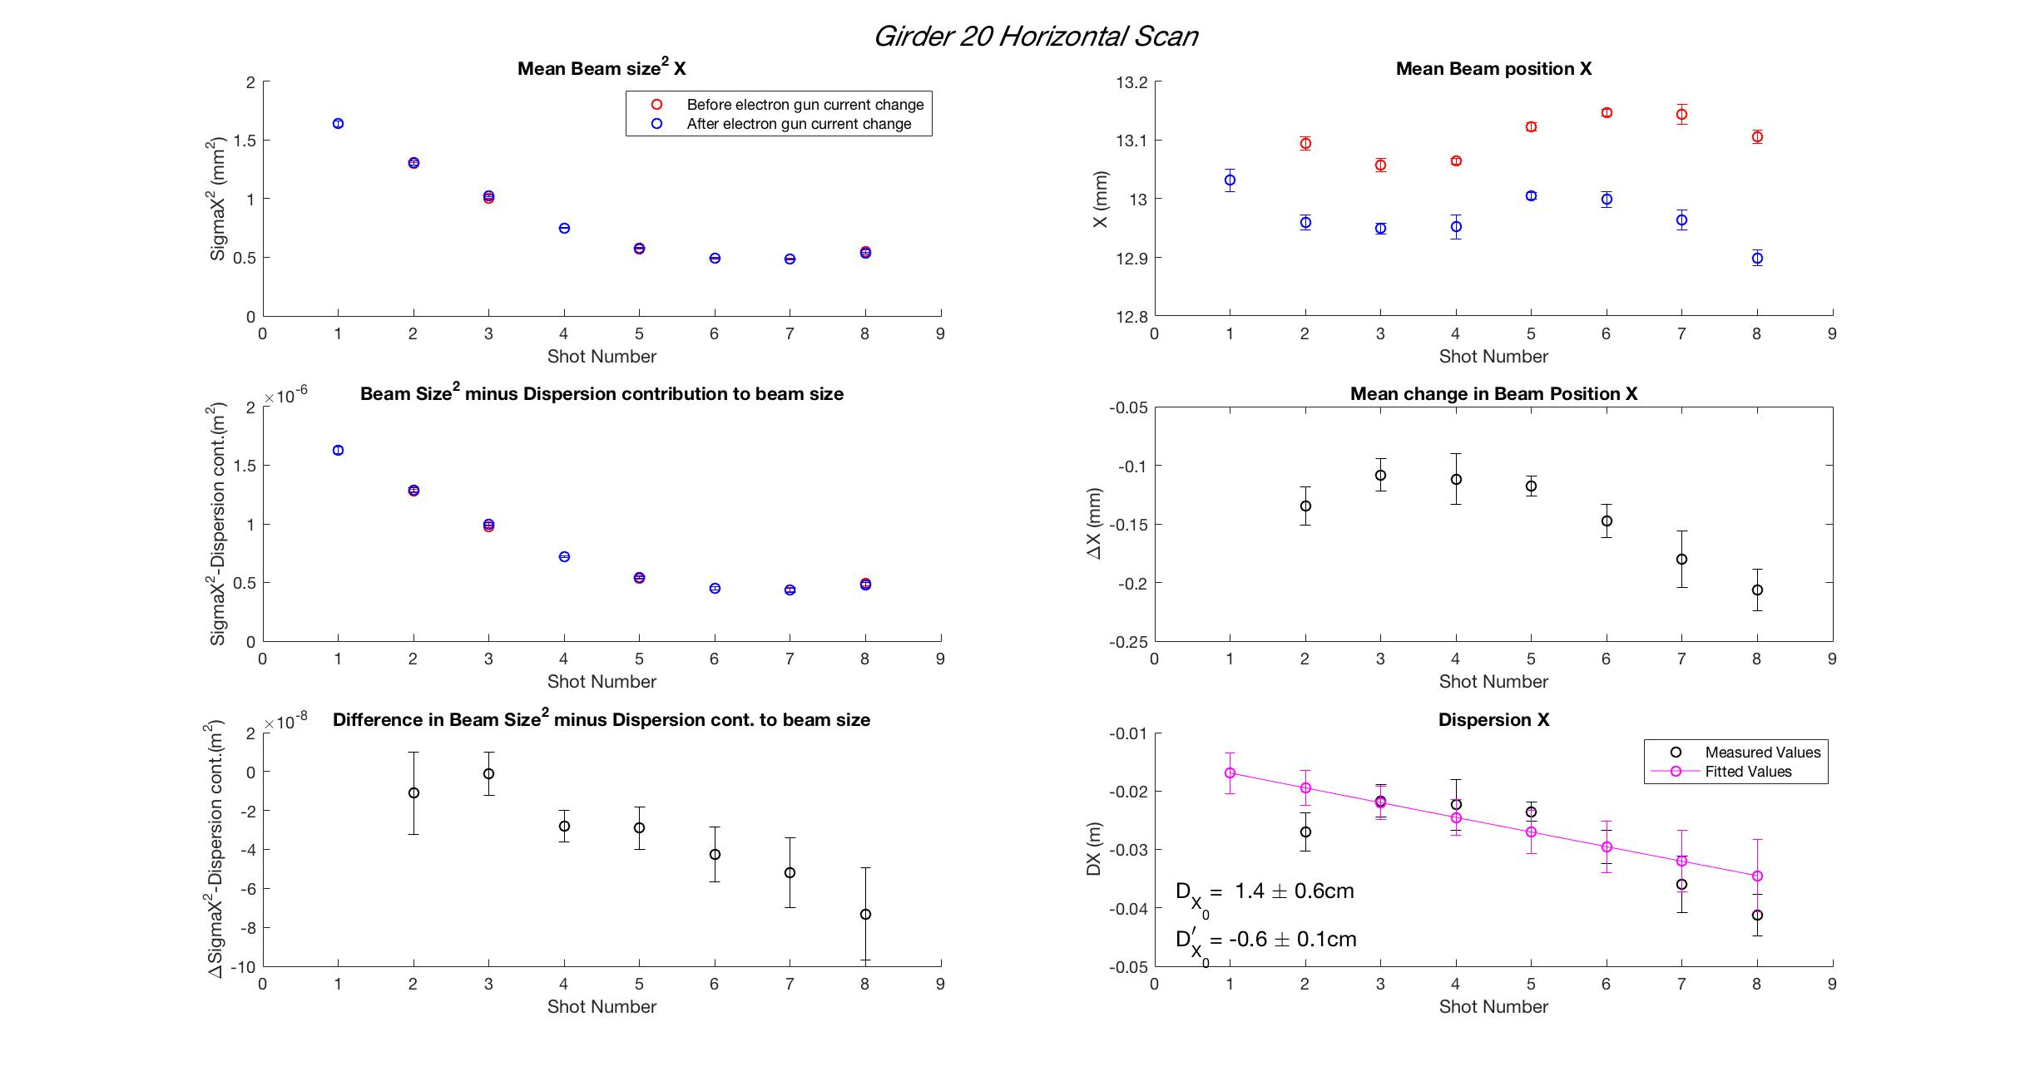

Slide 12
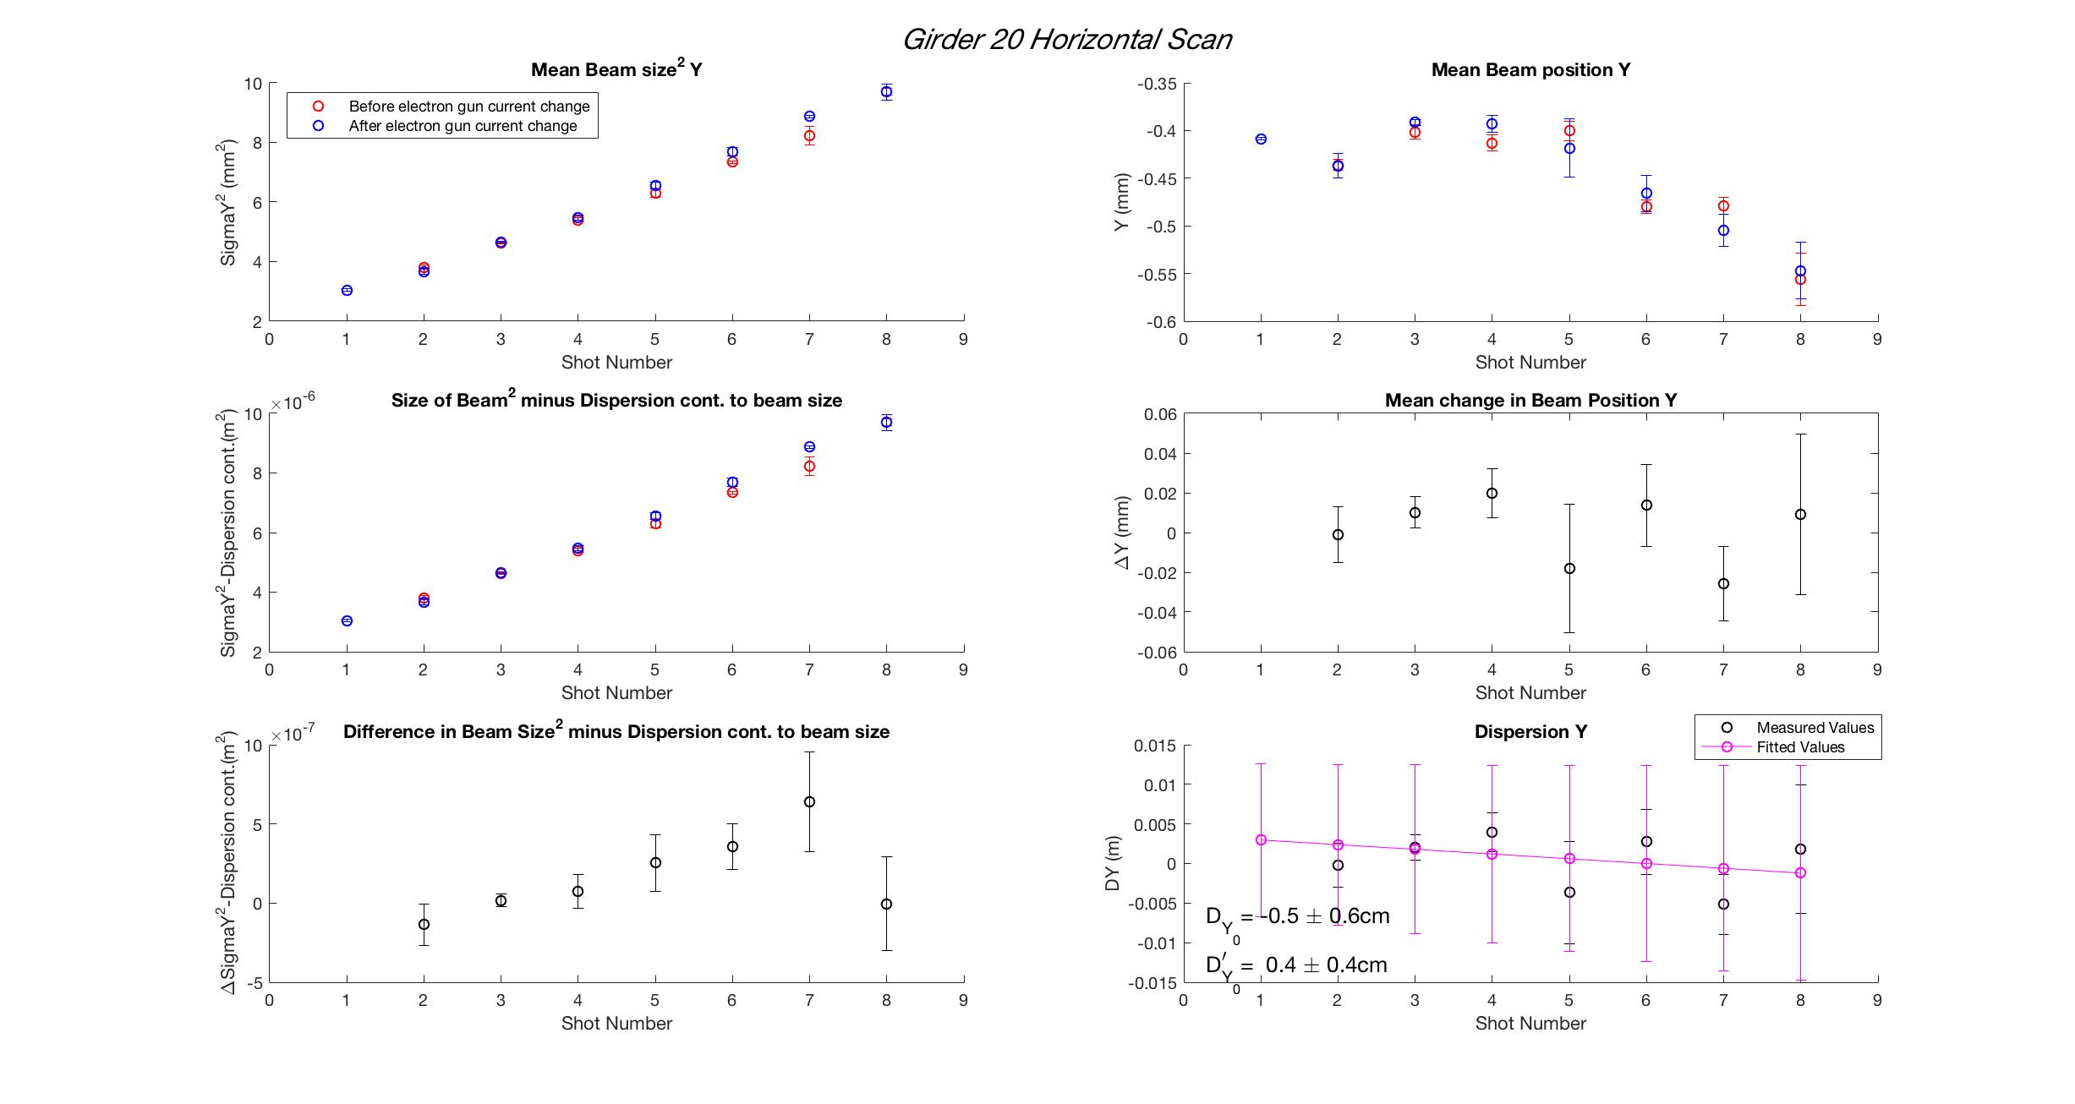

Slide 13
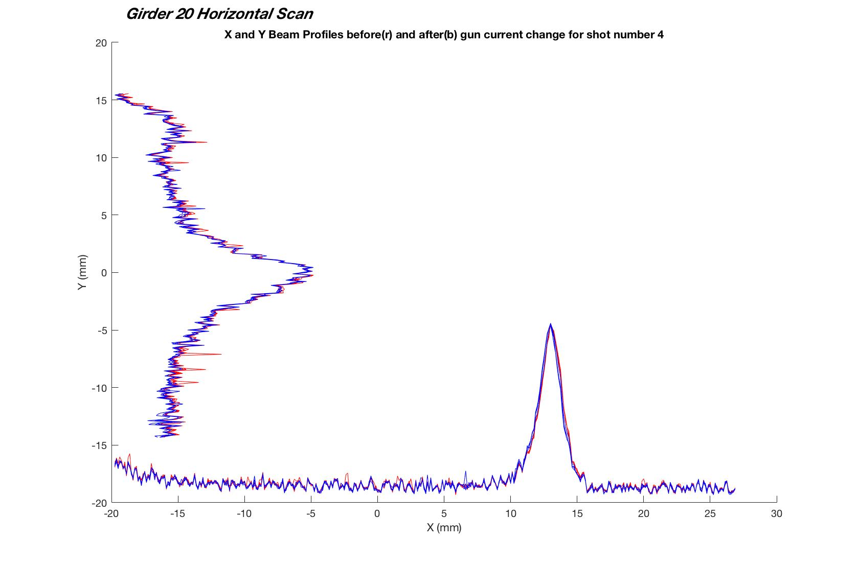

Slide 14
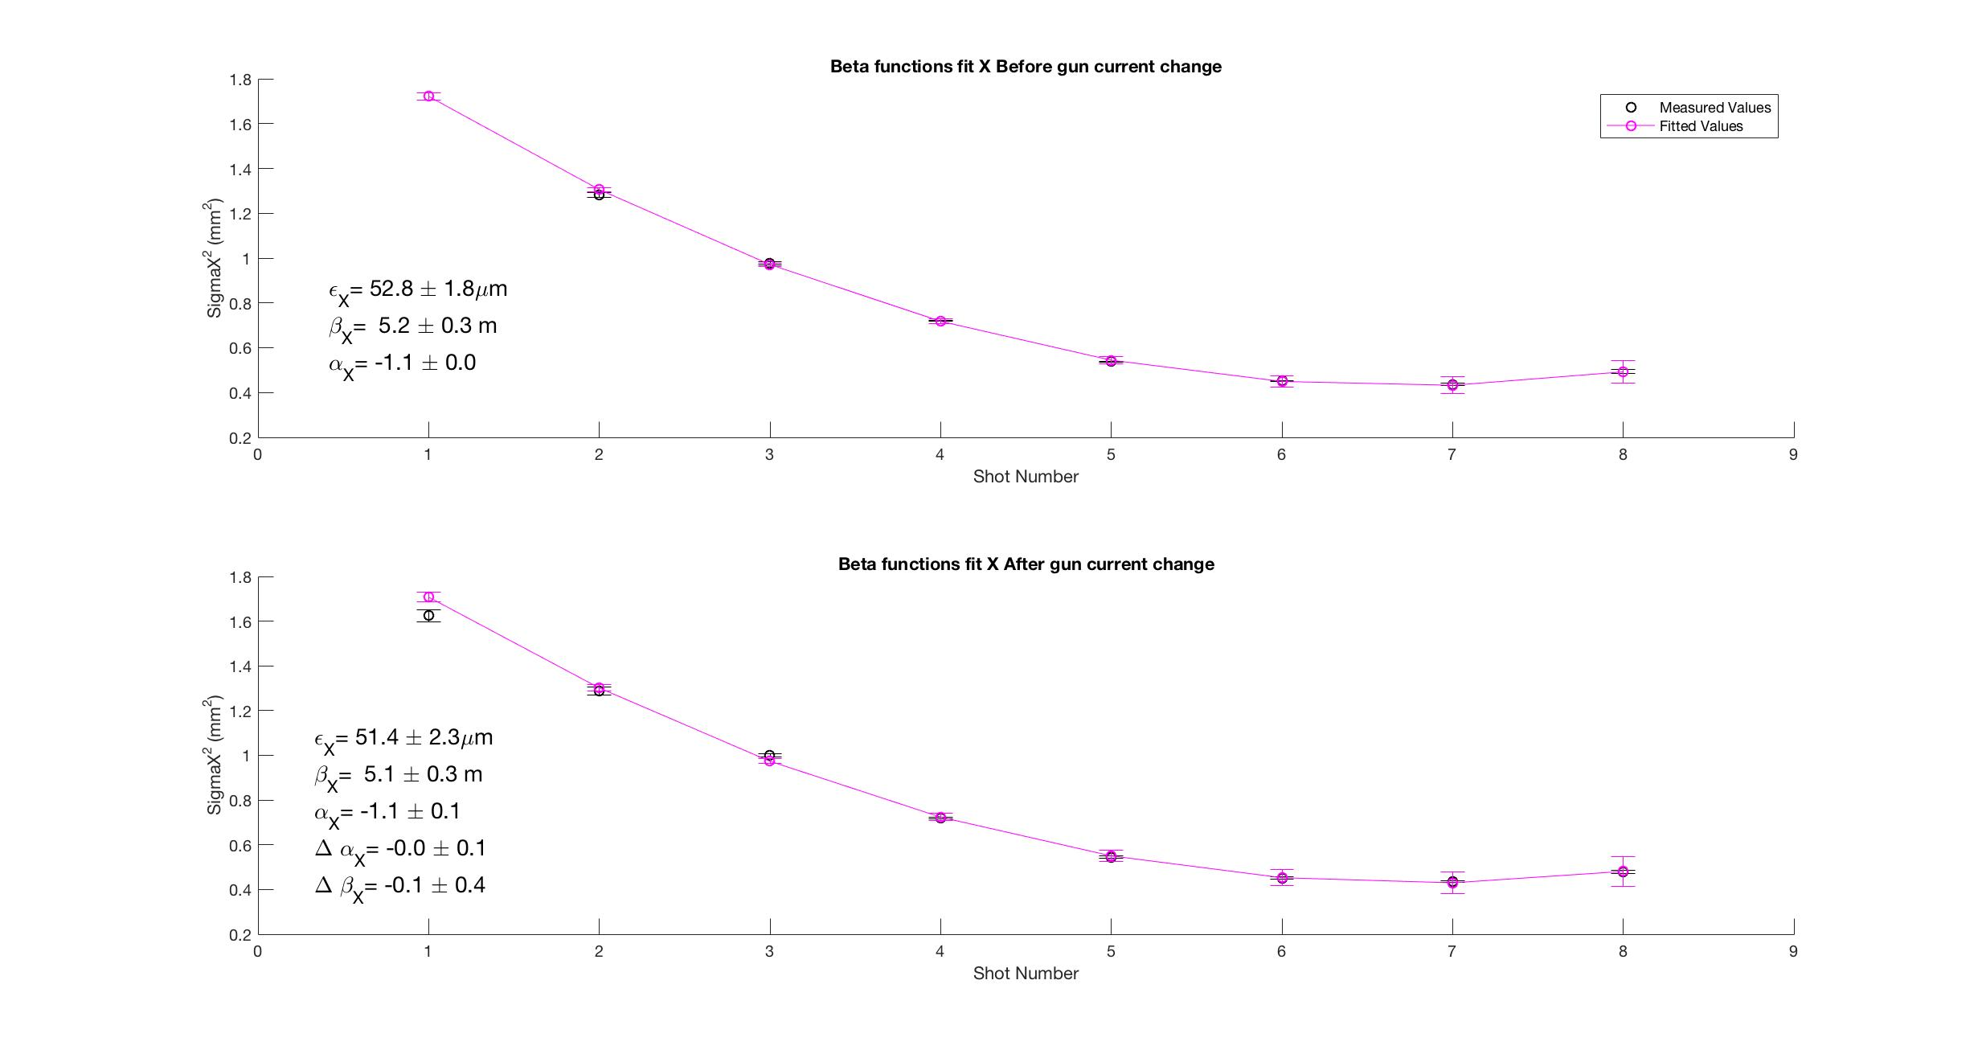

Slide 15

AB Change

Slide 16
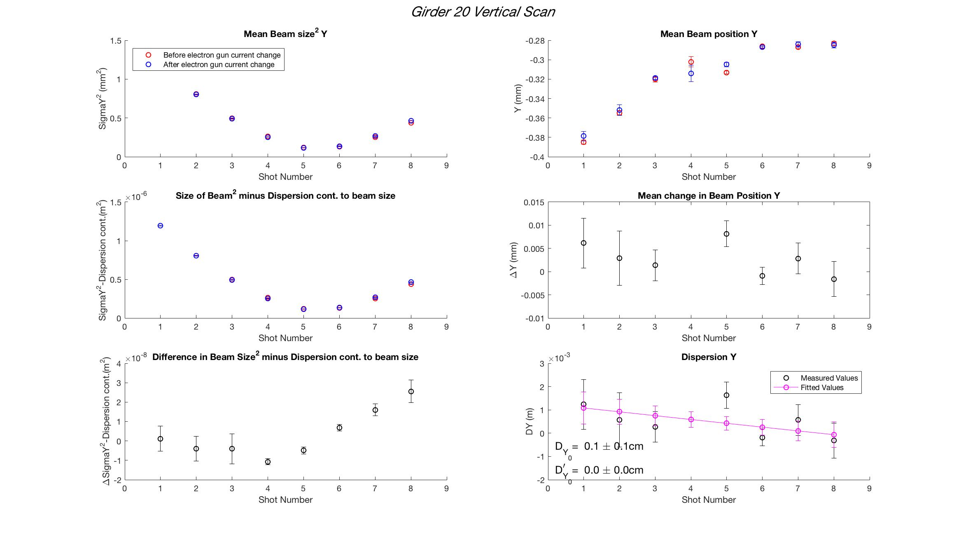

Slide 17
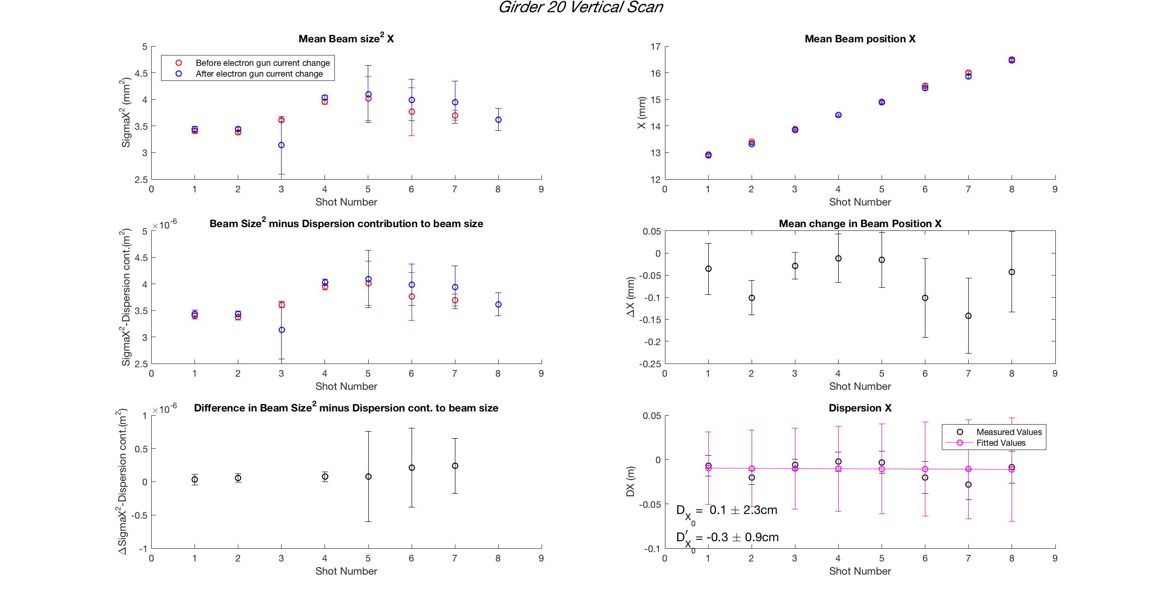

Slide 18
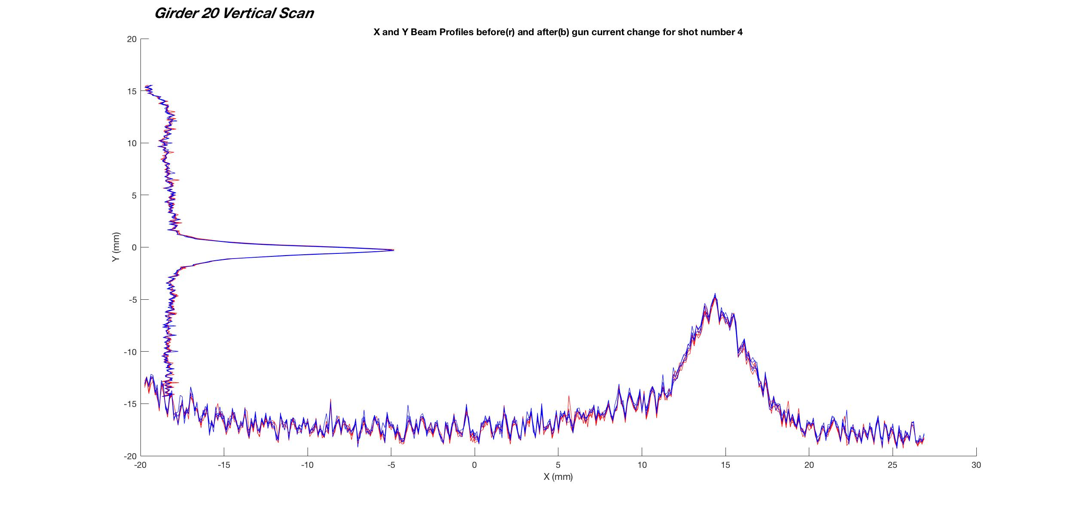

Slide 19
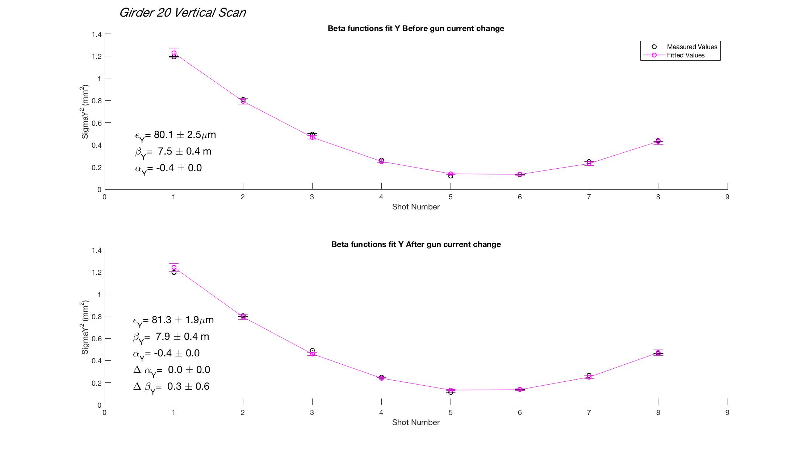

Slide 20
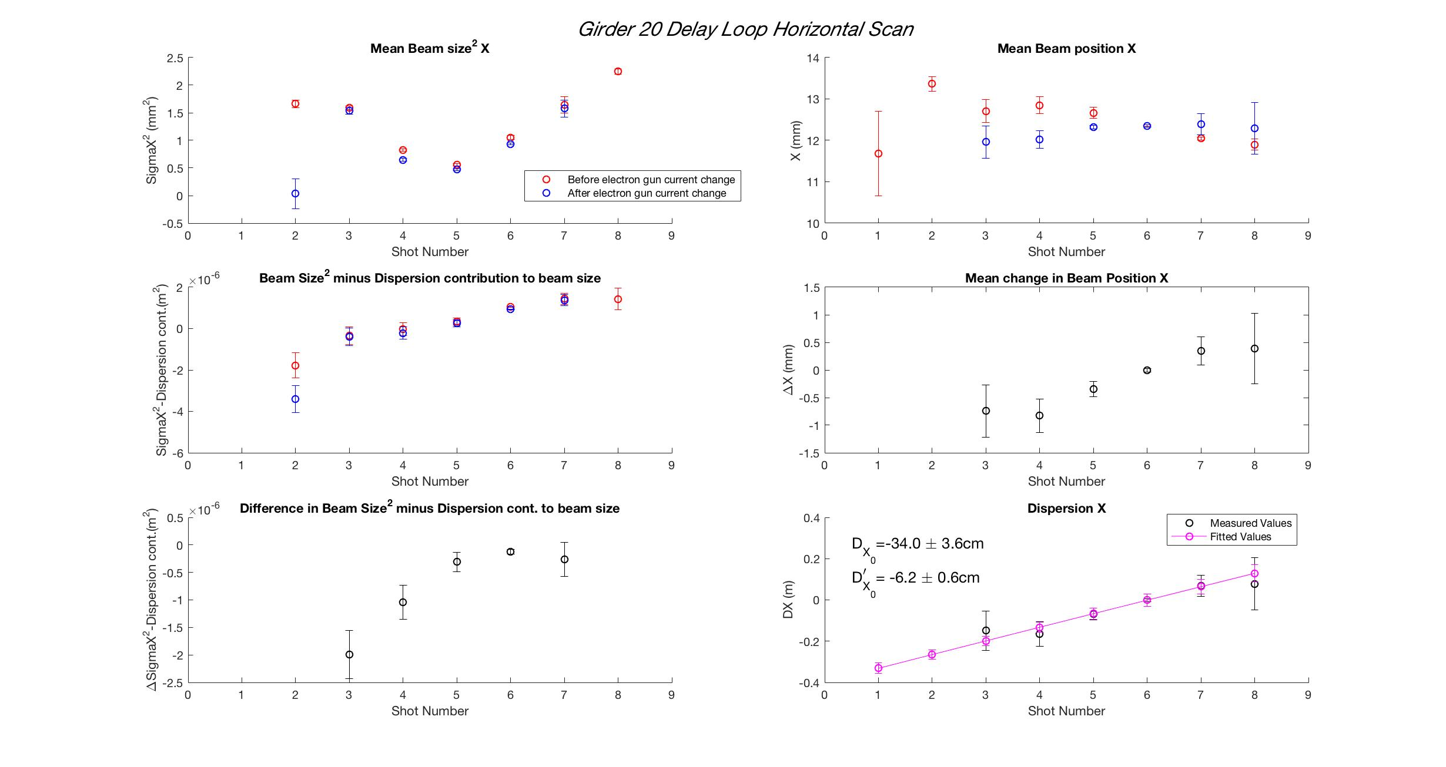

Slide 21
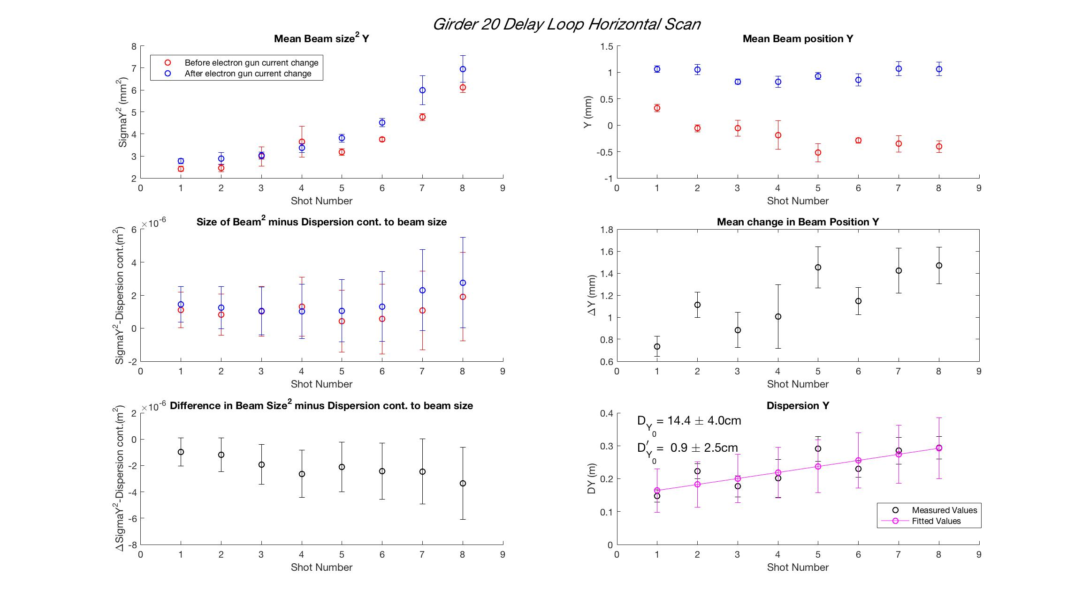

Slide 22
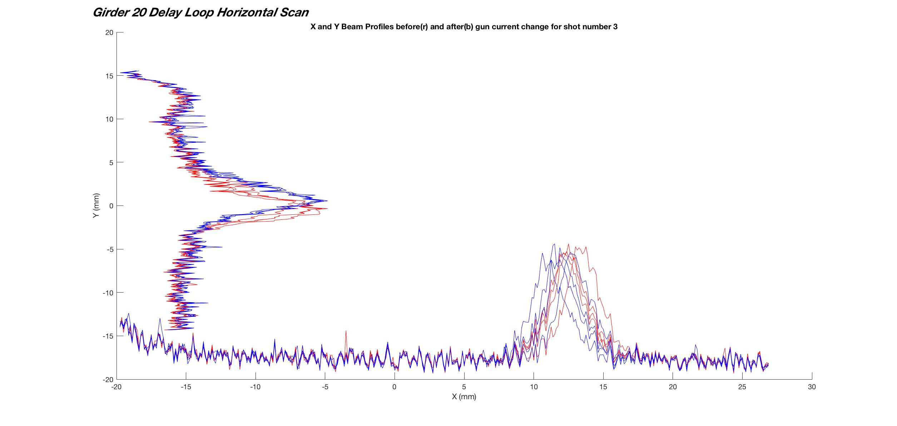

Slide 23
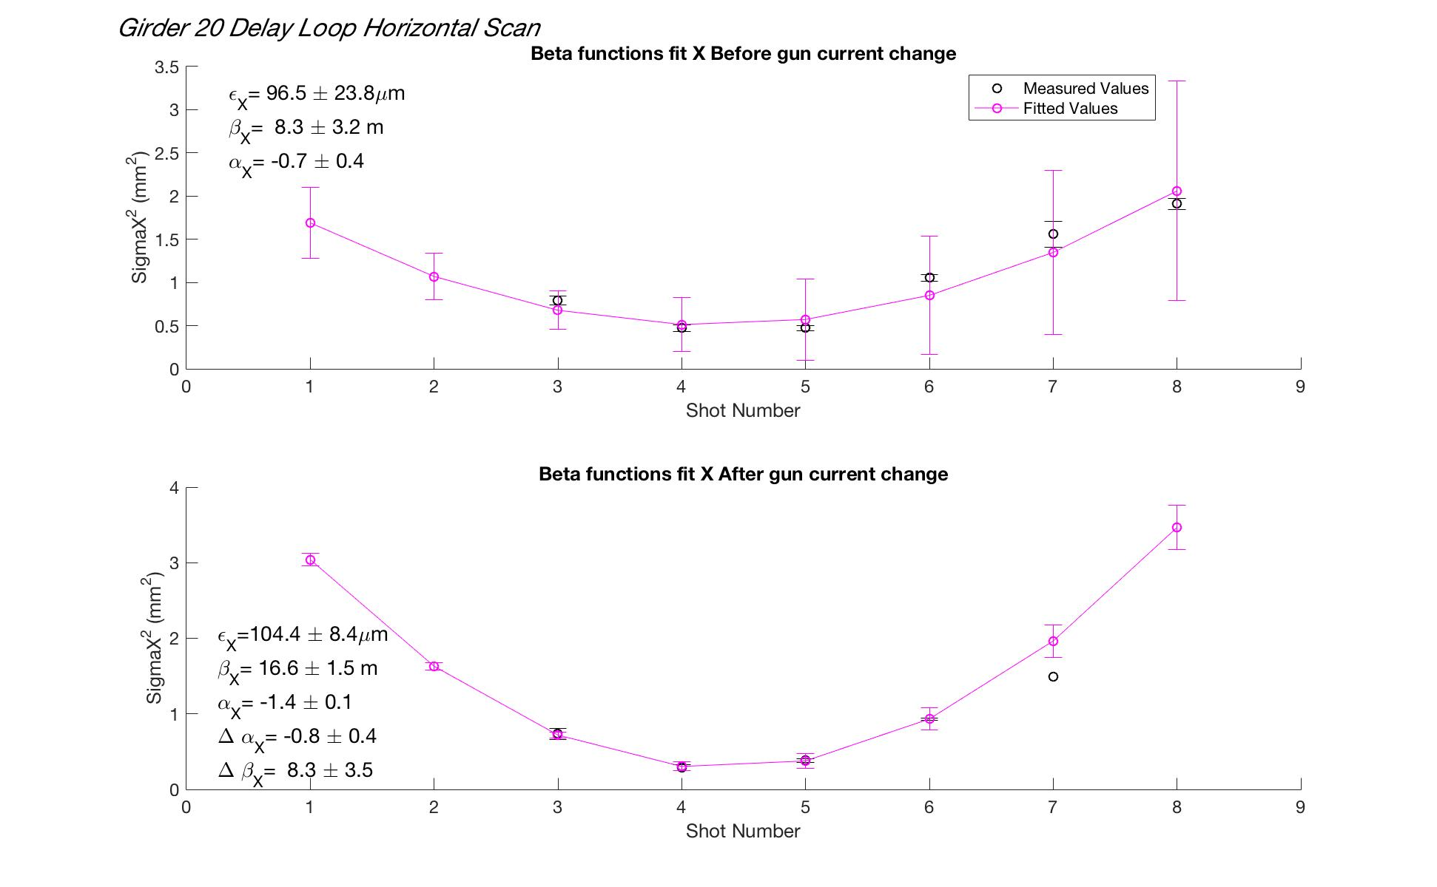

Slide 24
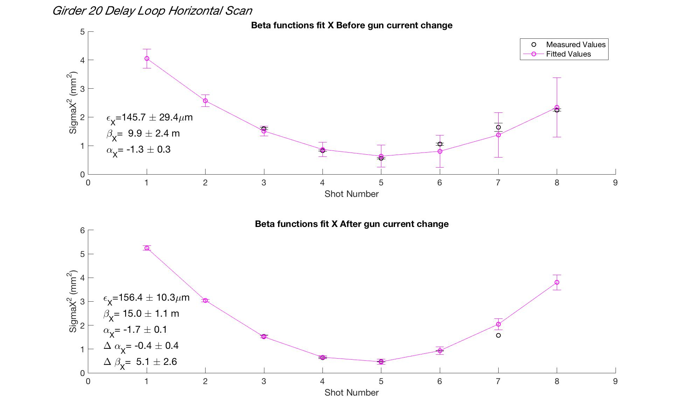
No disp. subtraction

Slide 25
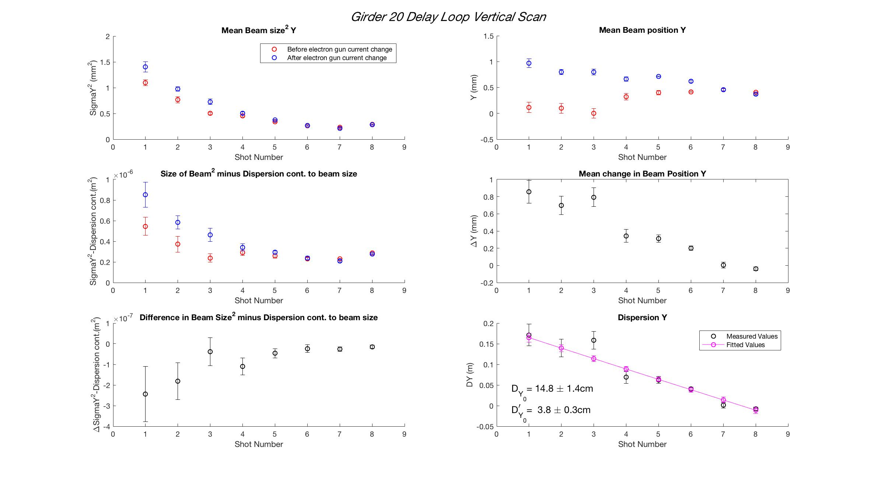

Slide 26
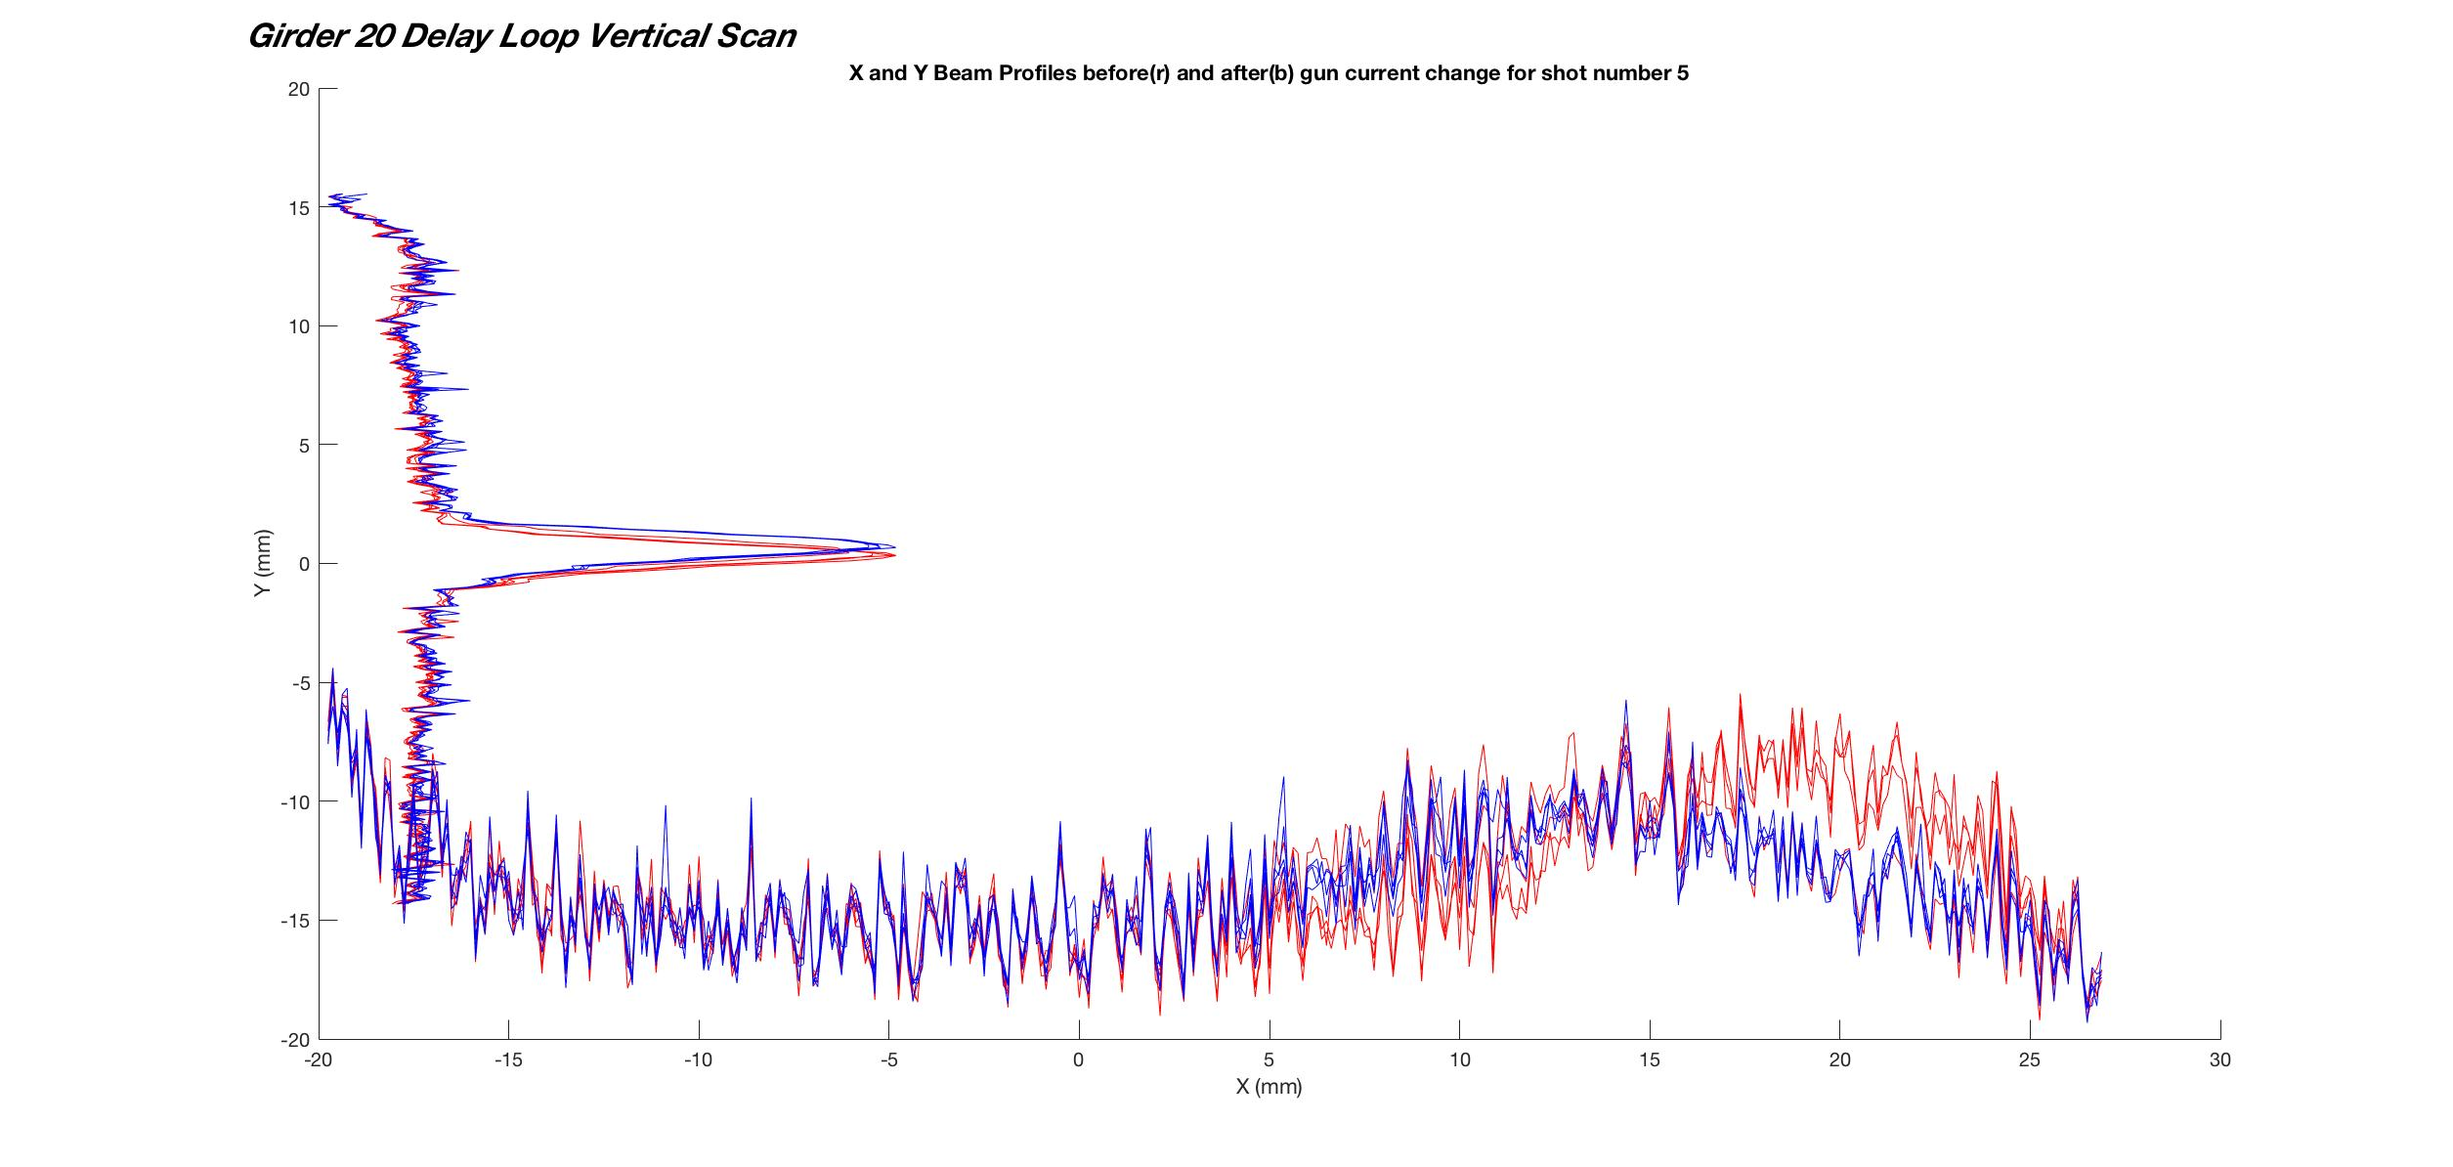

Slide 27
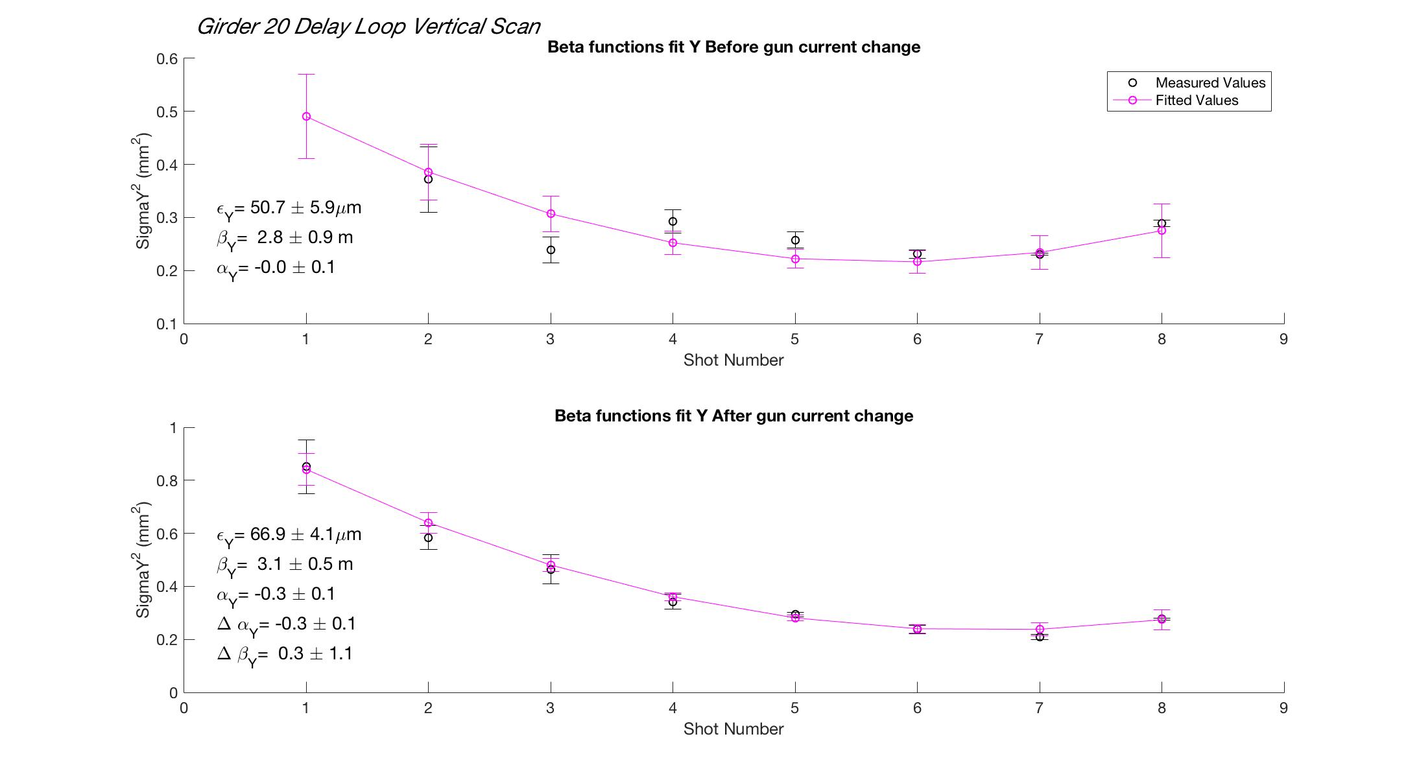

Slide 28
Normally take the energy spread to be 0.7 <-> 1 % for a beam not passing through the delay loop (measured with spectrometer)
However due to the collimation effect of the delay loop, beams coming from here can have an energy spread of ~0.5%. This gives much more reasonable values for the dispersion contribution to the beam size.

Slide 29
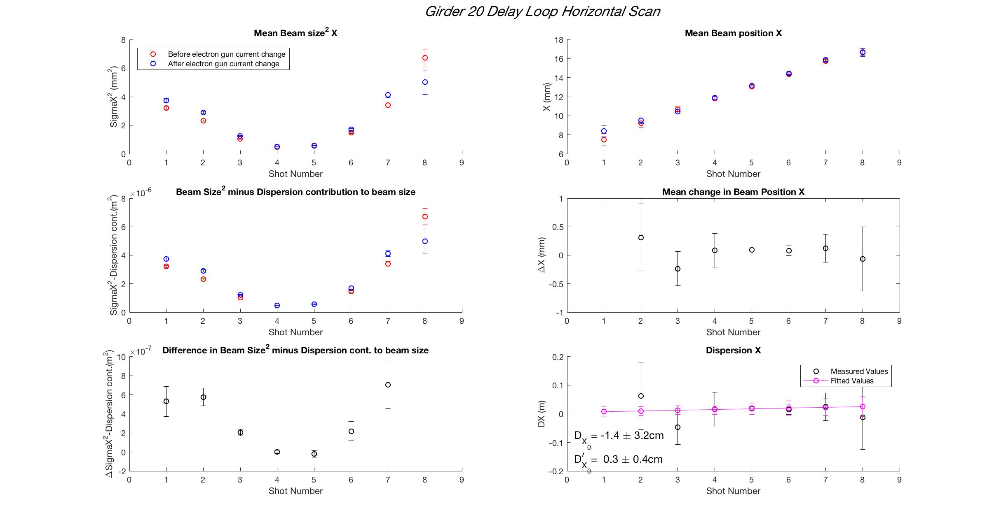

Slide 30
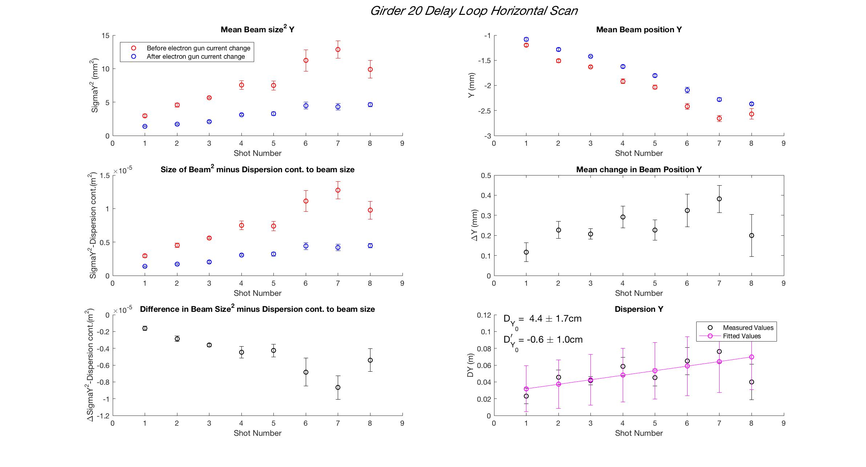

Slide 31
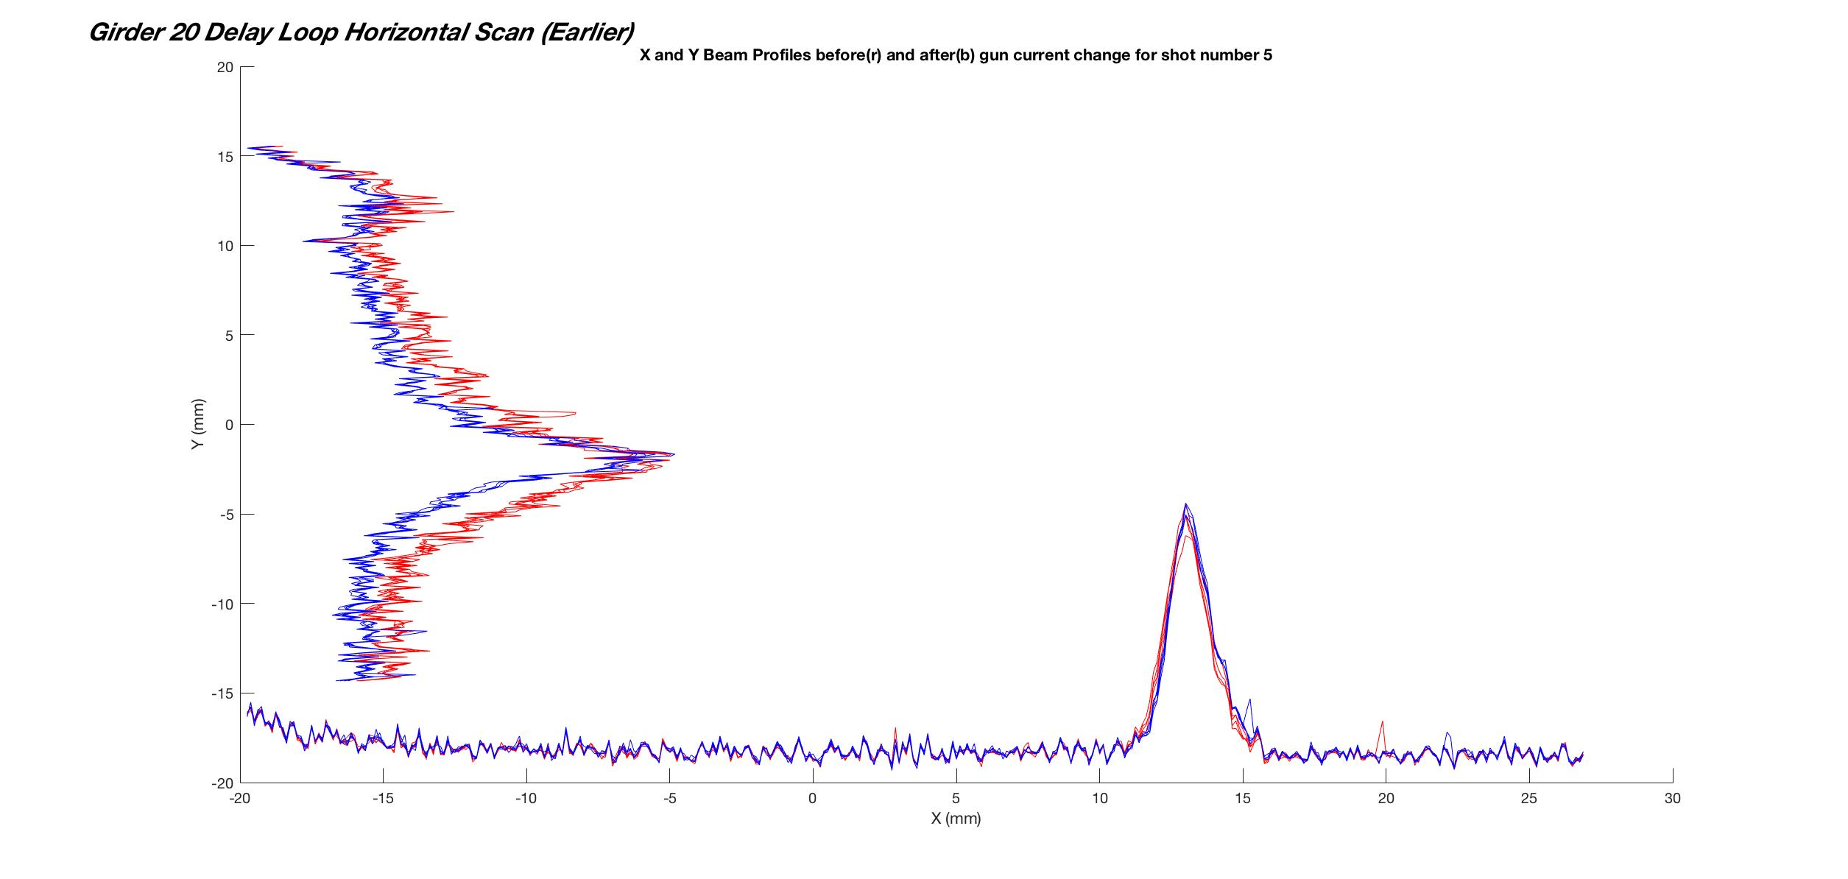

Slide 32
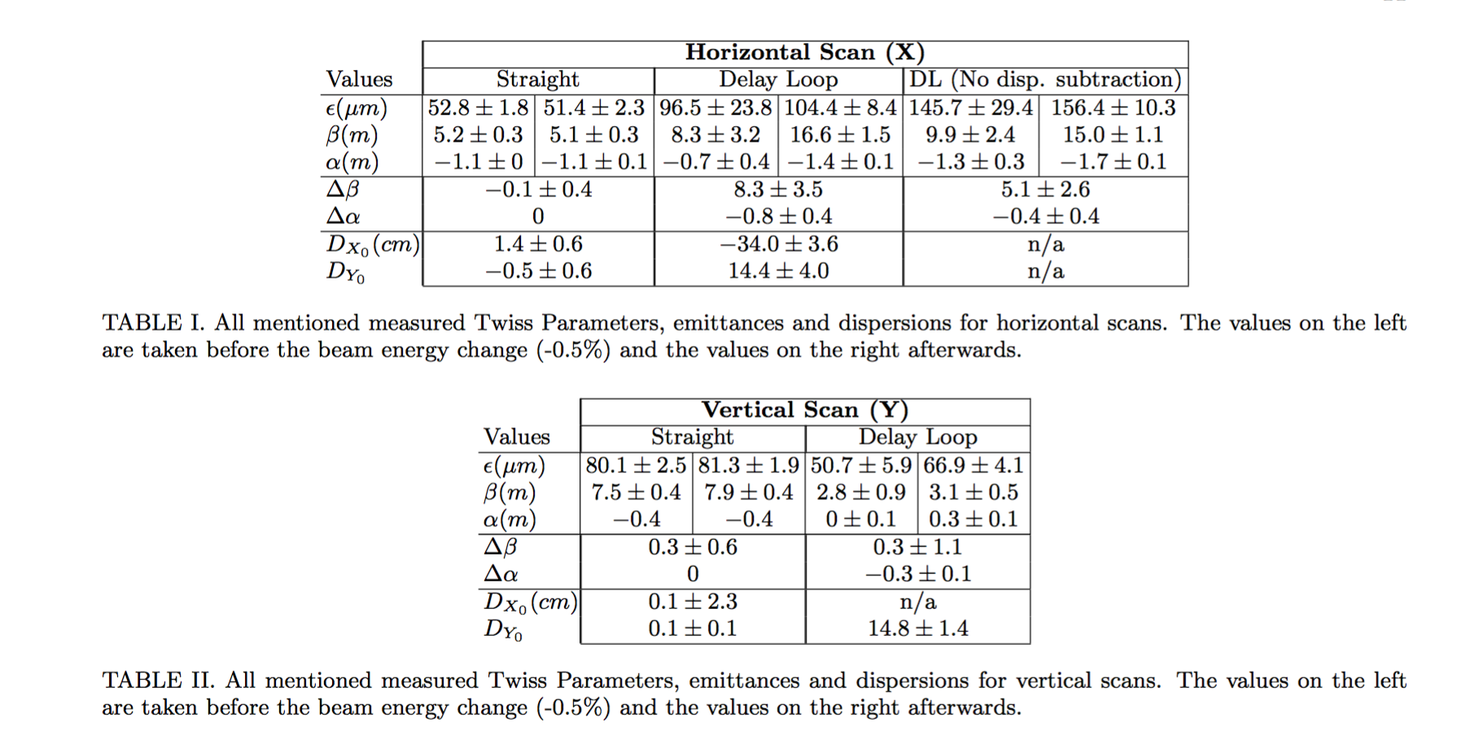

Slide 33
Implementing Dispersion Measurement into QuadScan Function
Perform QuadScan as normal at two different beam energies.
Run new program on the saved beam profiles
Results are output with dispersion subtraction

Slide 34
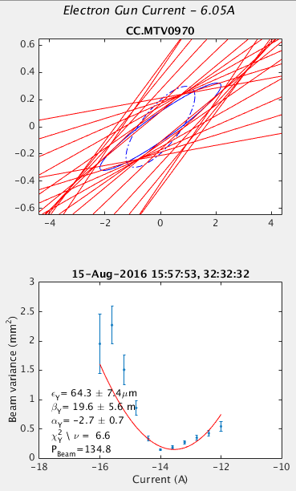
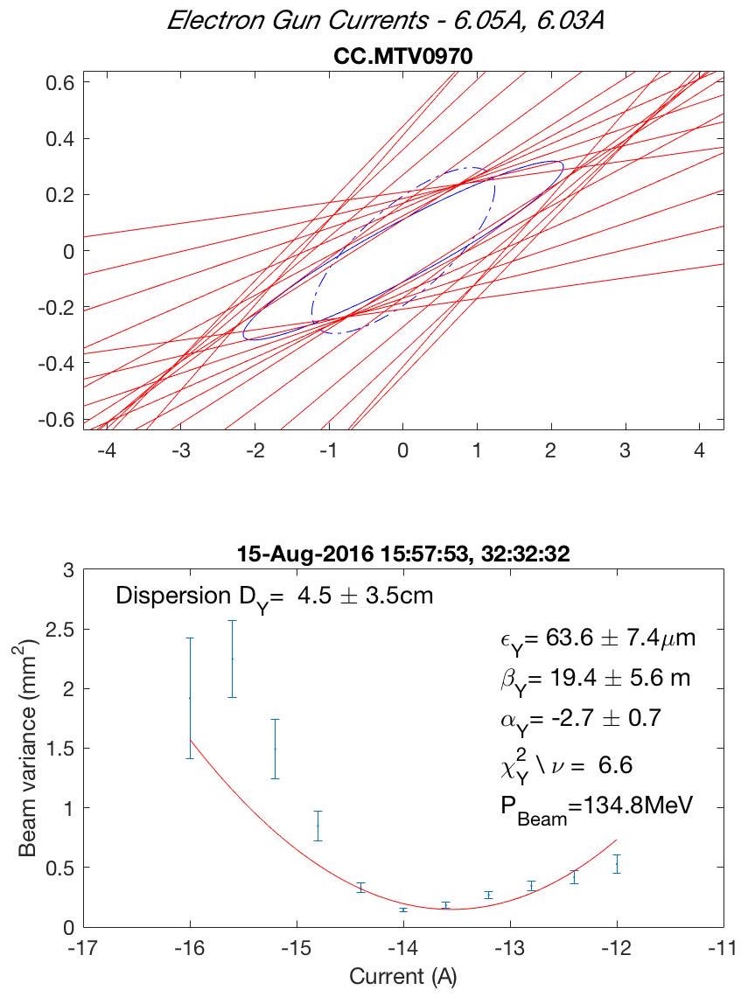

Slide 35
Looking to the Future
Accurate Twiss Parameter calculations facilitate the optimisation of the Delay Loop injection.
Finding the energy dependence of the chromatic aberration constants.
Placing limits on the energy spread using measurements of the dispersion contribution to beam size.

