Slide 1
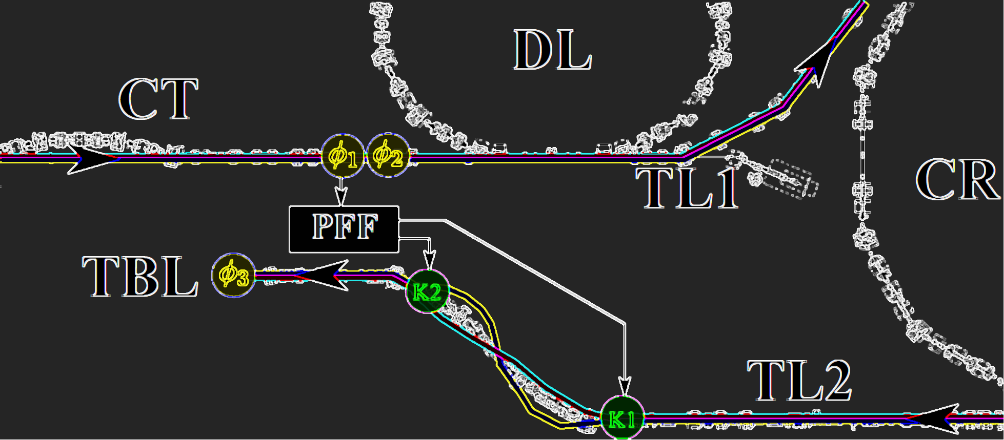
Phase Feedforward:
Couple of Updates
Jack Roberts

Slide 2
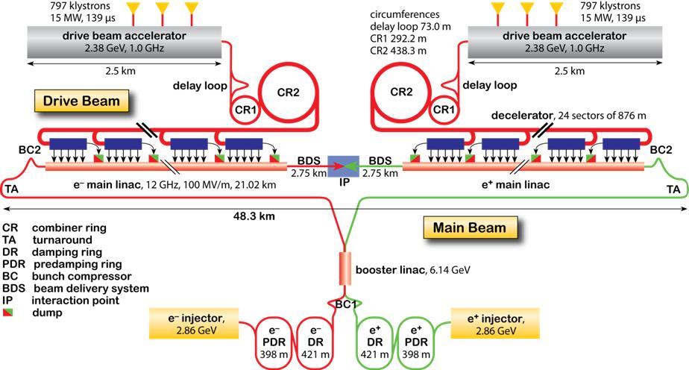
What Phase Feedforward is For
CLIC Concept: Power Extracted from high intensity (~100 A) drive beam. Used to accelerate high energy main beam (up to 1.5 TeV).
Main beam size must be at ~nanometre level to meet luminosity targets.
Energy errors in main beam cause focusing errors -> increase in beam size at the interaction point (IP) -> Energy must be very stable.
Energy of main beam is defined by properties of drive beam -> Drive beam must be very stable.
Phase or arrival time of drive beam must by synchronised with main beam at 50 fs (or 0.2 degrees at 12 GHz) level.
Expected “raw” drive beam phase stability: 2 degrees @ 12 GHz -> Phase Feedforward System.

Slide 3
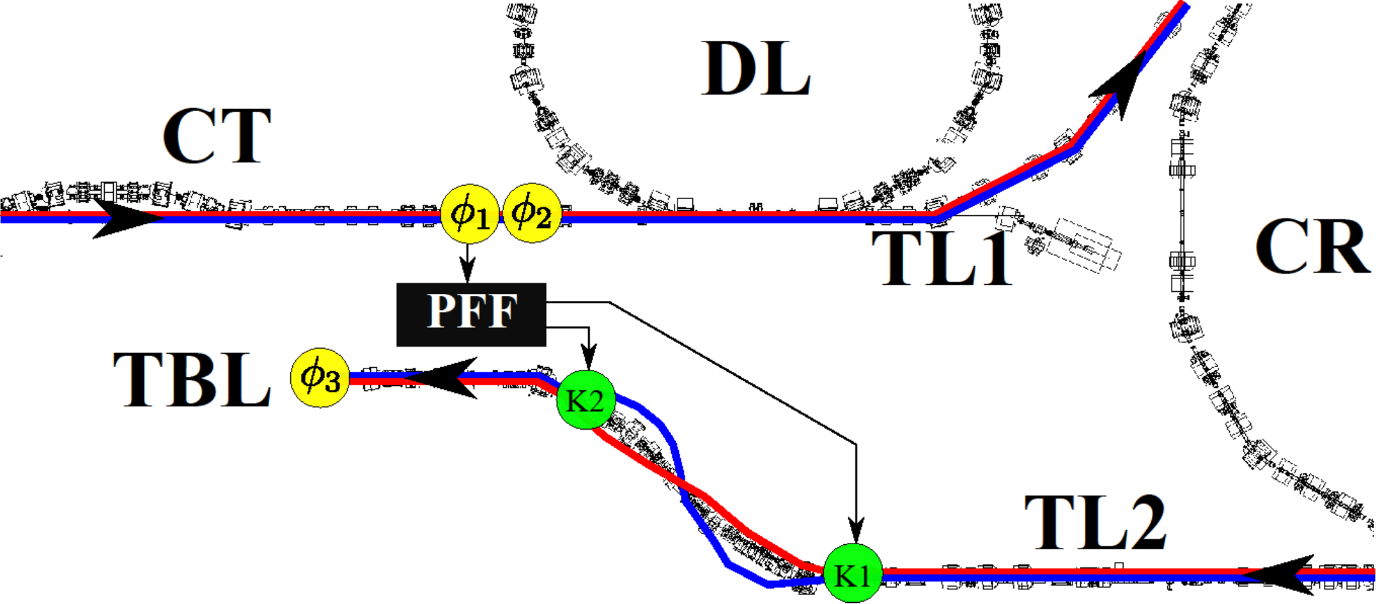
Phase Feedforward Overview: Prototype at CTF3
1. Beam (~135 MeV e⁻) enters CT line.
2. Beam time of arrival of bunches measured by “upstream” phase monitors.
4. Meanwhile beam is progressing through TL1 (Transfer Line 1), CR (Combiner Ring) and TL2 (Transfer Line 2).
3. Digitiser (FONT5a board) processed phase signals. Outputs phase dependent drive voltage for amplifier.
7. Stabilise the arrival time/phase in the “downstream” phase monitor (TBL line).
5. Amplifier voltage arrives at first kicker in time with the beam. System latency <380 ns beam time of flight.
6. Kicker deflects beam on to longer/shorter trajectories in the chicane. Longer for early bunches. Shorter for late bunches.

Slide 4
Phase Monitor Resolution
Must be better than 0.2 degrees to achieve that level of corrected phase stability with the PFF system.
Many issues along the way!
Best achieved resolution: 0.13º
Measured end of last year: 0.40º
Measured in July: 0.20º
Measured this week…

Slide 5
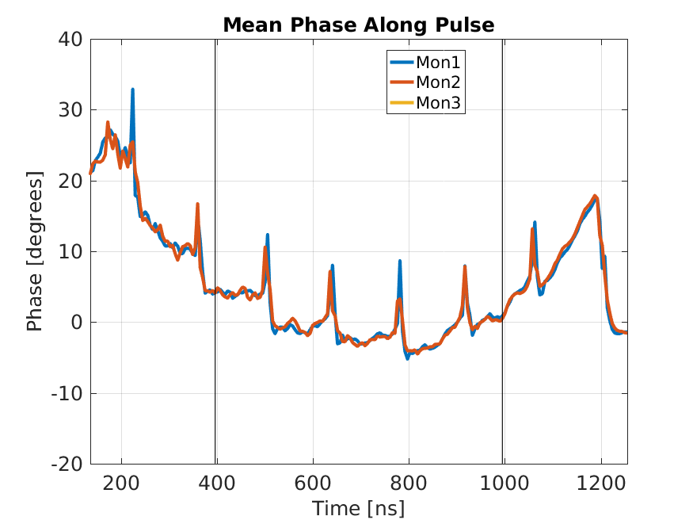
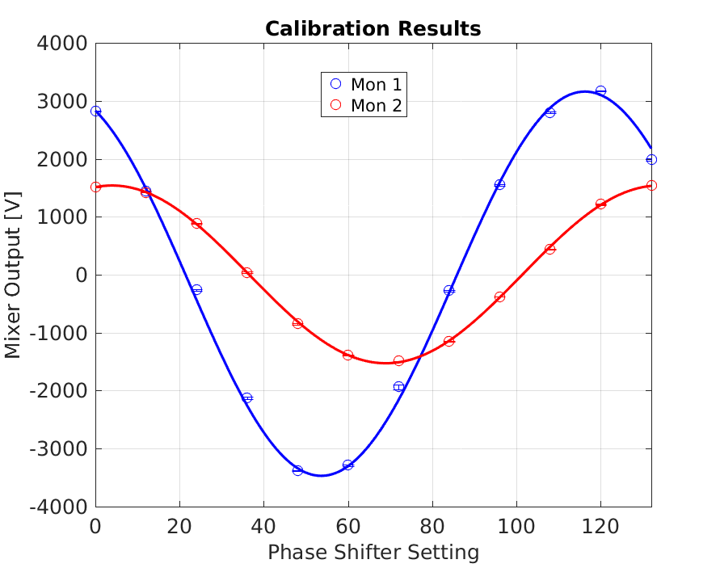
Phase Monitor Measurements
With 1.5 GHz beam: Less stable, phase switches (for combination process in delay loop).
Calibrations give same results as July (Mixer 2 still giving lower output).

Slide 6
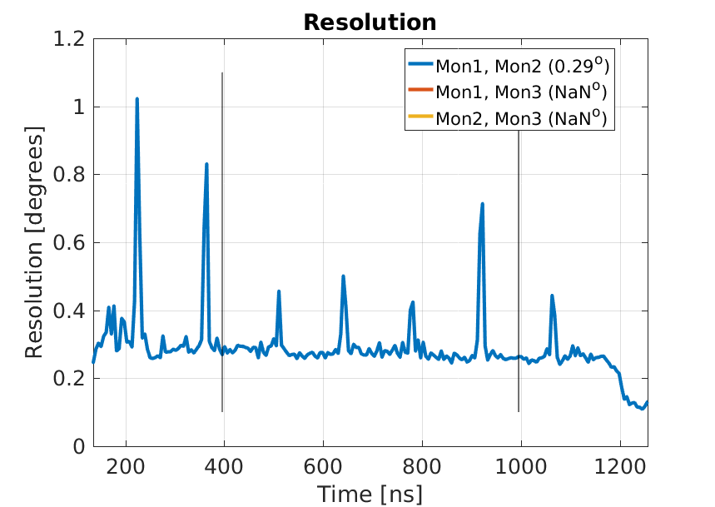
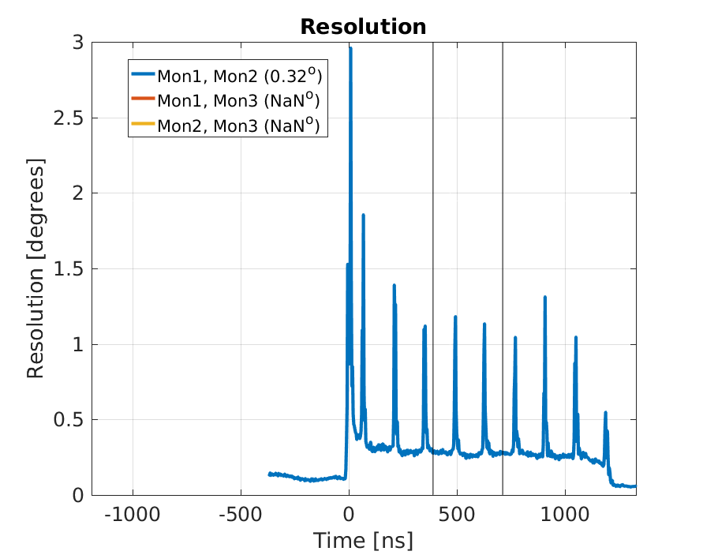
Phase Monitor Measurements
Measured resolution is about 0.25 degrees (if phase switches ignored).
To be verified with 3 GHz beam.
May attempt tests using a common LO (i.e. same multiplier, amplifier, shifter) at some point.
SiS
FONT

Slide 7
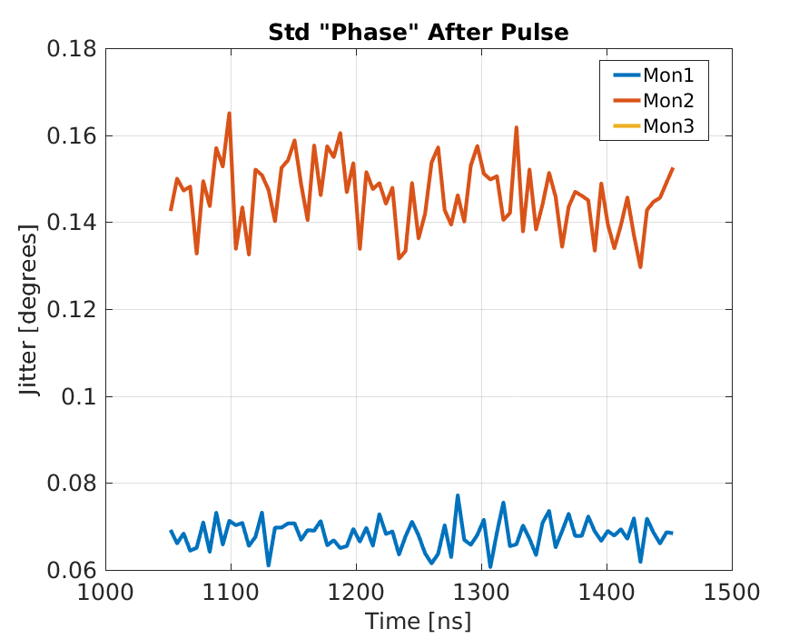
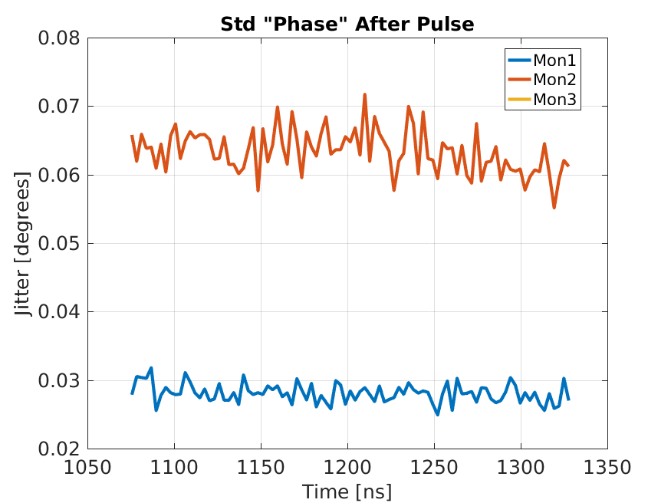
Digitiser Noise
SiS
FONT
Could be reduced by removing attenuation before pre-amplifier.

Slide 8
Automatic Offset Adjustment
Significant phase Drifts on LO/beam compared to correction range on ~hour time scales.
End up using large portion of correction range just to remove static mean offset, e.g.:
ADC INPUT (phase mon signal)
DAC OUTPUT (amplifier drive signal)
Blue – zero offset at mid-point.
Red – 200 counts offset.
Half of correction range just
to remove mean offset.
And saturates earlier

Slide 9
Automatic Offset Adjustment
For longer datasets want to try to automatically adjust baseline offset of the ADC to keep the mean at zero (ADC2 chanel offset).
Managed to get something working this week:
  Added global variables to DAQ (channel offset, ADC1, ADC2)
  Created a new VI which uses global variables to calculate mean and change offset.

Slide 10
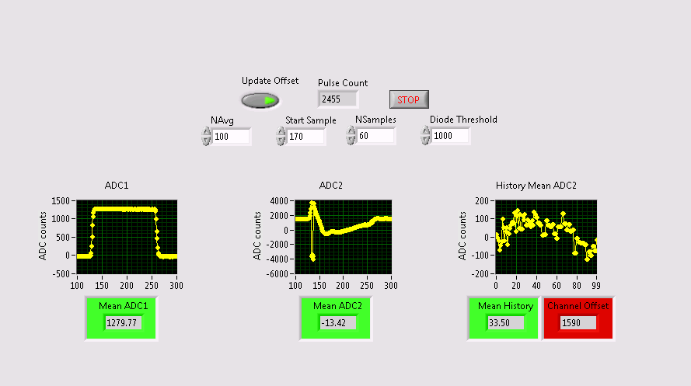
Automatic Offset Adjustment
Pause if beam not present (based on diode level)
Calculate mean ADC2 in defined range
Update offset based on mean offset of last NAvg pulses

Slide 11
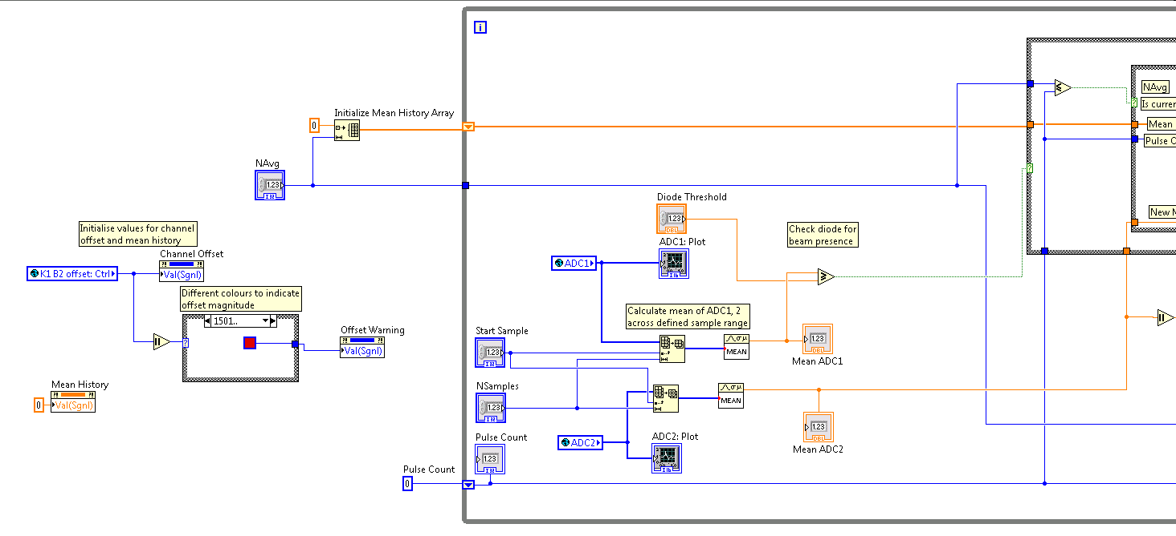
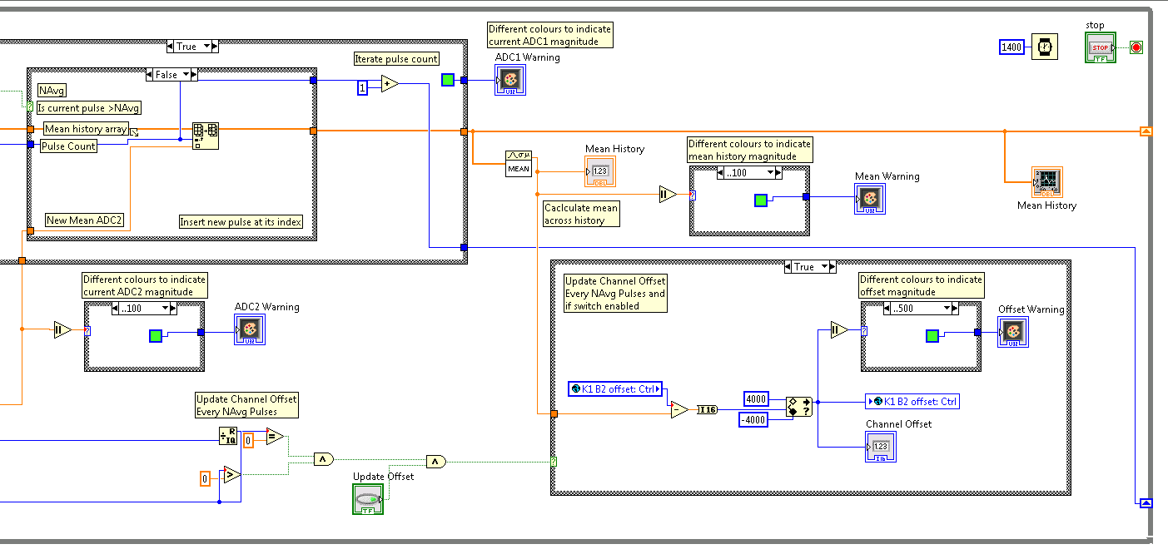
Automatic Offset Adjustment
The block diagram, not worth talking about but pleased I managed to get something working in LabVIEW…

Slide 12
Acquisition Over Control System
Think it makes sense to combine it with when Elizabeth comes.
General idea: Adding modules to send data over control system was causing issues with missing/duplicate pulses.
My theory: Acquiring 6 ADCs channels already marginal with serial port baud rate, anything added means DAQ can’t meet timing requirements (next trigger arrives before previous processed).
Have used 115 kbps serial port on PC up to now at CTF.
Revisited using serial server. Couldn’t get it to work before (years ago…) but managed this time with some help from Doug!
Looks more promising to get acquisition over control system working.
Will pack up the serial server to give to Doug this afternoon.

