Slide 1
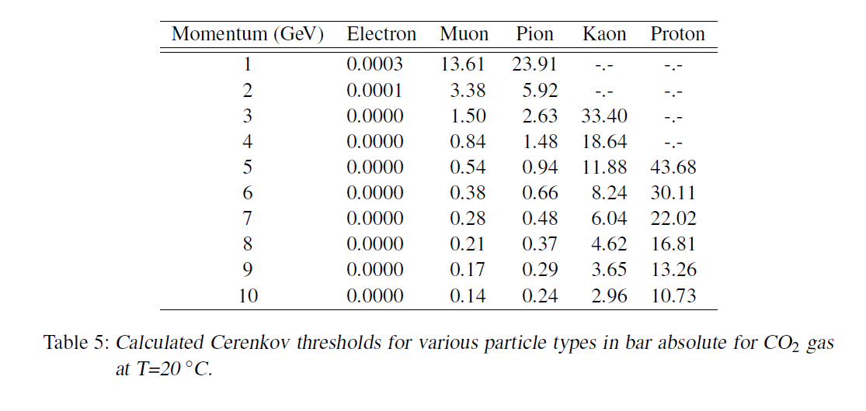
LCD-Note-2012-002

