Slide 1
Status of LCFIPlus
LCFIPlus team:
Taikan Suehara (Kyushu)
T. Tanabe, M. Kurata (Tokyo), J. Strube (PNNL)

Slide 2
Publication of DBD LCFIPlus
Please refer this: NIM A 808 (2016) 109-116

Slide 3
Recent problems
Compatibility with Latest TMVA/ROOT (OK until ROOT 5.28)
Crash with ROOT6

Slide 4
Our usage of TMVA
We categorized events with
# vtx = 0, 1, 1+1 (single track vertex), 2
We have multiclass output in BDT
Gradient boost (BDTG)
b-likeness, c-likeness, uds-likeness (3-class)
Sum of three likenesses should be 1
We just combine likeness of four categories
Training: 100k bb + 100k cc + 100k qq
Number of events at each category is not the same (eg. Category #vtx=2 is >90% bb)
We assume the average x-likeness of each category equals the fraction of events of xx

Slide 5
A TMVA modification
MethodBDT.cxx
if (!DoRegression()){
Log() << kINFO << "<InitEventSample> For classification trees, "<< Endl;
Log() << kINFO << " the effective number of backgrounds is scaled to match "<<Endl;
Log() << kINFO << " the signal. Othersise the first boosting step would do 'just that'!"<<Endl;
// it does not make sense in decision trees to start with unequal number of signal/background
// events (weights) .. hence normalize them now (happens atherwise in first 'boosting step'
// anyway..
(nip)
if (sumSigW && sumBkgW){
Double_t normSig = nevents/((1+fSigToBkgFraction)*sumSigW)*fSigToBkgFraction;
Double_t normBkg = nevents/((1+fSigToBkgFraction)*sumBkgW); ;
Log() << kINFO << "re-normlise events such that Sig and Bkg have respective sum of weights = "
<< fSigToBkgFraction << Endl;
Log() << kINFO << " sig->sig*"<<normSig << "ev. bkg->bkg*"<<normBkg << "ev." <<Endl;
Log() << kINFO << "#events: (reweighted) sig: "<< sumSigW*normSig << " bkg: " << sumBkgW*normBkg << Endl;
Log() << kINFO << "#events: (unweighted) sig: "<< sumSig << " bkg: " << sumBkg << Endl;
for (Long64_t ievt=0; ievt<nevents; ievt++) {
if ((DataInfo().IsSignal(fEventSample[ievt])) ) fEventSample[ievt]->SetBoostWeight(normSig);
else fEventSample[ievt]->SetBoostWeight(normBkg);
}
(nip)
This violates our expectation of average x-likeness!

Slide 6
Treatment to it
We found that if we comment out this feature the performance is recovered.
The comment says this normalization do not have side effects, which is not true.
We submitted a patch to have an option called “SkipNormalization” to BDTG to skip the feature
The patch was accepted to the official ROOT repository (16 Sep. 2016)
The option is automatically added inside latest LCFIPlus (still not in the official release)
With older version you can explicitly specify “SkipNormalization” in “TrainMVA.BookOptions” in train.xml (new ROOT necessary)

Slide 7
Another issue: crash in ROOT6
Crash of LCFIPlus at somewhere in event creation
Might be some different behavior between ROOT 5 and 6
Under investigation…

Slide 8
Release plan
Adaptive Vertex Fitter and Vertex Mass Recovery added
Courtesy of M. Kurata
Dedicated steering files prepared in ILDConfig
Identify the reason of the crash
Release

Slide 10
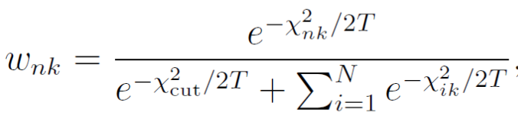
Adaptive vertex fitting
More tracks associated to vertices after vertex finder
For each unassociated track, weight to every vertex is calculated
Improvement on flavor tagging highly expected
Associated to vertex with weight >0.5
T: temperature to reject fake tracks in multi-vertex environment
method | bjet with 2vtx | bjet with 1+1vtx | bjet with 1vtx | total
DBD-b | 10586 | 9111 | 12844 | 32541
AVF-b | 13179 | 6360 | 13375 | 32914
DBD-c | 48 | 149 | 6261 | 6458
AVF-c | 59 | 141 | 6327 | 6527
Weight

Slide 11
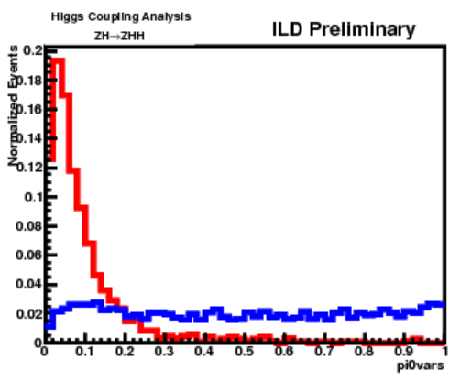
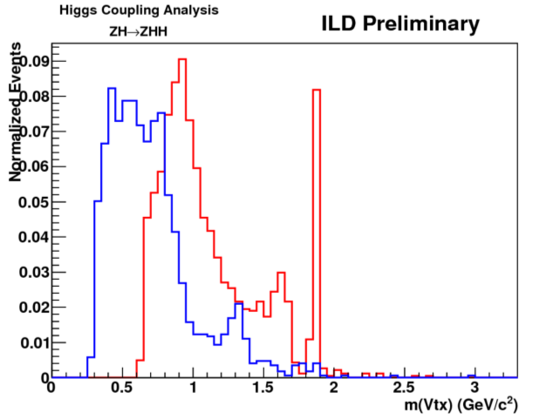
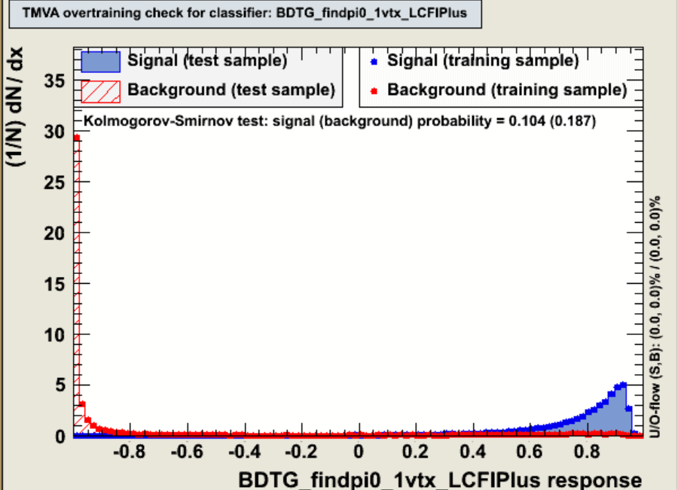
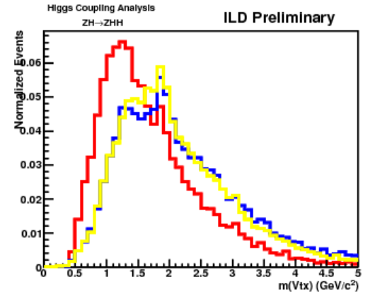
Vertex mass recovery
Using pi0s which escape from vertices
Need to choose good pi0 candidates –construct pi0 vertex finder
Key issue –pi0 kinematics, very collinear to vertex direction
Particle ID is the other key to classify vertices
Different particle patterns have different vertex mass patterns
Construct Pi0 Vertex finder
using MVA
Identify which vertex pi0s are coming from
Pi0 from vertex
Pi0 from primary
K+π
π+π
3 tracks in bjet
Reconstruction
Perfect
Pi0 finder

Slide 12
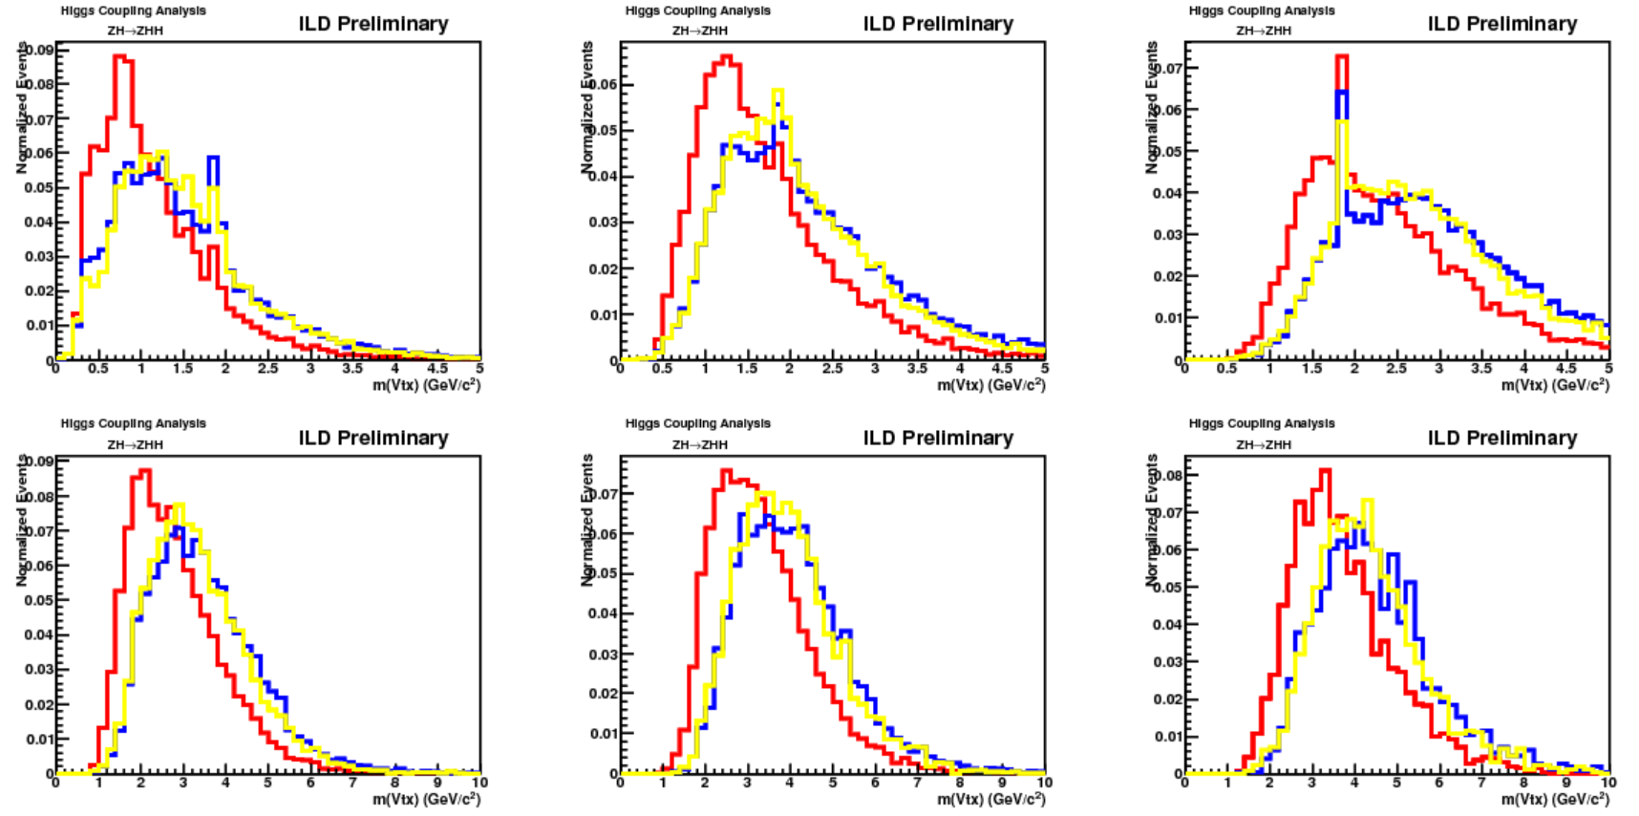
Vtx masses of bjets in double-Higgs process
Vtx mass distributions for each vertex pattern(ntrk)
These results are the outputs of LCFIPlus(unofficial ver.)!
Difference is limited by mis-pairing of gammas(eff. ～50%) and mis-attachment of pi0s
Need better gamma pairing!
2 tracks
Reconstruction
Perfect
Pi0 finder
3 tracks
4 tracks
5 tracks
6 tracks
7 tracks

Slide 13
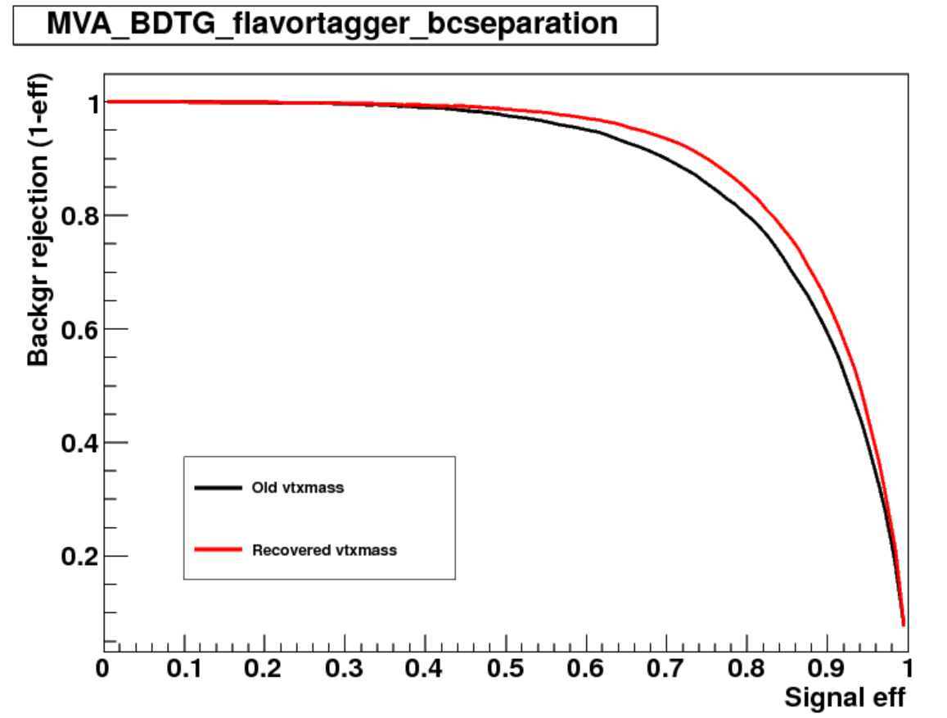
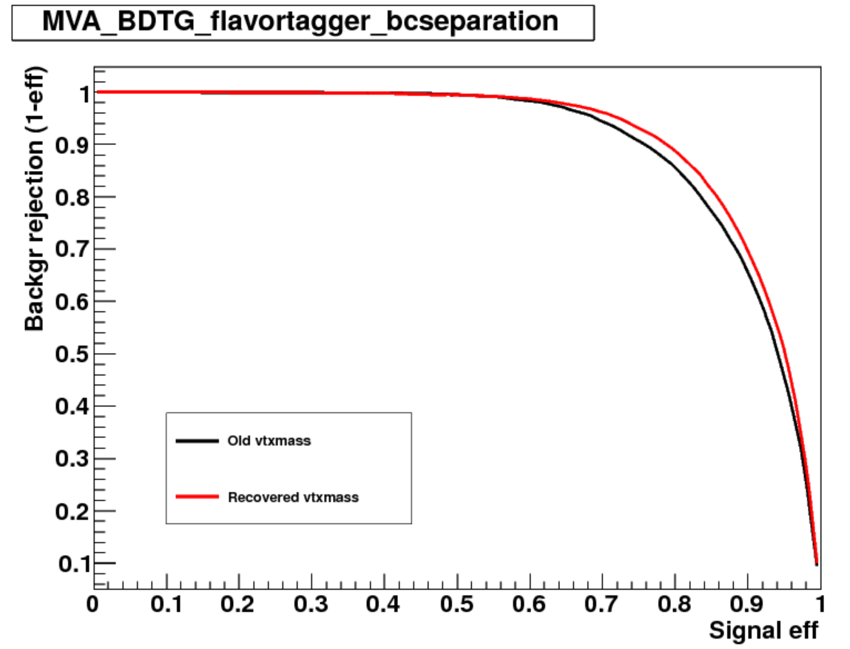
Vertex mass recovery effect on flavor tagging
Construct a “toy” flavor tagger
Input variables are obtained from LCFIPlus
Input variable selection is too primitive!
Only vertex mass is replaced to recovered vertex mass
Compare with ROC curve
Vertex is created using DBD LCFIPlus vertex finding
need to check AVF case
BETTER
BETTER
Nvtx==1 jets
Nvtx>=1 jets

