Slide 1



ILC-CR-0014 Cryogenic Layout (2)
Hirotaka NAKAI, KEK
Takahiro OKAMURA, KEK
Akira YAMAMOTO, KEK and CERN
in collaboration with
Dimitri DELIKARIS, CERN
Thomas PETERSON, FNAL
  20161108/CMB Meeting
Rev. 0:

Slide 2
Introduction
CR-0009
• Location of 4.5 K refrigerators was pending
Discussions after CR-0009
• 4.5 K refrigerators may be installed underground to eliminate expensive long cryogenic transfer lines
• Helium recovery process in emergency situations, such as sudden blackouts and cryogenic system failures, should be well considered
• Helium inventory procedure should be carefully prepared for long-term shutdowns
  20161108/CMB Meeting

Slide 3
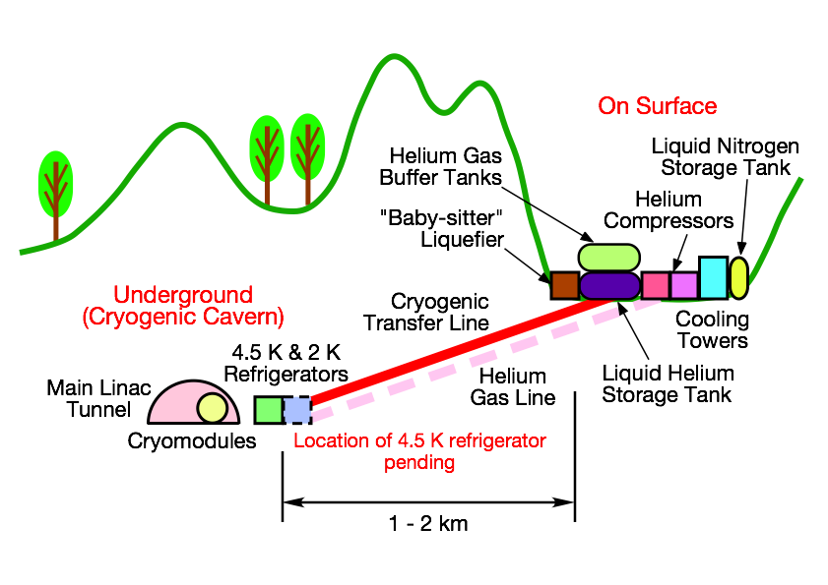
Cryogenic Layout Proposed in CR-0009
  20161108/CMB Meeting

Slide 4
Location of 4.5 K Refrigerators
Location of 4.5 K Refrigerators
• Liquid helium storage tanks are not utilized as liquid buffer tanks for stable supply of liquid helium to 2 K refrigerators
• 4.5 K refrigerators and liquid helium storage tanks can be installed separately
• 4.5 K refrigerator should be installed underground to eliminate expensive and long cryogenic transfer lines to 2 K refrigerators in cryogenic caverns
• More sophisticated and effective design can be expected, since 4.5 K and 2 K refrigerators installed together in cryogenic caverns
  20161108/CMB Meeting

Slide 5
Helium Recovery Process in Emergency
• He loss should be minimized even in any emergency situations, because He is fully imported in Japan,
• The max. recovery time from the power failure to normal operation is assumed to be ≤24 hrs:
  • Check of cryoplants before restart
  • 6 hours estimated to resume 10 cryoplants distributed over 30 km
  • Sufficient contingency should be considered (6 hrs x 4 = 24 hrs)
• A He recovery compressor should be added on the surface to allow continuous evaporation of liquid He in cryo-plants and cryomodules during 24 hours after blackouts
•
A gas/oil emergency power generator of ≤1 MW will be equipped at each cryoplant to operate the He recovery compressor and its associated devices such as a cooling water system, an air compressor for valve operation and so on,
• Part of evaporated cold He gas can be used (by-passed) to keep thermal shield and intercept temperature of the cryomodule low enough, and it may result in the liquid He evapolation rate in the cryomodules can be suppressed
• Thermal insulation of the cold He-gas recovery lines may be needed to minimize excessive liquid oxygen production or ice formation on the helium recovery lines
• A passive heat exchanger will be also needed to warm up the evaporated helium gas before the recovery compressors.
  20161108/CMB Meeting

Slide 6
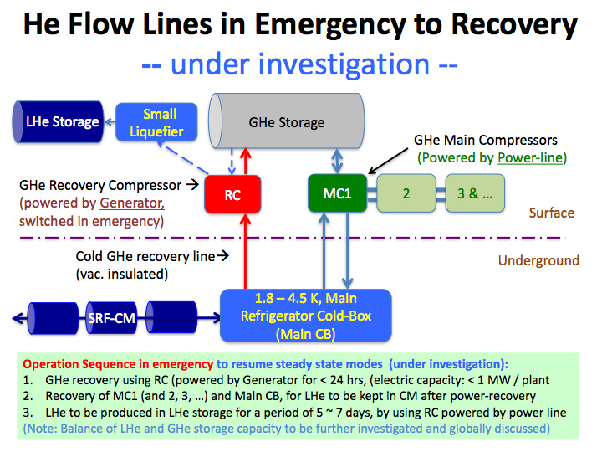
  20161108/CMB Meeting

Slide 7
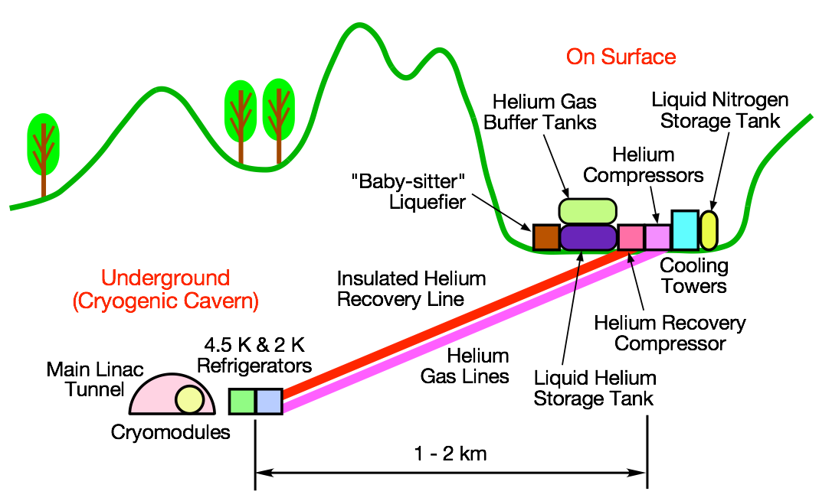
Cryogenic Layout Proposed in This CR
  20161108/CMB Meeting

Slide 8
Helium Inventory
Helium Inventory During Long-Term Shutdowns
• Liquid He storage tanks will not be utilized as liquid buffer tanks for stable supply of liquid helium to 2 K refrigerators
• Large amount of He may be stored as either gas or liquid during long-term shutdowns
• Gas storage requires a number of large gas-storage tanks (~ 6 x 250 m^3, which may affect landscape preservation
• Liquid storage requires only one liquid storage tank, but a “baby-sitter” helium liquefier is needed to re-liquefy evaporated helium gas from the liquid storage tanks
• Further investigation is needed to determine the optimized ratio of gas and liquid storages of helium during long-term shutdowns
  20161108/CMB Meeting

Slide 9
Cost Balance
Cost saving:
• A cryogenic transfer line can be eliminated between the cryogenic cavern underground and the surface cryogenic components
Cost increase:
• A recovery compressor on the surface inevitably required
• An insulated He recovery line between the cryogenic cavern and the recovery compressor on the surface
• Costs of a “baby-sitter” He liquefier on the surface and He gas lines between the 4.5 K refrigerator in the cryogenic caver and He compressors on the surface have been already included in last change request CR-0009.
  20161108/CMB Meeting

