Slide 1
Resolution Analysis
Oct 2016
N. Blaskovic, T. Bromwich, R. Ramjiawan

Slide 2
Outline
Resolution analysis for files with best FB performance –
using fitting and geometric methods: Jitter File: fbRun9_Board2_281016, Calibration File: AQD0FFyScan5_0dB_Board2_271016.
And a study of resolution scaling with attenuation.

Slide 3
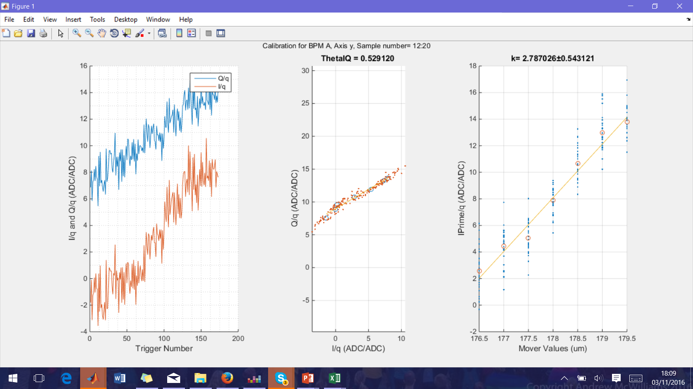
Calibration AQD0FF Scan IPA
Calibration File: AQD0FFyScan5_0dB.
Complete fitting method (fitting to position and constant term).
IQ Samples 12:20,
Ref Sample: 21.
Threshold cut= all even numbered triggers.
Reference cuts on charge= 62 249 350
197 triggers remaining.

Slide 4
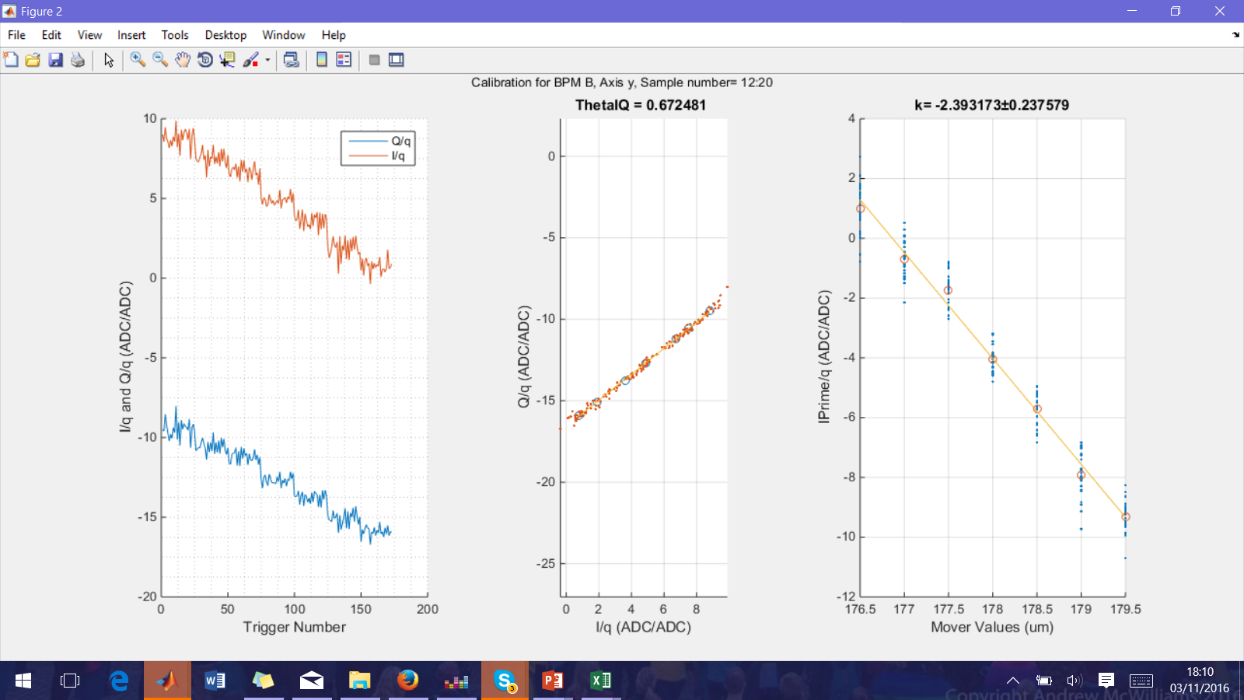
Calibration AQD0FF Scan IPB
Calibration File: AQD0FFyScan5_0dB.
Complete fitting method (fitting to position and constant term).
IQ Samples 12:20,
Ref Sample: 21.
Threshold cut= all even numbered triggers.
Reference cuts on charge= 62 249 350
197 triggers remaining.

Slide 5
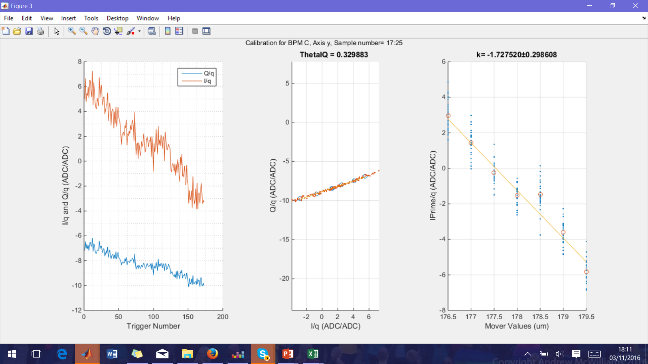
Calibration AQD0FF Scan IPC
Calibration File: AQD0FFyScan5_0dB.
Complete fitting method (fitting to position and constant term).
IQ Samples 17:25,
Ref Sample: 21.
Threshold cut= all even numbered triggers.
Reference cuts on charge= 62 249 350
197 triggers remaining.

Slide 6
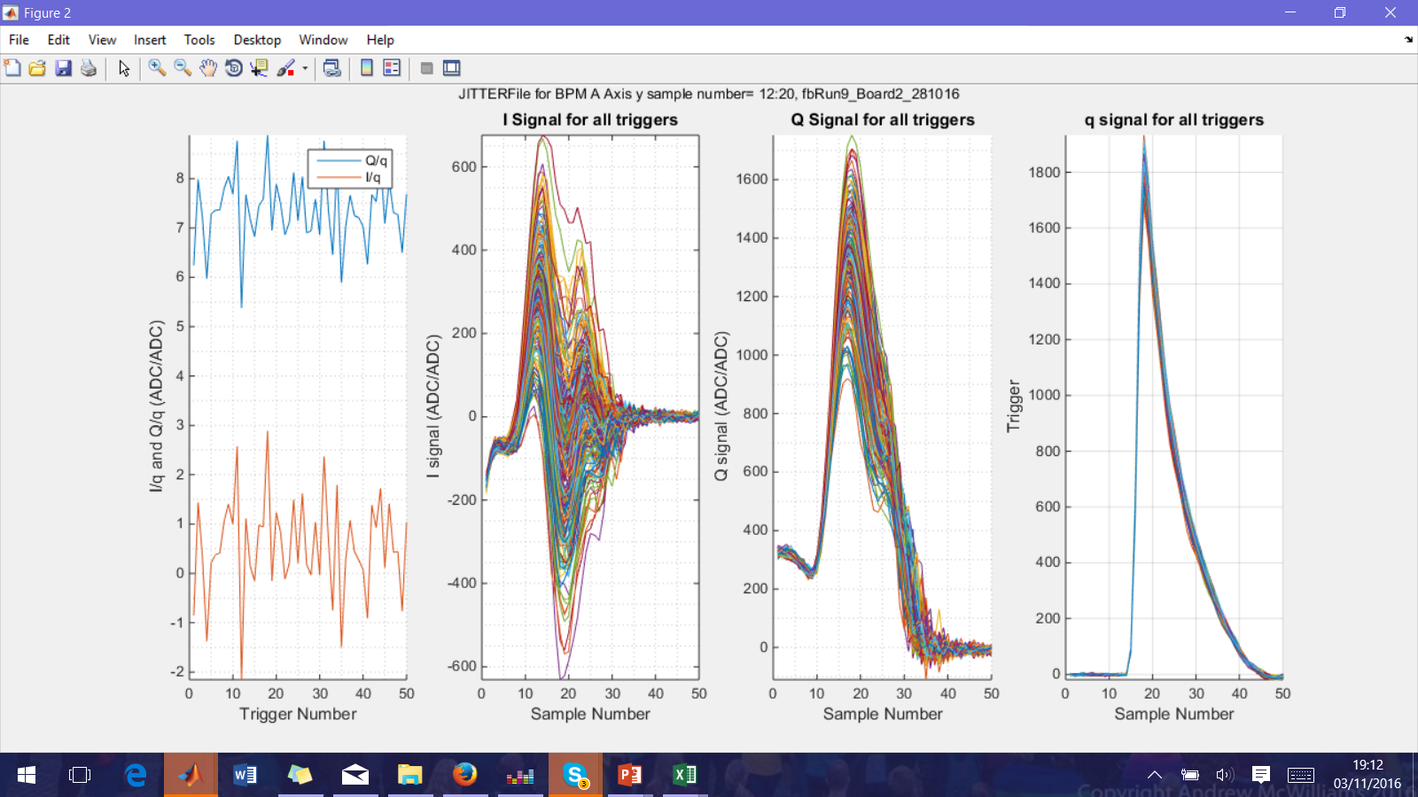
Jitter File Analysed IPA
File=
fbRun9_Board2_281016.
BPM =A
Axis=y
Sample Range=12:20
Trigs initially =400
Threshold cut= all odd numbered triggers.
Reference cuts on charge= 31 73 282 316 356 368 370 380.
Prime Cuts= 308.

Slide 7
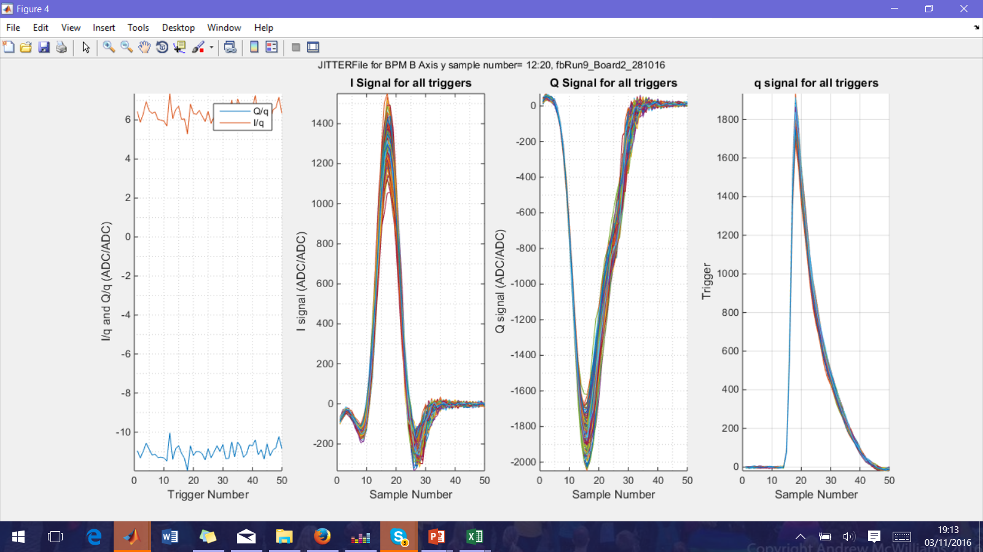
Jitter File Analysed IPB
File=
fbRun9_Board2_281016.
BPM =B
Axis=y
Sample Range=12:20
Trigs initially =400
Threshold cut= all odd numbered triggers.
Reference cuts on charge= 31 73 282 316 356 368 370 380.
Prime Cuts= 308.

Slide 8
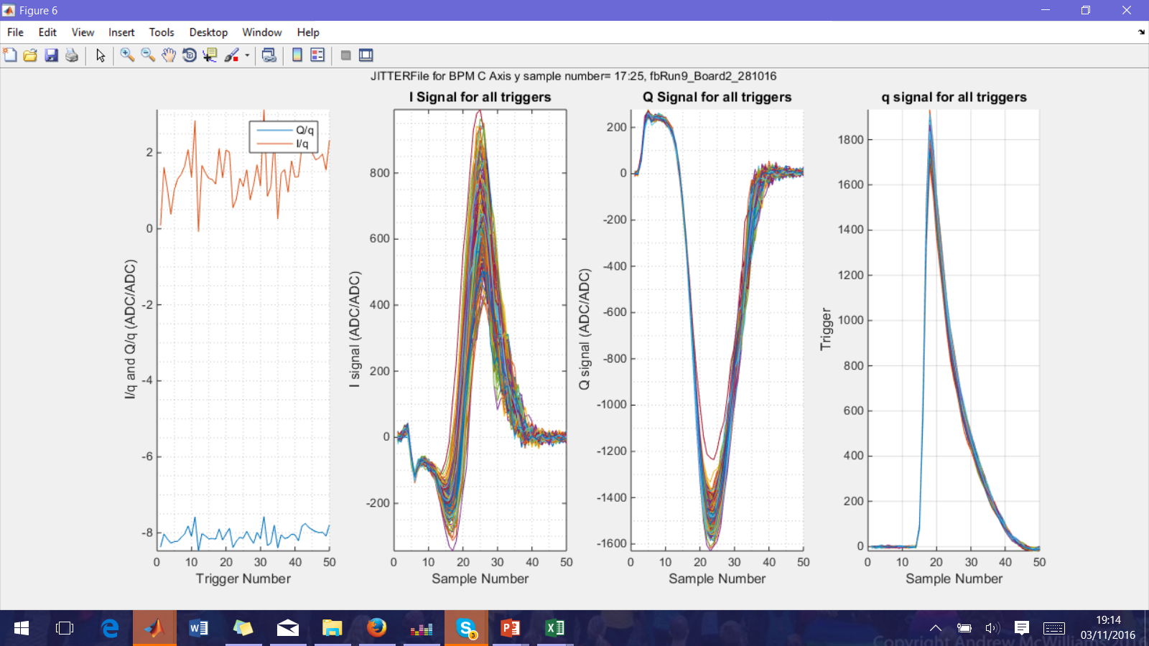
Jitter File Analysed IPC
File=
fbRun9_Board2_281016.
BPM =C
Axis=y
Sample Range=17:21
Trigs initially =400
Threshold cut= all odd numbered triggers.
Reference cuts on charge= 31 73 282 316 356 368 370 380.
Prime Cuts= 308.

Slide 9

Complete Fitting
‘Complete fitting method’:$\frac{std\left(residuals\right)}{\sqrt{1+α^{2}+β^{2}}}$with residuals, $α$ and $β$ found from fitting.
$y_{1}=αy_{2}+βy_{3}+c$.

Slide 10
Complete fitting resolution
Calibration File: AQD0FFyScan5_0dB. Jitter File: fbRun9 - Files producing best FB results.
Single sample resolution using complete fitting method (fitting to position and constant term).
Attenuation: 0dB, 197 triggers, bunch one. Reference sample: 21.

Slide 11
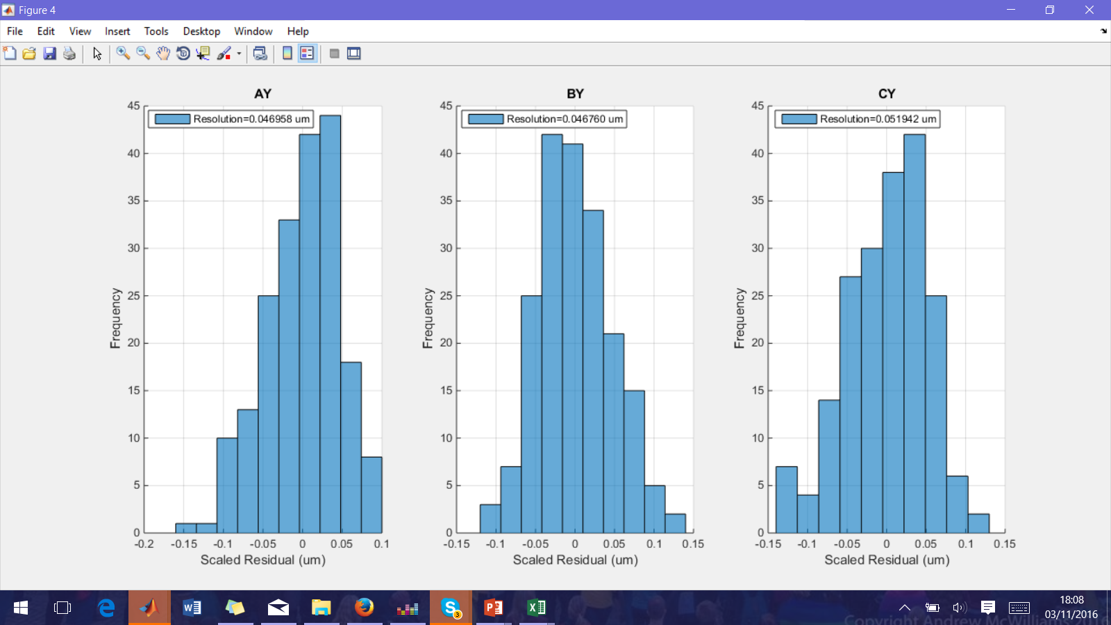
Best Resolution Complete Fitting
Calibration File: AQD0FFyScan5_0dB. JITTER File: fbRun9.
Complete fitting method (fitting to position and constant term). IQ Samples 12:20/17:25, Ref Sample: 21.

Slide 12
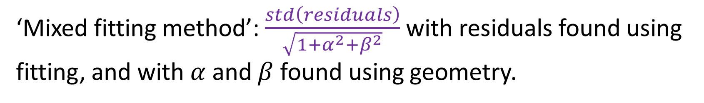
Mixed Fitting
‘Mixed fitting method’: $\frac{std\left(residuals\right)}{\sqrt{1+α^{2}+β^{2}}}$ with residuals found using fitting, and with $α$ and $β$ found using geometry.

Slide 13
Fitting to Multiple Parameters
Calibration File: AQD0FFyScan5_0dB. Jitter File: fbRun9. 194 triggers, bunch one. Reference sample: 21.
Sample range | Complete fitting to y Resolution (nm) (3 parameters) |  |  | Mixed fitting to I’/q Resolution (nm) (3 parameters) |  |  | Mixed fitting to I’/q, Q’/q Resolution (nm) (5 parameters)
14:20 | 50.7±3.6 | 50.5±3.5 | 56±3.9 | 47.5±3.3 | 51.1±3.5 | 41.7±2.9 | 43.6±3 | 42.5±2.9 | 37±2.6
14:19 | 54.9±3.8 | 54.5±8.8 | 55.9±3.9 | 48.3±3.4 | 52.2±3.7 | 42.3±3.0 | 44.3±3.1 | 42.9±3 | 37.4±2.6
13:20 | 48.9±3.4 | 48.7±3.4 | 54±3.8 | 46±3.2 | 49.1±3.4 | 41±2.9 | 41.4±2.9 | 41.5±2.6 | 36.6±2.5
12:20 | 47±3.3 | 46.8±3.3 | 51.8±3.6 | 44.3±3.1 | 47.2±3.3 | 40±2.8 | 39.6±2.7 | 40.3±2.8 | 35.6±2.5
16:20 | 53.9±3.8 | 53.8±3.8 | 59±4.1 | 50±3.5 | 55.1±3.8 | 42.5±3 | 47.4±3 | 45.7±3.2 | 36.9±2.6
12:16 | 48.3±3.4 | 48.1±3.5 | 54.7±3.8 | 45.5±3.2 | 48±3.4 | 41.6±2.9 | 41.4±2.9 | 38.8±2.7 | 34.1±2.4
A
B
C
A
B
C
A
B
C

Slide 14
Mixed Fitting for I’/q: 5 Parameter Fit
Parameter | Coefficient IPA | Coefficient IPB | Coefficient IPC
I’/q (1) | -1.6781 | -0.64272 | 1.1735
I’/q (2) | 0.62868 | 0.39781 | 1.6064
Q’/q (1) | 1.3148 | 0.41227 | -0.8956
Q’/q (2) | -2.2272 | -0.87317 | -0.49912
Const. | 0.12927 | -8.2974 | -3.9111

Slide 15
Geometric Method
CALIB File:AQD0FFyScan5_0dB. JITTER File: fbRun9.
194 triggers, bunch one only. Reference sample: 21.
Sample number | Geometric method Resolution (nm)
12 | 63.7±4.4
13 | 57.9±4.1
14 | 57.5±4.1
15 | 62.1±4.3
16 | 64.7±4.5
17 | 66.1±4.6
18 | 57.3±4.0
19 | 64.4±4.4
20 | 68.2±4.7
Sample range | Geometric method Resolution (nm)
14:20 | 51. 8±3.6
14:19 | 53.2±3.7
13:20 | 49.8±3.4
12:20 | 47.9±3.6
16:20 | 56.6±4.0
12:16 | 48.8±3.4

Slide 16
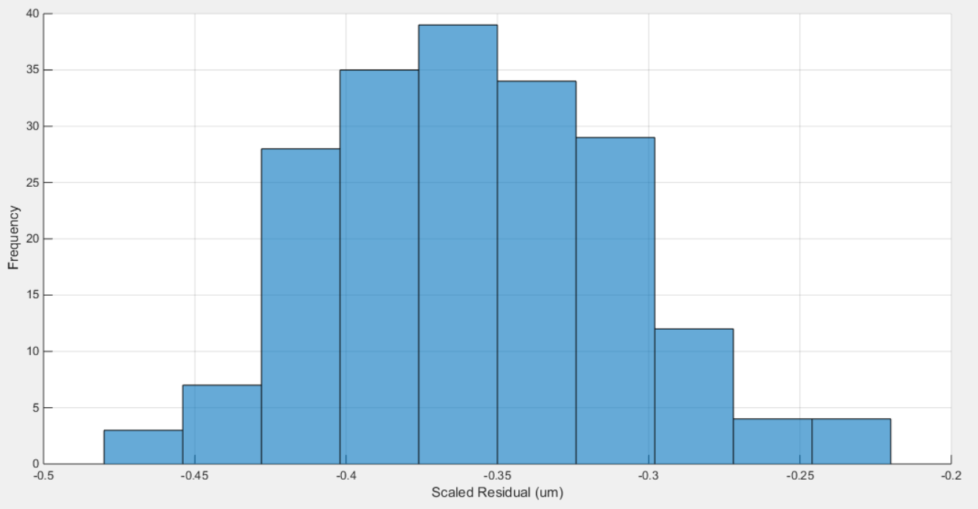
Best Geometric Method Result
Calibration file: AQD0FFyScan5_0dB.
Jitter file: fbRun9.
Resolution 47.9±3.6 nm.
194 triggers.
IQ Samples: 12:20.
Reference Sample: 21.
Two bunch mode.
Calibration constants:
A: 2.79±0.54
B: -2.39±0.24
C: -1.73±0.30

Slide 17
Files Analysed: Resolution vs Attenuation
All files collected consecutively at the end of the Owl shift, 28/10/2016.
Attenuation | Jitter File | Calibration File
0dB | jitRun13_0dB | AQD0FFyScan8_0dB
10dB | jitRun10_10dB | AQD0FFyScan7_10dB
20dB | jitRun14_20dB | AQD0FFyScan9_20dB
30dB | fbRun23_30dB | AQD0FFyScan10_30dB
40dB | fbRun24_40dB | AQD0FFyScan11_40dB

Slide 18
Resolution with Attenuation
Files: AQD0FF scans – 8, 7, 9, 10,11. Jit Run – 13, 10, 14. FB Run – 23, 24.
IQ Samples: 12:20, Reference Sample: 21.
Dotted lines show extrapolation from 40dB case.

