Slide 1
IP BPM diagnostic tests
N. Blaskovic, T. Bromwich, R. Ramjiawan

Slide 2
BPM Test 1A – Dipole output of first-stage
FIRST STAGE MIXER
Dipole
Reference
SCOPE
SIGNAL GENERATOR
y = 6.4 GHz
x = 5.7 GHz
714 MHz
Damping Ring
714 MHz
Frequency
Multiplier
Working without beam, use a signal generator to produce 6.426 GHz. Work at 0dBm power input.
Look at the dipole outputs of the first stage on a scope
Repeat for all dipole cavity signals i.e. A, B, C in Y

Slide 3
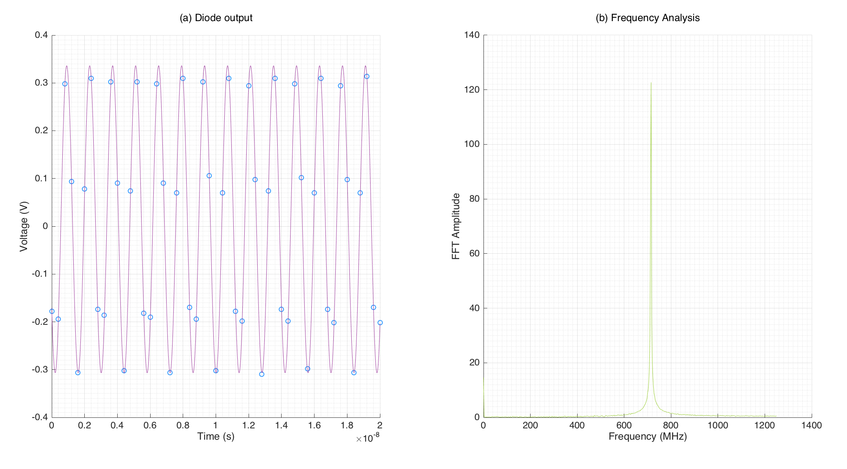
Waveform output example for IPA Y
  Plot (a) of dipole output. Scope data points shown as blue circles. A sine function fit applied with interpolated points in purple.
  Plot (b) FFT analysis of original data points. Shows fairly clean peak around the desired frequency output.
  Waveforms for IPBY and IPCY are similar.
  Scope sample interval: 0.4ns
  Scope sample frequency: 2.5 GHz
  0dBm power input level on the signal generator.
  Note: for display purposes, only 20 ns of
  the waveform is shown. 400 ns of data was gathered with each data set, and the full
  set is used for the frequency analysis.

Slide 4
BPM Test 1B – Reference output of first-stage
FIRST STAGE MIXER
Dipole
Reference
SIGNAL GENERATOR
y = 6.4 GHz
x = 5.7 GHz
SCOPE
714 MHz
Damping Ring
714 MHz
Frequency
Multiplier
Repeat for reference output of first stage.
Change the strength of the signal generator to vary input power.
Monitor reference output power as a function of input power.

Slide 5
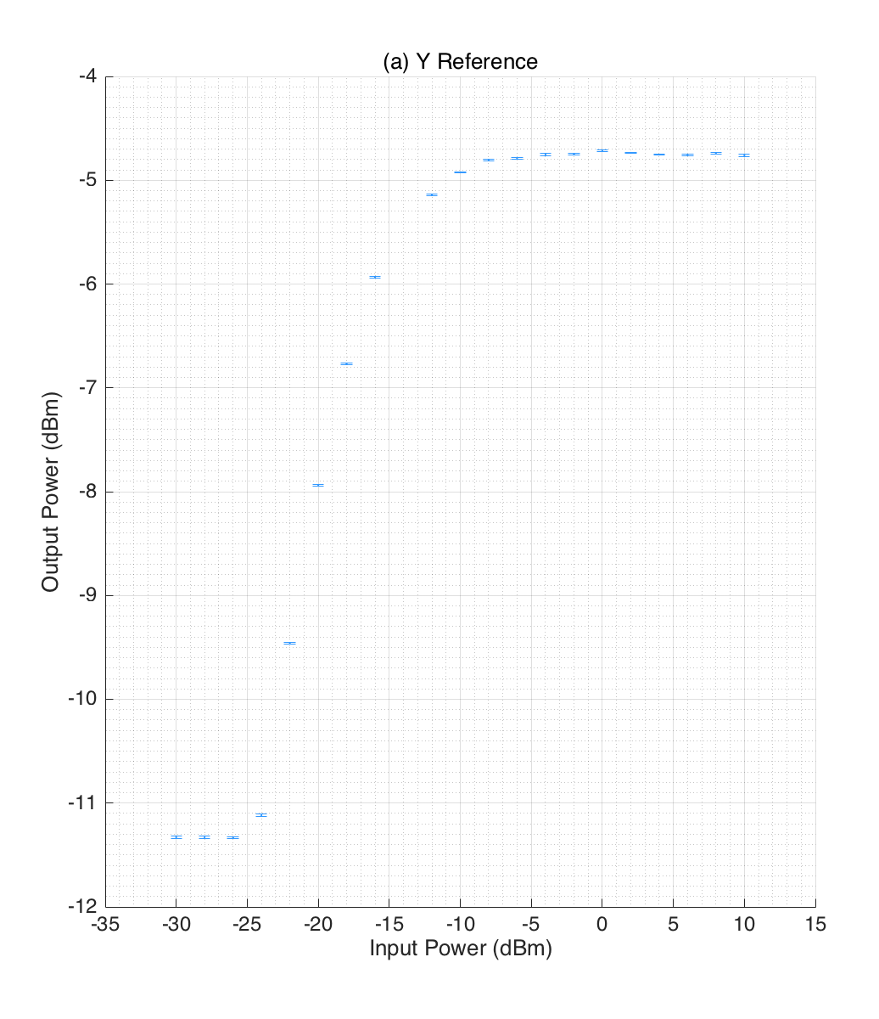
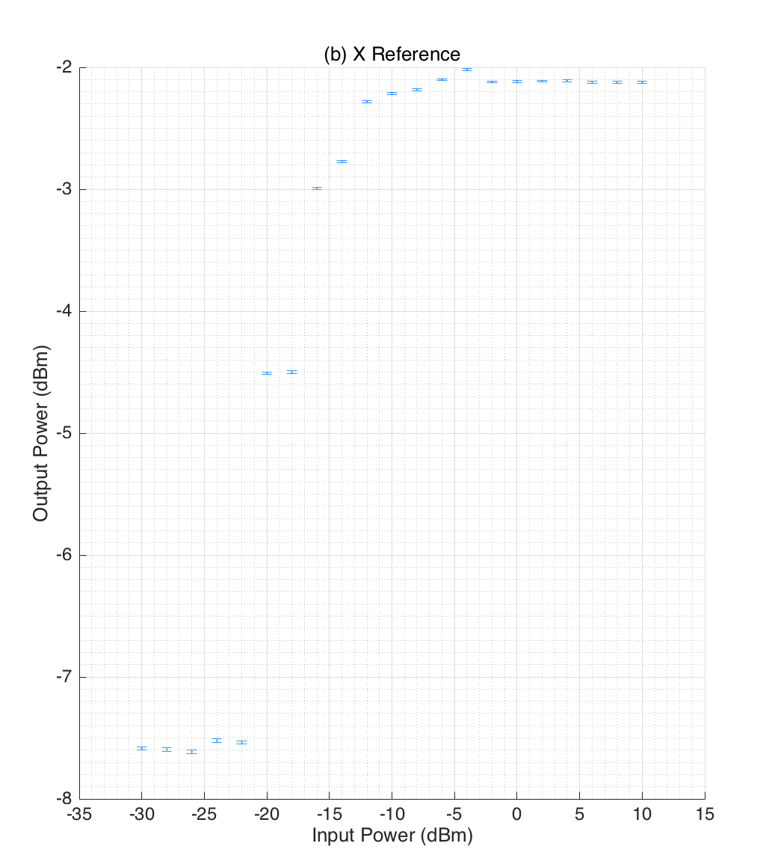
Reference first stage output power
  Method: calculate the voltage amplitude from the sine function fit to the data. Convert this voltage reading to a power in dBm using equation
  Power = 10+20*log₁₀(abs(Volts)).
  Plot this output power versus the input power of the signal generator.
  We want to operate in a linear region where the output power is dependent on the input power. According to this plot that is between -25 and -15 dBm. This a seems VERY narrow operating range. Typically place 50 dB on the reference input to the first stage. Do not know the power levels of the signals from the BPM cavities.
  From input powers -26 dBm downwards, signal generator reads “unlevelled”?

Slide 6
BPM Test 2A – Output of the limiter
FIRST STAGE MIXER
Dipole
Reference
SIGNAL GENERATOR
y = 6.4 GHz
x = 5.7 GHz
SCOPE
714 MHz
Limiting Amplifier
Damping Ring
714 MHz
Frequency
Multiplier
Provide the input to the first stage using a signal generator.
Change the strength of the signal generator to vary input power.
Monitor the three output channels and the limiter diode.

Slide 7
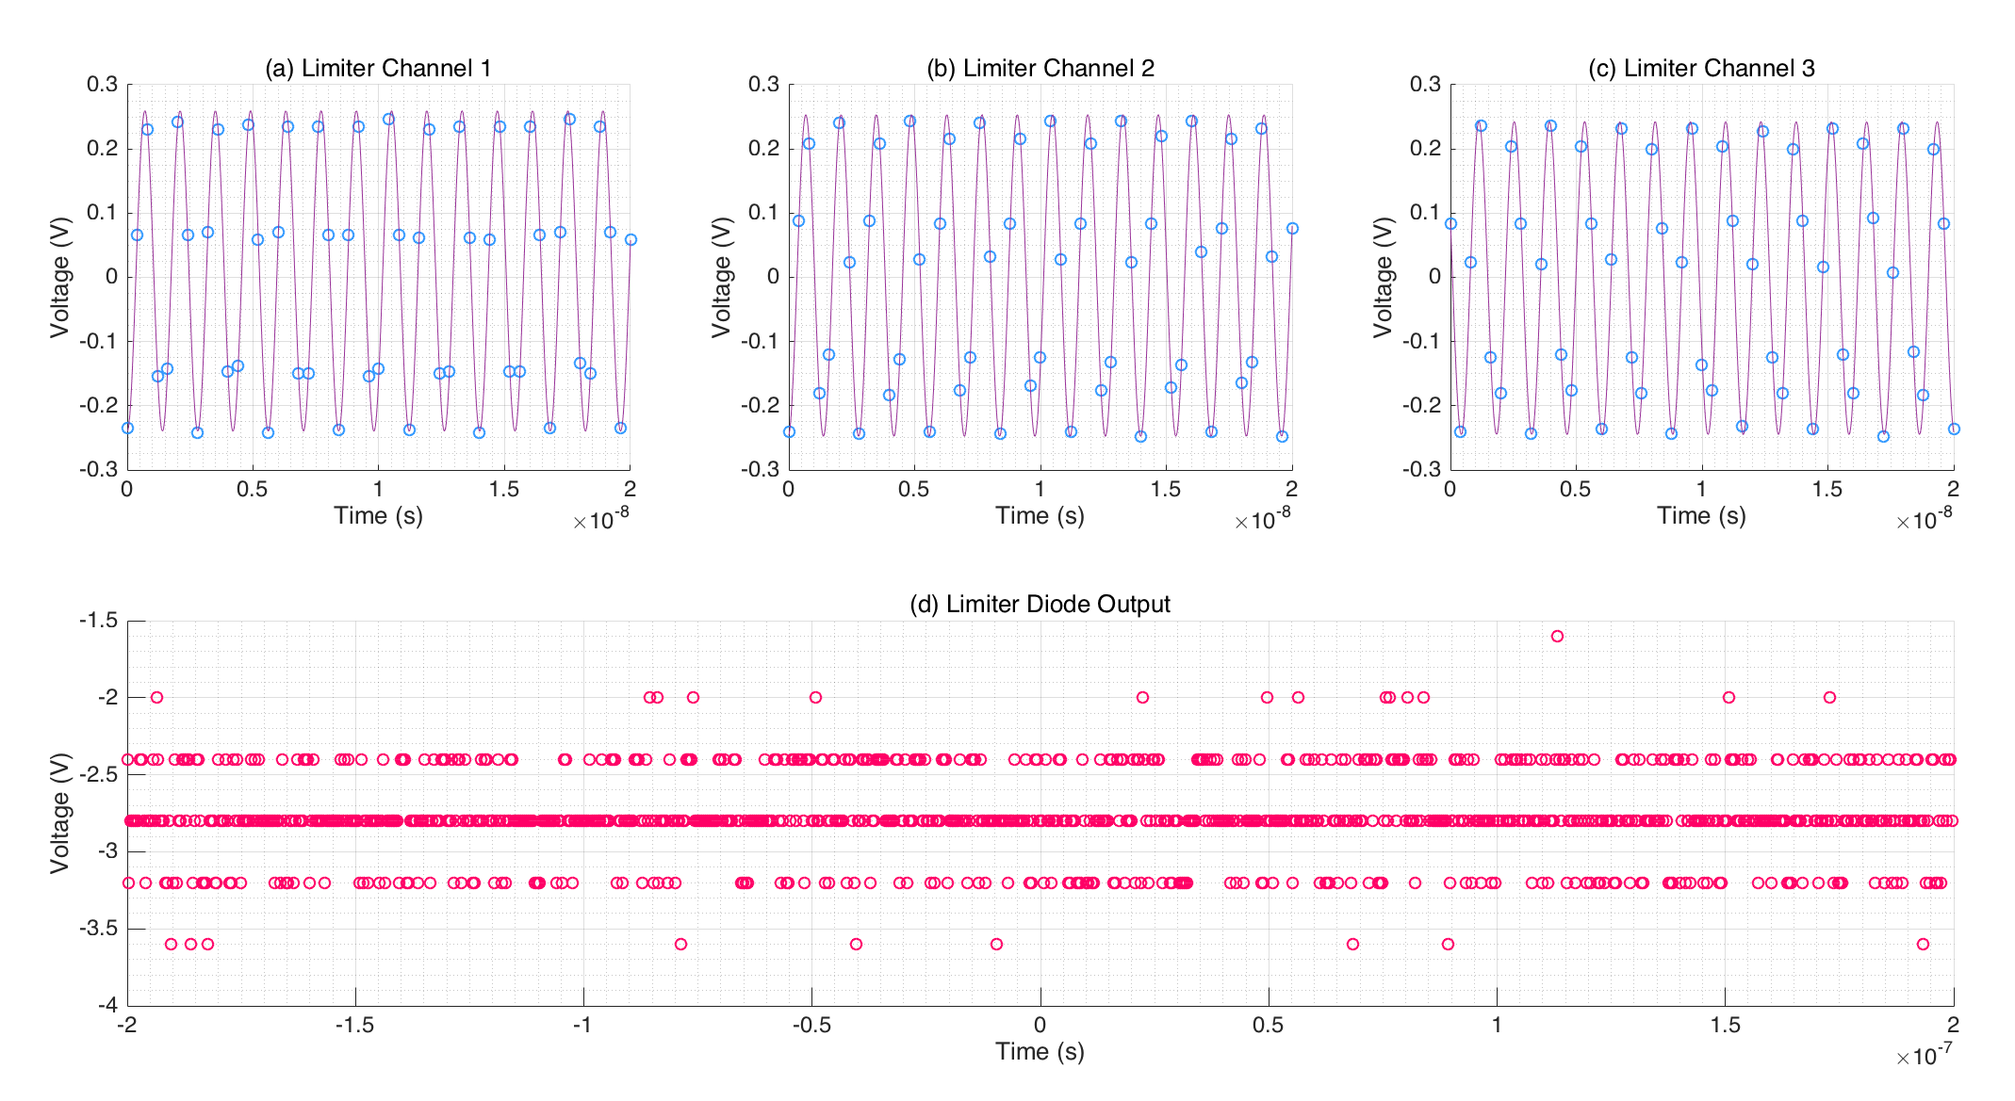
Waveform outputs example:
  Plots (a-c) 20ns samples
  of the three limiter output waveforms. Scope data points shown as blue circles. A sine function fit in purple.
  Plot (d) full 400 ns of the limiter diode output.
  The diode appears to be very jittery but only at discreet values. We tried different oscilloscope channels to confirm the output. Same discreet value jittering output observed.

Slide 8
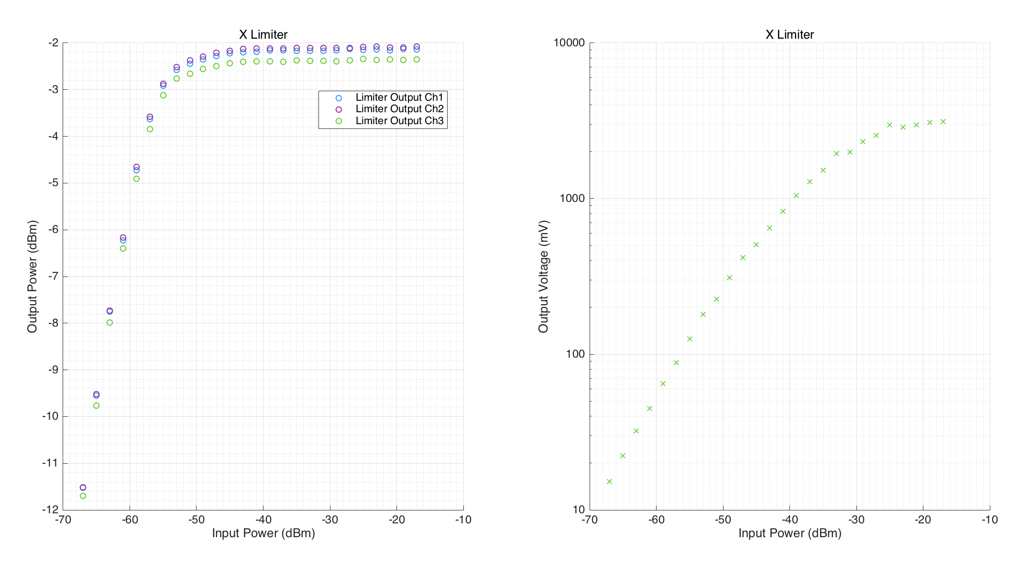
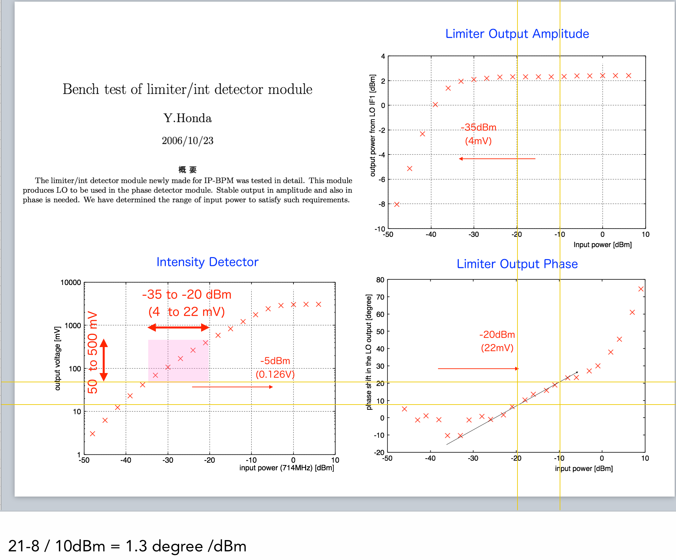
X Limiter
  Relationship appears almost linear -55 to -35 dBm. This range differs from Honda’s result by ~-15 dBm. However, input power is determined from signal generator display rather than actual output measurement, subtracting 43dBm due to additional attenuators applied to reach lower power levels.

Slide 9
BPM Test 2B – Output of the limiter
SIGNAL GENERATOR
714 MHz
SCOPE
(runs up to 1 GHz)
Limiting Amplifier
Bypass first stage and supply signal to limiting amplifier direct from signal generator.
Change the strength of the signal generator to vary input power.
Monitor the three output channels and the limiter diode.

Slide 10
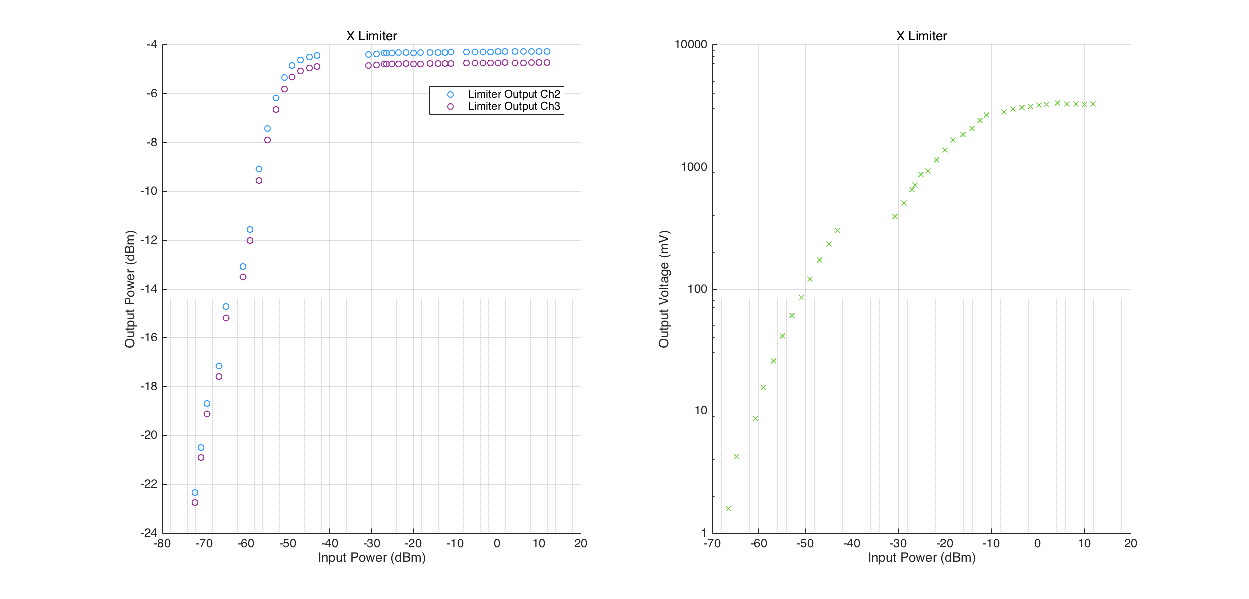
X Limiter
  Input power is determined from an oscilloscope measurement, with the signal generator output split to send one arm into the scope and one arm into the limiter. There is a gap in the data between -32 dBm and -42 dBm due to the different attenuation ranges reachable with the various attenuator/splitter combinations.

Slide 11
BPM Test 3A – Externally supplied LO
FIRST STAGE MIXER
Dipole
Reference
SIGNAL GENERATOR
y = 6.4 GHz
x = 5.7 GHz
SECOND STAGE
MIXER
714 MHz
I
Q
714 MHz
Limiting Amplifier
Reference
Processor
Damping Ring
714 MHz
Frequency
Multiplier
SIGNAL GENERATOR
714 MHz
Bypass first stage reference and supply the LO externally using
714 MHz signal generator.
Change the frequency of the
6.4 GHz signal generator.
Monitor the I and Q signals.

Slide 12
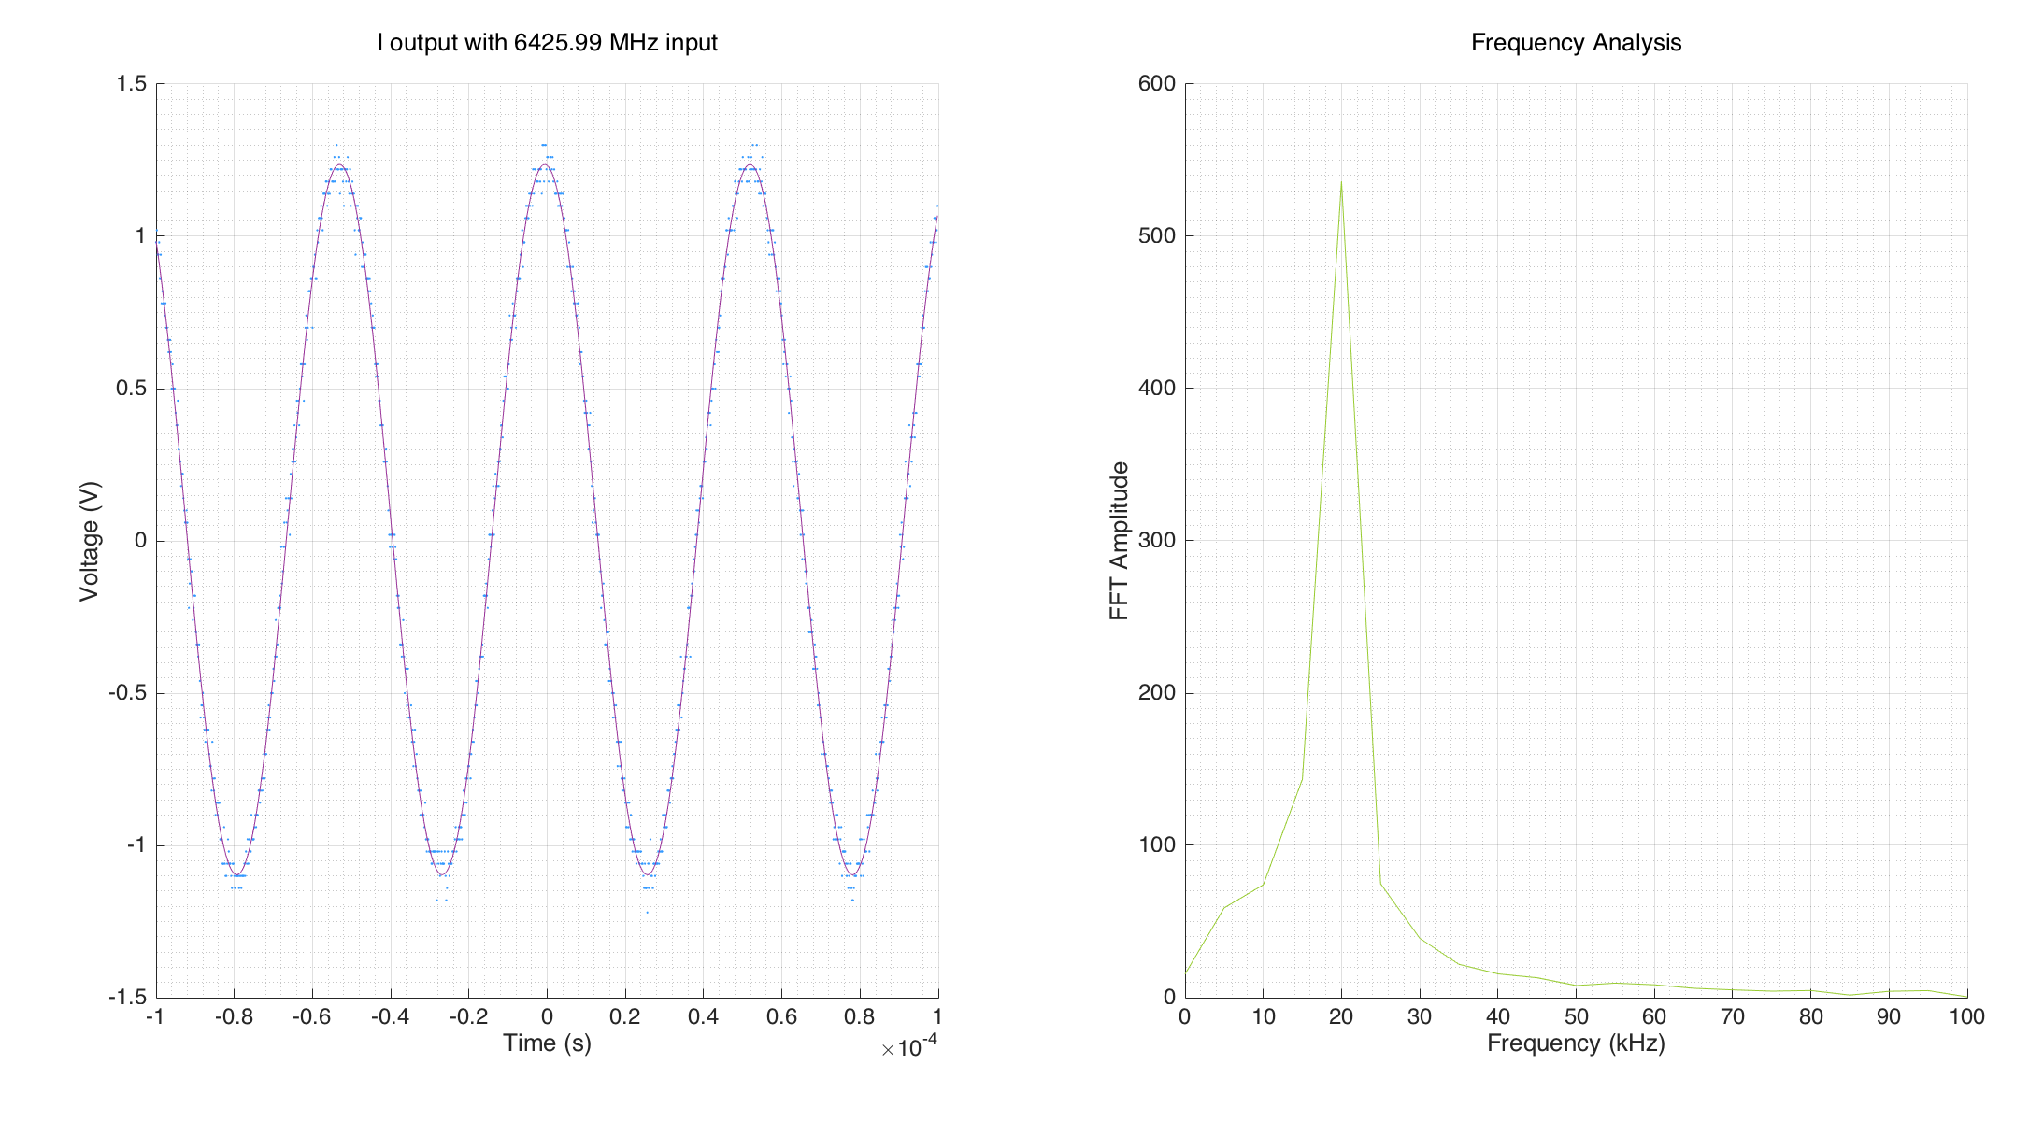
Example waveforms: with 6425.99 MHz input
I signal waveform and frequency analysis with a 6425.99 kHz input, i.e. when down-mixing produces a signal 20 kHz away from matching the externally supplied 714 MHz LO, with which it is mixed in the second stage.
Frequency varied either side of exact matching.

Slide 13
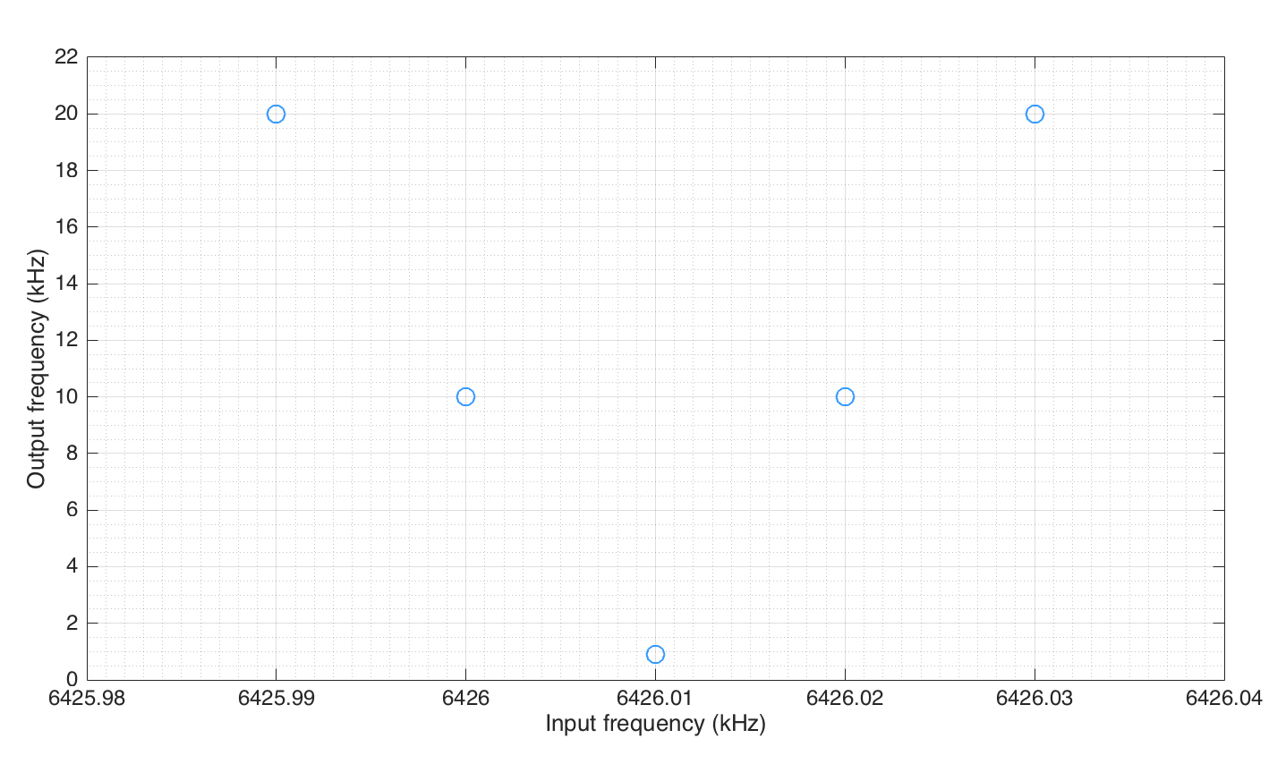
Frequency output versus frequency input
Expected result as you move away from desired frequency.

Slide 14
BPM Test 3B – External LO, with beam
FIRST STAGE MIXER
Dipole
Reference
DIPOLE CAVITY
SECOND STAGE
MIXER
I
714 MHz
Q
REFERENCE CAVITY
714 MHz
Limiting Amplifier
Reference
Processor
Damping Ring
714 MHz
Frequency
Multiplier
SIGNAL GENERATOR
714 MHz
Bypass first stage reference and supply the LO externally using
714 MHz signal generator.
Change the frequency of the
signal generator.
Monitor the I and Q signals.

Slide 15
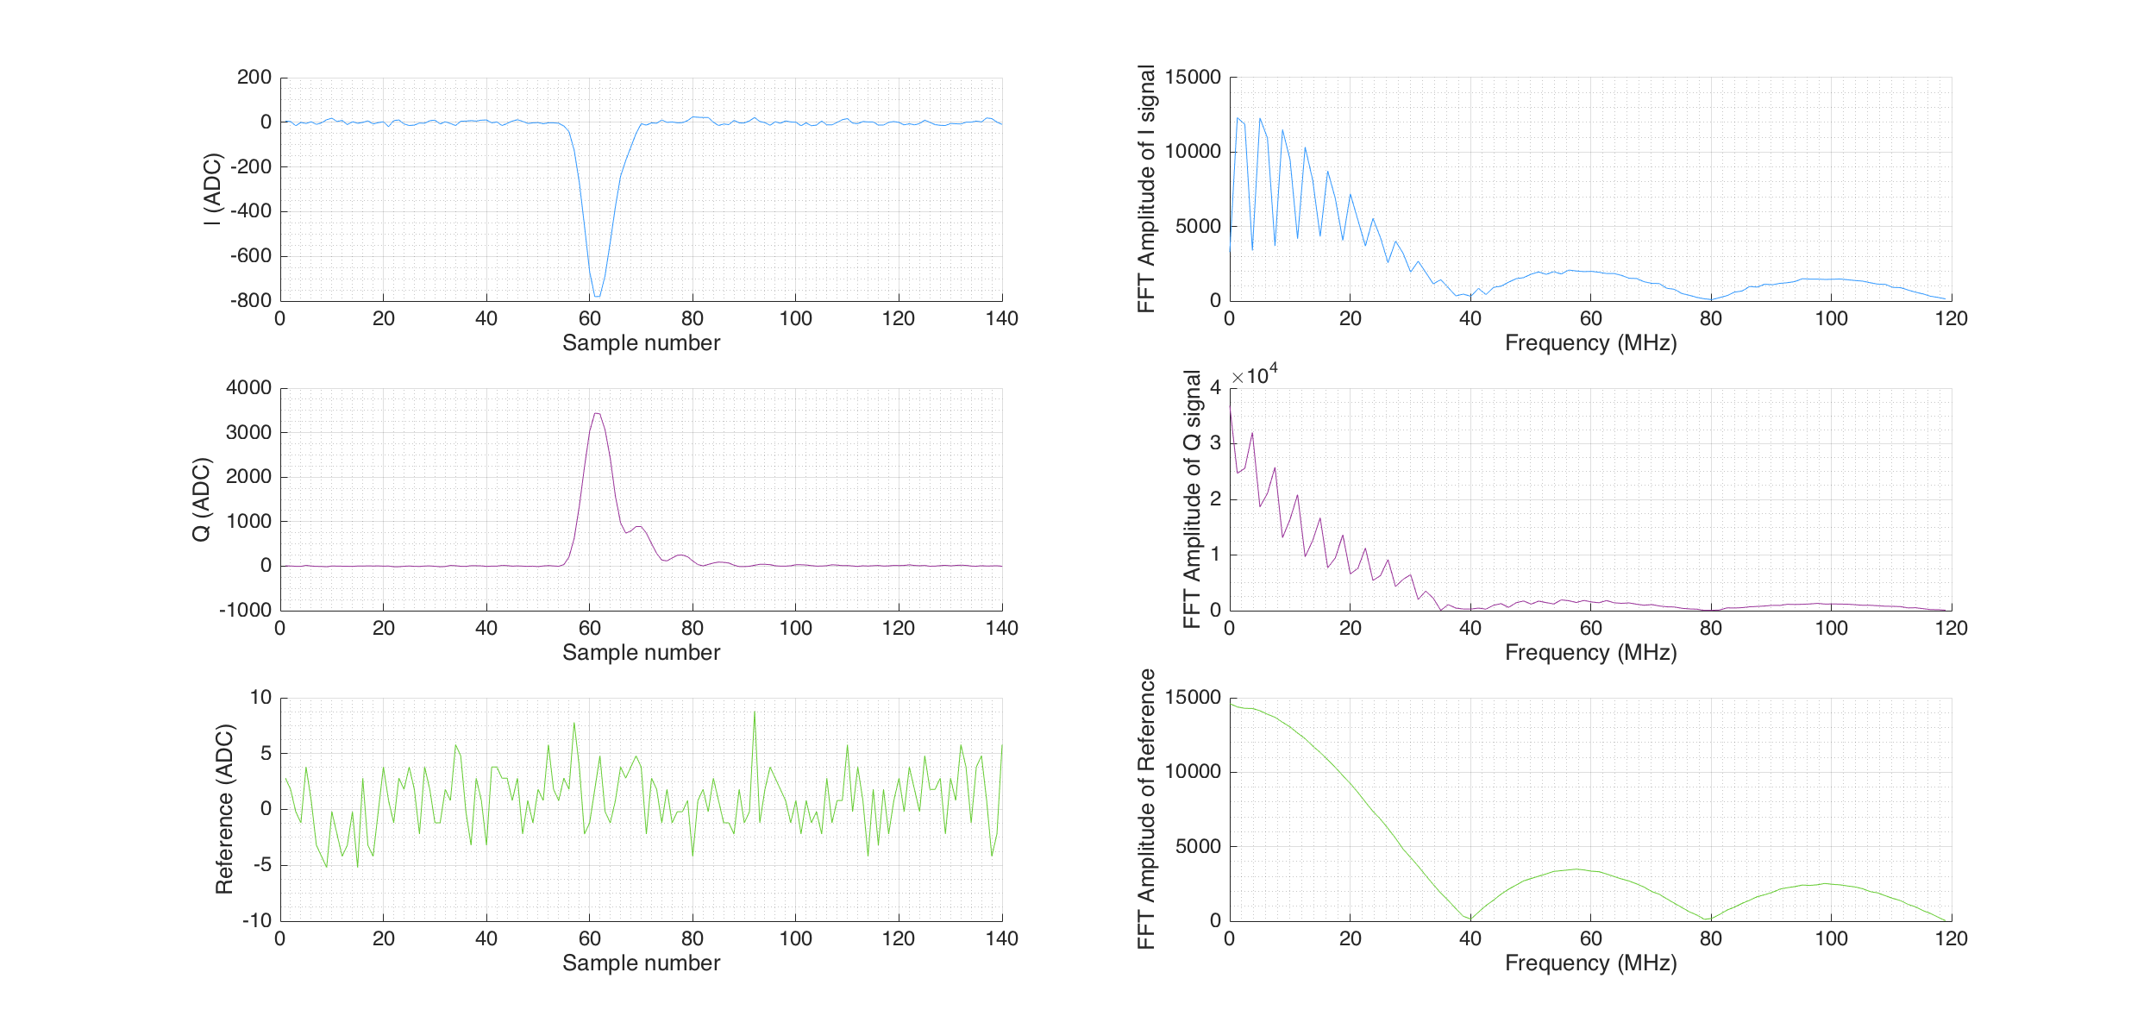
Example waveform with SG @ 714 MHz
Externally supplied LO at 714 MHz mixed with dipole cavity signals.
IPA(X) example output signals for one trigger:
I signal, Q signal and Reference captured using the SIS digitiser.
40 dB attenuation on the dipole signals.
-10 dBm on signal generator in the S-band hut. -17 dBm on travelling inside: attenuation inside -27 dBm.
FFT presented next to each waveform.

Slide 16
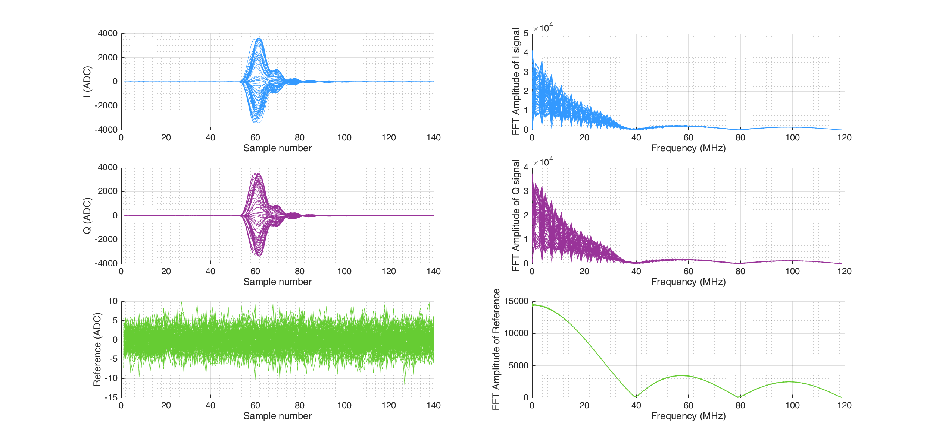
All triggers with SG @ 714 MHz
Externally supplied LO at 714 MHz mixed with dipole cavity signals.
IPA(X) example output signals for ALL triggers in a jitter run: I signal, Q signal and Reference captured using the SIS.
FFT presented next to each waveform.

Slide 17
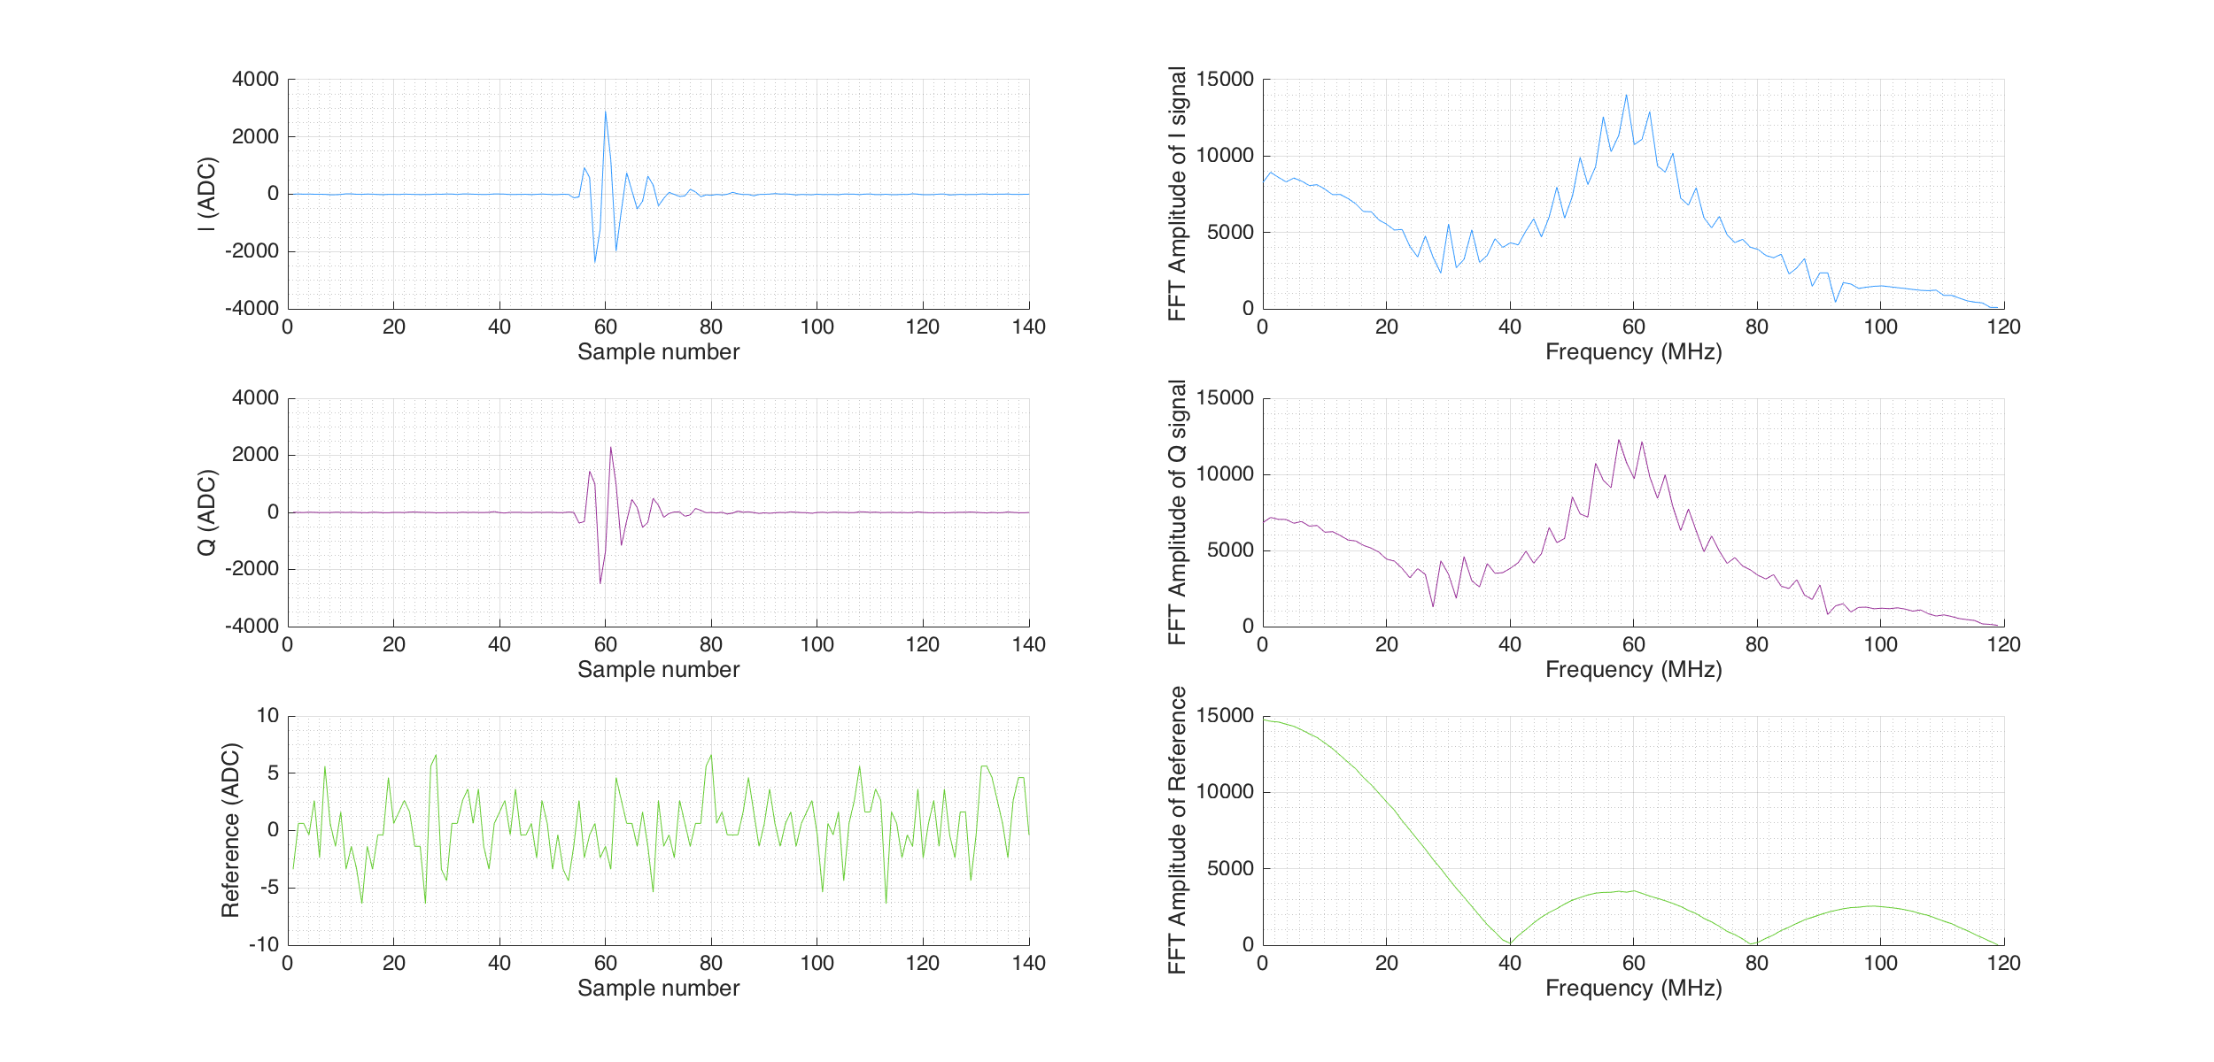
Example waveform with SG @ 654 MHz
Externally supplied LO at 654 MHz mixed with dipole cavity signals. i.e. LO is 60 MHz away from design frequency for mixing.
IPA(X) example output signals for one trigger: I signal, Q signal and Reference captured using the SIS digitiser.
FFT presented next to each waveform.

Slide 18
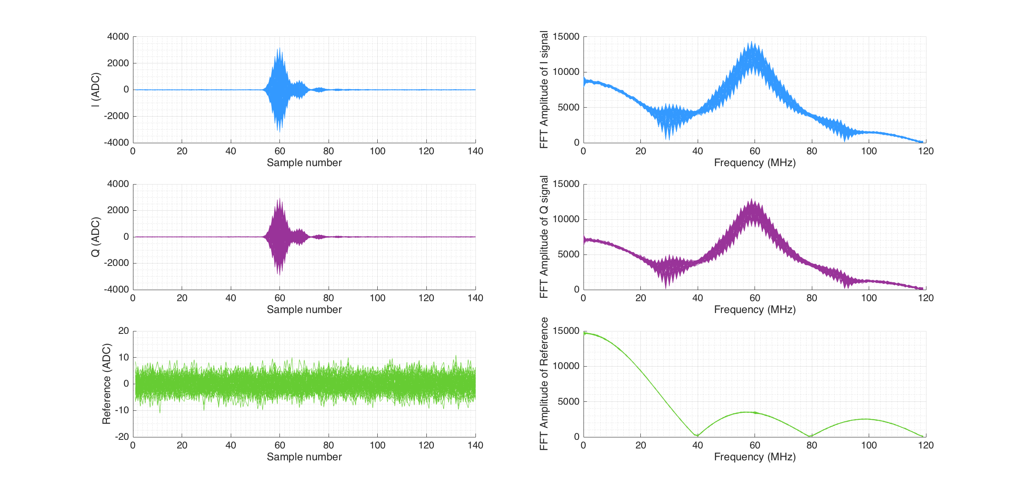
All triggers with SG @ 654 MHz
Externally supplied LO at 654 MHz mixed with dipole cavity signals. i.e. LO is 60 MHz away from design frequency for mixing.
IPA(X) example output signals for ALL triggers in a jitter run: I signal, Q signal and Reference captured using the SIS.
FFT presented next to each waveform.

Slide 19
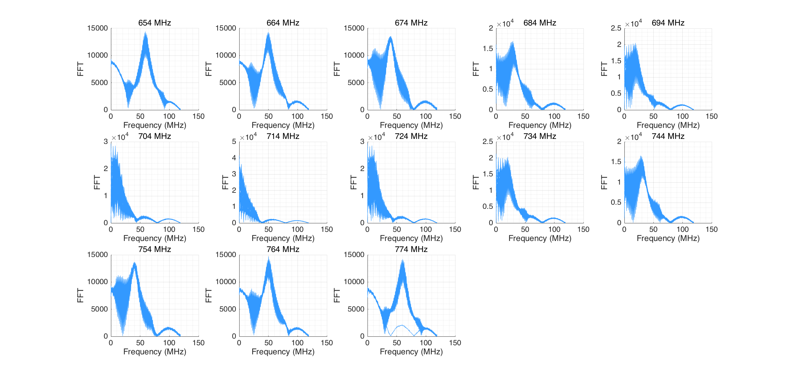
I signal at different external LO frequencies
FFT analysis of the I signals for a range of externally-supplied LO frequencies.

Slide 20
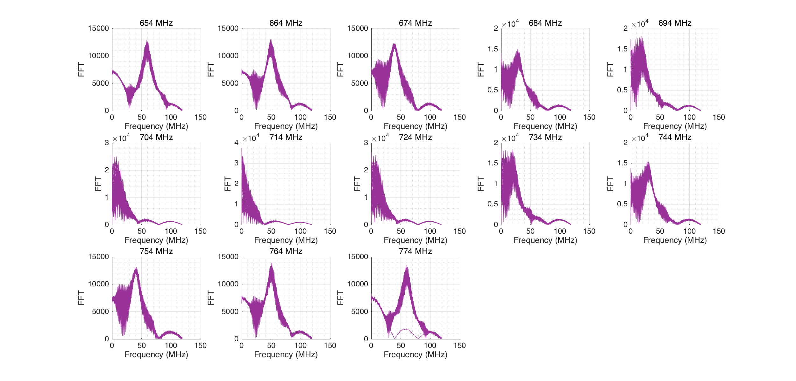
Q signal at different external LO frequencies
FFT analysis of the Q signals for a range of externally-supplied LO frequencies.

Slide 21
BPM Test 3C – External dipole, with beam
Bypass first stage dipole and supply the signal externally using 714 MHz signal generator.
Change the frequency of the signal generator.
SIGNAL GENERATOR
714 MHz
FIRST STAGE MIXER
Dipole
Reference
DIPOLE CAVITY
SECOND STAGE
MIXER
I
714 MHz
Q
REFERENCE CAVITY
714 MHz
Limiting Amplifier
Reference
Processor
Damping Ring
714 MHz
Frequency
Multiplier

Slide 22
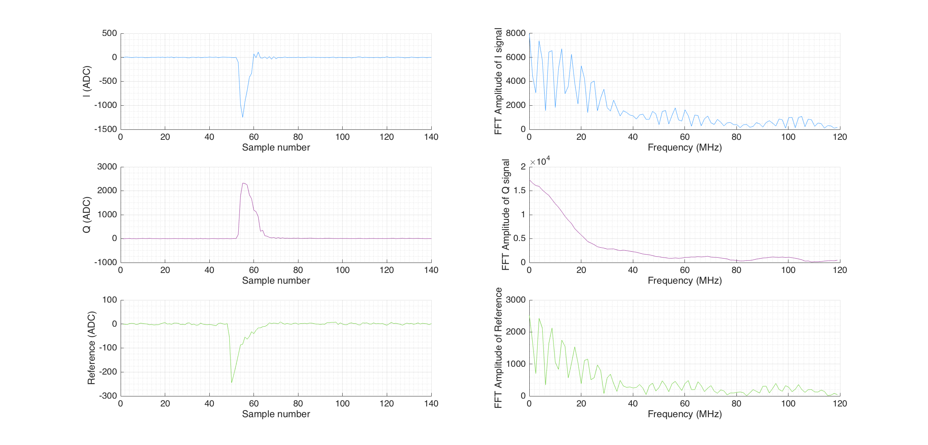
Example waveform with SG @ 714 MHz
Externally-supplied dipole signal at 714 MHz mixed with reference cavity signal.
IPA(X) example output signals for one trigger: I signal, Q signal and Reference captured using the SIS digitiser.
FFT presented next to each waveform.

Slide 23
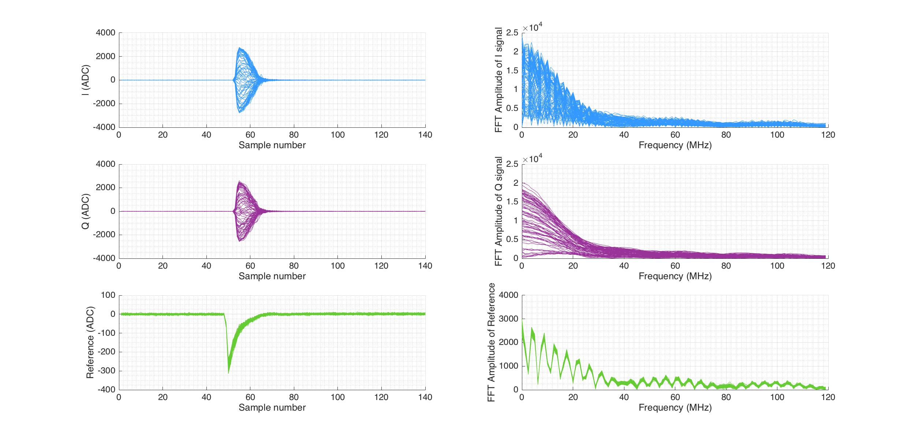
All triggers with SG @ 714 MHz

Slide 24
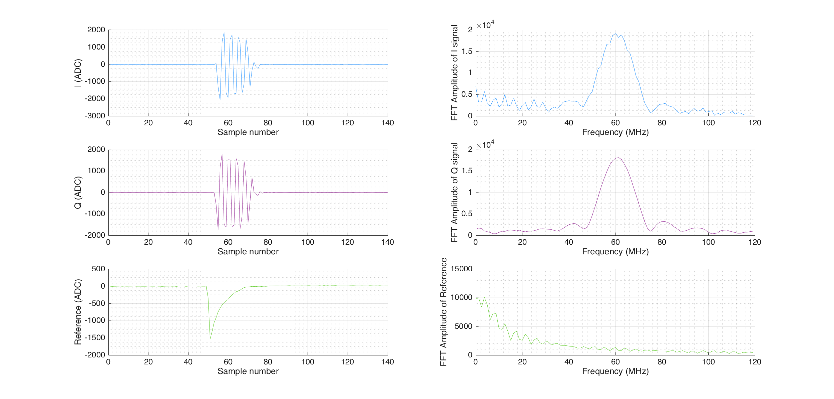
Example waveform with SG @ 654 MHz
Externally-supplied dipole signal at 654 MHz mixed with reference cavity signal. i.e. signal generated dipole signal is 60 MHz away from design frequency.
IPA(X) example output signals for one trigger: I signal, Q signal and Reference captured using the SIS digitiser.
FFT presented next to each waveform.

Slide 25
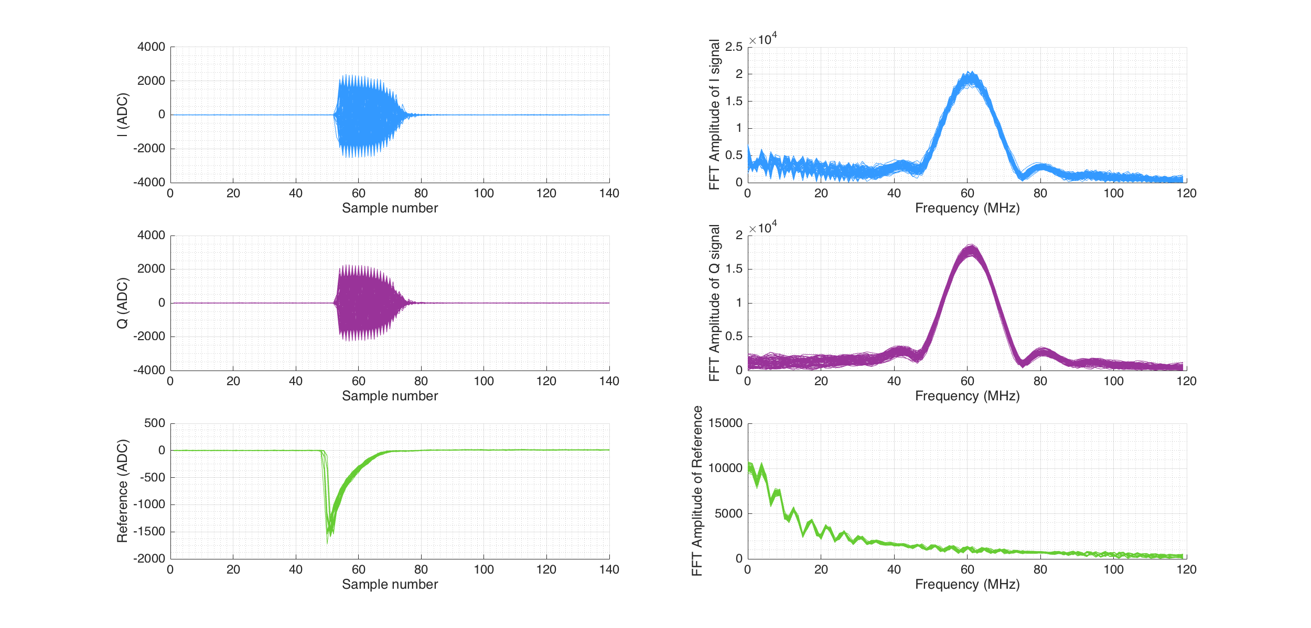
All triggers with SG @ 654

Slide 26
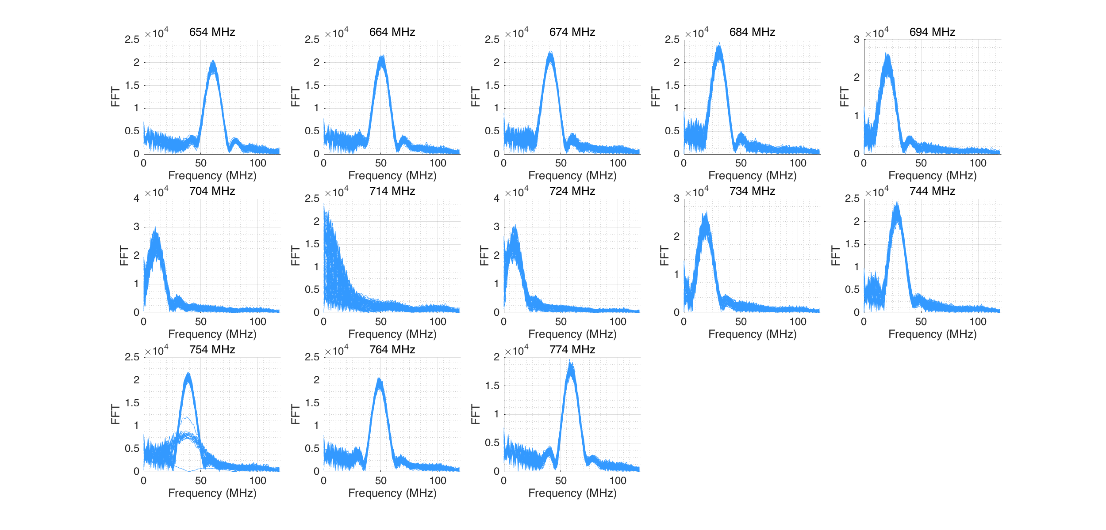
I signal at different dipole SG frequencies

Slide 27
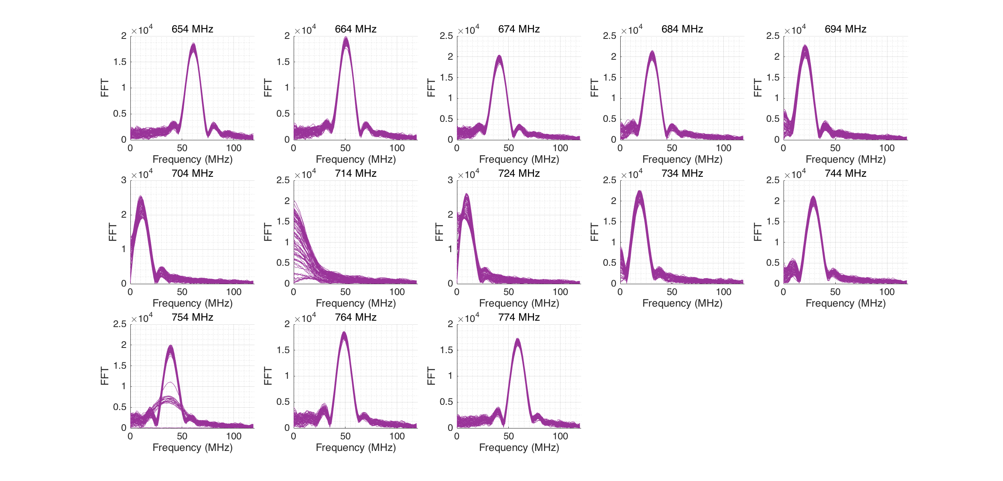
Q signal at different dipole SG frequencies

Slide 28
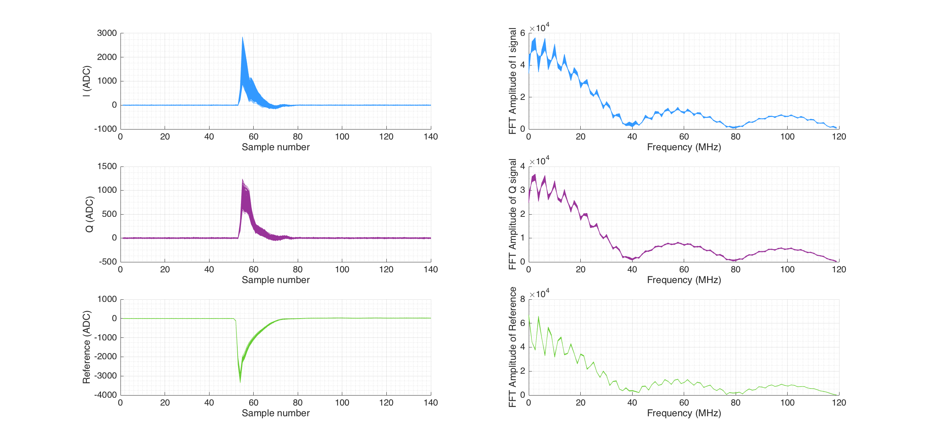
Static waveforms? IPAX 20dB June

Slide 29
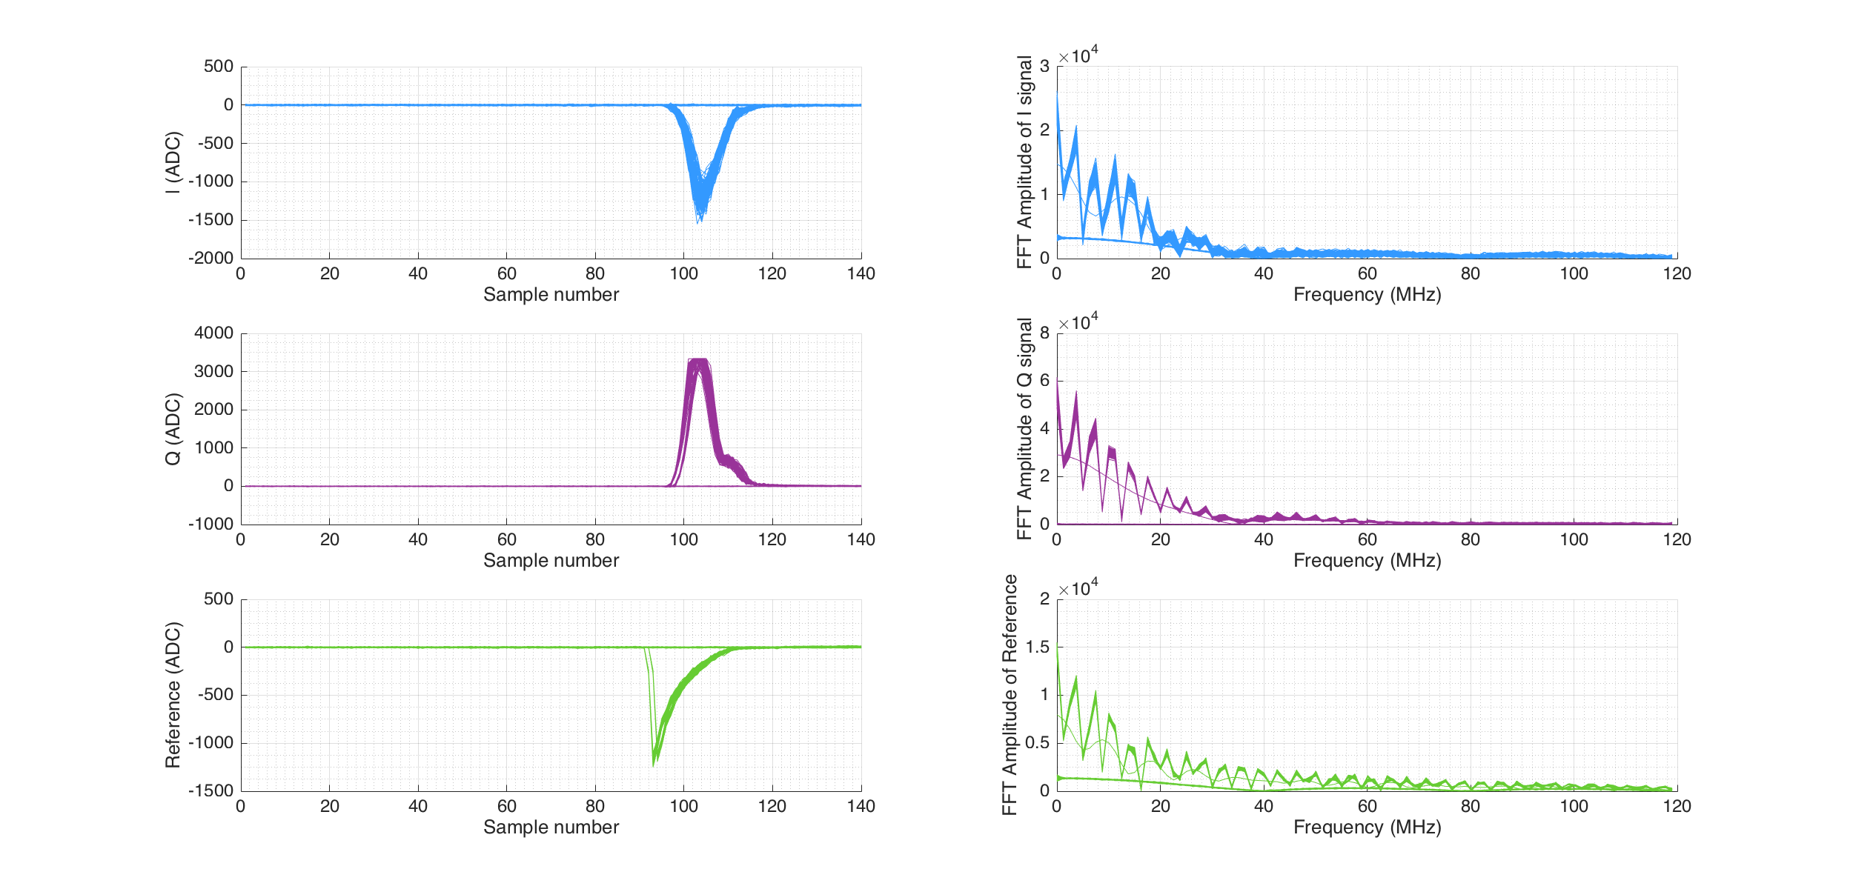
Static waveforms? IPAX 20dB October

