Slide 1
2-BPM IP feedback results
N. Blaskovic, T. Bromwich & R. Ramjiawan
N. Blaskovic

Slide 2
Introduction
2-BPM IP feedback operated on 271016 with Glenn’s new firmware on high β optics
IPA and IPC used to stabilise beam at IPB
Results:
Waveforms
BPM and kicker calibrations
Feedback results
BPM-to-BPM and bunch-to-bunch correlations
Feedback scans
N. Blaskovic

Slide 3
Waveforms and calibrations
Performed at 0 dB
All 3 IP BPMs aligned using only AQD0FF and IP BPM movers with no other changes to optics
BPM calibrations done simultaneously on all 3 IP BPMs by moving AQD0FF mover
IP kicker calibrations analysed using set DAC value
N. Blaskovic

Slide 4
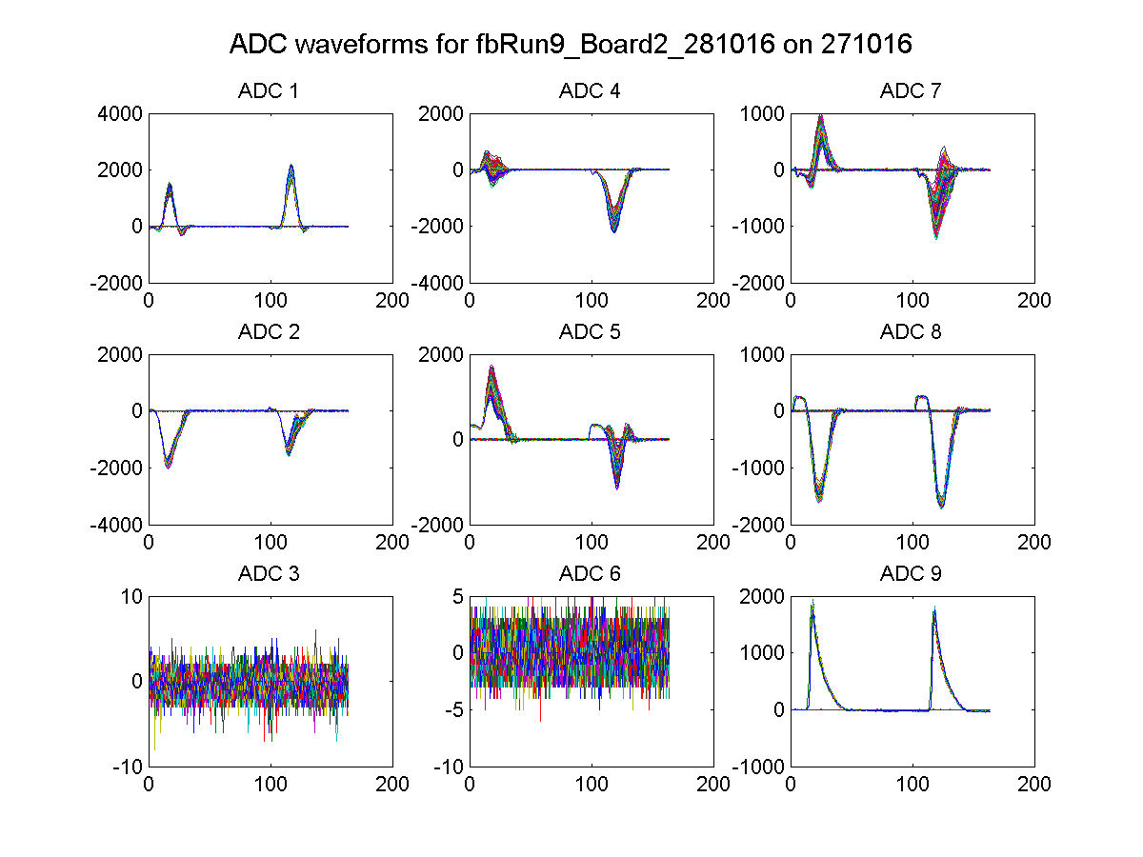
fbRun9
IPB(Y) I
IPA(Y) I
IPC(Y) I
IPB(Y) Q
IPA(Y) Q
IPC(Y) Q
Ref(Y)
N. Blaskovic

Slide 5
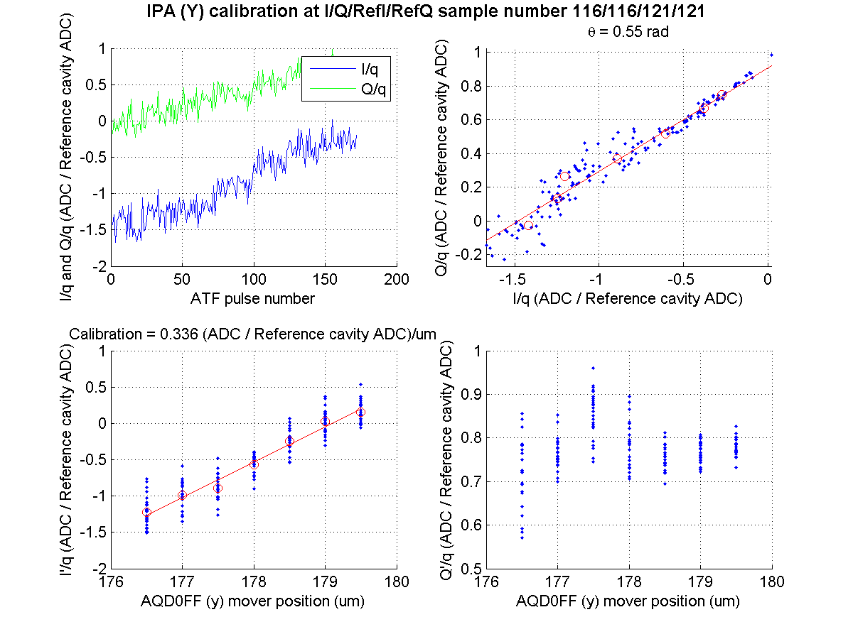
N. Blaskovic

Slide 6
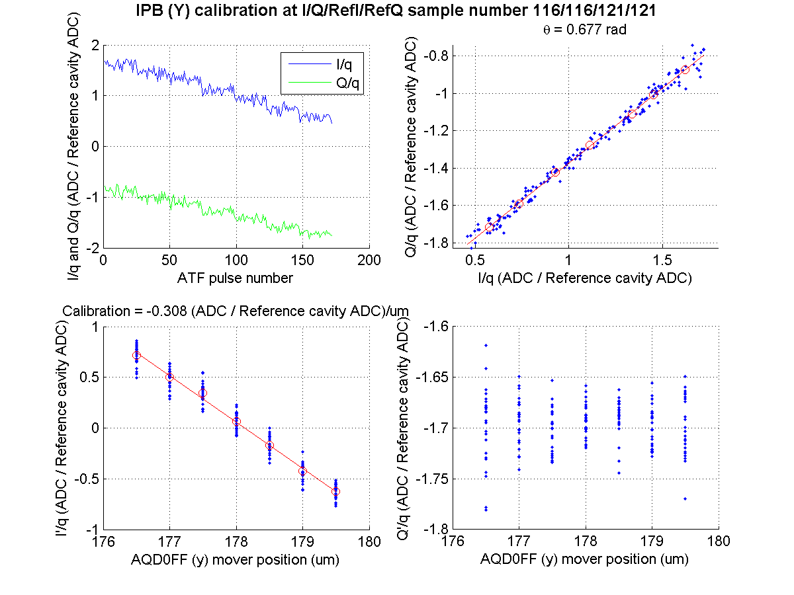
N. Blaskovic

Slide 7
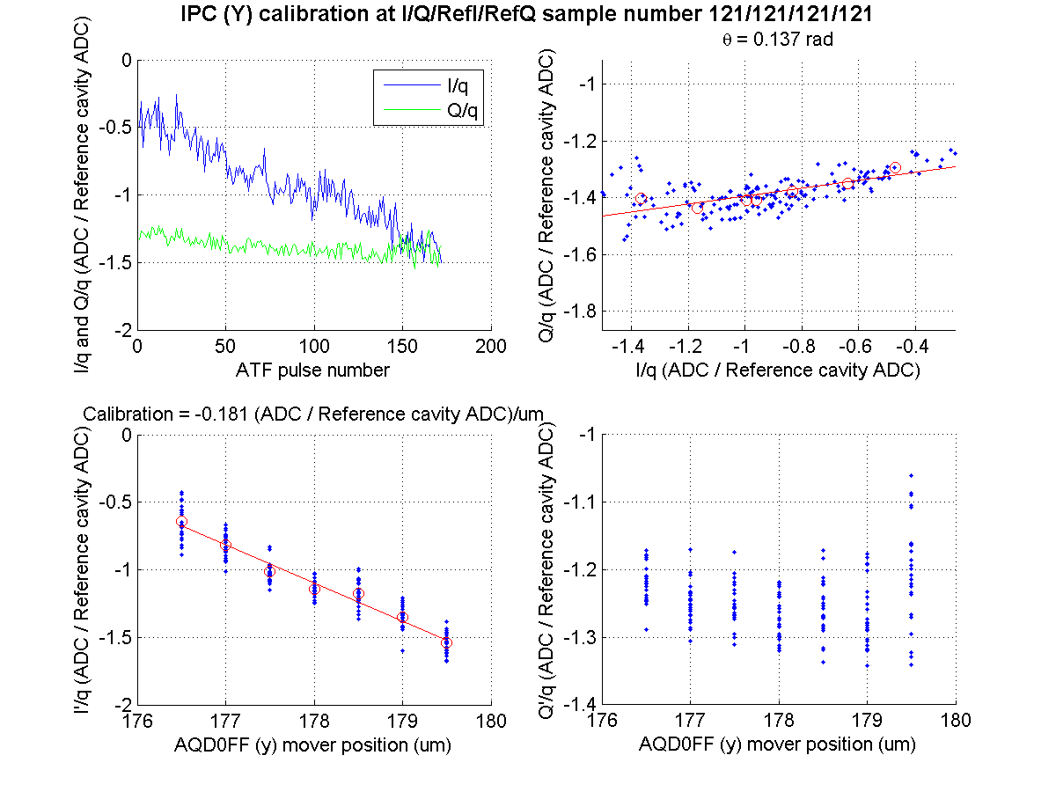
N. Blaskovic

Slide 8
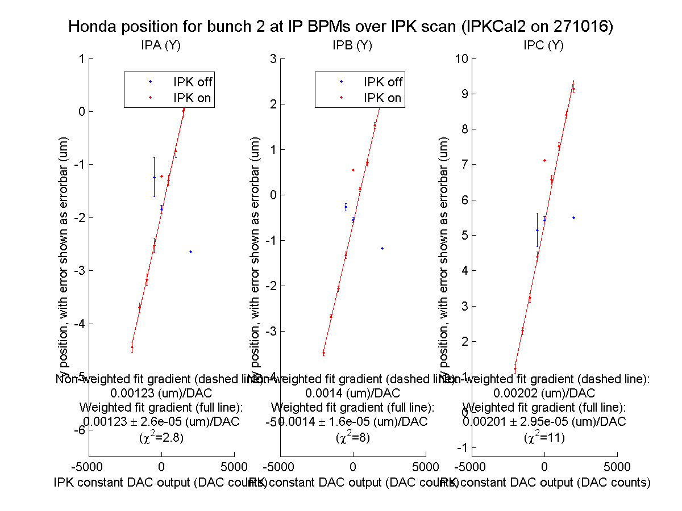
N. Blaskovic

Slide 9
Feedback
Best feedback run is fbRun9, stabilising the beam at IPB to 130 nm
Typical stabilisation is in the region of 150 to 250 nm, e.g. fbRun10 and fbRun14
N. Blaskovic

Slide 10
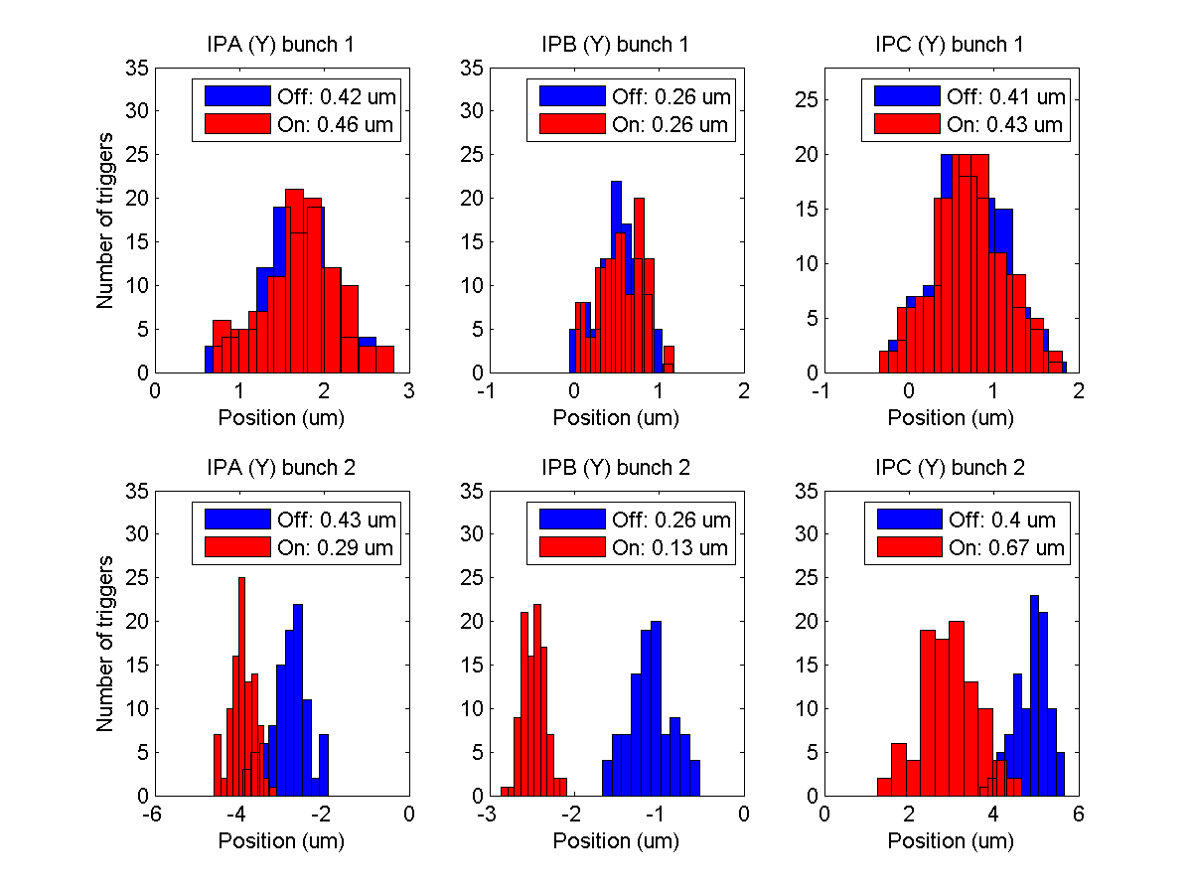
fbRun9
N. Blaskovic

Slide 11
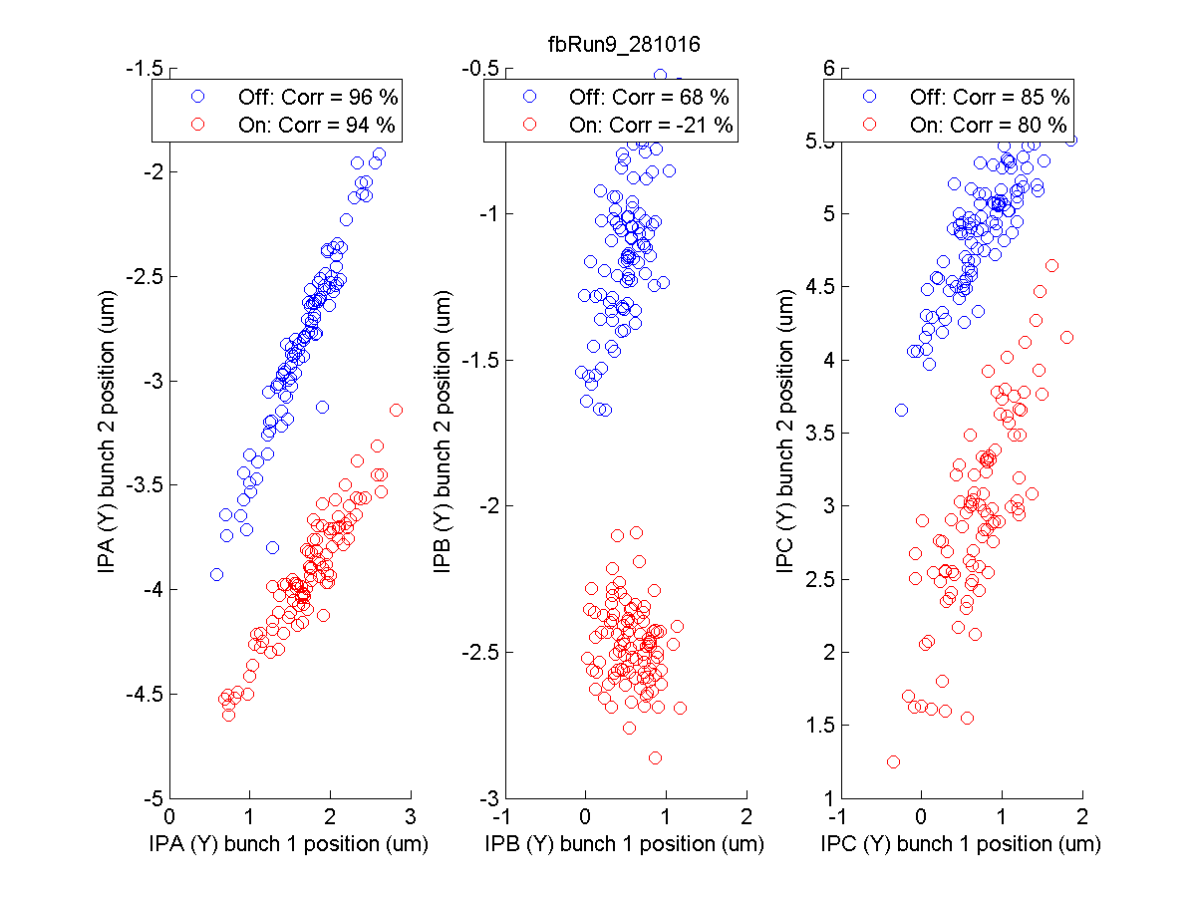
fbRun9
N. Blaskovic

Slide 12
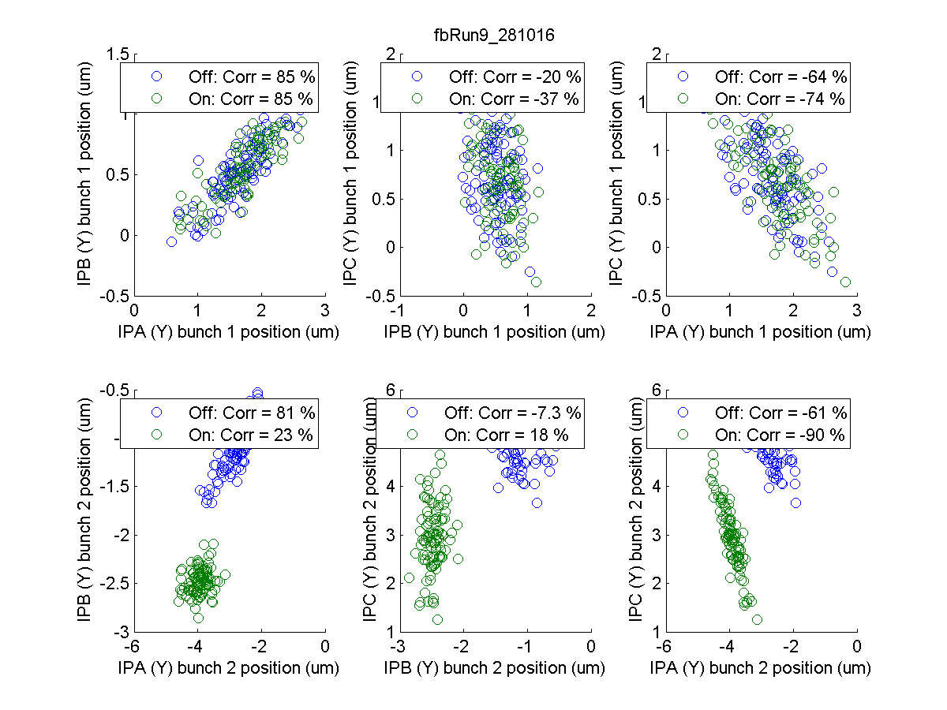
fbRun9
N. Blaskovic

Slide 13
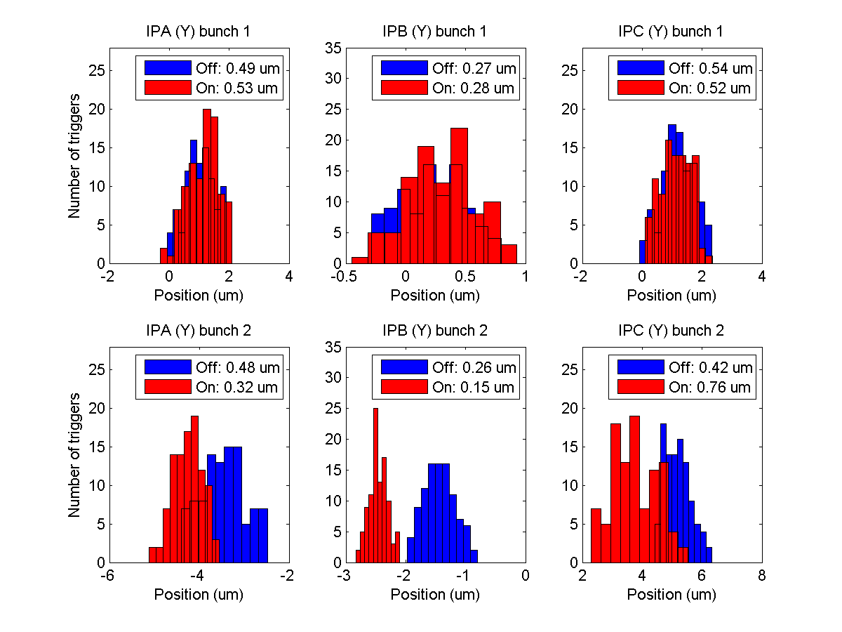
fbRun10
N. Blaskovic

Slide 14
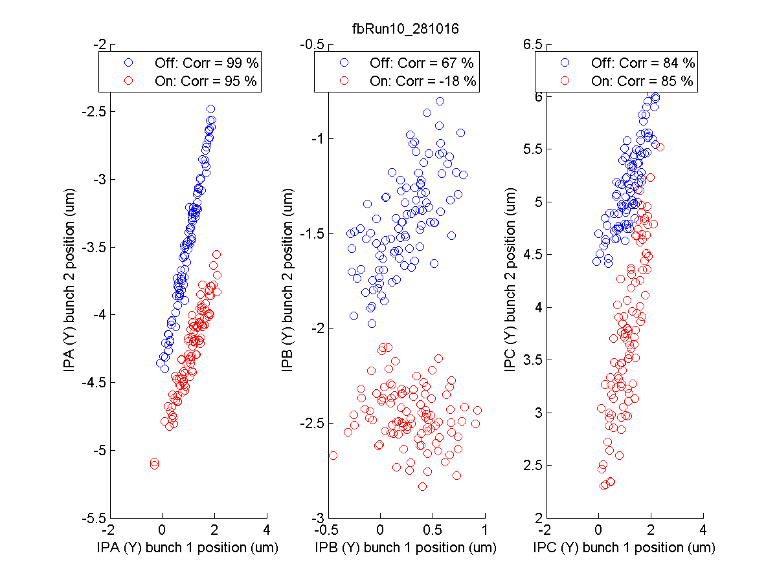
fbRun10
N. Blaskovic

Slide 15
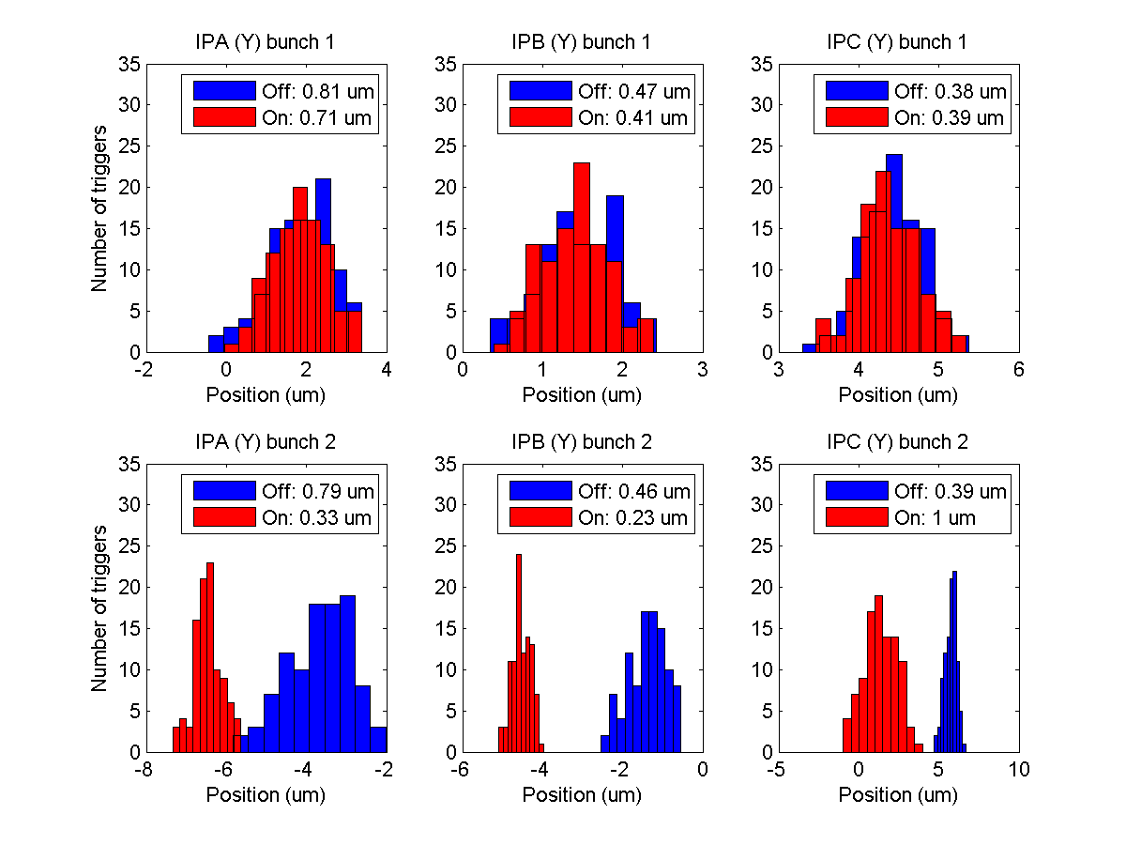
fbRun14
N. Blaskovic

Slide 16
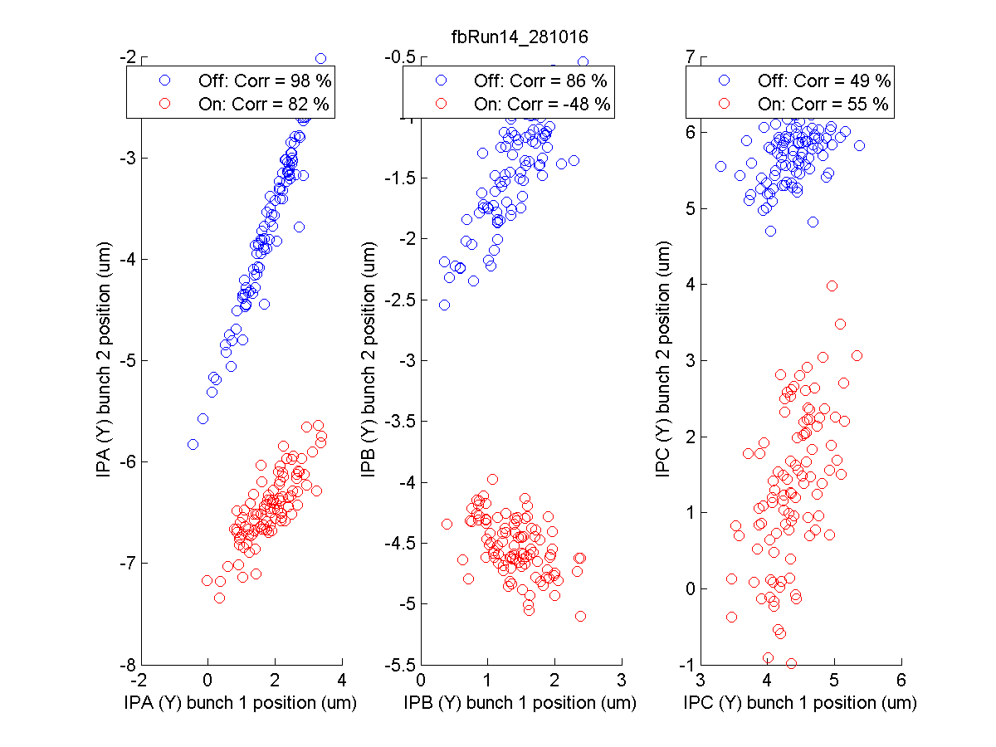
fbRun14
N. Blaskovic

Slide 17
Extraction timing scan
Extraction timing scan performed to try to optimise bunch-to-bunch correlation
Similar quality of bunch extraction observed over a wide flat top of ~100 ns (with a bunch spacing of 280 ns)
Extraction kicker timing set to 4.106 us to place bunches in the middle of extraction pulse
N. Blaskovic

Slide 18
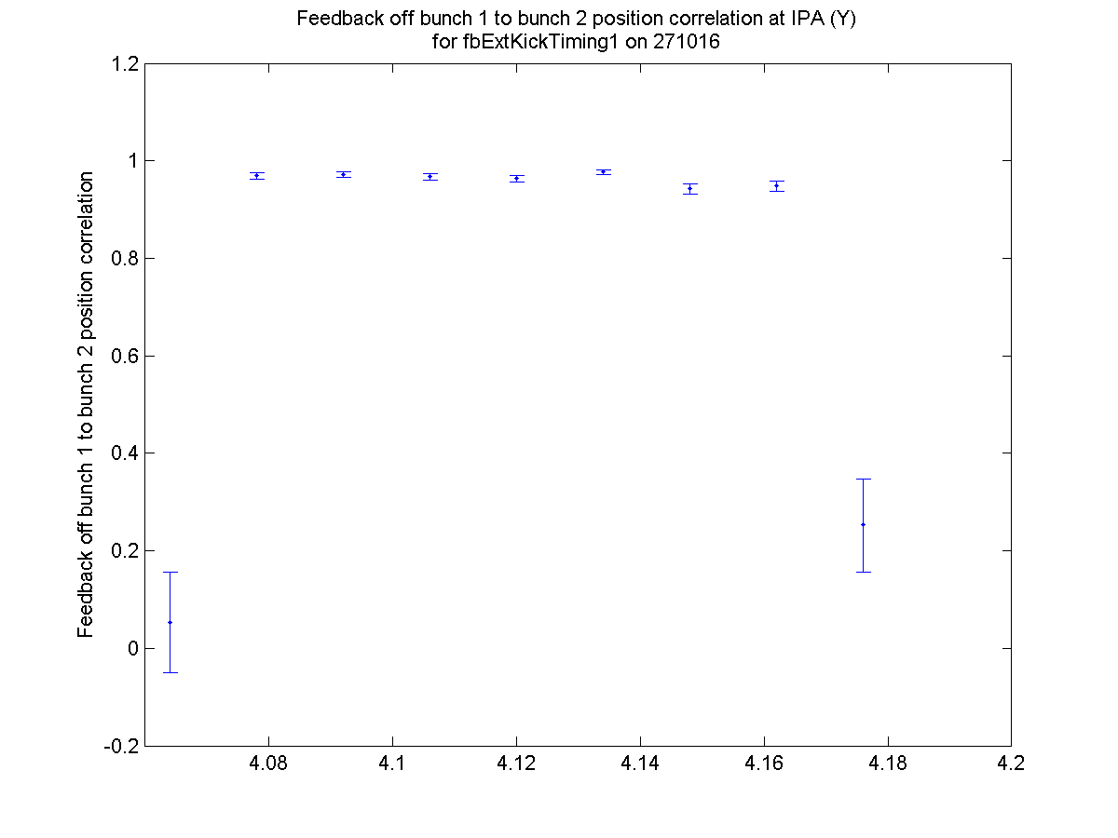
N. Blaskovic

Slide 19
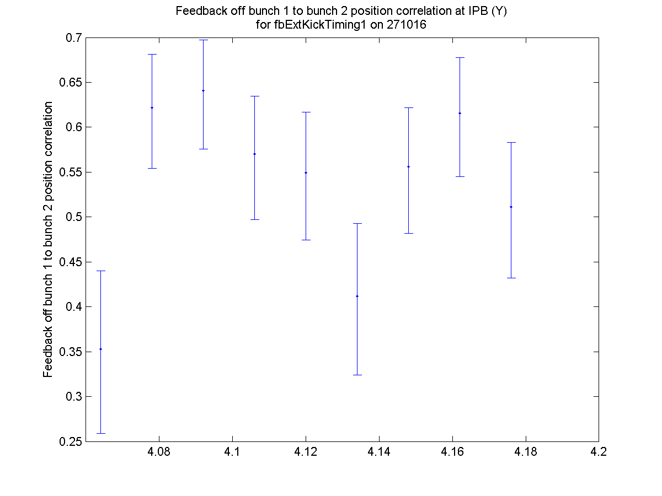
N. Blaskovic

Slide 20
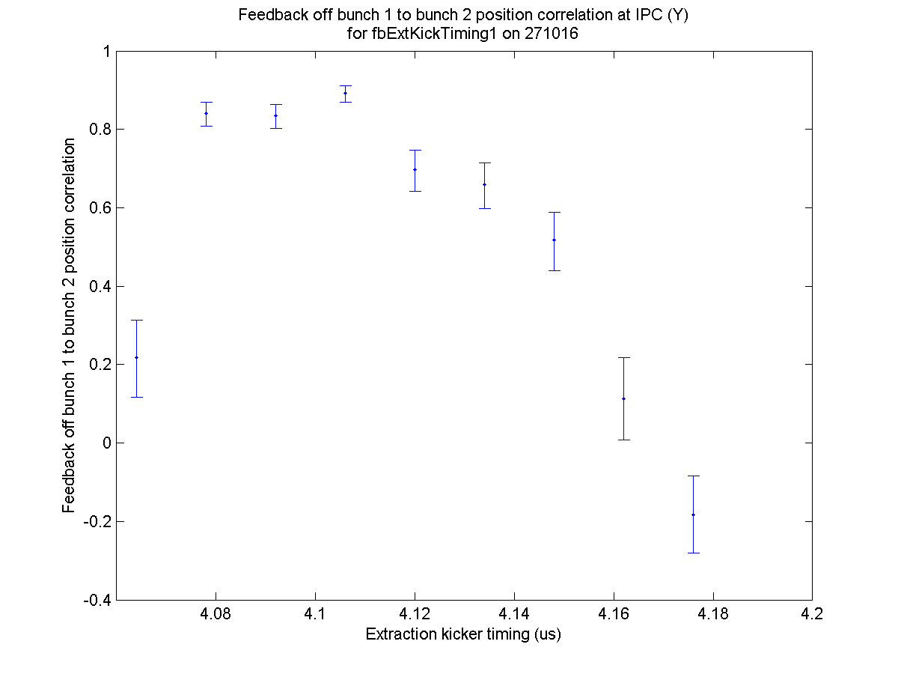
N. Blaskovic

Slide 21
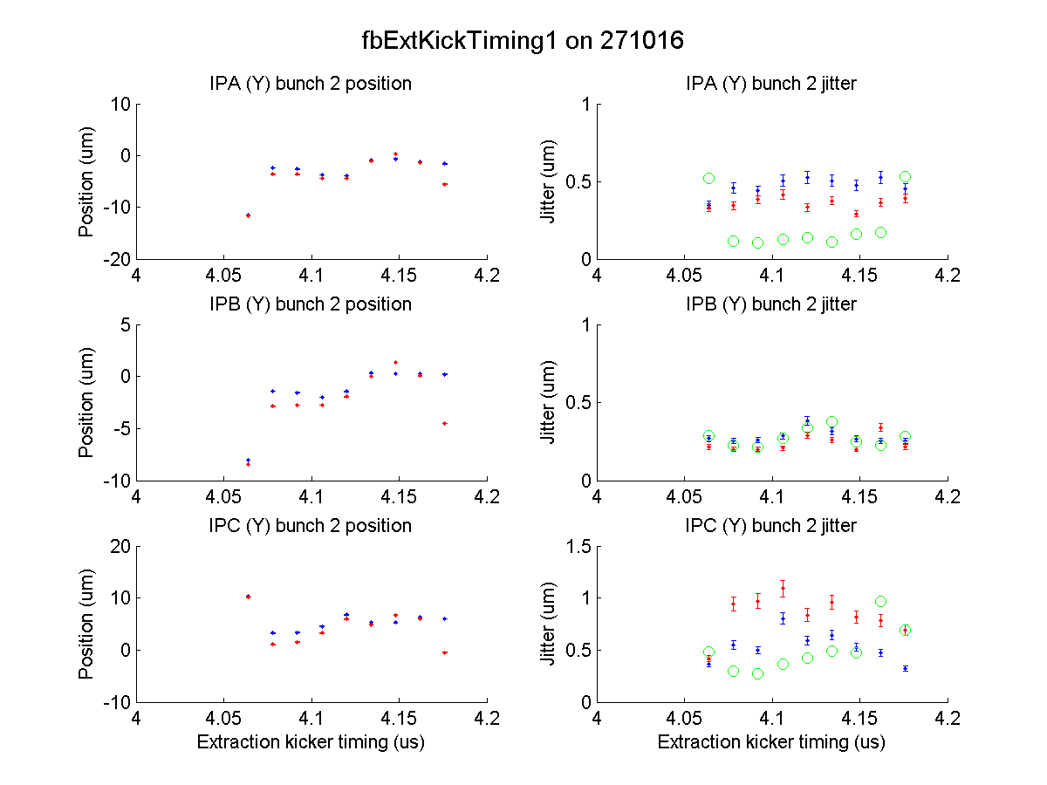
N. Blaskovic

Slide 22
Feedback scans
Scans performed at 10 dB:
AQD0FF mover scan (orbit scan)
Percentage gain scan (scale all gains)
Gain ratio scan (scale IPA gain to IPC gain)
Random jitter scan (using jitter source)
Green circles show expected stabilisation given incoming beam conditions assuming single-loop feedback at each BPM!
N. Blaskovic

Slide 23
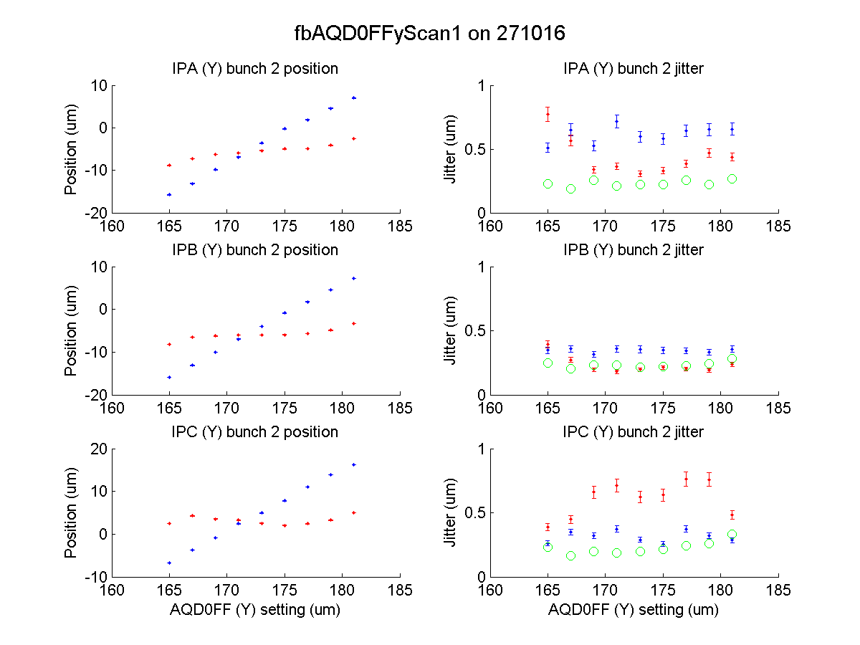
>20 um
N. Blaskovic

Slide 24
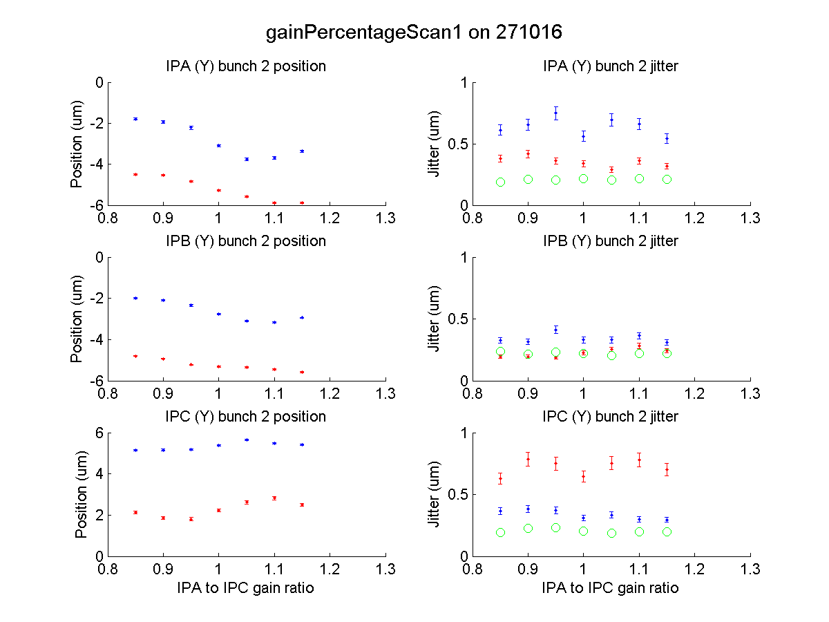
optimum?
Fraction of nominal gain
Fraction of nominal gain
N. Blaskovic

Slide 25
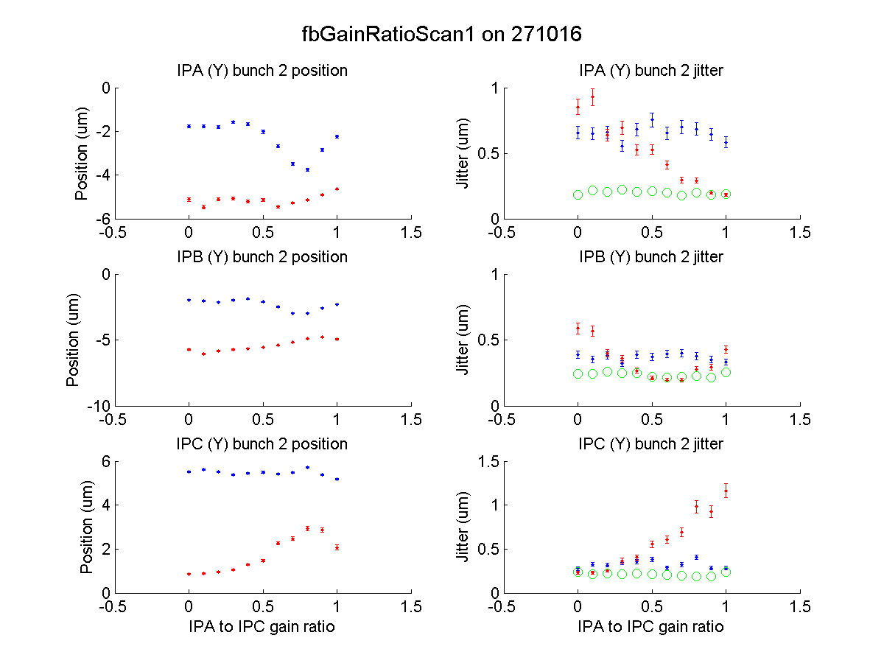
expected from geometry
N. Blaskovic

Slide 26
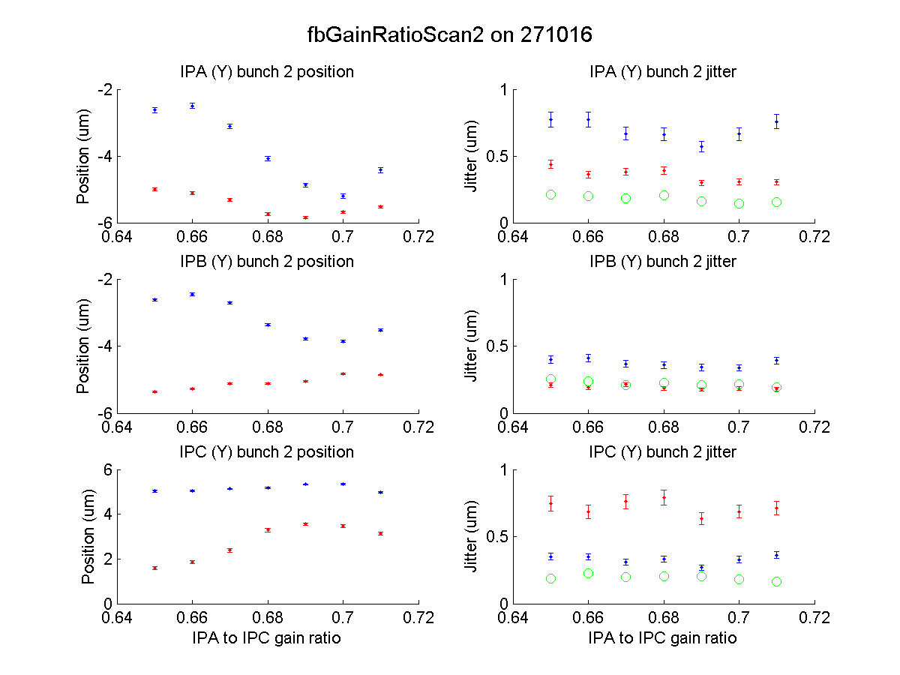
expected from geometry
N. Blaskovic

Slide 27
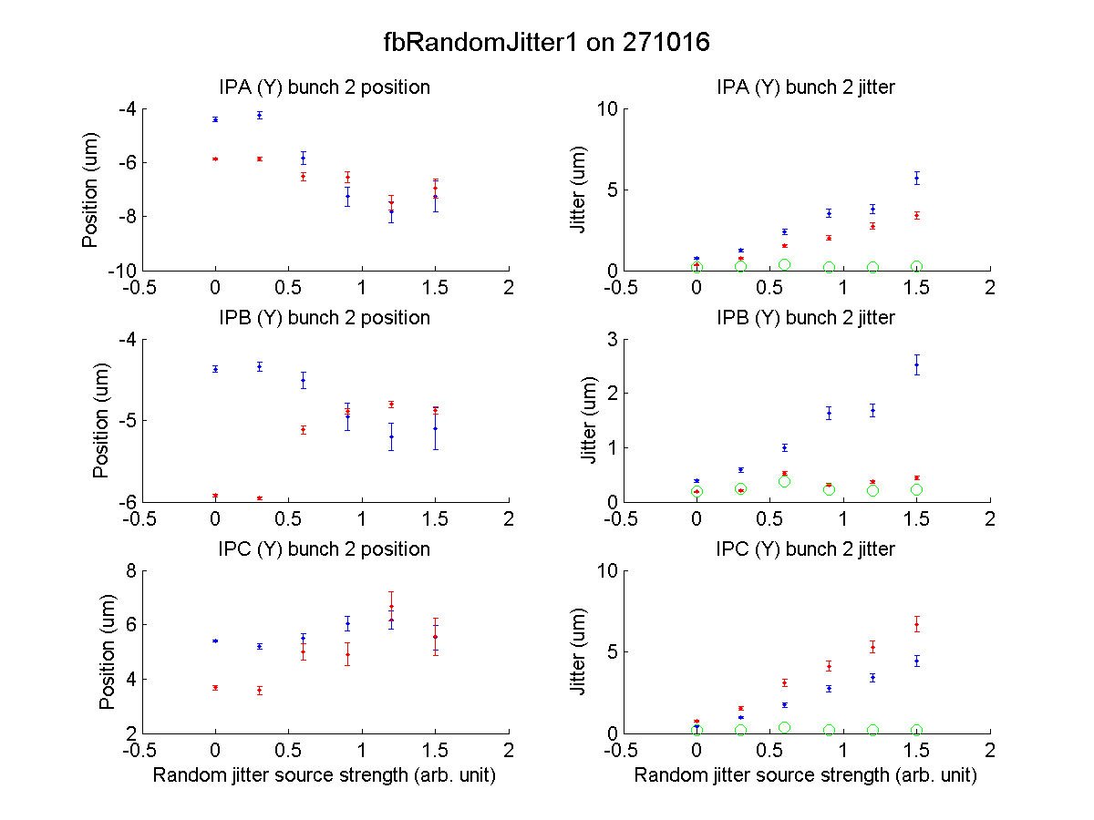
N. Blaskovic

Slide 28
Attenuation scan
Evaluated feedback performance as a function of IP BPM attenuation
IP BPM and kicker calibrations performed at each setting; gains recalculated each time
N. Blaskovic

Slide 29
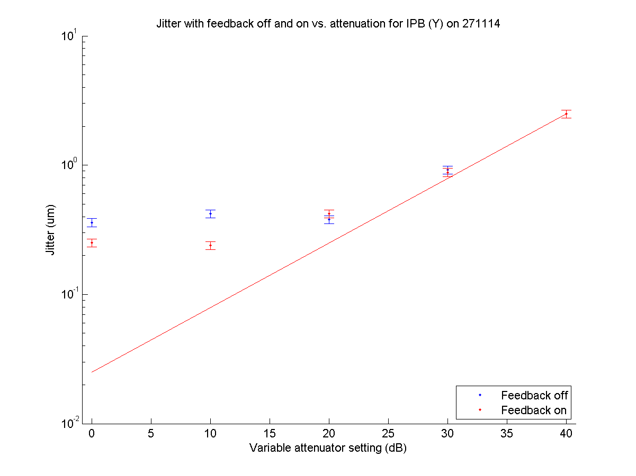
N. Blaskovic

Slide 30
Conclusion
2-BPM IP feedback successfully operated
Best stabilisation at witness (IPB): 130 nm
Typical stabilisation ~ 200 nm at 0 dB
Gain ratio as expected from geometry
>20 um incoming dynamic range at 10 dB
N. Blaskovic

Slide 31
Appendix
Interpolated vs. measured jitter at IPB
N. Blaskovic

Slide 32
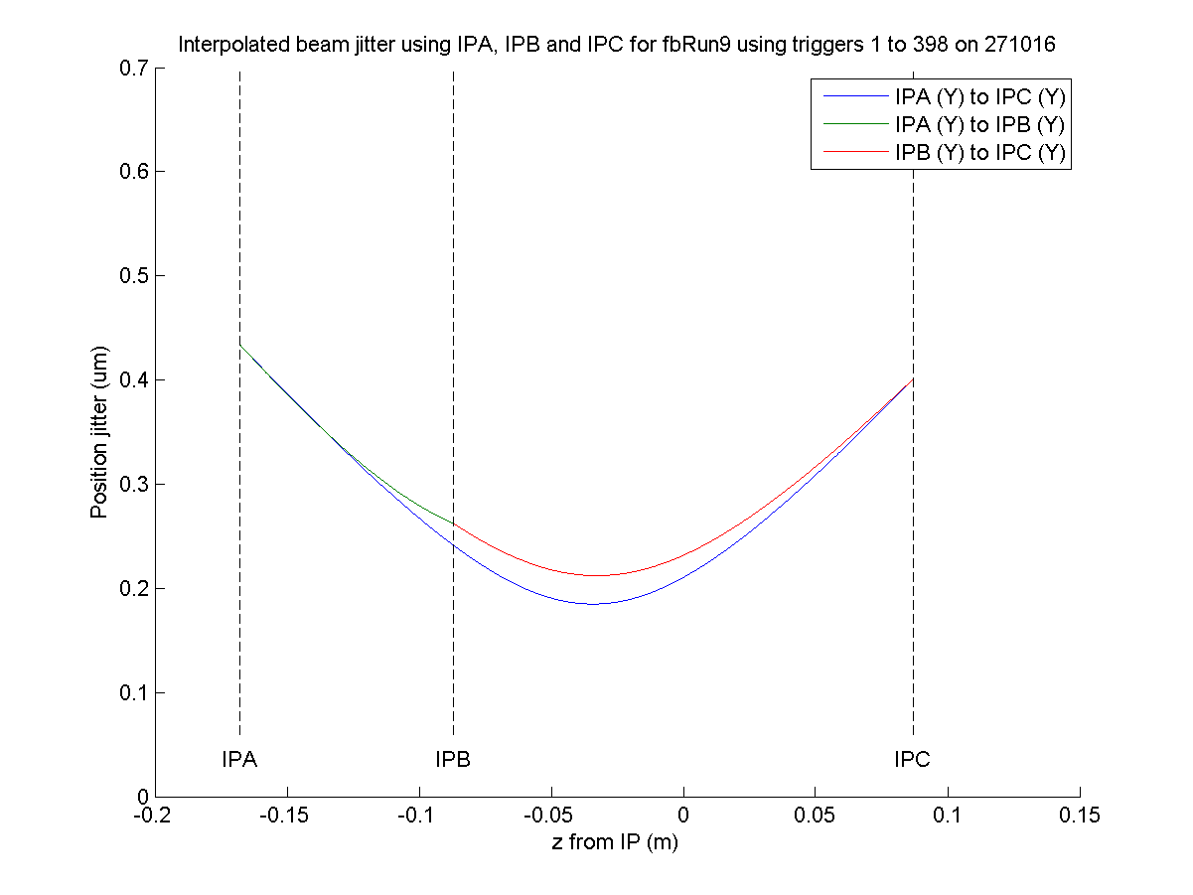
fbRun9
bunch 2
feedback off
Measured: 263 nm
Interpolated: 242 nm
N. Blaskovic

Slide 33
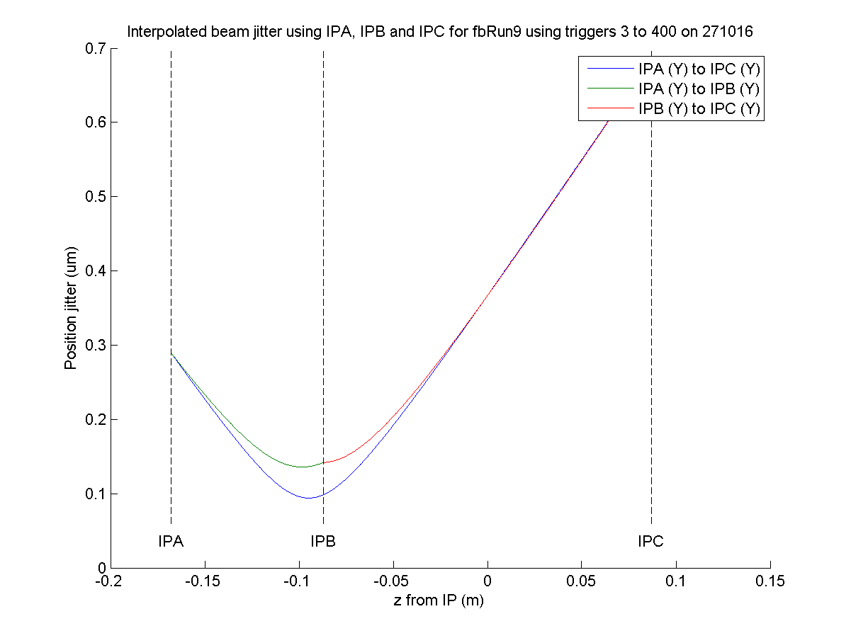
fbRun9
bunch 2
feedback on
Measured: 142 nm
Interpolated: 98 nm
N. Blaskovic

Slide 34
Appendix
Single-loop IP feedback at IPA with 0 dB
N. Blaskovic

Slide 35
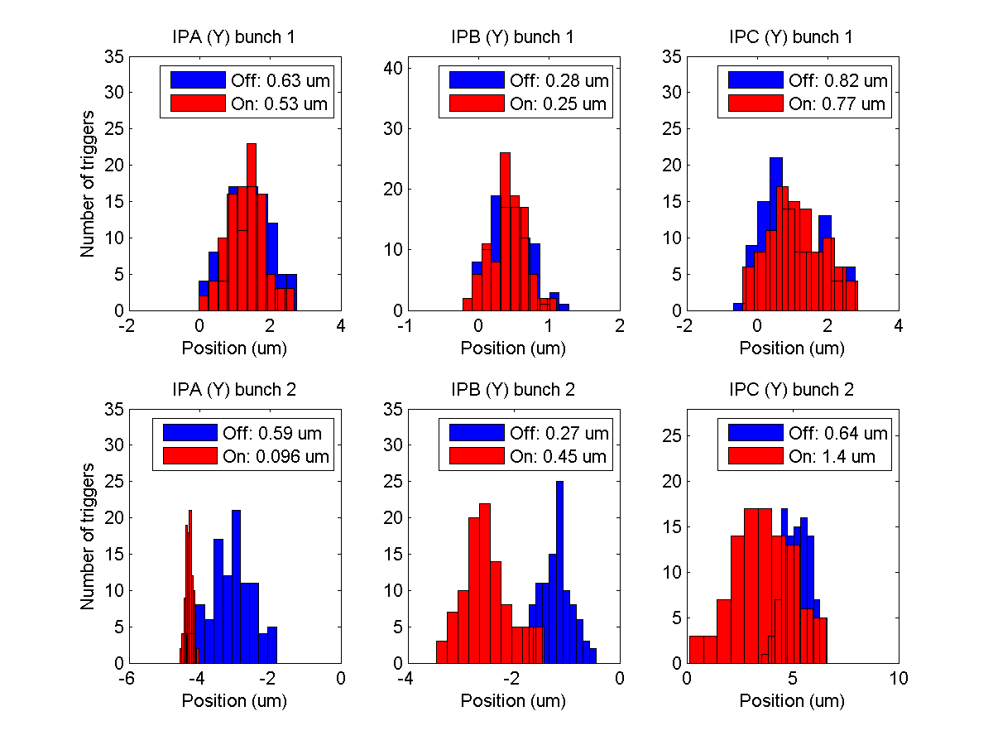
fbRun7
N. Blaskovic

