Slide 1

UK Calorimetry For ILC
(Digital Calorimetry)
Alasdair Winter
University Of Birmingham

Slide 2
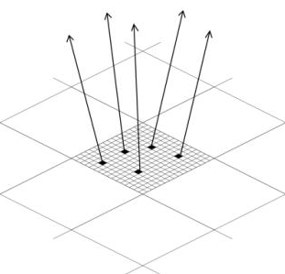
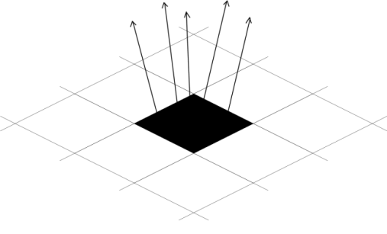
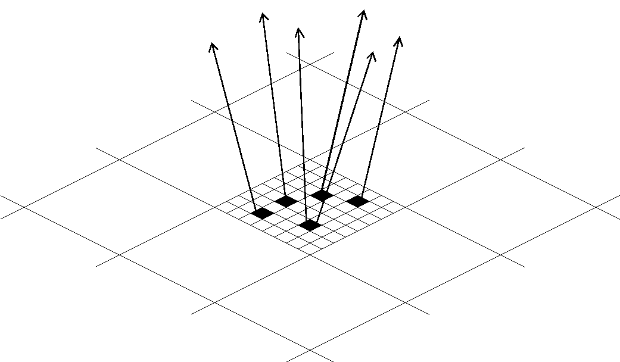
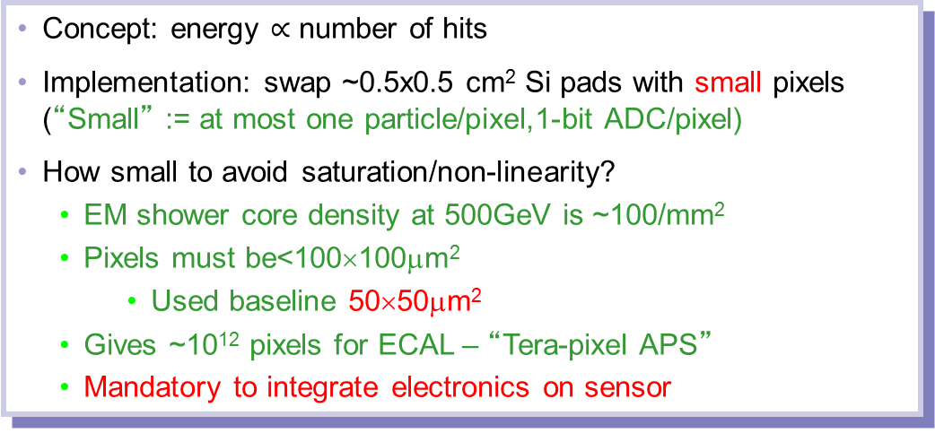
DECAL Concept - Reminder
Concept: energy $∝$ number of hits
Implementation: swap ~0.5x0.5 cm² Si pads with small pixels (“Small” := at most one particle/pixel,1-bit ADC/pixel)
How small to avoid saturation/non-linearity?
  EM shower core density at 500GeV is ~100/mm²
  Pixels must be<100×100μm²
    Used baseline 50×50μm²
  Gives ~10¹² pixels for ECAL – “Tera-pixel APS”
  Mandatory to integrate electronics on sensor
AECAL
DECAL N_{pixels}<N_{particles}
DECAL N_{pixels}=N_{particles}

Slide 3
Why DECAL?
Relies on CMOS MAPS technology
Mature, high volume industrial devices: no proprietary processes → reduced costs
Low(-ish) power, depending on duty cycle
Low material budget, can be very thin
Radiation hard (~ 5Mrad)
  Already OK for ILC, but not for other applications, e.g. HL-LHC, FCC(h)
Very granular (pixels ~25um), offers potential benefits for particle flow
Potential single technology choice across both tracker and calorimetry
Diminishes effect of angular distribution of particles

Slide 4
A brief history of decal…

Slide 5
History of UK Calorimetry for LC
Concentrating on niche UK interests given effort
Most novel aspect is DECAL
Reminder
  (from 2005) digital calorimetry (CALICE)
  Followed by SPIDER
  Arachnid (generic detector and ALICE ITS)
  Main sensors for calorimetry were TPAC (engineering run, sensors 28k pixels, 50x50μm^{2,} epitaxial layer thickness 12/18μm)
  CHERWELL (MPW, tracking and vertexing, and some DECAL components)

Slide 6
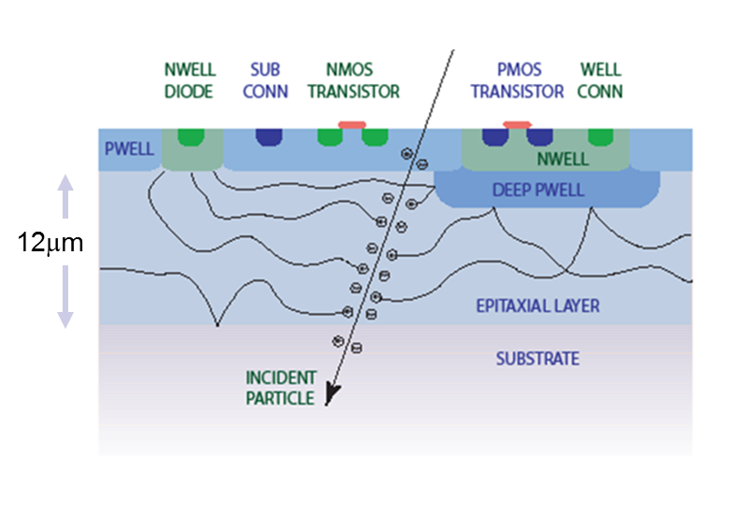
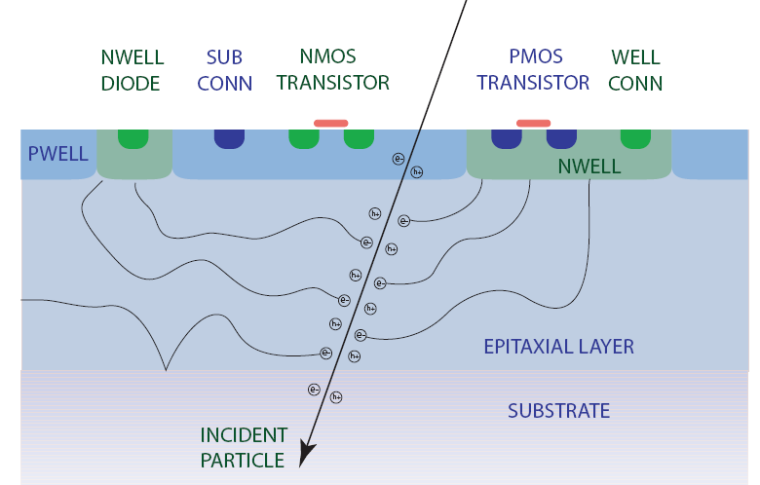
Key Innovations- INMAPS Process
Standard CMOS
CMOS with INMAPS

Slide 7

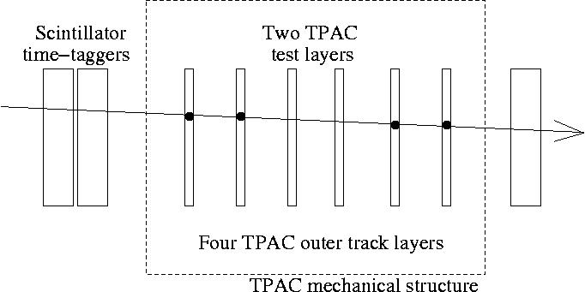
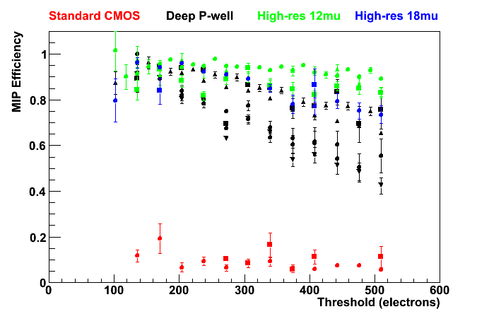
MAPS, MIP Efficiency
2 TPAC test sensors
Project tracks to individual test sensors
Check for sensor hits as function of track (x,y) position relative to pixel centre
Determine efficiency by fitting distribution
scintillators
4 TPAC track sensors
Efficiency for 4 sensor variants, from CERN (Aug.’09, 120 GeV π) and DESY (Mar.’10, 1-5 GeV e⁻) testbeams
Standard CMOS sensors have low efficiency due to signal absorption by circuit elements
Deep p-well (INMAPS) reduces signal absorption, raises efficiency by factor ~5
(12μm) high-resistivity epitaxial layer raises efficiency by further factor ~x2
Preliminary 2009/10 testbeam data
Notes:
Remember to mention high-resistivity epi too

Slide 8
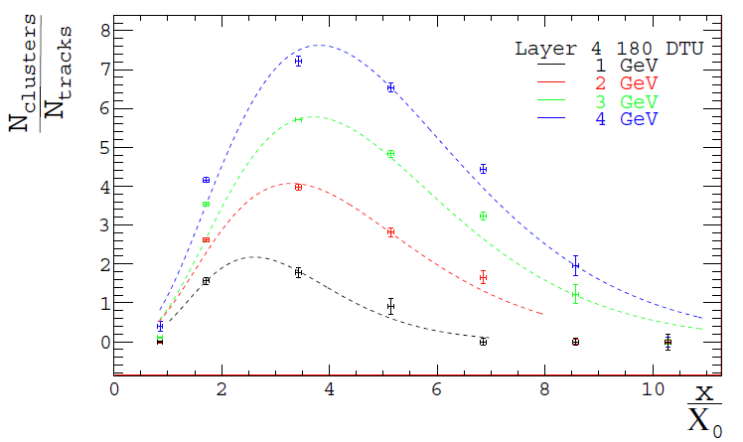
MAPS for DECAL, (~)Shower Profile
2 TPAC test sensors
Project tracks to individual test sensors
Vary depth of absorber thickness, study downstream hit multiplicity
Purely to cut cost – not ideal
scintillators
4 TPAC track sensors
Study TPAC sensors as “calorimeter” layer
Peak of sensor activity vs. depth of material
Single sensor study of EM shower response
Electron beam shows expected log behaviour
(NB: single sensor transverse size)
# clusters/# tracks
Absorber thickness (X₀)

Slide 9
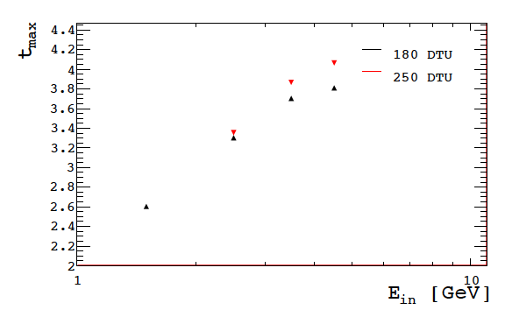
MAPS for DECAL, (~)Shower Profile
2 TPAC test sensors
Project tracks to individual test sensors
Vary depth of absorber thickness, study downstream hit multiplicity
Purely to cut cost – not ideal
scintillators
4 TPAC track sensors
Shower max. depth (X₀)
Incident e⁻ energy (GeV)

Slide 10
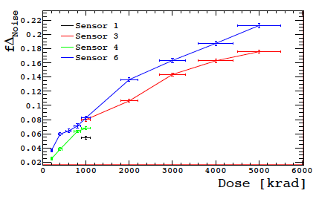
Radiation hardness testing
Potential use of TPAC sensor technology in high radiation environments such as tracking and vertex systems
Need to understand sensor’s response/tolerance
Multiple sensors tested, 50 keVγ
Sensors held at 0 V and 1.8 V
Exposures between 0.2-5.0 Mrad
Mean noise and pedestal of the pixels tested after each dose
Conclusion: rad. Hard enough for use in ILD (CLIC ILD or ILC ILD)
Fractional increase in noise,
Non-biased sensors (@60rad/s)
Acceptable noise increase to ~5 MRad
T Price et al, First radiation hardness results of the TeraPixel Active Calorimeter (TPAC) sensor, 2013 JINST 8 P01007,doi:10.1088/1748-0221/8/01/P01007

Slide 11
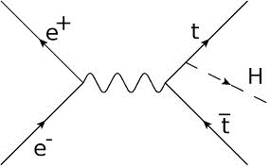
Pre-2015 studies
Full Mokka, DBD vintage
Compare SiECAL with DECAL in ttH study
Multi-jet performance
Detector model ILD_01_v02
Only parameters changed were
  Cell sizes reduced to 50x50μm²
  Sensitive epi thickness to 12μm (as in TPAC sensor)
  Digital readout turned on in PandoraPFA
Minimal change in performance
  Individual quantities and “bottom line” for ttH analysis
  All details in Tony Price thesis and papers:
Study semileptonic channel
6 hadronic jets, 1 charged lepton, neutrino
Good test of PFA impact of ECAL
MVA-based removal of ttZ, tt, ttbb backgrounds
T. Price, N. Watson, T. Tanabe, and V. Martin, Measurement of the top Yukawa coupling at sqrt(s)=1 TeV using the ILD detector LC-REP-2013-004, http://www-flc.desy.de/lcnotes/notes/LC-REP-2013-004.pdf
T. Price, P. Roloff, J. Strube and T. Tanabe, Full simulation study of the top Yukawa coupling at the ILC at sqrt(s) = 1 TeV, Eur. Phys. J. C (2015) 75:309

Slide 12
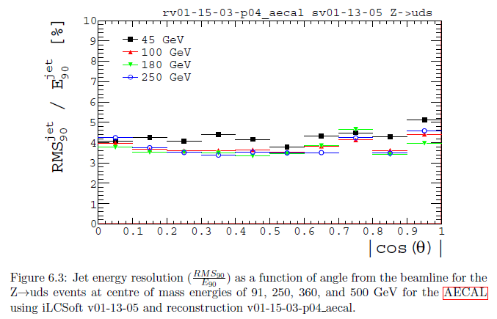
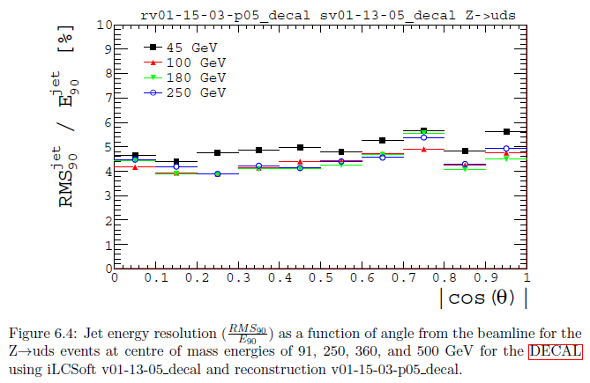
Pre-2015 studies
uds jets
Full Mokka, DBD vintage
Compare SiECAL with DECAL in ttH study
Multi-jet performance
Detector model ILD_01_v02
Only parameters changed were
  Cell sizes reduced to 50x50μm²
  Sensitive epi thickness to 12μm (as in TPAC sensor)
  Digital readout turned on in PandoraPFA
Minimal change in performance
  Individual quantities and “bottom line” for ttH analysis
  All details in Tony Price thesis ( and papers:
SiECAL
RMS₉₀(jet) (%)
DECAL
RMS₉₀(jet) (%)

Slide 13
New Developments…

Slide 14
For Calice
  Birmingham (Nigel, Alasdair Winter, Tony Price, +), Sussex (Fabrizio Salvatore, Tom Coates, +), RAL,+
  Concentrate on niche area where we could make some impact
  Opportunity to clarify (or abandon) future of DECAL
  Thomas Peitzmann’s group (Utrecht/Alice), also members of CALICE
  Genuinely complementary activities – but some competition
  UK groups will investigate “show-stoppers” for DECAL principle
  Assume no sensor we have at present would be used after 2016
  Modest studies still going on for DECAL in specific areas
    Power consumption (duty cycle - “no harm” tests)
    Pixel ganging (exploit tracker technology)
    Preparing to characterise DECAL parts of CHERWELL sensor

Slide 15
Back on the map!!
DECAL!!!

Slide 16
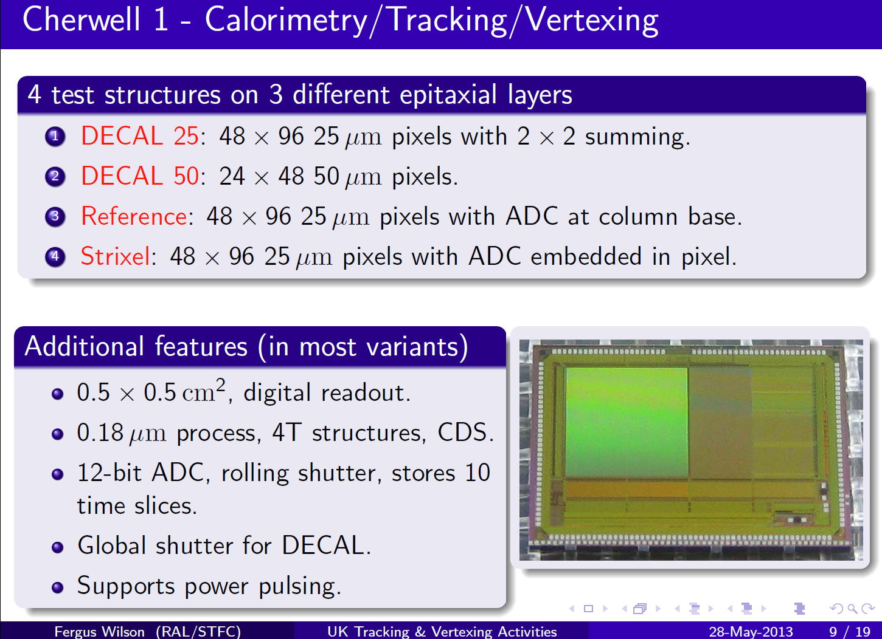
Cherwell Overview
See Fergus Wilson’s talk, ECFA LC 2013, DESY, for generic MAPS/silicon R&D in UK
Notes:
Remember to mention Fergus work

Slide 17
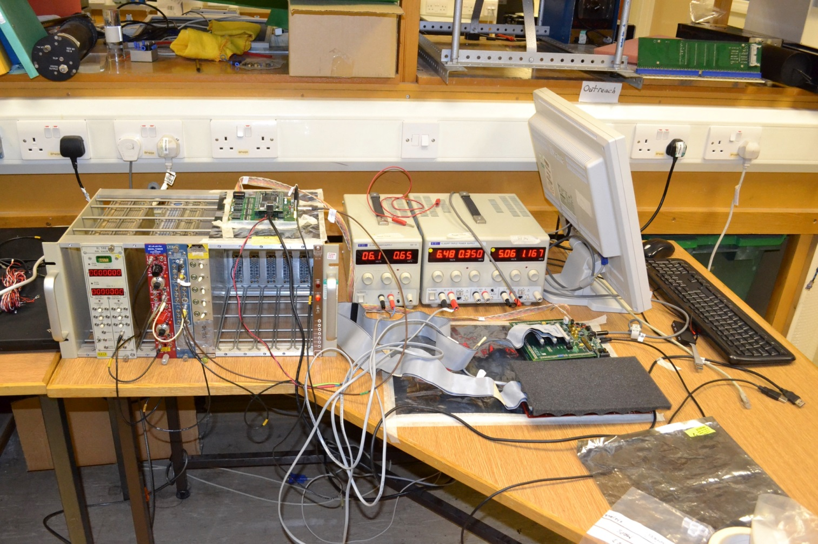
Test stand at Bham

Slide 18
Cooling and power
Cooling for the ECAL is a general issue
Compared to analog pad ECAL
  Factor 10³-10⁴ more Channels
  Factor ~10 more power
Power Savings due to duty cycle (1%)
Target Value for existing ECAL ASICS
  4 µW/mm2
Last measured (years ago) consumption of MAPS ECAL:
  40 µW/mm2 depending on pixel architecture
  TPAC1 not optimized at all for power consumption
Advantage: Heat load is spread evenly
Aim: characterise for noise/source/laser
Study impact of variable duty cycle (firmware controlled), how close to 1% can we go?
Some difficulties with firmware, designer at DL, no longer with STFC, work in progress
In the mean time….
Notes:
Check these number

Slide 19
Simulation Studies
Adapted from Mokka 08-05, SECAL04
  Cell sizes set to 50x50μm²
  Sensitive epi thickness set to 12μm
  Guard rings removed for now
Many studies to perform:
  Energy Resolution
  Linearity
  Design Optimization
    Pitch
    Sensitive epi layer thickness
    Material choices
Effect of added realism: charge spread, clustering etc….

Slide 20
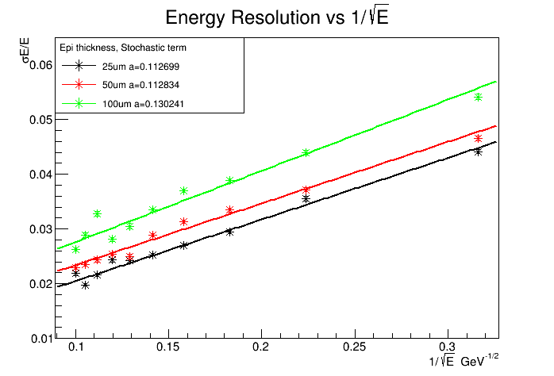
Energy Resolution
Resolution, Pixel Pitch
13.0%, 100um
11.3%, 50um
11.3%, 25um

Slide 21
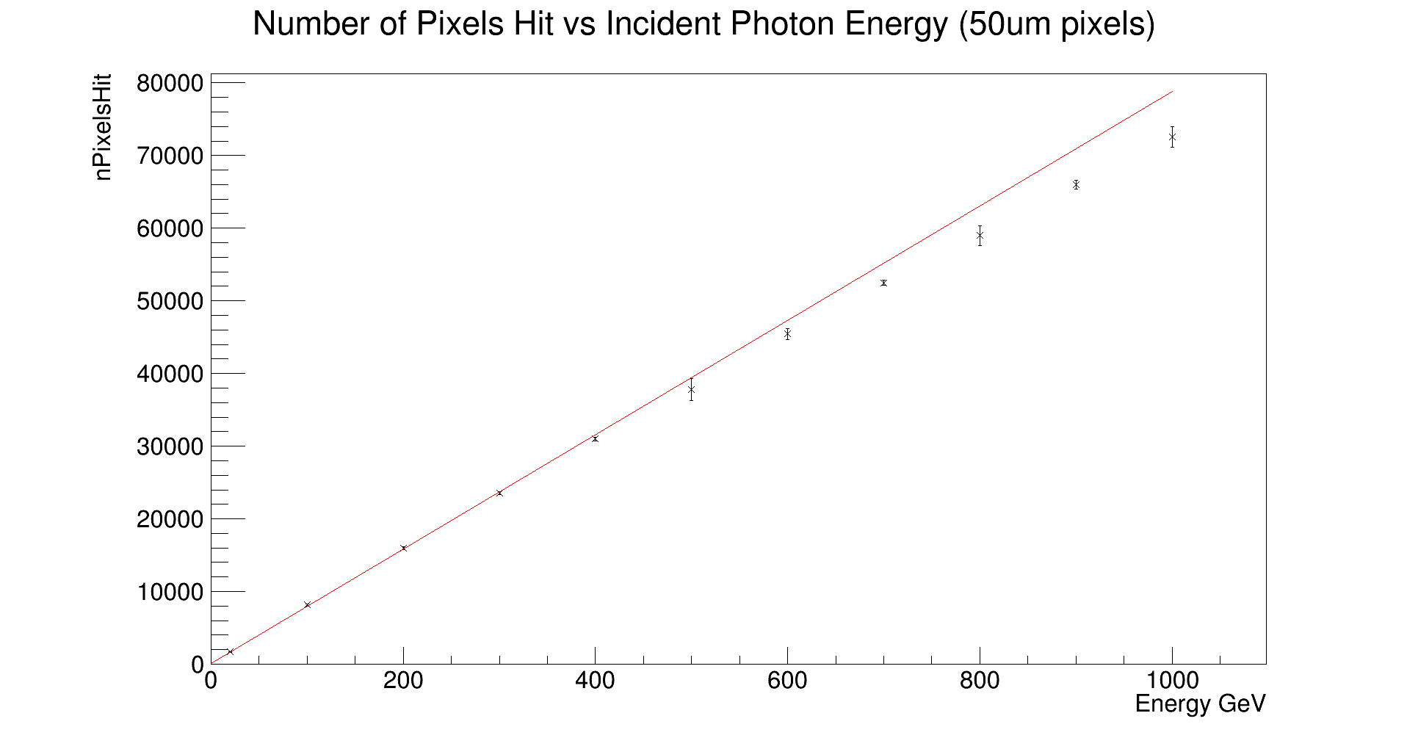
Linearity
Linear
Non-Linear
ILC Beam Energy
Notes:
Remind that this is a huge extension from previous work where max was ~6GeV

Slide 22
DigiMAPS Package
Tool for adding additional levels of realism to simulations
Developed for CALICE in 2008 by Anne-Marie Magnan (Imperial,CMS), adapted by Birmingham group for recent studies
Accounts for numerous effects not dealt with by Mokka:
  Charge spread
  Dead space
  Clustering
  Noise
  Threshold spread

Slide 23
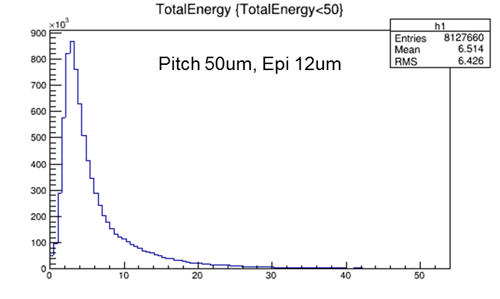
Energy Distribution Per Pixel
Energy Deposited (keV)

Slide 24
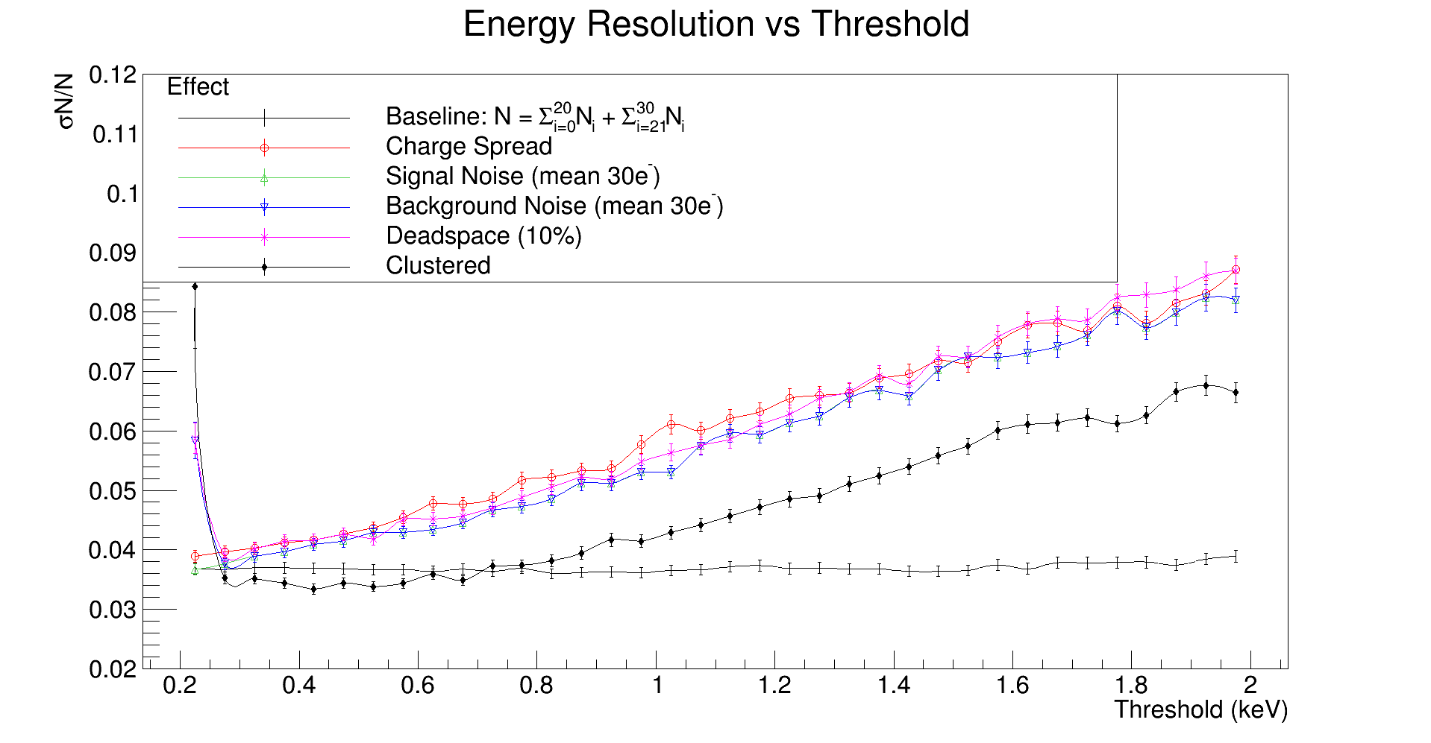
Effect of additional realism
Stable resolution for wide range of thresholds

Slide 25
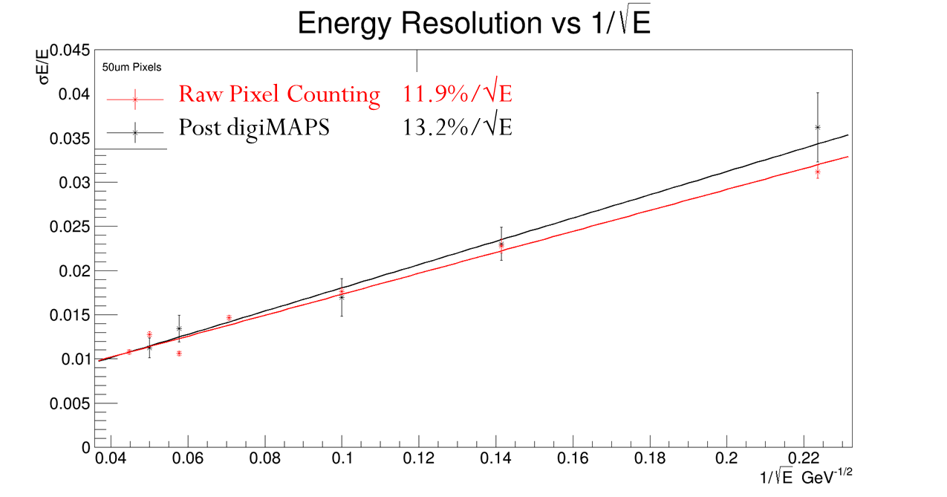
DigiMAPS:
Impact on energy resolution
Full MOKKA Simulation with DECAL adaptation of ECAL04 (digital readout of 50x50um pixels)
Single particle resolution degraded as expected but by only 1.3%/√E

Slide 26
Concerns over aspect ratio
Good Situation
Bad Situation

Slide 27
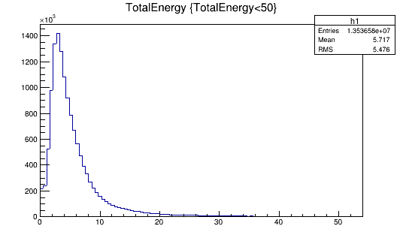
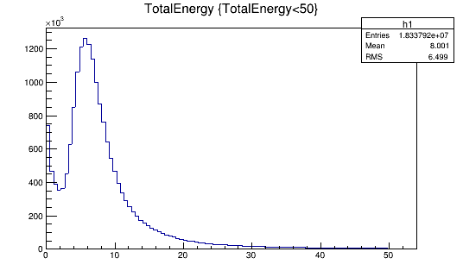
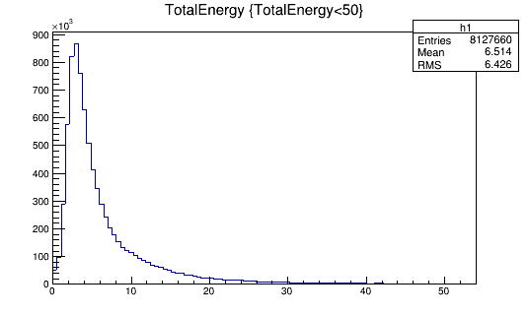
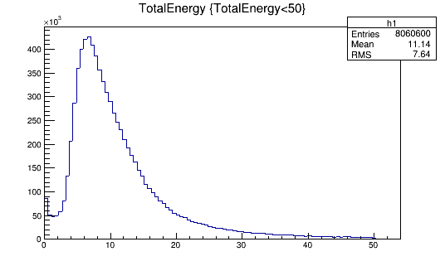
Concerns over aspect ratio
Pitch 25um, Epi 12um
Pitch 25um, Epi 25um
Energy Deposited (keV)
Energy Deposited (keV)
Pitch 50um, Epi 12um
Pitch 50um, Epi 25um
Energy Deposited (keV)
Energy Deposited (keV)

Slide 28
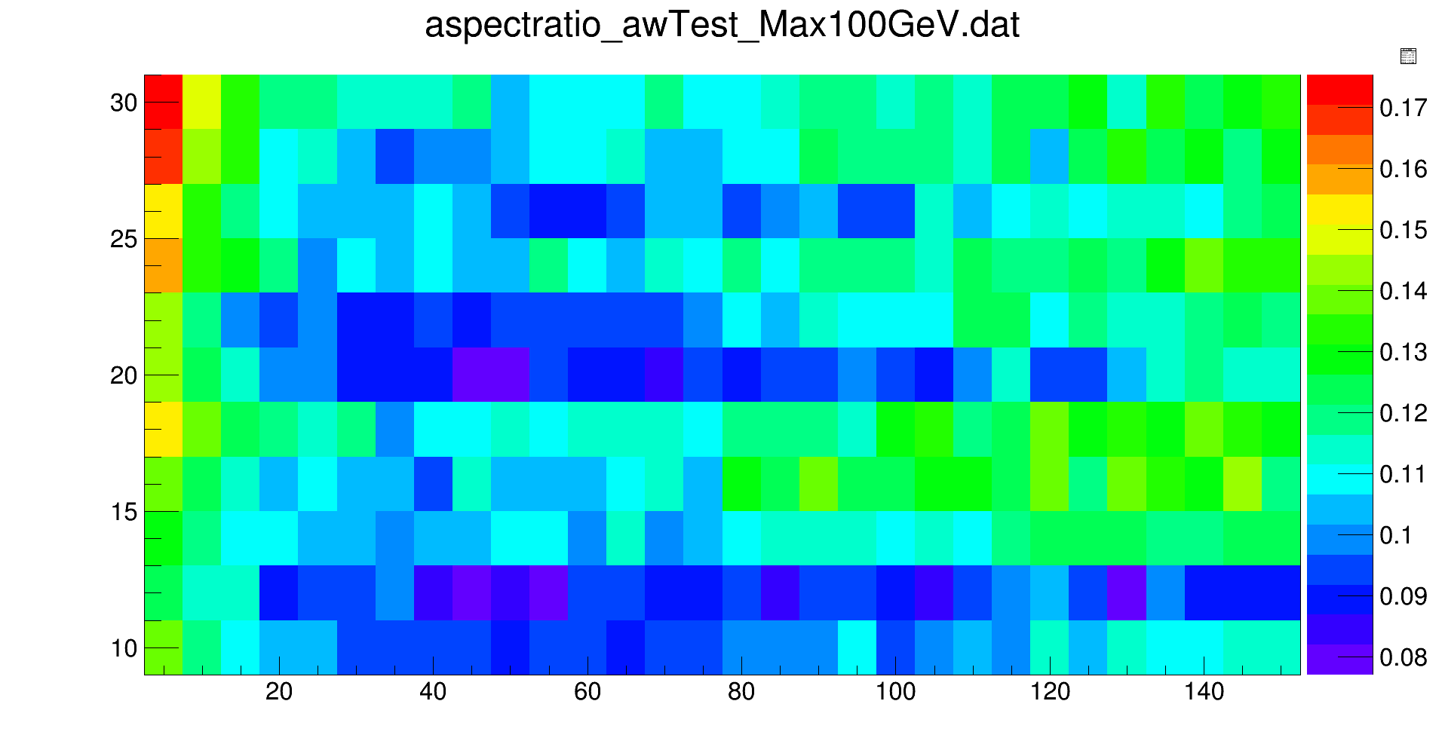
Energy Resolution:
Pixel Pitch vs Epi Thickness
Epi
Thickness
(µm)
NO THRESHOLD APPLIED HERE (YET)!
Pixel Pitch (µm)

Slide 29
Rad-hard maps proposal
New opportunity
  Motivated by FCC(h), HL-LHC, ILC/CLIC
  Fully monolithic device that is rad hard has many potential applications
Includes ILC, even though we don’t need rad-hard parts, new sensor line
  Project started June 2016
Large focus on reconfigurability

Slide 30
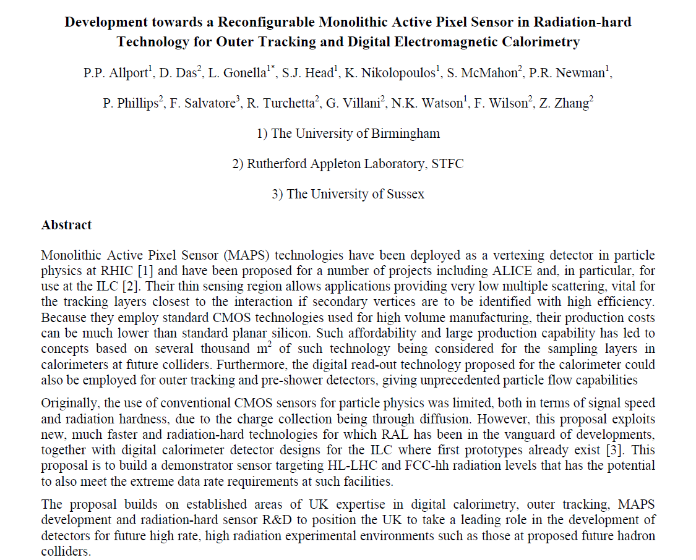

Slide 31
Absorber Material: is tungsten best?

Slide 32
Conclusions
UK calorimetry efforts are increasing!
Focus remains on DECAL concept
Reintegrating with CALICE collaboration
TPAC test beams showed proof of concept and radiation hardness of ~5MRad, sufficient for ILC/CLIC
Predicted energy resolution of ~13% with linearity to >250GeV
Power-pulsing and pixel grouping to be investigated with CHERWELL sensors
Rad Hard MAPS project offers opportunity to produce new test structures for further studies
Design optimization underway with preliminary results suggesting ~50um pitch, ~20um epi

Slide 33
Backup slides

Slide 34
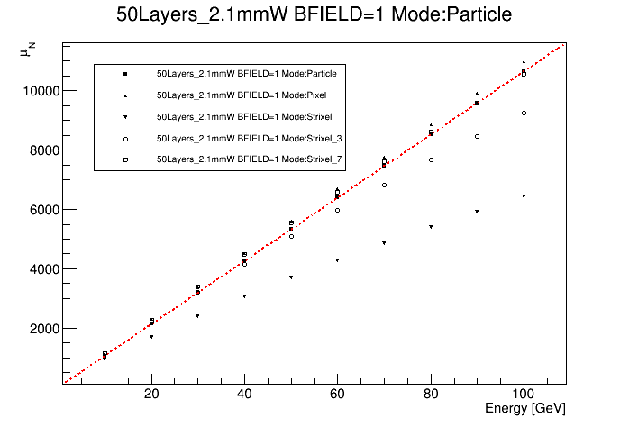
Linearity
Counts are for Pad mode with number of hits per column restricted to 1,3,or 7
Red dashed line is number of particles, want to be as close to this as possible
3 hits per column shows non linearities above 50 GeV, 7 hits mitigates this.

Slide 35
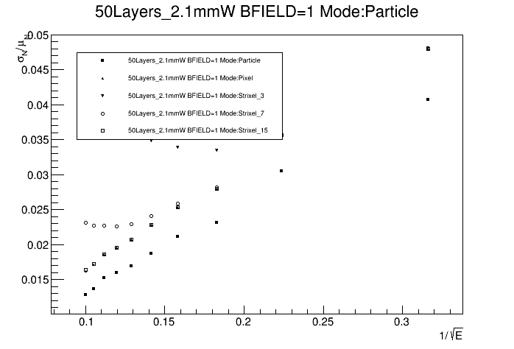
Resolution with 15 hits per Column
Same dataset as previous slide but showing that allowing 15 hits per column would yield and excellent energy resolution up to 100 GeV
Iain asked what the impact of larger pixels (60um pitch) to allow this was on the resolution

Slide 36
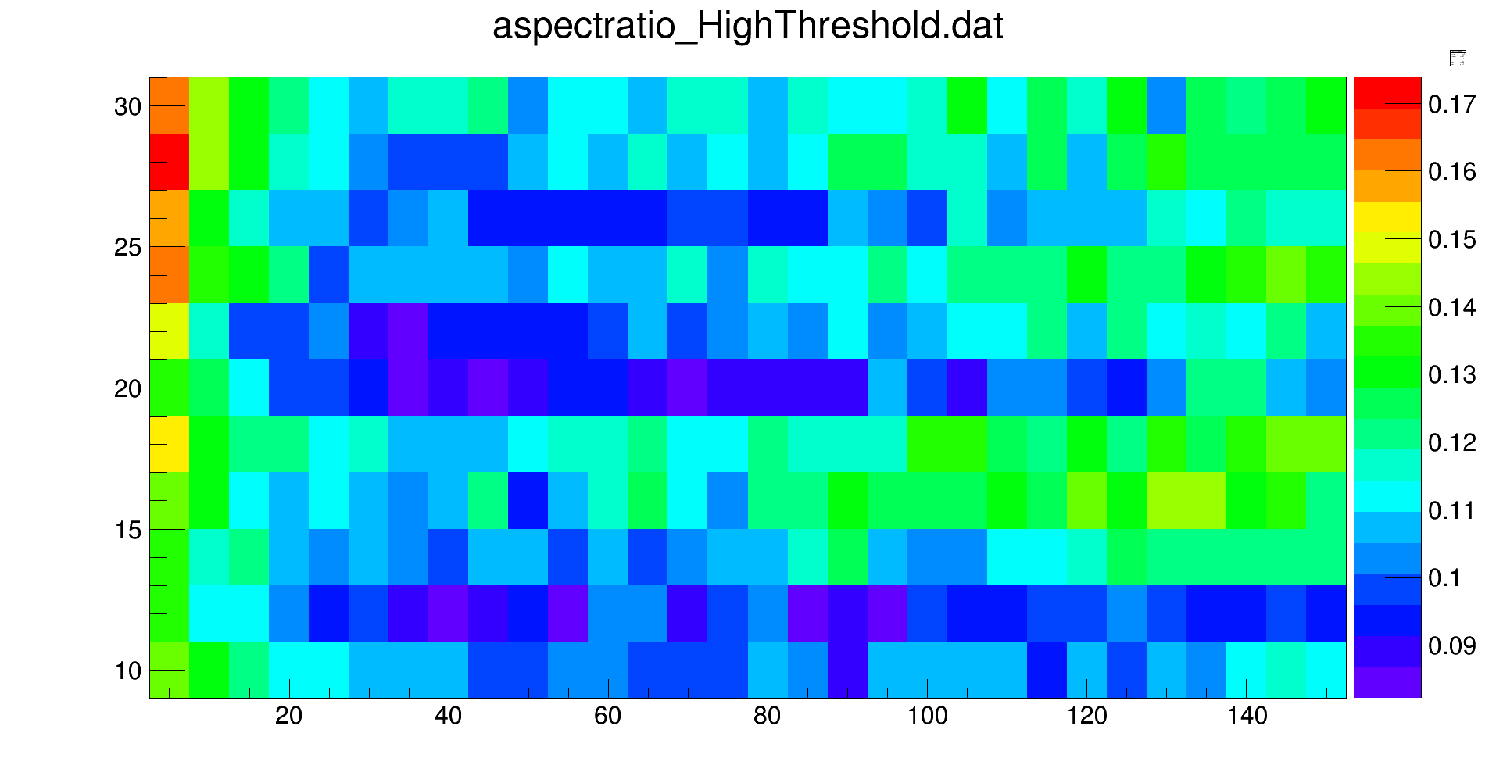
Threshold 1.8keV

Slide 37
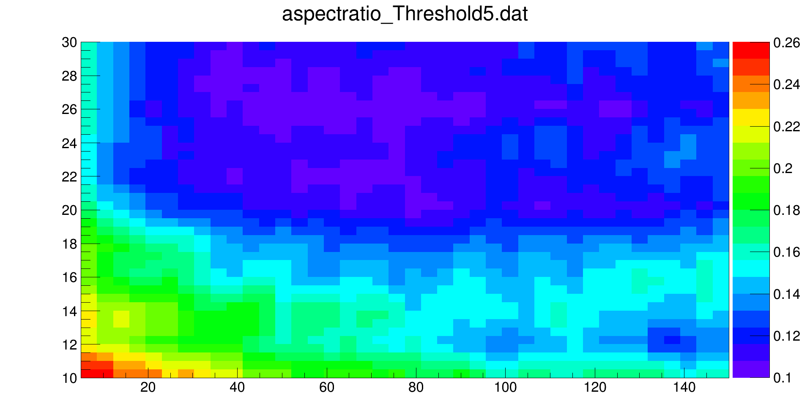
Threshold 5keV

