Slide 1
Further Resolution Analysis
Oct 2016
N. Blaskovic, T. Bromwich, R. Ramjiawan

Slide 2
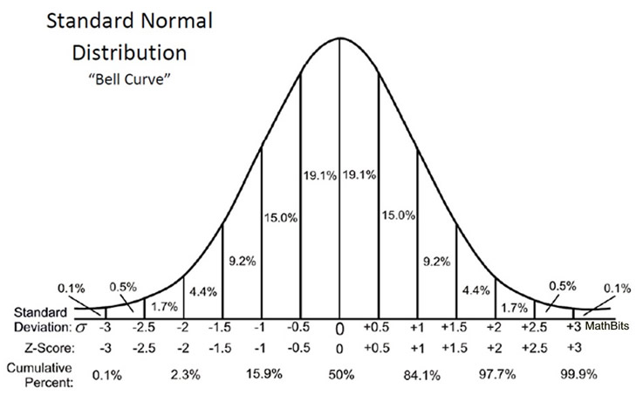
Sub-dividing Data Sets
After combining seven consecutive feedback runs I separated the data based on position information.

Slide 3
Sub-division cutting on A
Files: AQD0FF scan – 5. FB Run – 6 to 13. 1557 triggers total.
IQ Samples: 12:20, Reference Sample: 21.
Mixed fitting to I’/q.
Resolution (um)
Below -1s.d -1s.d to -0.5s.d -0.5s.d to 0s.d 0s.d to 0.5s.d 0.5s.d to 1s.d Above 1s.d

Slide 4
Sub-division Cutting on B
Files: AQD0FF scan – 5. FB Run – 6 to 13. 1557 triggers total.
IQ Samples: 12:20, Reference Sample: 21.
Mixed fitting to I’/q.
Resolution (um)
Below -1s.d -1s.d to -0.5s.d -0.5s.d to 0s.d 0s.d to 0.5s.d 0.5s.d to 1s.d Above 1s.d

Slide 5
Sub-division Cutting on C
Files: AQD0FF scan – 5. FB Run – 6 to 13. 1557 triggers total.
IQ Samples: 12:20, Reference Sample: 21.
Mixed fitting to I’/q.
Resolution (um)
Below -1s.d -1s.d to -0.5s.d -0.5s.d to 0s.d 0s.d to 0.5s.d 0.5s.d to 1s.d Above 1s.d

Slide 6
Calibration Constant with Attenuation
Files: AQD0FF scans – 8, 7, 9, 10,11. Jit Run – 13, 10, 14. FB Run – 23, 24.
IQ Samples: 12:20, Reference Sample: 21.

Slide 7
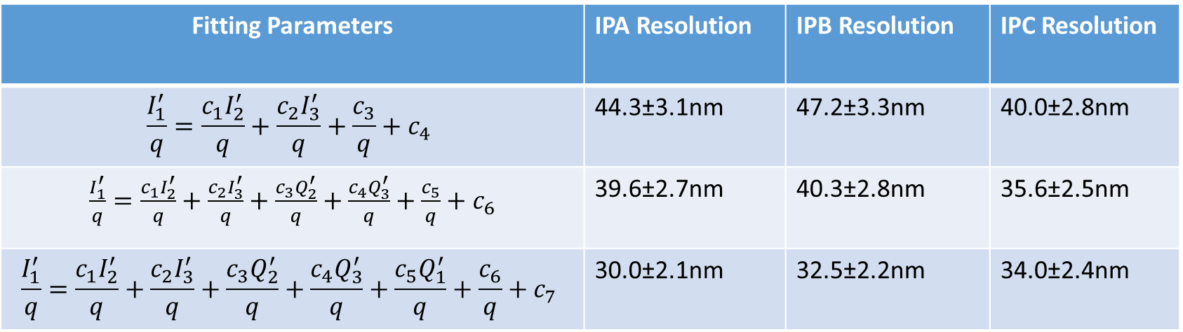
Resolution: Fitting to Self Q Prime
Calibration File: AQD0FFyScan5_0dB (271016 owl shift).
Jitter File: fbRun9_Board2_281016.
194 triggers, analysing bunch one.
I and Q signal sample numbers used: 12:20, reference signal sample used: 21.
Geometric method resolution: 47.9±3.6 nm.
Fitting Parameters | IPA Resolution | IPB Resolution | IPC Resolution
$$\frac{I_{1}^{′}}{q}=\frac{c_{1}I_{2}^{′}}{q}+\frac{c_{2}I_{3}^{′}}{q}+\frac{c_{3}}{q}+c_{4}$$ | 44.3±3.1nm | 47.2±3.3nm | 40.0±2.8nm
$\frac{I_{1}^{′}}{q}=\frac{c_{1}I_{2}^{′}}{q}+\frac{c_{2}I_{3}^{′}}{q}+\frac{c_{3}Q_{2}^{′}}{q}+\frac{c_{4}Q_{3}^{′}}{q}+\frac{c_{5}}{q}+c_{6}$ | 39.6±2.7nm | 40.3±2.8nm | 35.6±2.5nm
$$\frac{I_{1}^{′}}{q}=\frac{c_{1}I_{2}^{′}}{q}+\frac{c_{2}I_{3}^{′}}{q}+\frac{c_{3}Q_{2}^{′}}{q}+\frac{c_{4}Q_{3}^{′}}{q}+\frac{c_{5}Q_{1}^{′}}{q}+\frac{c_{6}}{q}+c_{7}$$ | 30.0±2.1nm | 32.5±2.2nm | 34.0±2.4nm

Slide 8
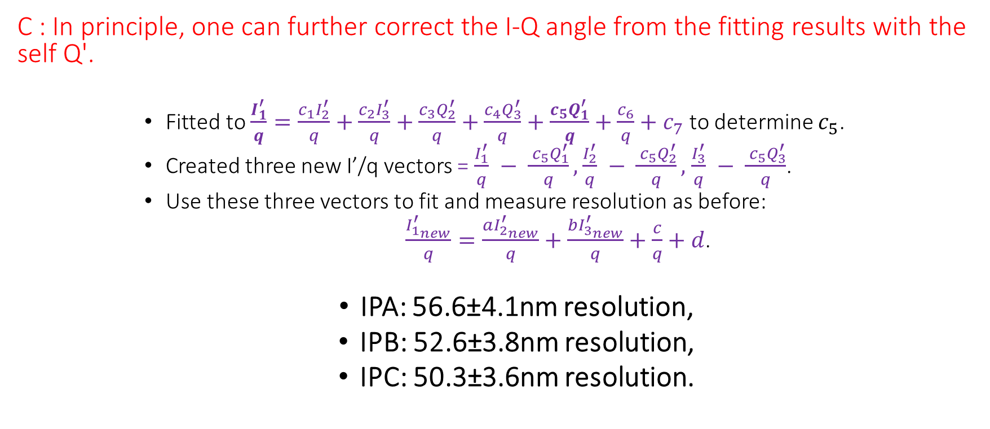
Tauchi-san’s Resolution Questions
C : In principle, one can further correct the I-Q angle from the fitting results with the self Q'.
      Fitted to $\frac{I_{1}^{′}}{q}=\frac{c_{1}I_{2}^{′}}{q}+\frac{c_{2}I_{3}^{′}}{q}+\frac{c_{3}Q_{2}^{′}}{q}+\frac{c_{4}Q_{3}^{′}}{q}+\frac{c_{5}Q_{1}^{′}}{q}+\frac{c_{6}}{q}+c_{7}$ to determine $c_{5}$.
      Created three new I’/q vectors = $\frac{I_{1}^{′}}{q} − \frac{ c_{5}Q_{1}^{′}}{q},$ $\frac{I_{2}^{′}}{q} − \frac{ c_{5}Q_{2}^{′}}{q},$ $\frac{I_{3}^{′}}{q} − \frac{ c_{5}Q_{3}^{′}}{q}$.
      Use these three vectors to fit and measure resolution as before:
      $\frac{I_{1_{new}}^{′}}{q}=\frac{aI_{2_{new}}^{′}}{q}+\frac{bI_{3_{new}}^{′}}{q}+\frac{c}{q}+d$.
  IPA: 56.6±4.1nm resolution,
  IPB: 52.6±3.8nm resolution,
  IPC: 50.3±3.6nm resolution.

Slide 9
Appendix

Slide 10
Tauchi-san’s Questions
C : It may be interesting to see any correlation of Q' between IPA, IPB and IPC, since Q' shows the angle of the beam in principle.
Q : How much are the beam sizes at IPA, IPB and IPC ?
Q : Are the beam angles (Q') zero at IPA, IPB and IPC ? If not, how much are they (Q') ?
Q : How much are errors of the position jitters to see the significance?
Q : How much are errors of the correlations to see the significance?
Q : How much is the angle jitters measured by the Q' signals assuming the conversion coefficient of 3.2um/mrad ?
Q : Are the average of Q' signals centered at 0, i.e. zero angle ?
C : In principle, one can further correct the I-Q angle from the fitting results with the self Q'.
Q : Assuming the above fine adjustments, can you calculate the correlations and the angle jitters ?

