Slide 1
Bunch-to-bunch correlation
N. Blaskovic, T. Bromwich, R. Ramjiawan

Slide 2
Outline
Poor bunch-to-bunch correlation (<90%) was measured at IP BPMs B and C in the October run, despite very good correlation measured at A.
Plot bunch-to-bunch position correlation as a function of sample number at the three BPMs.
The following slides show results from fbRun9 at 0dB. Consistent patterns observed for all files analysed (fbRun6 → fbRun13)

Slide 3
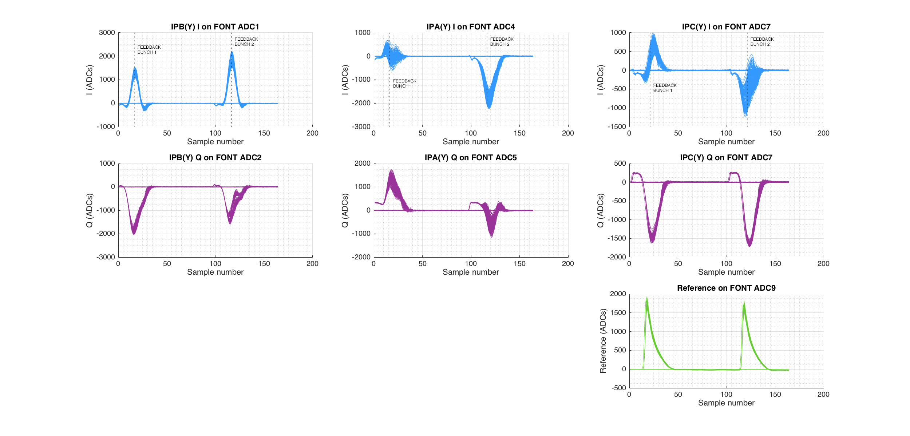
Waveforms for fbRun9
All previous bunch-to-bunch correlation calculations (and feedback) used bunch 1 sample 16 for A and B, and sample 21 for C. (Samples 116 and 121 used for bunch 2).
Reference samples 21 and 121.

Slide 4
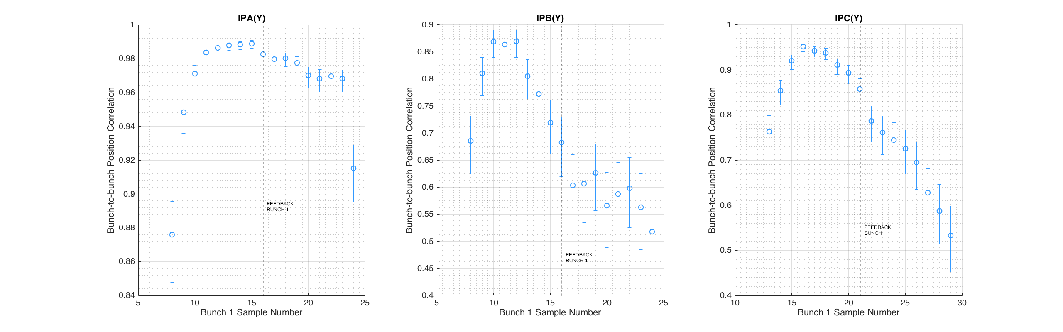
Bunch-to-bunch position correlation fbRun9
All previous bunch-to-bunch correlation calculations (and feedback) used bunch 1 sample 16 for A and B, and sample 21 for C, shown on plots with dashed line. (Samples 116 and 121 used for bunch 2).
Reference samples 21 and 121 used throughout. Bunch 2 sample number adjusted to always 100 more than bunch 1 sample number.

Slide 5
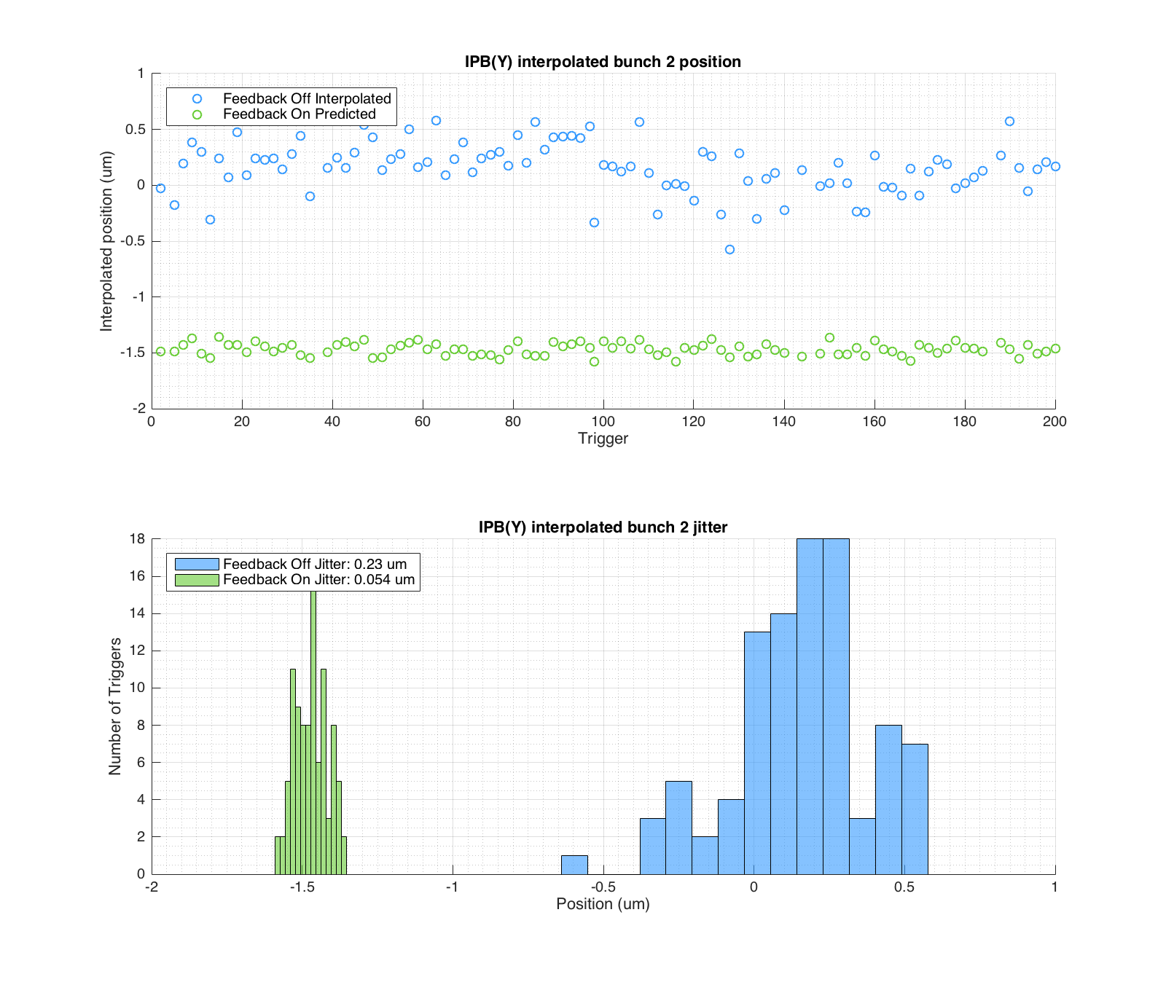
Interpolated feedback performance
Re-sample feedback OFF data from IPA and IPC at sample numbers with improved bunch-to-bunch position correlation: IPA: Sample 12 IPC: Sample 17
Interpolate the position at IPB. Plot interpolated position and histogram for interpolated position jitter (blue).
Use two-BPM feedback calculation to predict the feedback ON positions at IPB, assuming optimal gain.
Plot predicted corrected position at IPB and histogram for predicted corrected jitter at IPB (green).
Predicts two-BPM feedback could correct to 54nm.

Slide 6
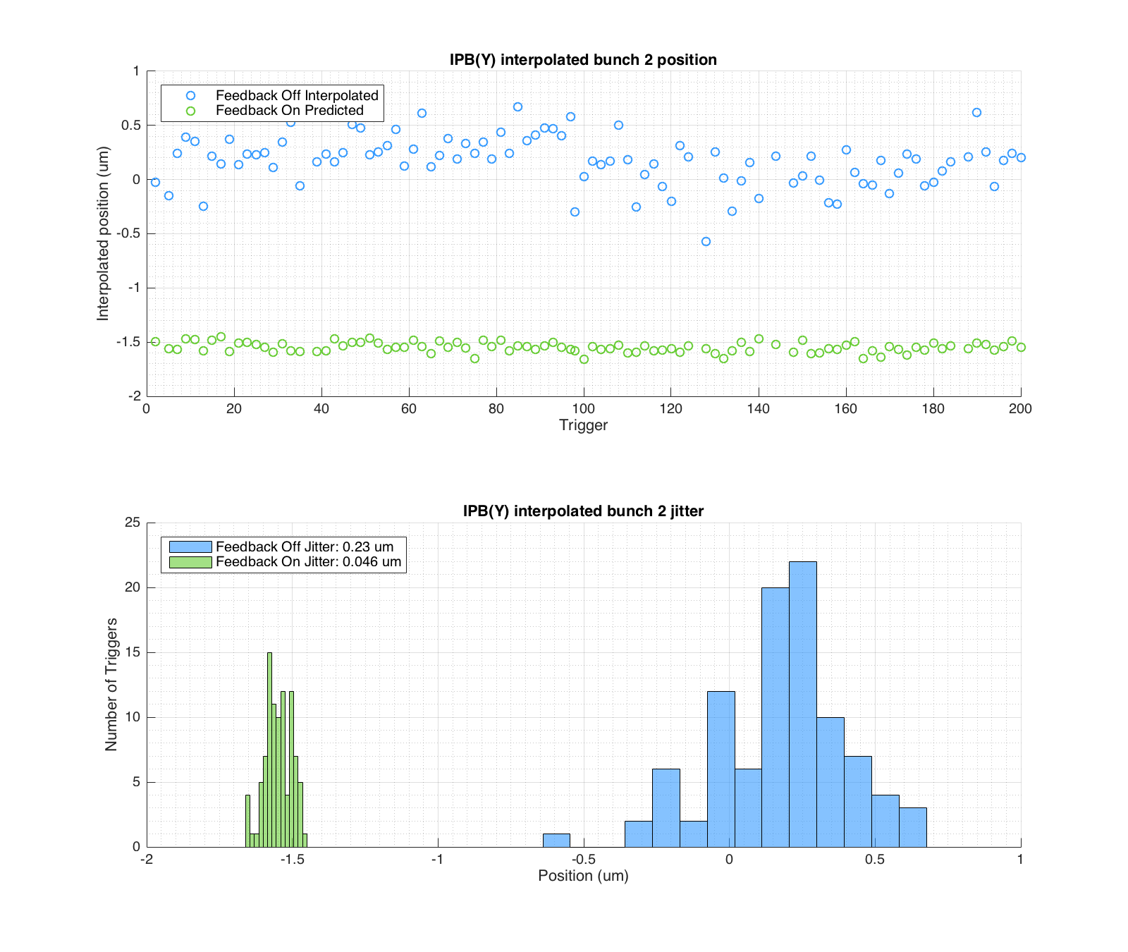
Interpolated feedback performance
If you ignore the 5 sample delay between IPA and IPC, and just select samples on the basis of best bunch-to-bunch correlation:
IPA: Sample 15 IPC: Sample 16
Predicts two-BPM feedback could correct to 46nm.

Slide 7
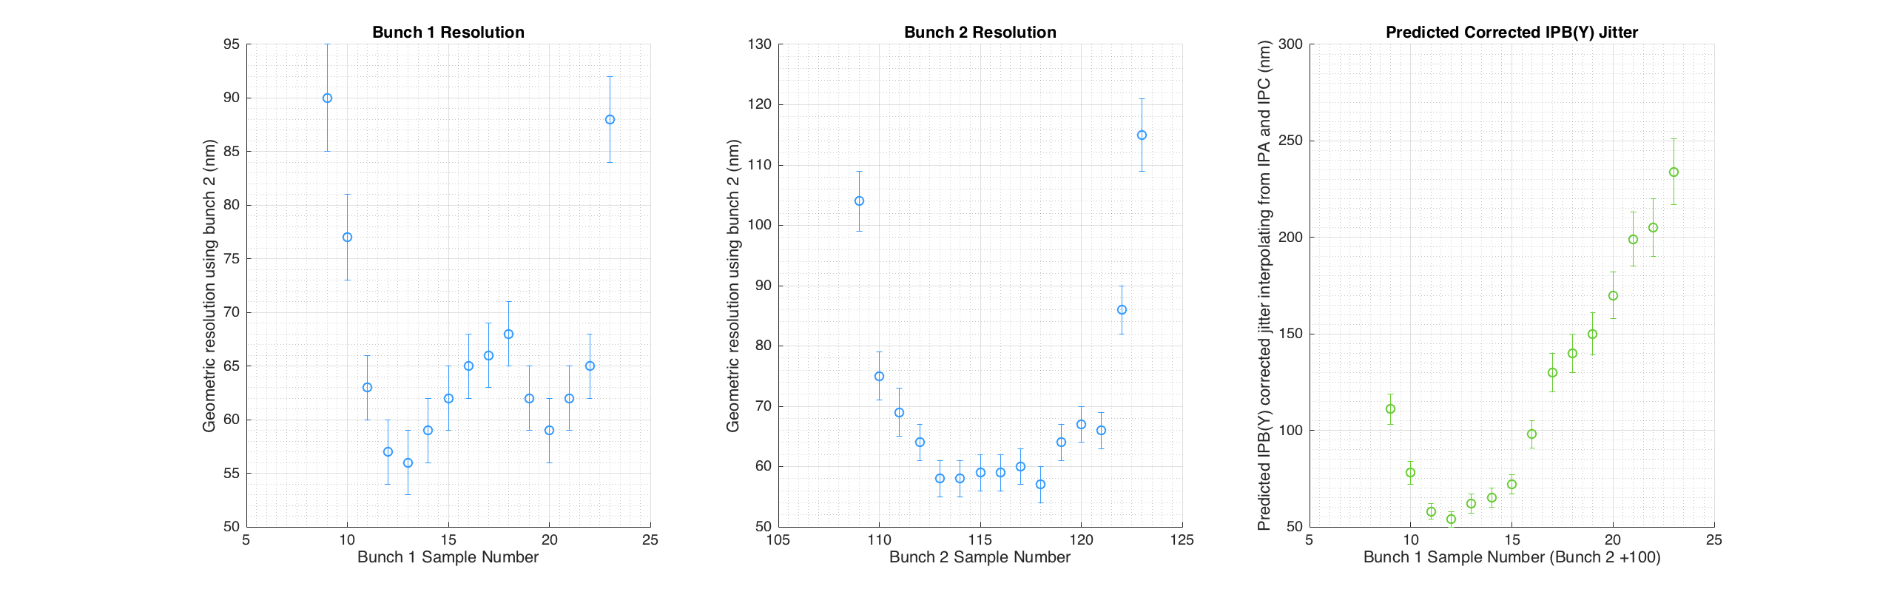
Resolution and predicted feedback
Bunch 1 sample number plotted on x-axis is at IPA and IPB. Data for IPC will be +5 samples.
Resolution does not seem to vary more than 10 nm or so between sample number 11 and 17, calculating with bunch 1 or bunch 2. However, predicted corrected jitter at IPB using interpolation from A and C shows a clear sample number dependence.

Slide 8
Witness vs interpolation
Note: interpolating consistently out-performs the witness measurement.
e.g. for sample 16 for IPA, sample 21 for IPC:
the measured jitter at IPB (feedback on): 133 +/- 10 nm
the interpolated jitter at IPB (feedback on): 99 +/- 7 nm
the predicted interpolated jitter at IPB: 98 +/- 7 nm
e.g. for sample 12 for IPA, sample 17 for IPC:
the measured jitter at IPB (feedback on): 114 +/- 8 nm
the interpolated jitter at IPB (feedback on): 72 +/- 5 nm
the predicted interpolated jitter at IPB: 54 +/- 4 nm

Slide 9
Summary
Bunch-to-bunch correlation is dependent on sample number at B and C.
We may need to sample earlier in the 714 MHz BPF-distorted waveform to achieve similar correlations at all three BPMs.
Interpolated predicted feedback correction at IPB (Y) was calculated using optimal sampling. Predicts a best corrected jitter at IPB(Y) of 57 nm (sample 12 IPA, sample 17 IPC, i.e. 5 sample delay). Predicts a best corrected jitter at IPB(Y) of 46 nm (sample 15 IPA, sample 16 IPC, i.e. ignore 5 sample delay).
Note however that witness measurement is typically worse than interpolated result.

