Slide 1
Study in top pair creation threshold range
Kiyoaki Ozawa

Slide 2
Introduction
The peak position of top momentum (P_peak) and Vtb, αs have following correlation.
These parameter can be calculated by top momentum.
At first I check combinatorial BG to evaluate statistics error and systematic error of P_peak.

Slide 3
Reconstruct jets
The jets are reconstructed by Durham algorithm. Two most b-like jets are chosen from reconstructed jets, and W is reconstructed by remaining jets.
The combination of jets is made so that mass χ ² is minimized.
I check the parameter of the top reconstructed after this process and look for combinatorial BG.

Slide 4
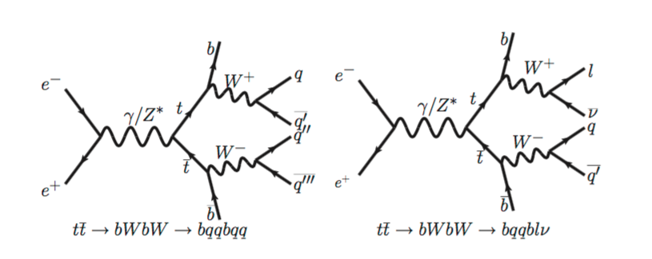
Momentum
I check the hadronic top in 4jet this time.
These are 2D histograms of P_{rec} − P_{MC} vs P_{MC} in X direction and Z direction(P_{rec}: reconstructed momentumP_{MC}: MC momentum).
P_{rec}.x – P_{MC}.x
P_{rec}.z – P_{MC}.z
X direction
Z direction
P_{MC}.x
P_{MC}.z

Slide 5
Tail
The histogram is sliced by P_{MC} every 48GeV. And following 1D histograms are made.
The tail (P_{rec} – P_{MC} ≒ ±50GeV) is shown.
It is similar in the Z direction.
P_{MC.}x = -24 ~ -72
P_{MC.}x = 24 ~ 72
X
ΔP
ΔP
ΔP.x > 50GeV
ΔP.x < −50GeV

Slide 6
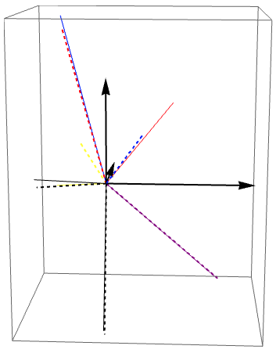
Hadronic b ⇄ Leptonic b
This graph shows jets of miss reconstruction event (|ΔP|<50GeV).
Hadronic b is mistaken for leptonic b.
There is the reverse patern.
Red: Hadronic b
Blue: Leptonic b
Black: Jet from W
Purple: Lepton
Yellow: Neutrino
Solid line: MC
Dashed line: Reconstructed

Slide 7
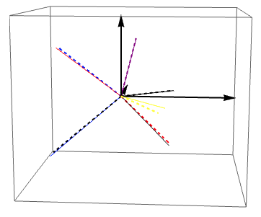
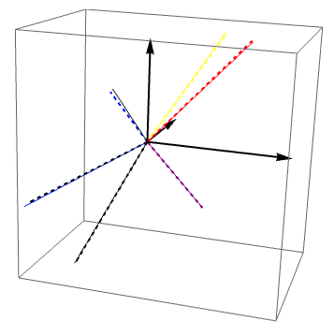
Miss recognition of b
The jet which is not b is recognized to be b.
Red: Hadronic b
Blue: Leptonic b
Black: Jet from W
Purple: Lepton
Yellow: Neutrino
Solid line: MC
Dashed line: Reconstructed

Slide 8
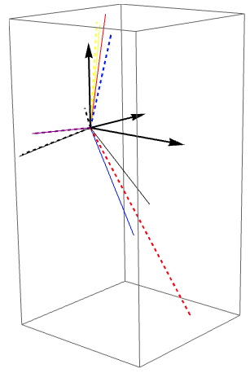
2jet → 1jet
2 jets are recognized to be 1 jet.
In this case, the small jet is reconstructed.
Red: Hadronic b
Blue: Leptonic b
Black: Jet from W
Purple: Lepton
Yellow: Neutrino
Solid line: MC
Dashed line: Reconstructed

Slide 9
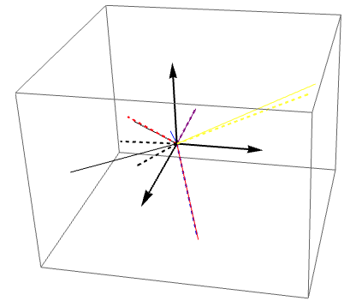
1jet → 2jet
1 jet is recognized to be 2 jets.
The jet which is not used for reconstruction exists because it is too small.
Red: Hadronic b
Blue: Leptonic b
Black: Jet from W
Purple: Lepton
Yellow: Neutrino
Solid line: MC
Dashed line: Reconstructed

Slide 10
Number of miss event
Among 100 miss events, the lower graph shows how many events there are in each case.
There are the most miss reconstruction of hadronic b and leptonic b.
Case of the miss reconstruction | Number of event
hadronic b ⇄ leptonic b | 85 (85%)
Miss recognition of b | 21 (21%)
2jet → 1jet | 22 (22%)
1jet → 2jet | 15 (15%)
others | 20 (20%)

Slide 11
Summary & Plan
There seem to be the most miss reconstruction of hadronic b and leptonic b in the miss event.
I want to decide the cut value of combinatorial BG.

