Slide 1
Further Resolution Analysis
And Phase Shifters
N. Blaskovic, T. Bromwich, R. Ramjiawan

Slide 2
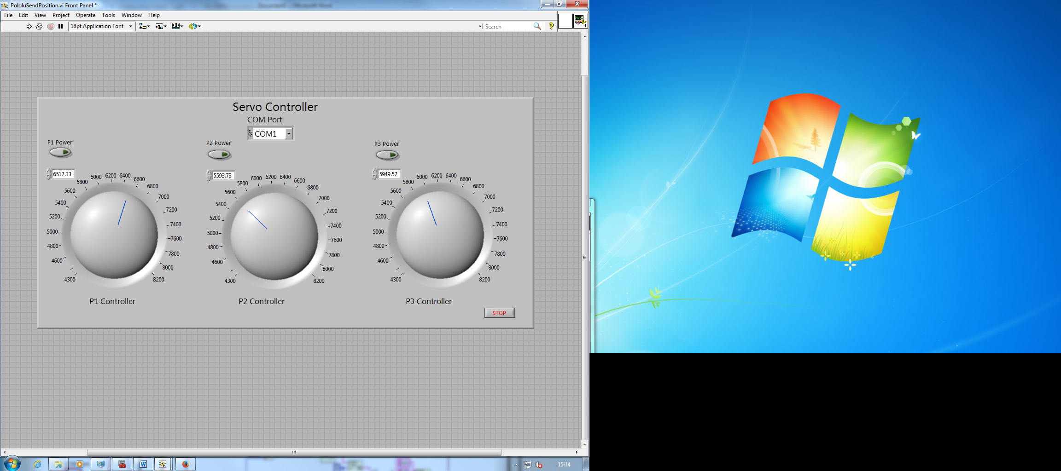
Phase Shifters
Next steps:
Approach all values from below: struggling to implement this in real-time.
Measure phase shift varying with input values: using network analyser.
Try sending signals through serial server.

Slide 3
Fitting to Self Q’/q
The Seven Parameter Fit

Slide 4
IPA Resolution: 7 parameters
Files: AQD0FF scan – 5. FB Run – 6 to 12. IQ Samples 12:20, Ref Sample 21.
Fb Run | 6 | 7 | 8 | 9 | 10 | 11 | 12
I’₂/q | -1.5387 | -1.5913 | -1.4884 | -1.4255 | -1.4277 | -1.5299 | -1.6081
I’₃/q | 0.58667 | 0.53449 | 0.69604 | 0.61084 | 0.59369 | 0.55283 | 0.56405
Q’₂/q | 0.66116 | 1.2046 | 0.49572 | 1.3863 | 1.461 | 1.7955 | 1.589
Q’₃/q | -0.77944 | -1.1708 | -1.2746 | -1.0986 | -1.1969 | -2.8865 | -2.4142
Q’₁/q | 0.91925 | 0.63092 | 0.29368 | 1.4263 | 1.1531 | 0.9697 | 0.61853
1/q | -0.0011522 | -0.00097489 | 0.0012161 | -0.0040787 | -0.0027368 | -0.00110139 | -0.0015481
Const. | -0.56871 | 5.1559 | -5.3604 | 7.6605 | 7.2953 | -3.6744 | -0.37917

Slide 5
IPB Resolution: 7 parameters
Files: AQD0FF scan – 5. FB Run – 6 to 12. IQ Samples 12:20, Ref Sample 21.
Fb Run | 6 | 7 | 8 | 9 | 10 | 11 | 12
I’₂/q | -0.61318 | -0.5892 | -0.60515 | -0.64193 | -0.61113 | -0.60456 | -0.54419
I’₃/q | 0.35658 | 0.30804 | 0.3942 | 0.36707 | 0.33872 | 0.33367 | 0.33311
Q’₂/q | 0.45824 | 0.23983 | 0.10629 | 0.70237 | 0.3153 | 0.42756 | -0.049808
Q’₃/q | -0.64287 | -0.88519 | -1.079 | -1.2942 | -1.3491 | -1.8957 | -1.6341
Q’₁/q | 0.46619 | 0.78502 | 0.49491 | 1.0711 | 1.032 | 1.2021 | 0.94524
1/q | -0.00068336 | -0.00038268 | 0.00091329 | -0.0015097 | -0.00029283 | -0.00046917 | -0.00052073
Const. | -0.4109 | 2.7714 | -3.3155 | 1.998 | 1.4693 | -1.3982 | 0.11361

Slide 6
IPC Resolution: 7 parameters
Files: AQD0FF scan – 5. FB Run – 6 to 12. IQ Samples 12:20, Ref Sample 21.
Fb Run | 6 | 7 | 8 | 9 | 10 | 11 | 12
I’₂/q | 1.3502 | 1.254 | 1.1743 | 1.3441 | 1.2687 | 1.3334 | 1.1907
I’₃/q | 2.0594 | 1.9518 | 1.6358 | 1.7936 | 1.691 | 2.0366 | 2.0779
Q’₂/q | -0.75725 | 0.10509 | -0.16287 | -1.9643 | -1.1847 | -0.48886 | 0.97765
Q’₃/q | -0.34379 | -0.80033 | -0.27606 | -1.3498 | -1.0136 | -1.7539 | -1.3896
Q’₁/q | 0.58957 | -0.43559 | 0.91375 | -0.14958 | -0.23883 | 3.1166 | 3.2103
1/q | 0.00085216 | 0.00024504 | -0.001915 | 0.0067042 | 0.0035526 | 0.00061419 | -0.00029768
Const. | 1.0961 | -17.269 | 4.6333 | -18.837 | -15.261 | 2.9354 | 0.87635

Slide 7
Analysis of 1557 Triggers
From 7 consecutive fbRuns

Slide 8
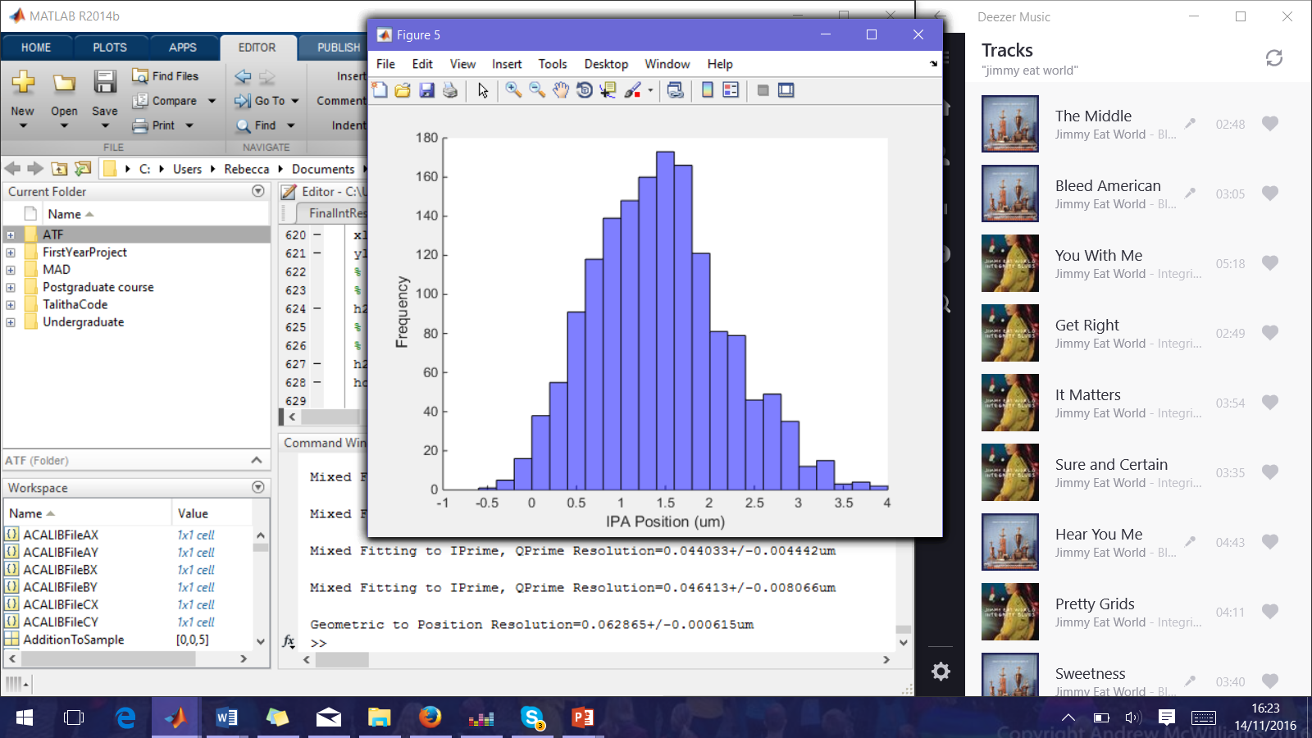
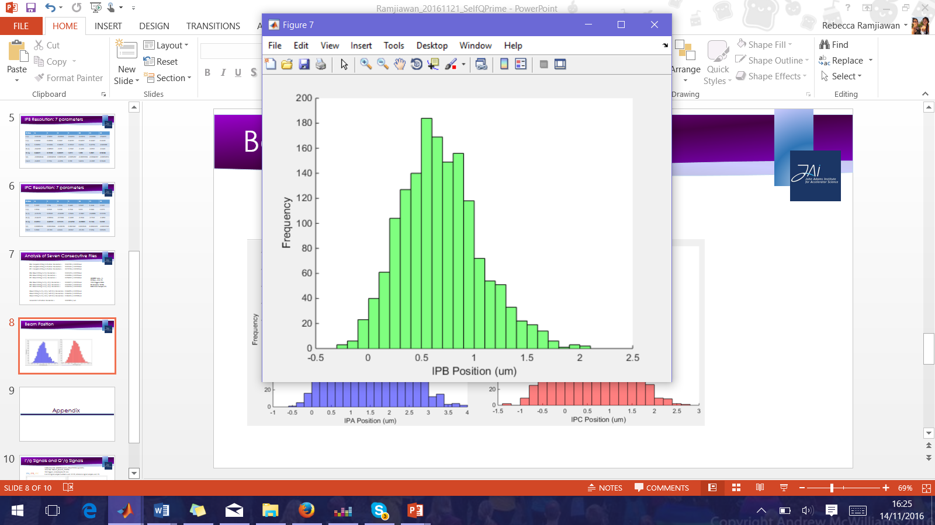
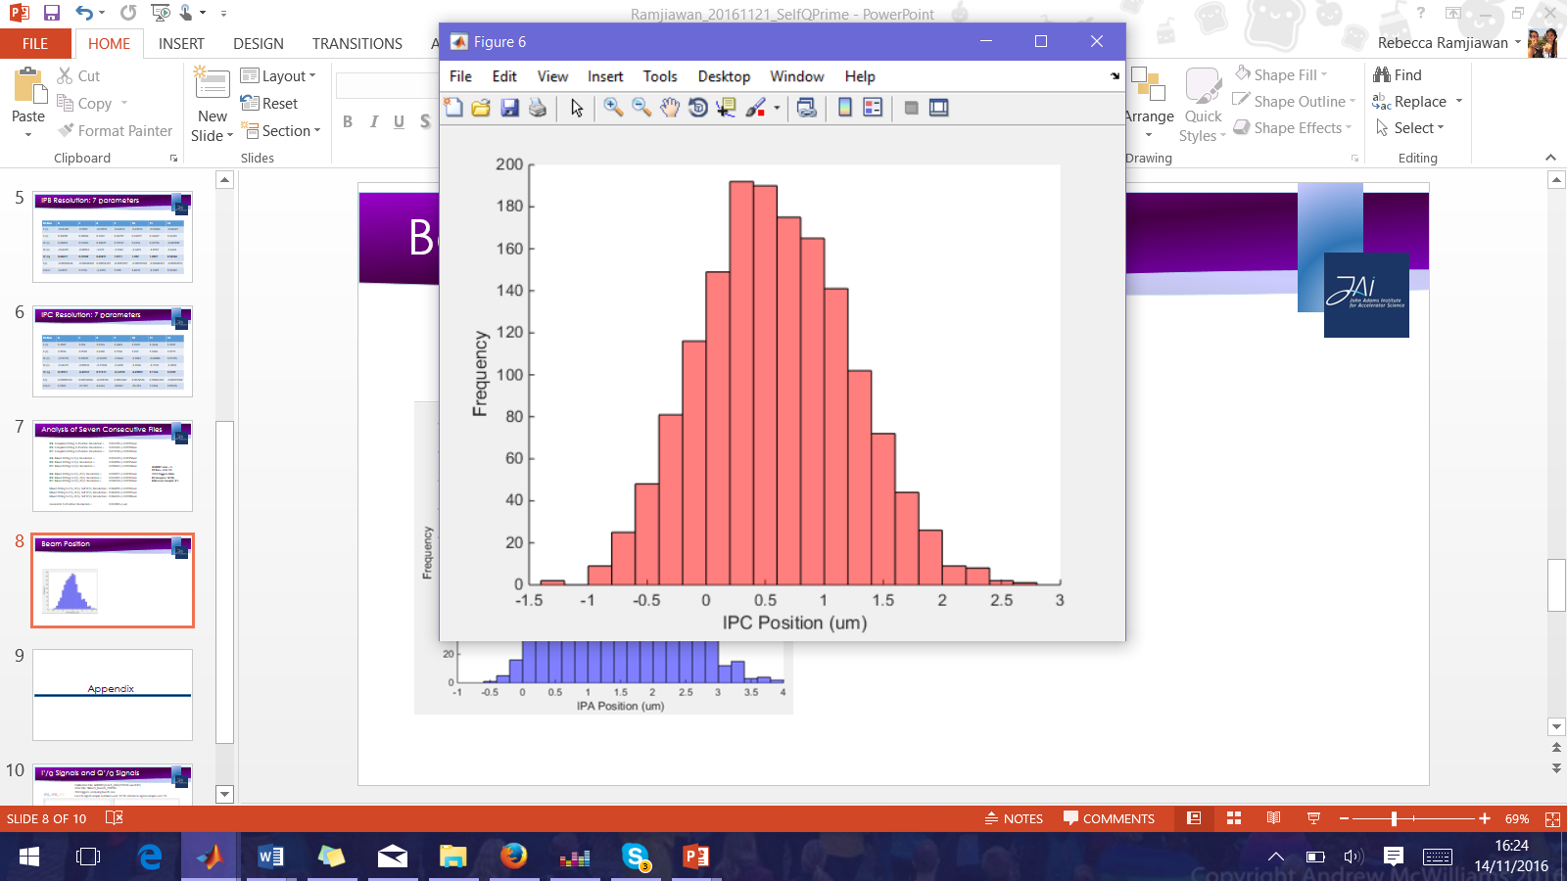
Beam Position For Consecutive Files
Files: AQD0FF scan – 5. FB Run – 6 to 13. 1557 triggers total.
IQ Samples: 12:20, Reference Sample: 21.

Slide 9
Analysis of Seven Consecutive Files
IPA: Complete Fitting to Position: Resolution = 0.062789+/-0.00159um
IPB: Complete Fitting to Position: Resolution = 0.062431+/-0.00158um
IPC: Complete Fitting to Position: Resolution = 0.071704+/-0.00182um
IPA: Mixed Fitting to I’/q: Resolution = 0.062470+/-0.00158um
IPB: Mixed Fitting to I’/q: Resolution = 0.060856+/-0.00154um
IPC: Mixed Fitting to I’/q: Resolution = 0.058452+/-0.00148um
IPA: Mixed Fitting to I’/q, Q’/q: Resolution = 0.045877+/-0.00116um
IPB: Mixed Fitting to I’/q, Q’/q: Resolution = 0.047062+/-0.00119um
IPC: Mixed Fitting to I’/q, Q’/q: Resolution = 0.046524+/-0.00118um
IPA: Mixed Fitting to I’/q, Q’/q, Self Q’/q: Resolution= 0.044815+/-0.00116um
IPB: Mixed Fitting to I’/q, Q’/q, Self Q’/q: Resolution= 0.044033+/-0.00115um
IPC: Mixed Fitting to I’/q, Q’/q, Self Q’/q: Resolution= 0.046413+/-0.00186um
Geometric Method: Resolution = 0.062865+/-um
AQD0FF scan – 5.
FB Run – 6 to 13.
1557 triggers total.
IQ Samples: 12:20,
Reference Sample: 21.

Slide 10
Calibration Constant with Attenuation

Slide 11
Variation in Calibration Constant
Files: AQD0FF scans – 8, 7, 9, 10,11. Jit Run – 13, 10, 14. FB Run – 23, 24.
IQ Samples: 12:20, Reference Sample: 21.

Slide 12
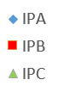
Calibration Constant Scaling With Attenuation

Slide 13
Appendix

Slide 14
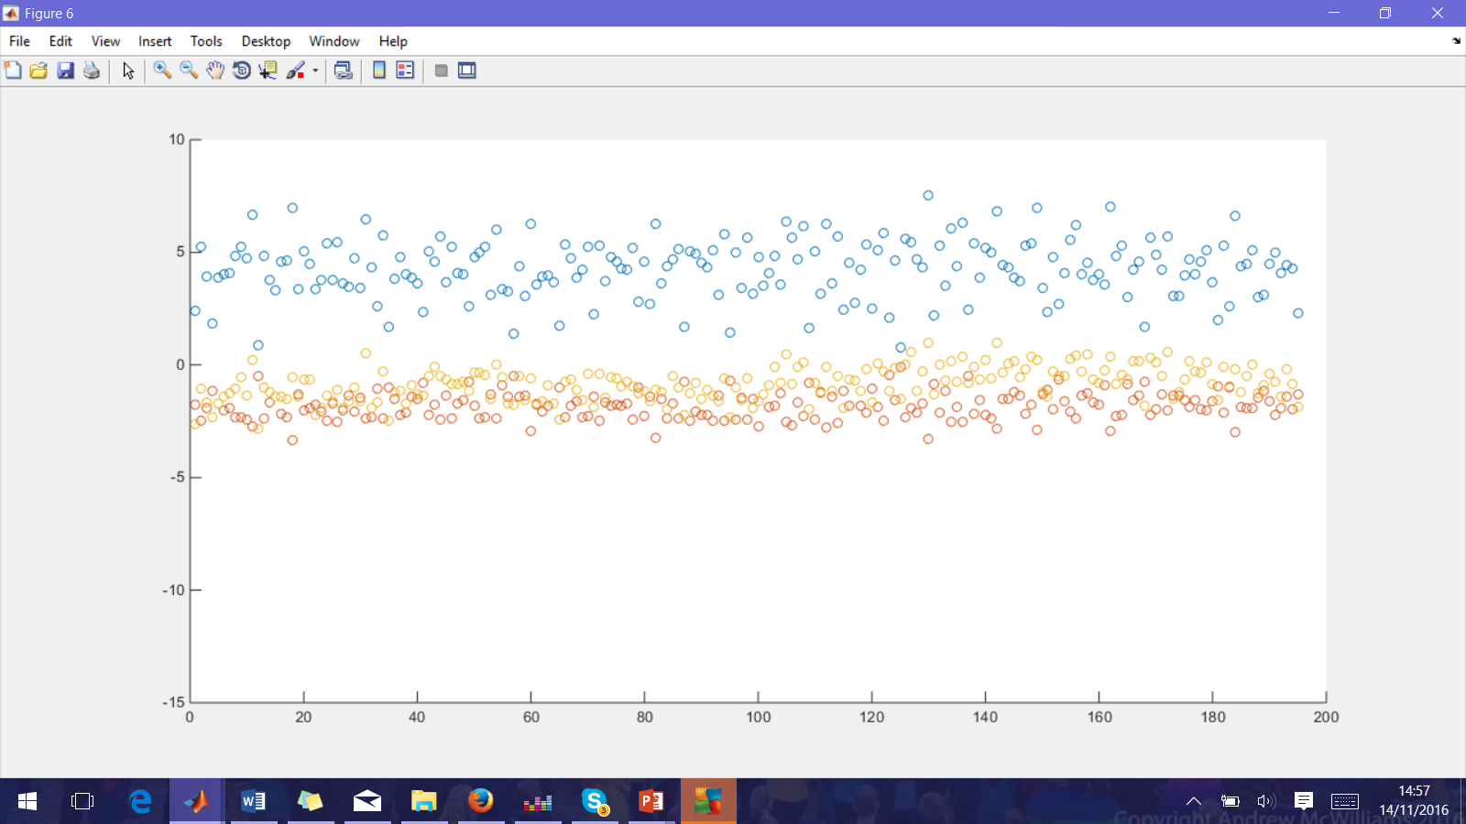
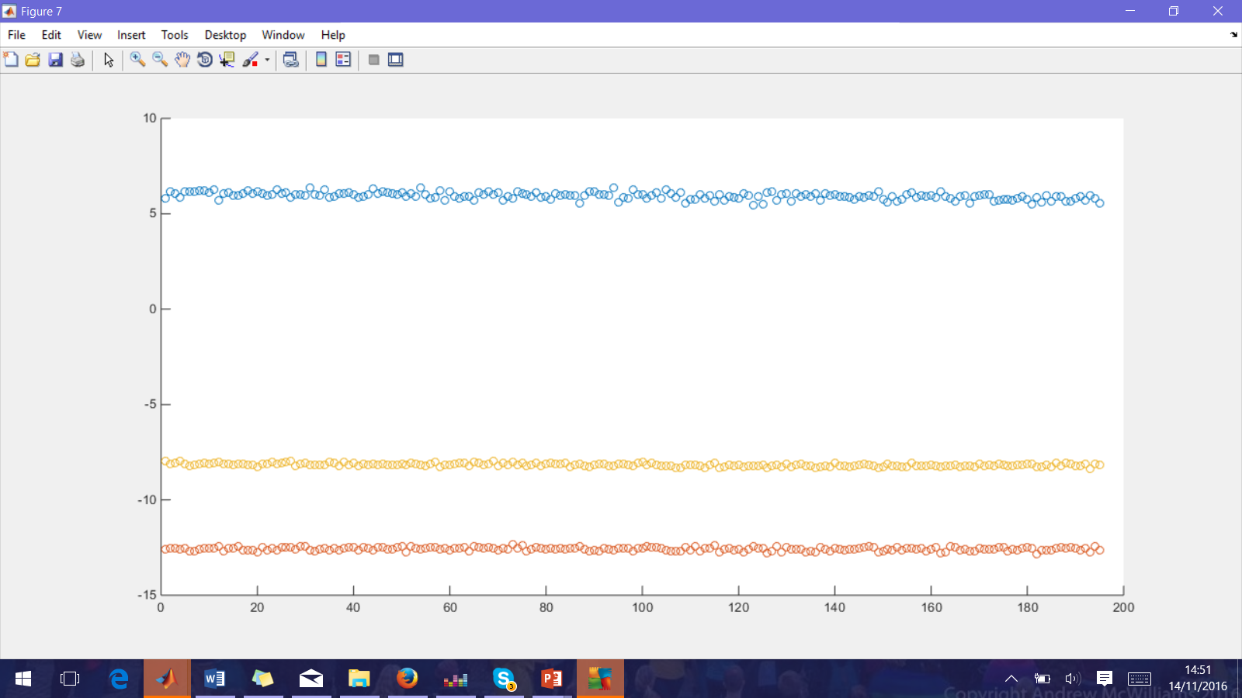
I’/q Signals and Q’/q Signals
Calibration File: AQD0FFyScan5_0dB (271016 owl shift).
Jitter File: fbRun9_Board2_281016.
194 triggers, analysing bunch one.
I and Q signal sample numbers used: 12:20, reference signal sample used: 21.
IPA, IPB, IPC

Slide 15
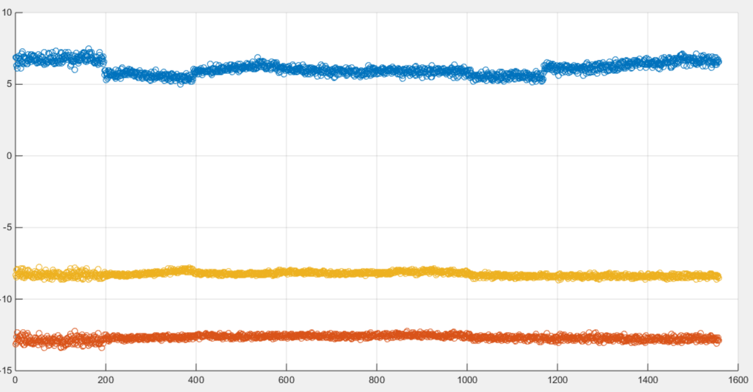
Q’/q summed over 9 samples
IPA
Q’/q (ADC/ADC)
IPC
IPB
Trigger

Slide 16
Sub-division cutting on A
Files: AQD0FF scan – 5. FB Run – 6 to 13. 1557 triggers total.
IQ Samples: 12:20, Reference Sample: 21.
Mixed fitting to I’/q.
Resolution (um)
Below -1s.d -1s.d to -0.5s.d -0.5s.d to 0s.d 0s.d to 0.5s.d 0.5s.d to 1s.d Above 1s.d

Slide 17
Sub-division Cutting on B
Files: AQD0FF scan – 5. FB Run – 6 to 13. 1557 triggers total.
IQ Samples: 12:20, Reference Sample: 21.
Mixed fitting to I’/q.
Resolution (um)
Below -1s.d -1s.d to -0.5s.d -0.5s.d to 0s.d 0s.d to 0.5s.d 0.5s.d to 1s.d Above 1s.d

Slide 18
Sub-division Cutting on C
Files: AQD0FF scan – 5. FB Run – 6 to 13. 1557 triggers total.
IQ Samples: 12:20, Reference Sample: 21.
Mixed fitting to I’/q.
Resolution (um)
Below -1s.d -1s.d to -0.5s.d -0.5s.d to 0s.d 0s.d to 0.5s.d 0.5s.d to 1s.d Above 1s.d

