Slide 1
Bunch-to-bunch correlation
N. Blaskovic, T. Bromwich, R. Ramjiawan

Slide 2
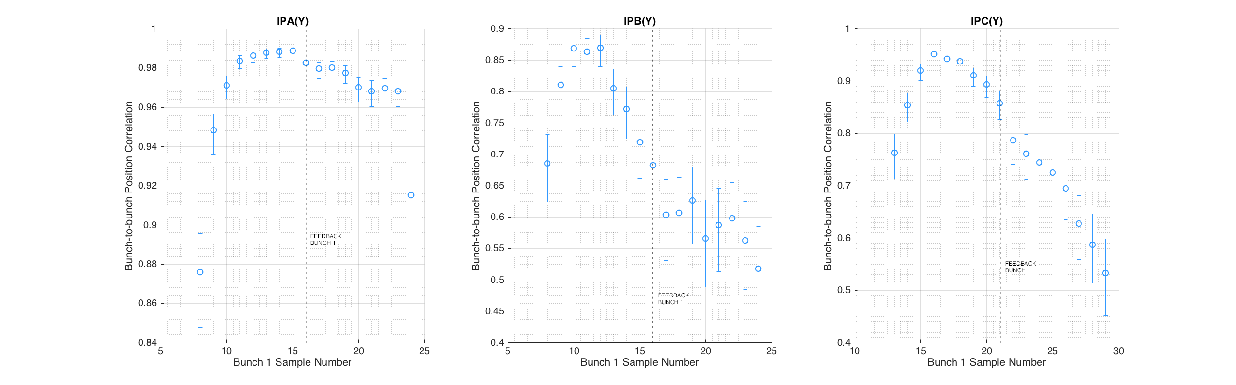
Bunch-to-bunch correlation fbRun9 @ 0dB
All previous bunch-to-bunch correlation calculations (and feedback) used bunch 1 sample 16 for A and B, and sample 21 for C, shown on plots with dashed line. (Samples 116 and 121 used for bunch 2).
Reference samples 21 and 121 used throughout. Bunch 2 sample number adjusted to always 100 more than bunch 1 sample number.

Slide 3
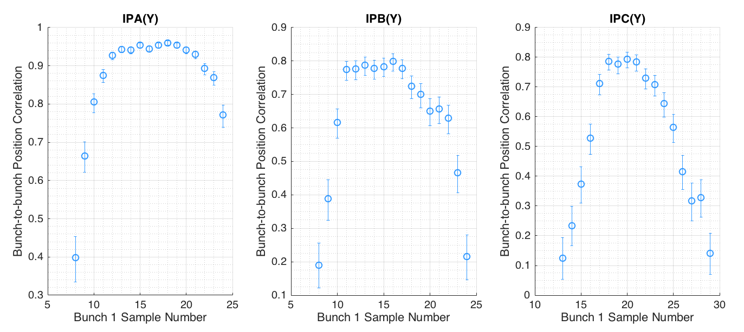
Bunch-to-bunch correlation fbRun18 @ 10dB

Slide 4
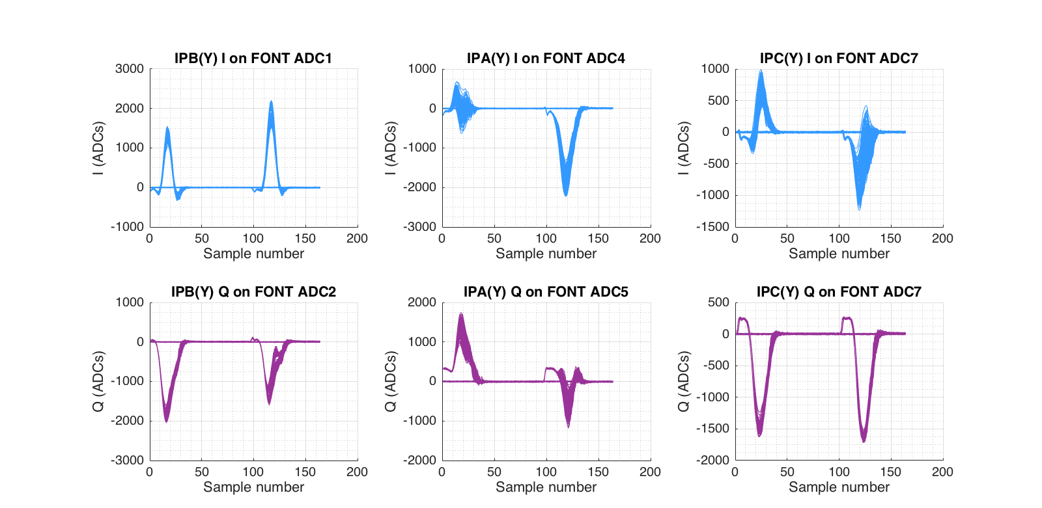
Waveforms fbRun9 @ 0dB

Slide 5
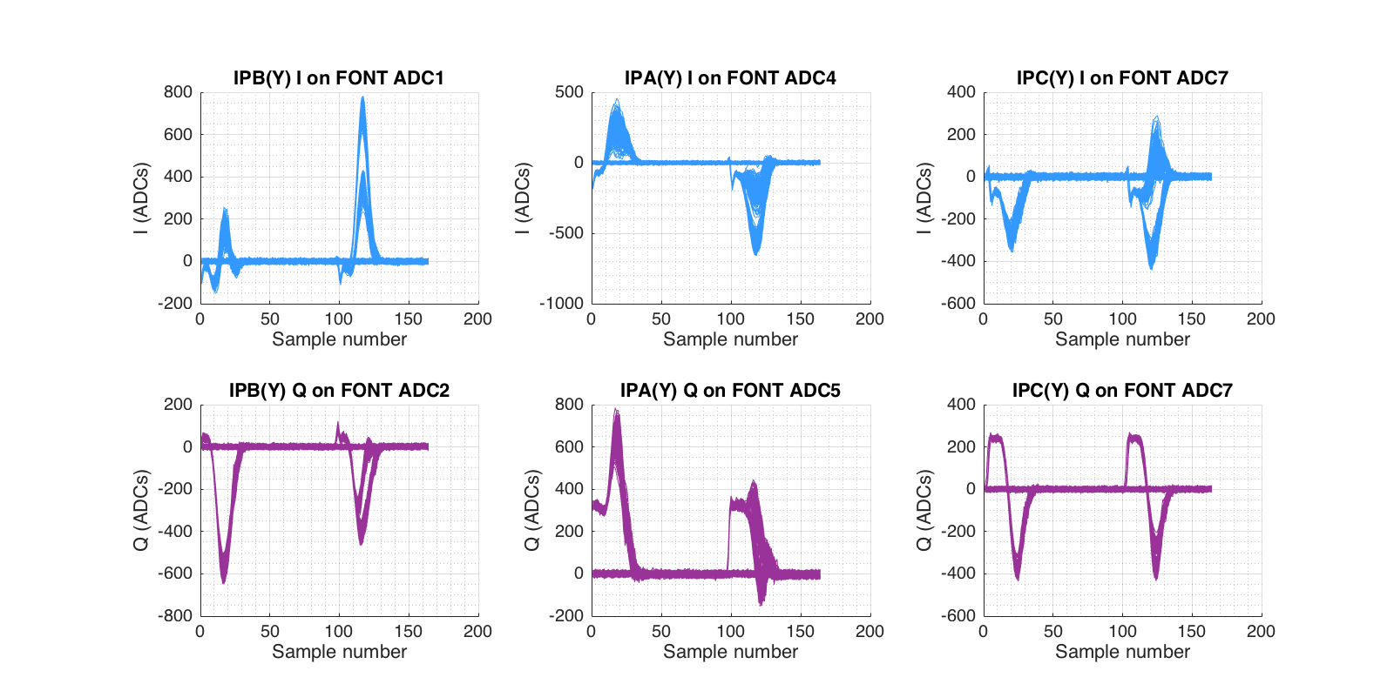
Waveforms fbRun18 @ 10dB

