Slide 1
Plots for LCWS

Slide 2
Noise from Veta
Noise as a function of time (run)
Noise as a function of pads
Noise as a function of layers

Slide 3
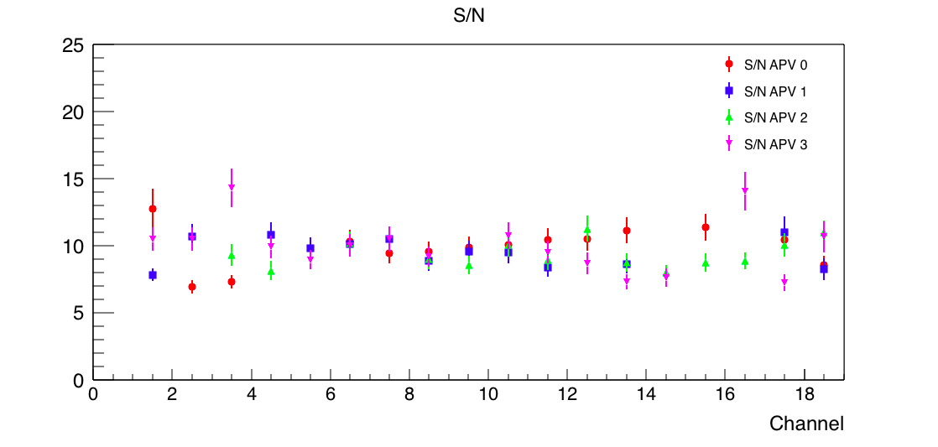
SNR from Yan
Fit with landau convoluted with a gaussian
10 channels around the center of the beam

