Slide 1
Stripline phase shifter performance
N. Blaskovic & T. Bromwich
N. Blaskovic

Slide 2
Introduction
New LabVIEW-controlled stripline phase shifters installed on P1, P2 & P3
Thanks to Colin for building them and Rebecca for the LabVIEW interface
Results:
Phase sensitivity (position vs. LO phase) at optimum stripline phase shifter setting
Phase sensitivity as a function of stripline phase shifter setting
N. Blaskovic

Slide 3
Lowest phase sensitivity
Phase sensitivity for P1, P2 & P3 at optimum stripline phase shifter setting
N. Blaskovic

Slide 4
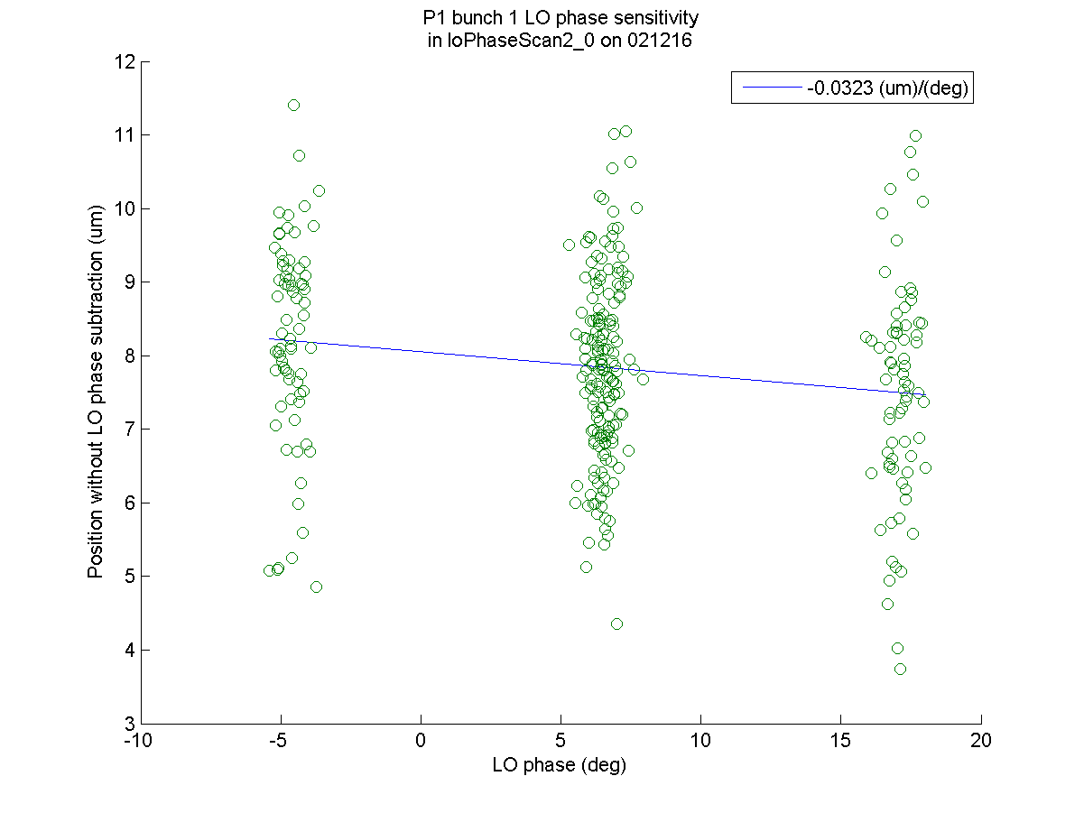
Stripline phase shifter optimally set
N. Blaskovic

Slide 5
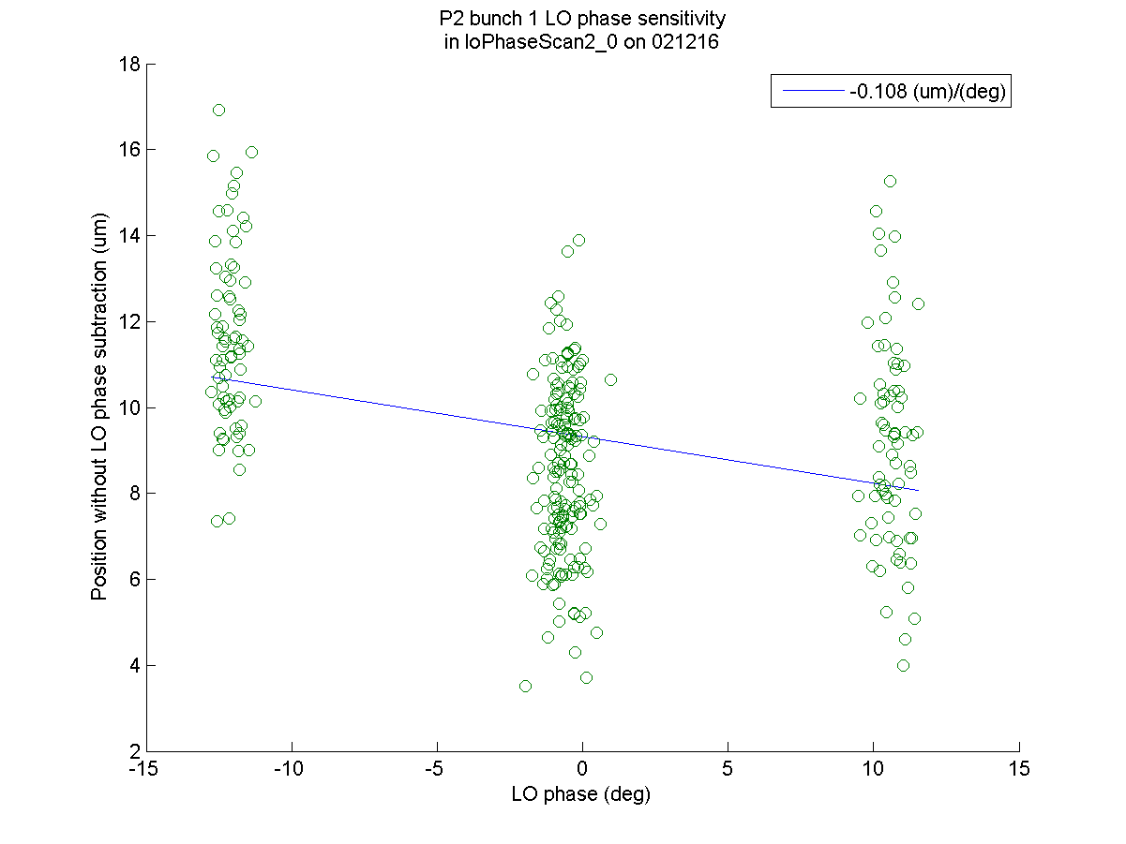
Stripline phase shifter optimally set
N. Blaskovic

Slide 6
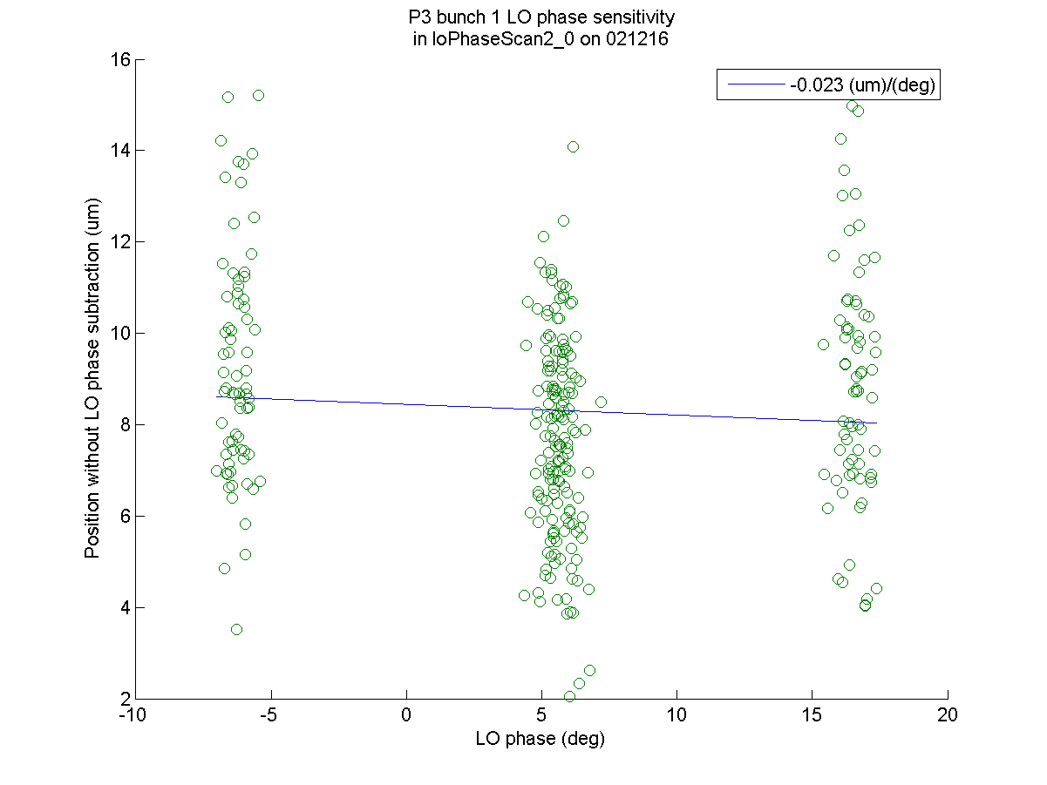
Stripline phase shifter optimally set
N. Blaskovic

Slide 7
Scan of phase sensitivities
Phase sensitivity varied by changing stripline phase shifter away from optimum setting
Two scans performed:
loPhaseScan1: all 3 stripline phase shifters scanned from lower to higher settings
loPhaseScan2: P1 & P2 scanned upwards, P3 scanned downwards, for lowest phase sensitivity when optimally set (slides 3–6)
N. Blaskovic

Slide 8
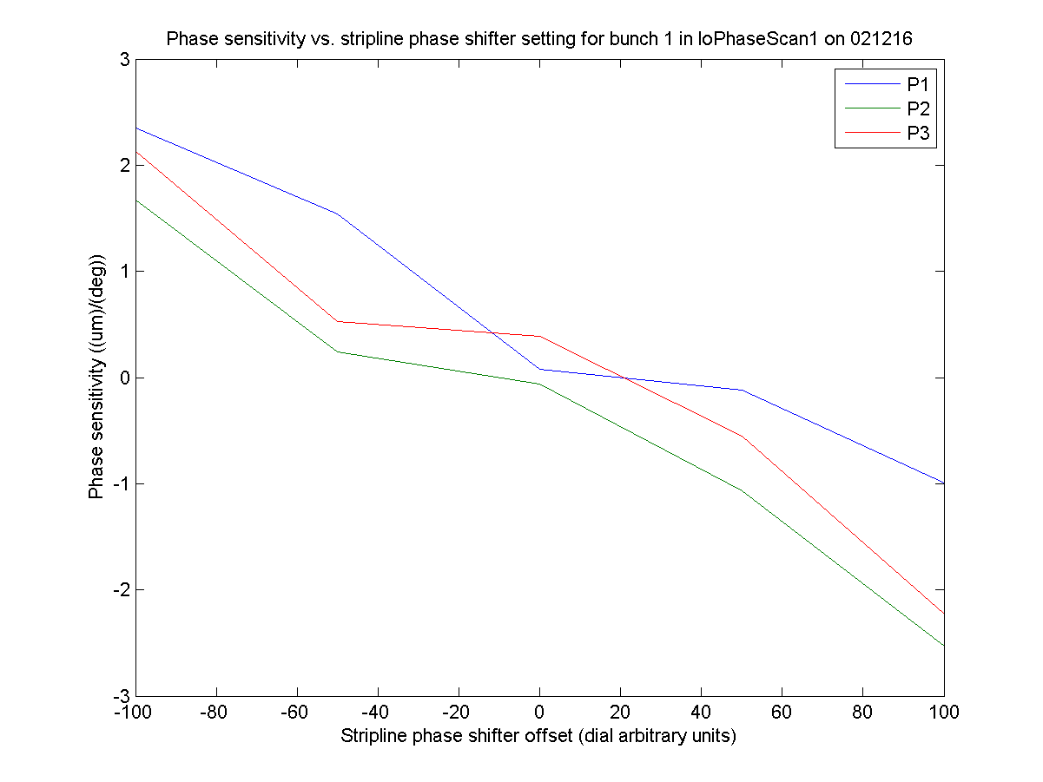
loPhaseScan1
N. Blaskovic

Slide 9
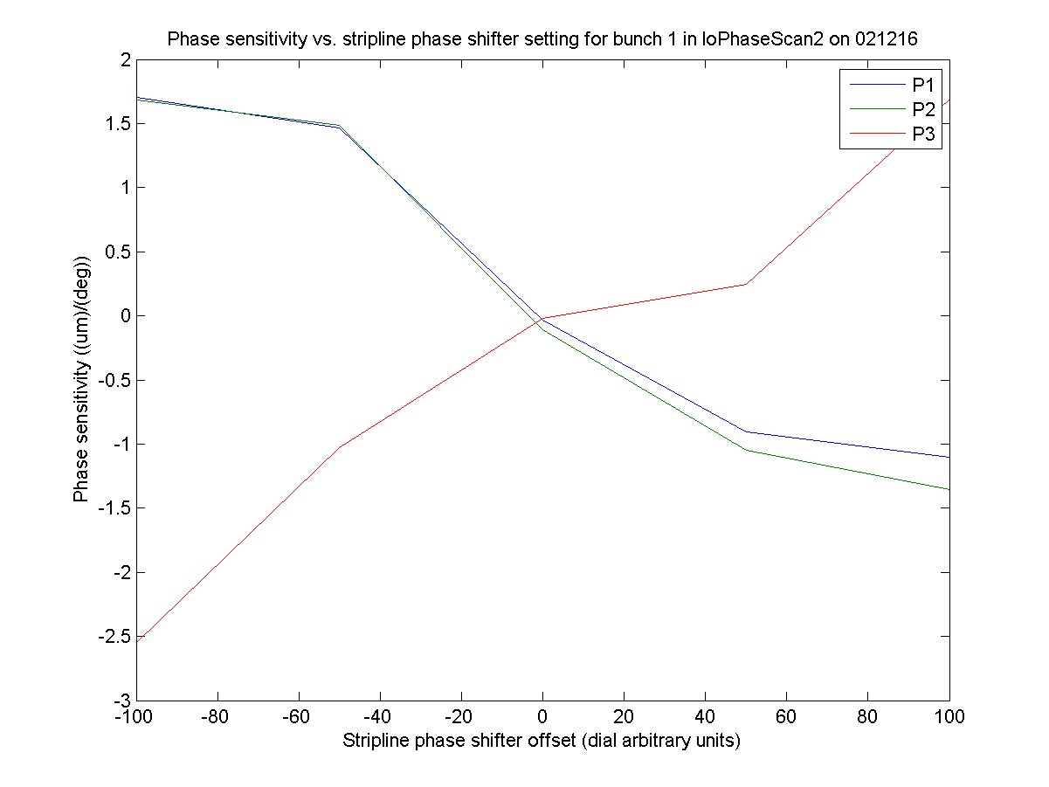
loPhaseScan2
N. Blaskovic

Slide 10
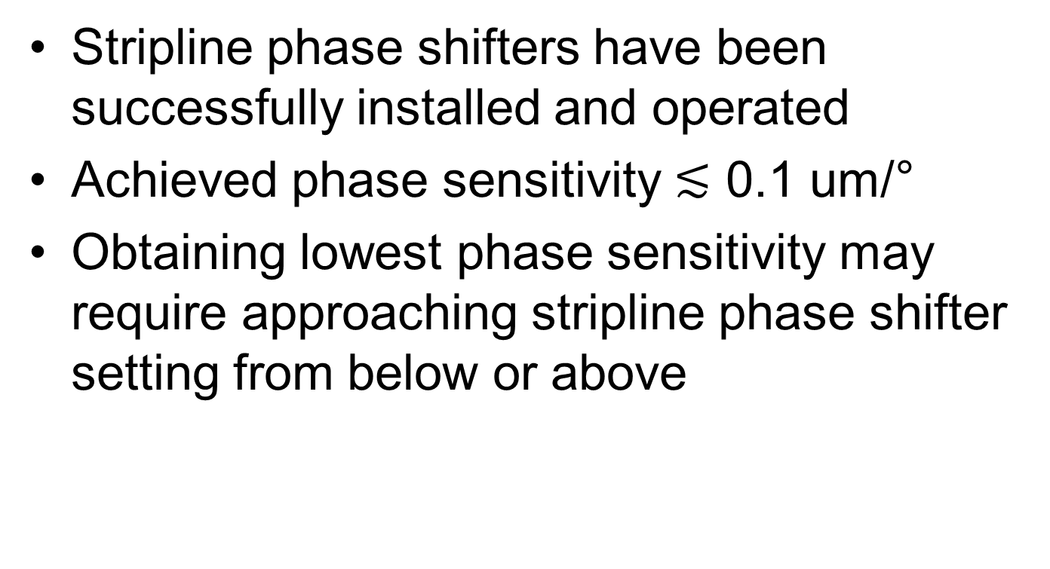
Conclusion
Stripline phase shifters have been successfully installed and operated
Achieved phase sensitivity $≲$ 0.1 um/°
Obtaining lowest phase sensitivity may require approaching stripline phase shifter setting from below or above
N. Blaskovic

