Slide 1
FONT stripline BPM resolution
N. Blaskovic, R. Bodenstein, T. Bromwich,
P. Burrows, G. Christian, C. Perry, R. Ramjiawan
John Adams Institute, Oxford University
N. Blaskovic

Slide 2
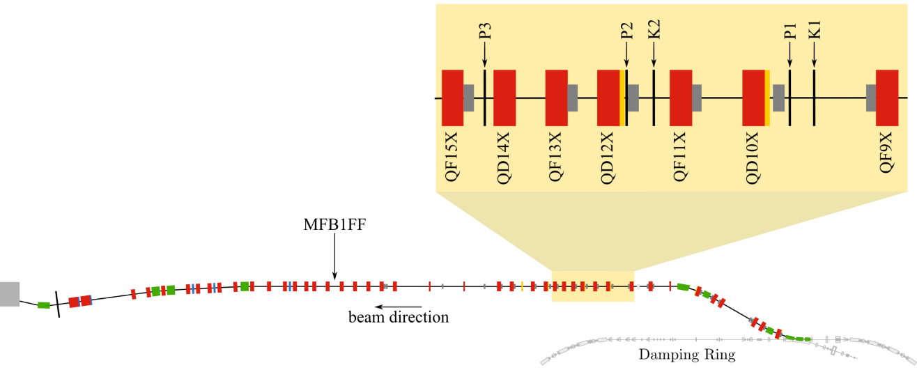
Stripline BPM system
3 stripline BPMs P1, P2 & P3 in EXT line
Previous resolution 291 ± 10 nm at charge of 0.5 x 10¹⁰ (PRST-AB 18, 032803, 2015)
based on figure from G. White et al. (PRL, 2014)
N. Blaskovic

Slide 3
Stripline BPM system upgrades
Upgraded phase shifter (finer setting)
Installed 6 dB attenuator in processor (double maximum operating charge: 10¹⁰)
Introduced FONT5A board clock filtering
stripline
BPM
phase
shifter
processor
FONT5A board
hybrids
mixers
attenuator
Φ
+
6dB

–

N. Blaskovic

Slide 4
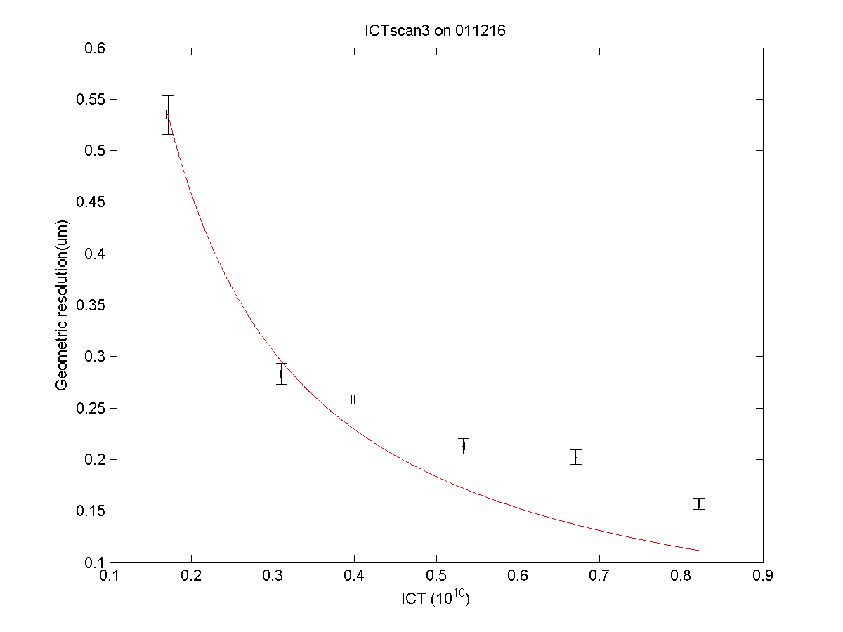
latest results
213 nm
at ~0.5 x 10¹⁰
157 nm
at ~0.8 x 10¹⁰
N. Blaskovic

Slide 5
Conclusion
Stripline BPM system hardware upgraded for improved resolution and higher charge
Best resolution: ~150 nm at 0.8 x 10¹⁰
Thanks to Glen White and the rest of the ATF team for stable high-charge beam!
N. Blaskovic

