Slide 1






December PFF Shifts
FONT Meeting, 21st December 2016
Jack Roberts

Slide 2
Overview
4 days we took phase feedforward (PFF) data in December:
  Thurs 8th – whole day.
  Fri 9th – whole day.
  Thurs 15th – evening.
  Fri 16th – Hour in afternoon (last ever CTF3 measurement).
Many different measurements (next slide).
Look at the main results here. Some may not be the best we have, others not shown at all.

Slide 3
Datasets Taken
Correction of straight beam:
  Gain scan.
  Longer datasets.
  Automatic gain/offset adjustment.
  2-input correction.
Correction of factor 4 beam:
  Setup of new firmware.
  Improve correlation between uncombined upstream, and combined downstream phase.
  Correction attempts.
Orbit closure.
Phase monitor resolution.
IN THIS PPT
NOT IN THIS PPT

Slide 4
Correction of Straight Beam
Mean Phase
Point-by-point
Gain scan
  Have a fairly reasonable scan, but still with outliers. Very difficult to get a clean result in drifting beam conditions.
2-input
  Correction using both Mon 1 and Mon 2. Demonstrated similar performance to using only Mon 1.
Automatic gain/offset adjustment
  Tried a few times with new VIs I wrote in LabVIEW. They do what they’re meant to, but probably more likely to make results worse rather than better.
IN THIS PPT
NOT IN THIS PPT

Slide 5
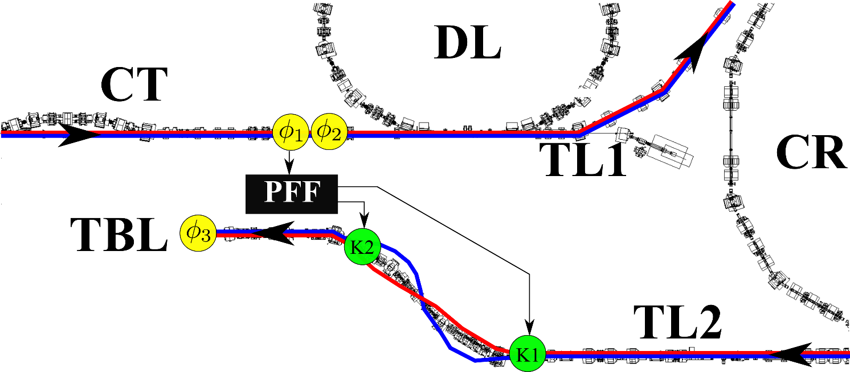
Normal PFF Correction Mode
UPSTREAM PHASE
1.2µs, 3GHz beam pulse
4A beam current.
COMBINER RING
0.5 turns.
Magnetic injection.
DOWNSTREAM PHASE
1.1µs, 3GHz beam pulse.
3.5A beam current.

Slide 6
Mean Phase
Dataset: 20161209_1835
1800 pulses (36 minutes) interleaved.
Record achieved mean phase jitter in part of this dataset.
Nominal (not PFF) optics in TL2.
All signals connected to FONT5a board.
Gain 1000.

Slide 7
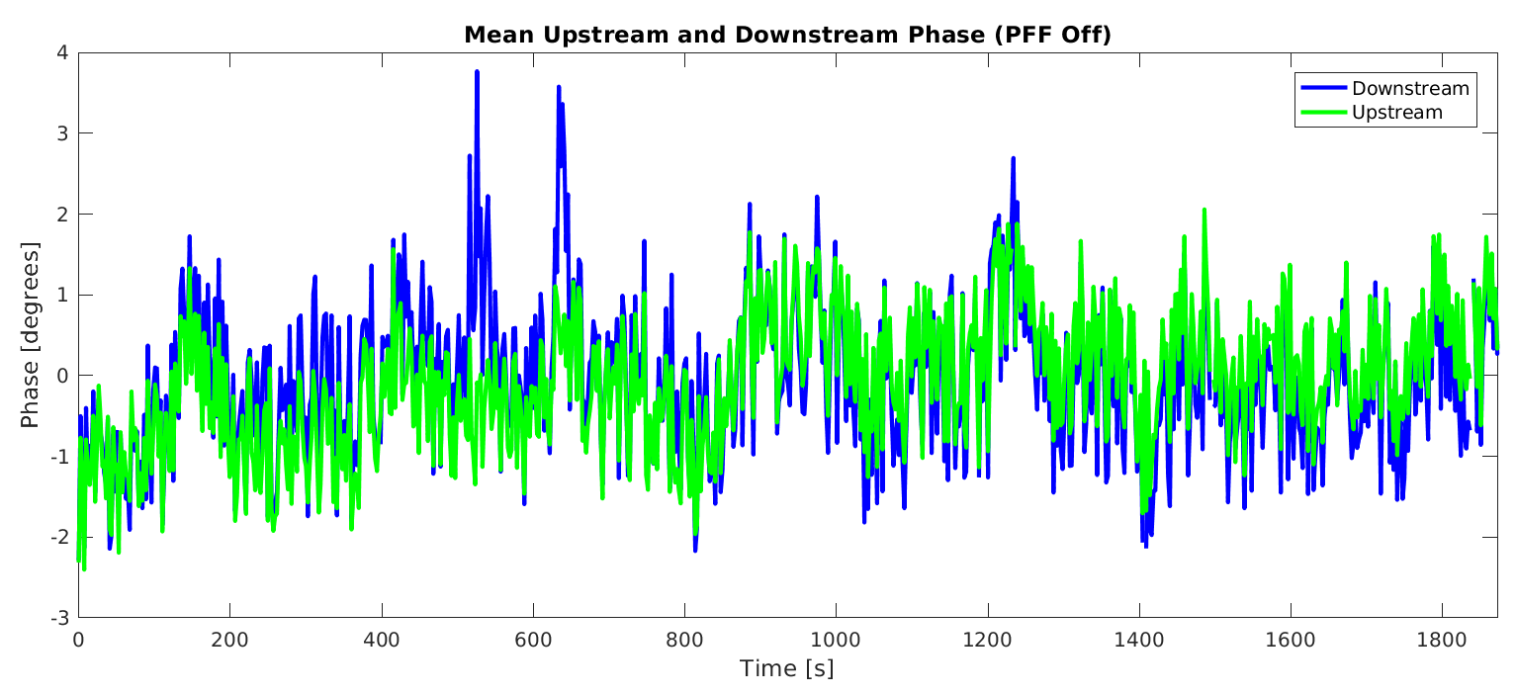
Whole Dataset: PFF Off

Slide 8
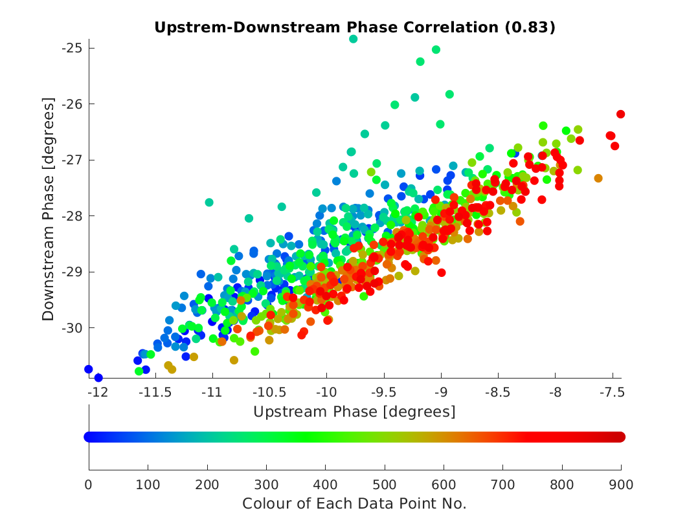
Whole Dataset: PFF Off

Slide 9
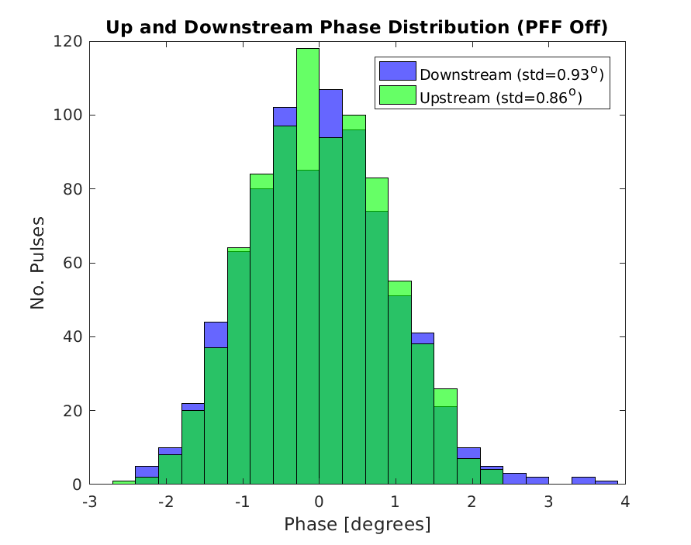
Whole Dataset: PFF Off

Slide 10
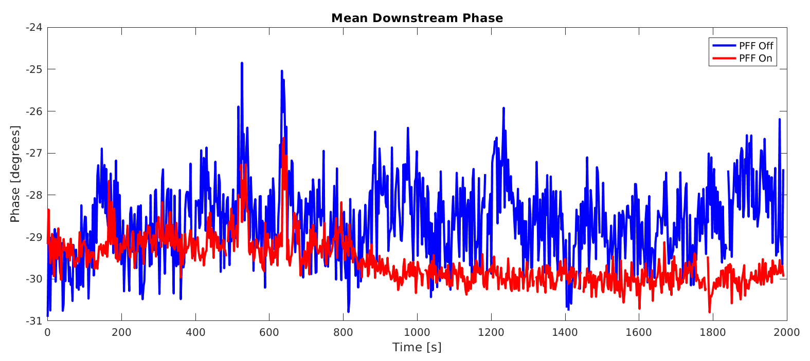
Whole Dataset: Downstream PFF Off/On

Slide 11
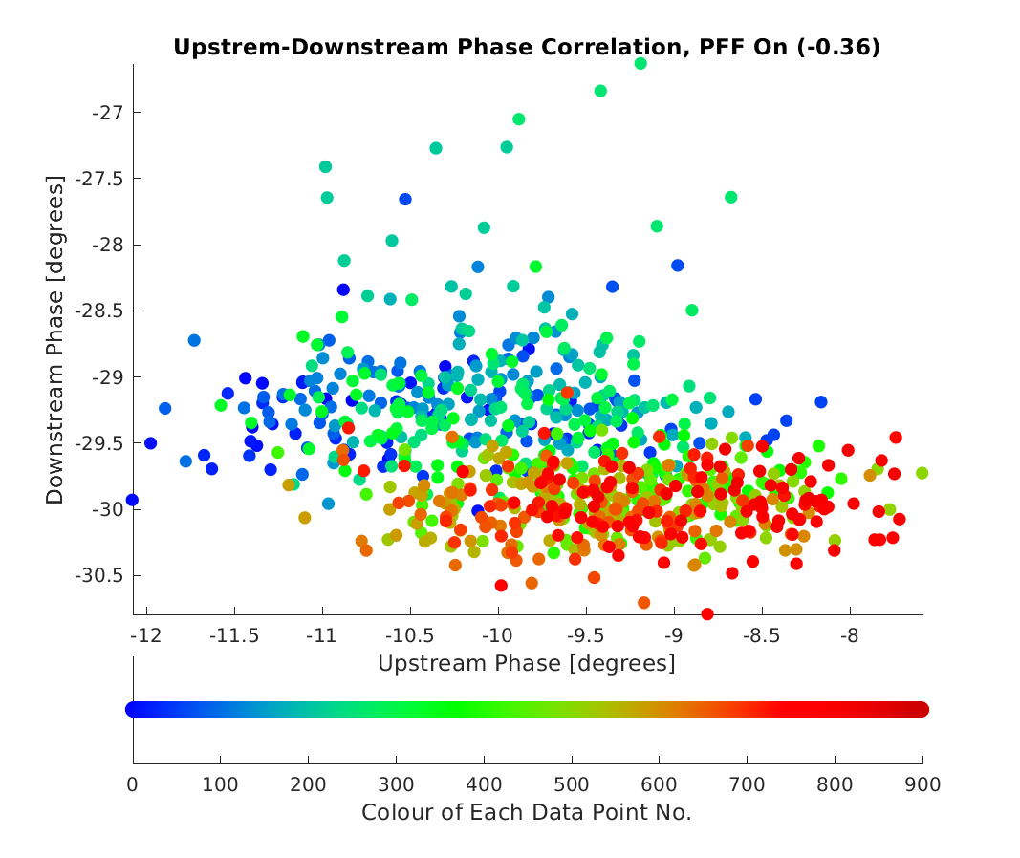
Whole Dataset: PFF On

Slide 12
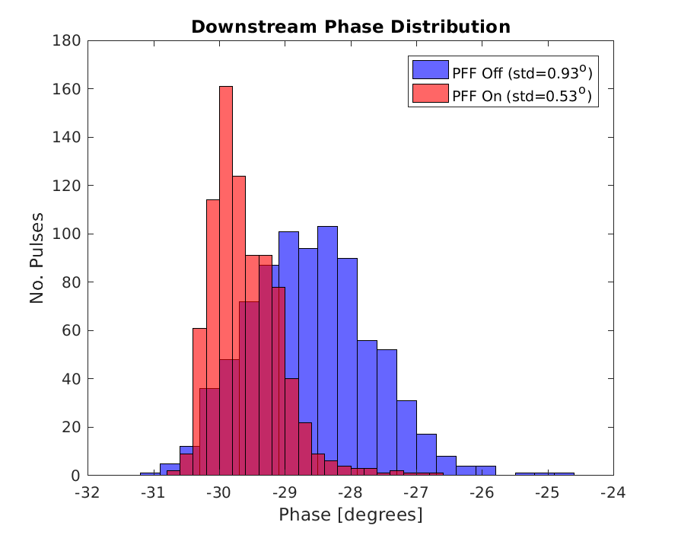
Whole Dataset: D/S PFF Off/On

Slide 13
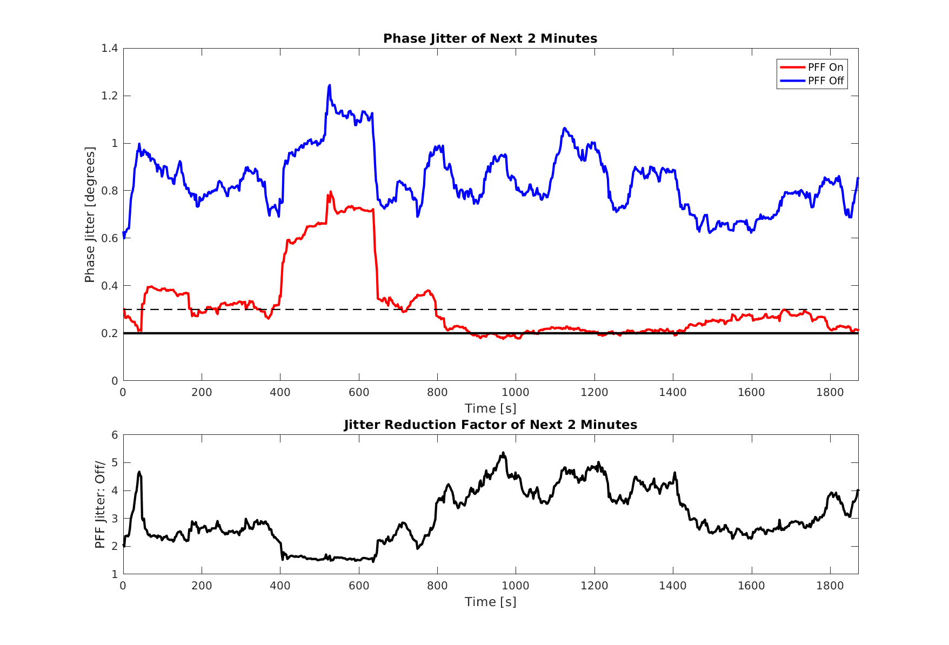
Downstream Jitter of 2 Minute Periods

Slide 14
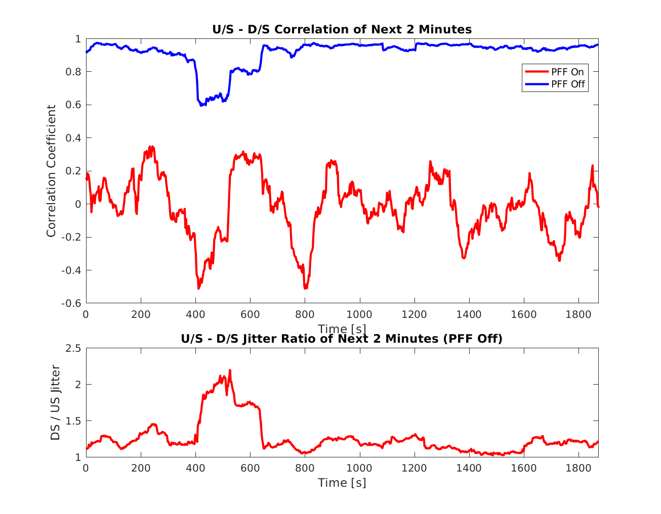
Correlation of 2 Minute Periods

Slide 15
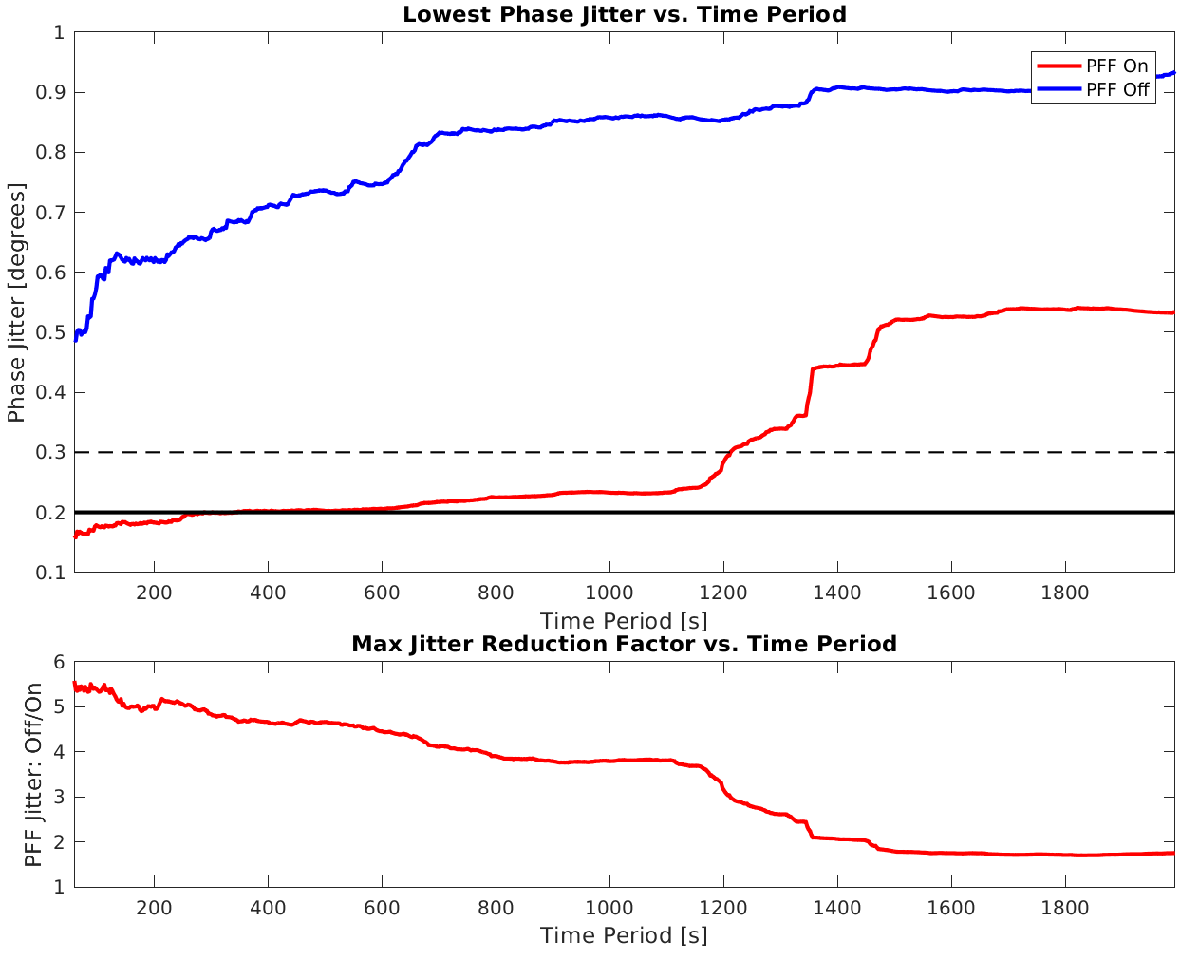
Lowest Jitter for Different Periods

Slide 16
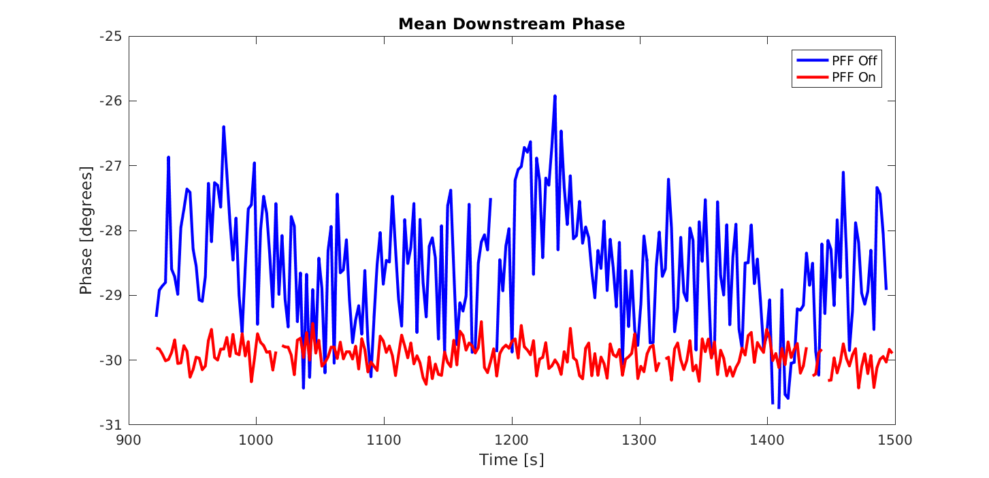
Longest 0.20º Period

Slide 17
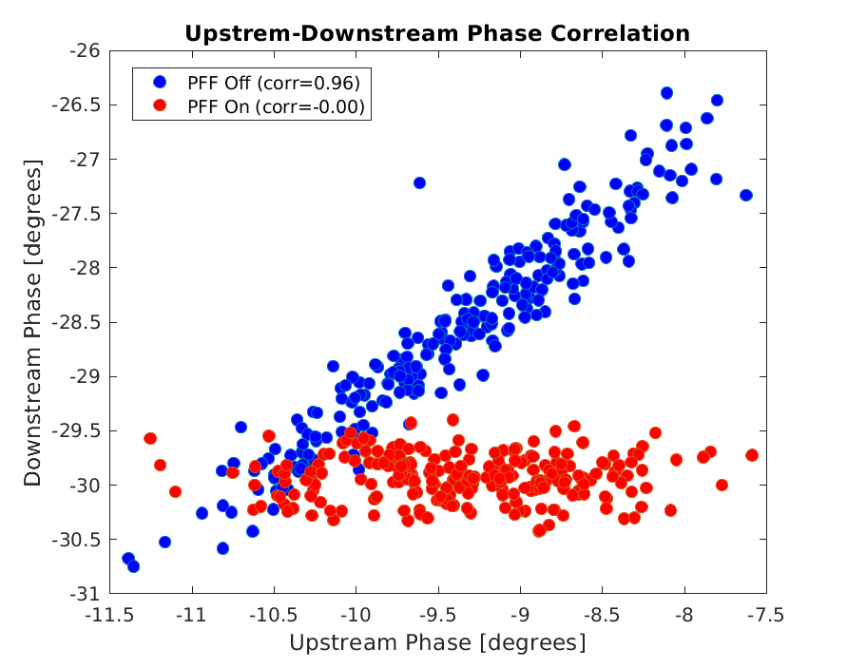
Longest 0.20º Period

Slide 18
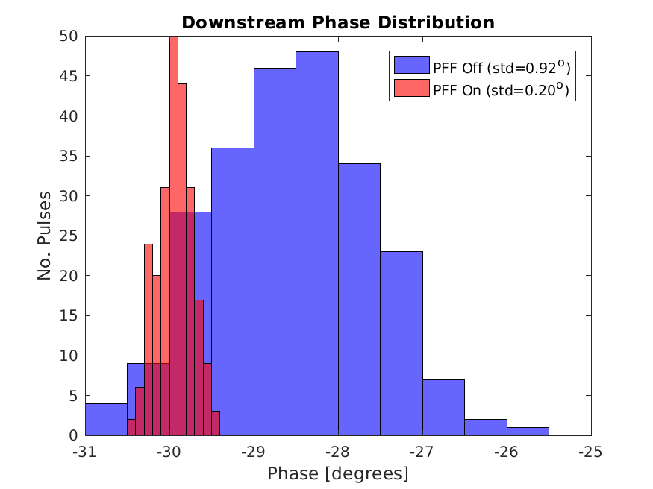
Longest 0.20º Period

Slide 19
Point-by-point Phase
Variations along the pulse.
Dataset from 15th Dec – not analysed all datasets, may have better.
Record dataset for mean phase did not give best point by point results:
  Better correction of shape if timing moved 5.6 (2 clock cycles) earlier than on that day.

Slide 20
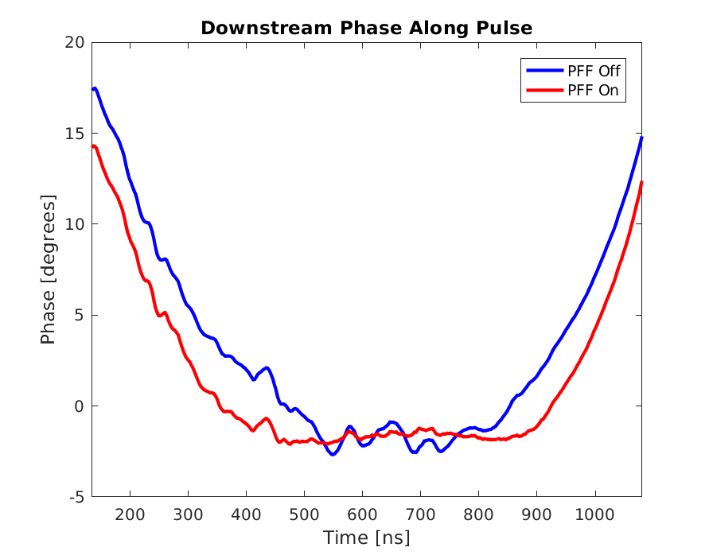
Correction of Pulse Shape

Slide 21
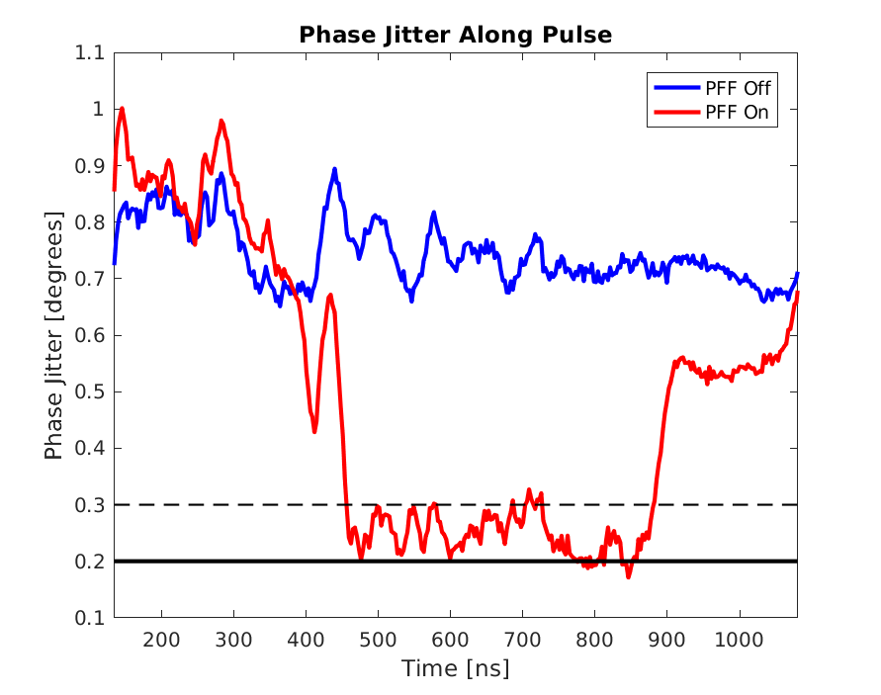
Point-by-point Jitter

Slide 22
Correction of Factor 4 Beam
Setup of new firmware.
Correction attempts.
Improve correlation between uncombined upstream, and combined downstream phase.
  Short pulse doing different no. turns in combiner ring – zero R56 for each case.
  Up to ~75% correlation achieved without wiggling. Not very stable.
  Up to ~85% correlation with wiggling, and stable at that level.
IN THIS PPT
NOT IN THIS PPT

Slide 23
Normal PFF Correction Mode
UPSTREAM PHASE
1.2µs, 3GHz beam pulse
4A beam current.
COMBINER RING
0.5 turns.
Magnetic injection.
DOWNSTREAM PHASE
1.1µs, 3GHz beam pulse.
3.5A beam current.

Slide 24
Factor 4 PFF Correction Mode
UPSTREAM PHASE
1.2µs, 3GHz beam pulse
4A beam current.
COMBINER RING
3.5 turns.
RF injection.
DOWNSTREAM PHASE
280 ns, 12GHz beam pulse.
14A beam current.

Slide 25
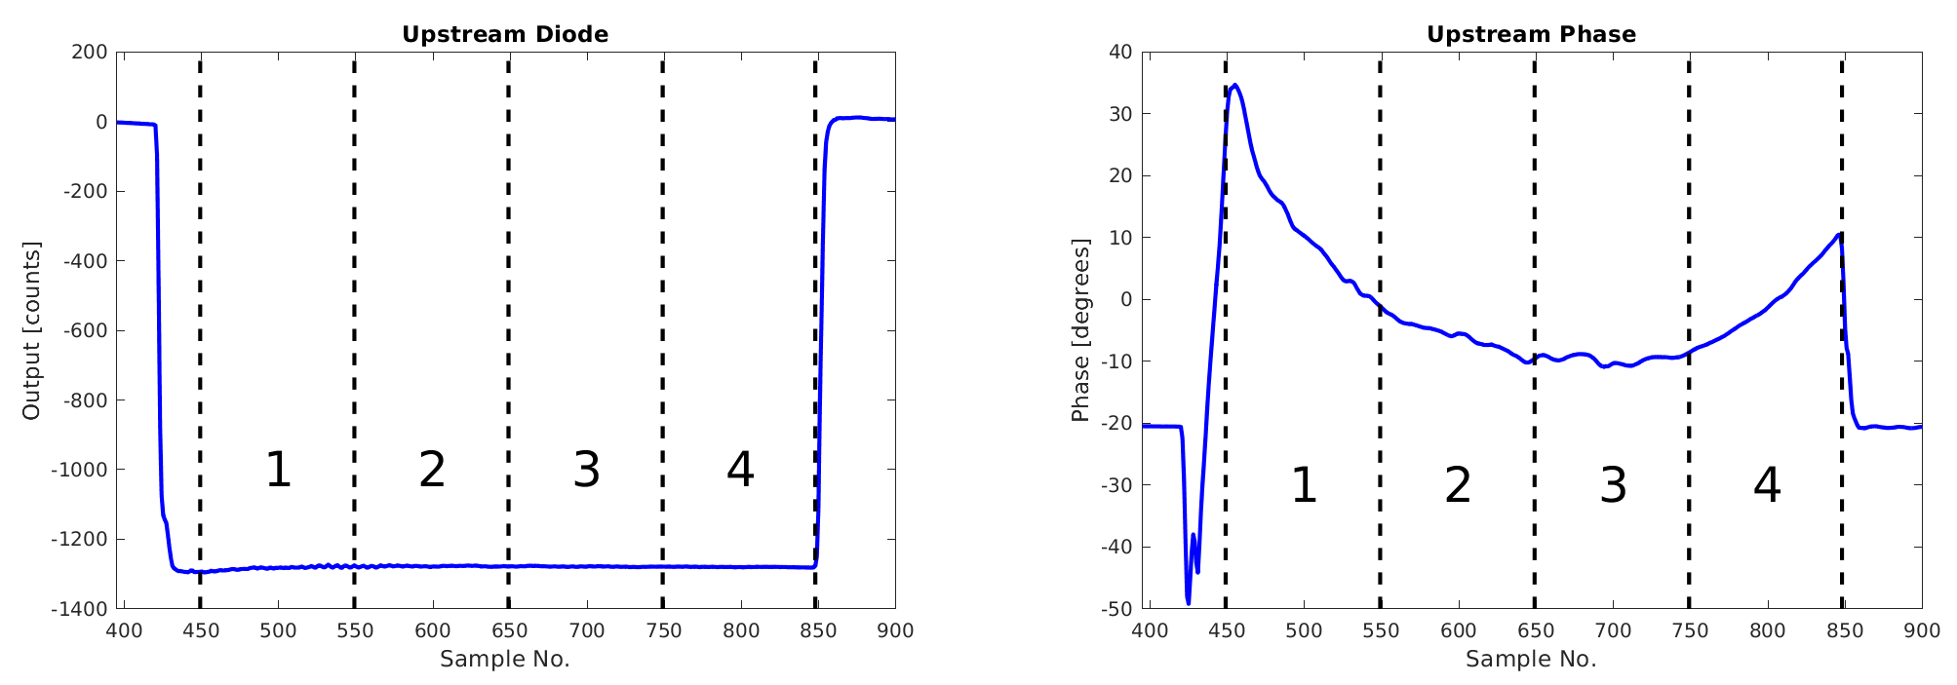
Upstream Sub-Pulses
Four, 280 ns (100 samples) sub-pulses. Defined in firmware from end of pulse.
Note transient at start, which is lost early in the machine and not combined.

Slide 26
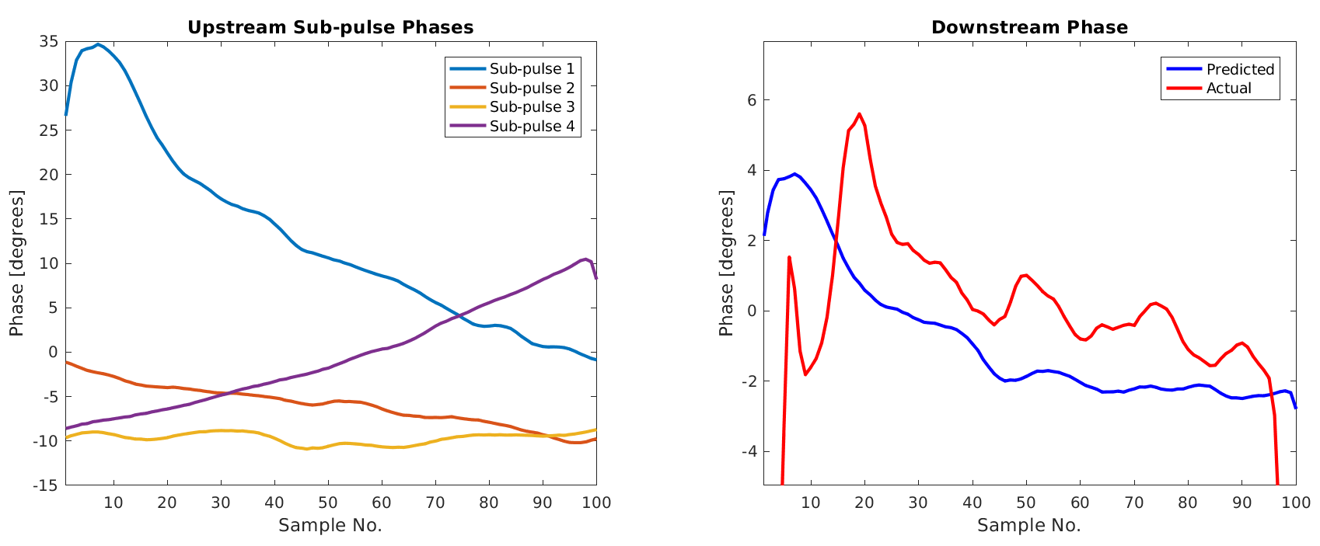
Combined Downstream Phase
Actual combined factor 4 pulse a bit shorter than expected.

Slide 27
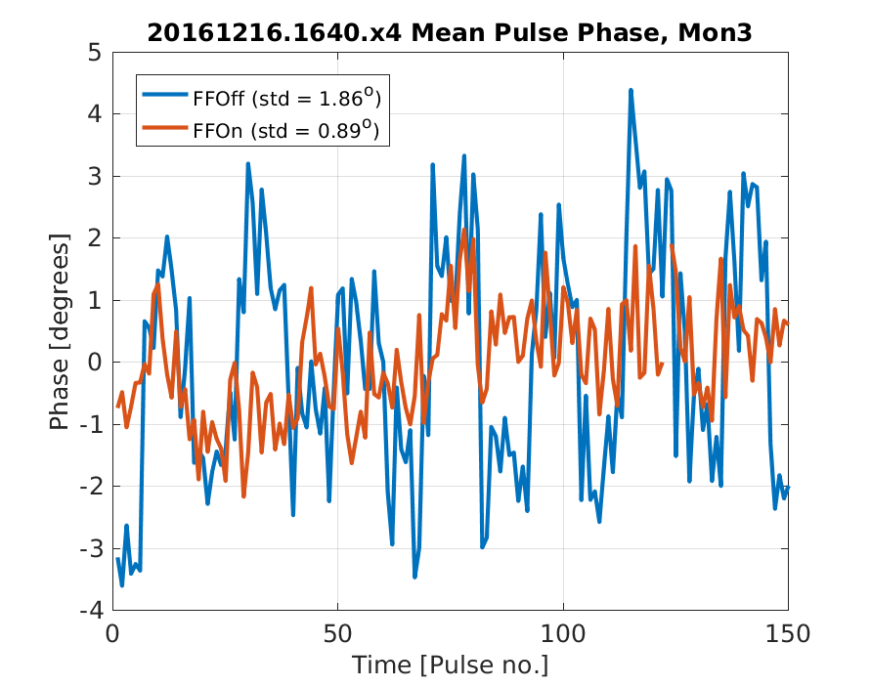
Correction of Mean x4 Phase (with Wiggling)

Slide 28
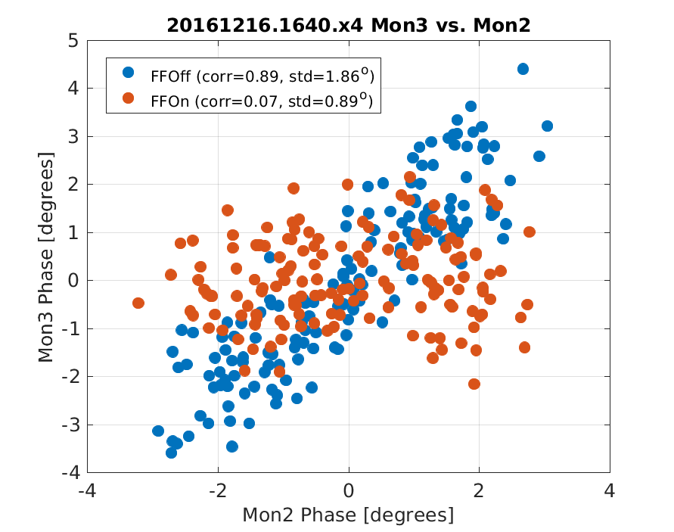
Correction of Mean x4 Phase (with Wiggling)

Slide 29
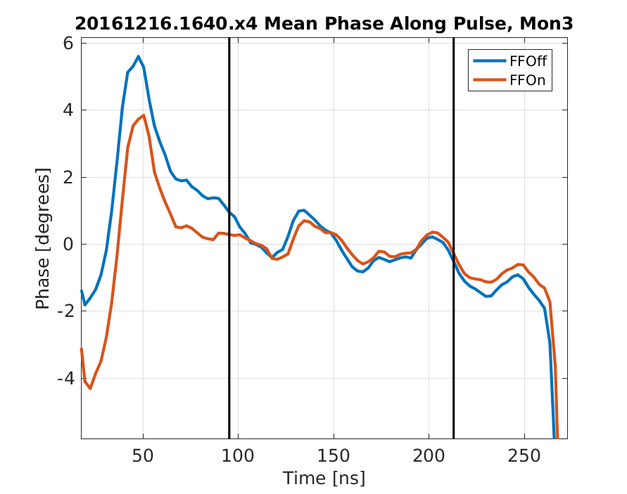
Correction of x4 Pulse Shape

Slide 30
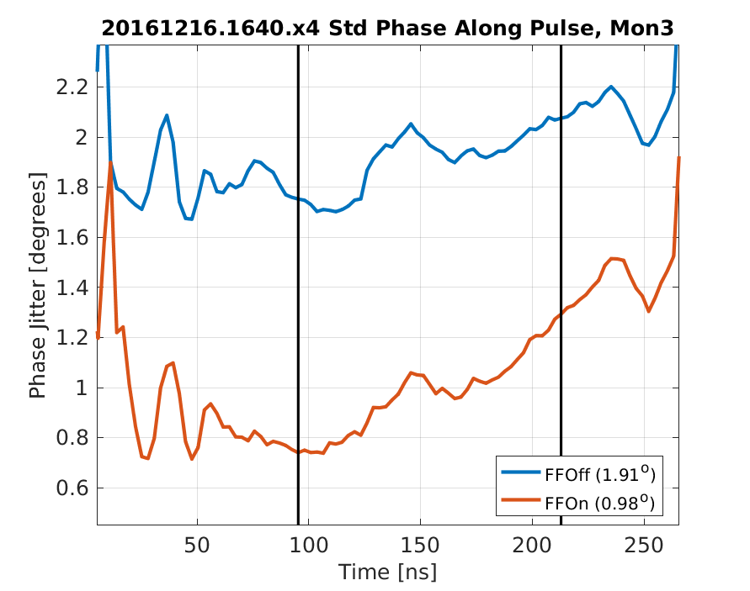
x4 Point-by-Point Jitter (with Wiggling)

Slide 31
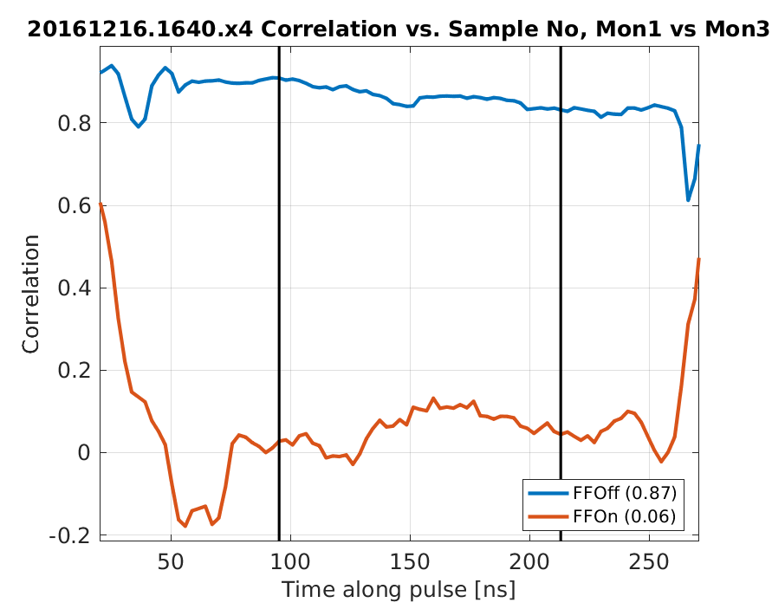
x4 Point-by-Point Correlation (with Wiggling)

Slide 32
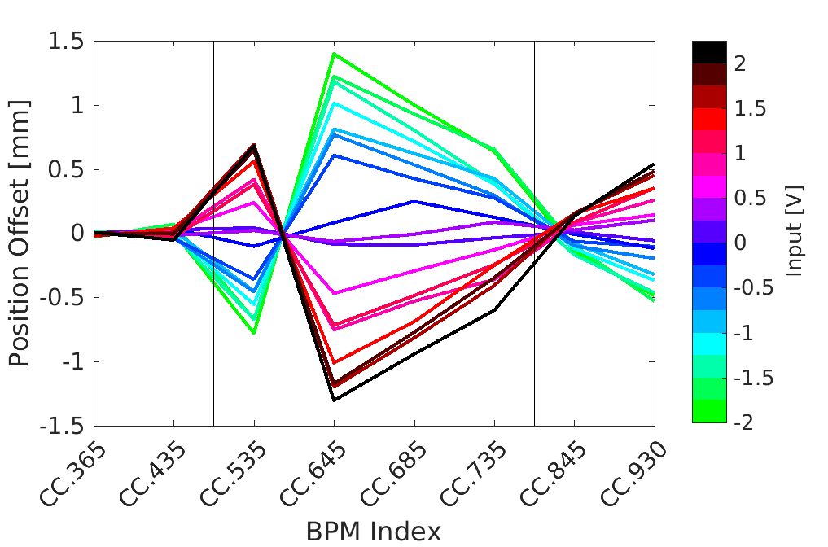
Orbit Closure
PFF system should not degrade beam orbit stability after chicane – i.e. position after chicane is independent of kick.
Last year – 0.5 mm offset in CC.930 for max kick. Some quadrupoles not nominal in TL2.

Slide 33
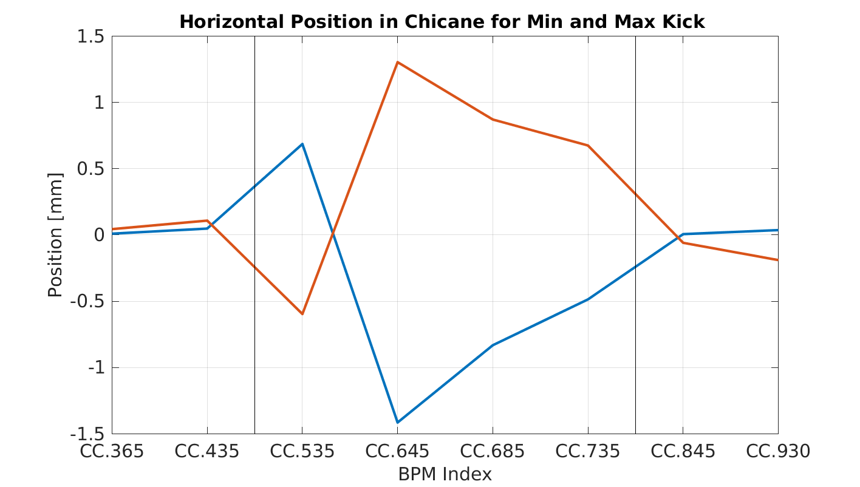
Orbit Closure
2 weeks ago with nominal PFF optics in TL2. 0.1 mm in CC.930.

Slide 34
Phase Monitor Resolution
Consistently measuring <0.2 degrees, and close to record (0.12 degrees point-by-point) in December.
Changes:
  Using the FONT5a board and not the SiS digitisers.
  Winter not summer – suspect reduced drifts/noise in electronics.
  Lower output from second mixer (since August) – suspect death of dodgy component in second mixer.

Slide 35
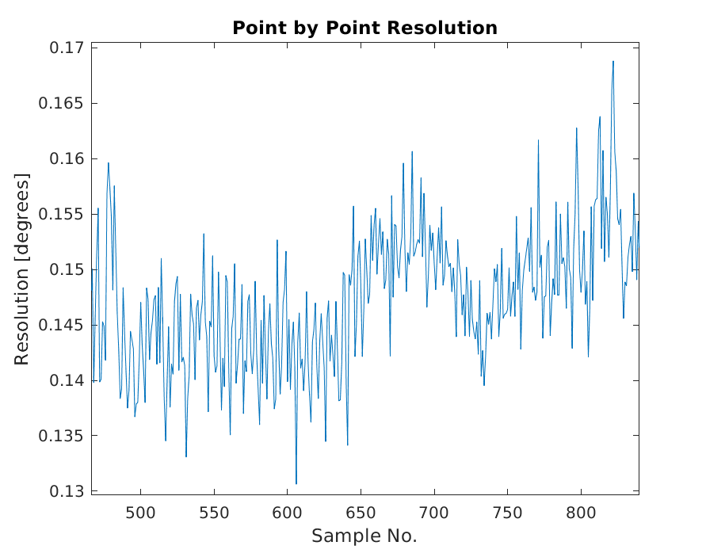
Example of Phase Monitor Resolution

Slide 36
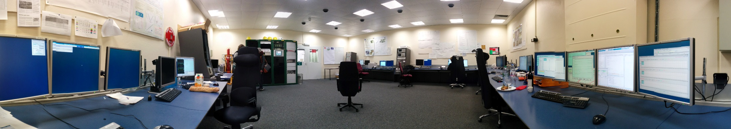
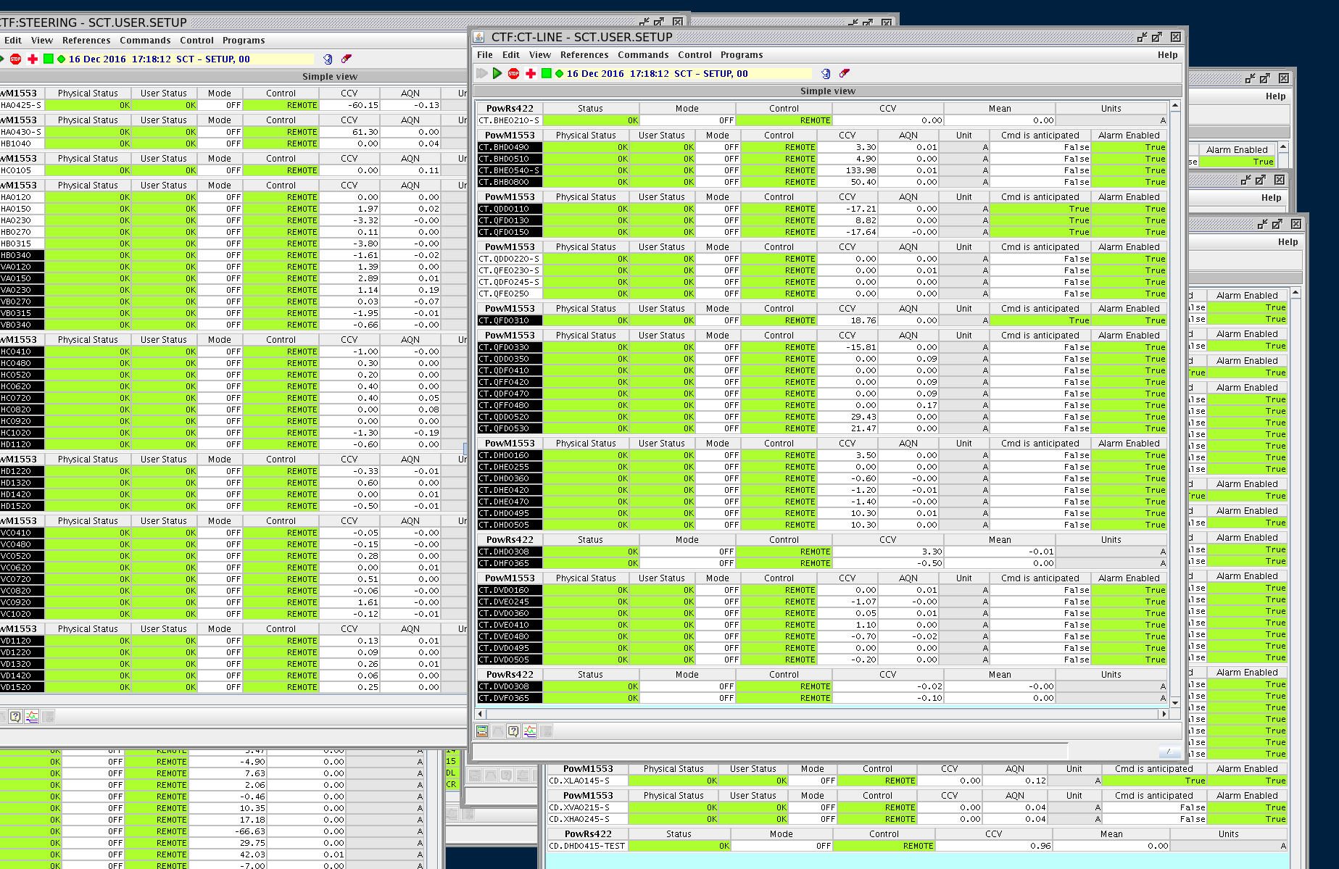
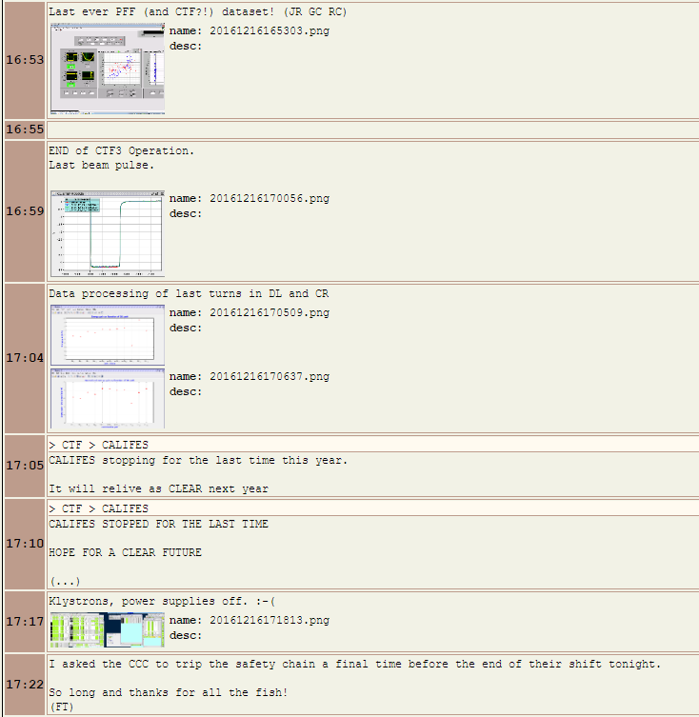
Bye bye CTF3!

Slide 37
Summary
Very productive few days of shifts!
Jitter achievements:
  0.18 (maybe 0.17) degrees mean phase jitter across 2 minutes.
  0.20 degrees mean phase jitter across 10 minutes.
  0.30 degrees mean phase jitter across 20 minutes.
  Better than 0.20 degrees single point jitter across 2 minutes (maybe better).
Demonstrated a reduction in jitter for a factor 4 beam (at least with wiggling).
Demonstrated orbit closure.
Many more bits and pieces not seen here (2 input correction, gain scan etc.).
Merry Christmas!!!

