Slide 1
IP BPM archaeology
T. Bromwich (using slides by S. Jang)

Slide 2
Key parameters
f₀ = resonant frequency of the cavity.
Δf₀ = bandwidth at half maximum.
Q = Quality factor = Energy stored in cavity/ Energy dissipated in cavity walls per radian (higher the Q factor, the lower the rate of energy loss relative to stored energy i.e. oscillations die out more slowly)
Q_{L} = loaded Q factor – calculated Q for the cavity connected to outside world – total losses combined with source and load resistances. This is, by necessity, the first Q factor you can calculate from measurements. Q₀ = unloaded Q factor – calculated Q for the cavity alone, isolated from rest of the system. Q_{ext} = external Q factor - calculated Q for the external coupling structure.
β = coupling factor = ratio of power loss externally to power loss in the cavity.
τ = decay time of the cavity.

Slide 3
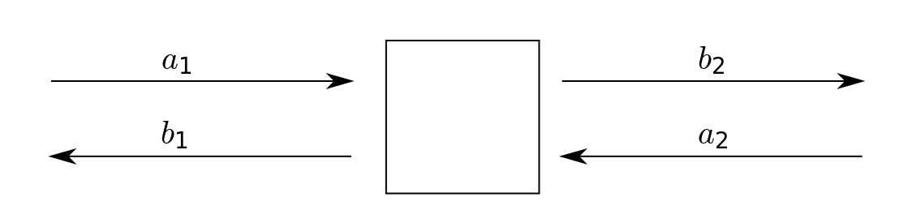
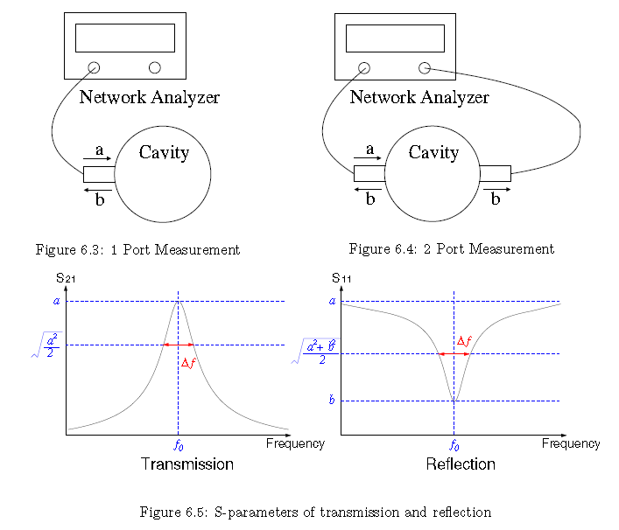
S-parameters
Transmission measurement of S₂₁ – network analyzer on both ports. Port 2 terminated so b₂ is totally absorbed and a₂ equal to zero.
Reflection measurement of S₁₁ – network analyzer on one port. Again, port 2 terminated so a₂ becomes zero.
Note: the magnitude of the S₂₁ expressed in decibels is called insertion loss, α. Since S₂₁ is always smaller than unity, α is a negative number. To compute S₂₁ you use:
https://engineering.olemiss.edu/~eedarko/experience/rfqmeas2b.pdf

Slide 4
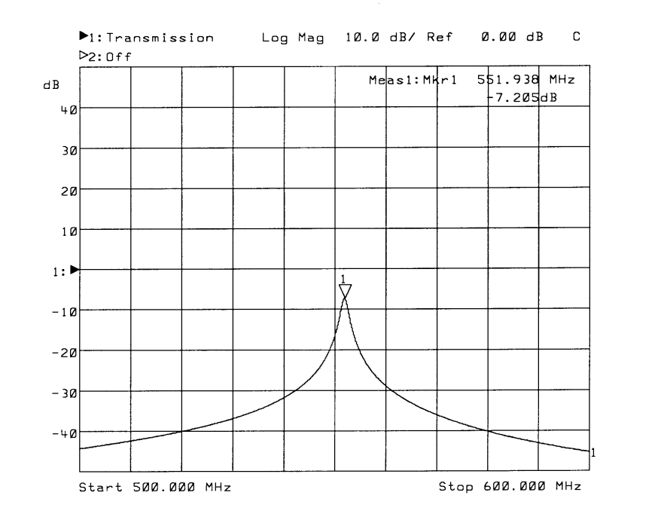
How parameters have been measured / calculated
calculated
calculated
calculated
physical dimensions of the cavity
measured
 | X (m) | Y (m) | f₀ (GHz) | Δf (MHz) | Q_{L} | Decay time(ns) | S21(dB) | S21 | Β | Q₀ | Qext
Simulation | 0.04855 | 0.06085 | 6.4270 | 11.10 | 579.009 | 14.338 | -1.3595 | 0.855 | 5.902 | 3996.361 | 677.112
calculated
α measured in dB
calculated
 | measured
 | calculated
calculated
Transmission measurement
Reflection measurement

Slide 5
IPBPM chronology
 | Currently installed
 | In Oxford
 |  |  | Installed | Notes
IPA | IPB |  | Before 2013 | Copper brazed
IPA | IPB | IPC | July 2013 | Aluminium #1
IPA | IPB | IPC | November 2014 | Aluminium #2 new dimensions
 |  | IPC | March 2016 | Aluminium #3 with indium sealing + no chemical polishing + better accuracy
Note: Aluminium #2 were fabricated twice, because the first time they were built to incorrect dimensions. 17 September 2014 IPBPM/FONT meeting IPBPM refabrication status and electronics repair status,(IPBPM RF test, Ref. BPM resonant freq. measurement, LPF replacement of electronics) by Siwon Jang : http://atf.kek.jp/twiki/bin/exit.cgi?url=http%3A%2F%2Fatf.kek.jp%2Ftwiki%2Fpub%2FATF%2FIPBPMmeetings2%2FIP-BPM_status_%28140917%29.pptx
This faulty first batch were never installed ATF, however, they were RF tested at KNU in September 2015 to show that the problem with the installed Aluminium #2 IPC was specific to that one BPM, hence the decision to re-fabricate IPC
The IPC from this faulty batch was also re-machined to be used for Indium sealing tests.

Slide 6
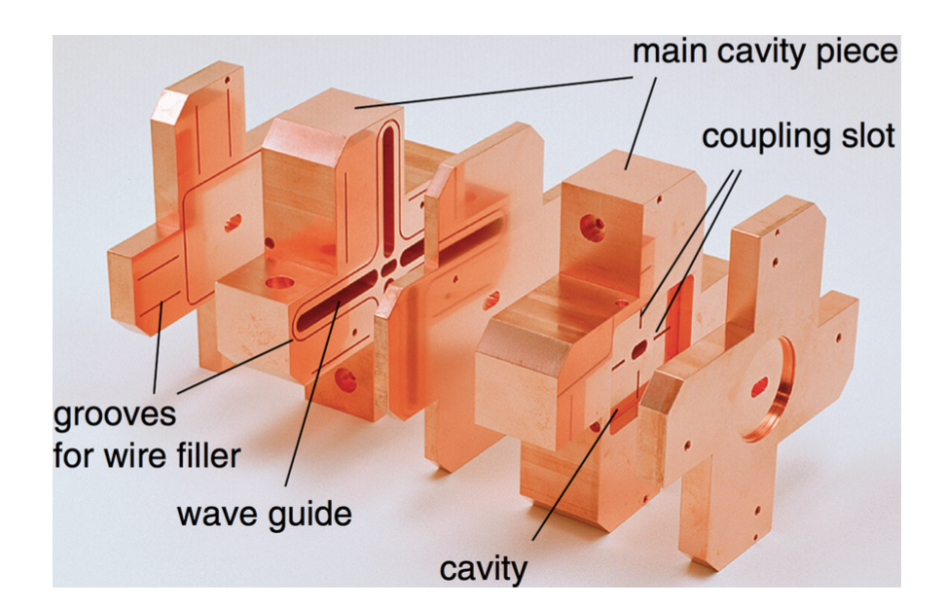
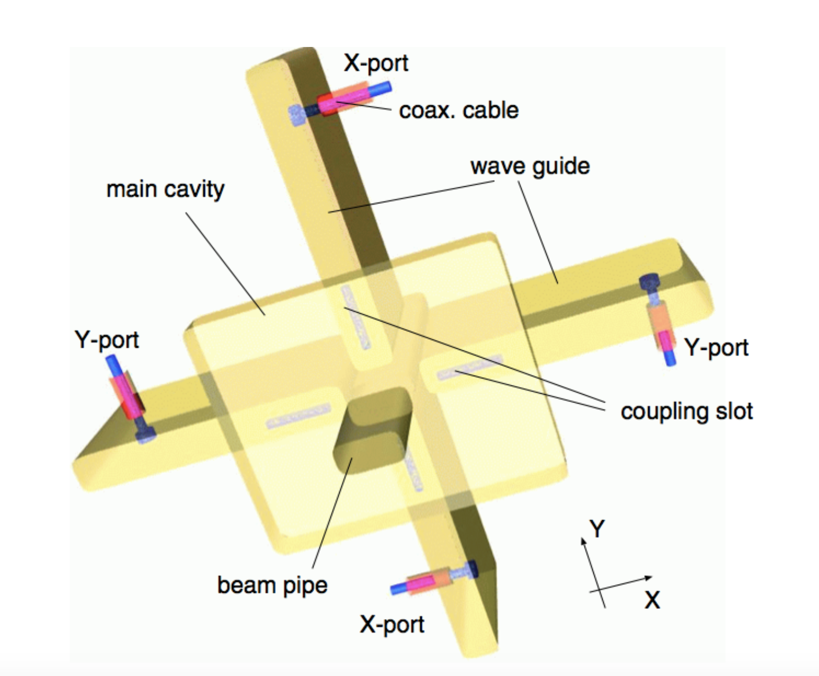
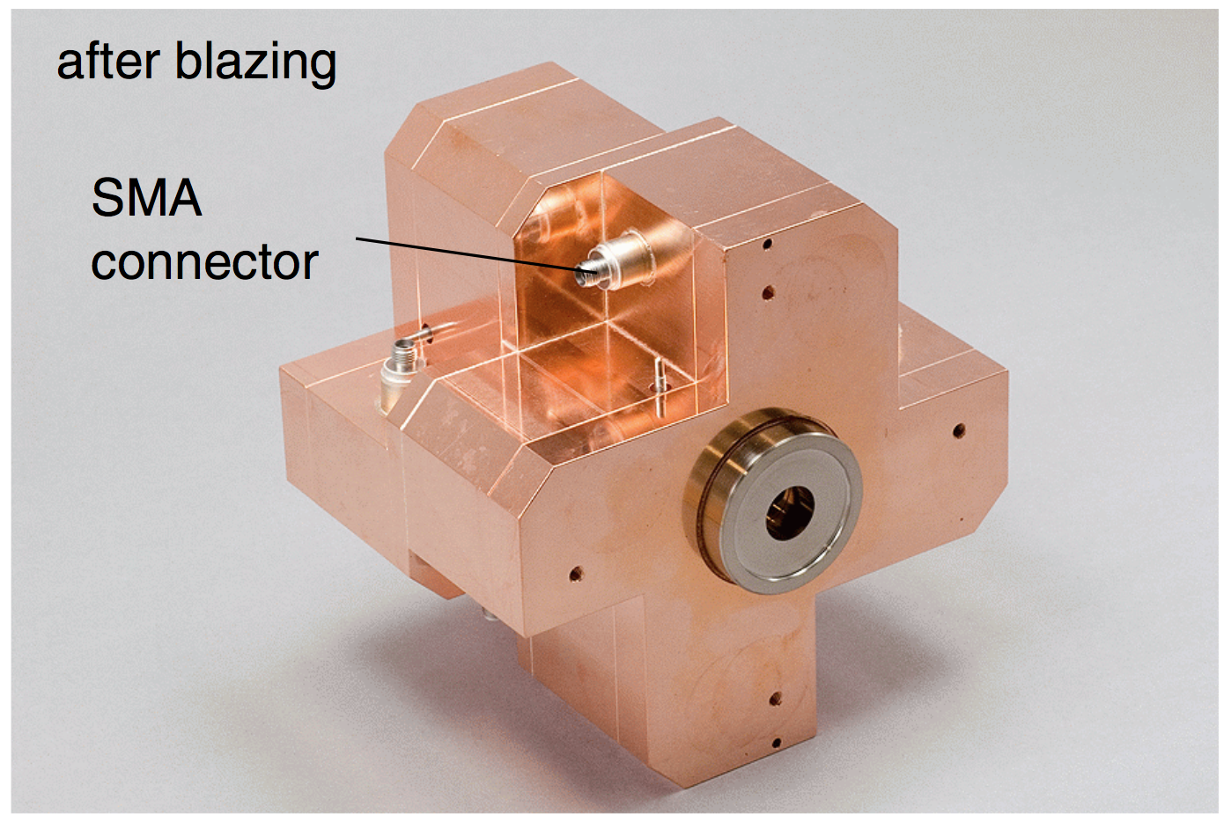
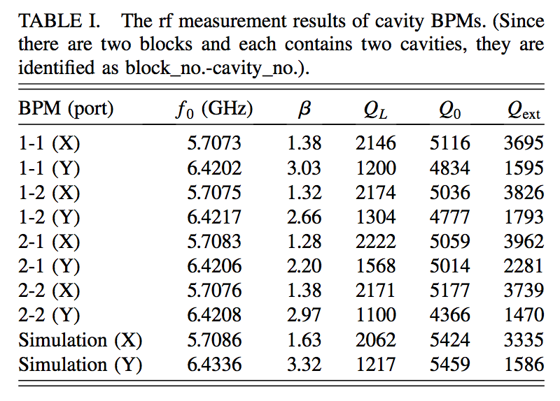
Copper brazed IP BPMs
5 pieces of copper brazed together to form a single block
 | f₀ (GHz) | Q_{L} | Decay time(ns) | Β | Q₀ | Qext
Simulation Y | 6.4336 | 1217 | 30.11 | 3.32 | 5459 | 1586
Measured 1-1(Y) | 6.4202 | 1200 | 29.75 | 3.03 | 4834 | 1595
Example results in Y for 1-1 measurent summarised in Siwon-style table
Y. Inoue, H. Hayano, Y. Honda, etc, Development of a high- resolution cavity-beam position monitor, Phys. Rev. ST Accel. Beams 11 (2008) 062801.

Slide 7
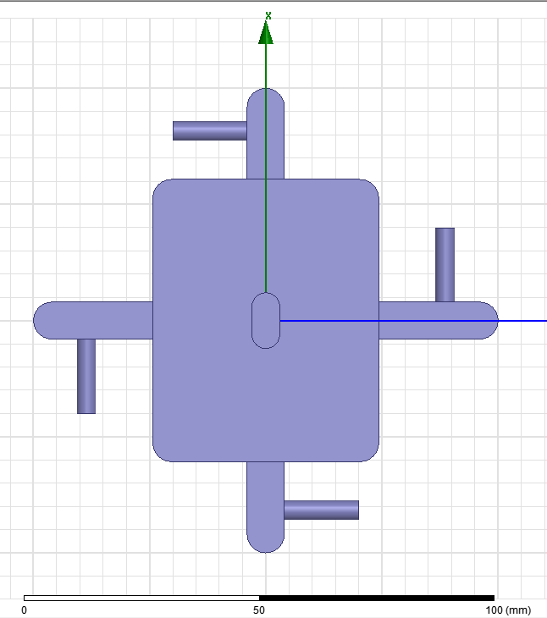
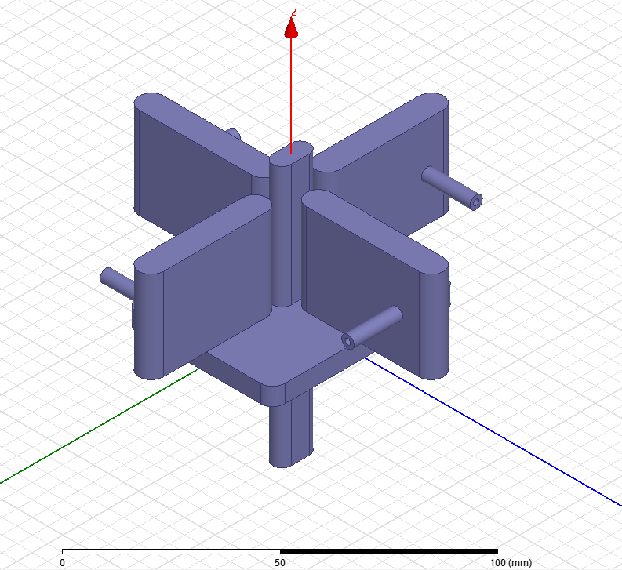
Aluminium #1
100mm
Made from aluminium for low mass, with approximately 1 kg per BPM.
Novelty of a lower Q₀ giving faster signal decay times and minimising signal contamination between different bunches.
X = 48.60mm, Y = 60.90mm
Resonant frequencies found to be lower than simulations.
100mm
Sensor cavity
Wave guide
Antenna
Designed frequency
X-port: 5.712 GHz
Y-port: 6.426 GHz
Full size : 11cmx11cm
(to install IP-Chamber)
Light weight:
1 kg (Single)
2 kg (Double)
Results measured in the IP chamber July 2013
 | f₀ (GHz) | Q_{L} | Decay time(ns) | Β | Q₀ | Qext
Simulation Y | 6.4280 | 698.70 | 17.23 | 5.684 | 4670.43 | 821.61
IPA | 6.4079 | 575.42 | 14.29 | 1.140 | 1231.64 | 1079.99
IPB | 6.4080 | 524.02 | 13.02 | 1.268 | 1188.69 | 937.154
IPC | 6.4075 | 597.71 | 14.85 | 1.206 | 1318.40 | 1093.43
27 February 2014, IPBPM/FONT meeting
IPBPM beam test results and electronics summary by Siwon, http://atf.kek.jp/twiki/bin/exit.cgi?url=http%3A%2F%2Fatf.kek.jp%2Ftwiki%2Fpub%2FATF%2FIPBPMmeetings2%2FIPBPM_beam_test_results_and_electronics_summary.pptx

Slide 8
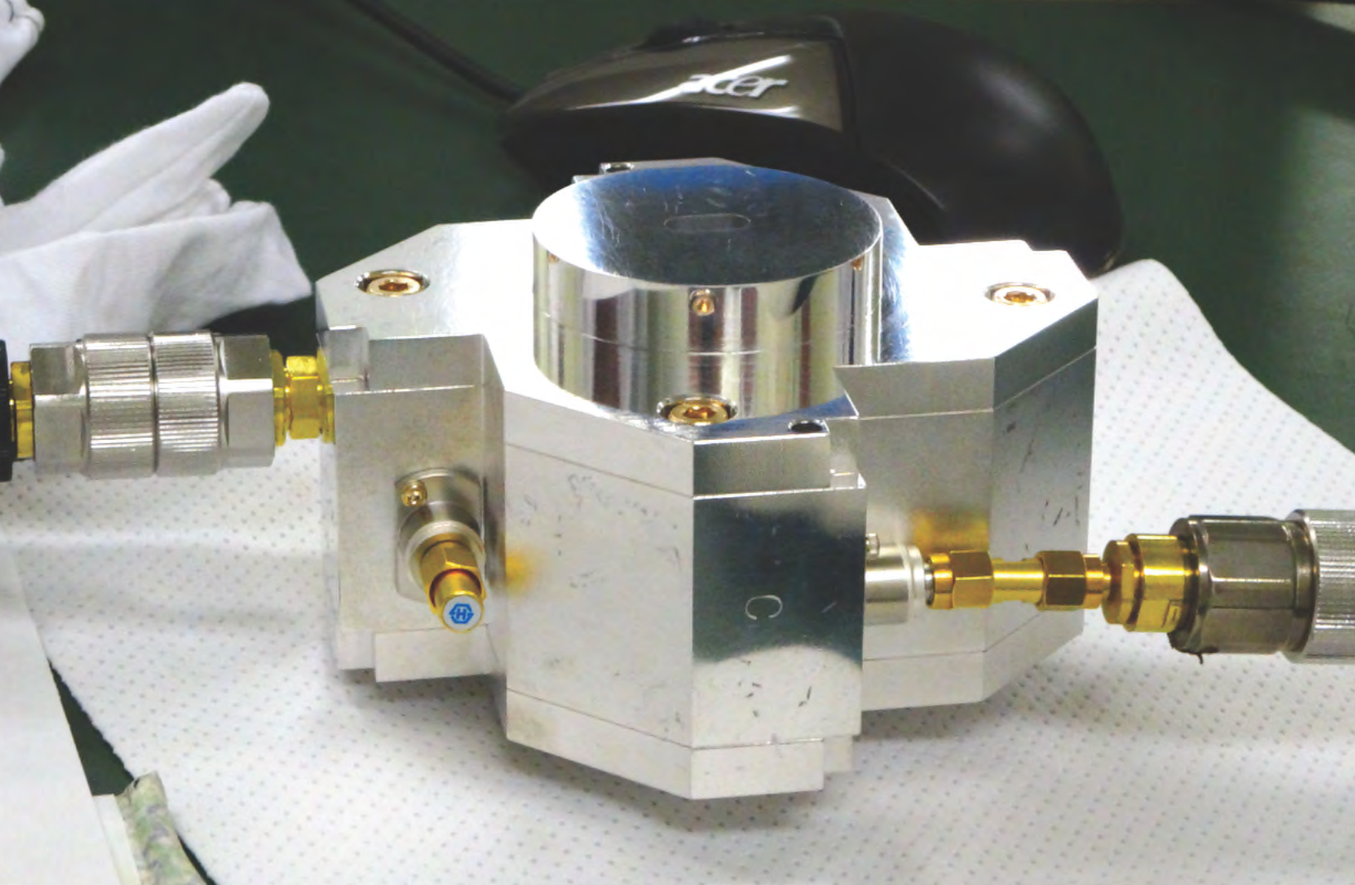
Aluminium #2
Cavities refabricated to have frequency closer to design with slightly modified cavity dimensions X = 48.55mm, Y = 60.85mm
Had to be built twice, as first batch were built to wrong specified dimensions.
Loaded Q values were low, and IPC observed to have lower loaded Q than the other two BPMs.
 | f₀ (GHz) | Δf (MHz) | Q_{L} | Decay time(ns) | Β | Q₀ | Qext
Simulation Y | 6.4345 | 9.100 | 707.1 | 17.49 | 4.761 | 4073.5 | 855.6
IPA | 6.4225 | 13.144 | 488.6 | 12.11 | 0.735 | 847.7 | 1153.3
IPB | 6.420 | 14.148 | 453.8 | 11.25 | 0.723 | 781.7 | 1081.6
IPC | 6.420 | 23.596 | 272.1 | 6.745 | 0.303 | 354.3 | 1171.3
MEASUREMENTS AT KNU 14 October 2014 ATF IPBPM/FONT meeting
IPBPM status by Siwon Jang (The x-port resonance problem solve and KNU electronics status) : http://atf.kek.jp/twiki/bin/exit.cgi?url=http%3A%2F%2Fatf.kek.jp%2Ftwiki%2Fpub%2FATF%2FIPBPMmeetings2%2FIPBPM_status_%28141014%29.pptx
IPA | 6.4210 | 15.0 | 428 | 10.61 | 0.5/0.49 | 626 | 1227
IPB | 6.4200 | 15.5 | 414 | 10.26 | 0.47/0.75 | 666 | 1092
IPC | 6.4165 | 24.0 | 267 | 6.62 | 0.28/0.30 | 344 | 1186
RE-MEASURED BY HONDA AT ATF 4 November 2014 ATF IPBPM/FONT meeting
Y.Honda, RF measurements of IPBPMs on 30th October 2014 at KEK http://atf.kek.jp/twiki/bin/exit.cgi?url=http%3A%2F%2Fatf.kek.jp%2Ftwiki%2Fpub%2FATF%2FIPBPMmeetings2%2FIPBPM141030_honda.pdf
Calculated from S21/S11

Slide 9
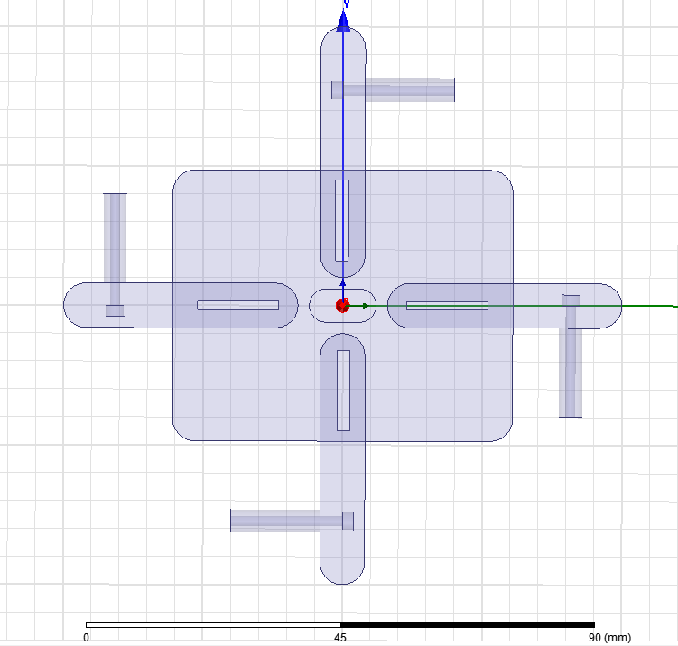
Low Q investigations
Y-slot size:
1.5x1.5x14.5
Center position:
X: ±18.75mm
Because of lower loaded Q values than predicted, studies were performed to see if gaps between between walls in the aluminium pieces could be a source of lowering the Q.
Faulty-dimension Aluminium #2 IPC with case tightened and loosened was RF tested. This was not found to radically change the loaded Q.
Simulations were run for different surface materials (Copper and Silver), different Copper coating dimensions, different cavity lengths and slot size and position modifications. Only the slot modifications were found to strongly effect the loaded Q.
See original slides for all results of all studies.
Y-slot
18.75mm
Slot1: x and y port slot size change to 1.5mm x 1.5mm x 13mm.
Slot2: slot size change and y-port slot position shift -0.5mm. (x: 18.25mm)
Slot3: slot size change and y-port slot position shift +0.5mm. (x: 19.25mm)
 | f₀ | Δf | Q_{L} | Decay time | S21(dB) | S21 | Β | Q₀ | Qext
Original_Al Re-Cal. | 6.4221 | 0.0111 | 578.568 | 14.338 | -1.6408 | 0.85 | 5.684 | 3867.43 | 680.348
Design_Al Slot1 | 6.4330 | 0.005900 | 1090.339 | 26.975 | -2.6710 | 0.735 | 2.778 | 4118.766 | 1482.899
Design_Al Slot2 | 6.4293 | 0.005800 | 1108.500 | 27.441 | -2.7391 | 0.730 | 2.697 | 4098.468 | 1519.465
Design_Al Slot3 | 6.4391 | 0.005900 | 1091.373 | 26.975 | -2.6785 | 0.735 | 2.768 | 4112.812 | 1485.587
10 September 2015 ATF IPBPM/FONT meeting
Siwon Jang, IPBPM-C surface coating study`
http://atf.kek.jp/twiki/bin/exit.cgi?url=http%3A%2F%2Fatf.kek.jp%2Ftwiki%2Fpub%2FATF%2FIPBPMmeetings2%2FIPBPM-C_cavity_surface_coating_study.pptx

Slide 10
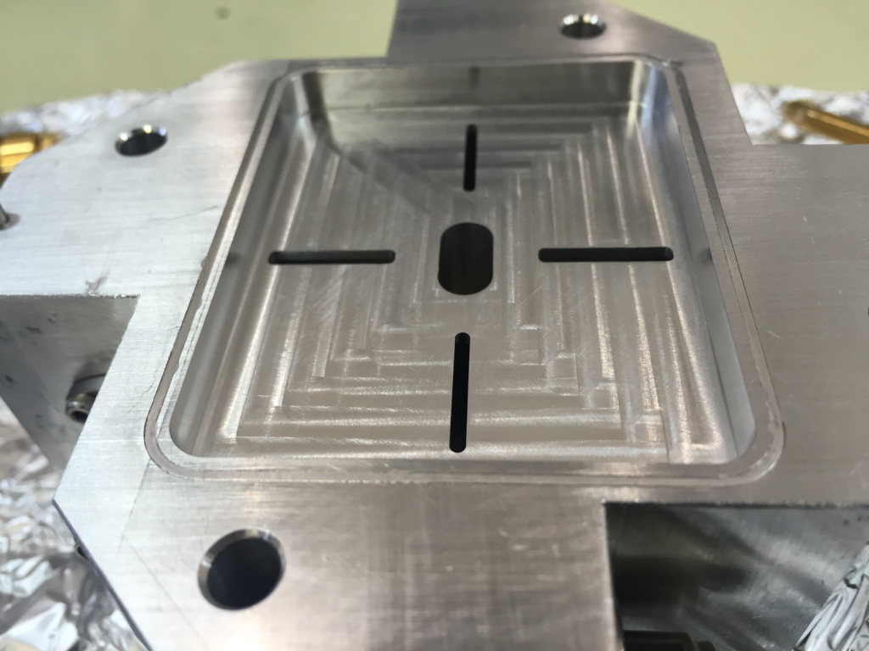
Indium tests on old IPC
Aluminium #2 faulty-dimensions IPC was re-machined to test the effects of including indium sealing.
The RF measurement results shows higher Q _{L} value than original one. The resonance frequency was increased around 2MHz than measured frequency before indium sealing.
Before
Indium seal
After
Indium seal
Indium sealing part
 | f₀ | Δf | Q_{L} | Decay time | S21(dB) | S21 | Β | Q₀ | Qext
Simulation | 6.42550 | 0.01070 | 600.514 | 14.874 | -1.4116 | 0.850 | 5.684 | 4014.131 | 706.155
IP-BPM C_S21 | 6.407448 | 0.010720 | 597.710 | 14.847 | -5.2460 | 0.547 | 1.206 | 1318.395 | 1093.428
Indium_C_S21 | 6.409400 | 0.007380 | 868.482 | 21.566 | -3.0800 | 0.701 | 2.350 | 2909.053 | 1238.115
Indium_C_S12 | 6.409200 | 0.007380 | 868.455 | 21.566 | -2.9311 | 0.714 | 2.491 | 3032.145 | 1217.033
- Indium wire diameter: 1mm
- Groove depth:0.8mm
- Groove width:1mm
29 October 2015 ATF IPBPM/FONT meeting
Siwon Jang(Korea Univ.), Old IPBPM-C indium sealing study: http://atf.kek.jp/twiki/bin/exit.cgi?url=http%3A%2F%2Fatf.kek.jp%2Ftwiki%2Fpub%2FATF%2FIPBPMmeetings2%2FOld_IPBPM-C_indium_sealing_study.pdf

Slide 11
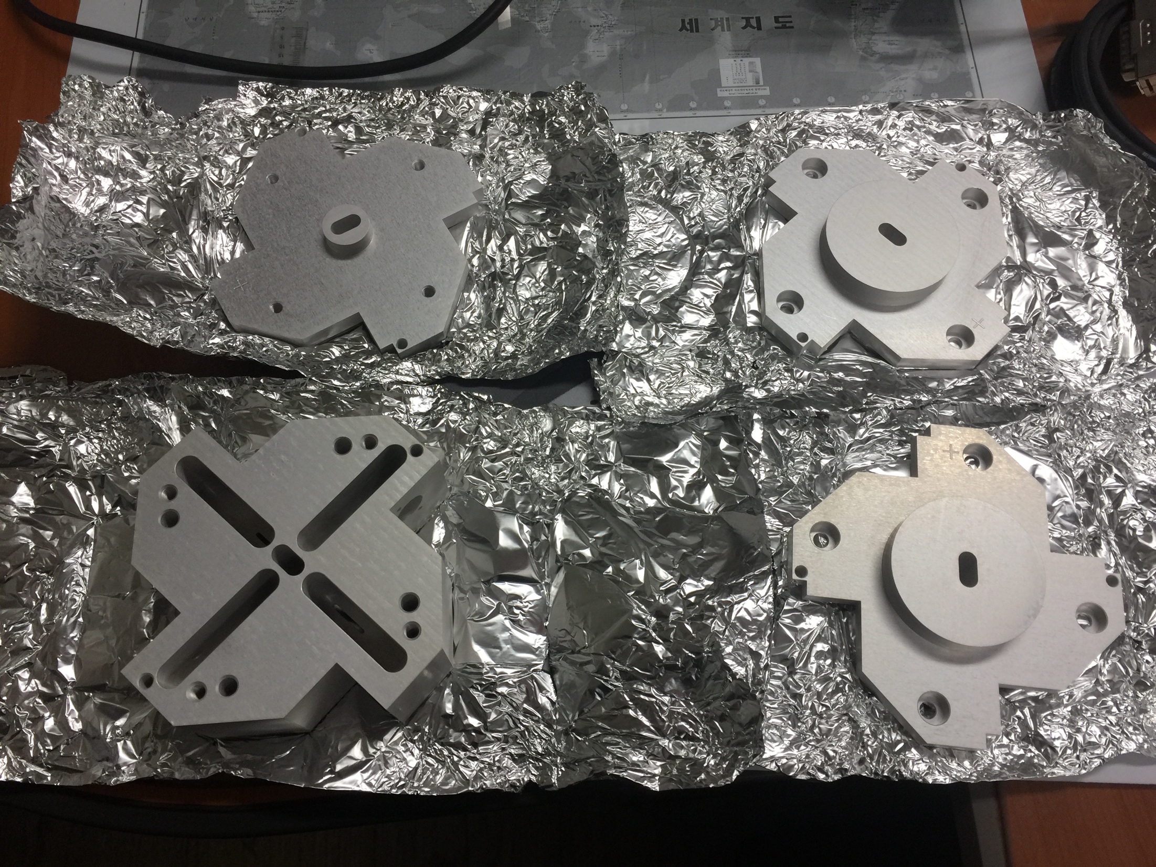
Nov 2015 to Feb 2016 – New IPC fabricated
The new IPC was re-fabricated using different methods.
Previous IPBPM fabrication method involved: Machining (with 20 um accuracy) + Chemical polishing.
New IP BPM-C: Only Machining (with 4 um accuracy).
Indium sealing applied to new IPC to attempt to recover the beta value and increase Q _{L}
A new side cover design was also tried, but was not ultimately used, as slightly higher Q _{L} and Beta values achieved with indium-sealed original cover design.
It is not clear if the suggested changes to the slot size / position from simulations were implemented in the newly fabricated Aluminium #3 IPC. Presumably yes??
22 January 2016 ATF IPBPM/FONT meeting after the ATF Operation meeting
Siwon Jang(Korea Univ.), RF test of New IPBPM-C http://atf.kek.jp/twiki/bin/exit.cgi?url=http%3A%2F%2Fatf.kek.jp%2Ftwiki%2Fpub%2FATF%2FIPBPMmeetings2%2FNew_IPC_RF_test_results.pptx

Slide 12
Aluminium #3 IPC Y-port RF tests
Before
Indium seal
First
Indium seal
Second
Re-Indium seal
Final check
Before install
The measured loaded Q value and beta value are increased for the y-ports by indium seal.
 | X (m) | Y (m) | f₀ (GHz) | Δf (MHz) | Q_{L} | Decay time(ns) | S21(dB) | S21 | Β | Q₀ | Qext
Simulation | 0.04855 | 0.06085 | 6.4270 | 11.10 | 579.009 | 14.338 | -1.3595 | 0.855 | 5.902 | 3996.361 | 677.112
IPC_S21 | 0.04855 | 0.06085 | 6.42320 | 9.86 | 651.440 | 16.141 | -4.4970 | 0.596 | 1.474 | 1611.949 | 1093.263
IPC_S12 | 0.04855 | 0.06085 | 6.42320 | 9.42 | 681.868 | 16.895 | -4.8260 | 0.574 | 1.346 | 1599.579 | 1188.504
IPC_S11 | 0.04855 | 0.06085 | 6.421250 | 9.75 | 658.590 | 16.324 | -4.557 | 0.592 | 1.449 | 1613.158 | 1112.974
IPC_S22 | 0.04855 | 0.06085 | 6.421250 | 10.00 | 642.125 | 15.915 | -5.044 | 0.560 | 1.270 | 1457.763 | 1147.649
IPC_S11 | 0.04855 | 0.06085 | 6.421750 | 8.22 | 781.235 | 19.362 | -3.583 | 0.662 | 1.959 | 2311.301 | 1180.124
IPC_S22 | 0.04855 | 0.06085 | 6.421750 | 8.67 | 740.686 | 18.357 | -3.592 | 0.661 | 1.953 | 2186.877 | 1120.039
IPC_S22 | 0.04855 | 0.06085 | 6.422500 | 8.58 | 748.543 | 18.550 | -4.002 | 0.631 | 1.709 | 2027.540 | 1186.634
4 March 2016 ATF IPBPM/FONT meeting after Friday's ATF operation meeting
Siwon Jang(Korea University), New IPC RF test before installatio http://atf.kek.jp/twiki/bin/exit.cgi?url=http%3A%2F%2Fatf.kek.jp%2Ftwiki%2Fpub%2FATF%2FIPBPMmeetings2%2FIPC_RF_test_before_install_Feb_2016.pptx

