Slide 1
SIS digitiser sample jumps
N. Blaskovic, T. Bromwich

Slide 2
Outline
1 December 2016 – Day Shift: Attempted to use SIS digitiser for IP BPMs. Sample jumps observed.
    Files taken:
    jitRun7 FONT Repeats _{1:...}, charge ~ 0.8 x 10^10
    AOC2FFxScan1 _-1mm SIS 20 dB in x and y, 60 dB in Ref (X) and Ref(Y), QD0FF current: 128.784 A. Two populations: sample jitter?
    jitRun8 FONT Repeats _{1:...}, charge ~ 0.8 x 10^10
    IPByCal1 _20dB SIS At AOC2FF (X) = AOC2FF (Y) = 0 mm
    IPCyCal1 _20dB SIS IQ plot: points not on straight line, sample jumps
    IPCyCal2 _20dB SIS Repeat, sample jumps!
    IPCyCal3 _20dB SIS Repeat, fewer sample jumps. Sample jumps are on SIS digitiser only, not FONT5 board
    IPCyCal4 _20dB SIS Repeat, no sample jumps? Saturation at high end?
    IPBxCal1 _20dB SIS
    IPCxCal1 _20dB SIS
    AOC2FFxScan2 _0mm SIS Sample jumps
    ICTscan3 FONT Charge at DR (10^10): 0.85, 0.7, 0.55, 0.4, 0.3, 0.15
SIS digitiser sampling rate 238 MHz (4.2 ns)
FONT board sampling rate 357 MHz (2.8 ns)
Damping ring RF master oscillator 714 MHz (1.4 ns), 165 usable buckets, 357 MHz (2.8 ns apart)
One SIS digitiser sample jump = 3 periods of 714 MHz
One FONT board sample jump = 2 periods of 714 MHz

Slide 3
AOC2FFxScan2_0mm_ipbpm_161201

Slide 4
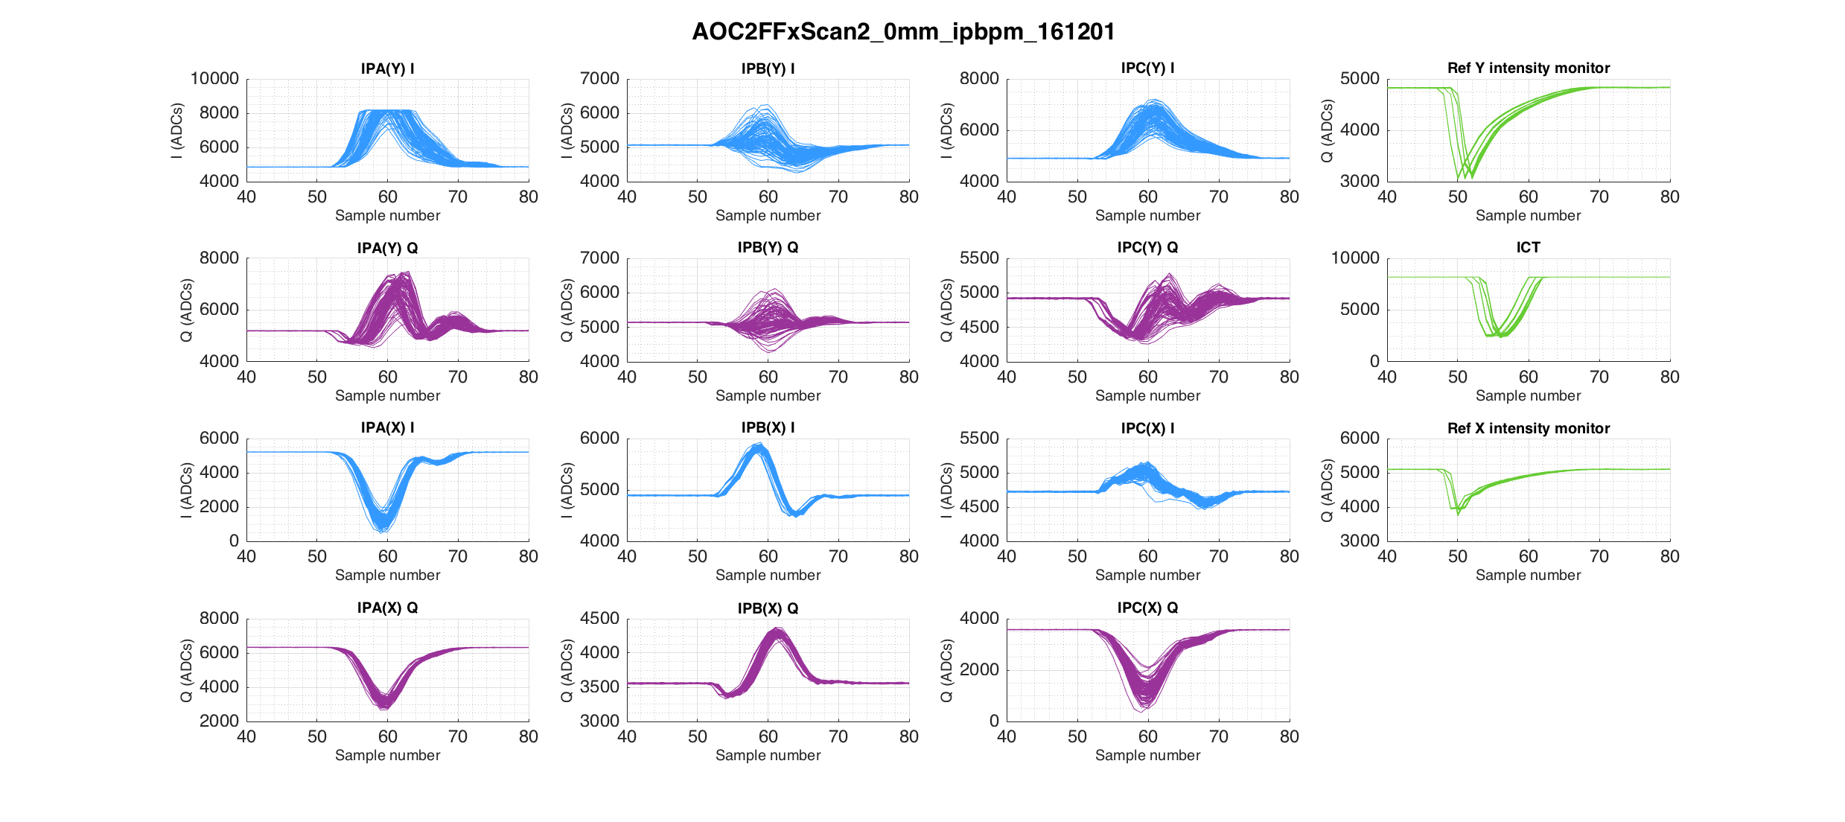
Waveforms

Slide 5
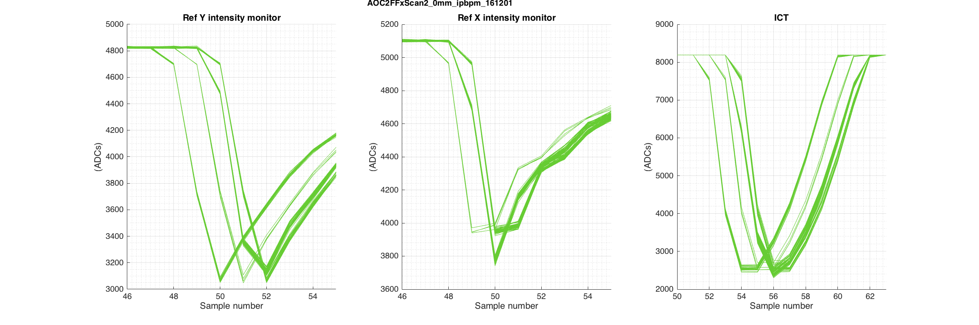
Reference cavity signals and ICT
Sample jumps most clearly visible on the reference cavity signals as the waveforms are sharper

Slide 6
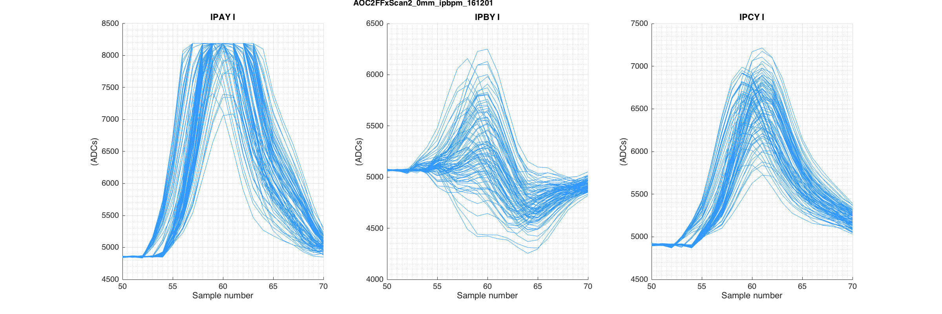
IP BPM I signals
Sample jumps trickier to differentiate, but still visible.

Slide 7
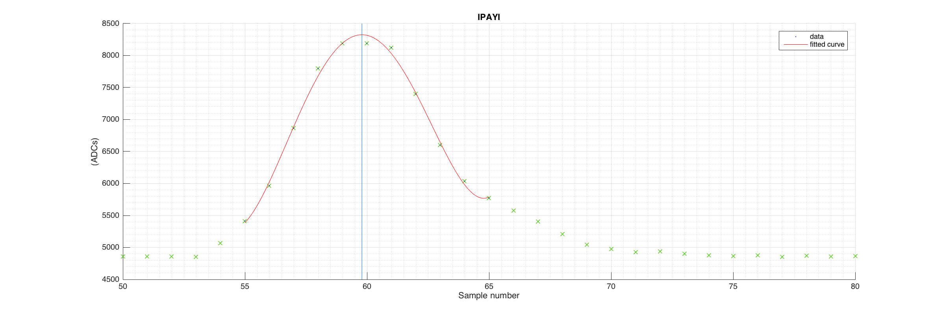
Identify peak location
4th order polynomial fit applied to the peak region of the I signal waveforms to interpolate and find an estimate for the maximum.

Slide 8
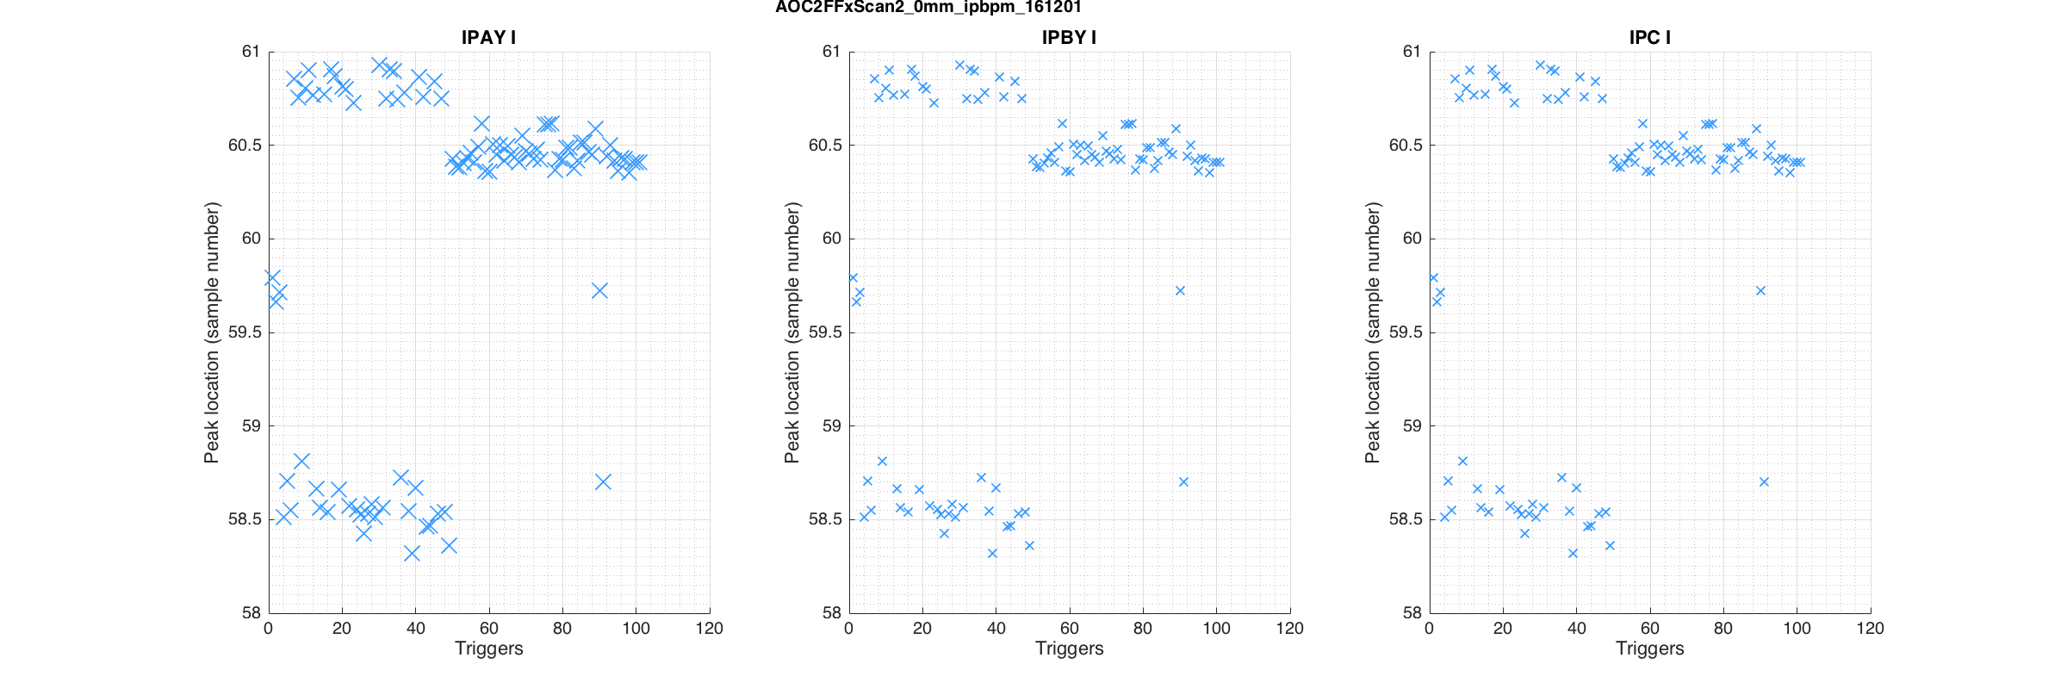
Peak location across many triggers – I signals Y
Calculated from the interpolated maximum to account for maximum falling between sample numbers.
⅓ SIS sample number = 1 period of 714 MHz
Fits for the peaks may not be perfect, but gives a temporal sense of when the jumps occur and the approximate size of the step

Slide 9
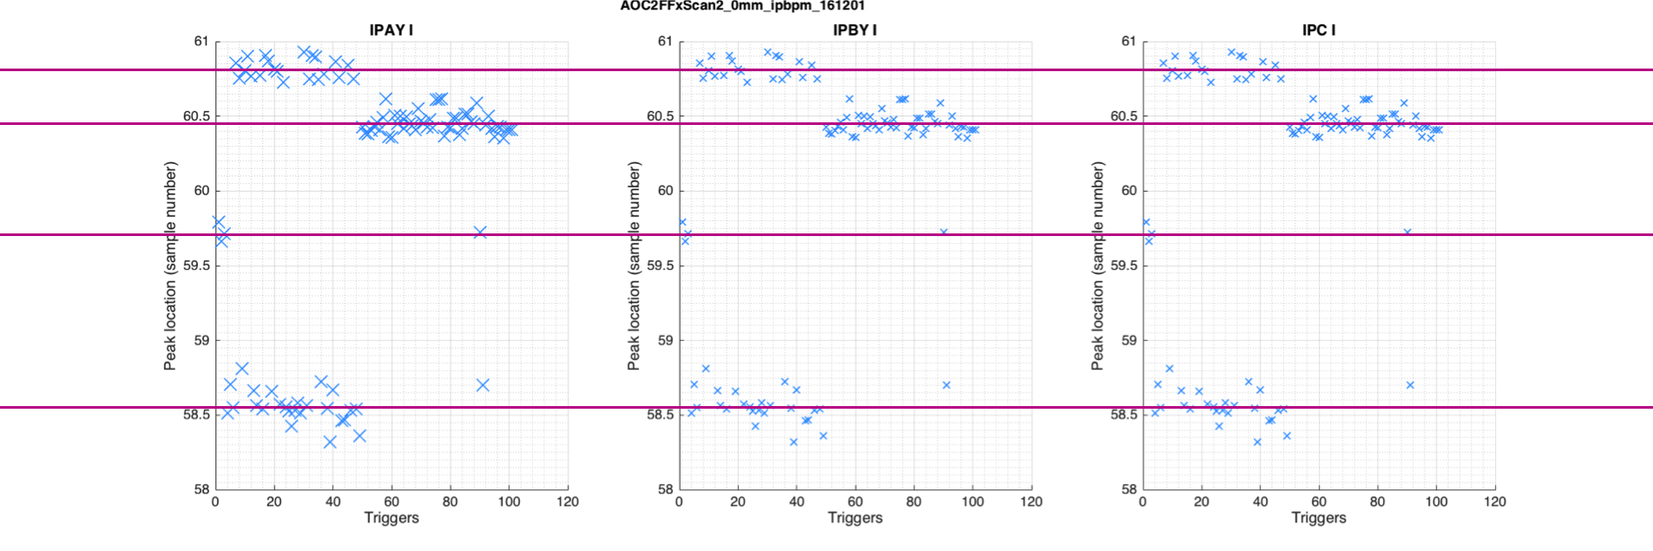
Peak location across many triggers – I signals Y
Calculated from the interpolated maximum to account for maximum falling between sample numbers.
⅓ SIS sample number = 1 period of 714 MHz
Fits for the peaks may not be perfect, but gives a temporal sense of when the jumps occur and the approximate size of the step
0.35
0.75
1.15

Slide 10
Reference and ICT waveforms from other SIS data files on this shift

Slide 11
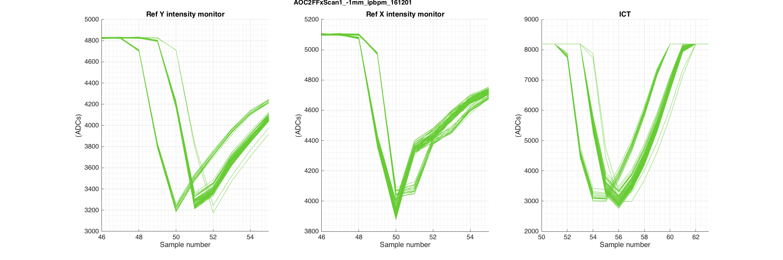
AOC2FFxScan1_-1mm_ipbpm_161201

Slide 12
AOC2FFxScan2_0mm_ipbpm_161201

Slide 13
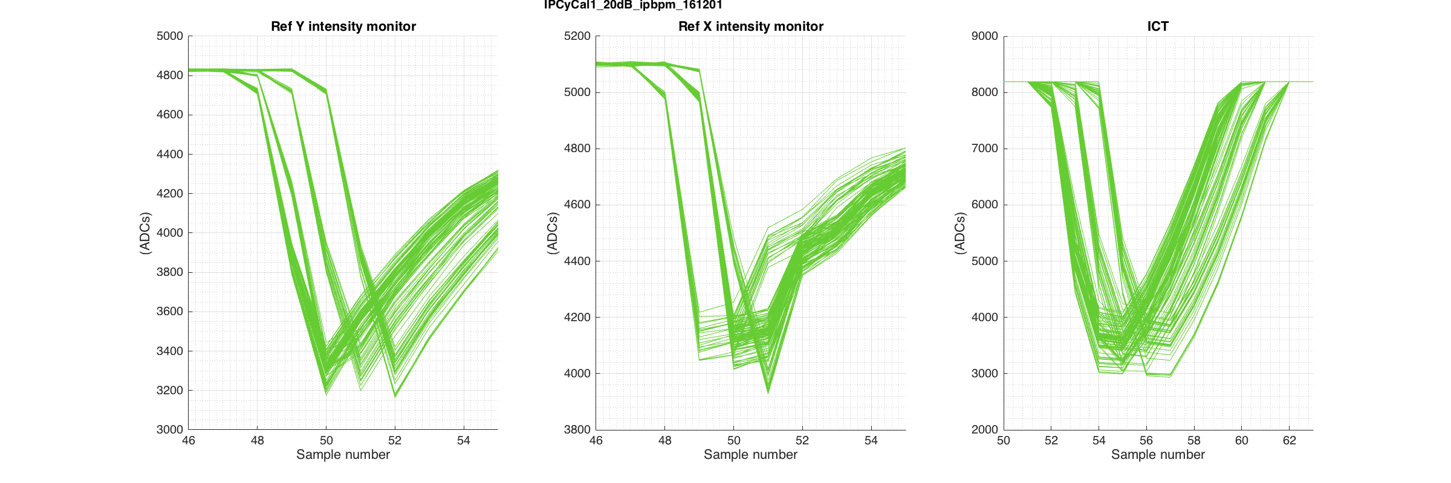
IPCyCal1_20dB_ipbpm_161201

Slide 14
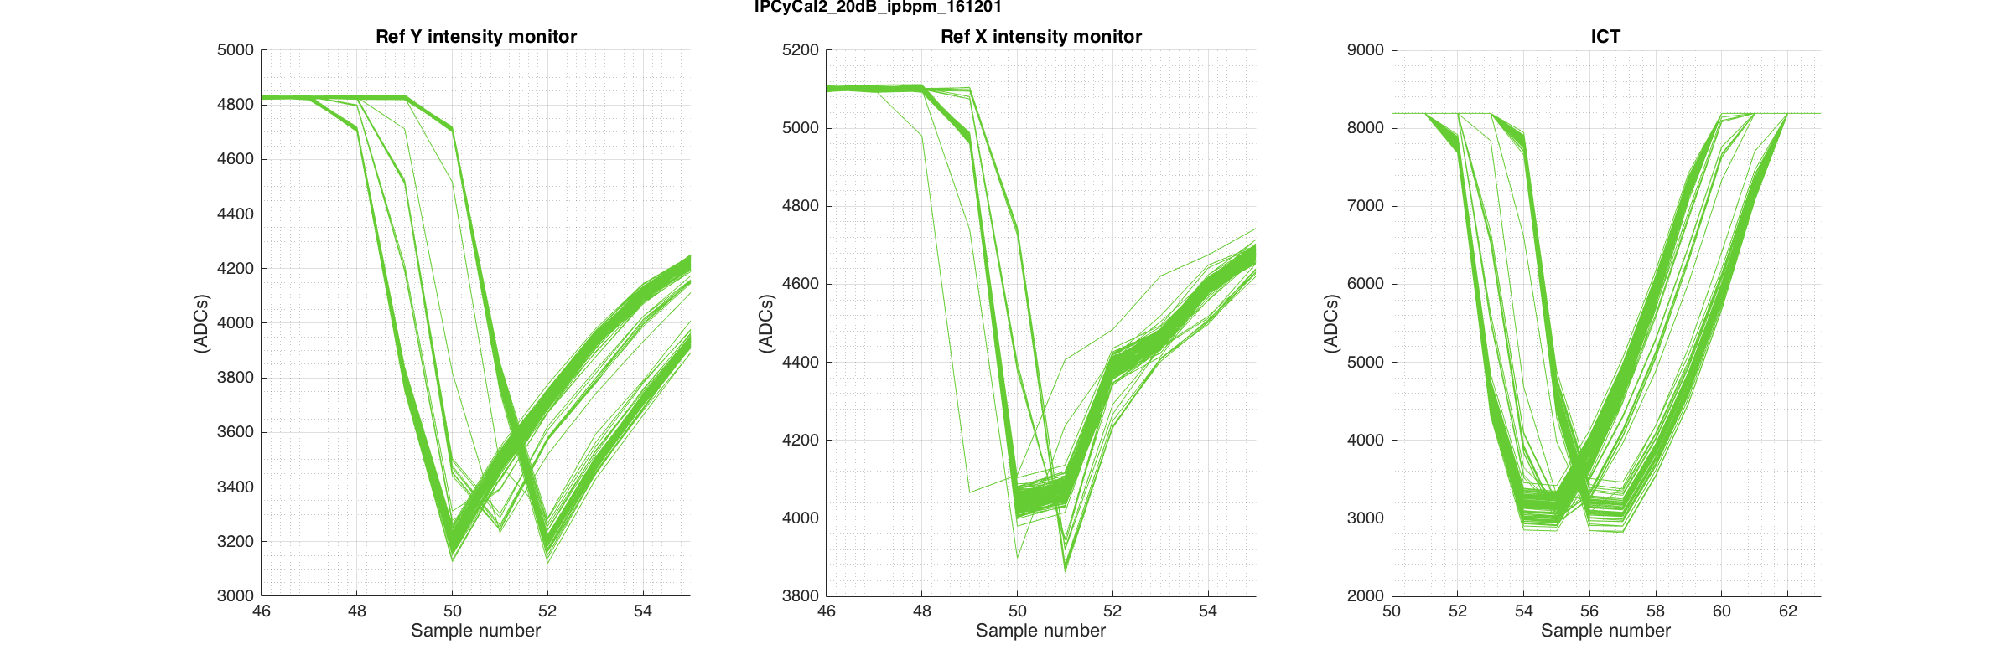
IPCyCal2_20dB_ipbpm_161201

Slide 15
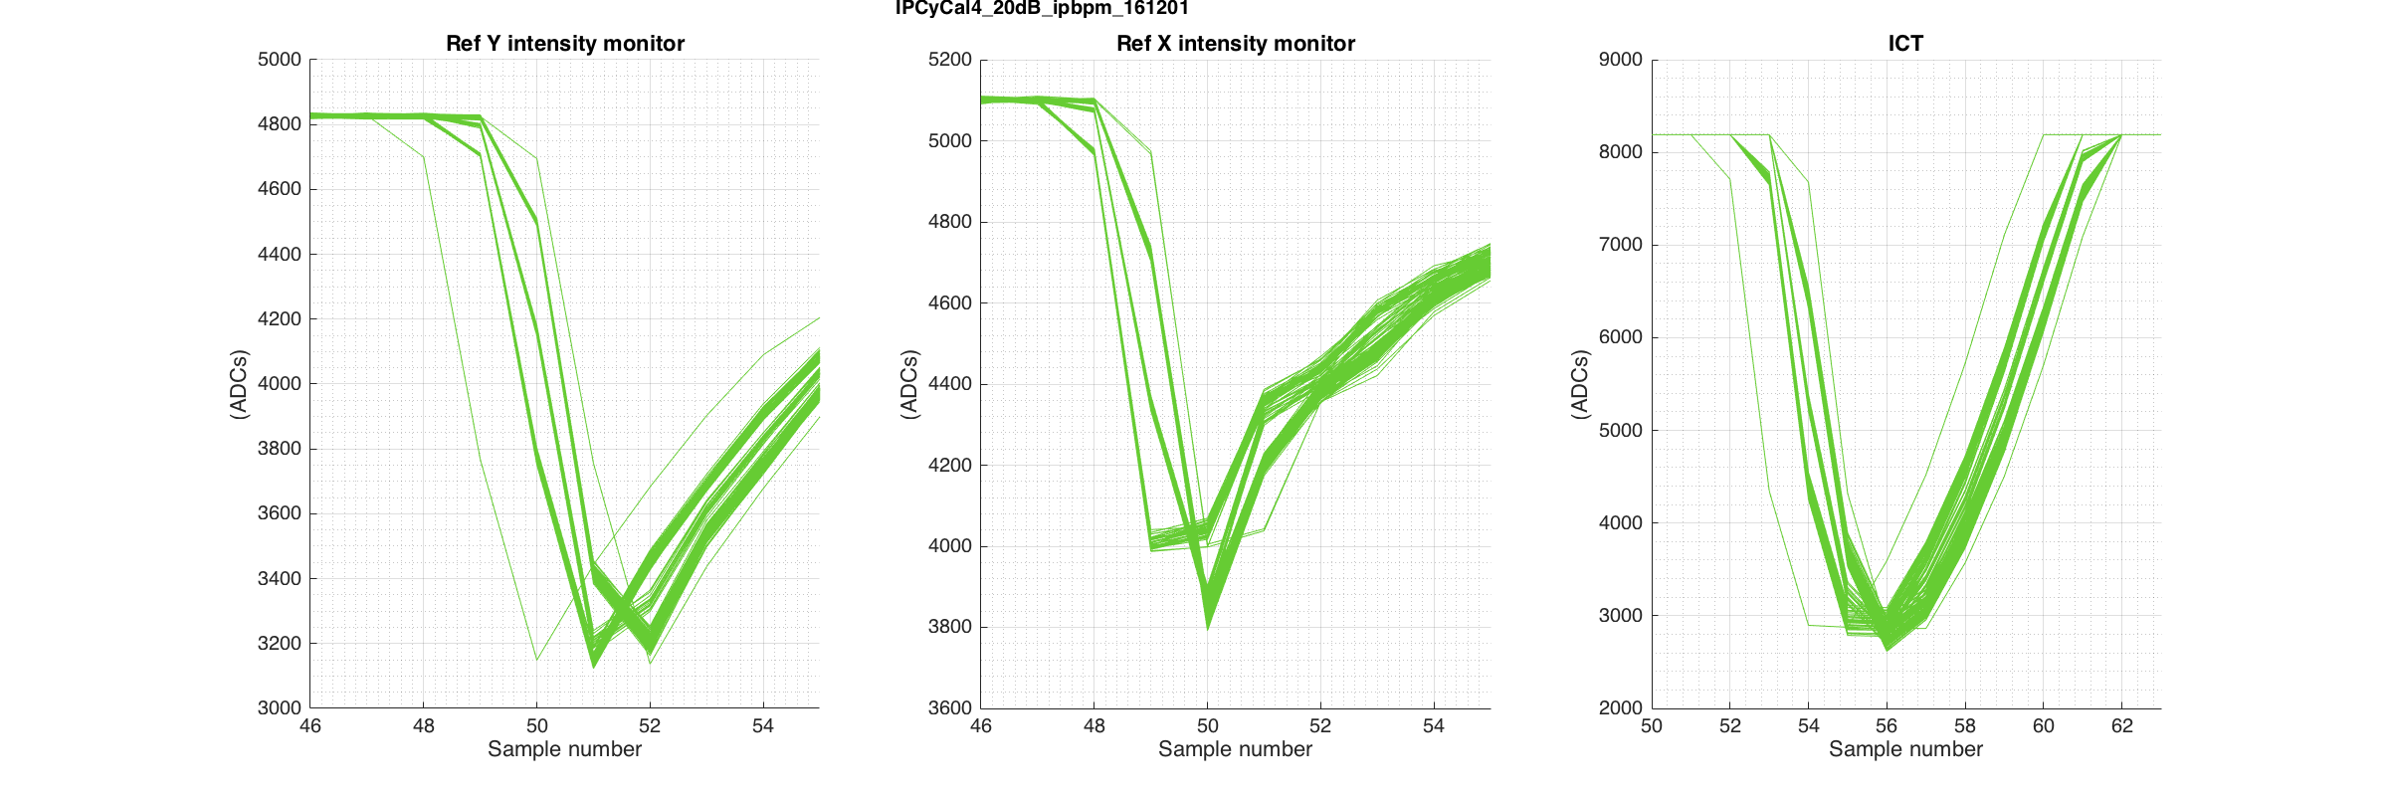
IPCyCal4_20dB_ipbpm_161201

Slide 16
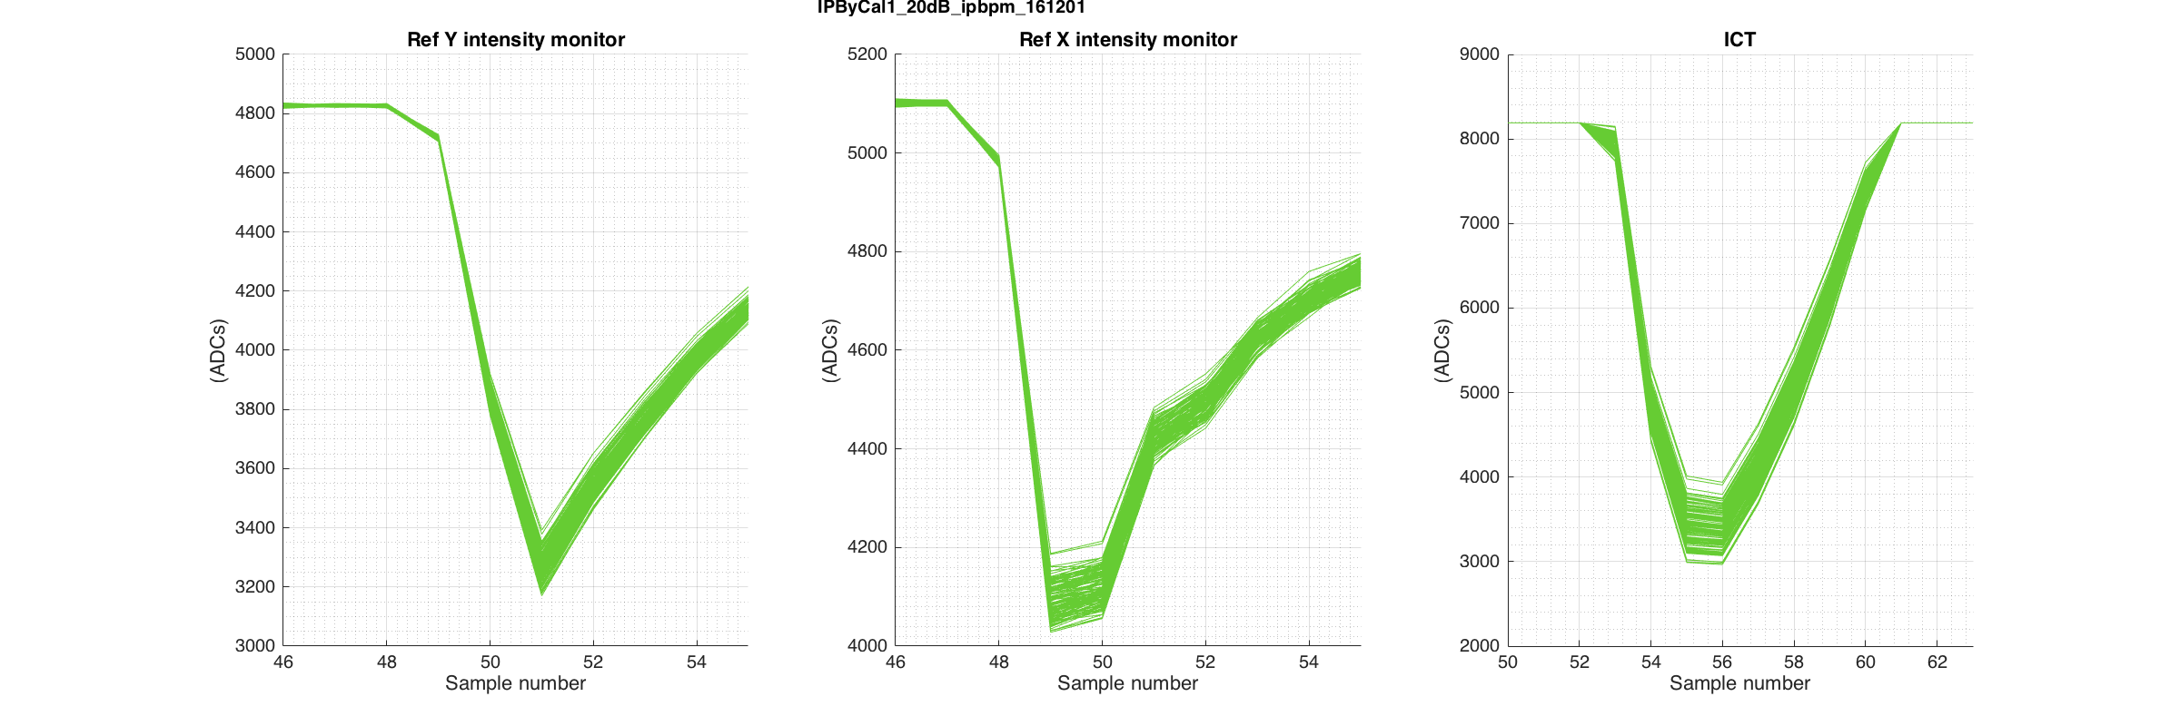
IPByCal1_20dB_ipbpm_161201
The only SIS data file taken on this shift with no observable sample jumps

Slide 17
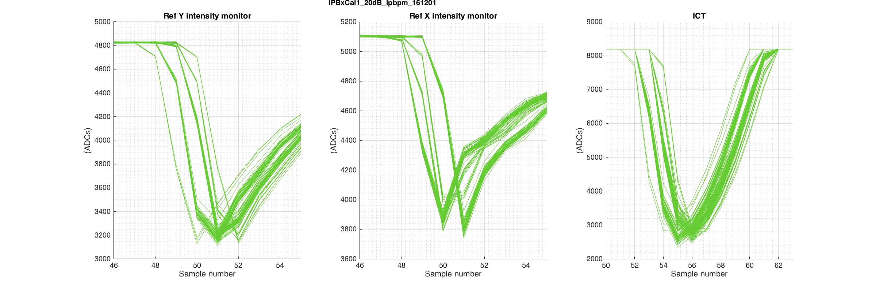
IPBxCal1_20dB_ipbpm_161201

Slide 18
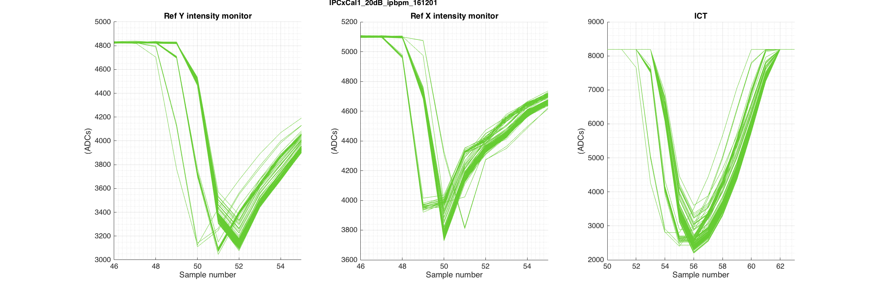
IPCxCal1_20dB_ipbpm_161201

Slide 19
FONT board data sets from this shift
Which also seem to show observable sample jumps

Slide 20
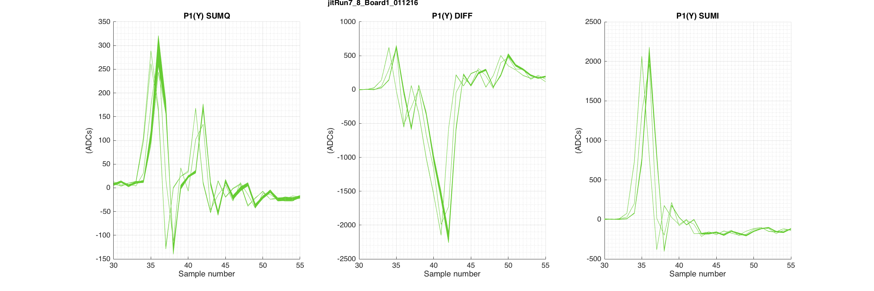
jitRun7_8_Board1_011216
40/56 of the files in this run of data sets contain sample jumps

Slide 21
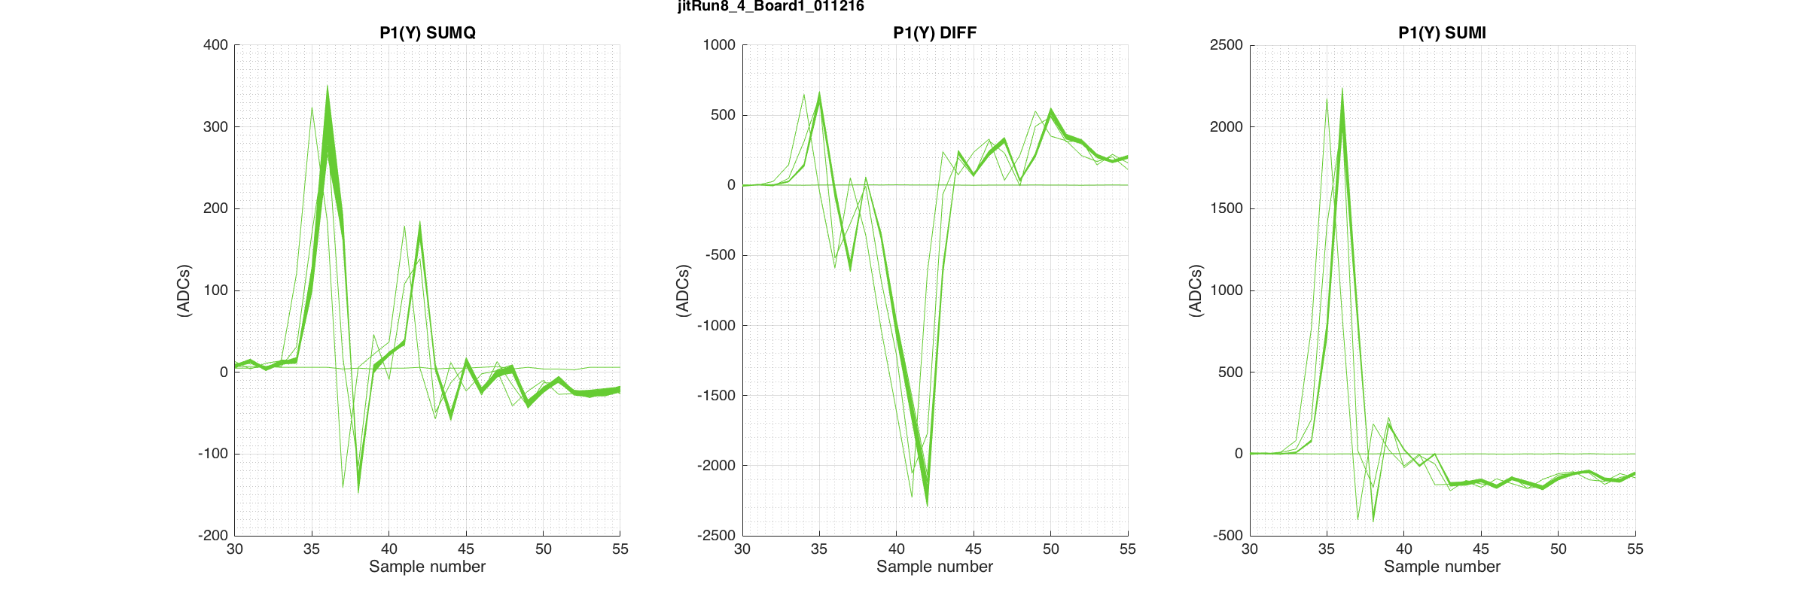
jitRun8_4_Board1_011216
5/8 of the files in this charge scan contain sample jumps

Slide 22
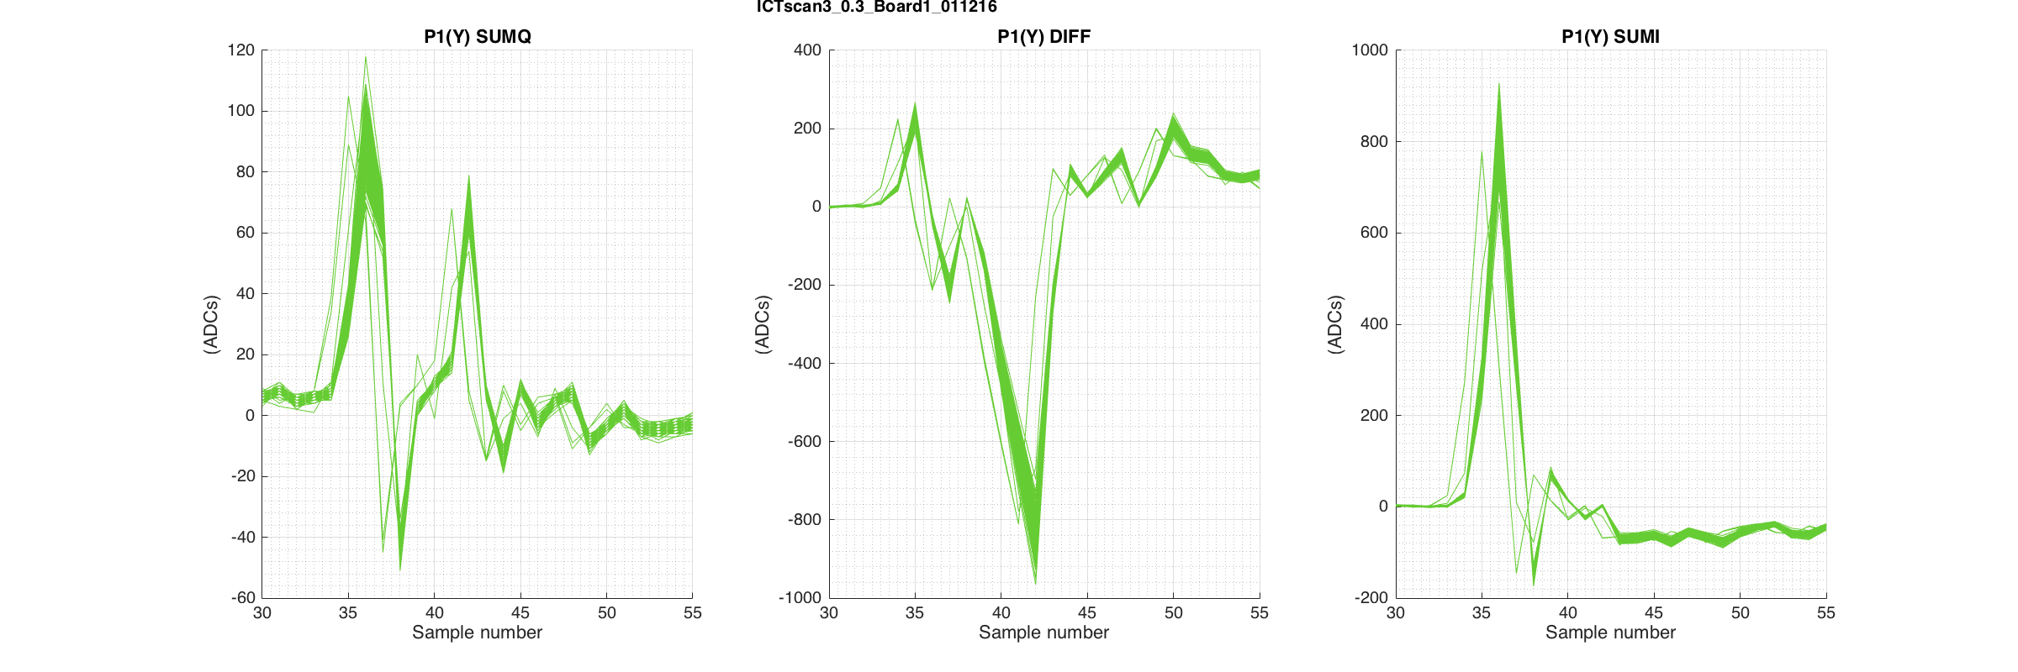
ICTscan3_0.85_Board1_011216
2/6 of the files in this charge scan contain sample jumps

