Slide 1
IP tests & noise floor estimates
N. Blaskovic, T. Bromwich, R. Ramjiawan

Slide 2
Outline
Current IP set-up
IP electronics tests still to do
Summary of past noise floor studies of the IP processing electronics
Summary of some past resolution results

Slide 3
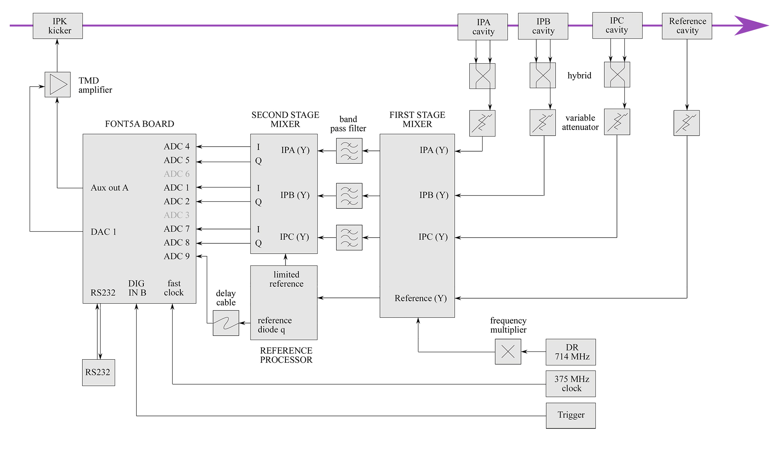
IP electronics set-up
This was the set-up for the 2-BPM feedback tests operation in October using the FONT board.
The outputs for both X and Y information were connected to the SIS digitiser in November/December as the IP BPMs were desired for other studies at ATF.

Slide 4
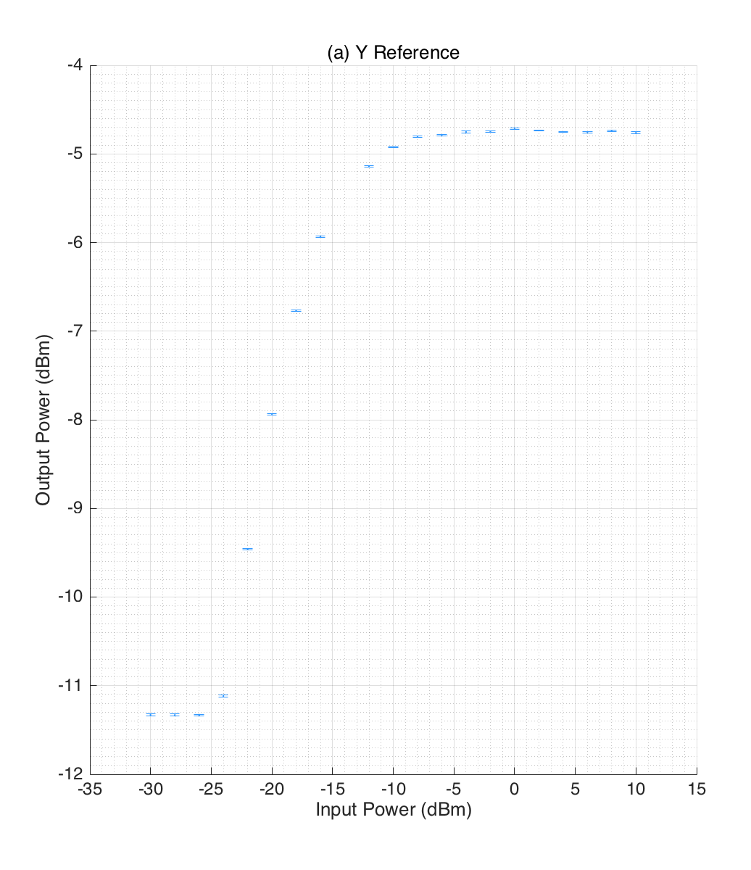
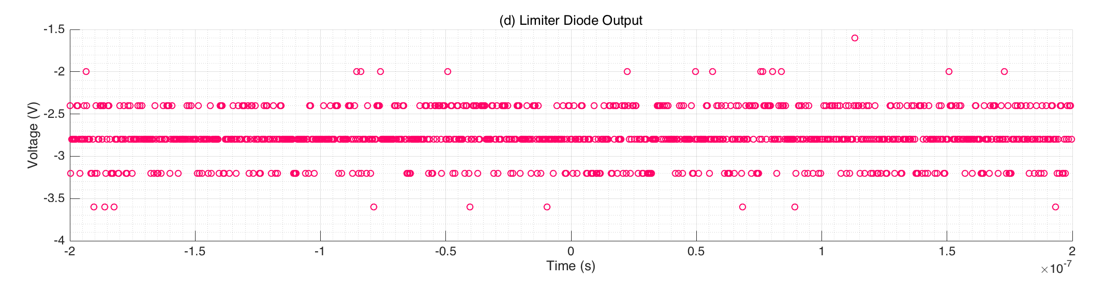
IP electronic tests to do
Look at the output of the 1st stage frequency multiplier using a spectrum analyser. Check the levels of 714MHz and other unwanted harmonics (particularly, +/-714MHz from the wanted output)
Re-test outputs of the first stage mixer that appeared to not reduce as the input power drops 10dB at the low end (see plot right).
Retake data from the limiting amplifier diode output using a scope we are more confident using, as this data was very odd (see plot below)
Note: none of these tests require beam

Slide 5
Noise floor studies of the IP processing electronics
Neven’s thesis: BPM signal split and sent through 2 sets of electronics; compare the outputs to estimate the noise (accounting for attenuation this is a measure of noise floor at equivalent charge of 0.36 x 10¹⁰)
36.0±1.1 nm (single point sampling) 23.0 ± 0.7 nm (7-sample averaging)
March 2016: 70dB attenuation on the dipole signal to observe the electronic noise in the absence of the dipole signal, but with the mixer still being driven. Integrating 6 samples, results at different charges:
Filename | JitterRun Charge ( x 10¹⁰ ) | IPA Jitter (nm) | IPB jitter (nm) | IPC Jitter (nm)
jitRun21_70dB_0.3_ipbpm_160315 | 0.3 | 31 ± 3 | 28 ± 2 | 32 ± 1
jitRun21_70dB_0.4_ipbpm_160315 | 0.4 | 21 ± 2 | 21 ± 1 | 33 ± 1
jitRun21_70dB_0.8_ipbpm_160315 | 0.7 | 14 ± 2 | 18 ± 1 | 24 ± 2
jitRun21_70dB_1_ipbpm_160315 | 0.9 | 13 ± 1 | 16 ± 2 | 26 ± 4

Slide 6
Summary of latest resolution results
27 October 2016. Jitter file: fbRun9_Board2_281016. Calibration File: AQD0FFyScan5_0dB.
Best geometric result with single sample: 57 ± 2 nm
Best geometric result integrating (9 samples): 46 ± 2 nm
Best multi-parameter fit with integrating results: ~39 nm (best single result 35.6 nm using IPC, 9 samples)
Previous results from March 2016 (data in HIGH SATURATION performed at charge of 0.95)
Best geometric result: 51.3 nm
Best multi-parameter fit result: 5.3 nm (geometric result for this data set is 216 nm!!!)
Results from 2015 and before:
All using fitting
 | Single sample | Integration
June 2015 No BPFs | 43 | 28
June 2015 714 MHz BPFs | 43 | 41
June 2015 KNU C-band BPFs | 38 | 35
Dec 2014 714 MHz BPFs | 31 | 27

