Slide 1




ECAL Day
New Design for Beam Test Structure
Guillaume FAYOLLE
03/21/2017
ECAL Day - New Design for Beam Test Structure
1/9

Slide 2
SUMMARY
1. Initial Design for Beam Test Structure
2. New Design for Beam Test Structure
Specifications
Design
Specifications
Design
Slab
Principle of assembly
Alignment and precision
Holding system
Steps of development
ECAL Day - New Design for Beam Test Structure
2/9

Slide 3
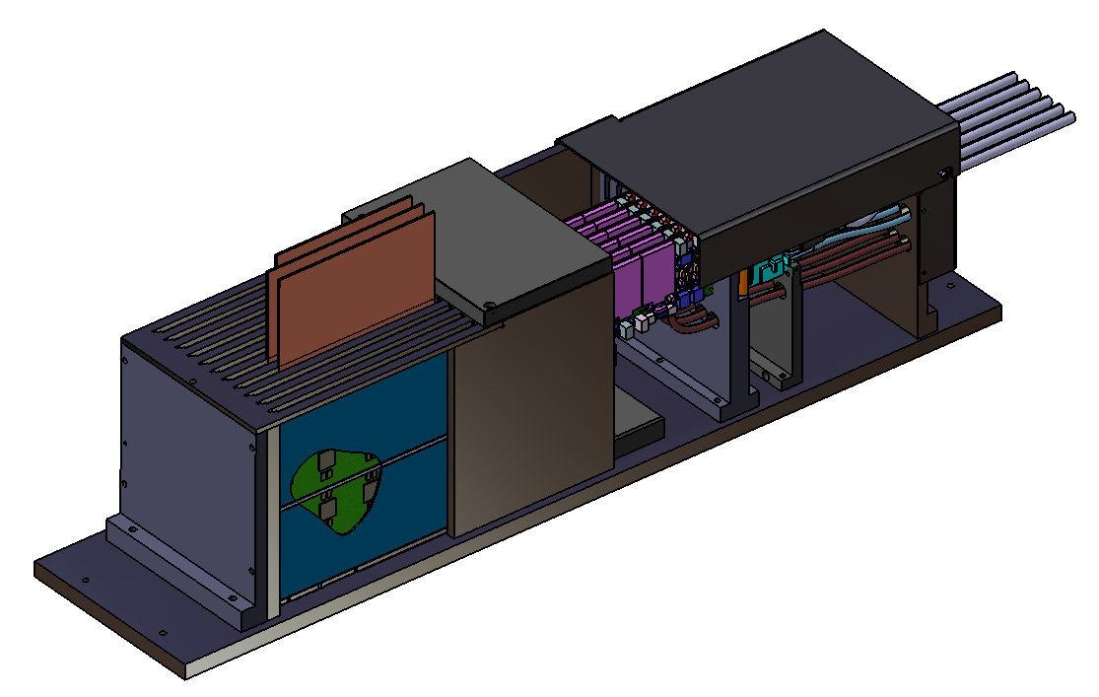
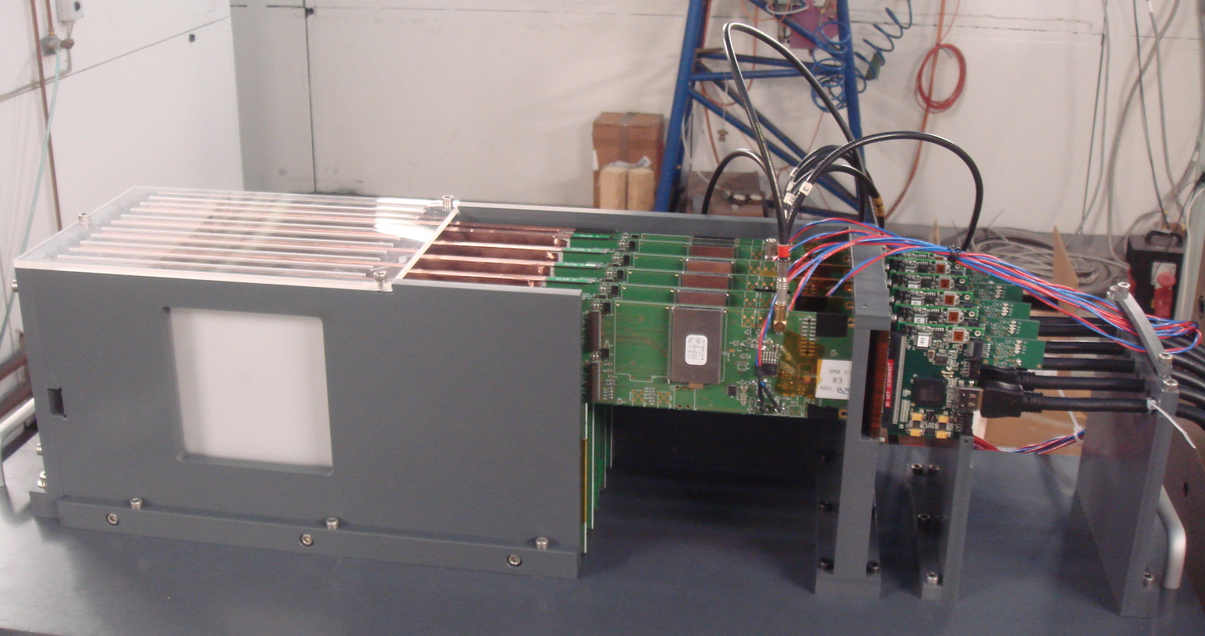
Initial Design for Beam Test Structure
Specifications
  10 slabs assembly
  Equal distance between slabs
  Possibility to insert 3 different thicknesses of tungsten between slabs
Constant gap between slabs : 8 mm
Constant gap between wafers : 15 mm
Design
Electronic cables
Tungsten
Slabs
Tungsten
Electronic cables
Slabs
Mechanical Structure
200 mm
850 mm
BEAM
Detection
Desy beam test (2012)
200 mm
BEAM
ECAL Day - New Design for Beam Test Structure
3/9

Slide 4
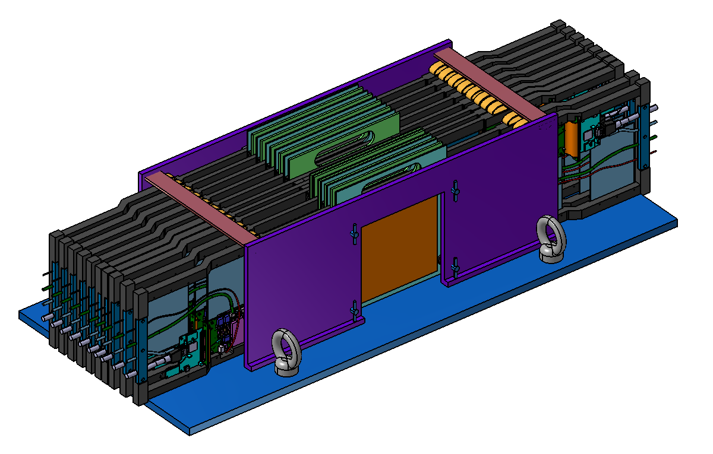
New Design for Beam Test Structure
Specifications
  20 slabs assembly
  Possibility to change and minimize the distance between slabs
  Possibility to insert different thicknesses of tungsten between slabs
Slabs
Tungsten
Design
Mechanical Structure
Slabs
Electronic cables
270 mm
Lifting ring
Detection
500 mm
BEAM
1100 mm
ECAL Day - New Design for Beam Test Structure
4/9

Slide 5
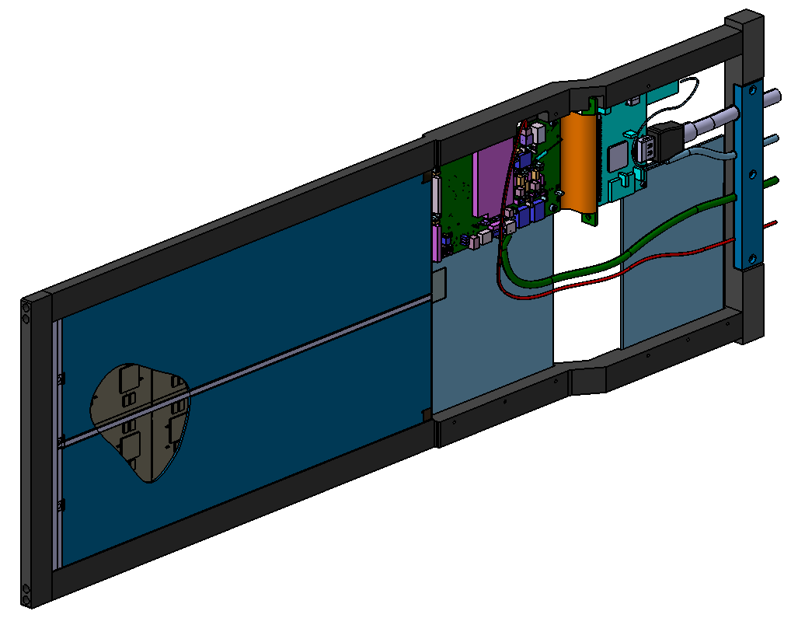
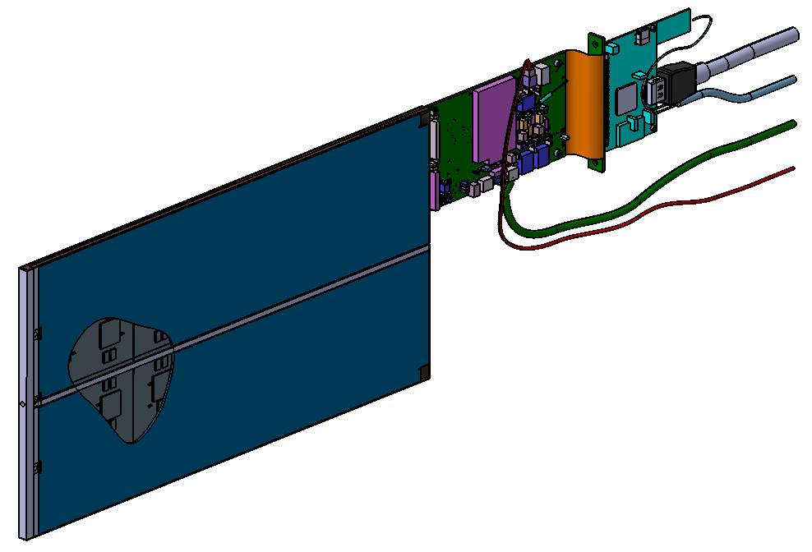

New Design for Beam Test Structure
Slab without the frame
Slab with the frame
Electronic part
16 mm
16 mm
Detection part
9,2 mm
Y wafers positioning +/- 0,1 mm
+
220 mm
Y wafers positioning +/- 0,2 mm
Origin (X0, Y0)
X wafers positioning +/- 0,1 mm
X wafers positioning +/- 0,2 mm
+
Origin (X0, Y0)
680 mm
ECAL Day - New Design for Beam Test Structure
5/9

Slide 6
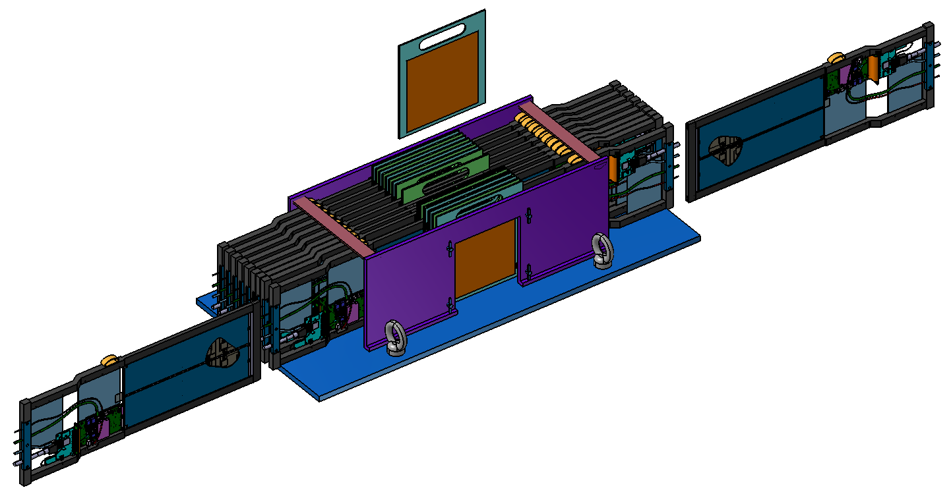
New Design for Beam Test Structure
Support frame
Elastic support
Principle of assembly
Support frame
Insertion of Tungsten
Slab
Tungsten
Insertion of the slab
Slab
Elastic support
Support frame
BEAM
Insertion of the slab
ECAL Day - New Design for Beam Test Structure
6/9

Slide 7
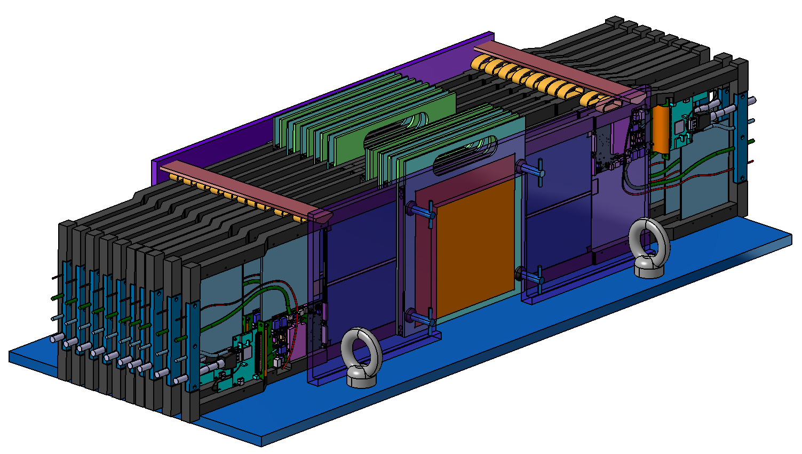
New Design for Beam Test Structure
Stop
Alignment and precision
Directly linked to the wafers positioning in X and Y directions
Base plate
Y slabs positioning +/- 0,2 mm
Stop contact
X slabs positioning +/- 0,2 mm
Stop contact
ECAL Day - New Design for Beam Test Structure
7/9

Slide 8
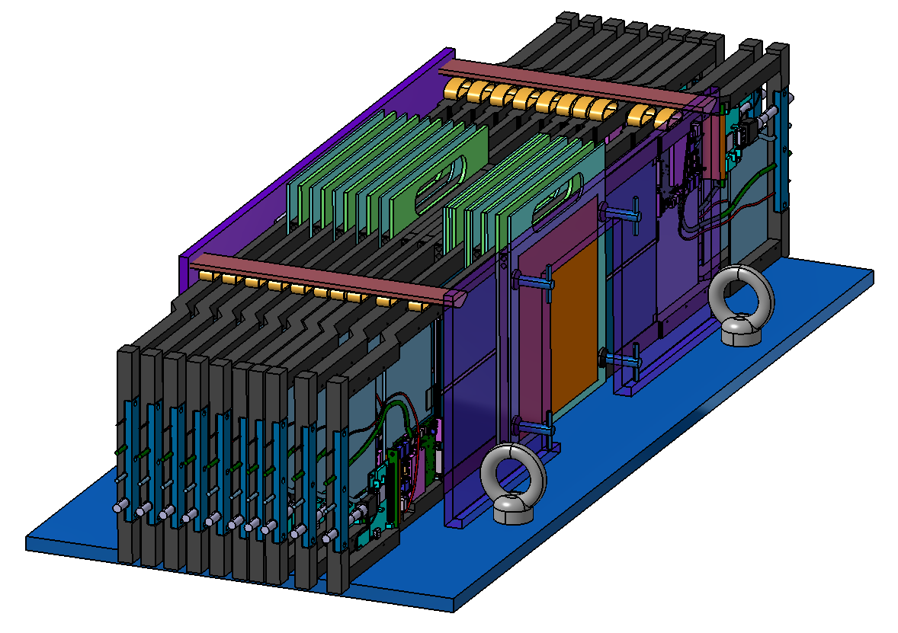

New Design for Beam Test Structure
Holding system
Rods to maintain the slabs
Slab elastic support
Minimum gap between slabs : 2,2 mm
Minimum gap between wafers : 9,2 mm
Gain of 5,8 mm in comparison to the initial design
Base plate
Screws to compact the assembly
ECAL Day - New Design for Beam Test Structure
8/9

Slide 9
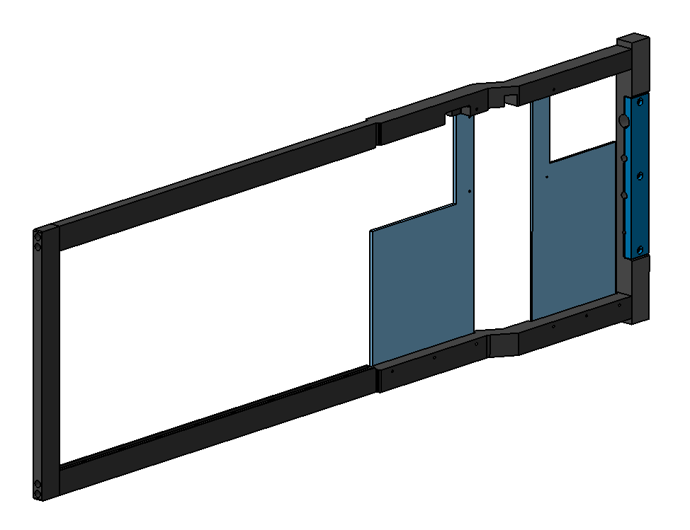
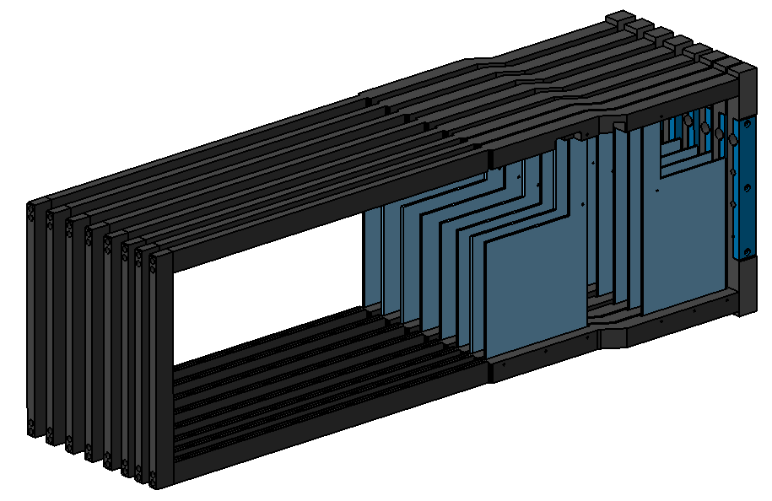
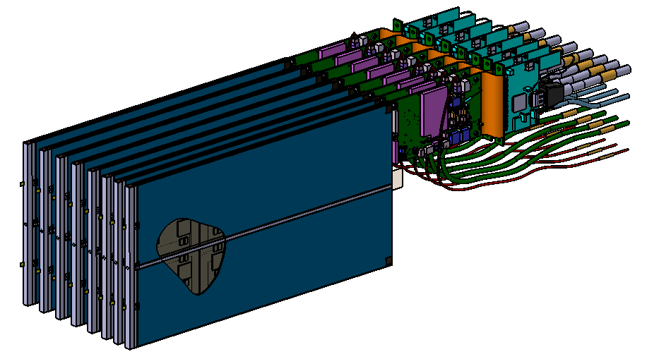
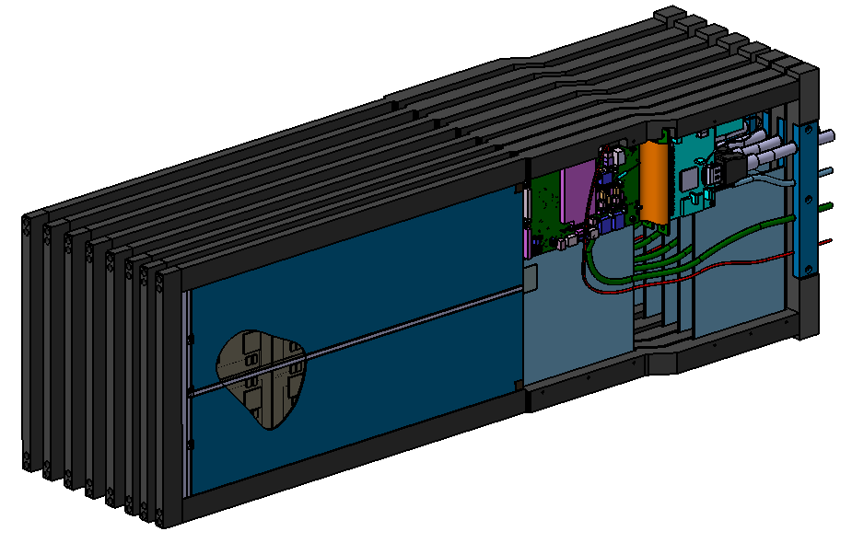
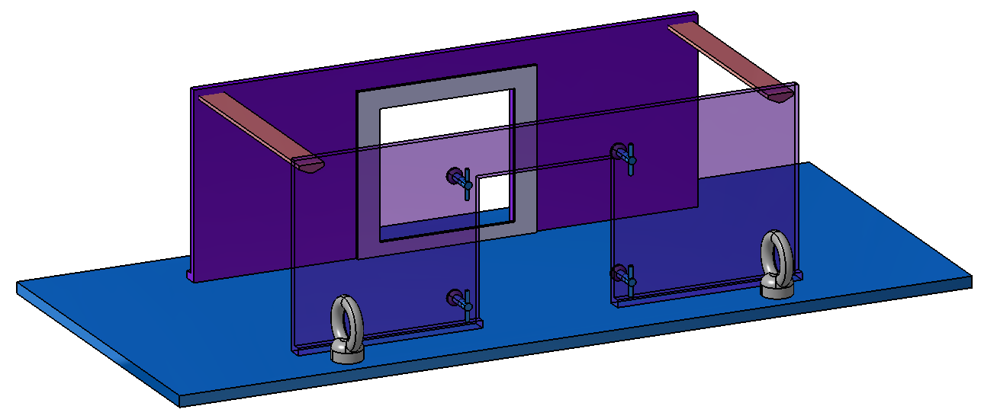

Steps of development
  Build a frame for one slab
  Integrate and test a frame for one slab
  Build and integrate all the frames on the slabs
  Build the test bench
  Integrate and test the whole assembly
  Beam test at CERN
+
=
+
=
ECAL Day - New Design for Beam Test Structure
9/9

