Slide 1
Electronic noise floor re-analysis
N. Blaskovic, T. Bromwich, R. Ramjiawan

Slide 2
Outline
Data taken in March 2016
70dB attenuation on the dipole signal to observe the electronic noise of the processing system in the absence of the dipole signal, but with the mixer still being driven.
Jitter runs at charges between 0.1 and 1 x 10¹⁰.
Analyse the jitter in ADC counts at different charges and different sample numbers.
Analyse the jitter in nm using calibration files (again at different charges and different sample numbers).
Analyse the jitter in nm by integrating to find positions.

Slide 3
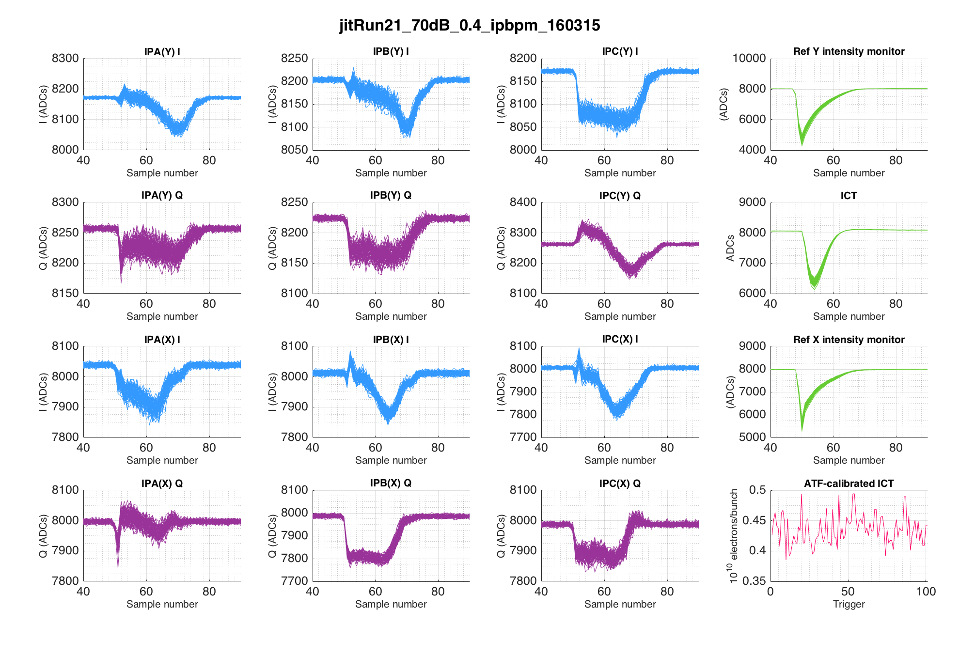
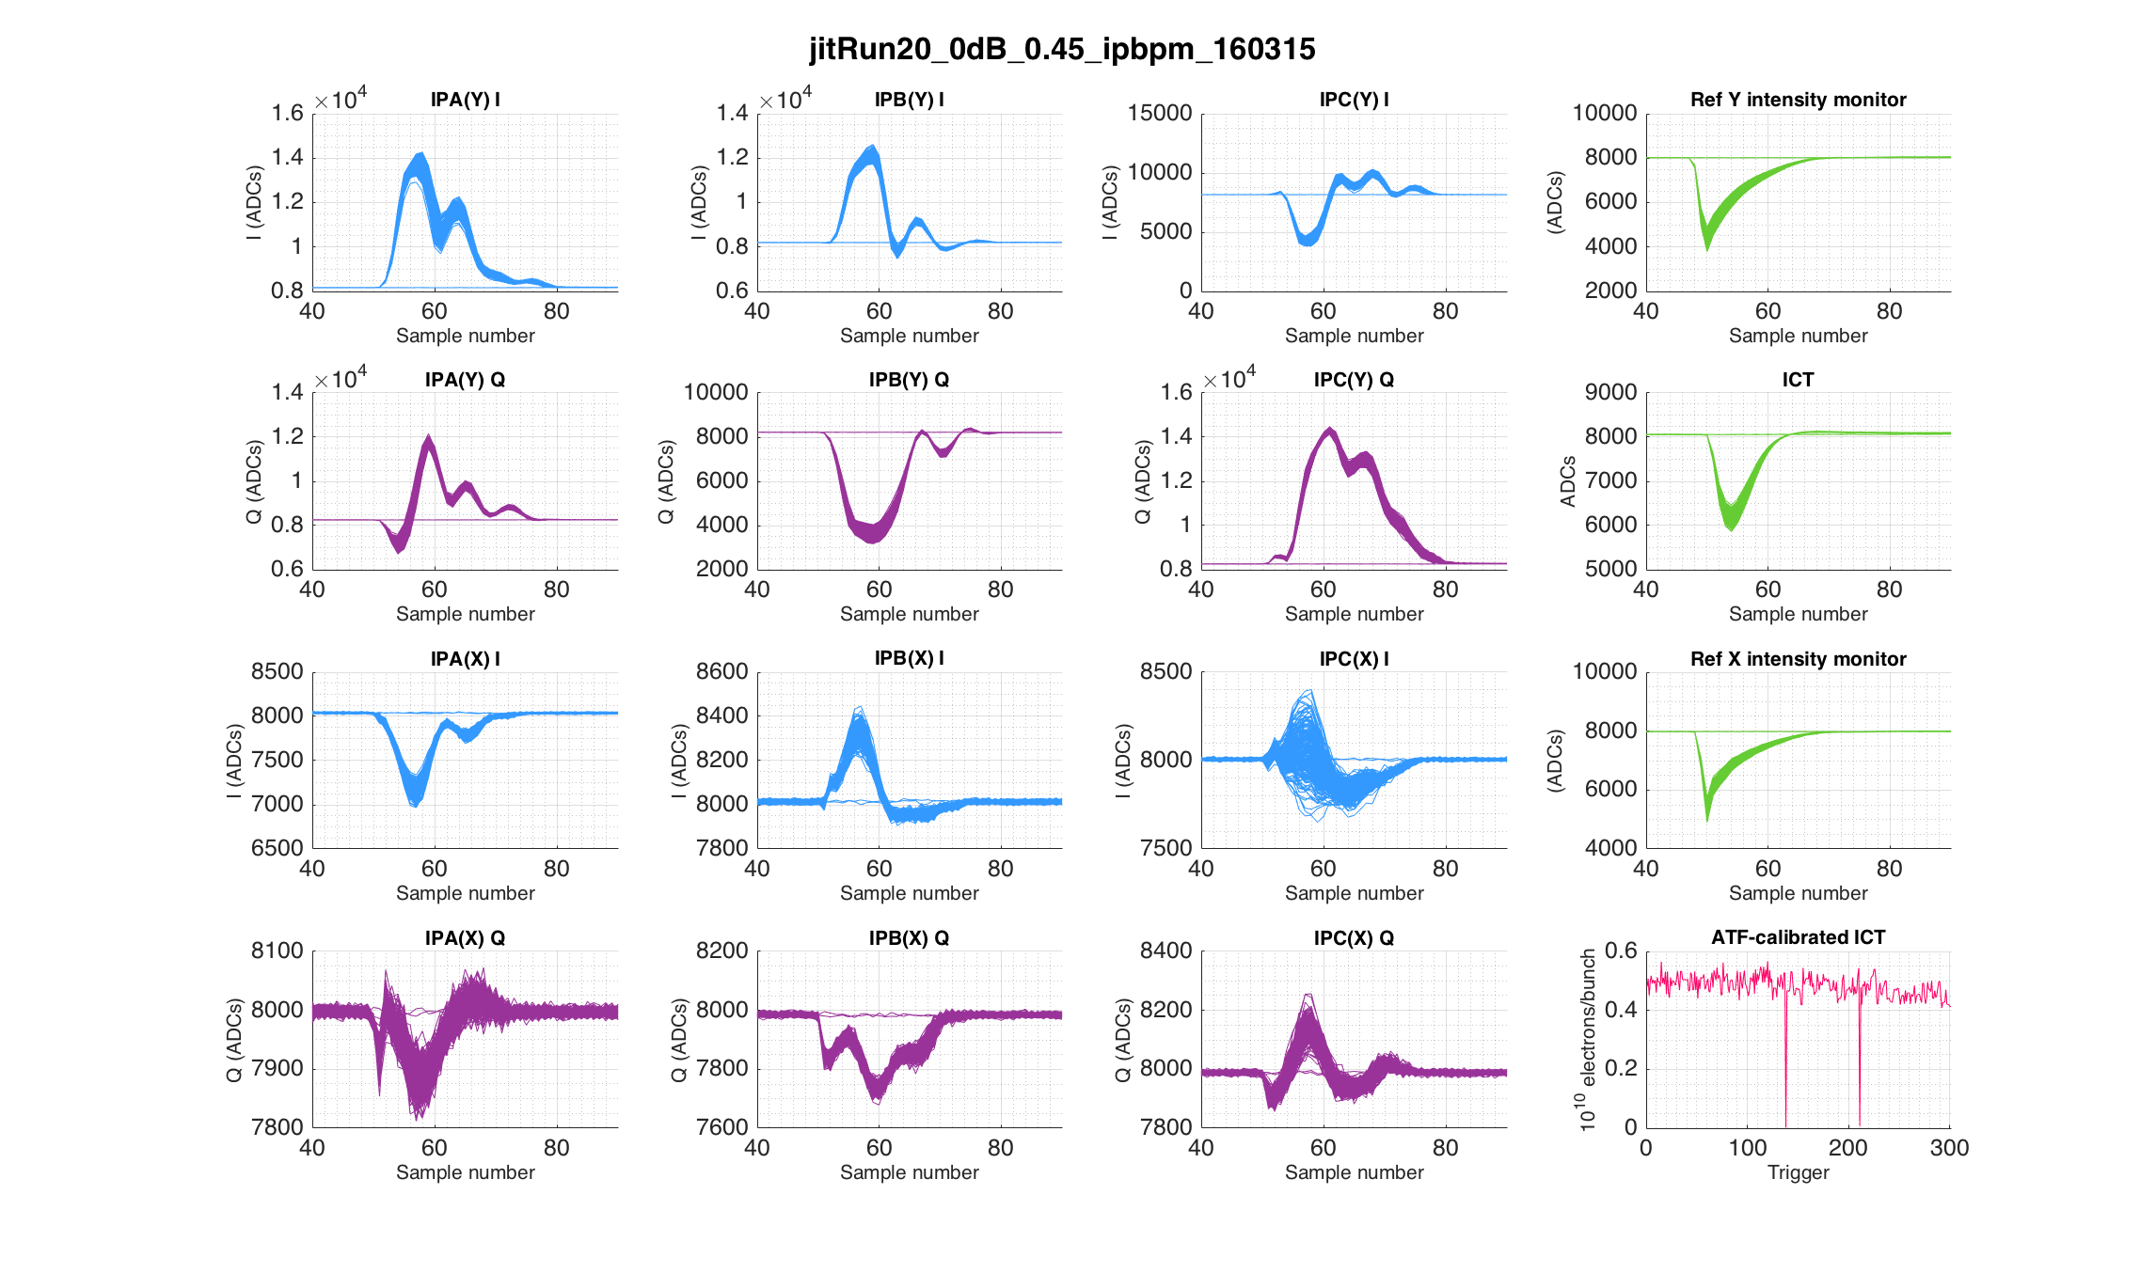
Example waveforms at 0.4 x 10¹⁰
Reference signal starts: 48
Reference signal peak: 50
Data with 0dB attenuation (see below) shows:
Dipole signal starts: 52
Dipole signal peak: 57 – 59

Slide 4
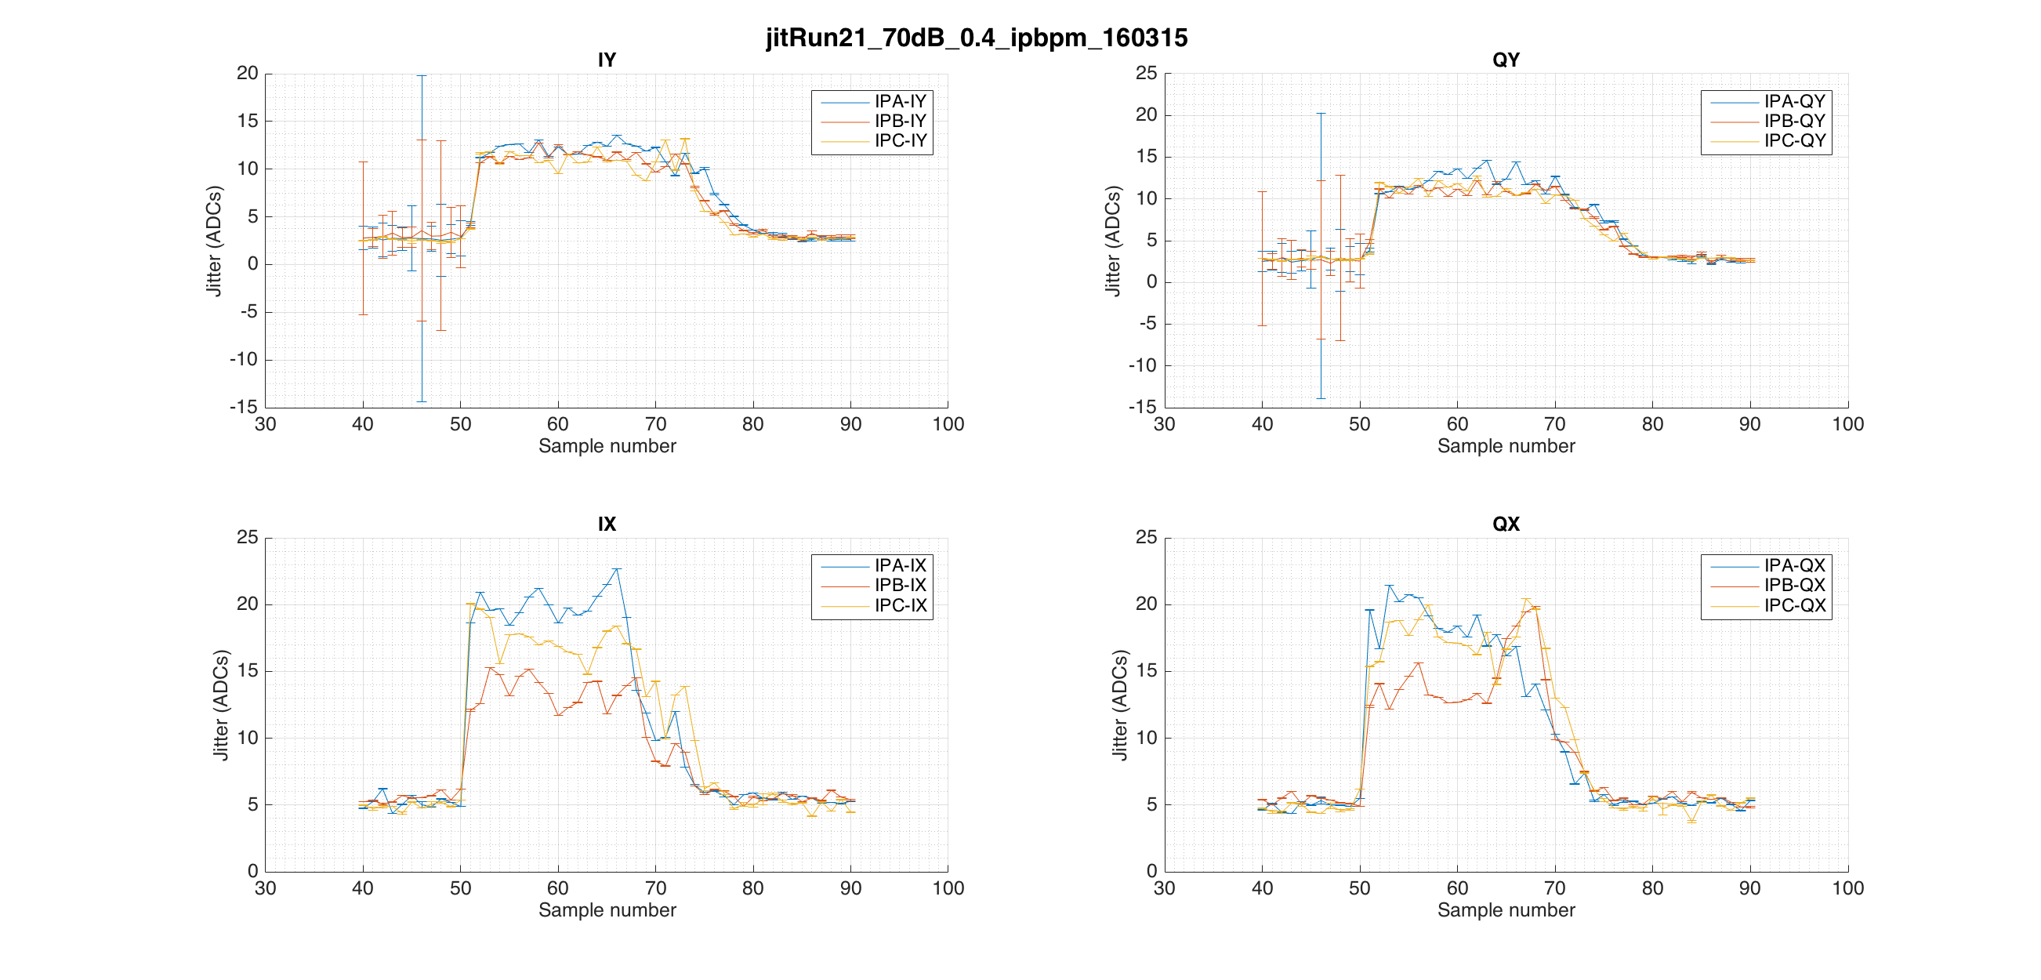
Noise in ADCs as a function of sample number

Slide 5
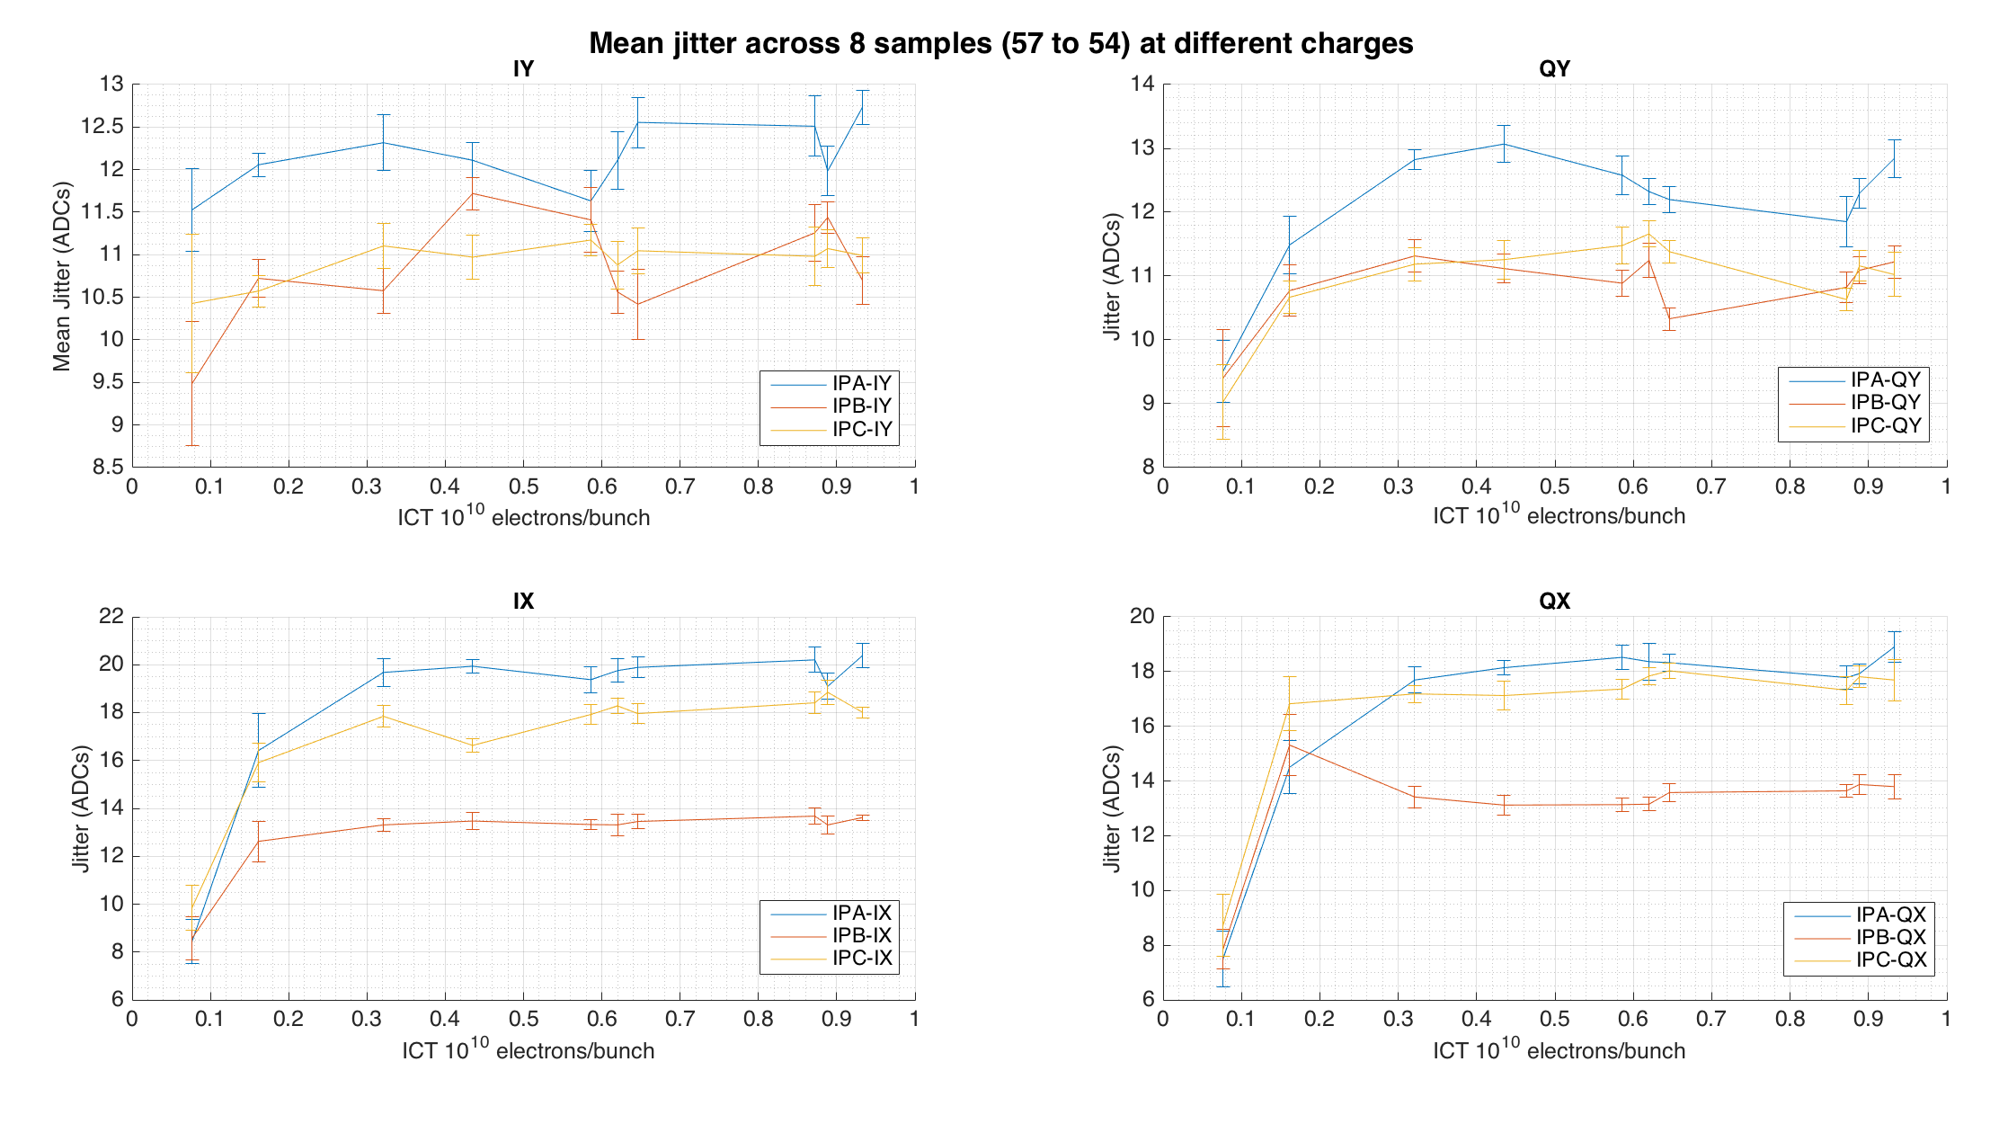
Mean jitter in region of pulse at different charges
Calculate jitter at 8 different sample numbers (57 to 64) in the region the pulse would be if there was no attenuation on dipole.
Take average of these jitter measurements.
Repeat at different charges.
Repeat for different BPMs.

Slide 6
Attempt to use calibrations to convert to jitter in μm
Calibration files were taken on the same shift at four different charges.
Matched charges as best as possible to jitter runs taken with 70dB attenuation on the dipole to convert ADC jitter to μm.
All calibration plots can be found in appendix.
Jitter Filename | JitterRun Charge ( x 10¹⁰ ) | Calibration Filename | Calibration Charge ( x 10¹⁰ )
jitRun21_70dB_0.3_ipbpm_160315 | 0.321 ± 0.001 | IPAyCal1_0dB_0.25_ipbpm_160315 IPByCal1_0dB_0.25_ipbpm_160315 IPByCal1_0dB_0.25_ipbpm_160315 | 0.276 ± 0.001 0.246 ± 0.001 0.275 ± 0.001
jitRun21_70dB_0.4_ipbpm_160315 | 0.435 ± 0.002 | IPAyCal1_0dB_0.45_ipbpm_160315 IPByCal1_0dB_0.45_ipbpm_160315 IPCyCal1_0dB_0.45_ipbpm_160315 | 0.532 ± 0.002 0.483 ± 0.002 0.454 ± 0.002
jitRun21_70dB_0.7_ipbpm_160315 | 0.646 ± 0.004 | IPAyCal1_0dB_0.7_ipbpm_160315 IPByCal1_0dB_0.7_ipbpm_160315 IPCyCal1_0dB_0.7_ipbpm_160315 | 0.707 ± 0.004 0.705 ± 0.004 0.769 ± 0.002
jitRun21_70dB_1_ipbpm_160315 | 0.933 ± 0.001 | IPAyCal1_0dB_1_ipbpm_160315 IPByCal1_0dB_1_ipbpm_160315 IPCyCal1_0dB_1_ipbpm_160315 | 0.936 ± 0.001 0.936 ± 0.001 0.929 ± 0.001

Slide 7
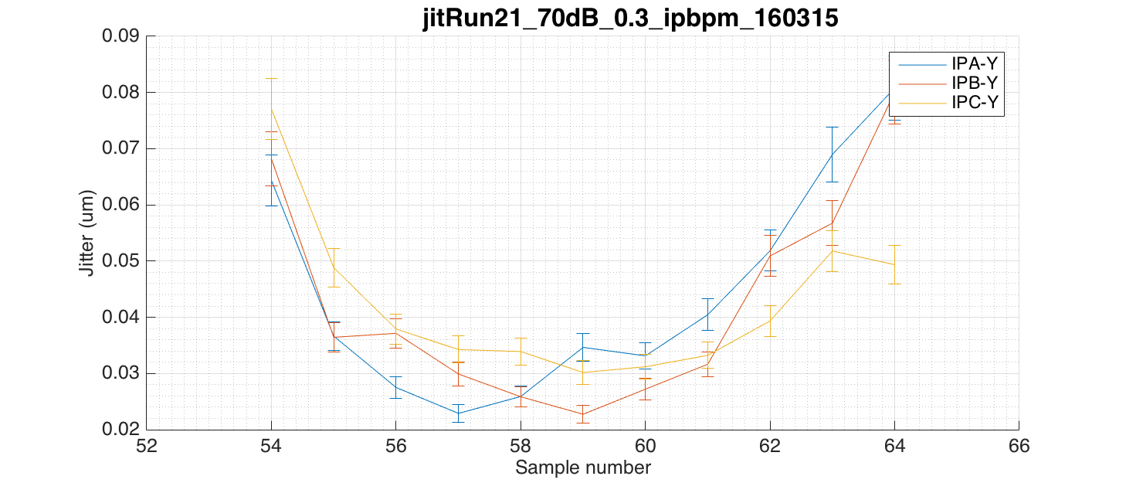
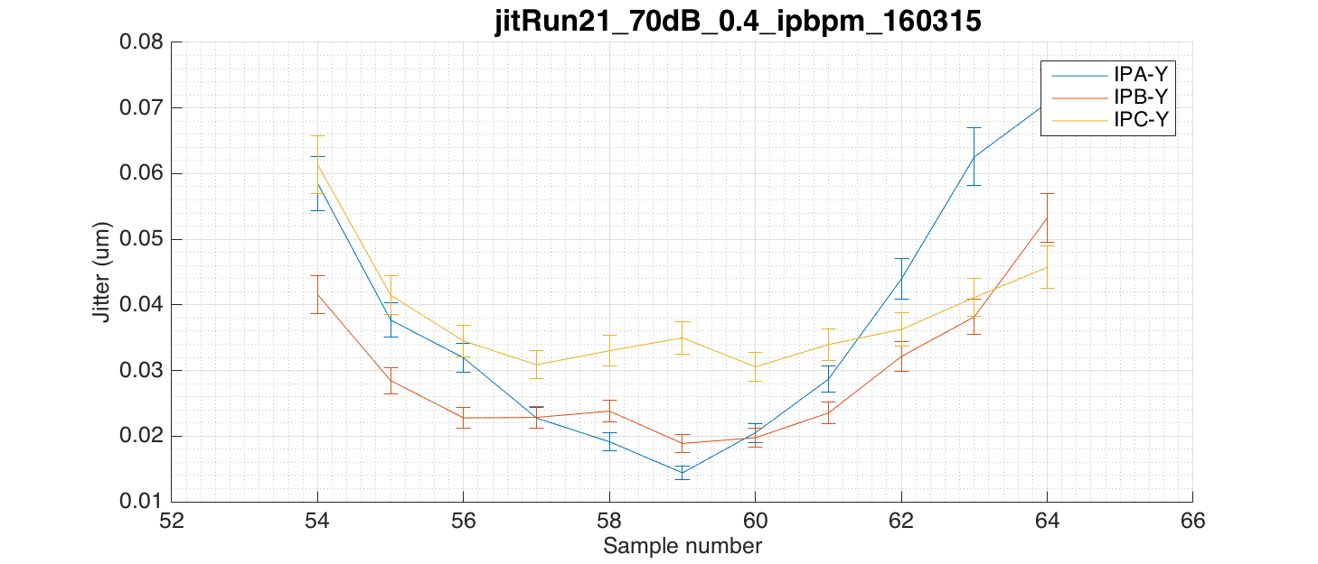
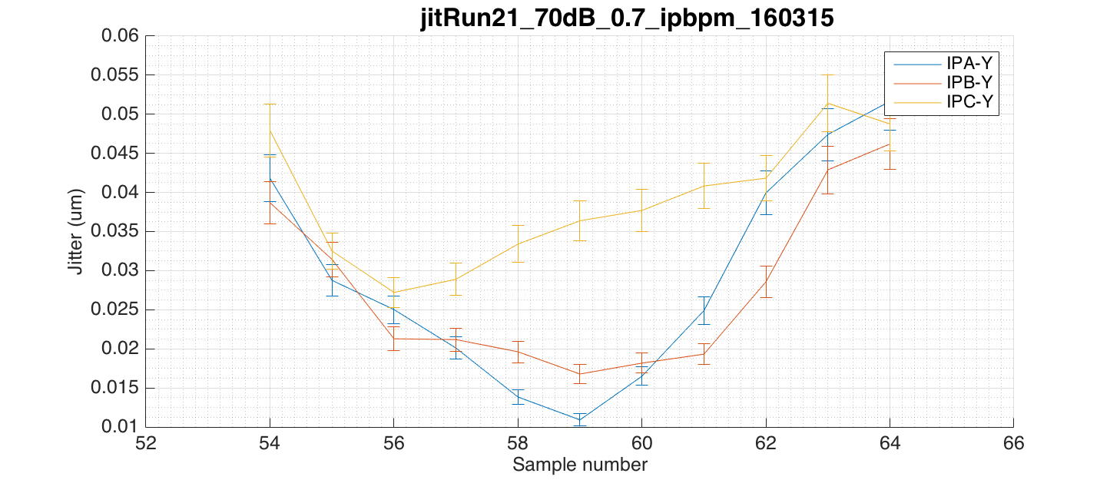
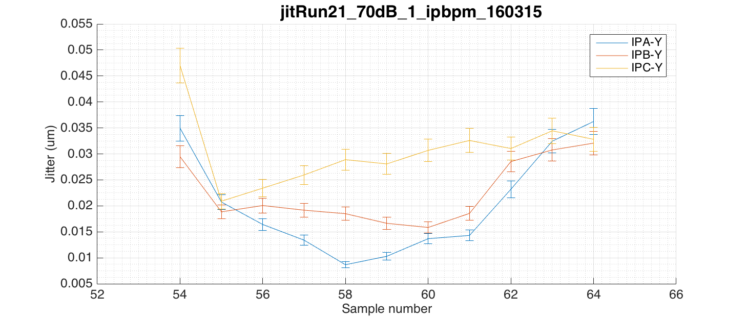
Noise in μm as a function of sample at different charges

Slide 8
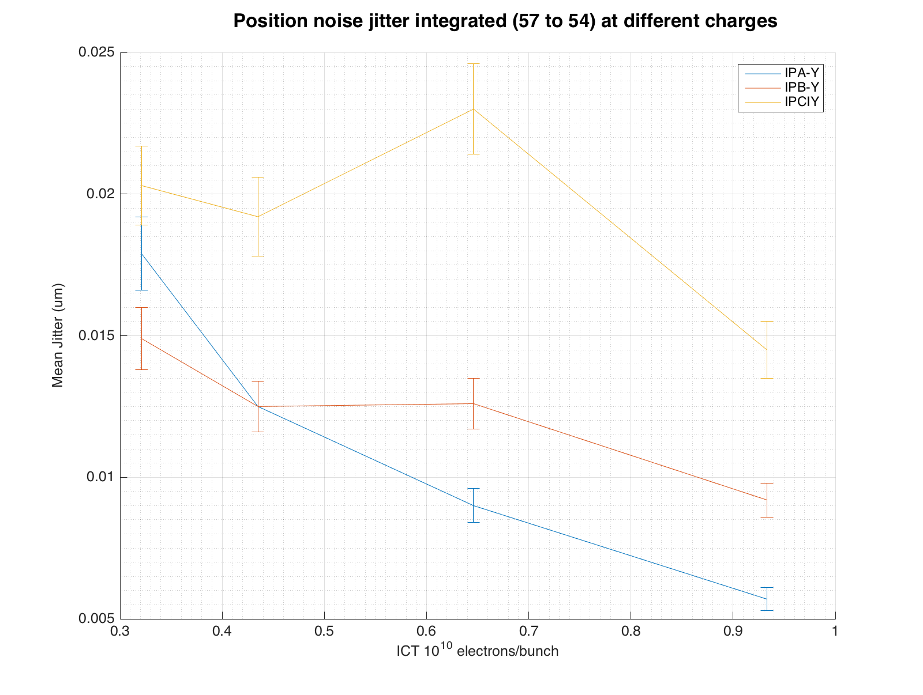
Jitter in μm integrating region of pulse at different charges
Calculate position jitter on the 70dB attenuated files using integration across 8 samples (57 to 64)
JitterRun Charge ( x 10¹⁰ ) | BPM | Calibration Charge ( x 10¹⁰ ) | Scale Factor (ADC/ADC)/um | Noise Jitter (nm)
0.321 ± 0.001 | IPA IPB IPC | 0.276 ± 0.001 0.246 ± 0.001 0.275 ± 0.001 | 1.22 ± 0.01 1.15 ± 0.02 1.28 ± -0.01 | 18 ± 1 15 ± 1 20 ± 1
0.435 ± 0.002 | IPA IPB IPC | 0.532 ± 0.002 0.483 ± 0.002 0.454 ± 0.002 | 1.31 ± 0.03 1.29 ± 0.02 0.93 ± -0.01 | 13 ± 1 13 ± 1 19 ± 1
0.646 ± 0.004 | IPA IPB IPC | 0.707 ± 0.004 0.705 ± 0.004 0.769 ± 0.002 | 1.19 ± 0.03 0.86 ± 0.02 0.63 ± -0.01 | 9 ± 1 13 ± 1 23 ± 2
0.933 ± 0.001 | IPA IPB IPC | 0.936 ± 0.001 0.936 ± 0.001 0.929 ± 0.001 | 1.30 ± 0.02 0.77 ± 0.02 0.53 ± -0.02 | 5.7± 0.4 9 ± 1 15 ± 1

Slide 9
Appendix
Waveforms and noise jitter analysis at other charges + calibration plots

Slide 10
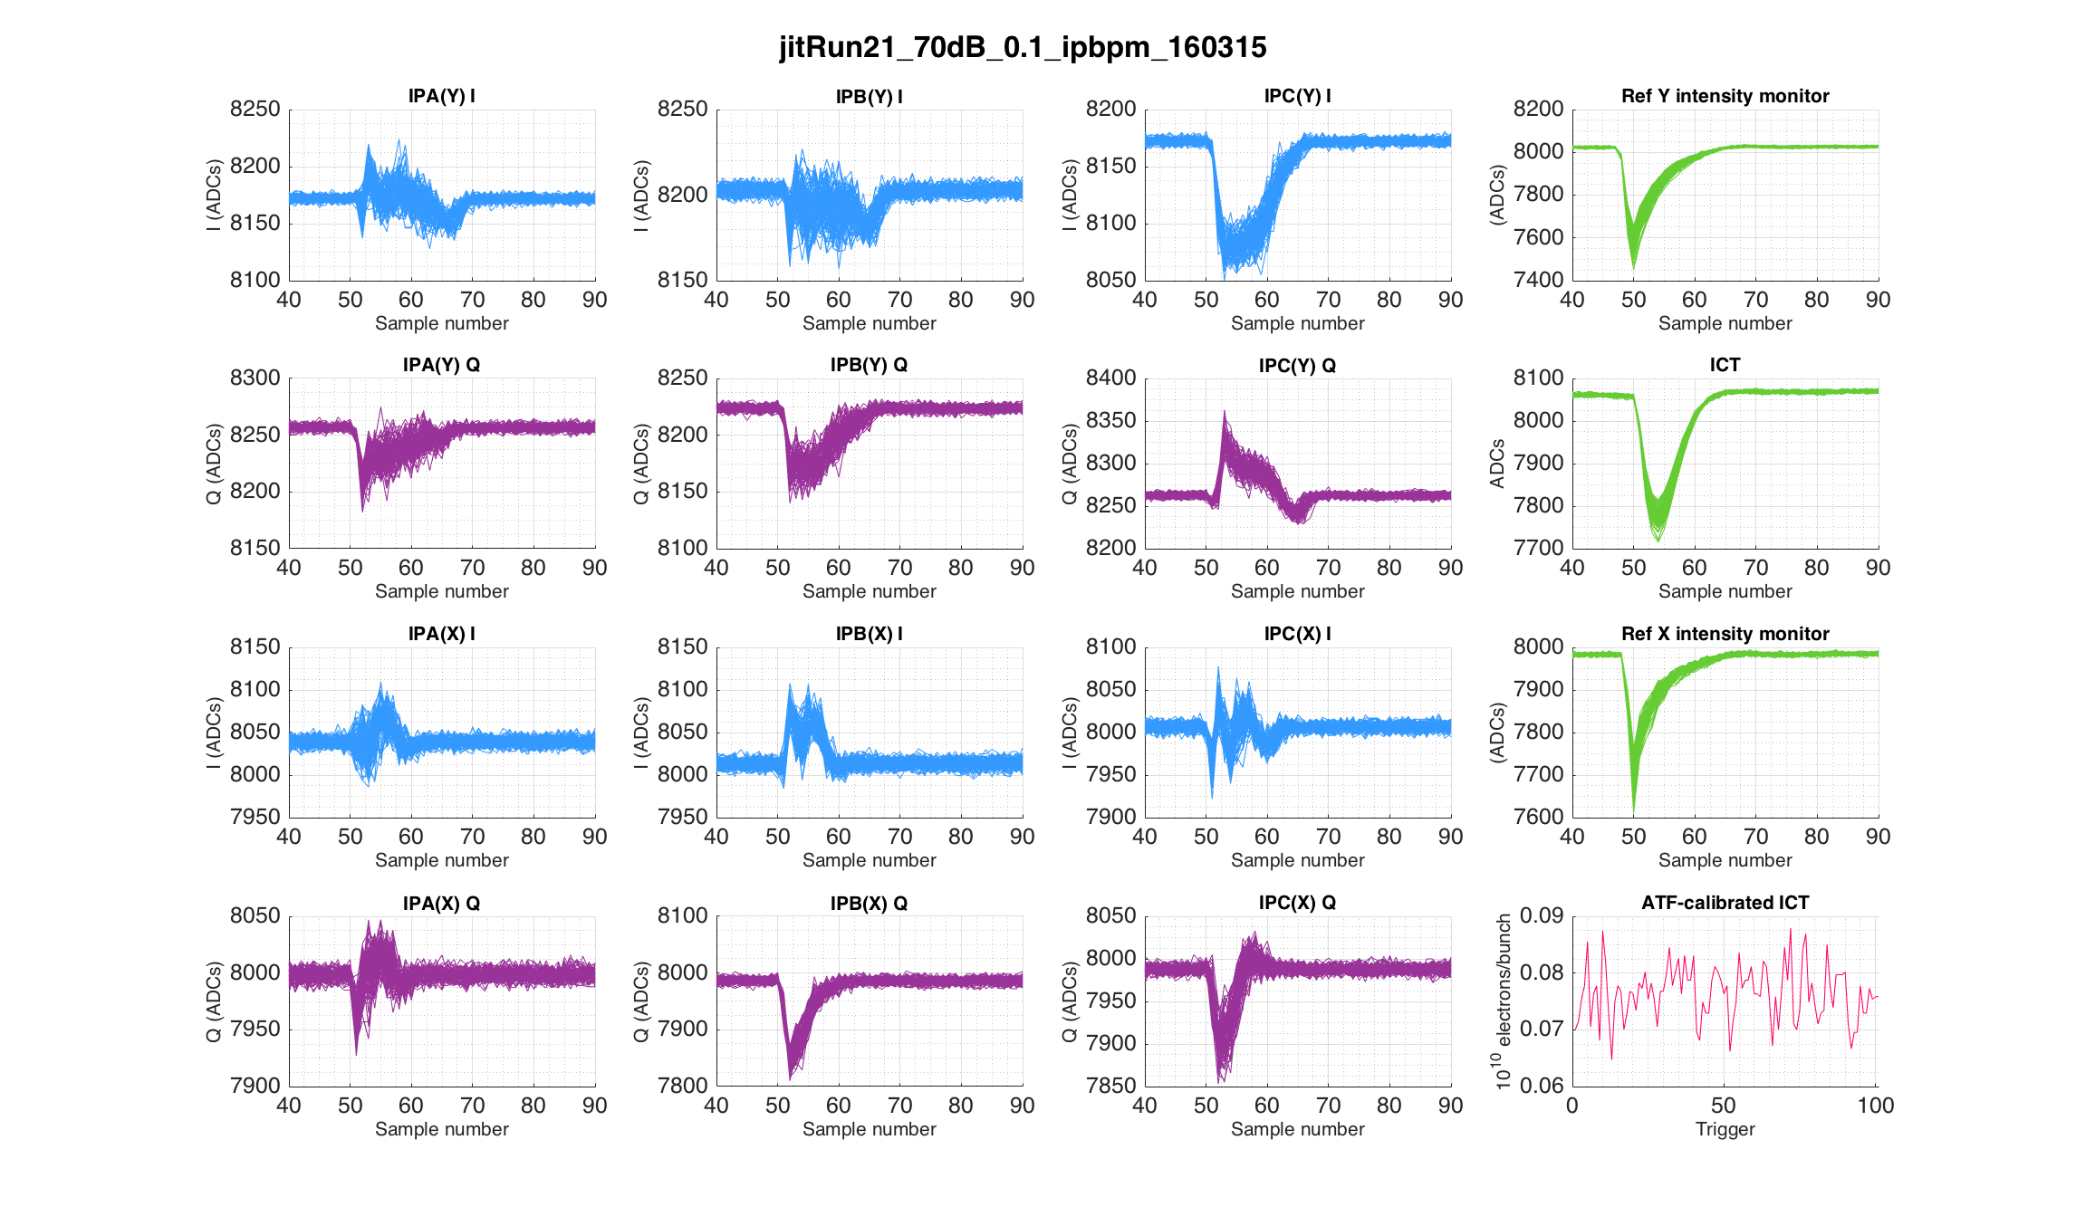

Slide 11
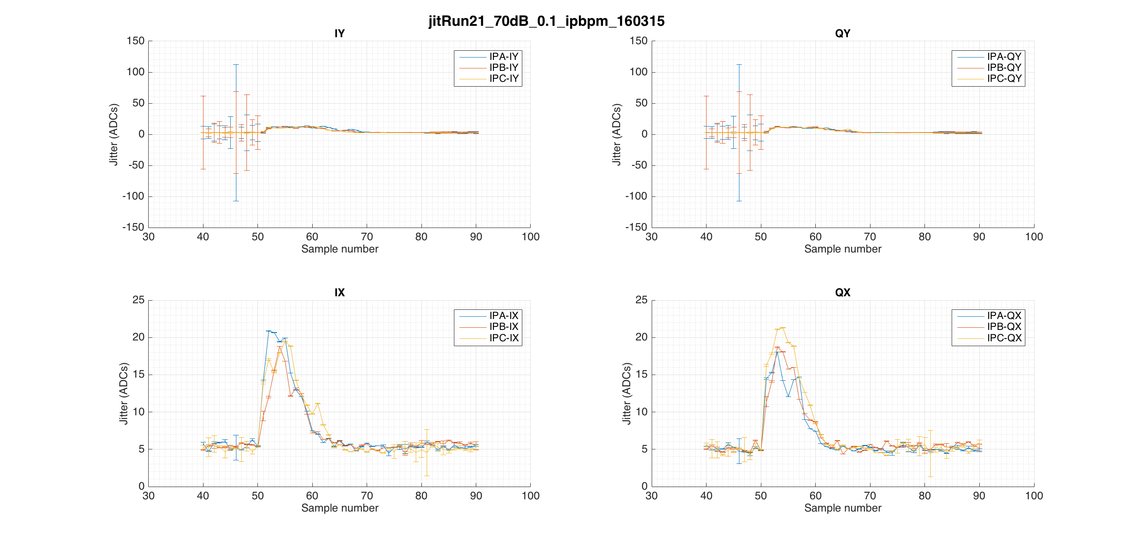

Slide 12
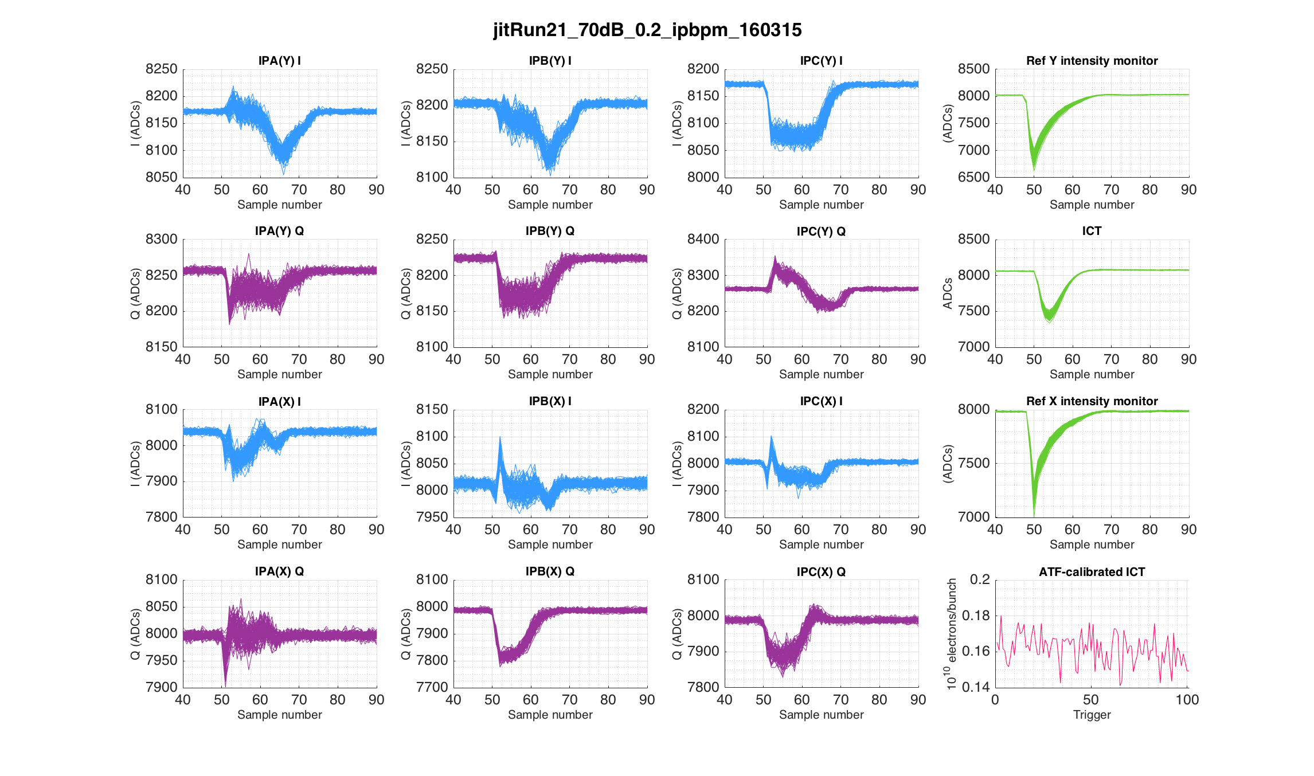

Slide 13
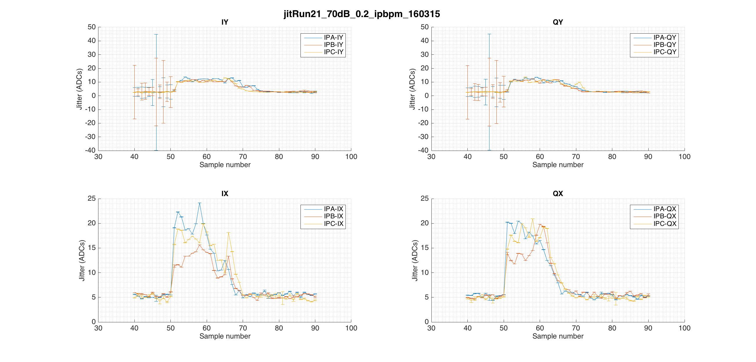

Slide 14
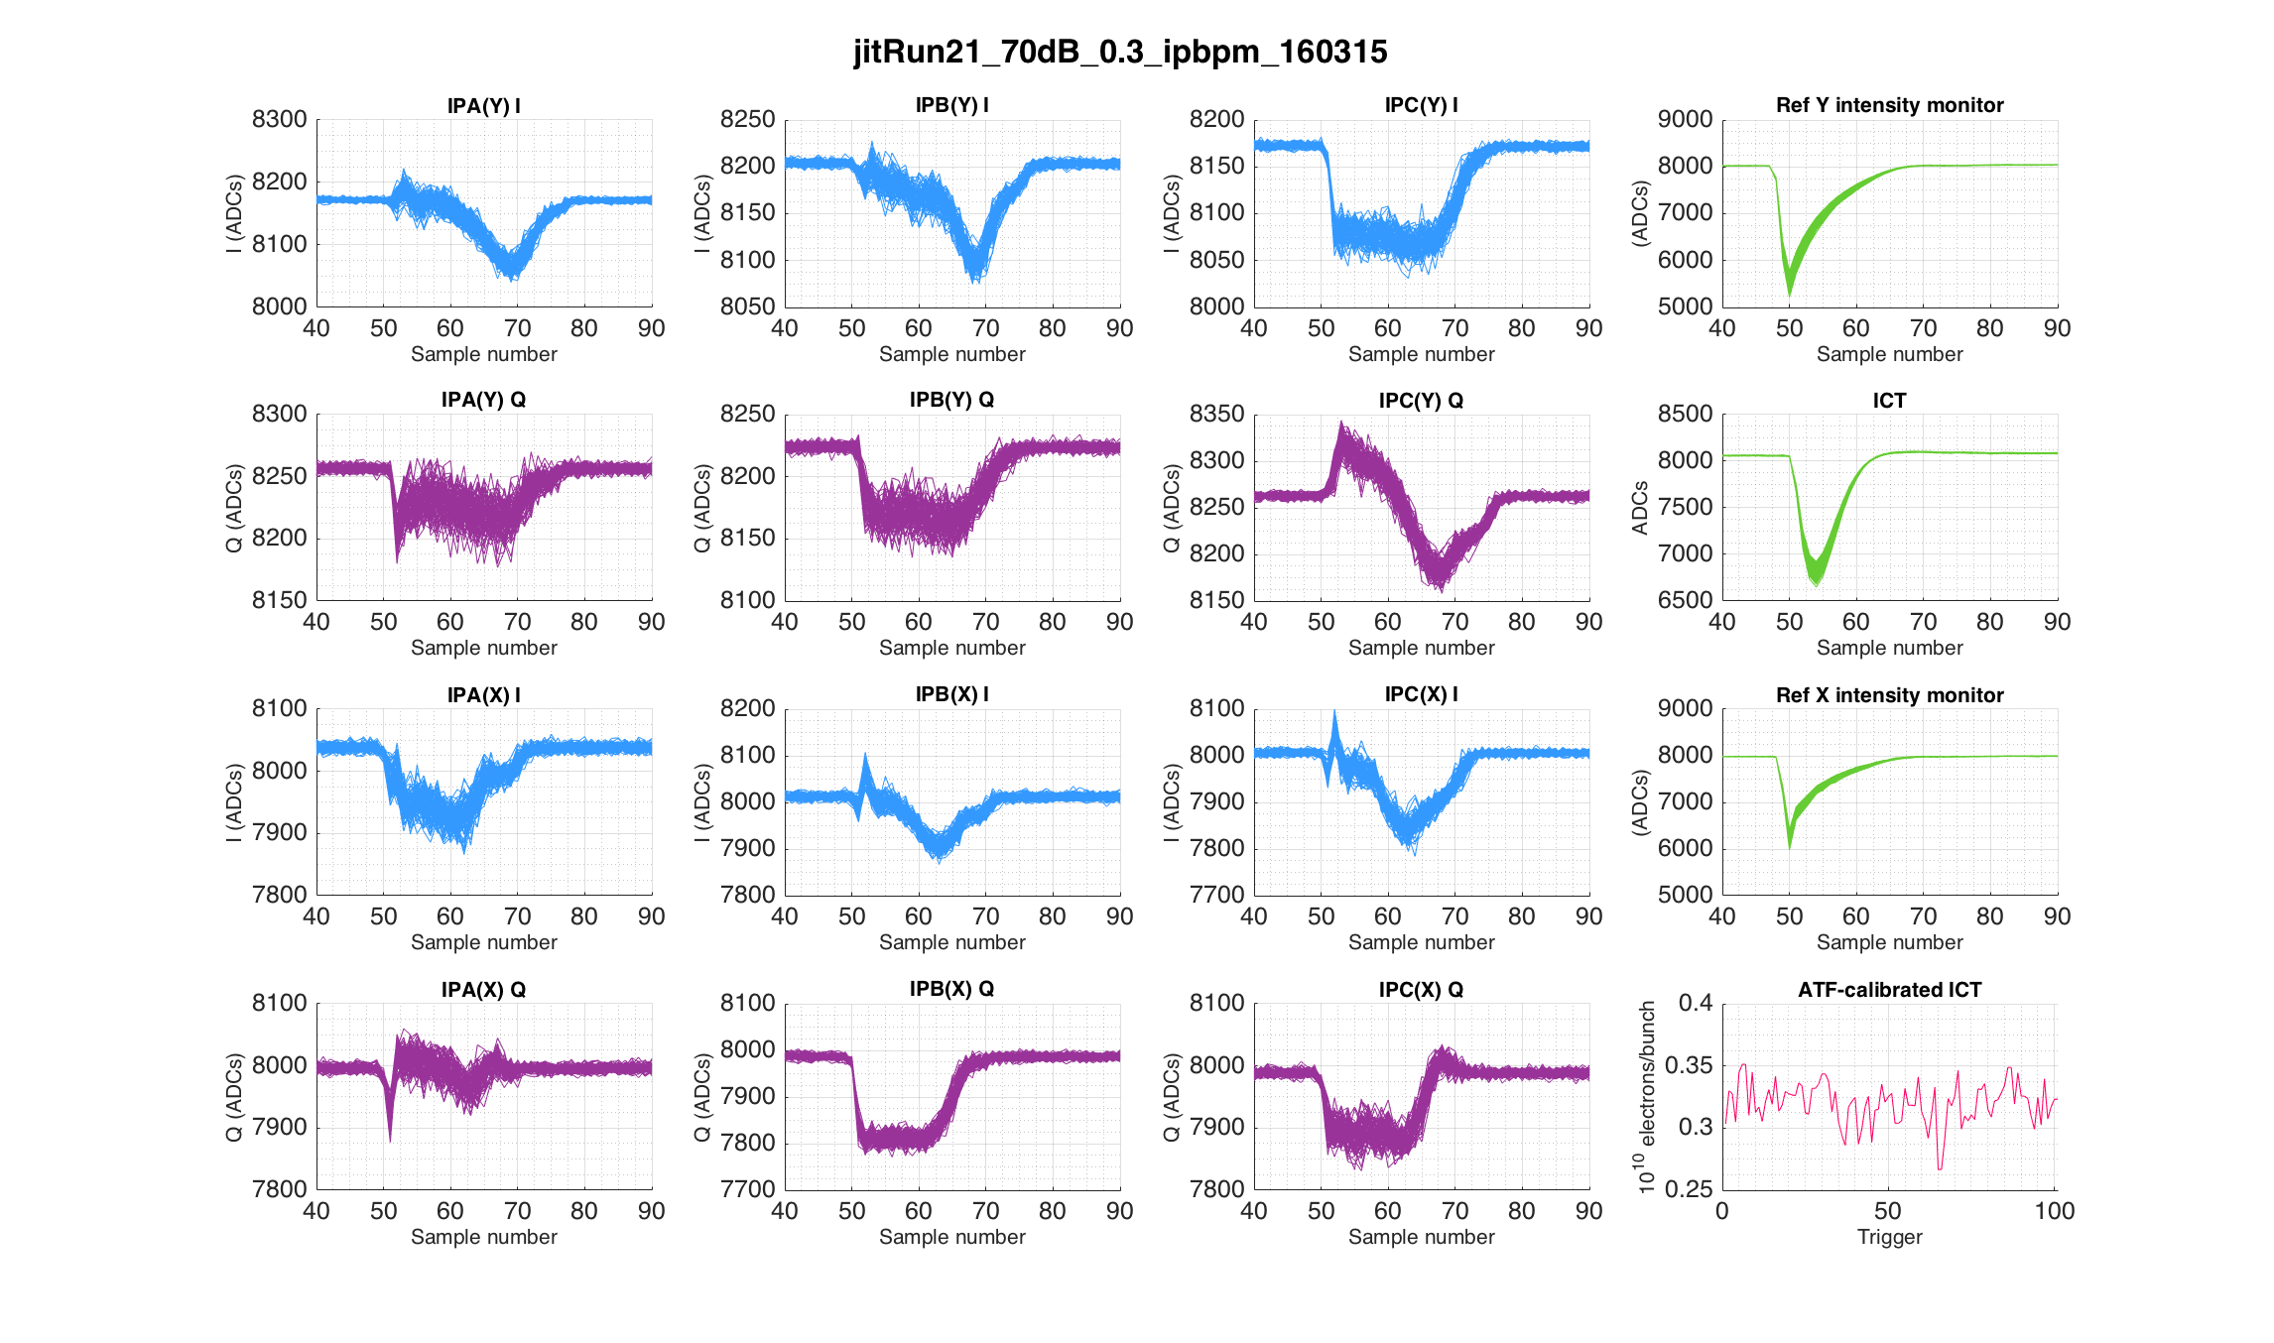

Slide 15
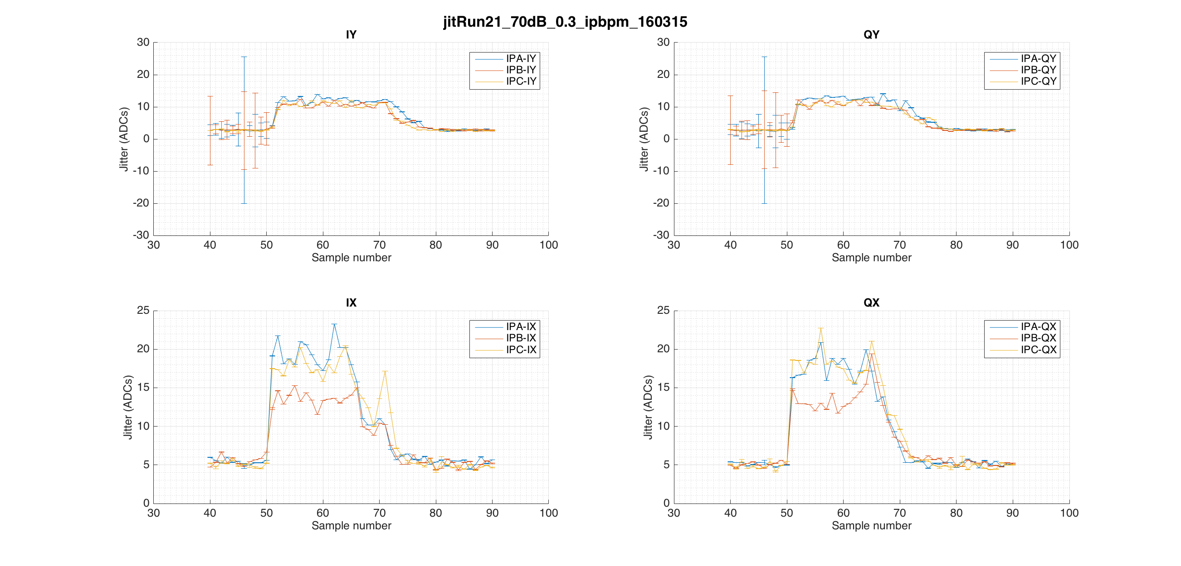

Slide 16
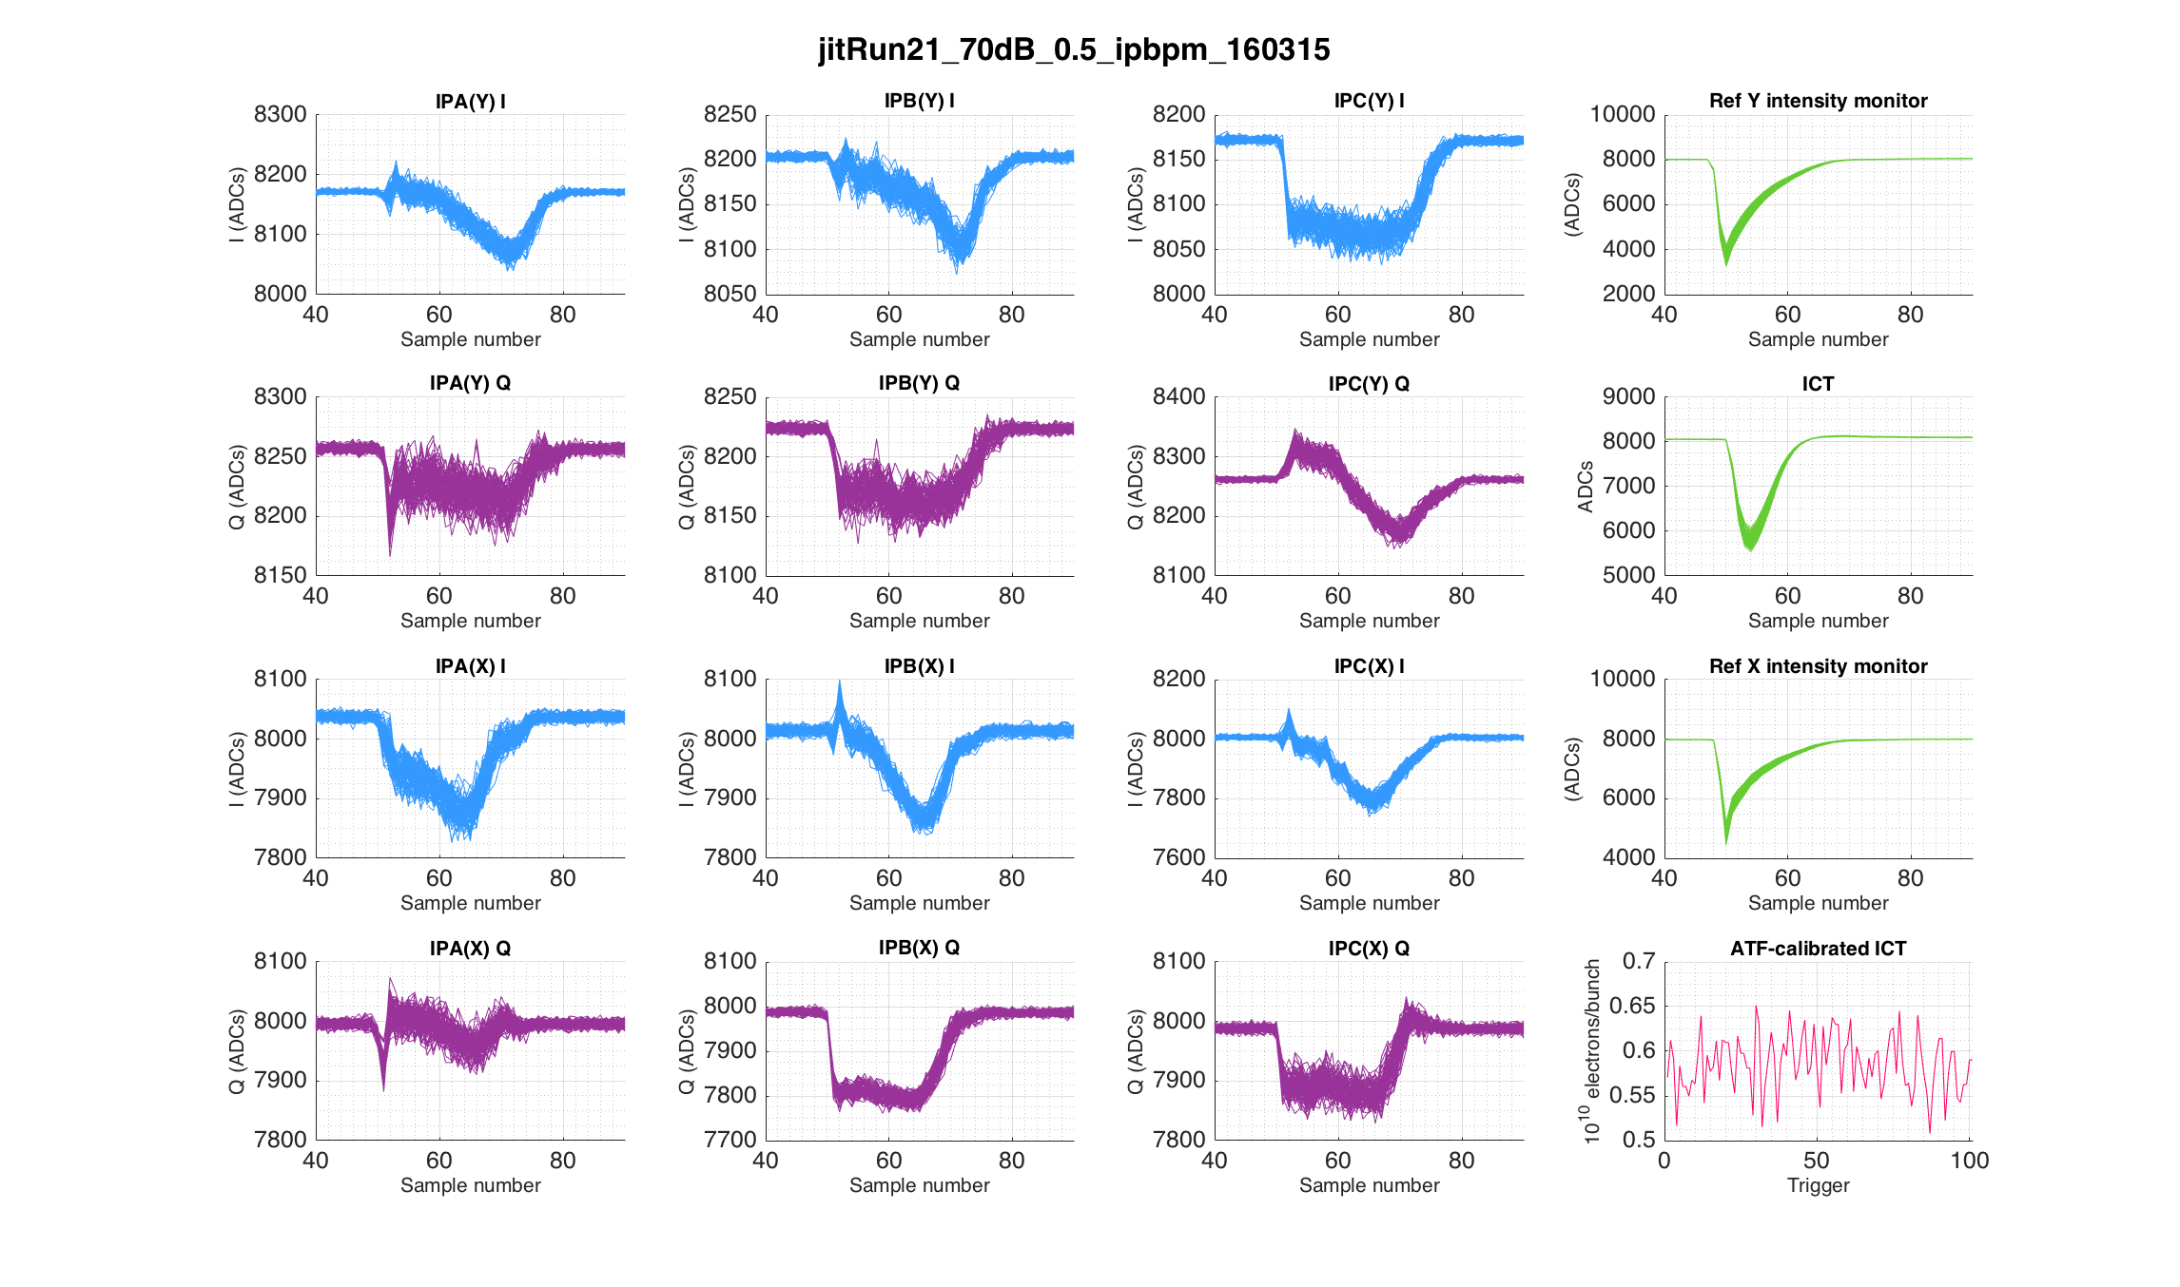

Slide 17
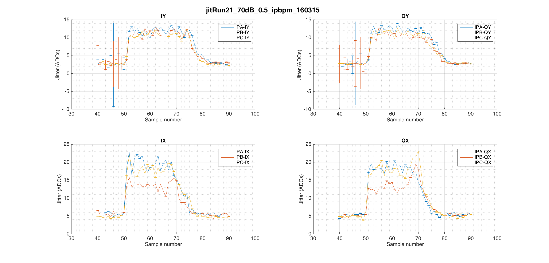

Slide 18
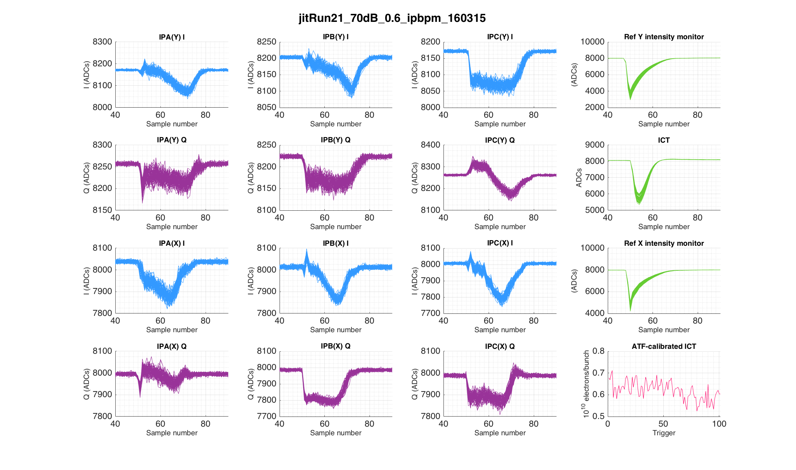

Slide 19
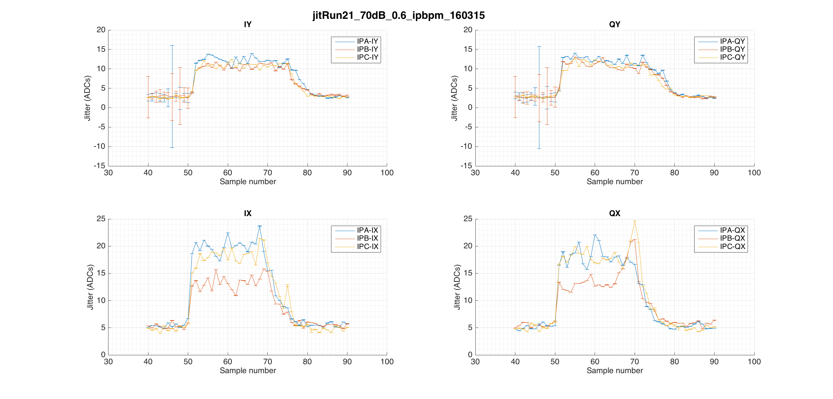

Slide 20
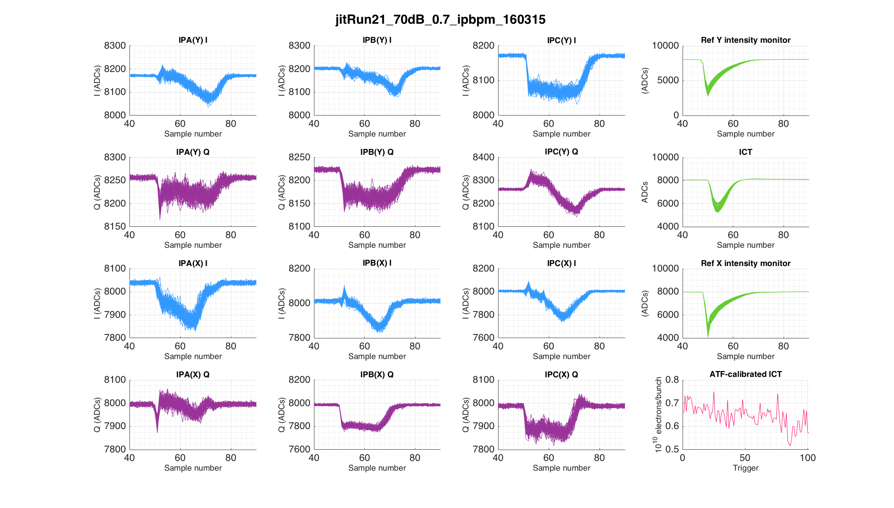

Slide 21
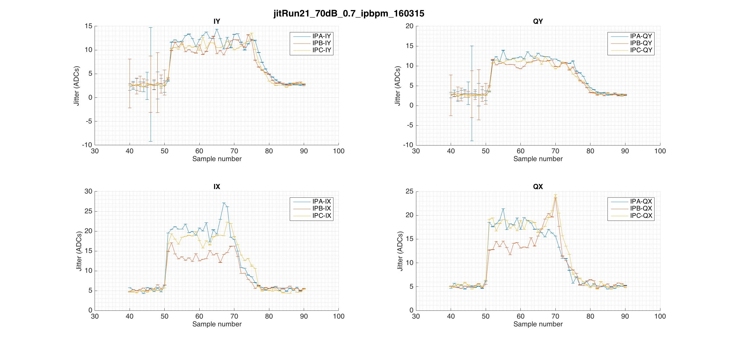

Slide 22
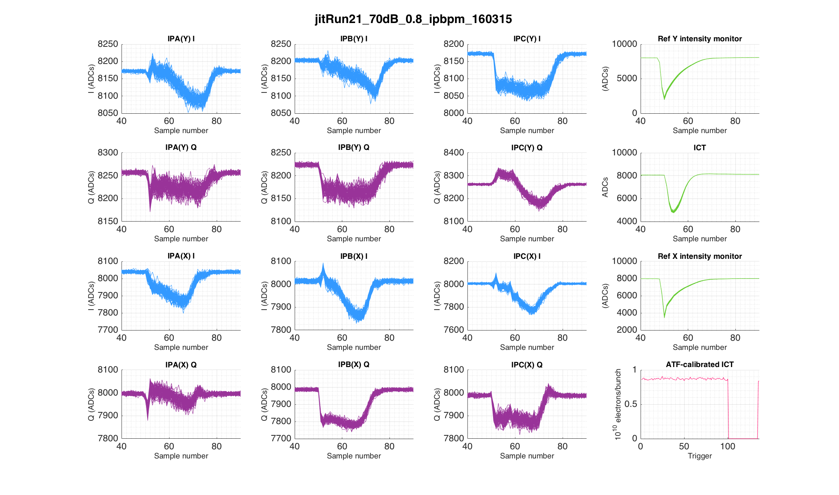

Slide 23
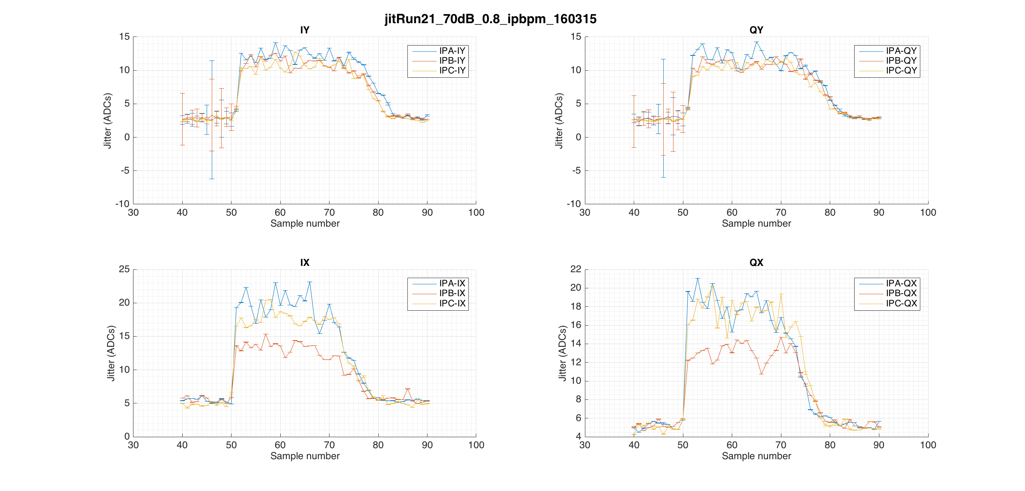

Slide 24
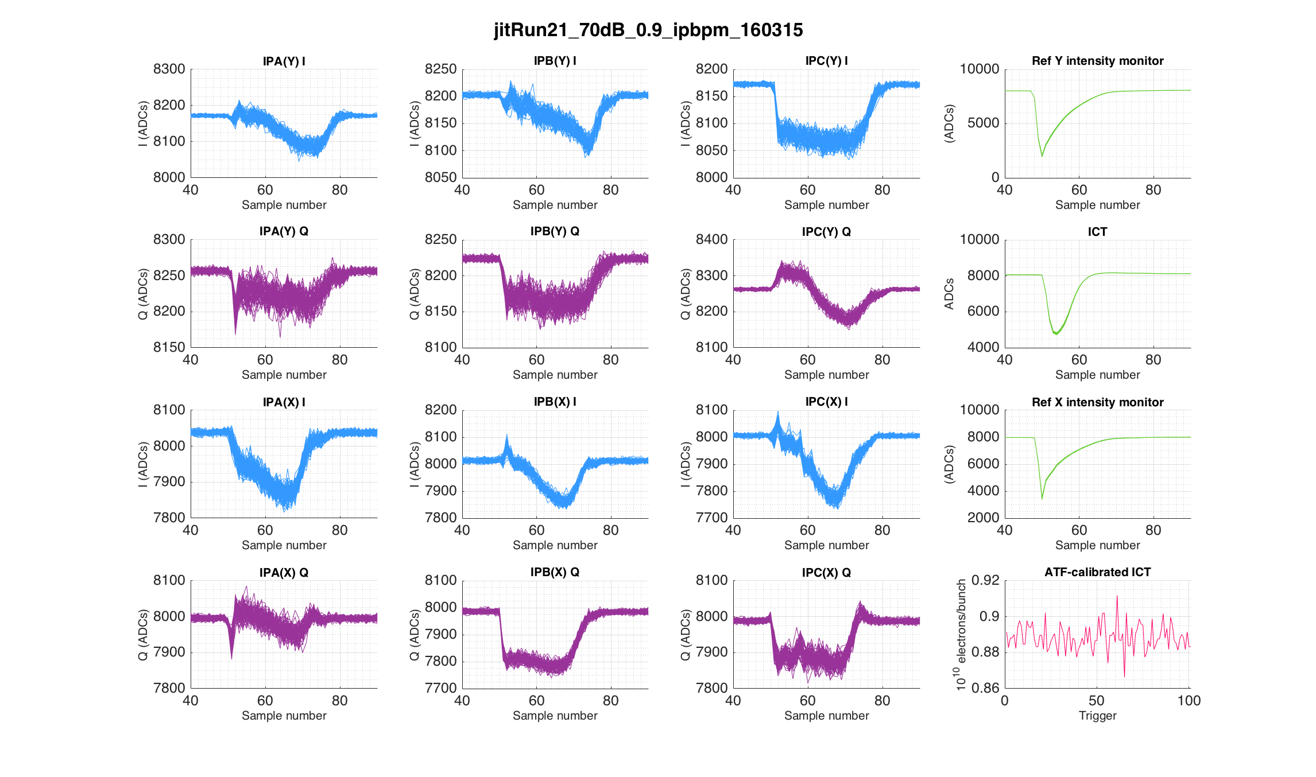

Slide 25
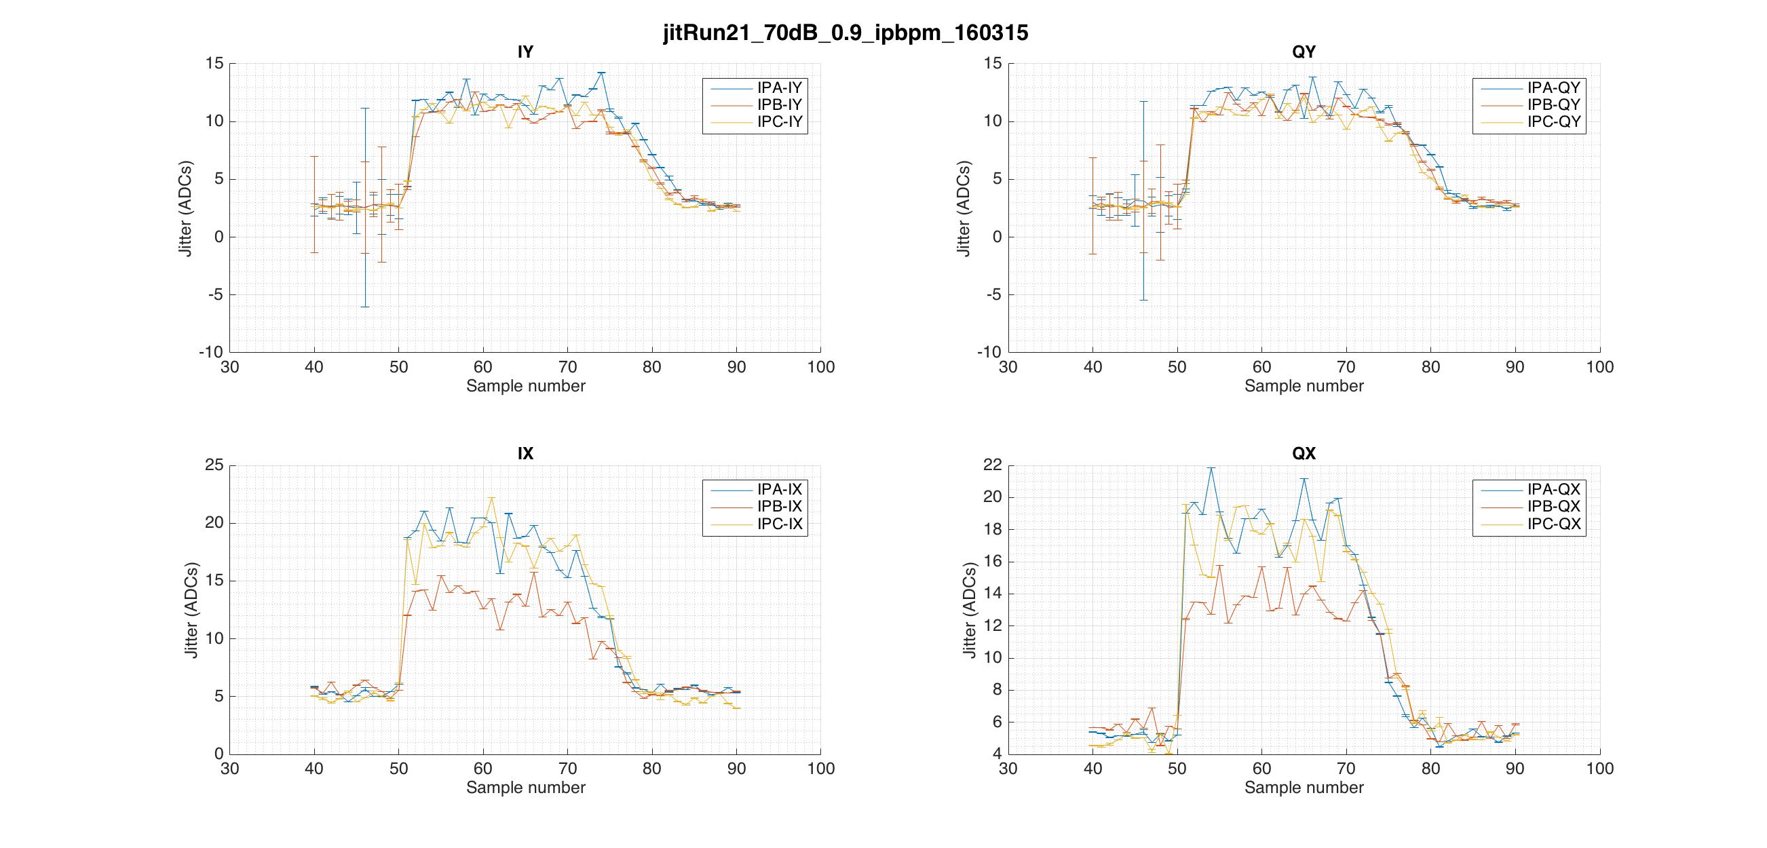

Slide 26
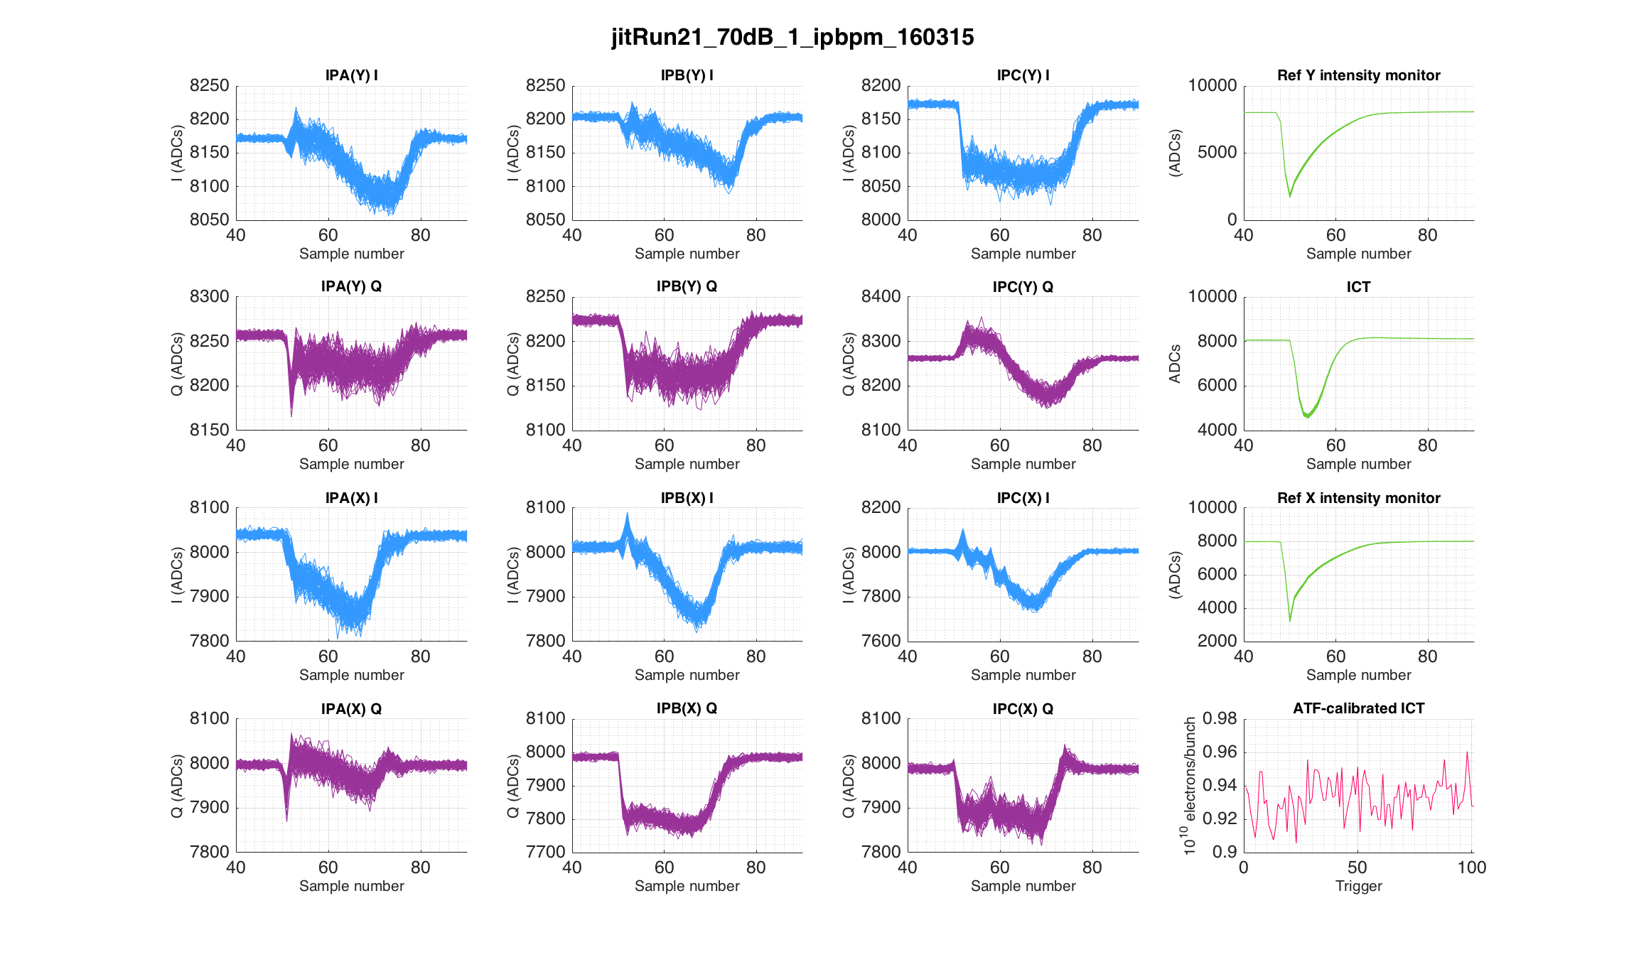

Slide 27
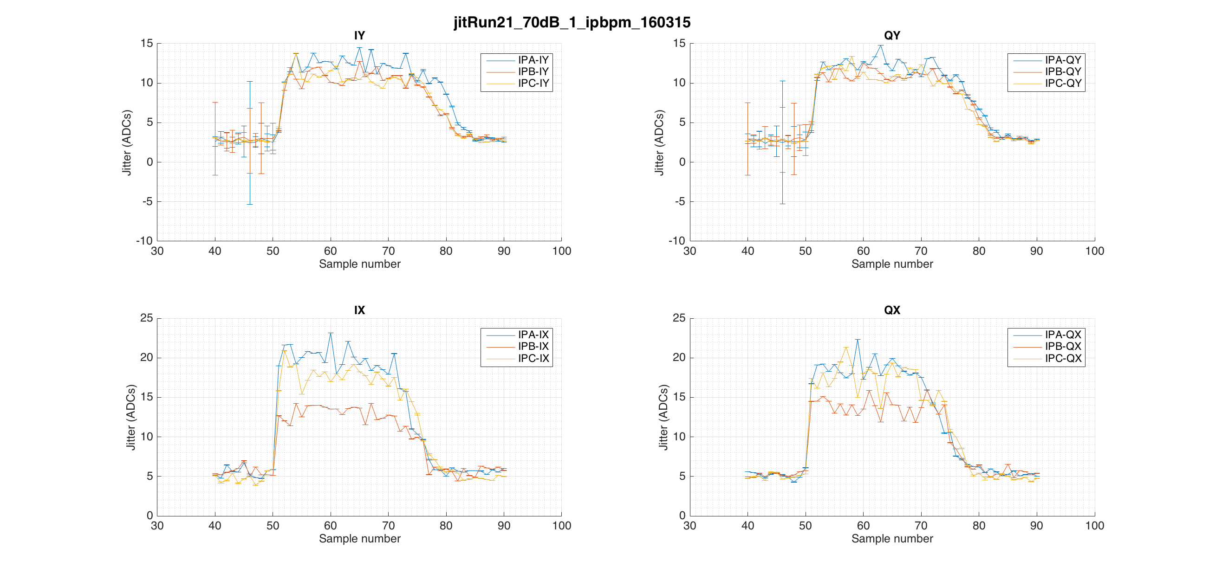

Slide 28
Mean jitter data from slide 5 plots
ICT | 0.0764 | 0.1615 | 0.321 | 0.435 | 0.586 | 0.62 | 0.646 | 0.872 | 0.8885 | 0.933
ICT_s | 0.0004 | 0.0008 | 0.001 | 0.002 | 0.003 | 0.004 | 0.004 | 0.001 | 0.0006 | 0.001
IPA IY | 11.526 | 12.0573 | 12.3166 | 12.1099 | 11.6327 | 12.1085 | 12.5549 | 12.51 | 11.9852 | 12.7357
IPA IY_s | 0.4847 | 0.1377 | 0.3304 | 0.2066 | 0.3604 | 0.3354 | 0.2963 | 0.3541 | 0.287 | 0.2005
IPB IY | 9.4853 | 10.7229 | 10.5777 | 11.7195 | 11.4096 | 10.5636 | 10.4194 | 11.2572 | 11.4395 | 10.6966
IPB IY_s | 0.7317 | 0.2176 | 0.2664 | 0.1924 | 0.377 | 0.247 | 0.4132 | 0.3355 | 0.1855 | 0.2756
IPC IY | 10.4279 | 10.5735 | 11.1041 | 10.9723 | 11.1731 | 10.8812 | 11.0471 | 10.9816 | 11.0727 | 10.991
IPC IY | 0.8183 | 0.1829 | 0.2613 | 0.2624 | 0.1844 | 0.2804 | 0.2685 | 0.339 | 0.2181 | 0.207
IPA QY | 9.5069 | 11.4885 | 12.8239 | 13.0677 | 12.5782 | 12.3231 | 12.1978 | 11.8517 | 12.2967 | 12.843
IPA QY_s | 0.4924 | 0.4499 | 0.1603 | 0.2918 | 0.3011 | 0.2065 | 0.1983 | 0.3902 | 0.2355 | 0.2955
IPB QY | 9.4028 | 10.7716 | 11.3148 | 11.117 | 10.8882 | 11.2463 | 10.3308 | 10.8238 | 11.0909 | 11.2228
IPB QY_s | 0.7568 | 0.4041 | 0.2557 | 0.2294 | 0.208 | 0.2658 | 0.1762 | 0.2448 | 0.2141 | 0.2543
IPC QY | 9.0278 | 10.6683 | 11.1857 | 11.2573 | 11.4786 | 11.6604 | 11.382 | 10.6327 | 11.1595 | 11.0238
IPC QY | 0.5889 | 0.2537 | 0.2604 | 0.3013 | 0.285 | 0.2002 | 0.1762 | 0.1766 | 0.2366 | 0.3468
IPA IX | 8.4269 | 16.4153 | 19.679 | 19.9364 | 19.3757 | 19.7554 | 19.8899 | 20.2031 | 19.0956 | 20.3861
IPA IX_s | 0.9161 | 1.543 | 0.5897 | 0.2693 | 0.5574 | 0.4925 | 0.4436 | 0.5297 | 0.5455 | 0.5199
IPB IX | 8.5693 | 12.6228 | 13.3091 | 13.4716 | 13.3247 | 13.3116 | 13.4534 | 13.6764 | 13.31 | 13.6182
IPB IX_s | 0.9166 | 0.844 | 0.257 | 0.3728 | 0.2084 | 0.4591 | 0.3028 | 0.3407 | 0.3788 | 0.1186
IPC IX | 9.8429 | 15.9126 | 17.8443 | 16.6302 | 17.9228 | 18.2803 | 17.959 | 18.4093 | 18.8489 | 18.0119
IPC IX | 0.9278 | 0.8083 | 0.4518 | 0.2699 | 0.4138 | 0.3336 | 0.4262 | 0.4548 | -0.5162 | 0.2265
IPA QX | 7.4989 | 14.5065 | 17.6908 | 18.1424 | 18.5209 | 18.3616 | 18.3252 | 17.7796 | 17.9255 | 18.9034
IPA QX_s | 1.0314 | 0.9757 | 0.4775 | 0.2502 | 0.4388 | 0.6834 | 0.3002 | 0.4251 | 0.3638 | 0.5526
IPB QX | 7.8475 | 15.3127 | 13.4174 | 13.1206 | 13.1373 | 13.1545 | 13.5789 | 13.6415 | 13.8727 | 13.7955
IPB QX_s | 0.7175 | 1.1239 | 0.4039 | 0.3718 | 0.2475 | 0.2475 | 0.3297 | 0.2329 | 0.3696 | 0.4396
IPC QX | 8.715 | 16.8238 | 17.1841 | 17.124 | 17.3624 | 17.8372 | 18.0283 | 17.3194 | 17.8121 | 17.6909
IPC QX_s | 1.1355 | 0.9793 | 0.3079 | 0.5282 | 0.361 | 0.3185 | 0.2857 | 0.5093 | 0.4017 | 0.7558

Slide 29
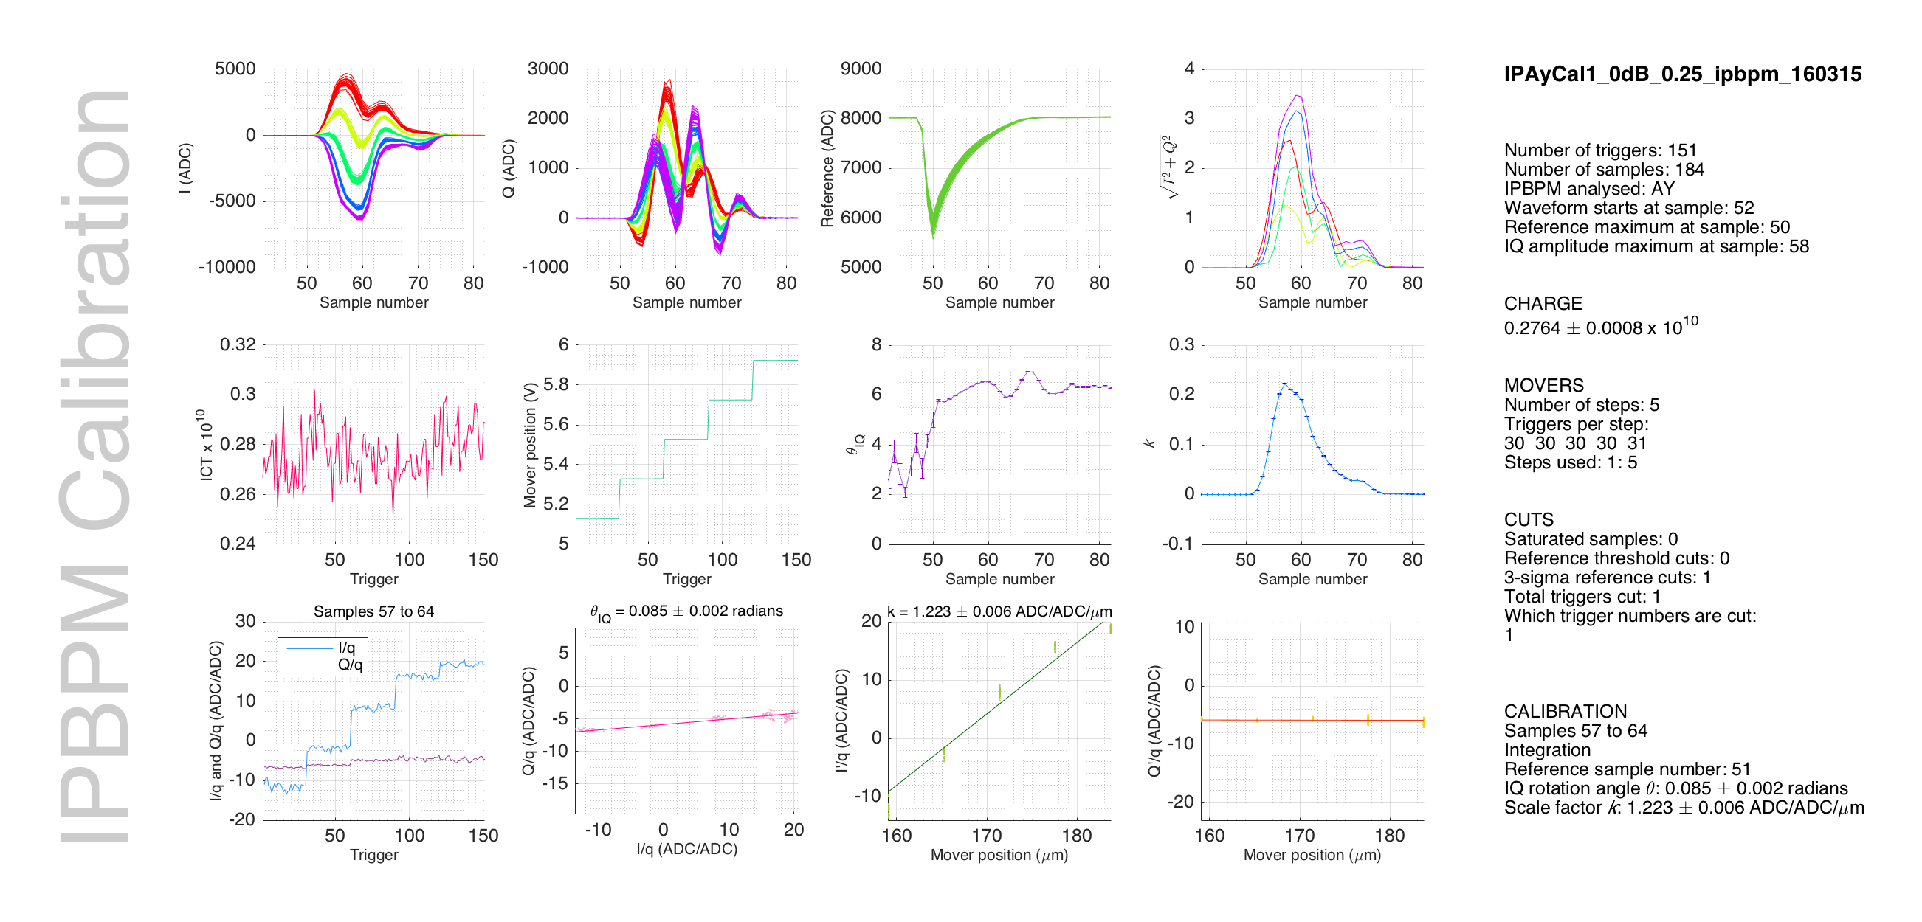

Slide 30
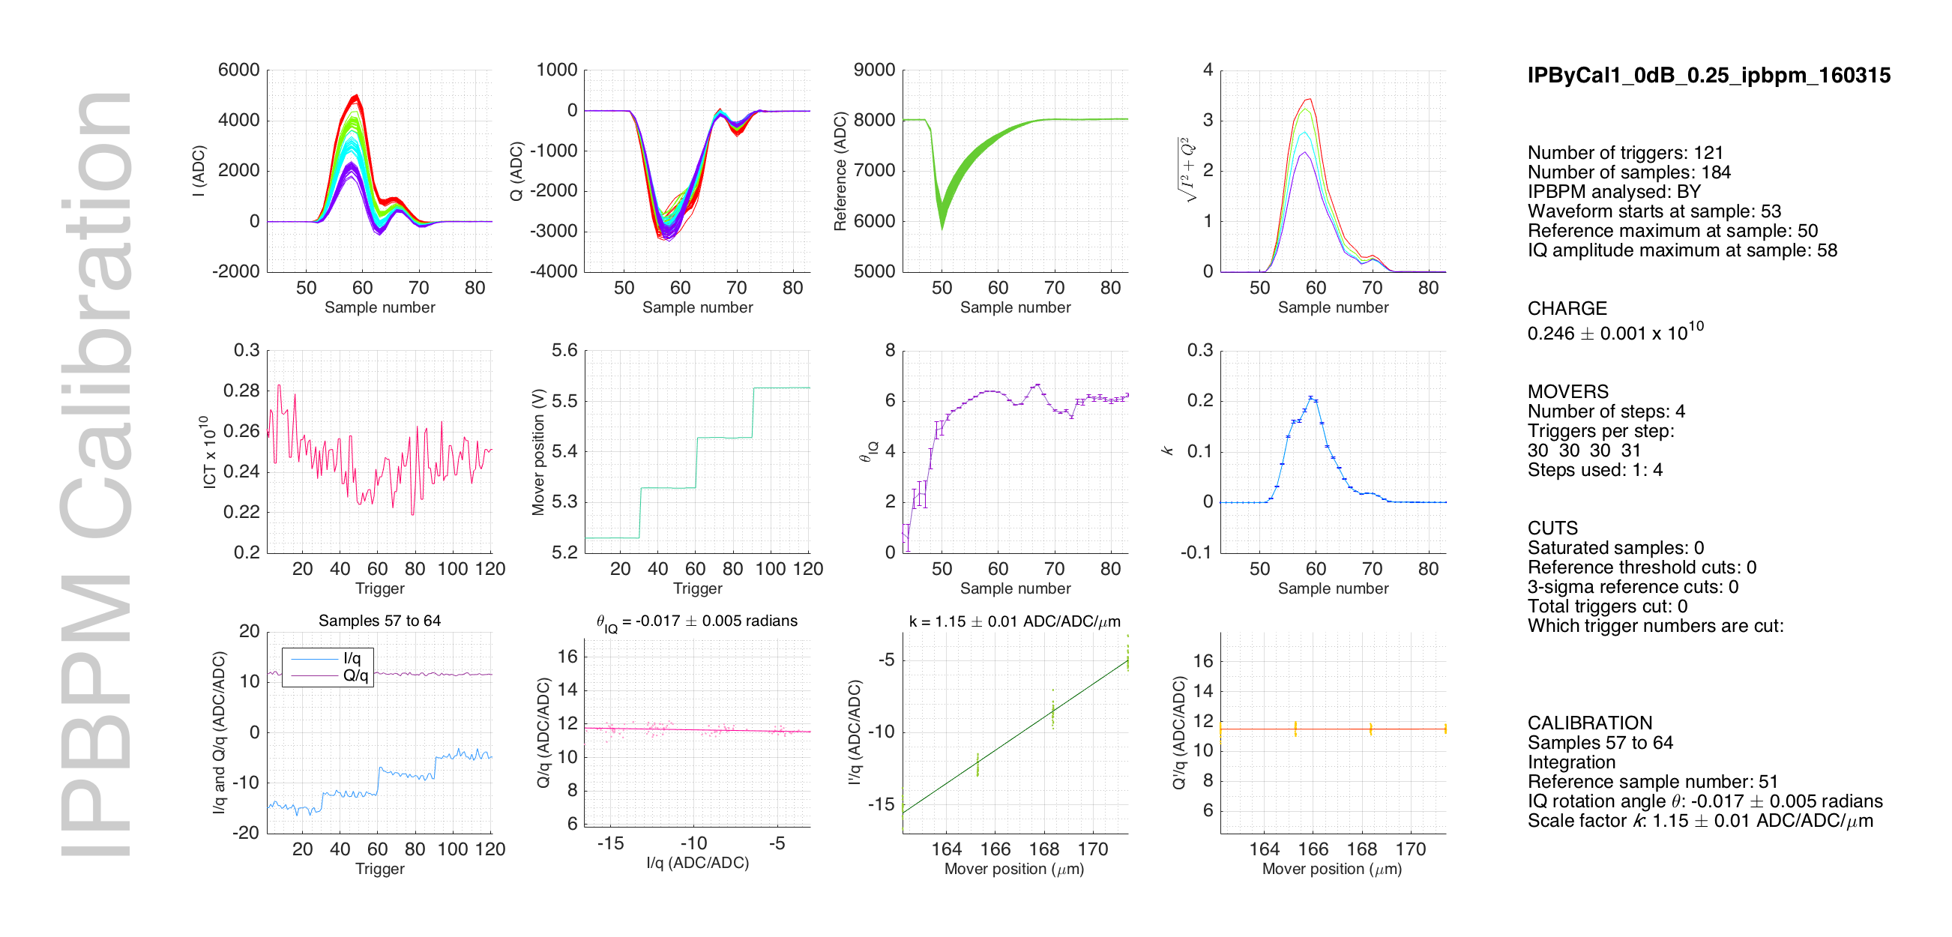

Slide 31
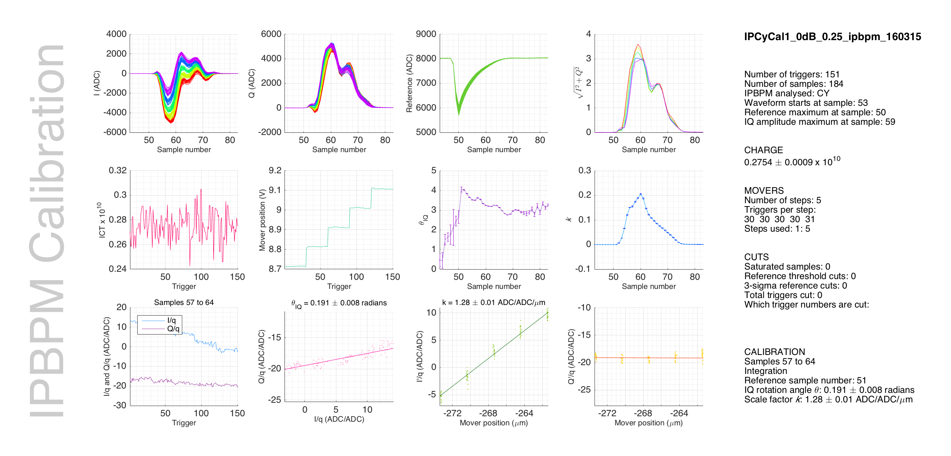

Slide 32
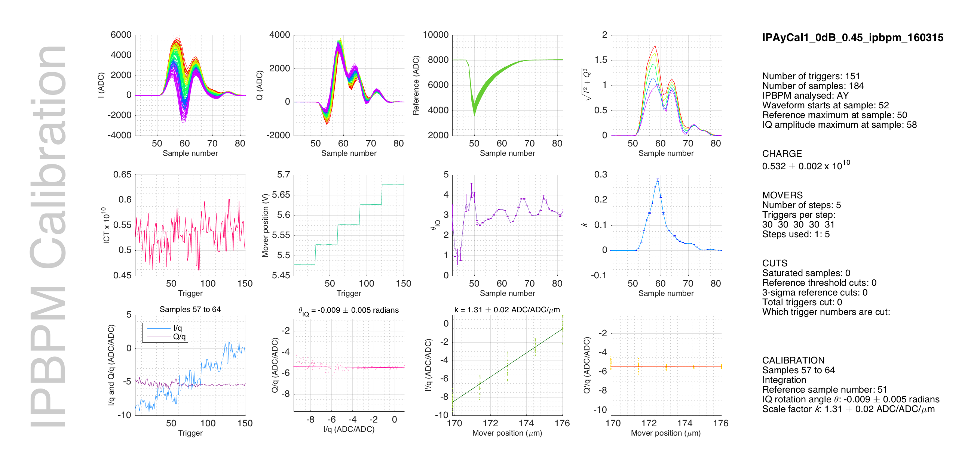

Slide 33
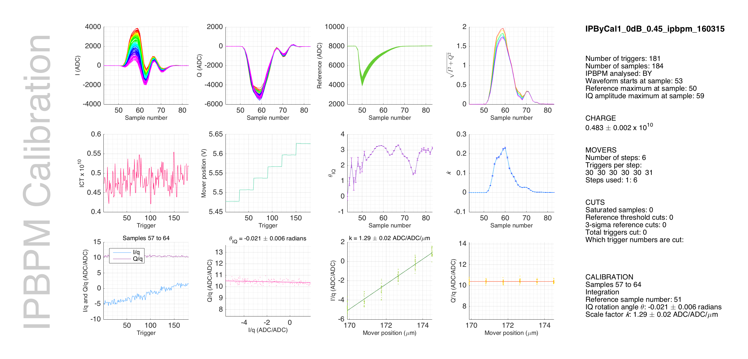

Slide 34
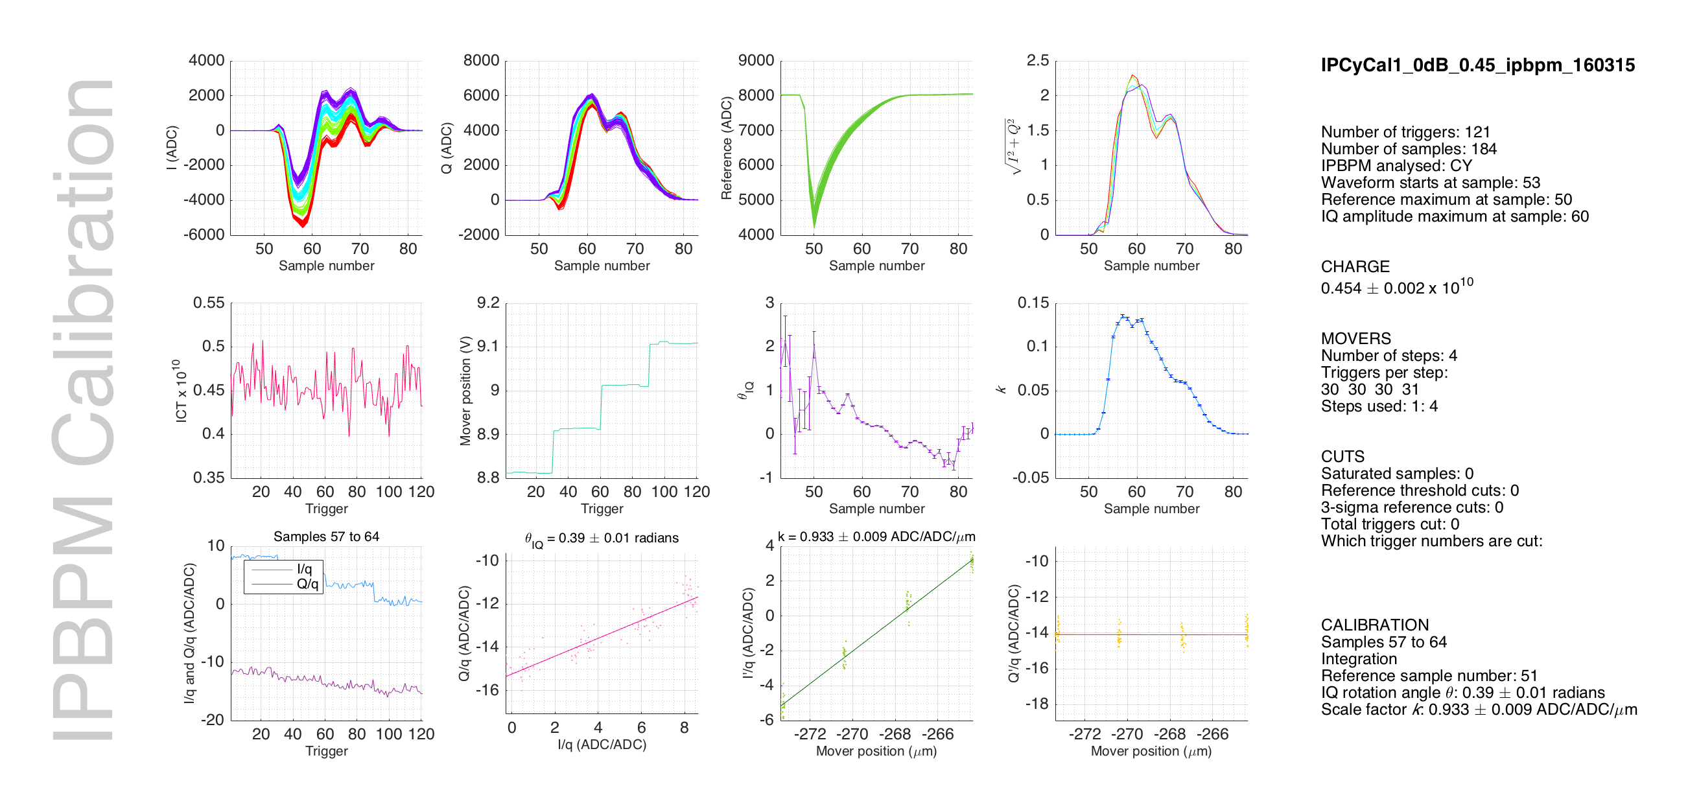

Slide 35
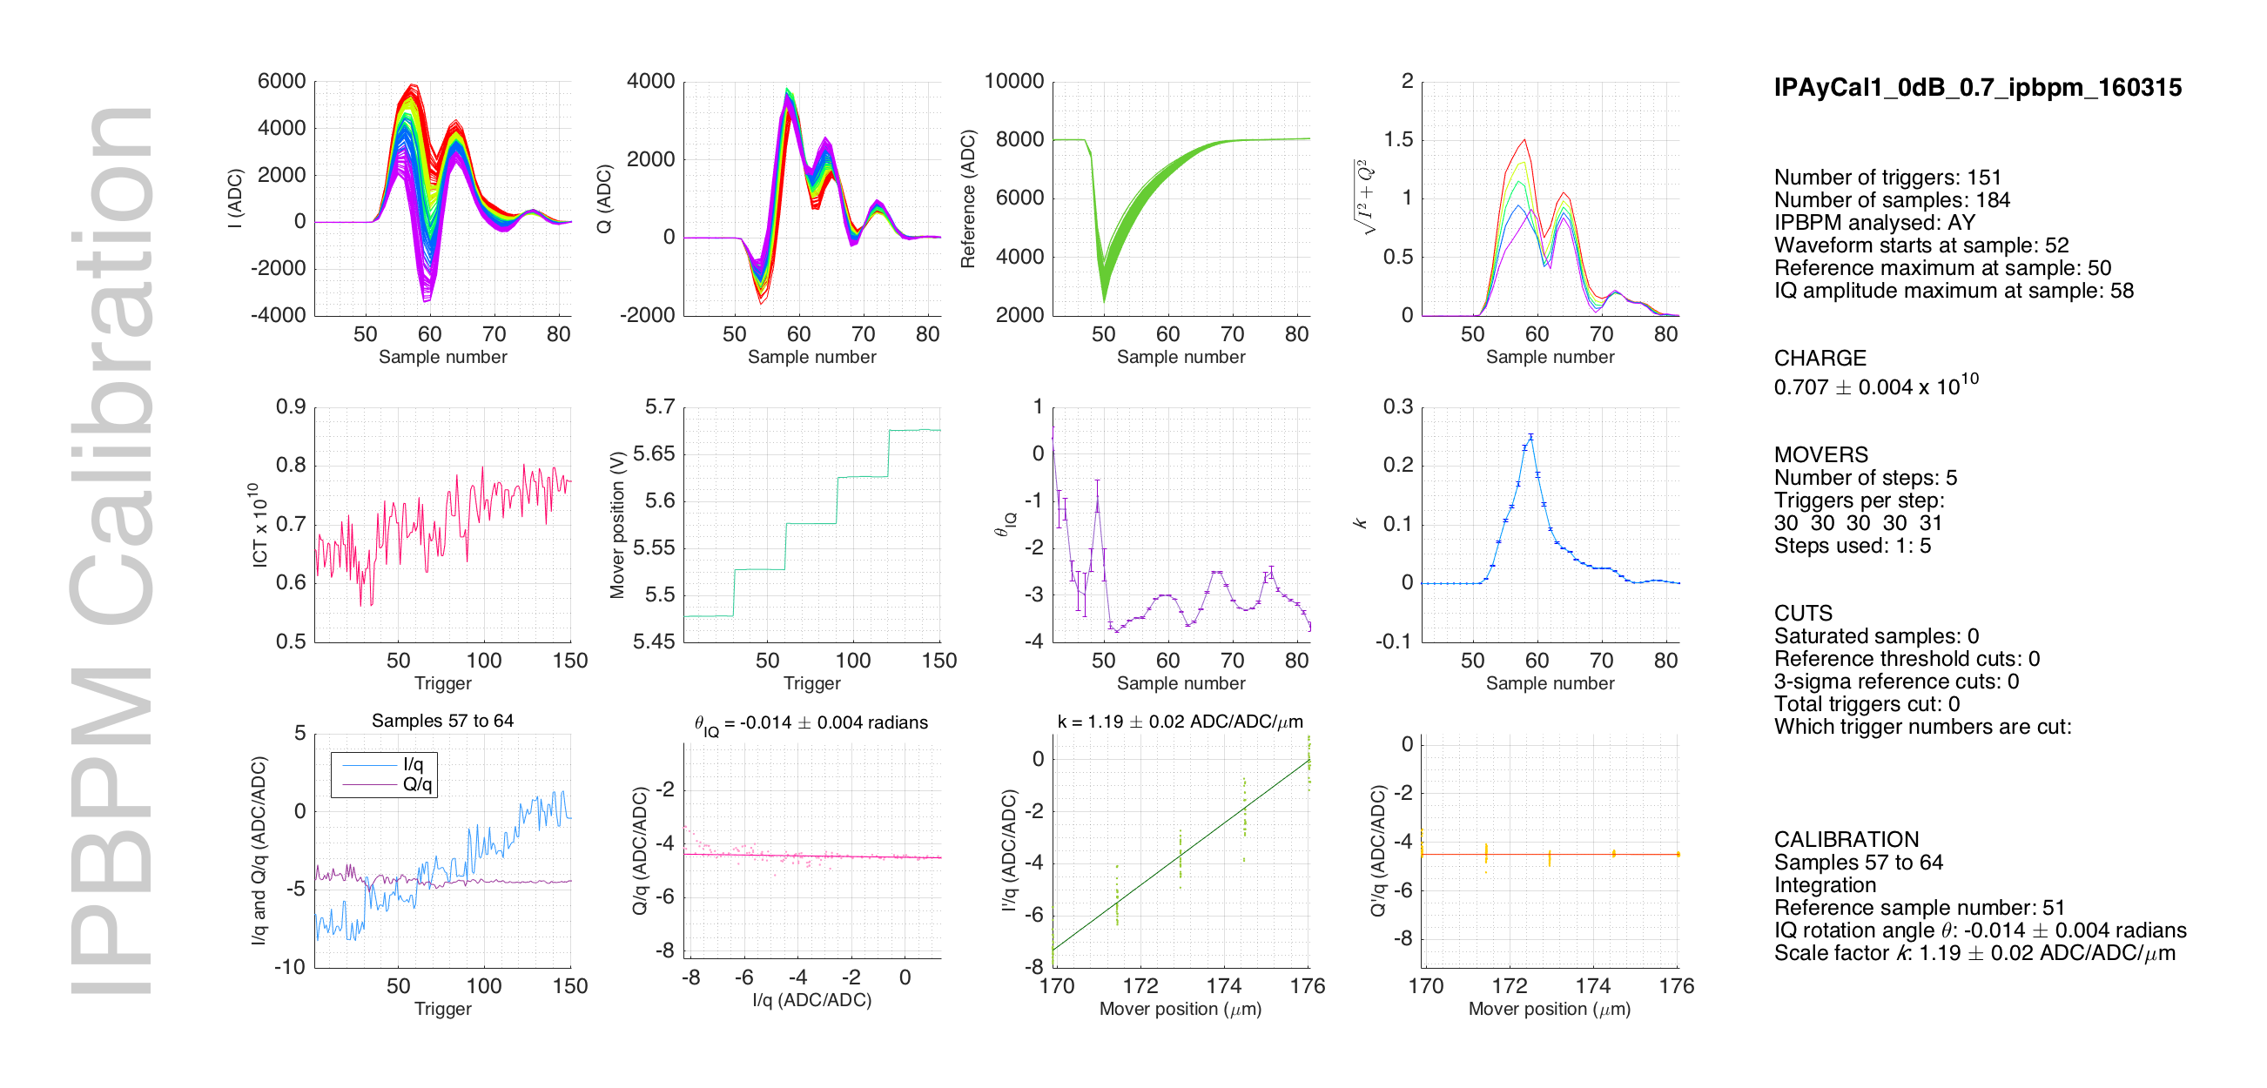

Slide 36
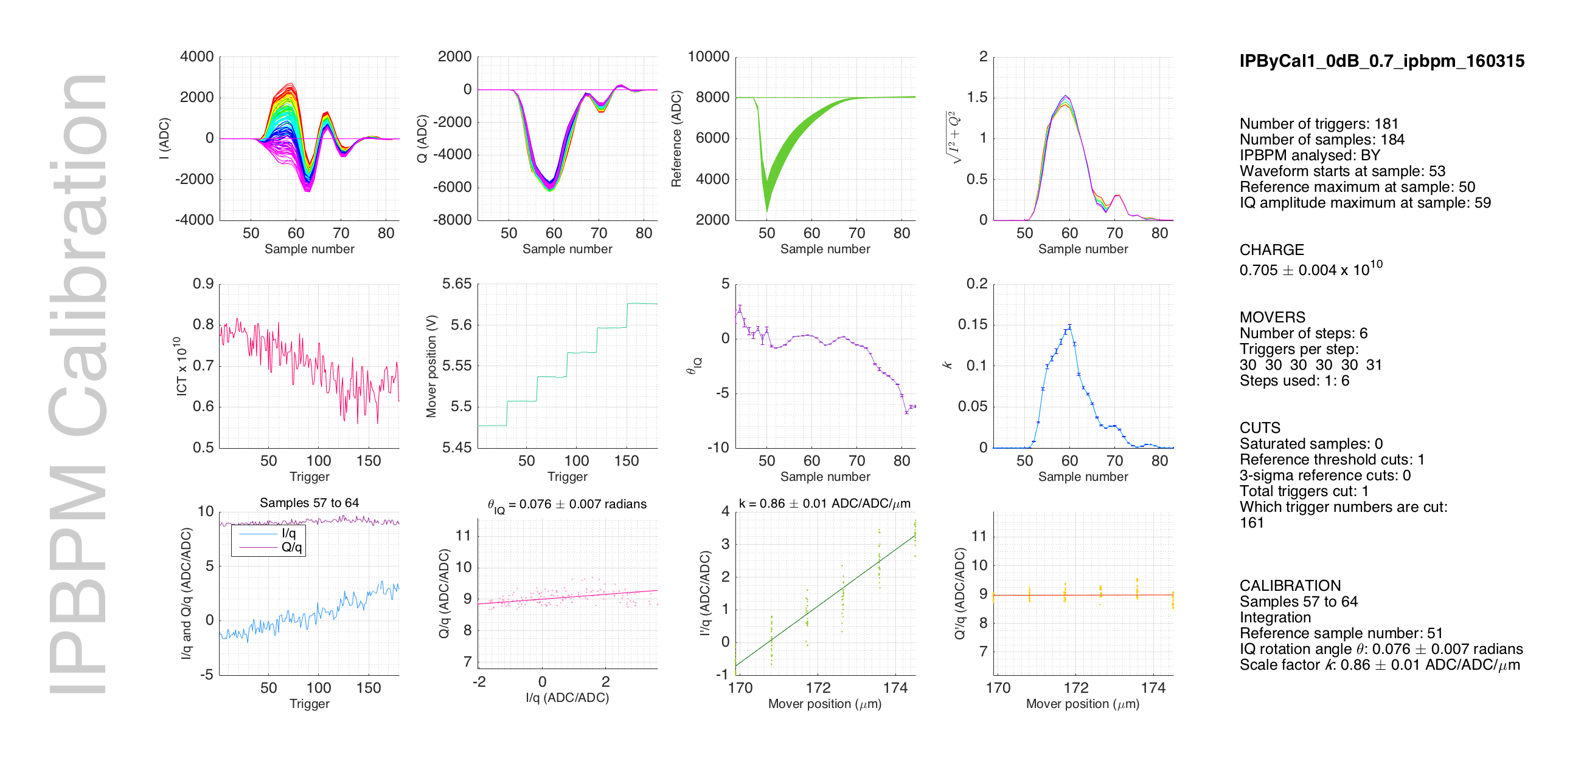

Slide 37
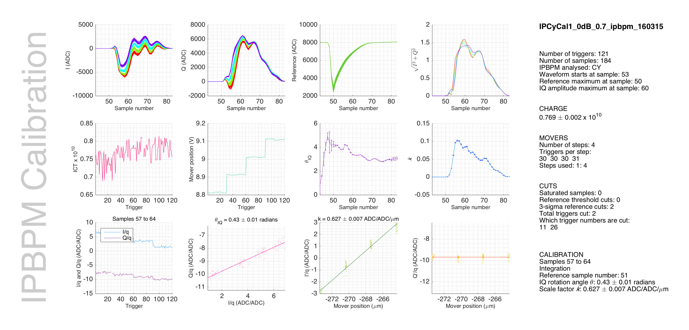

Slide 38
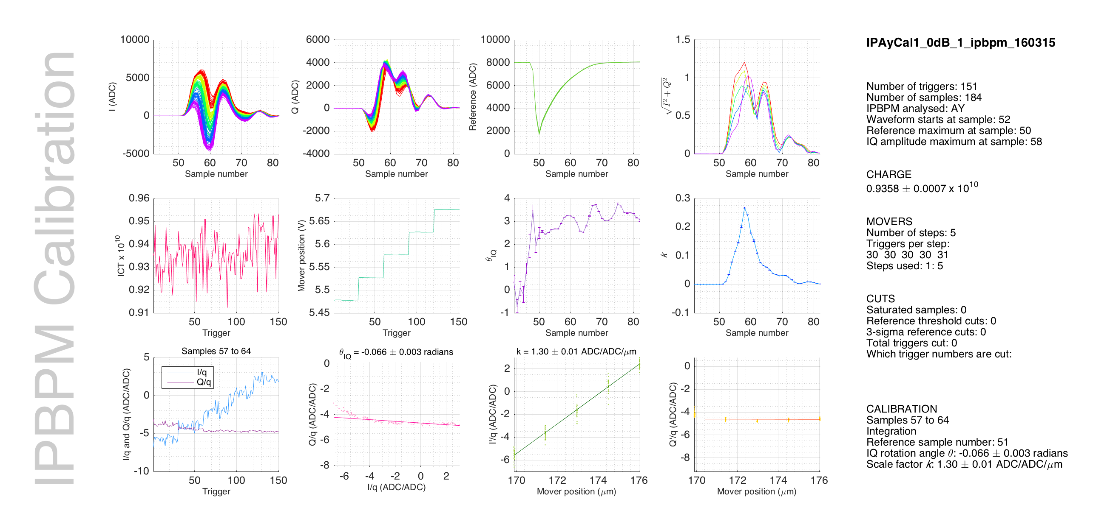

Slide 39
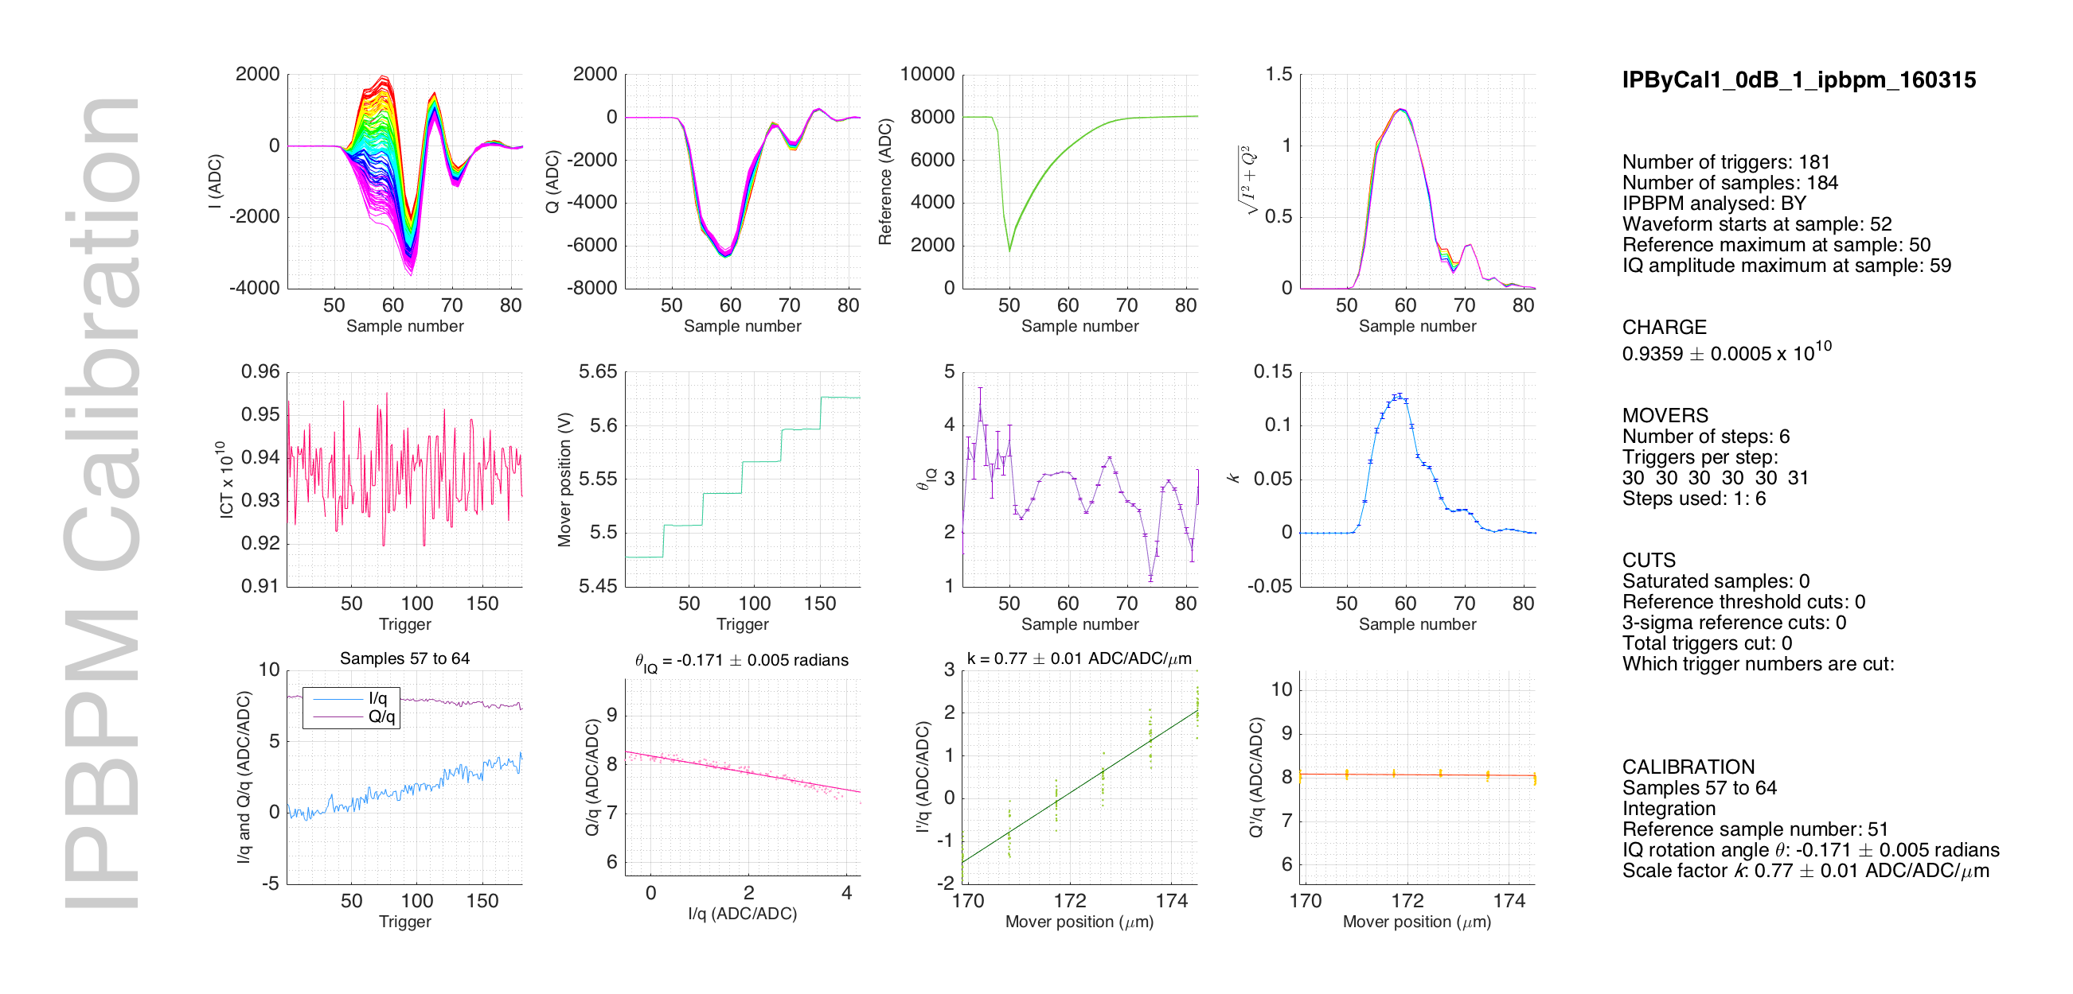

Slide 40
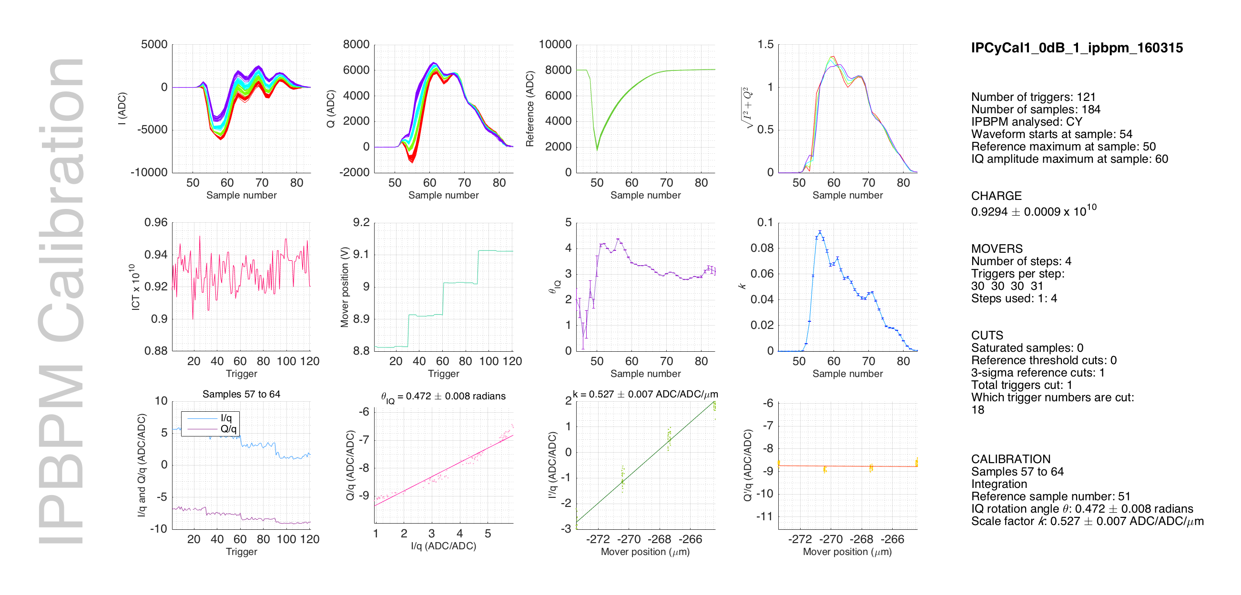

Slide 41
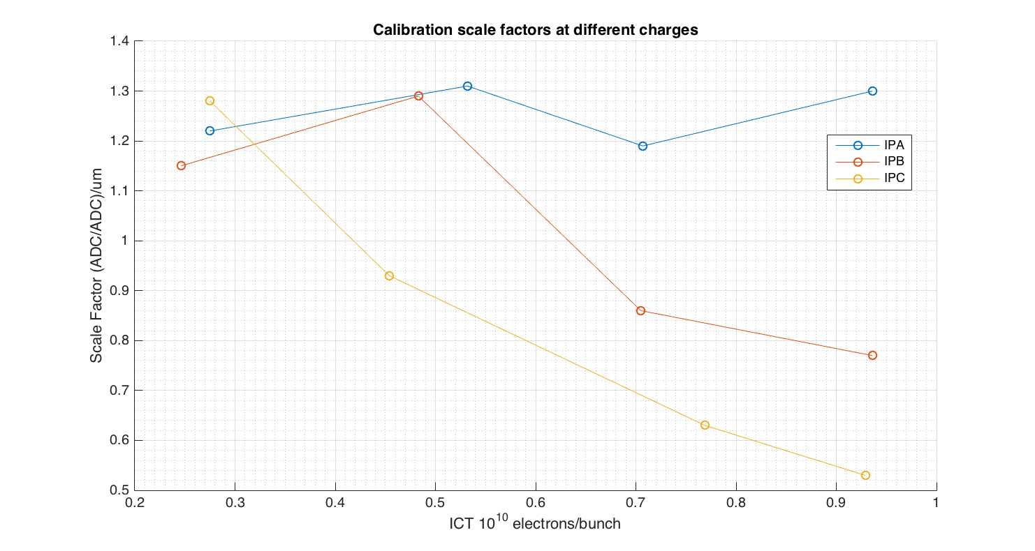
Calibration scale factors as function of charge

