Slide 1
LCC Report
Lyn Evans CERN/Imperial College
SLAC 29th June 2017

Slide 2
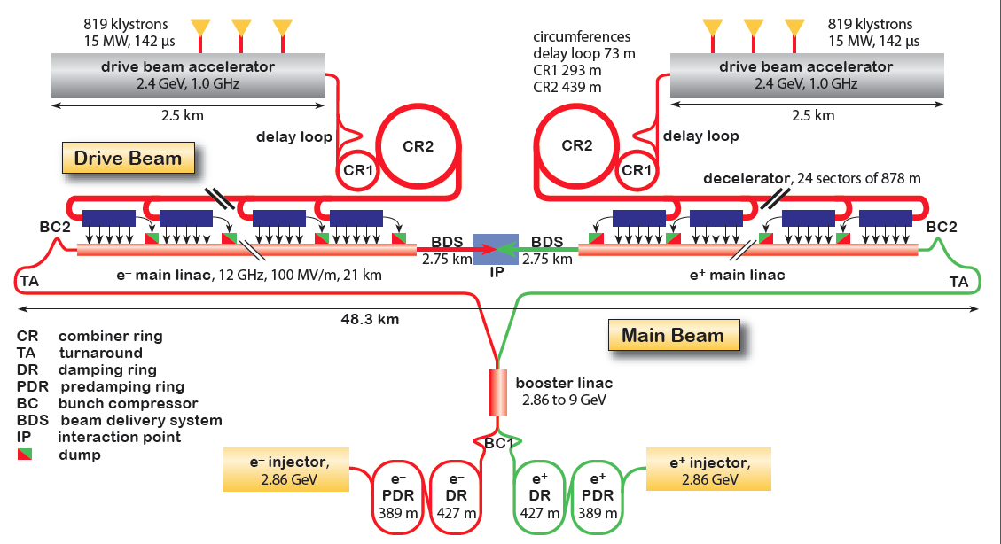
CLIC Layout at 3 TeV
Drive Beam Generation Complex
Drive beam time structure - initial
Drive beam time structure - final
240 ns
240 ns
5.8 μs
140 μs train length - 24 × 24 sub-pulses
4.2 A - 2.4 GeV – 60 cm between bunches
24 pulses – 101 A – 2.5 cm between bunches
Main Beam Generation Complex

Slide 3
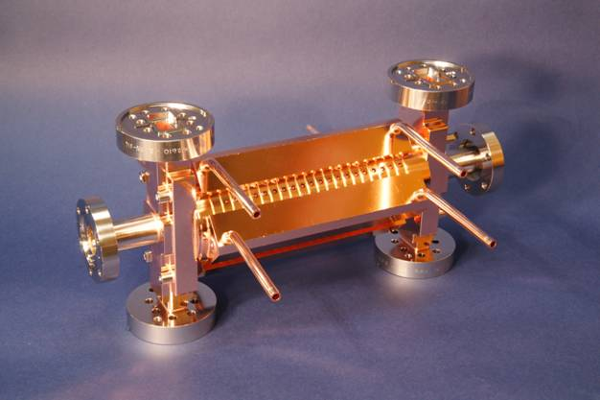
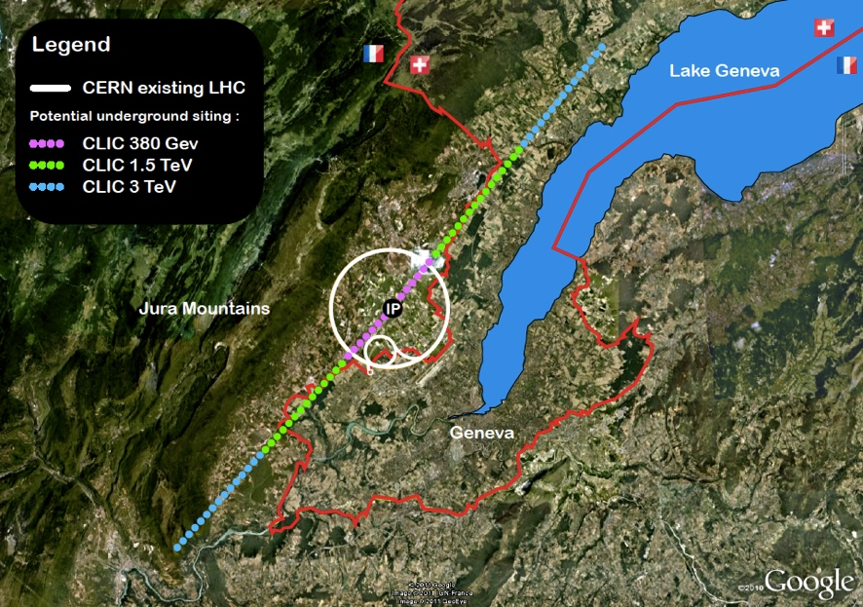
The CLIC project
Timeline for the European Strategy ~2019, goal:
Cost and power optimised 380 GeV machine (~11 km)(drivebeam and klystrons) upgradeable to 3 TeV
Key technical activities in the collaboration:
Xband statistics and optimisisation for cost
Work with FEL labs for use in smaller machines
Permanent magnets (power)
High Efficiency klystrons (power and cost)
Stability and alignment (lum performance)
Tests CTF3, CLEAR (next slide), ATF2, Low emittance rings
Physics and detectors
Notes:
Fix layout

Slide 4
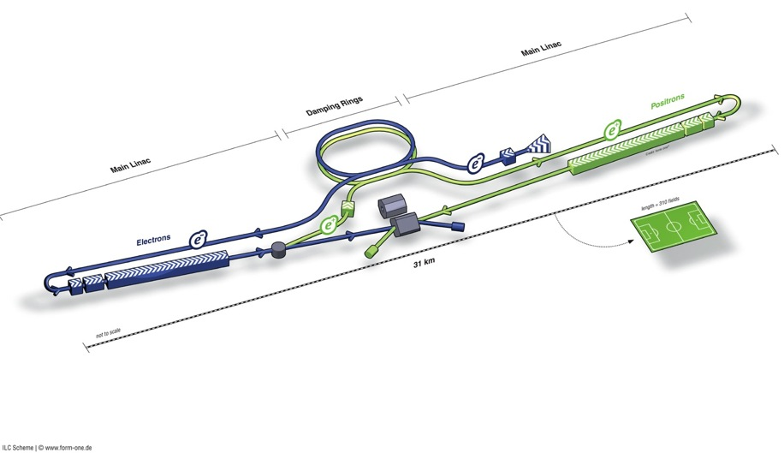
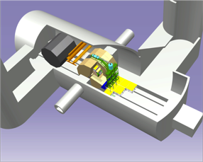
ILC Accelerator in TDR
Damping Rings
Polarised electron source
Ring to Main Linac (RTML)
(including
bunch compressors)
e+ Main Linac
e- Main Linac
Parameters | Value
C.M. Energy | 500 GeV
Peak luminosity | 1.8 x10³⁴ cm⁻²s⁻¹
Beam Rep. rate | 5 Hz
Pulse duration | 0.73 ms
Average current | 5.8 mA (in pulse)
FF beam size (y) | 5.9 nm
E gradient in SCRF acc. cavity | 31.5 MV/m +/-20% Q₀ = 1E10
E+ source
Demonstrated in TDR
Progress in 2014

Slide 5
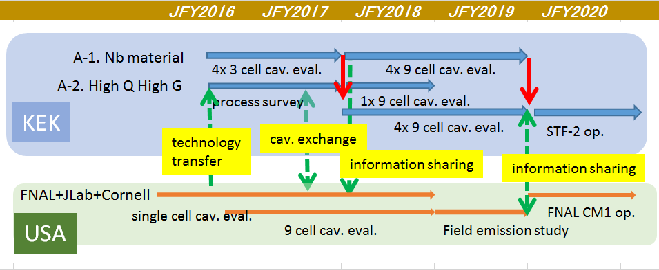
Collaboration between KEK and FNAL
Budget request: KEK->MEXT
JFY2018 total ~3.7 M$
fabricate 4 9-cell cavities (for Nb material R&D)
fabricate 4 9-cell cavities (for High-Q, HighG)
JFY2019 total ~3.7 M$
evaluate the performance
prepare the installation to STF-2
A-1. Nb material
4x 3 cell cav. eval.
4x 9 cell cav. eval.
A-2. High Q High G
process survey
1x 9 cell cav. eval.
KEK
4x 9 cell cav. eval.
STF-2 op.
technology
transfer
cav. exchange
information sharing
information sharing
FNAL+JLab+Cornell
single cell cav. eval.
FNAL CM1 op.
USA
9 cell cav. eval.
Field emission study

Slide 6
R&D Plans at worldwide Labs
 | On-going | R&D: ML Cavity | Assoc. System | Cryomodule | RF
Fermilab | LCLS-II | N₂-infusion (HQ-HG) | Coupler
JLab | LCLS-II | Nb-LG/FG (Ingot-sliced/rolled) , LSF cavity, N₂-infusion
DESY | EXFEL | N₂-infusion Nano-Lab study |  | High-performance CM
INFN-LASA | ESS | Nb-LG/FG systematic study for ESS
CEA/ CNRS-LAL | IFMIF ESS, SARAF | Vertical EP (VEP), N₂-Infusion | Magnetic shield Coupler | Assembly robotizing
KEK | STF | Nb-LG/FG N₂-infusion | Coupler, Tuner Crab. C. |  | Marx M.
IHEP | ADS | N₂-infusion, Industrialization |  | Industrialization | Marx M. h.e. Klystron
CERN | HL-LHC Hi-Isolde | Thin-film (Nb on Cu) | Coupler |  | h.e. Klystron
TRIUMF | ISAS-II, ARIEL | VEP, muSR
(Cornell) |  | N₂-infusion, VEP
successful only at FNAL

Slide 7

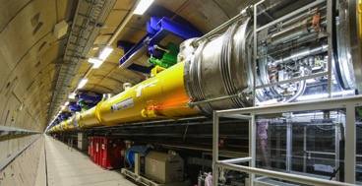
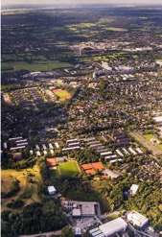

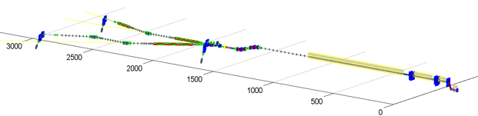
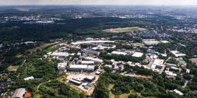

European XFEL SRF being Completed
Media.xfel.au, Dec. 2015
Progress:
2013: Construction started
2015: SRF cav. (100%) completed
CM (70%) progressed
Further Plan:
2016: E- XFEL acc. completion
2016/E: E-XFEL beam to start
Acc. : ~ 1/10 scale to ILC-ML
SRF system: ~ 1/20 scale to ILC-SRF
1.3 GHz / 23.6 MV/m
808 SRF acc. Cavities
101 Cryo-Modules (CM)
XFEL
DESY
1 km SRF Linac
XFEL site
DESY
7

Slide 8
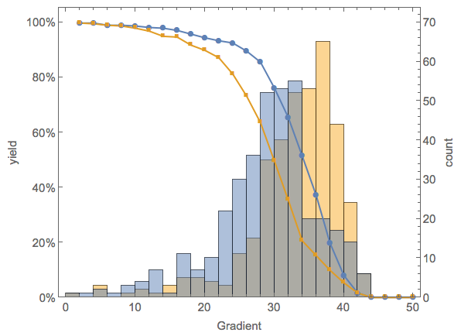
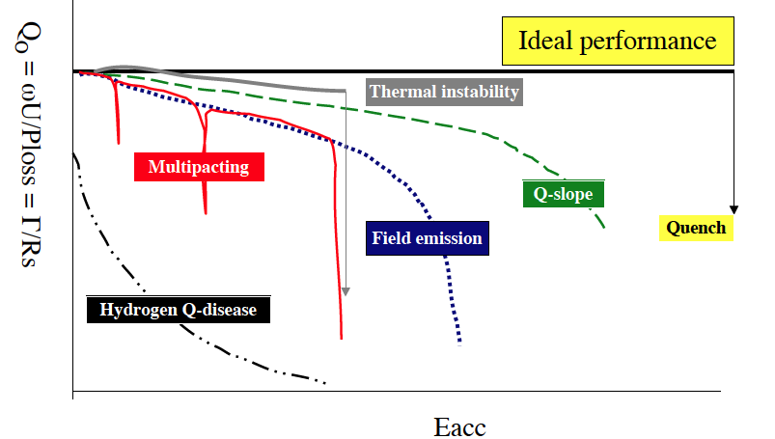
E-XFEL: SRF Cavity Performance (as received)
N. Walker, D. Reschke, SRF’15
SRF cavity production/test ；
# RI Cavities, 373 (as of Sept. 2015)
    Final process: 40 μm EP.
      w/ same recipe to ILC-SRF’s
    Tested at DESY-AMTF
Notes:：
    “Ultra-pure water rinsing as the 2nd process improving the gradient performance (> ~10%) for lower-performed cavities (not shown here).
G-max
G-usable
 | G-usable (Q₀> 10¹⁰ ) | G-max | (ILC)
<G> MV/m | 29.4 | 33 | (35)
Yield at 28MV/m | 66% | 86% | (90%)

Slide 9
Cost reduction efforts
Bilateral DOE/MEXT decision to concentrate effort on cost reduction.
Unwanted consequence is that all design effort has to stop in USA.
More effort on SCRF.

Slide 10
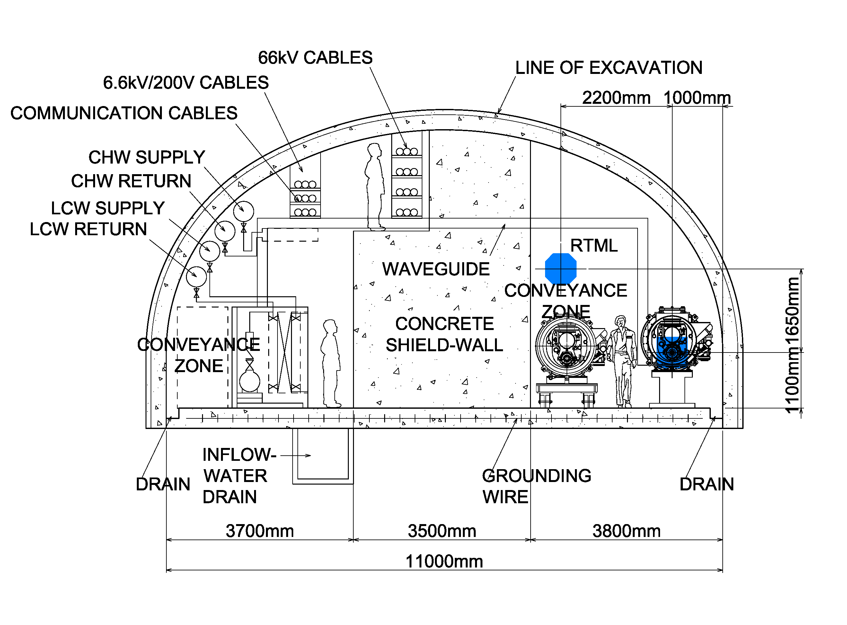
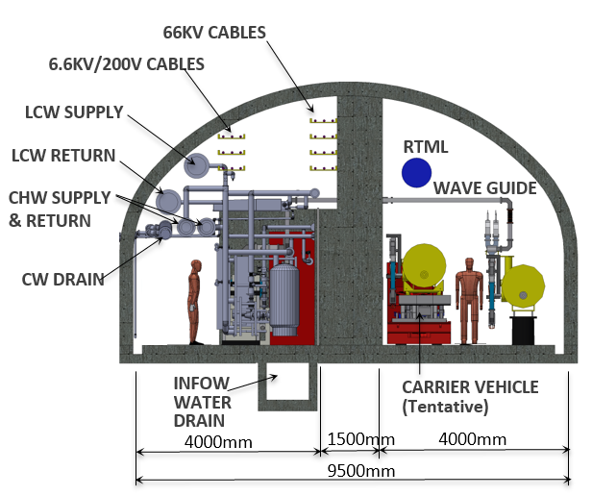
ILC ML Tunnel X-Section Reduced
Center-wall: 3.5m
Center-wall: 1.5m
 | TDR-baseline | Updated
Center-wall width | 3.5 m | 1.5 m
Tunnel width | 11 m | 9.5 m
Access to RF in CM-SRF operation | Yes | Yes
Access to RF in beam operation | Yes | No

Slide 11
Power input coupler fabrication
Cost reduction:
35%(SRF)*15%(coupler)*30%(reduction) → ~1.5%(of ILC total value in TDR)

Slide 12
Results comparison
“standard” 120C bake vs “N infused” 120C bake
Grassellino/Solyak
Achieved:
45.6 MV/m → 194 mT
With Q ~ 2e10!
Q at ~ 35 MV/m ~ 2.3e10!
ILC specs: Q=0.8e10 @ 35MV/m
Increase in Q factor of two, increase in gradient ~15%

Slide 13
Issues and questions
Positron production at low energy.
How important is polarization?
How interesting is gamma-gamma?

Slide 14
Cost reduction
All of these measures will reduce the cost by 10-20%, but that is not enough for a realistic project funding.
The beauty of a linear collider is that it can be staged.
Serious discussions must now start on realistic staging scenarios to bring the cost of the first stage down.

Slide 15
staging option name （given ｂｙ S. Michizono, 02052017）
350GeV option were added
500GeV
TDR:
250 GeV e-
250 GeV e+
250 GeV
125GeV e-
125GeV e+
Option C:
Option D:
125GeV e-
125GeV e+
350GeV Option D’:
Simple tunnel
(no center wall, no facilities)
Simple tunnel (no center wall, no facilities)
Option E:
125GeV e-
125GeV e+
350GeV Option E’:
less important
for staging
Option F:
125GeV e- sparse linac
125GeV e+ sparse linac
350GeV Option F’:

Slide 17
The Japanese government has expressed interest in hosting the ILC
The government has been put under pressure by strong and well organized lobby led by Satoru Yamashita and consisting of physicists, Diet members (about 150), politicians from the Tohoku region and Industry
It responded by consulting the Science Council of Japan which proposed a 2-3 year study of all aspects, scientific, socio-economic, technical. That study will be finished next year.
Staging. We were not instructed by MEXT to study staging. That would have effectively validated point 1 above. We were told by the “back door” that the 500 GeV machine has no chance.
Warm RF.
The best way to kill the ILC is to open this Pandora’s box.

Slide 18
ILC promotion
Schedule V-2017.June
JFY2016 | JFY2017 | JFY2018 | JFY2019 | JFY2020
Apr. Aug. Dec. Mar.
Aug.
CRITICAL
Aug.
NOW
Budget Request
Budget Request
June 2017
Budget
Request
Fiscal
Strategy
Budget Request
Fiscal
Strategy
Budget Request
Fiscal
Strategy
Government
2013~2016
Federation
US Visit
International
Agreement
Cost reduction R&D tasks
→Start (Operational budget
+ 0.6 oku)
LCLS-II construction: use technology
US-Japan
US-Japan 2nd year
(1st year R&D)
US-Japan 3rd year
US-Japan 4th year
(conclusion)
May: MEXT/DOE
Discussion Group
Within US-Japan S&T Cooperation framework
With US: need start serious discussion on management and possibility of cost sharing
Federation
US Visit
Federation: US-Europe-Japan cooperation
→ Support Parliament/Government/Inter-government discussion
Europe
End of October
With Europe (EU countries & CERN): need start concrete discussion on
sharing of cost, technology, human resources
IEEE
Cooperate with
new administration
& Congress
Federation
Europe Visit
Asia
Germany-Japan
(by second half of 2018)
Hon. Riesenhuber
Input
Gov. Panels
MEXT ILC Advisory Panel
Risk studies (commissioned)
Advisory
Panel
Conclusion
ESFRI (revised every 2 years; target 2019 spring)
Japan
Human resources
& devlopment
Organization,
governance
Summer 2018
2019, Jan-Dec
Studies on international organization (commissioned)
European Strategy
→ Next 5-year plan
Europen Strategy (2013)
Europe
Interim Report
ICFA: “staging” endorsement
Pre-discussion
Discussion → Proposal
EC S&T minister, gov’ts
P5 report (2014)
United States
LHC results
P5 report
International Meetings
2019
Aug
Feb
Aug
Nov
Feb
Aug
Feb
Aug
Feb
Aug
Feb
FALC
Cost reduction
ICFA
IEEE
ICFA critical decision
Keep or stop ILC Activities
International Conferences
LCWS2016
ALCW2017
LCWS2017
Hon. Kawamura Keynote Speech
LP2017
ICHEP2018
LCWS2018
LP2019
LCWS2019
ICHEP2020
International Design
Staging Design
(Cost Reduction)
Staging,
Cost, Physics
Phase-0
Phase-1
Technical Design Report (2013)
(includes staging scenarios)
International Effort
Cost reduction
Report
Detailed design, automation (cost reduction, stability), reduce cost risk, detector engineering design
Toward international consensus, technology applications, human development, management cores
Scientists
HEP community: consensus
Future plans, ILC staging
Report
KEK
consensus
Industry-Academia
Local area
Technology, cost reduction, local cost,
distributed centers, private funds, logistics
Report
Domestic Outreach
Toward domestic consensus

Slide 19
Timeline for ILC
May 1-4 Washington DC visit.
June 26-30 SLAC meeting.
August 9th ICFA Guangzhou.
End August. Budget request in Japan.
October LCWS Strasbourg. Visit of Diet members, Meeting EU/FR/DE
November ICFA seminar Ottawa. FALC meeting.
December Japanese government FY2018 budget.

Slide 20
Minimal Requirements for the International Situation:
August 2017 – end of 2017: Three Requirements
Budget request for FY2018 (August): From MEXT to MOF, propose sufficient budget on “Improving superconducting accelerator technology” which will be separate from the KEK operational budget and will connect directly to the US-Japan cost reduction discussion (US DOE/Congress and Europe are watching)
MEXT attitude at FALC (November): MEXT official’s report on ILC, including the conversational attitude, is being carefully watched and is reported immediately to the respective home countries.
Within this year, working with the Federation: Preparations to start bilateral discussion in Europe as well (especially Germany and France). For Europe as a whole, CERN can be the place for the coordination. Target end of October.
.

Slide 21
Needed by first half of 2018: Start of concrete discussions as early as possible
(Before making the decision as a government on whether or not to go ahead)
Without commitment, begin discussion on the possible scenarios of sharing of cost, technology, and human resources.
→European Strategy (begins in latter half of 2018 and conclude in 2019), P5 report in US must include the ILC project for its realization.
→Then, only after looking at the sharing of budget, human resources, and technology, make a decision by the government (which is in accord with report by Science Council of Japan and MEXT ILC Advisory Panel interim report)

Slide 22
European ILC Action Plan
Okada 2016:
“Producing a EAP (European Action Plan) for the ILC in timely manner is very important. After having established a discussion group with DOE, discussions with Europe are likely to become the next important topic for MEXT. MEXT is closely monitoring ILC-related activities and EAP is yet another evidence of the European interest in the project.”
Such a plan will also be important input to the European Strategy Update.
The work is underway – it was started in the autumn 2016. A draft exists and will be discussed with Japanese colleagues during the summer.
EJADE participants:
EJADE WP3 and centrally: Schoerner-Sadenius, Stanitzki
CERN; Stapnes (EJADE Scient coord)
CEA: Napoli, DESY: Walker/Weise/List, CNRS: Bambade/Jeremie
UK: Burrows, CSIC (now CNRS): Faus-Golfe
DESY and ILC TDR “memory”: Foster

