Slide 1
U.S. Political Developments on the ILC
Christopher Romans
Senior Manager for Government Relations
Mitsubishi Heavy Industries America
29 June 2017

Slide 2
Current U.S. Political Climate

Slide 3
Trump Administration Budget Request
HEP is Entering a Period of Considerable Budget Risk
FY18 Department of Energy Budget Request
America First Budget
Proposed 18% reduction in Office of Science budget ($900 million)
HEP received proposed cut of $122 million
National Labs also received significant cuts
Congressional Response
“Dead on Arrival”
House E&W Appropriations Subcommittee proposed Office of Science funding levels same as enacted FY17 levels.
Sen. Alexander has signaled his intent to mirror the House levels for his bill.
However, the odds of regular order being followed are low.

Slide 4
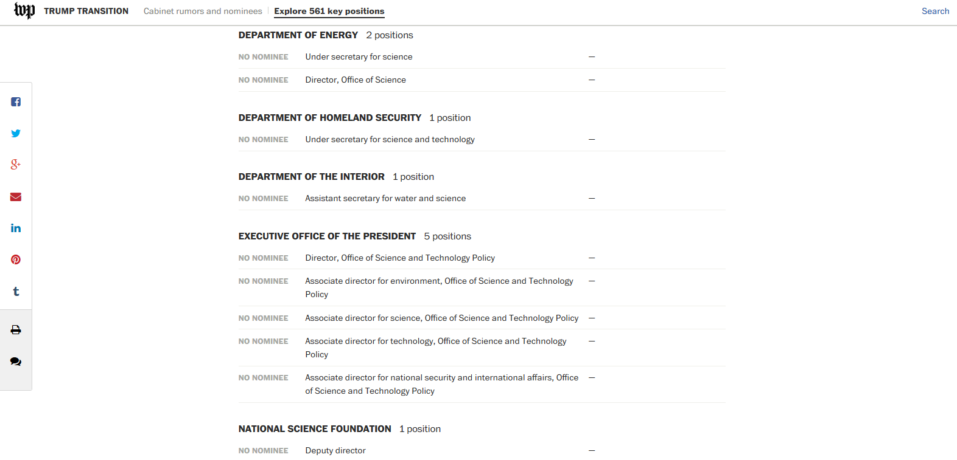
Staffing Challenges

Slide 5
ILC Activity to Date

Slide 6
AAA Engagement in Washington DC
AAA Representatives Have Visited DC on Average 2-3 times per year since 2015
House of Representatives
U.S. – Japan Relationship
Japan Caucus
  Rep. Joaquin Castro (D-TX)
  Rep. Dave Reichert (R-TX)
Congressional Study Group on Japan
  Rep. Diana DeGette (D-CO)
  Rep. Billy Long (R-MO)
Committee Relationships
House Science Committee
  Rep. Lamar Smith (R-TX)
  Rep. Eddie Bernice Johnson (D-TX)
  Rep. Randy Weber (R-TX)
  Rep. Steven Knight (R-CA)
  Rep. Don Beyer (D-VA)
House Appropriations Committee
  Rep. Mike Simpson (R-ID)
  Rep. Marcy Kaptur (D-OH)
Senate
Senate Energy and Natural Resources Committee
Sen. Lisa Murkowski (R-AK)
Sen. Maria Cantwell (D-WA)
Senate Appropriations Committee
Sen. Lamar Alexander (R-TN)
Sen. Dianne Feinstein (D-CA)
National Lab Relationships
Sen. Richard Durbin (D-IL)
Sen. Tammy Duckworth (D-IL)

Slide 7
Diet Member Visits to Washington DC
Summary of Diet – USG Interaction since 2015
2015
  Event on Science and Technology at Hudson Institute feat. Rep. Randy Hultgren
2016
  Event at Rayburn Building on Science and Technology
  In Person Visits with Reps. DeGette, Long, Castro
  Launch Event for DOE – MEXT Working Group
2017 (Golden Week 2017)
  In Person Visits with Reps. Castro, Johnson, Beyer, Veasey, Foster
  In Person Visits with Senior Committee Staff in House and Senate
  In Person Visit with Acting Office of Science Director Binkley
  Participated in Reception Featuring Sen. Hirono and other Members of House
  Other visits possible if needed

Slide 8
Future Outlook

Slide 9
Challenges Foreseen
Roadblocks to ILC Participation in this Administration
Continued Pressure on the Discretionary Budget
  DOE: OMB pressure downward will force the Department to plan based on reduced funding
  Congress: Inter-factional fighting will hamper the regular appropriations process
Leadership Vacuum will Disrupt Decision Making
  If choice is to leave seats empty, political decision cannot be made
  Recruitment efforts hampered by reputation risk
Uncertainty from the White House
  Ad hoc decision making
  Focus: wins and scandal evasion

Slide 10
Priorities for the Next Year
U.S. Activity is Focused on Two Primary Tracks
Information Flow
Monitor Congressional appropriations process
Monitor internal DOE decision making on projects and budget
Monitor personnel movements
Study the situation in Japan and report, as needed, to U.S. stakeholders
Update community members at appropriate venues
Preparation
Mirroring Diet Member Federation, create structure in U.S. Congress to support large HEP projects
Encourage White House to appoint science staff
Engage U.S. accelerator/detector industry and organize them to support the ILC when ready
Organize the HEP community at the grassroots to advocate for the ILC and HEP in general

Slide 11
A Call to Action

Slide 12

What Can the Community Do?
High Energy Physics Needs Your Help!
Connecting with Congress
  Members are influenced by their constituents
Writing Letters/Articles
  Members pay attention to their local newspapers
Sharing Information
  More information leads to better advocacy and strategy
How?
  Existing Structures: APS, AAAS, Others?
  New Structures: Frontier Science Coalition?
  Ad Hoc?

