Slide 1
ILC status in Japan
June 26, 2017
AWLC2017, SLAC
M.Yamauchi
KEK

Slide 2
Outline of this talk
Activities of each organization to push the ILC project forward
  Federation of Diet members
  MEXT
  KEK + LCC
  KEK + Fermilab
  KEK
  AAA
  Japanese HEP community → Aihara’s talk
NRI’s report on readiness of the ILC technology
Schedule - what will follow the cost reduction

Slide 3
Activities to push ILC forward in Japan (1)
Federation of Diet members
  Representatives of the Federation visited US on May 1-4.
    Met with Congress members and high level officials of DOE
  Latest meeting on June 1
    Staging plan and further cost reduction
    Schedule – possible visit to Europe
    R&D budget in JFY2018
    It was understood that some decision has to be made in one year time frame to give an input to the European strategy.

Slide 4
Activities to push ILC forward in Japan (2)
MEXT
  ILC Advisory Panel
    Started 4th working group to discuss management issues at the pre-lab and the ILC lab. Six meetings have been done in 4 months, and report will be released this summer.
  US-Japan Discussion Group
    Agreed to begin the joint R&D by KEK and Fermilab from April 2017 at the meeting on October 2016.
  Discussing R&D plan and budget with KEK in JFY2018.

Slide 5
US-Japan Discussion Group on ILC
First meeting on May 25, 2016 at Washington D.C
  Attended by Deputy Director-General, Research Promotion Bureau, MEXT, and Director, Office of Science, DOE.
  Agreed on item of discussion
Working level meeting on August 8, 2016 at ICHEP venue in Chicago
  Attended by Director, Basic Research Promotion Div., MEXT, and Associate Director for HEP, DOE.
  Heard from KEK and FNAL on the proposal of the joint R&D for cost reduction.
Second meeting on October 18, 2016 by video
  Attended by Deputy Director-General, Research Promotion Bureau, MEXT, and Director, Office of Science, DOE.
  Agreed to begin the joint R&D from April 2017.
Next meeting will be scheduled in summer 2017 to discuss management issues at the pre-lab and the ILC lab. Report from the management working group will be an input to this meeting.

Slide 6
Activities to push ILC forward in Japan (3)
KEK + LCC
  Continue accelerator R&D at ATF and STF.
  Program to get better understanding by scientists and general public in the world.
  Considering staging plans and estimation of the cost

Slide 7
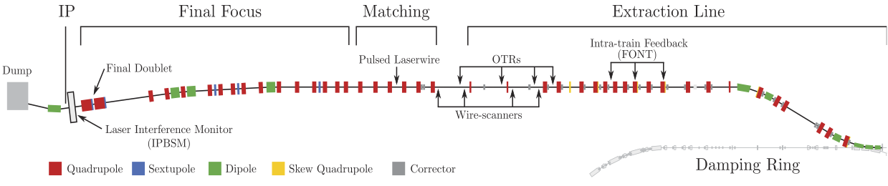
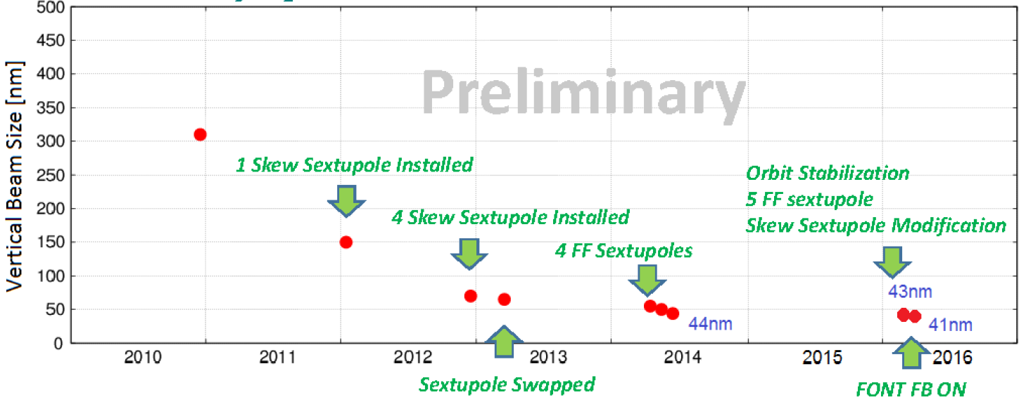
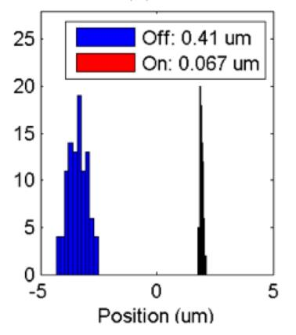
Progress in FF Beam Size and Stability at ATF2
Goal 1: Establish the ILC final focus method with same optics and comparable beamline tolerances
ATF2 Goal : 37 nm → ILC 6 nm
  Achieved 41 nm (2016)
Goal 2: Develop a few nm position stabilization for the ILC collision
FB latency 133 nsec achieved
(target: < 300 nsec)
positon jitter at IP: 410 → 67 nm (2015) (limited by the BPM resolution)
Nano-meter stabilization at IP
We continue efforts to achieve goal 1 and goal 2.
History of ATF2 small beam

Slide 8
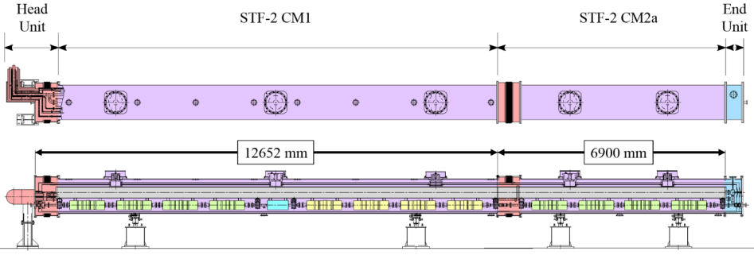
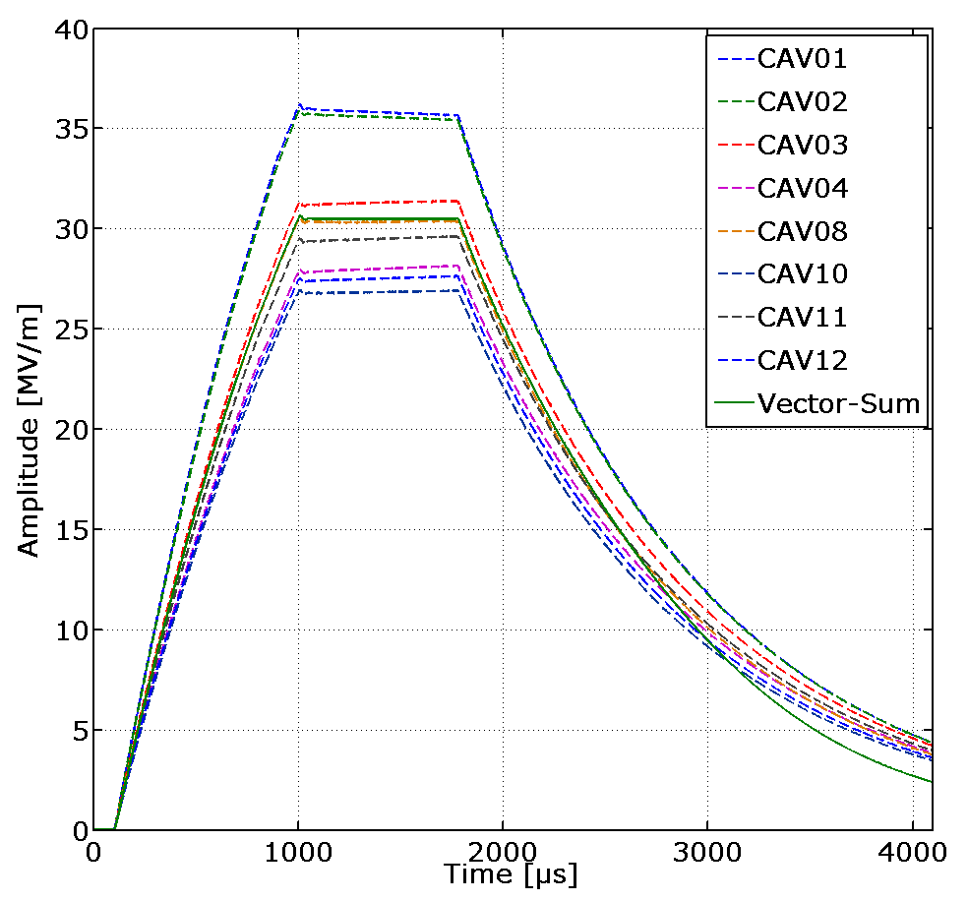
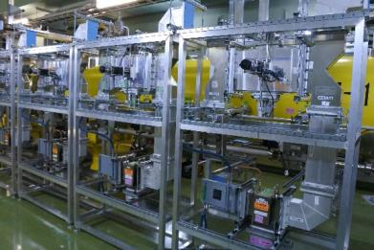
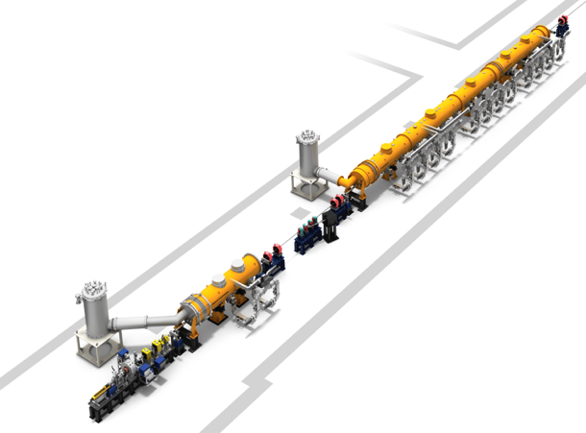
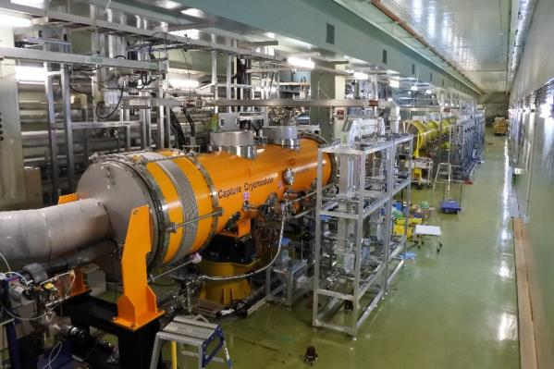
STF-2 Accelerator Cryomodule Test
8 Cavities were tuned on resonance by piezo, and vector-sum operation was done at 31MV/m.
CM2a
Waveguide system
Cold box
CM1
View from upstream
Capture CM
Cold box
To be constructed
RF Gun

Slide 9
Activities to push ILC forward in Japan (4)
KEK and Fermilab
  Joint R&D of SCRF

Slide 10
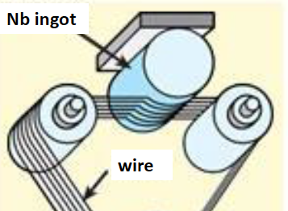
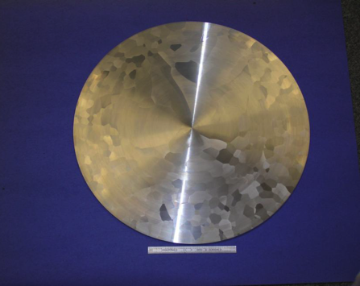
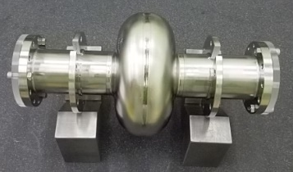
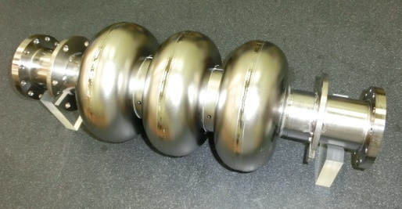
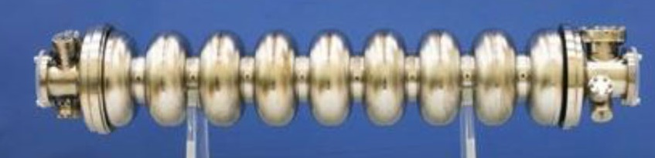
1. Cost reduction in Nb material preparation
Optimize the ingot purity with a lower residual resistivity ratio (RRR).
Simplify the manufacturing method such as forging, rolling, slicing and tube forming.
 | 2016 | 2017 | 2018 | 2019
KEK Masashi Yamanaka
Feasibility study using
3-cell cavities (ongoing)
Preparing
materials
Manufacture
8x9-cell cavities
Evaluation
(Vertical&Horizontal tests)
Medium or High RRR sheet for cells
Low RRR tube
for stiffener and beam pipe
Quality of Nb for the end part will be optimized at this stage.

Slide 11
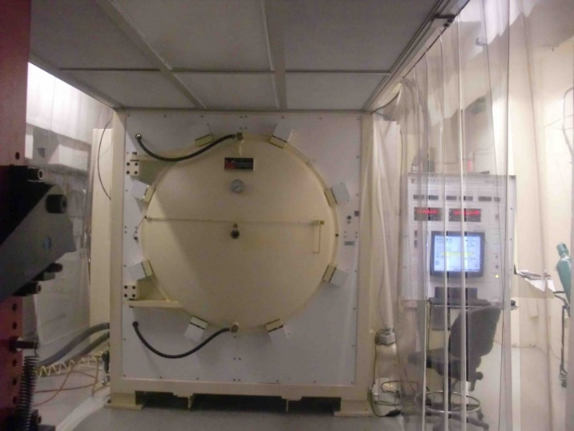
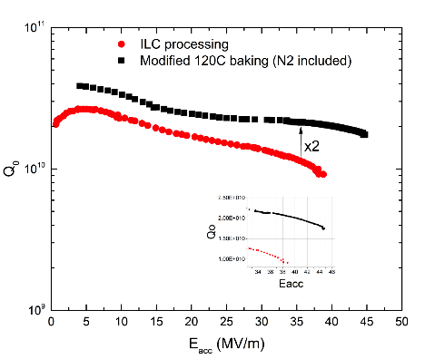
2. High-Q high-gradient SRC with nitrogen infusion
Confirm reproducibility of the nitrogen infusion method to improve Q and field gradient of SC RF cavity.
High statistics test of the yield by fabricating 8 9-cell cavities.
example of Cornell
Anna Grassellino, FNAL
 | 2016 | 2017 | 2018 | 2019
KEK Hitoshi HAYANO
FNAL process
1 cell processing
Performance test
Preparation for cryomodule
Preparation of vacuum furnace
3-9cell performance
8 - 9cell cavities fabrication
Performance test

Slide 12
Impact on the ILC cost
Possible cost reduction
 | ILC cost reduction
1. Nb material | 2-3%
2. High-Q high-G | 8-9%
sum | 10-12%

Slide 13
Activities to push ILC forward in Japan (5)
KEK
  Public relations to get better understanding by the general public in Japan
  Seminars and symposia to improve understanding by the scientists in the other research fields (27 seminars and lectures given in 2016.)
  A booklet to describe ILC and how it is beneficial to the society.
    “Why having ILC in Japan is good” must be clearly described to journalists and everybody in Japan. “Spin-off effects of ILC 2016” has been publicized.
  Clarification of scientific impact of ILC
    One of the recommendations in the ILC advisory panel, “Find a clear vision on the discovery potential of new particles” was given, partly because the panel has not been convinced with the scientific raison d'etre of ILC. We are working on far better and understandable justification to the panel under close collaboration with the LCC physics working group
  Collaborate with Japanese nuclear physics community to find ILC’s application to nuclear and hadron physics program. Similar efforts to be started with photon scientists.
  Development to applications of SCRF to other purposes such as EUV-FEL, RI production for medical use, etc.
  Support ILC accelerator and detector R&D through US-Japan program
  International relationship

Slide 14
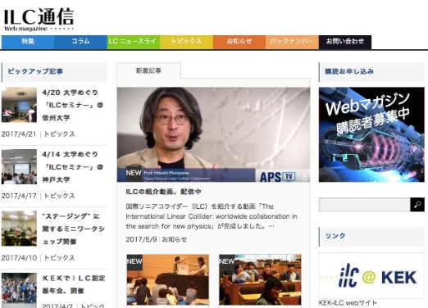
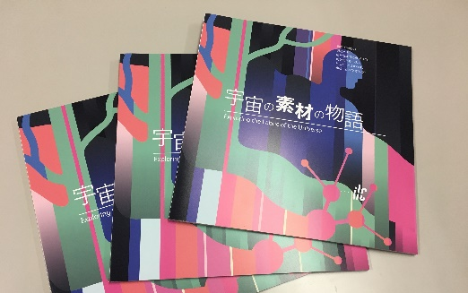
ILC public relations in Japan
KEK has an ILC outreach office, which provides basic information regarding the ILC mainly to the general public in Japan. KEK also help organizing lectures and outreach events hosted by other organizations.
In Dec 2016, KEK started fundraising program for ILC outreach. http://www2.kek.jp/kff/english/use_en.html
For 2017, KEK will focus on to increase media coverage, and social media influence.
ILC Tsushin (Japanese newsletter)
http://www2.kek.jp/ilc/ilc-tsushin/
Providing ILC related news through Website, Facebook, Twitter and Printed matter (2-3 times a year)
Facebook with 1834 likes, Twitter with 2852 followers.
ILC Physics brochure Japanese edition
Translated and printed ILC physics brochure edited by LCC.
PDF can be downloaded from following link
http://www2.kek.jp/ilc/ja/contents/docs/J_ExploringtheFabricoftheUniverse170419.pdf

Slide 15
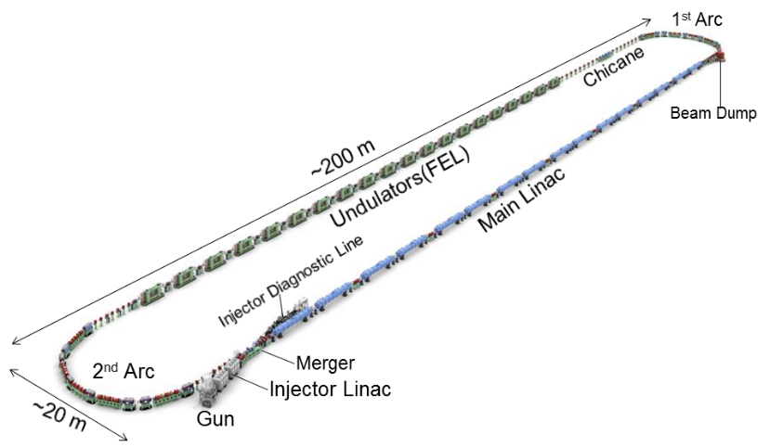
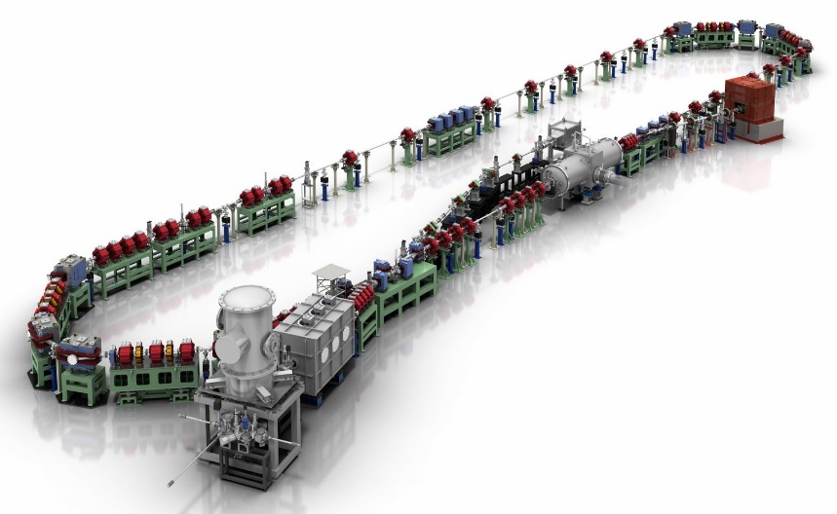
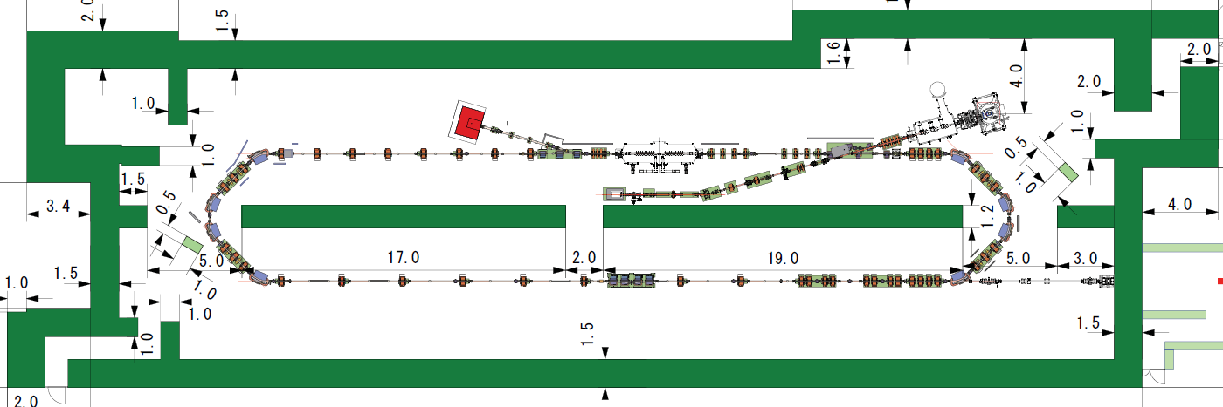
Application of SCRF technology: ILC is useful in your daily life!
EUV-FEL for lithography
STF at KEK
^{99m}Tc production with high intensity e⁻ beam
for medical use
Compact ERL (cERL) was built at KEK as a test bench for ERL technology
20-50MeV
electron beam
8-20MeV γ

Slide 16
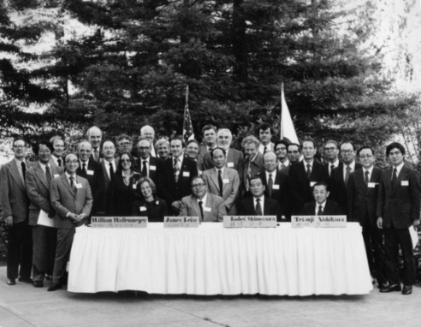
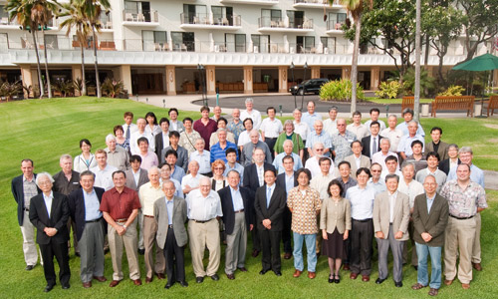
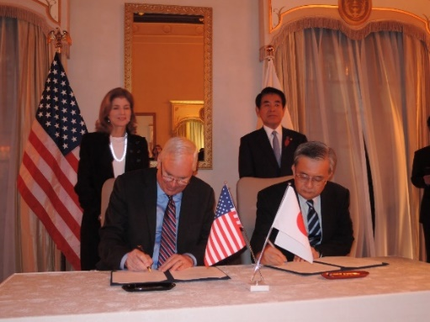
US-Japan cooperation in HEP
US and Japan have a long history (38 years!) of successful collaboration based on the governmental framework.
Oct. 2015, US Embassy in Tokyo
Signing ceremony in 1979 at SLAC
30th Anniversary meeting in Hawaii (2009)
US-Japan Project Arrangement was signed
This framework supports cost reduction R&D, generic R&D for accelerator and detector.

Slide 17
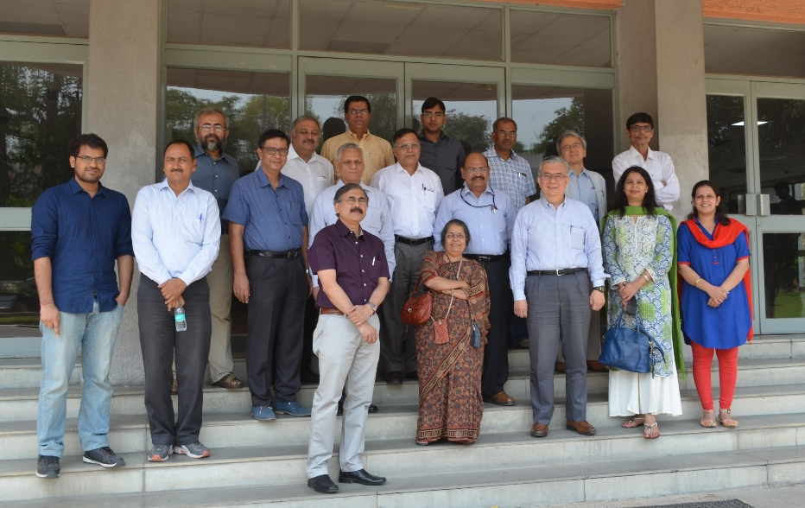
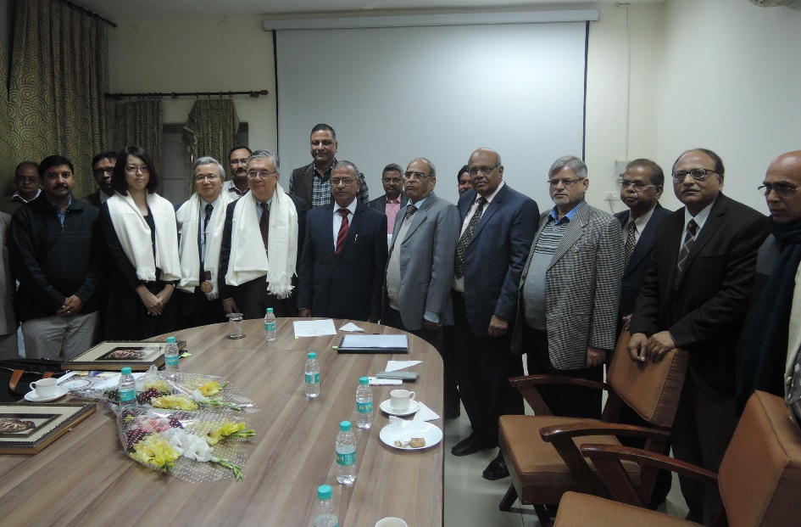
Collaboration with Indian Physicists
Representatives from KEK and 10 Indian accelerator labs had a meeting to discuss Indian involvement in ILC in April 2016.
“The members strongly opined that the accelerator and the high energy physics communities of India will jointly submit a proposal to the Indian Government stating that they would like to be a part of the ILC project.” (Minutes of the meeting on April 29, 2016 at IUAC)
We set up “Indo-Japan Centre for Accelerators and Detectors” in Benaras Hindu University as a base of Indian participation in ILC in January 2017.
April 29, 2016, IUAC, Delhi
January 29, 2017, BHU, Varanasi

Slide 18
Our reactions to the recommendations
Advisory panel recommendations once more:
  Recommendation 1: Share the cost internationally and Find a clear vision on the discovery potential of new particles.
  Recommendation 2: Closely monitor and analyze the development of the LHC experiments and Mitigate cost risk.
  Recommendation 3: Obtain general understanding by the public and science communities.
NRI’s survey pointed out some potential problems of the TDR design. Need to work on them.
International physics communities are urged to work with your funding agencies and governments.

Slide 19
Activities to push ILC forward in Japan (6)
AAA (Advanced Accelerator Association)
  111 private companies and 41 universities and research institutions
  Technology working group
    Alignment technologies for the advanced accelerators
    Beam control and vacuum technology
    Green ILC program …etc.
  Public relations working group
    Public symposium in Tohoku
    ILC Tokyo Event, July 2016 : “Science x Hello Kitty”
    Video program to introduce ILC to general public …etc.
  Civil engineering working group
    Geological survey and studies of legal regulations for the tunnel construction
    Exhaust heat recovery system
    Public transportation system …etc.
  Big project working group
    Promotion of international cooperation …etc.

Slide 20
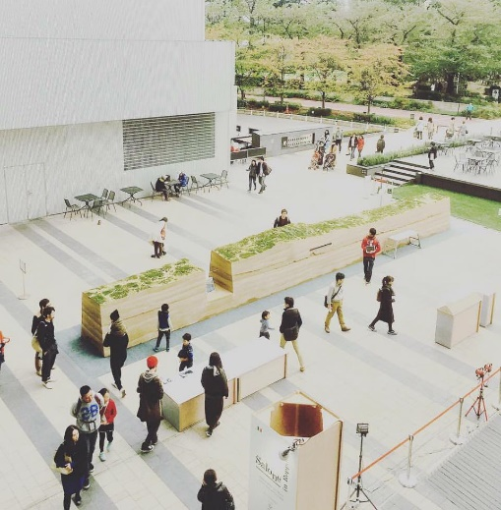
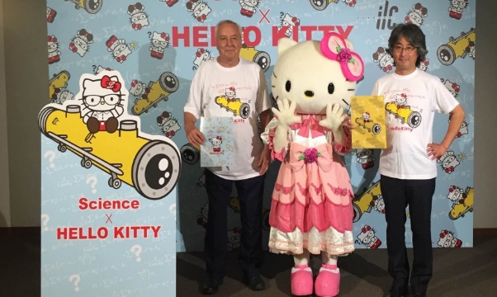
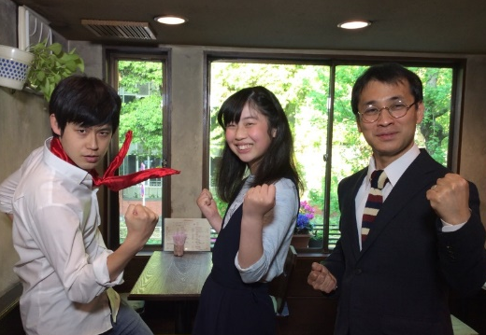
Outreach program by AAA
AAA cooperates with KEK to conduct various outreach activities including;
  Spain-Japan industrial collaboration events one in Tokyo, one in Spain
  Awareness event targeting influencers in Tokyo
  Talk show inviting Dr. Sheldon Glashow in Tokyo
  Public symposium in Tohoku area
  Exhibition at IEEE NSS/MIC in Strasbourg
Highlights in 2016
Salone in Roppongi
Supported an exhibition held at the heart of downtown Tokyo, attracted over 50,000 visitors. (hosted by LCC)
Science × Hello Kitty
Produced commercial goods collaborate with Hello Kitty, sold over 12000 items.
Online shop: goo.gl/3ACn4d
ILC Kids Club
Produced Cable TV program to gain understanding of the ILC project.

Slide 21
NRI’s report on readiness of ILC technology
NRI visited 12 research institutions and 15 industrial enterprises worldwide to study the followings, and reported them to MEXT.
  Technical feasibility of the proposed ILC
  Analyses of the remaining agenda in the accelerator construction
  Analyses of the possible efforts aimed at cost reduction
NRI pointed out that the following seven items need breakthrough by further R&D accompanied with prototyping.
  Klystron power supply
  Positron source, helical undulator, positron target and electron-driven positron source for back-up
  Rapid beam feed-back system for damping ring
  Beam dump
  Crab cavity

Slide 22
ILC schedule
Calendar year
2016 | 2017 | 2018 | 2019 | 2020
ICFA meetings
Feb.
Aug.
Feb.
Aug.
Nov.
Feb.
Aug.
Feb.
Aug.
Feb.
Aug.
Agreed to extend LCB/LCC until end of 2019
Proposal of the staging
Discussion of the staging
Decision of the staging scenario
Do we continue LCC beyond 2019?
Big discussion!
Term of the present LCB/LCC
Discussion of the next European strategy
Term of the next European strategy
ILC Advisory Panel requested MEXT to analyze the physics outcome of LHC Run2 at the end of 2017.
Japanese HEP community
2017 summer
Assessment of the 250GeV staging scenario
2017.11
2019.2

Slide 23
What will follow the cost reduction
Statement given in the interim report from the ILC Advisory Panel (June 2015):
  “The ILC project is an international project requiring enormous investment. It is necessary to conduct the project with support not only by a single country but also by international collaboration. The cost should be shared in such kind of international collaboration. It is important to confirm the willingness of each participating country to cover a reasonable part of the project cost.”
Following this statement, MEXT will study “willingness of participating countries” at some point before giving green light. It is, therefore, extremely important that physics communities of each country propose their governments to consider participation in ILC more officially, and to be ready to show their willingness in the study by MEXT.
If MEXT fails to collect enough “willingness” in their study, it will be end of the ILC story.

