Slide 1
N-dope/N-infusion R&D at KEK
2017/6/27
AWLC17@SLAC
K. Umemori, E. Kako, T. Dohmae, Y. Hori,
T. Konomi, G. Park, H. Sakai(KEK),
J. Kamiya, S. Kurosawa, K. Takeishi (JAEA)

Slide 2
Contents
Introduction
J-PARC furnace and experimental setup
N-dope
Heat treatment (without EP)
N-infusion
Summary

Slide 3
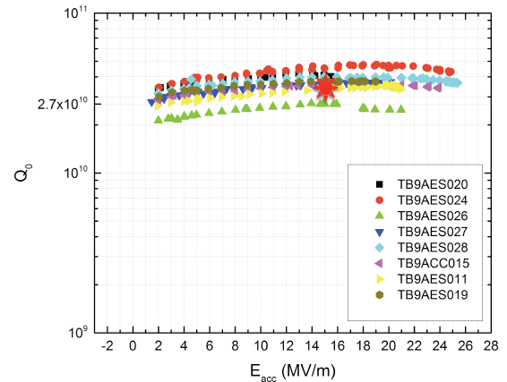
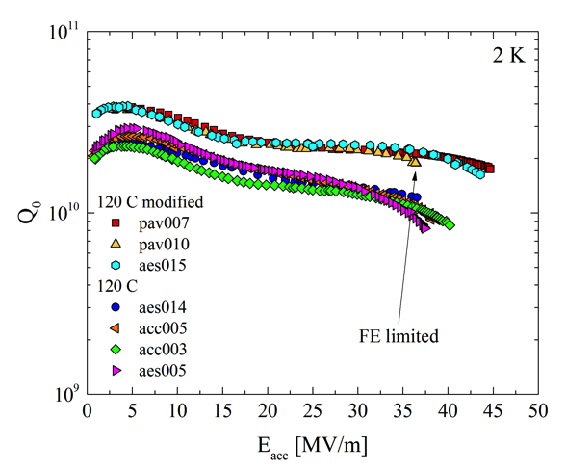
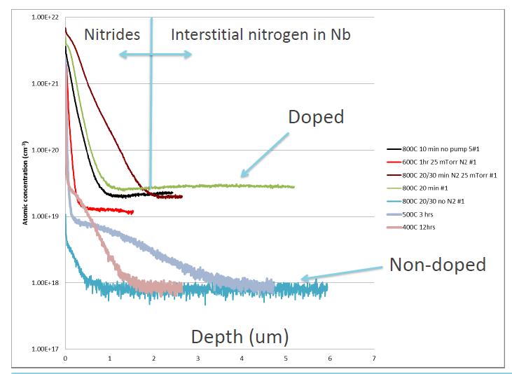
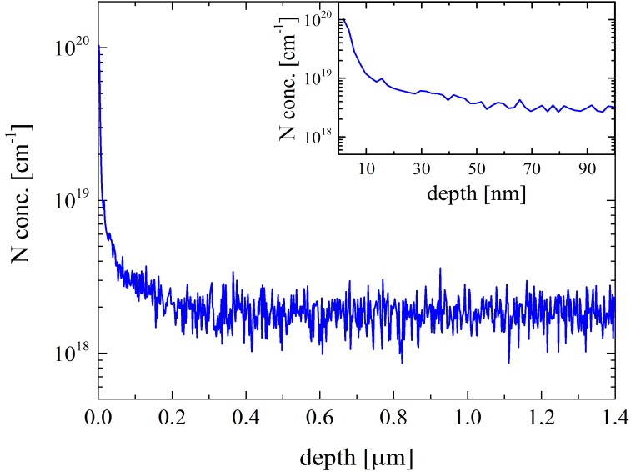
25mTorr N2
@800 deg C, 2min
N-infusion
25mTorr N2
@120 deg C, 48hours
N-dope
High-Q
High-Q &
High-G
TTC meeting（2014/Dec） A. Melnychuk 「Update on N doping at Fermilab」
N goes to around ten nm
N goes to several tens um
A. Romanenco (Linac14)
S. Aderhold / A. Grassellino (TTC@Saclay)

Slide 4
KEK tried following R&D issues using J-PARC furnace
Nitrogen doping
Heat treatment without EP
(Preparation for Nitrogen infusion)
Nitrogen infusion

Slide 5
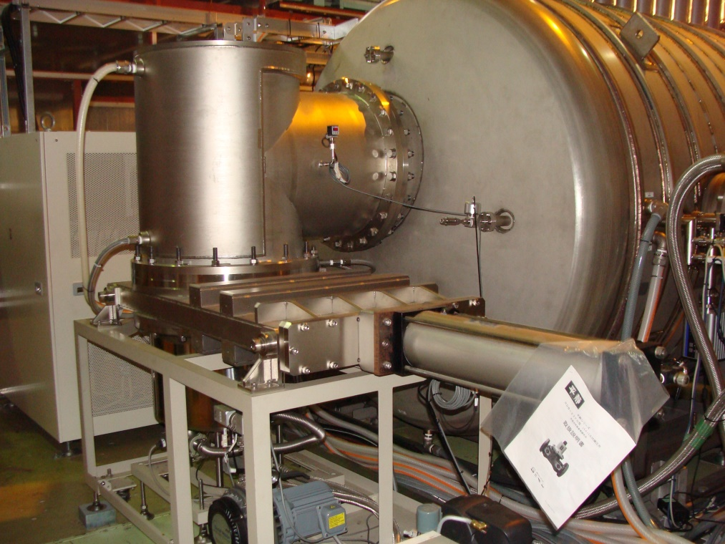
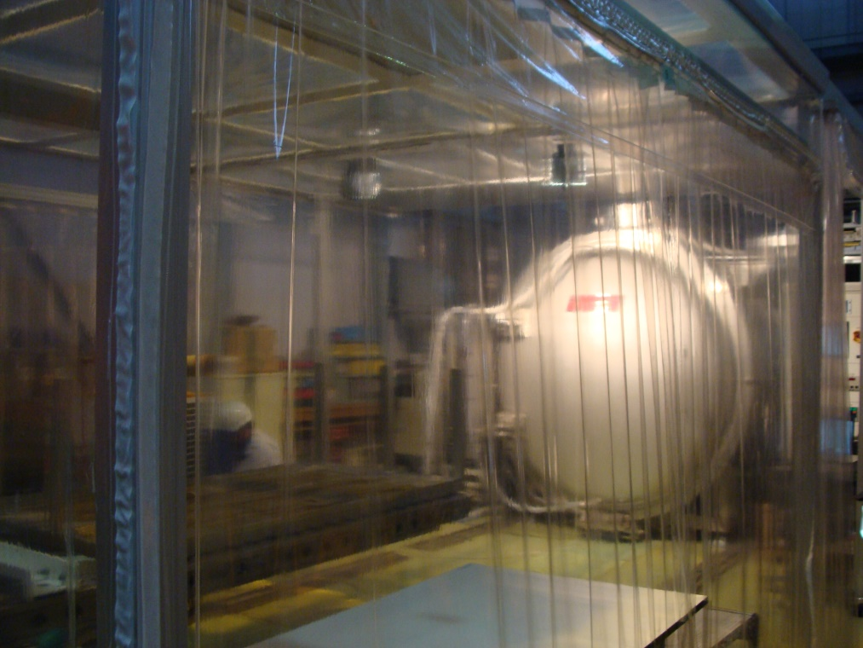
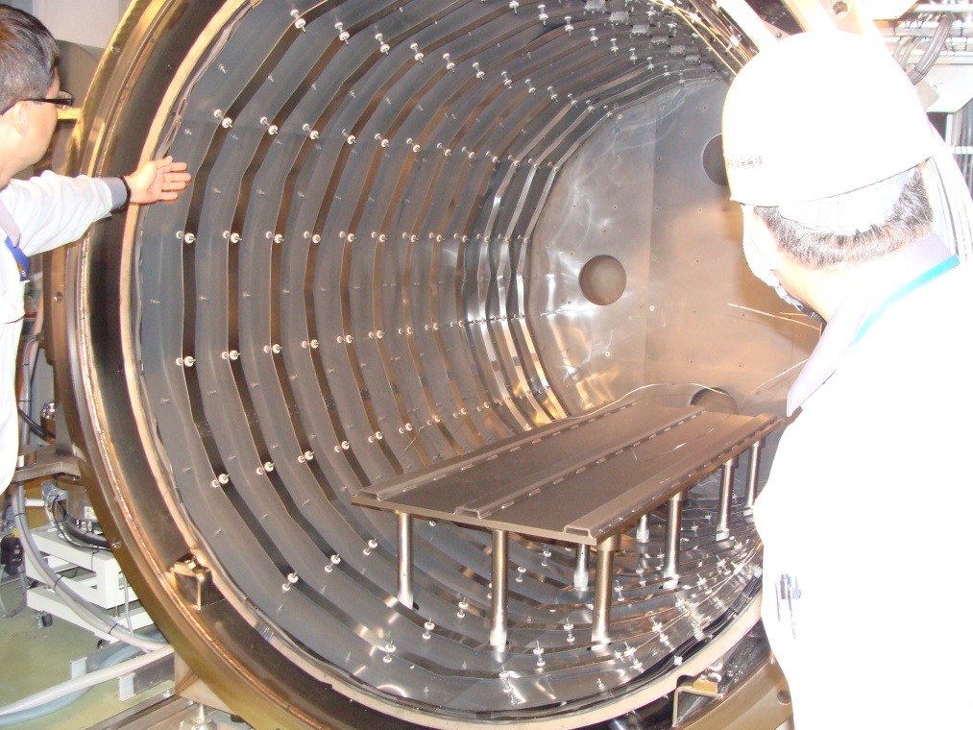
N-dope/N-infusion trial using J-PARC furnace
J-PARC has oil-free furnace with cryo-pump and TMP.
Vacuum level reached to ~1e-6 Pa.
Normally used for degassing of beam-duct and components.

Slide 6
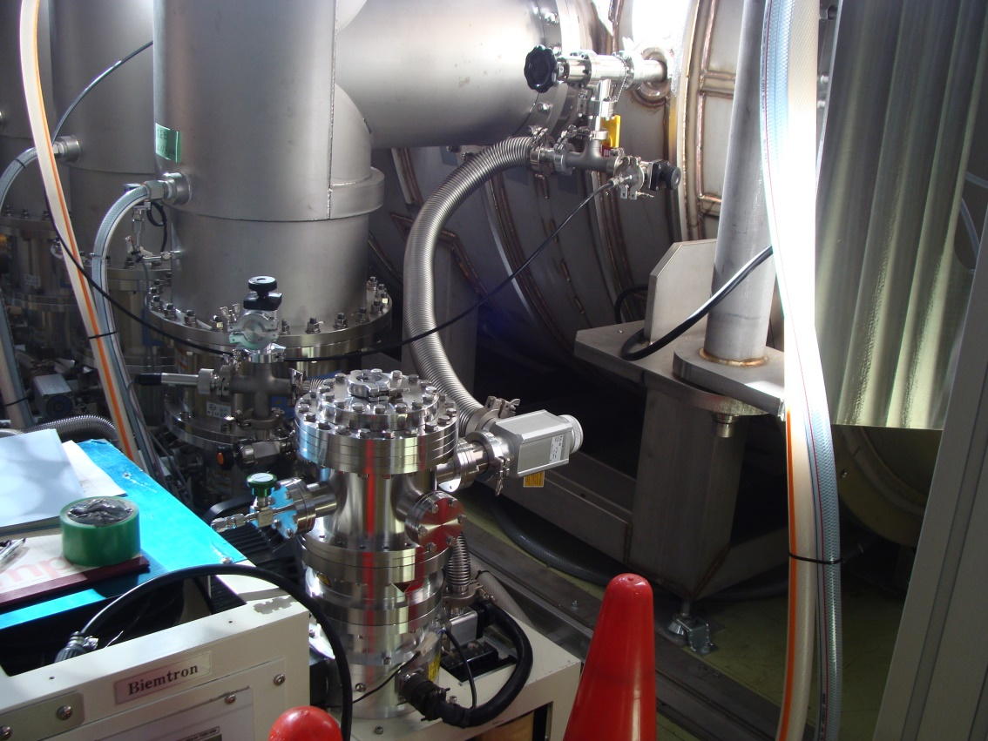
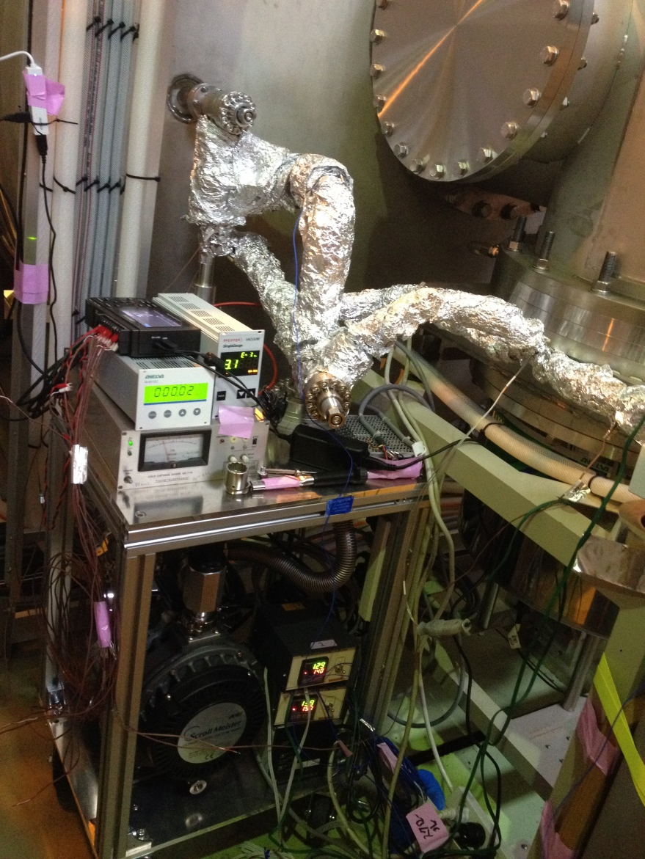
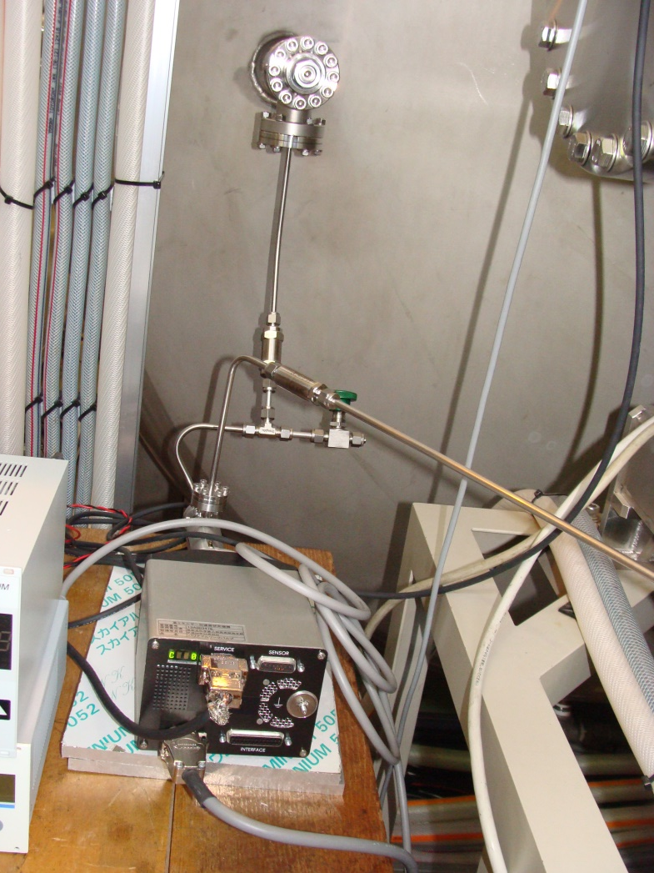
N-injection system
Nitrogen pressure is controlled by variable leak valve
Cryo-pump is closed and TMPs are off during N-injection. Small pump set, TMP and scroll, pump the furnace.

Slide 7
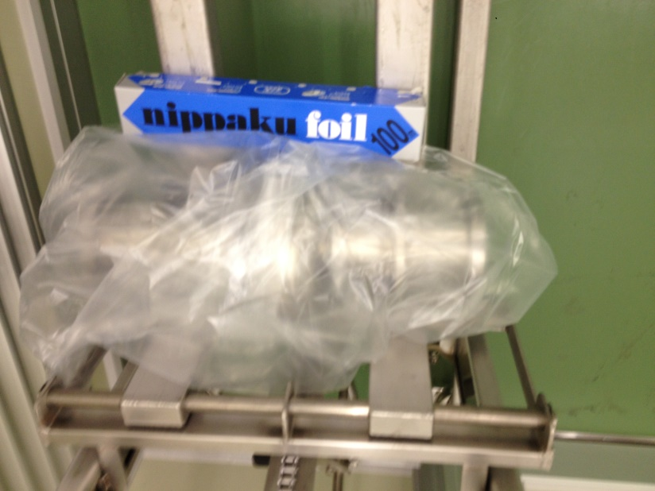
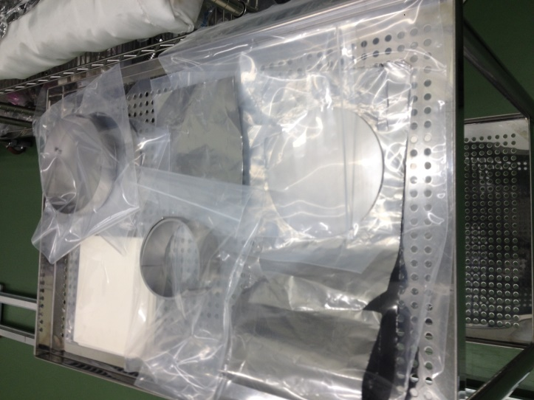
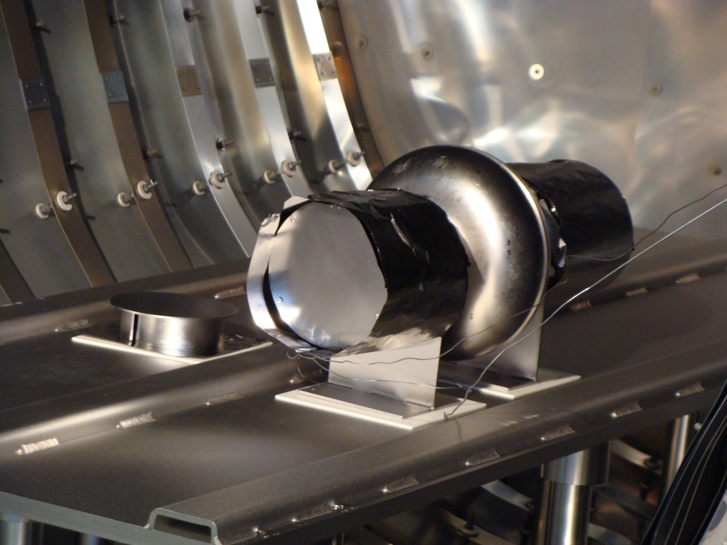
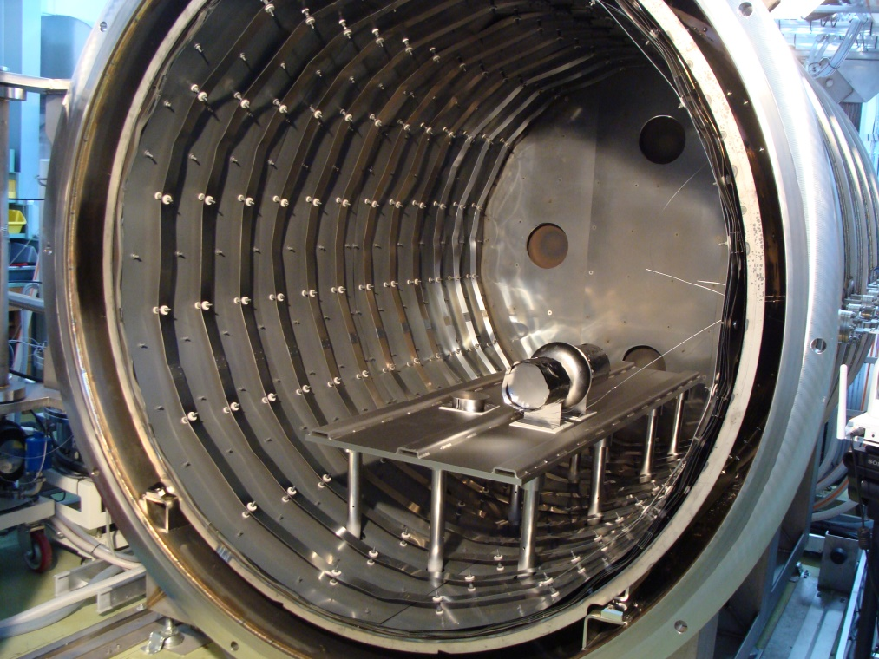
Cavity preparation for heat treatment
HPR (flange open) 2 hours, drying one night
Cavity was double-packed inside class-1000
Nb cap & foil was ultrasonic cleaned with degreasing, drying inside class-10, packed inside class-1000
Transport to J-PARC
Setup into J-PARC furnace

Slide 8
N-dope

Slide 9
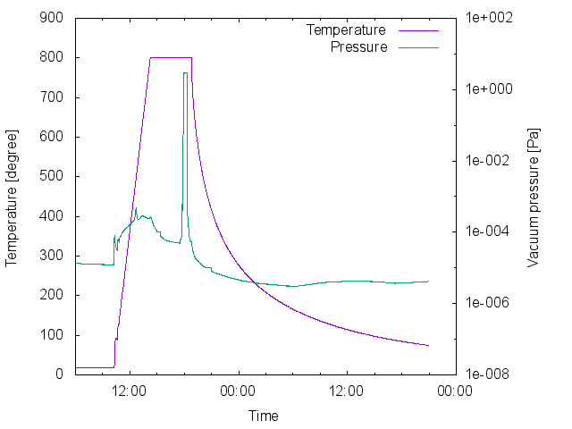
800 deg, 3 hours
800 deg, 20 min, N 2.7Pa
800 deg, 30 min
Cooldown
N-dope
(J-lab parameter)
KEK tried J-lab N-doping parameter.

Slide 10
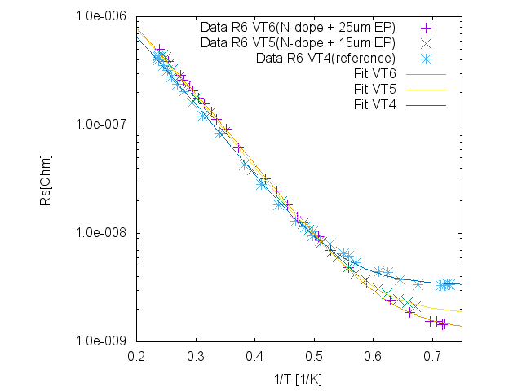
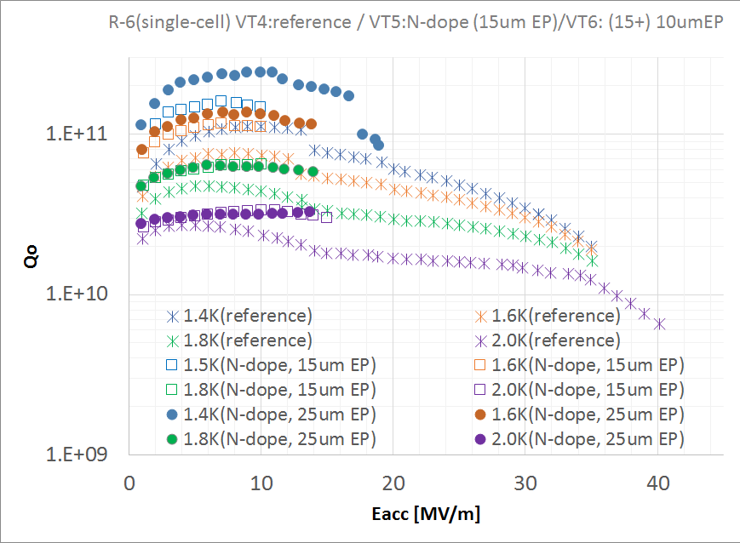
VT results of N-doping
VT4(reference measurement)
N-doping
15um EP → VT5
Additional 10um EP →VT6
Magnetic field canceled. (< 1mG)
Cooled down with thermal gradient
VT4(reference) Rs=3.3nΩ
VT5(N-dope) Rs=1.8nΩ
VT6(add EP) Rs=1.2nΩ
Very high Q up to high field
Q = 2.4e11@11MV/m, 1.4K
Q = 3.3e10@14MV/m, 2.0K
Quench at 19MV/m
No field emission
First success in Japan

Slide 11
Heat treatment without EP
(Preparation for N-infusion)

Slide 12
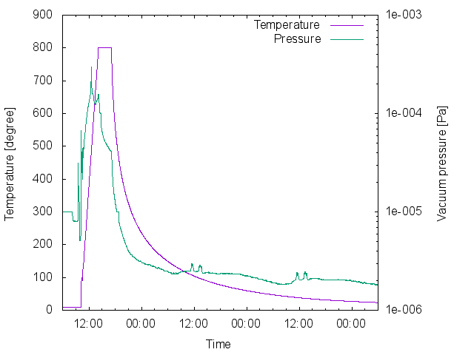
Heat treatment (800 C, 3h) and VT preparation
800℃, 3hours heat treatment at J-PARC furnace
Transfer to KEK with double-packed
HPR
Assembly
120℃ baking
Vertical test
No EP was applied!

Slide 13
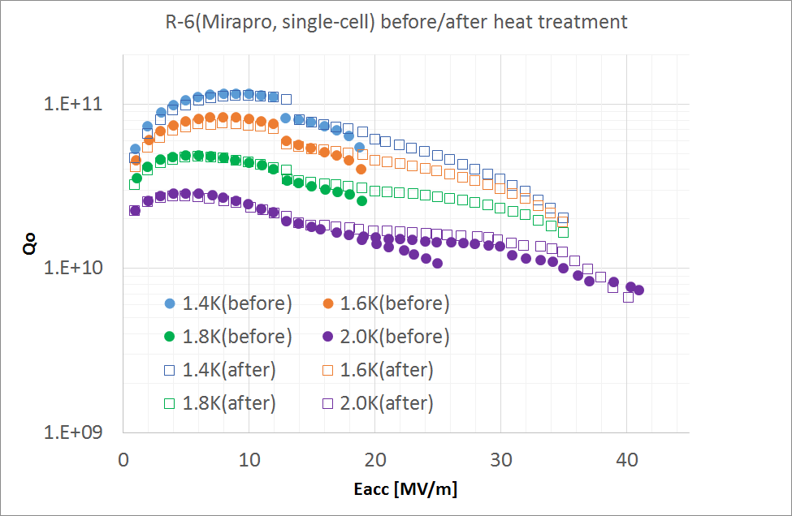
Vertical test results
(comparison before/after heat treatment)
Cavity performance was perfectly reproduced.
No degradation!!
Stop meas.
(No quench)
Stop meas.
(No quench)

Slide 14
N-infusion

Slide 15
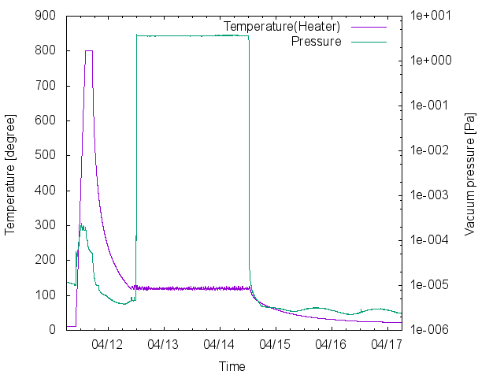
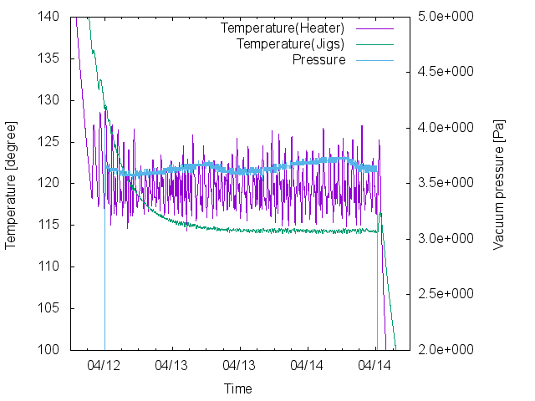
Pressure is stabilized less than 0.1Pa
Different vacuum gauges at different positions show around 0.3 Pa offset.
Temperature is stabilized with +/- 5 degree.
Temp. offset ~ 5 degree between furnace and jigs.
Heat treatment
800 degree C
3 hours
120 degree C
N-infusion (3.3Pa = 25mTorr)
48 hours

Slide 16
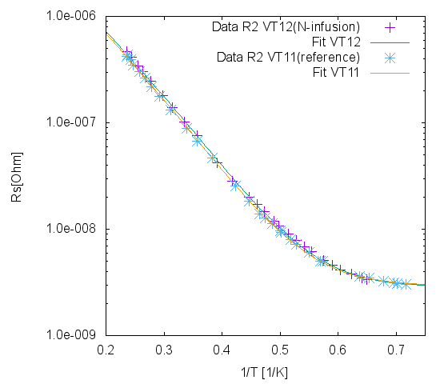
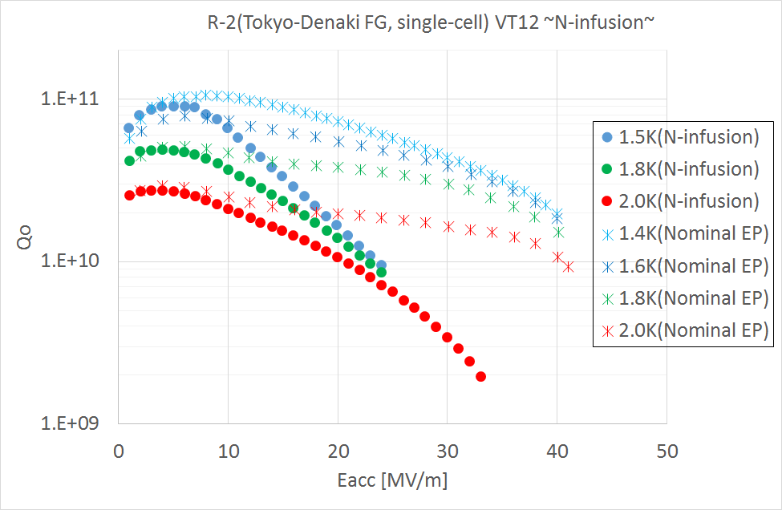
VT results for N-infusion
Transfer to KEK
HPR (No EP applied)
Assembly
Magnetic field canceled. (< 1mG)
Cooled down with thermal gradient
VT11: 2.9 nΩ
VT12: 2.9 nΩ
Q-slope above Eacc > 5 MV/m
Degradation was observed for > 5 MV/m
Eacc was limited at 33MV/m by quench at 225 degree equator
No field emission

Slide 17
Summary
N-dope and N-infusion study is on going at KEK to realize high performance of SRF cavities.
Heat treatment was carried out using J-PARC furnace, which is pumped by a cryo-pump and TMPs.
N-doping was successful. High-Q was obtained for 10-15 MV/m.
Cavity performance was tested after heat treatment. No degradation was observed, even not applying EP.
N-infusion was carried out. Degradation occurred at more than 5 MV/m.
We will try to push to realize N-infusion technique for high performance SRF accelerators.

Slide 18
Backup slide

Slide 19
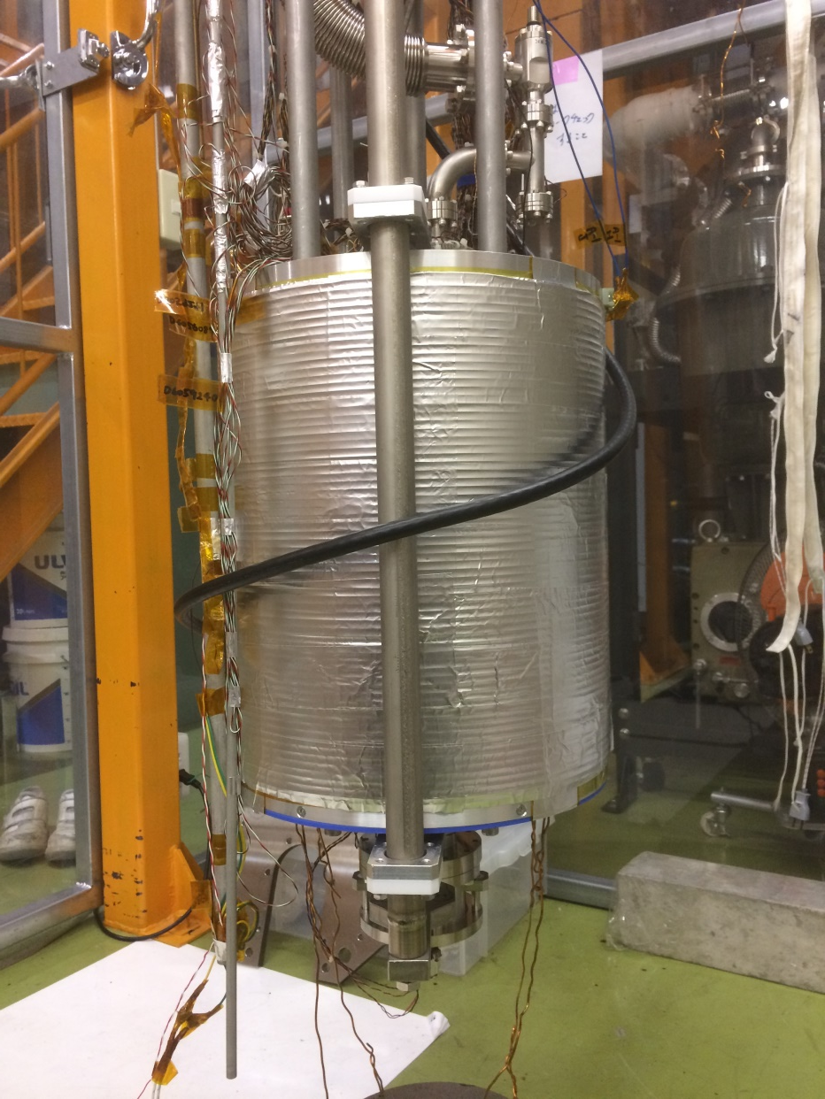
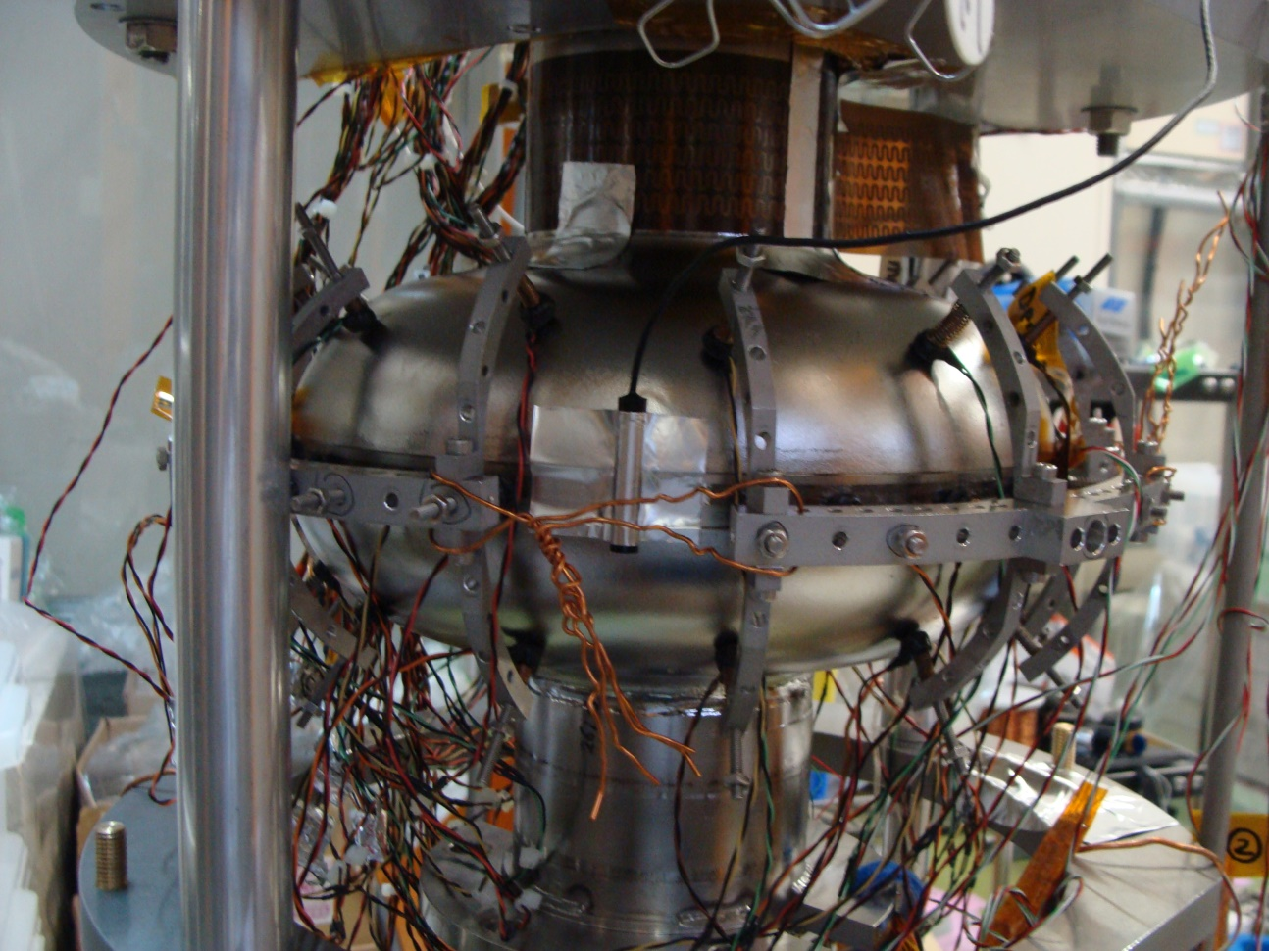
Typical vertical test setup
※ Pictures are for different measurement.
※ But setup of sensors and coil are same.
Heater
Solenoid coil
Flux gate sensor
Si temperature sensor
(Equator and beamtube)
Flux gate sensor, Si temperature sensor, heater and solenoid coil were used.

