Slide 1
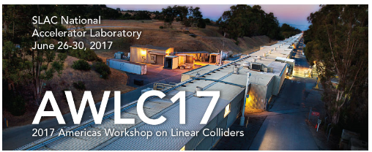
CLIC – Civil Engineering, Infrastructure and Siting Working Group, (CEIS)
John Osborne – Matthew Stuart CERN SMB-SE-FAS

Slide 2
CEIS Working Group
Civil Engineering, Infrastructure and Siting – Core Disciplines:
Civil Engineering and Chair J.Osborne
Technical Secretary M.Stuart CE Fellow started 1st March ‘17
CLIC Link Persons S.Stapnes/D.Schulte/C.Rossi/R.Corsini
Cooling and Ventilation CV M.Nonis + Fellow/PJA
Electricity EL N.Bellegarde/D.Bozzini
Survey SU H.Mainaud Durand
Transport & Handling HE I.Ruehl
Interaction Region K.Elsener
Logistics/lab readiness M. Tiirakari
CE Layouts and cross-sections SMB/Civil Engineering Design Office
HSE Link Person S.Marsh
Schedule K.Foraz
ILC Link Persons J.Osborne/A.Yamamoto

Slide 3
Mandate for the CLIC Civil Engineering & Infrastructure and Siting (CEIS) Working Group
General Objective
Develop the existing layouts for the project from a civil engineering and technical infrastructure point of view, and work with the various actors towards a realistic design and project planning as needed for the ‘CLIC Implementation Plan’, due 2018-19.
Specific responsibilities:
Develop new and/or update civil engineering layouts for 380GeV, 1.5TeV and 3TeV machine.
Develop new civil engineering layout for 380GeV machine using Klystron technology.
Update the tunnel design and layout to accommodate the machine (e.g. ventilation, electricity, survey, controls, safety and handling equipment).
Develop a layout for the interaction region.
Study environmental aspects of the project and siting preparation.
Work together with ILC on areas of synergy.
Produce schedule and cost estimates.
Consider and update transport, installation and CERN logistics issues for the project.
Technical infrastructure and installation scheduling.
This group will report to the CLIC Accelerator Steering Committee.
Regular meetings are planned for approximately every 6 weeks. Provisional slot is Friday mornings from 9am until 11am. Initial Kick-off meeting took place on Friday 31 March 2017.
Ad-hoc meetings as needed on dedicated subjects. Additional experts will be contacted as needed.

Slide 4
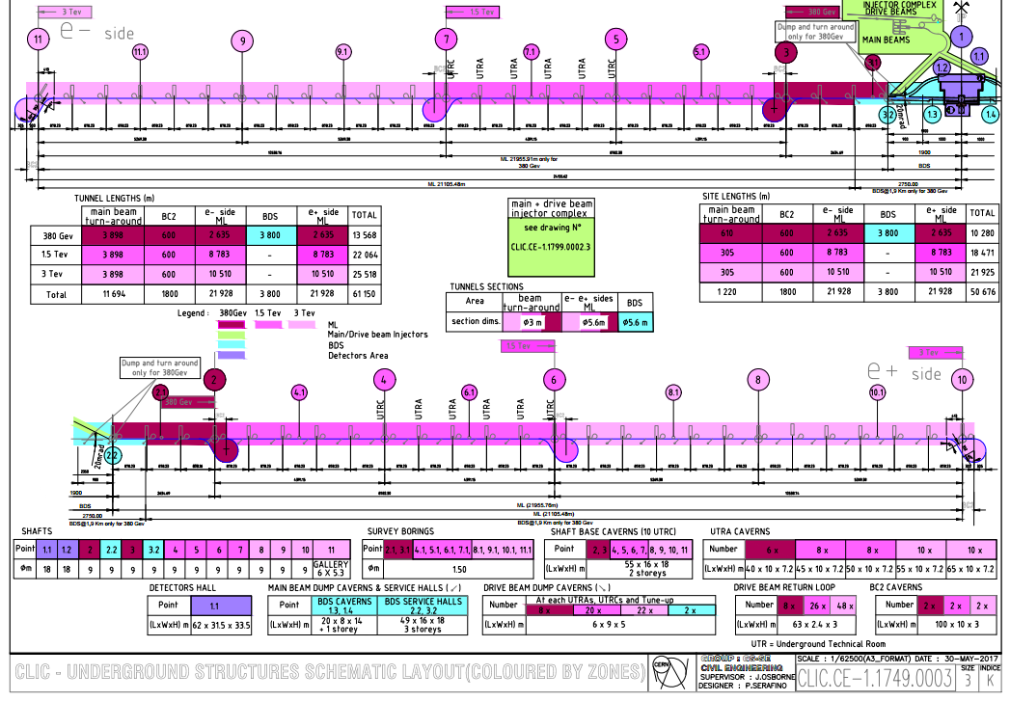
CDR Updated Plans and Layouts
Comments:
Most important drawing for costing
Tunnel length includes all tunnels (main tunnel, turnarounds etc…)
Site length is the amount of land needed to build CLIC
Colour Code:
380 GeV – Dark Red
1.5 TeV – Pink
3 TeV – Light Pink
BDS – Light Blue section.
Injection Complex - Green

Slide 5
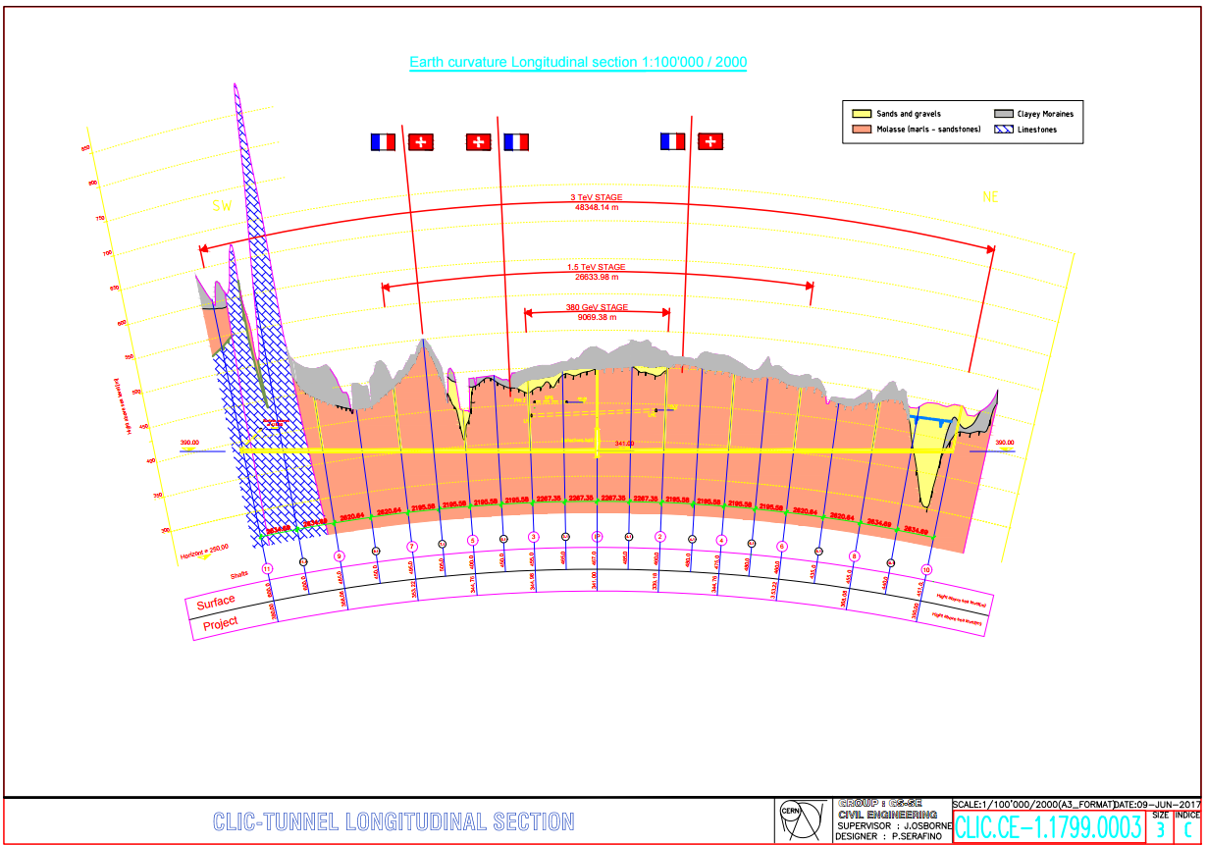
CDR Updated Plans and Layouts
Long profile from CDR updated for new energy stages:
Laser straight tunnels (unlike horizontal tunnel for ILC)
Tunnel was ‘rotated’ to reduce depths
Tunnel passes through the Gland depression i.e. same depth as ILC RDR
3TeV machine enters into Limestone rock
Water transfer tunnel from lake has been removed
3 TeV
1.5 TeV
380 GeV

Slide 6
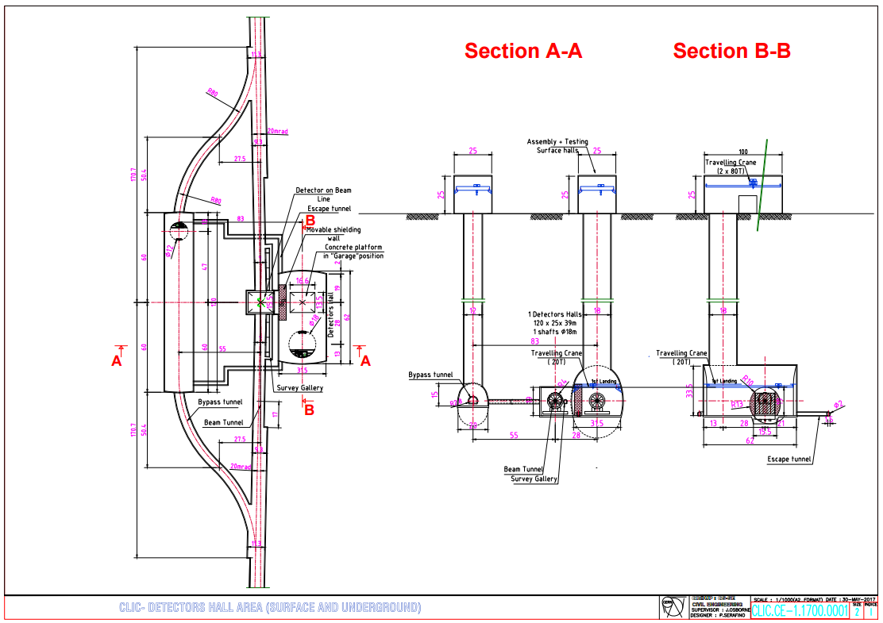
CDR Updated Plans and Layouts
Plan
The second detector hall has been removed.
Only one shielding wall now required.
A new service cavern has been added and includes a 12m diameter shaft
Section
Assembly and testing hall required for the detector.

Slide 7
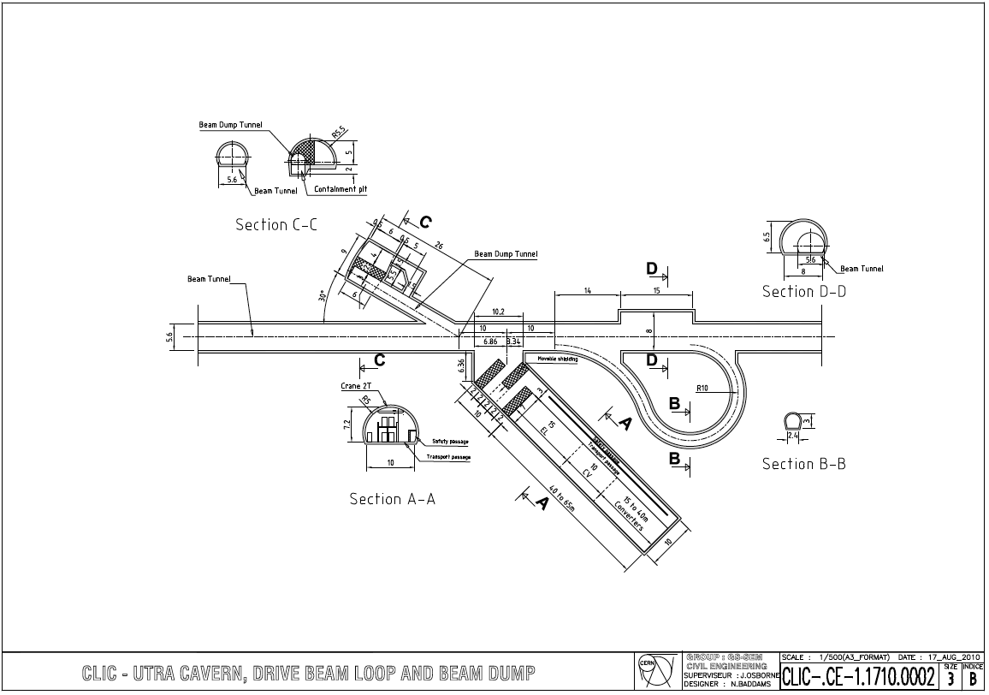
Turnaround Region Plan
Turnaround Plan:
Turnaround region every 878m
The size of the facility cavern has increased significantly to host power converter/CV/ EL equipment
The lengths of the turnaround loops may need to be increased.

Slide 8
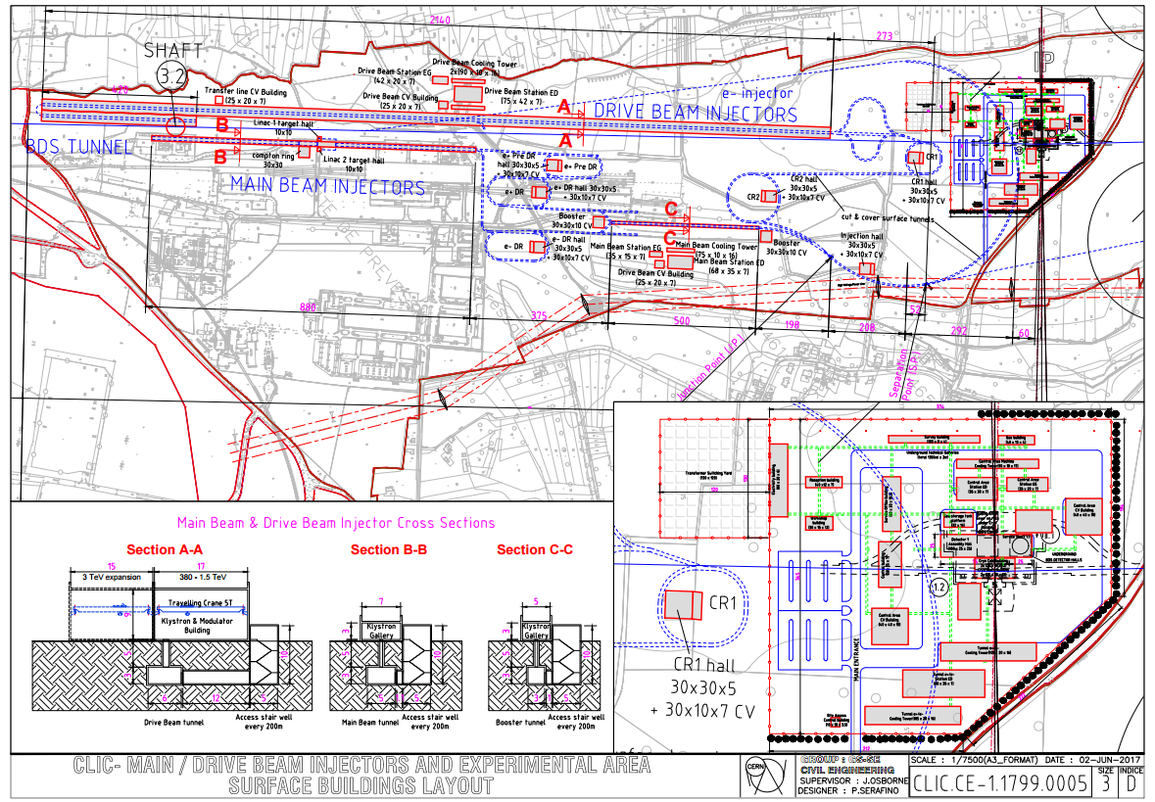
Injector Complex Layout
Injection Complex Layout:
2.5km drive beam injector building, feasibility study required for transport options within the building.
2500mx30mx9m building – the full area of this building is only required for the 3 TeV energy stage.

Slide 9
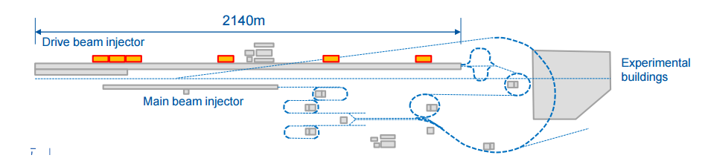
Drive Beam Injector
Since the CDR, RF power distribution has been moved out of the 2.5km Klystron and Modulator building:
Approximately 10,000m² of building space required for 6 substations – highlighted below.
Notes:
Central injection complex, located on CERN land in Prévessin, consisting of surface buildings and shallow underground galleries. This complex will be divided into several parts:
The Main Beam injector complex:
10 x surface buildings, largest of which is approximately 400m x 7m x 3m.
11 x shallow cut and cover type tunnels of varying sizes.
The Drive Beam injector complex:
3 x surface buildings, the largest of which will be approximately 2560m x 30m x 9m.
7 x shallow cut and cover type tunnels of varying sizes.
Common transfer tunnel from junction point to separation point 277m x 6m x 3m and surface building 30m x 30m x 5m
2 x Final Transfer tunnels (from separation point).
Experimental area surface buildings consisting of:
19 x surface buildings.
2 x gas storage areas.
1 x transformer switching yard.
Access roads and a car park.
RF Tunnel lengths/layout – to be discussed with Daniel – is the required for TOT

Slide 10
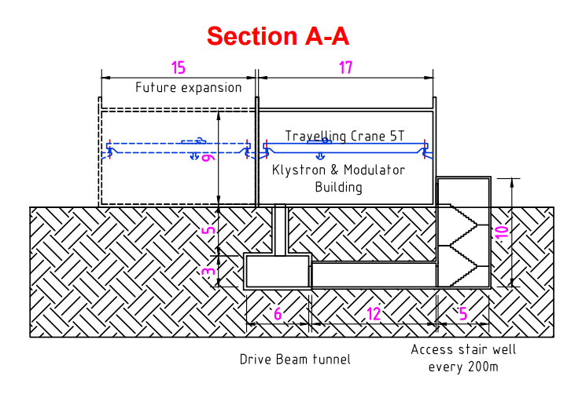
Drive Beam Injector
Section A-A: For 380 GeV a reduced building cross section has been shown:
  Minimum width possible for reduced cross section is 17m.
  Extension of a further 15m will be required for upgrades.
  Two cranes will be required for future upgrades (transport options still being studied).
  Initial cost saving due to decreased surface building size by approx. 40%
  Overall cost increase for upgrades.
Notes:
Central injection complex, located on CERN land in Prévessin, consisting of surface buildings and shallow underground galleries. This complex will be divided into several parts:
The Main Beam injector complex:
10 x surface buildings, largest of which is approximately 400m x 7m x 3m.
11 x shallow cut and cover type tunnels of varying sizes.
The Drive Beam injector complex:
3 x surface buildings, the largest of which will be approximately 2560m x 30m x 9m.
7 x shallow cut and cover type tunnels of varying sizes.
Common transfer tunnel from junction point to separation point 277m x 6m x 3m and surface building 30m x 30m x 5m
2 x Final Transfer tunnels (from separation point).
Experimental area surface buildings consisting of:
19 x surface buildings.
2 x gas storage areas.
1 x transformer switching yard.
Access roads and a car park.
RF Tunnel lengths/layout – to be discussed with Daniel – is the required for TOT

Slide 11
Drive Beam Injector
Section A-A: For 380 GeV a reduced building cross section has been shown:
  Minimum width possible for reduced cross section is 17m.
  Extension of a further 15m will be required for upgrades.
  Two cranes will be required for future upgrades (transport options still being studied).
  Initial cost saving due to decreased surface building size by approx. 40%
  Overall cost increase for upgrades.
Notes:
Central injection complex, located on CERN land in Prévessin, consisting of surface buildings and shallow underground galleries. This complex will be divided into several parts:
The Main Beam injector complex:
10 x surface buildings, largest of which is approximately 400m x 7m x 3m.
11 x shallow cut and cover type tunnels of varying sizes.
The Drive Beam injector complex:
3 x surface buildings, the largest of which will be approximately 2560m x 30m x 9m.
7 x shallow cut and cover type tunnels of varying sizes.
Common transfer tunnel from junction point to separation point 277m x 6m x 3m and surface building 30m x 30m x 5m
2 x Final Transfer tunnels (from separation point).
Experimental area surface buildings consisting of:
19 x surface buildings.
2 x gas storage areas.
1 x transformer switching yard.
Access roads and a car park.
RF Tunnel lengths/layout – to be discussed with Daniel – is the required for TOT

Slide 12
Drive Beam Injector
Increased Material and installation costs
Section A-A: For 380 GeV a reduced building cross section has been shown:
  Minimum width possible for reduced cross section is 17m.
  Extension of a further 15m will be required for upgrades.
  Two cranes will be required for future upgrades (transport options still being studied).
  Initial cost saving due to decreased surface building size by approx. 40%
  Overall cost increase for upgrades.
Notes:
Central injection complex, located on CERN land in Prévessin, consisting of surface buildings and shallow underground galleries. This complex will be divided into several parts:
The Main Beam injector complex:
10 x surface buildings, largest of which is approximately 400m x 7m x 3m.
11 x shallow cut and cover type tunnels of varying sizes.
The Drive Beam injector complex:
3 x surface buildings, the largest of which will be approximately 2560m x 30m x 9m.
7 x shallow cut and cover type tunnels of varying sizes.
Common transfer tunnel from junction point to separation point 277m x 6m x 3m and surface building 30m x 30m x 5m
2 x Final Transfer tunnels (from separation point).
Experimental area surface buildings consisting of:
19 x surface buildings.
2 x gas storage areas.
1 x transformer switching yard.
Access roads and a car park.
RF Tunnel lengths/layout – to be discussed with Daniel – is the required for TOT

Slide 13
Drive Beam Injector
Section A-A: For 380 GeV a reduced building cross section has been shown:
  Minimum width possible for reduced cross section is 17m.
  Extension of a further 15m will be required for upgrades.
  Two cranes will be required for future upgrades (transport options still being studied).
  Initial cost saving due to decreased surface building size by approx. 40%
  Overall cost increase for upgrades.
Notes:
Central injection complex, located on CERN land in Prévessin, consisting of surface buildings and shallow underground galleries. This complex will be divided into several parts:
The Main Beam injector complex:
10 x surface buildings, largest of which is approximately 400m x 7m x 3m.
11 x shallow cut and cover type tunnels of varying sizes.
The Drive Beam injector complex:
3 x surface buildings, the largest of which will be approximately 2560m x 30m x 9m.
7 x shallow cut and cover type tunnels of varying sizes.
Common transfer tunnel from junction point to separation point 277m x 6m x 3m and surface building 30m x 30m x 5m
2 x Final Transfer tunnels (from separation point).
Experimental area surface buildings consisting of:
19 x surface buildings.
2 x gas storage areas.
1 x transformer switching yard.
Access roads and a car park.
RF Tunnel lengths/layout – to be discussed with Daniel – is the required for TOT

Slide 14
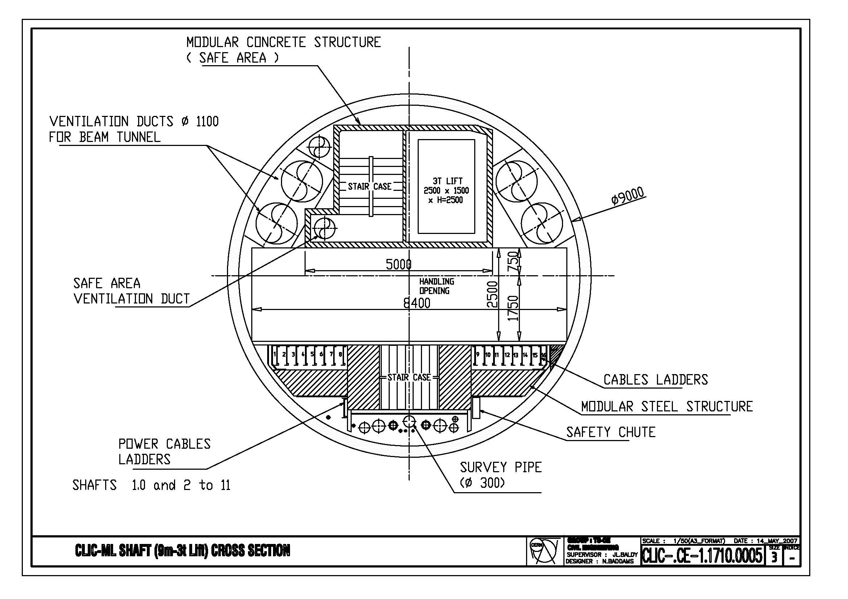
Shaft Layout
CDR Shaft Layout:
Expected to change – a second lift required.
Current shafts are 9m in diameter.
The depth of the shafts are expected to be less than 300m.

Slide 15
Fire Safety and ventilation
Fire doors seal off the section on fire and the two adjacent sectors.
Each sector of tunnel shall be a fire compartment with a capable fire resistance of at least 2 hours.
Positive pressurization from the ventilation system in adjacent sectors to contrast the smoke pressure.

Slide 16
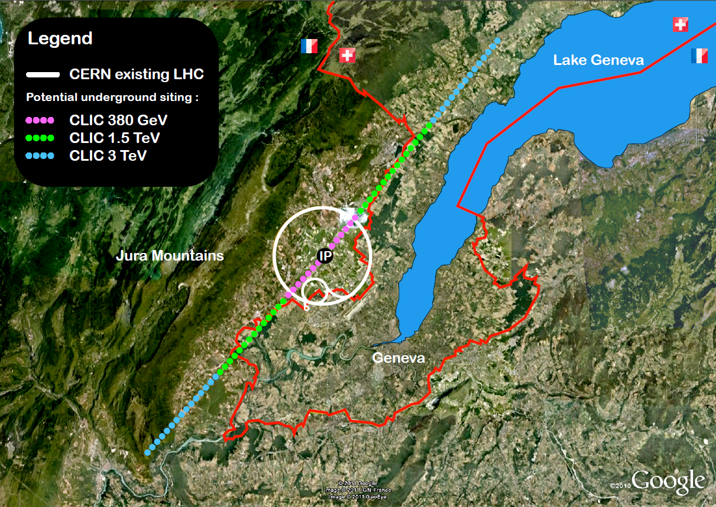
CLIC-Tunnel Optimisation Tool
CLIC TOT will allow us to optimise the position, depth, and angle of the tunnels.
Using a separate layer CLIC TOT will enable us to optimise the position of the surface Injection complex and relate this to the position of the main tunnel.
User inputs and Geological data requirements are to be refined to understand the potential for a machine learning tool that can be used to automatically optimise the position of CLIC based on the user inputs.

Slide 17
Data & Functionality Prioritisation
Datasets:
Rotation of the machine tunnel in both the vertical and horizontal plane in 0.1 degree increments.
A max gradient of 6%.
Adjustable shaft locations – Aiming for one shaft per 5km.
A maximum shaft depth of 300m – inclined tunnels a possibility if required.
Central injection complex input as a separate file.
Task 1 | Establish Project Setup and Technical Basis | June (mid)
Task 2 | Data and Functionality Prioritisation | June (end)
Task 3 | Specifications and TOT-CLIC architecting/wireframing (Concept Stage) | July (mid)
Task 4 | Data Integration and TOT-CLIC (beta) development | July (mid)
Task 5 | Finalised TOT-CLIC Development | Sept (end)
Task 6 | Troubleshooting and Technical Support | -

Slide 18
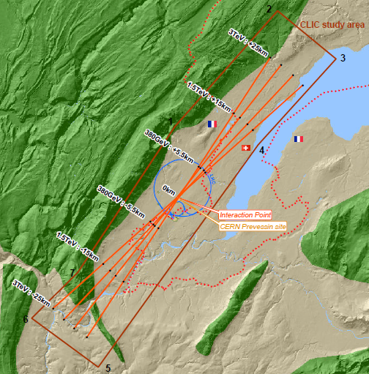
CLIC Study Boundary
Study Area
Position of CLIC between the Jura and Lake Geneva
CLIC straddles the France Switzerland border – Potential to keep the first energy stage in France.
Two depressions containing complex moraines – Gland and Allondon. Could be avoided at lower energy stage.
Jura mountain range.
Lake Geneva

Slide 19
CLIC Study Boundary
Study Area
Position of CLIC between the Jura and Lake Geneva
CLIC straddles the France Switzerland border – Potential to keep the first energy stage in France.
Two depressions containing complex moraines – Gland and Allondon. Could be avoided at lower energy stage.
Lake Geneva
Border: Dotted red line.

Slide 20
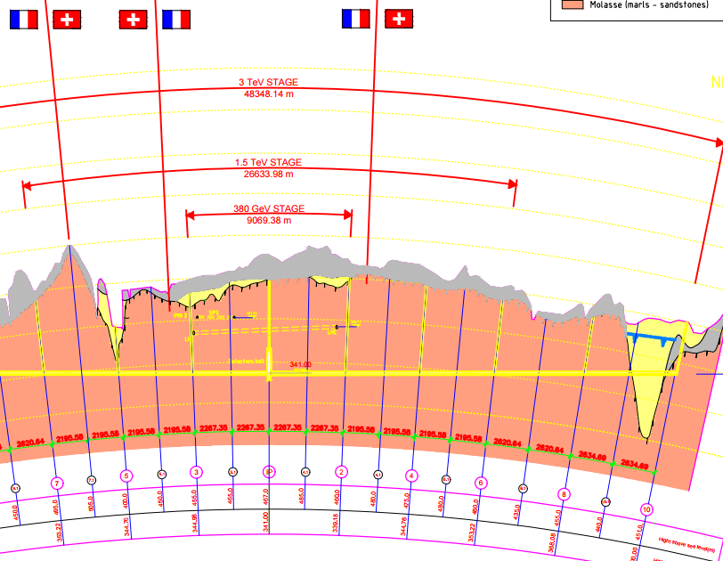
CLIC Study Boundary
Study Area
Position of CLIC between the Jura and Lake Geneva
CLIC straddles the France Switzerland border – Potential to keep the first energy stage in France.
Two depressions containing complex moraines – Gland and Allondon. Could be avoided at lower energy stage..
Gland
Allondon

Slide 21
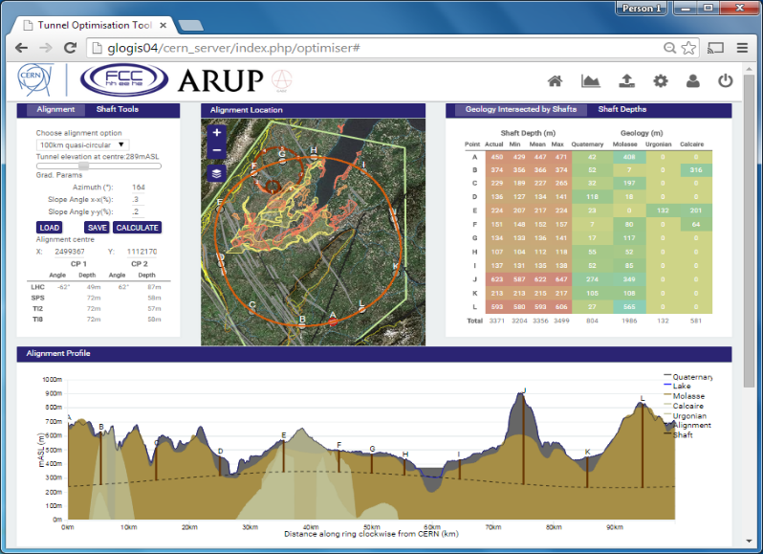
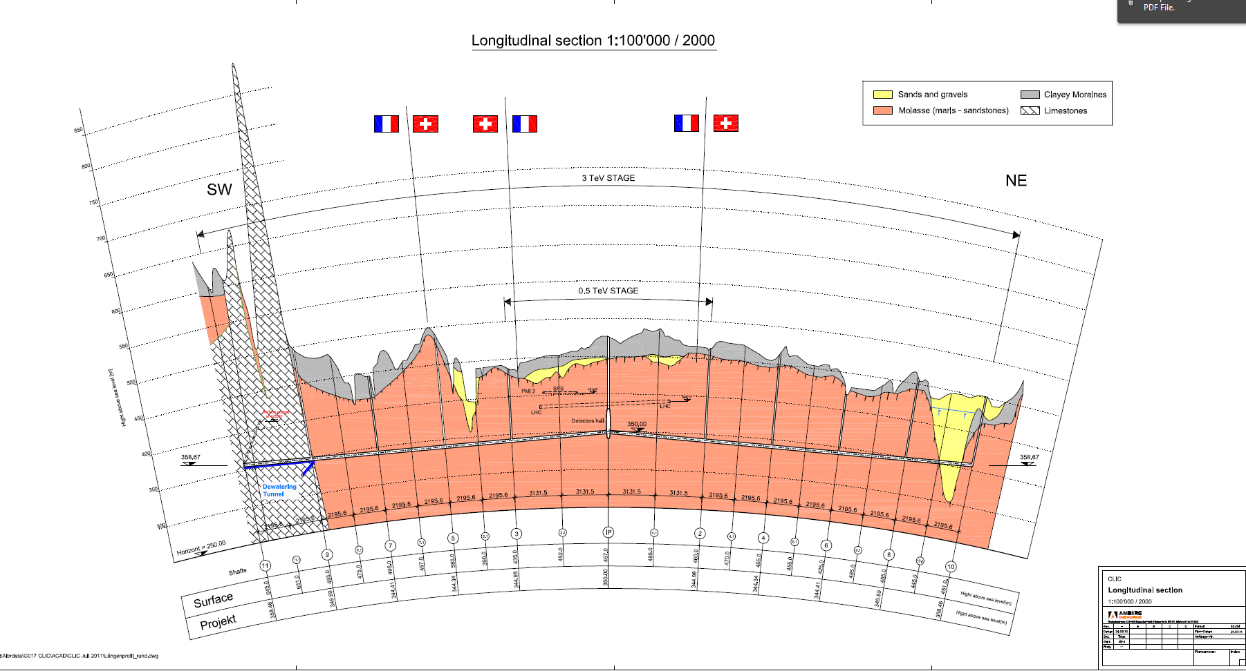
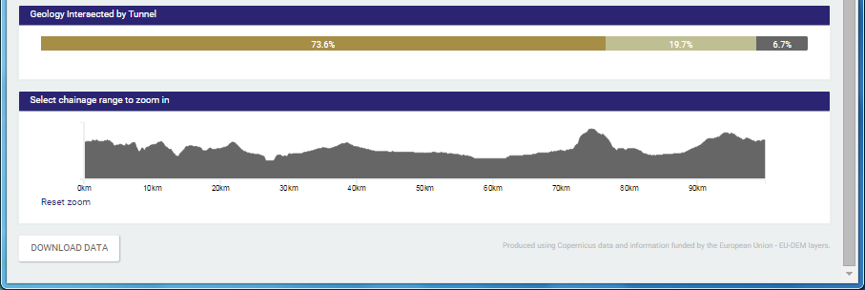
BIM – Tunnel Optimisation Tool (FCC)
Streamlines the conventional approach which is broadly linear and manual
Max value extracted from early project data
Single Source of Data
Visual decision aid
Clash detection – Regional Scale
Iterative process and comparison of options

Slide 22
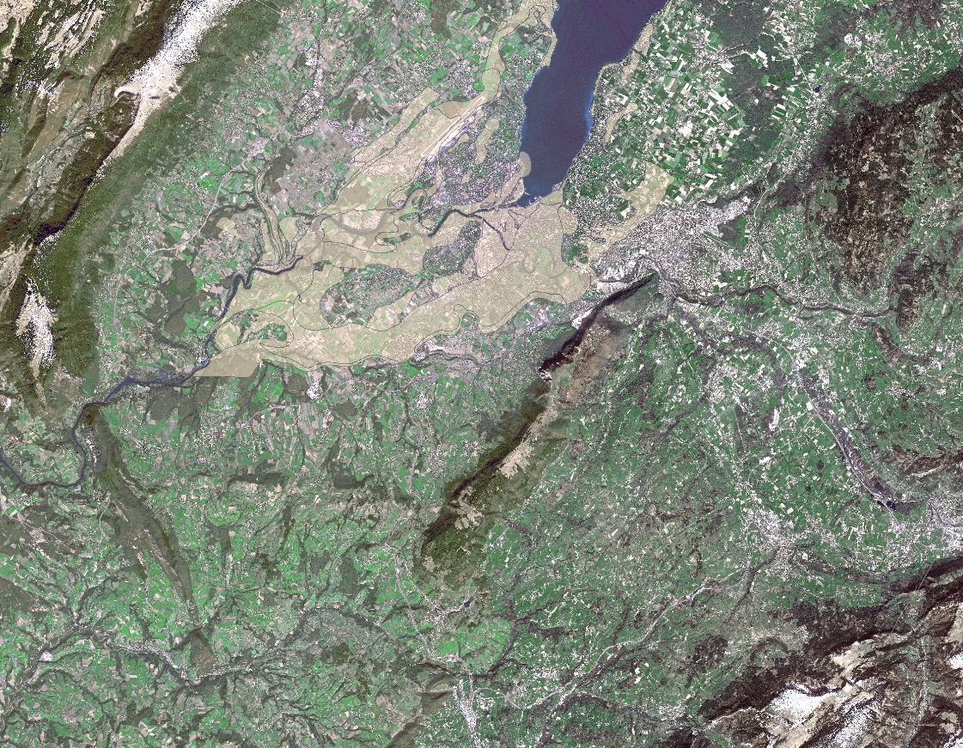
Feasibility Study – Hydrology
Lake
Geneva
The Rhone
L’Arve River
Aquifers

Slide 23
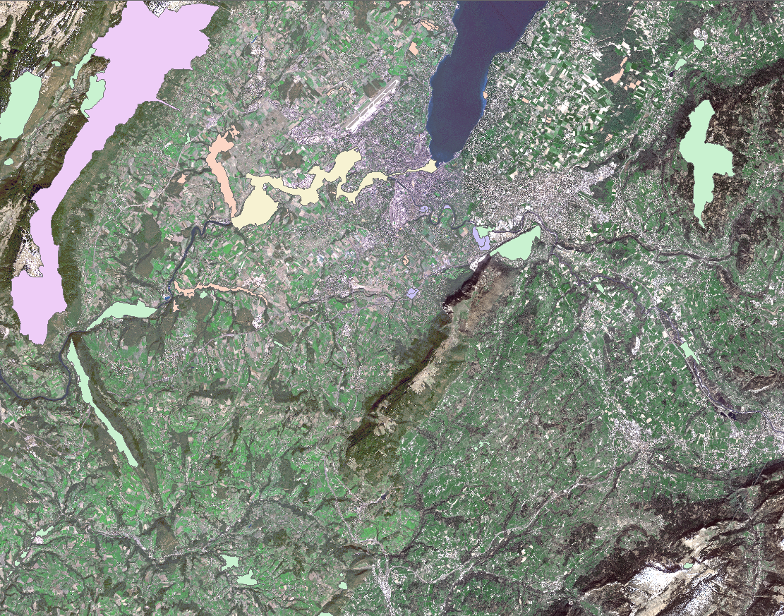
Environmental Considerations
Nature reserves
Protected wetlands
Areas of biological importance

Slide 24
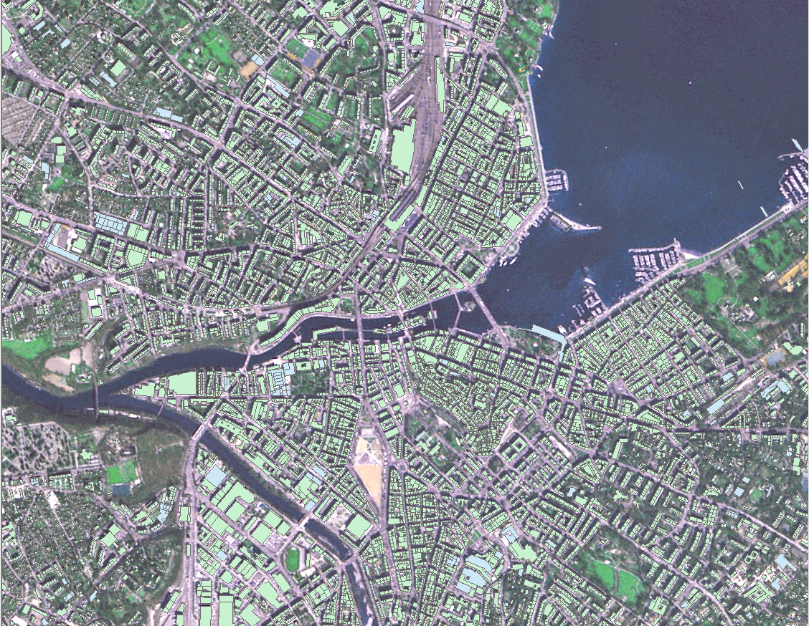
Buildings

Slide 25
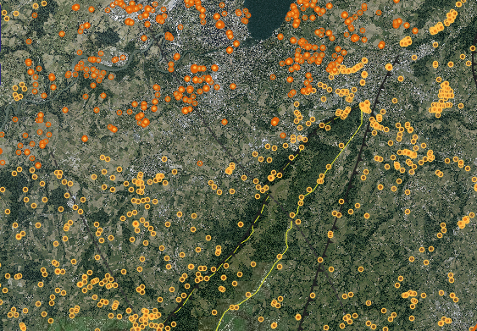
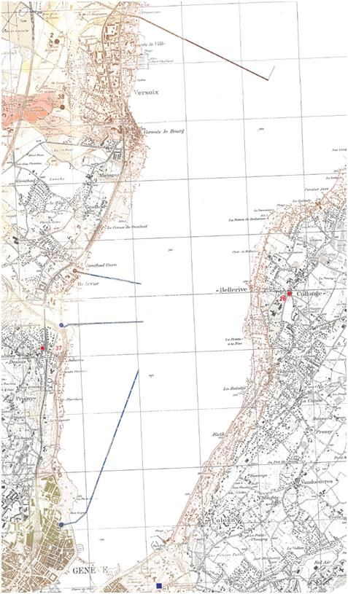
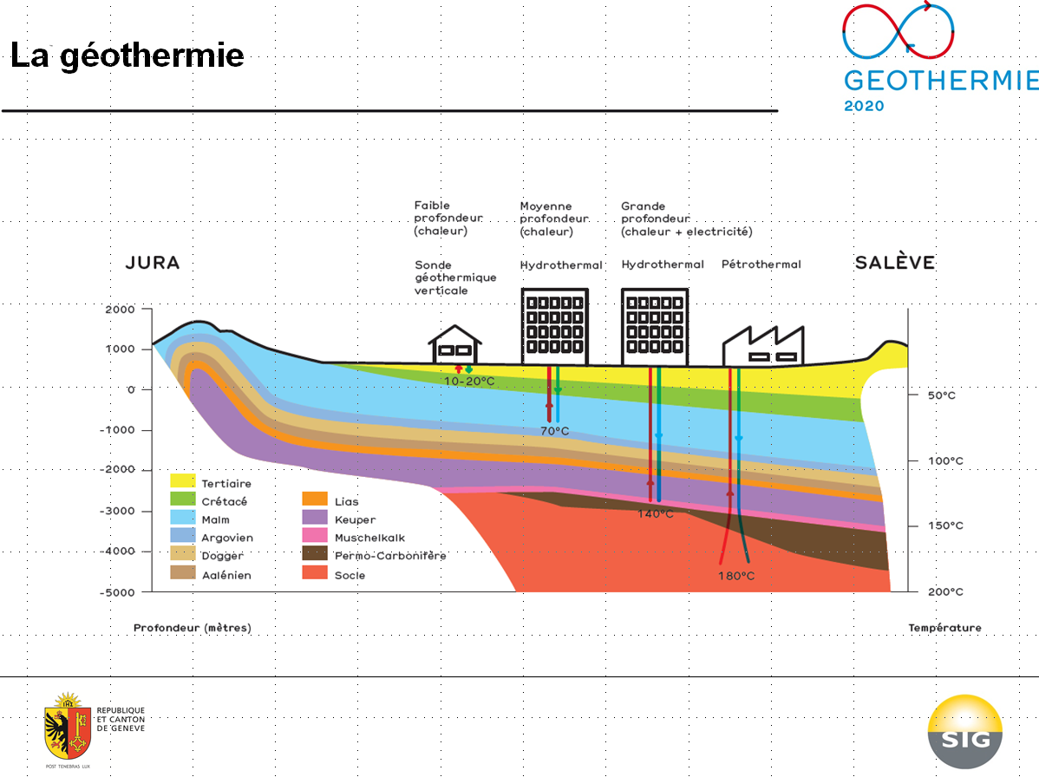
Geothermal Boreholes
Water supply pipelines
Geothermal drillings

Slide 26
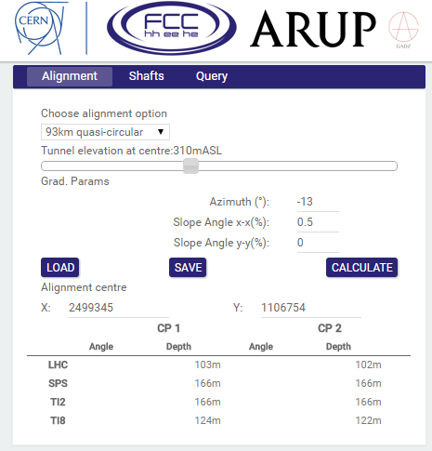
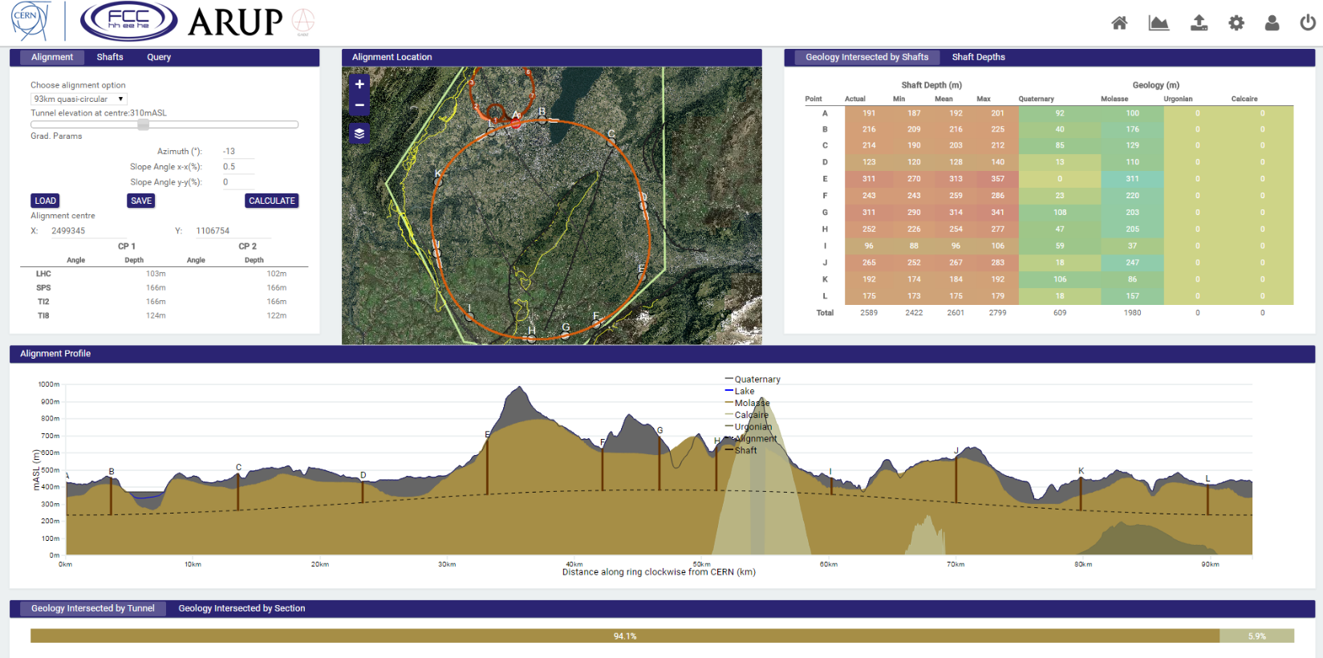
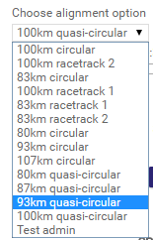
User interface – Input Parameters

Slide 27
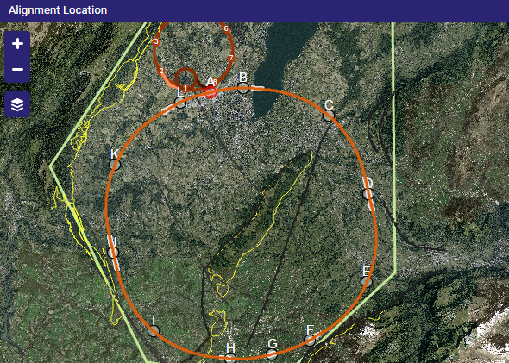
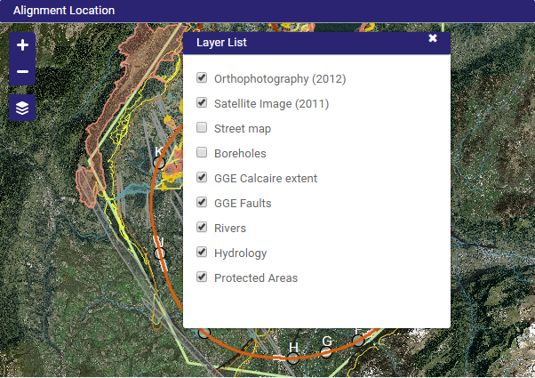
User interface – Input Parameters

Slide 28
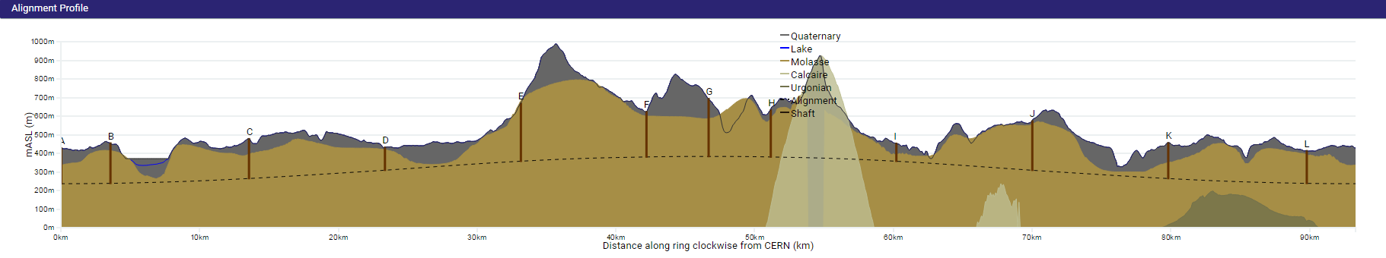
User Interface – Alignment Profile

Slide 29
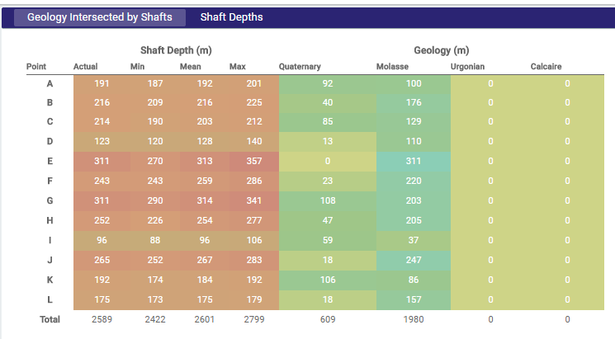
User Interface - Outputs

Slide 30
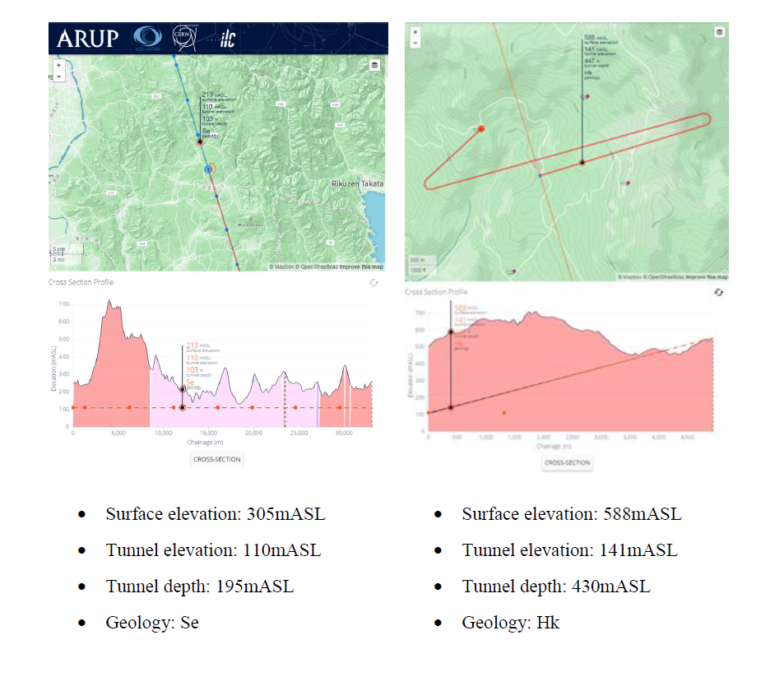
CERN/KEK Collaboration to develop TOT for ILC Optimisation
Many new features added to the tool that can be utilised in CLIC TOT, such as :
IP position can be changed.
LINAC Rotation/Flip
Inclined Access tunnels

Slide 31
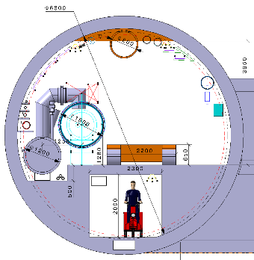
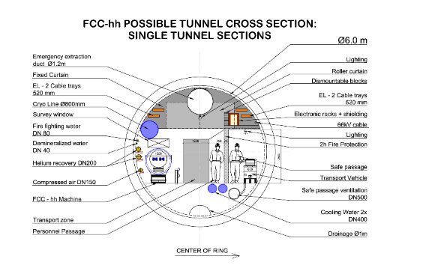
FCC Cross Section Development
Previously updated Large 6.8m tunnel.
Transport tunnel located beneath false floor.
Increased dimensions of machine components.
Original 6m cross sectional design.
Two compartments separated by fire protection wall.
Small emergency air extraction

Slide 32
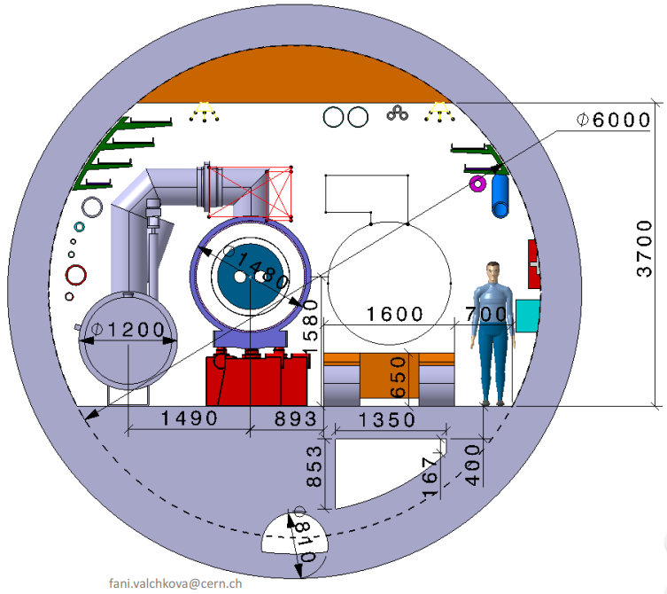
FCC Cross Section Development
New FCC Layout.
Extraction located above false ceiling.
Air intake located below false floor.
Machine dimension reduced from 1500mm to 1480mm.
Fire doors section off the tunnel at specified intervals.

Slide 33
FCC Cross Section Development
New FCC Layout.
Extraction located above false ceiling.
Air intake located below false floor.
Machine dimension reduced from 1500mm to 1480mm.
Fire doors section off the tunnel at specified intervals.

Slide 34
FCC Cross Section Development
New FCC Layout.
Extraction located above false ceiling.
Air intake located below false floor.
Machine dimension reduced from 1500mm to 1480mm.
Fire doors section off the tunnel at specified intervals.

Slide 35
FCC Cross Section Development
New FCC Layout.
Extraction located above false ceiling.
Air intake located below false floor.
Machine dimension reduced from 1500mm to 1480mm.
Fire doors section off the tunnel at specified intervals.

Slide 36
FCC Cross Section Development
New FCC Layout.
Extraction located above false ceiling.
Air intake located below false floor.
Fire doors section off the tunnel at specified intervals.
Can these concepts be considered for CLIC?

Slide 37
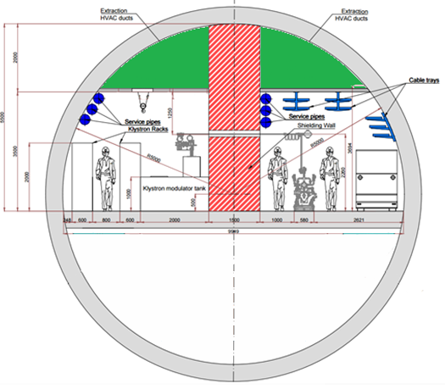
Klystron Single Tunnel - TBM
Extraction located above false ceiling 2.6m²
1.5m
TBM Tunnel
10m TBM required to achieve required surface width within tunnel.
A lot of space below the floor – potential to have a services located here. (see example for Tunnel Mont-Sion)
Backfill from tunnel excavation to be utilised. (see example for Tunnel Mont-Sion)
3.2m
9.9m
Backfill around Service tunnel – Access to be provided at regular intervals
Notes:
Same structure design?
Consistent layout with drive beam proposed layout
Compatible for both klystron and drive beam upgrades

Slide 38
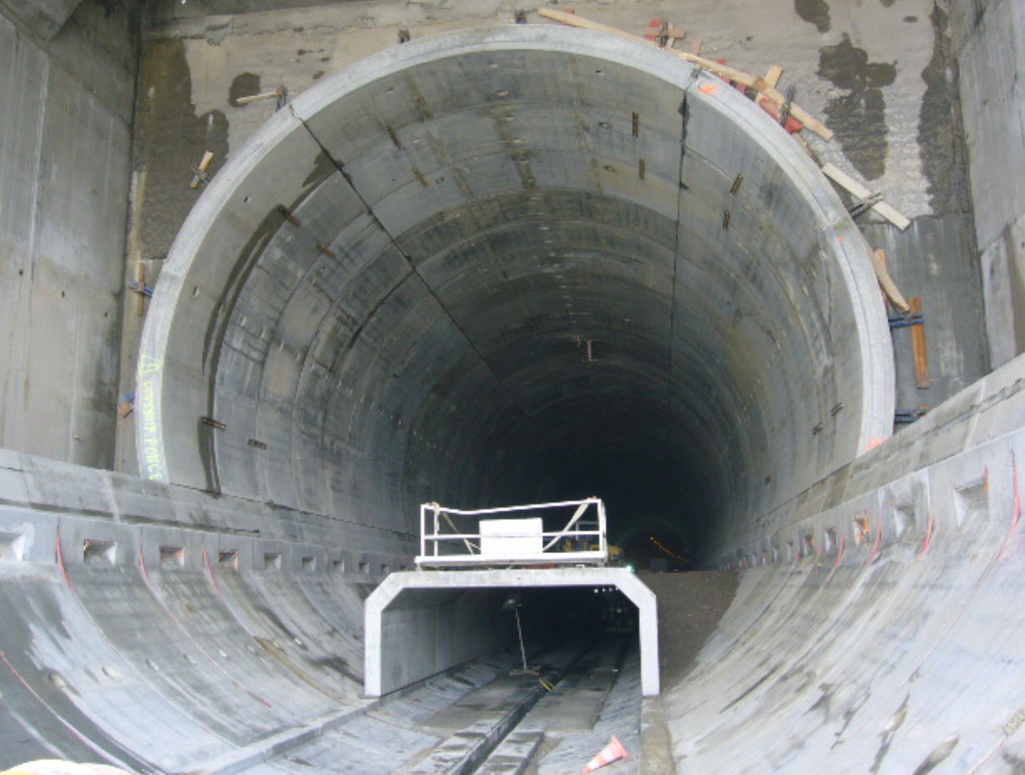
Mont-Sion Tunnel (Autoroute, Geneva to Annecy)
TBM Tunnel
Slightly larger than the CLIC tunnel at a diameter of 12m
The example shows the utilisation of space below the road level in Mont-Sion tunnel – a similar thing could be done for a single TBM tunnel at the Klystron 380 GeV energy stage.
Notes:
Same structure design?
Consistent layout with drive beam proposed layout
Compatible for both klystron and drive beam upgrades

Slide 39
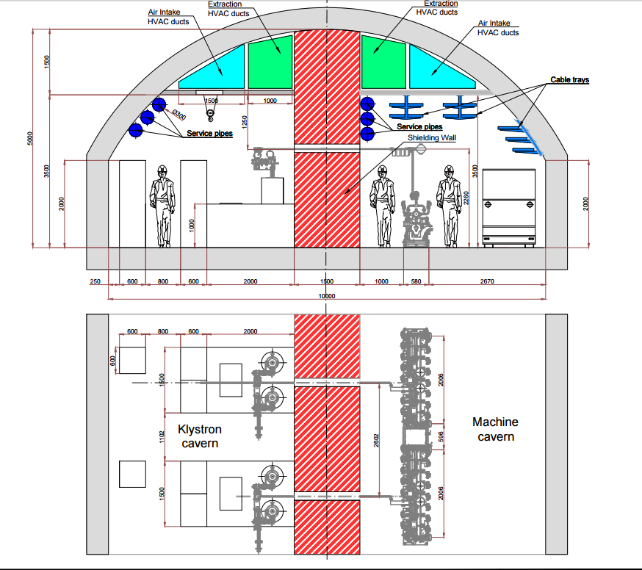
Klystron Single Tunnel - Roadheaders
Crane requirements for klystron module cavern to be determined?
Roadheader Tunnel
Single tunnel layout – 10m width, similar to the ILC potential for the same space reductions as the TBM tunnel.
Approx. 11km of mined tunnelling can be expensive and time consuming.
Must be compatible with TBM drive beam upgrades.
What services will be required?
(Machine Design is for presentation purposes only and is subject to change)
Notes:
Waveguides every 1m or 2m!
Second tunnel to be located slightly above the Accelerator tunnel to avoid beam dumps with waveguide connections.

Slide 40
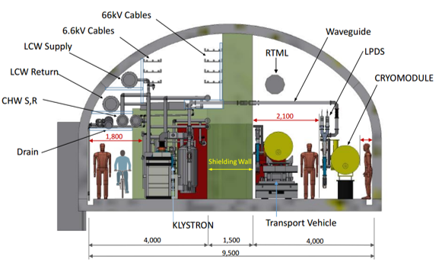
Klystron Single Tunnel - Roadheaders
ILC – CLIC Comparison
(Machine Design is for presentation purposes only and is subject to change)
Notes:
Waveguides every 1m or 2m!
Second tunnel to be located slightly above the Accelerator tunnel to avoid beam dumps with waveguide connections.

Slide 41
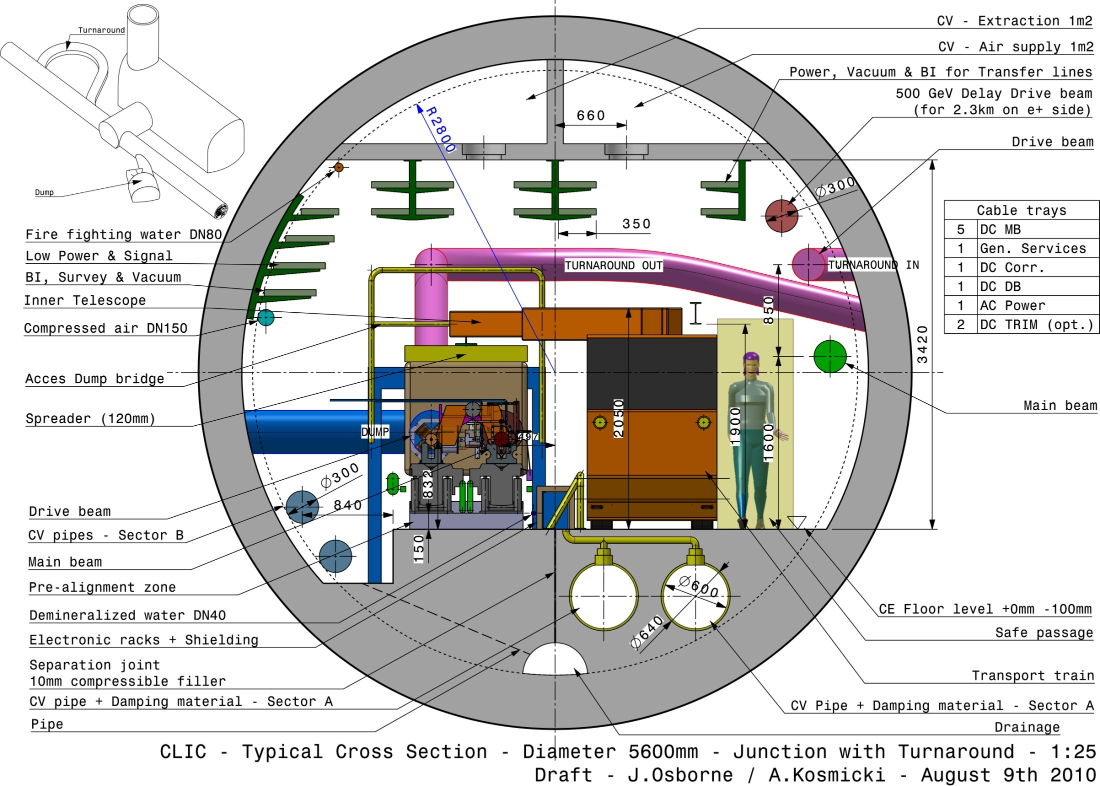
Klystron Single Tunnel - Roadheaders
Roadheader Tunnel
Single tunnel layout – 9.5m width, potential for the same space reductions as the TBM tunnel.
Approx. 11km of mined tunnelling can be expensive and time consuming.
Must be compatible with TBM drive beam upgrades.
Notes:
Waveguides every 1m or 2m!
Second tunnel to be located slightly above the Accelerator tunnel to avoid beam dumps with waveguide connections.

Slide 42
Drive Beam Option – Main Tunnel Cross Section
Main tunnel cross section:
Cross section was increased from 4.5m to 5.6m
5.6m is the standard size for European subways
Power converter community requested a lot more space => increase diameter of tunnel
CV pipes in slab are now isolated from machine by a compressible filler
Cable trays are not individually labelled for now
Transversal Ventilation no longer compatible with current heat loads.
Notes:
Waveguides every 1m or 2m!
Second tunnel to be located slightly above the Accelerator tunnel to avoid beam dumps with waveguide connections.

Slide 43
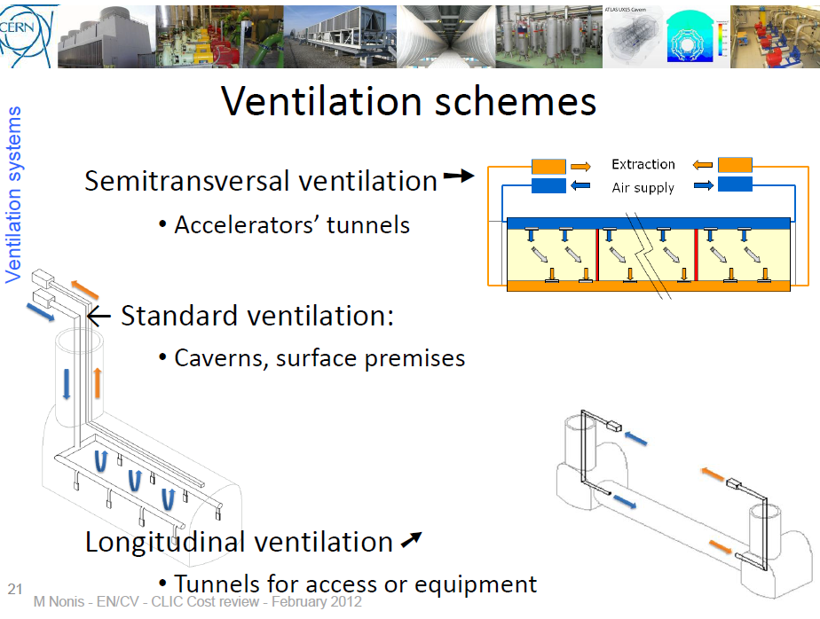
Cooling and Ventilation
Ventilation schemes:
Original concept was a transversal ventilation system as shown.
Extremely high air flow rate required to cool down the modules.
Current numbers are much higher with respect to the CDR! CDR numbers omitted the heat loads of the RF components to air (Accelerating structures + RF-loads and PETS ≈ 350-410 W/m)
Feasibility study for local Cooling system is to be undertaken.

Slide 44
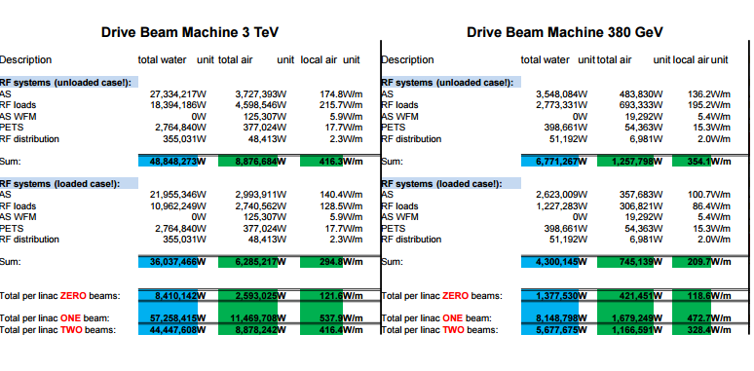
Cooling and Ventilation – Heat Loads
Heat load to air (worst case at one beam):
380 GeV:
  1679.249W
  472.7W/m
3 TeV:
  11,469,708W
  537.9W/m
Heat Load to water (worst case at one beam):
380 GeV:
  8,148,798W
3 TeV:
  57,258,415W

Slide 45
Summary
380GeV, 1.5TeV and 3TeV machine layouts to be created.
Develop new engineering layouts for the 380 GeV Klystron Machine – both single and double tunnel layouts
380 GeV Klystron design compatible with energy upgrades. Double tunnel or single tunnel required.
New Tunnel Optimisation Tool to be developed specifically for CLIC.
Civil Drawings are to be produced by Civil Draughtsmen - new drawings to be produced for the Klystron design and existing drive beam design drawings to be changed.
A detailed cost estimate for infrastructure to be produced and work together with ILC on areas of synergy.
We are looking forward to the ILC AAA visit at CERN on the 12/13th July 2017

Slide 46
Thank You For Your Attention
Thank you to all contributors

