Slide 1
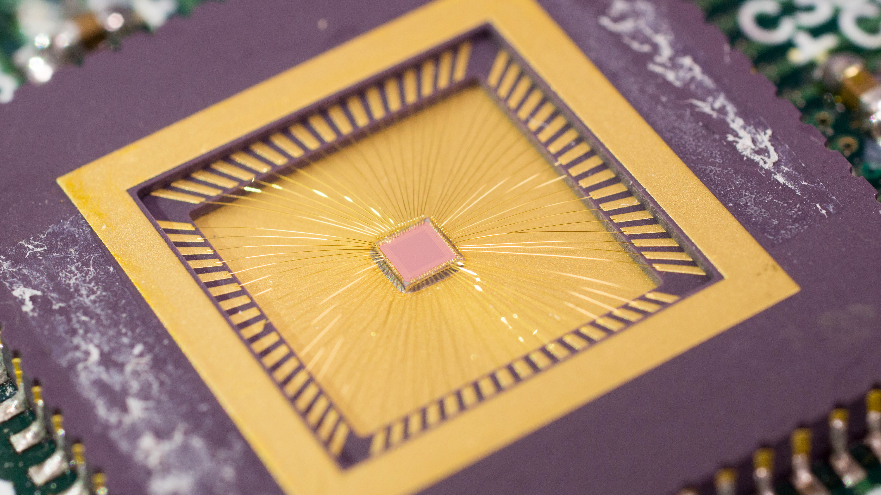
Radiation Hardness, Sensitivity, Charge Collection Time
Update on Chronopixel R&D
1.2mm
Americas Workshop on Linear Colliders 2017
June 27, 2017
Christian Weber, Yale University
Notes:
Thank you!
Chronopixel – Fully Monolithic pixel detector in CMOS technology
Will explain what that means
Present tests of it pertinent to the ALAS phase 2 operation after the High luminosity upgrade of the LHC

Slide 2
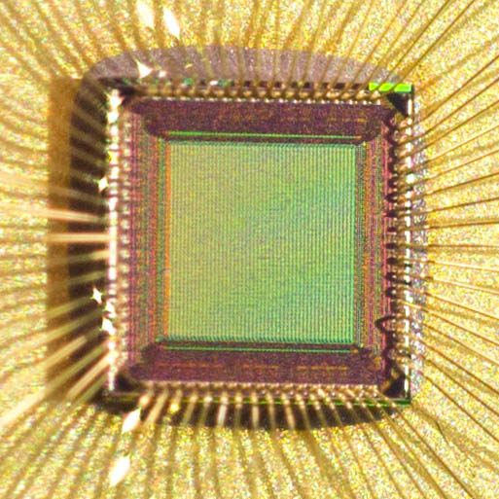

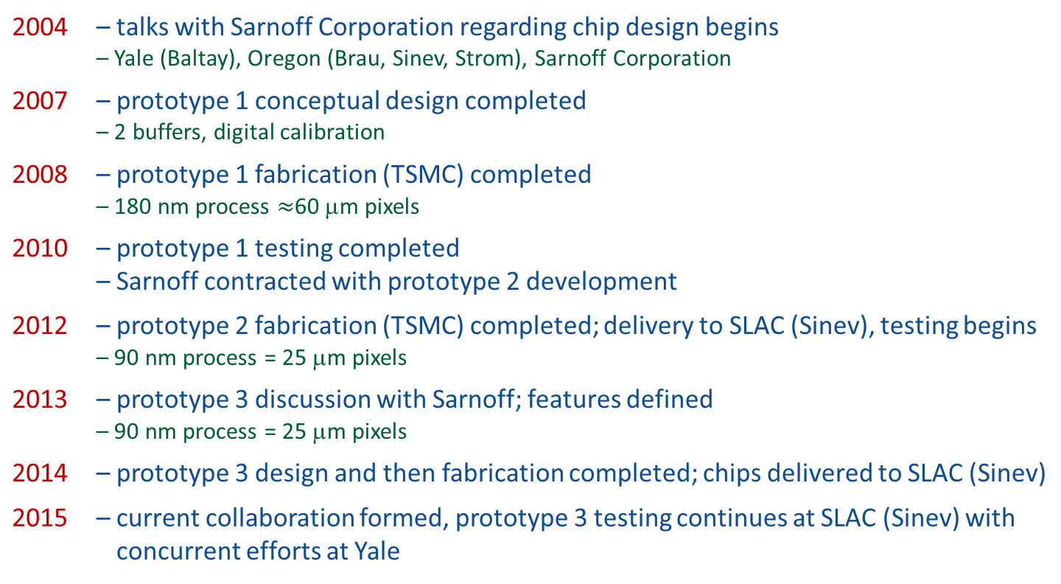
Chronopixel
a fully monolithic active pixel sensor, designed for the International Linear Collider’s (ILC) Silicon Detector
Development History
2004 | – talks with Sarnoff Corporation regarding chip design begins – Yale (Baltay), Oregon (Brau, Sinev, Strom), Sarnoff Corporation
2007 | – prototype 1 conceptual design completed – 2 buffers, digital calibration
2008 | – prototype 1 fabrication (TSMC) completed – 180 nm process $≈$60 μm pixels
2010 | – prototype 1 testing completed – Sarnoff contracted with prototype 2 development
2012 | – prototype 2 fabrication (TSMC) completed; delivery to SLAC (Sinev), testing begins – 90 nm process = 25 μm pixels
2013 | – prototype 3 discussion with Sarnoff; features defined – 90 nm process = 25 μm pixels
2014 | – prototype 3 design and then fabrication completed; chips delivered to SLAC (Sinev)
2015 | – current collaboration formed, prototype 3 testing continues at SLAC (Sinev) with – concurrent efforts at Yale
Chronopixel prototype 3
$\sim 1.2$mm
Notes:
Fullly Monolithic active pixel sensor, being developed for the ILC, since 2004

Slide 3
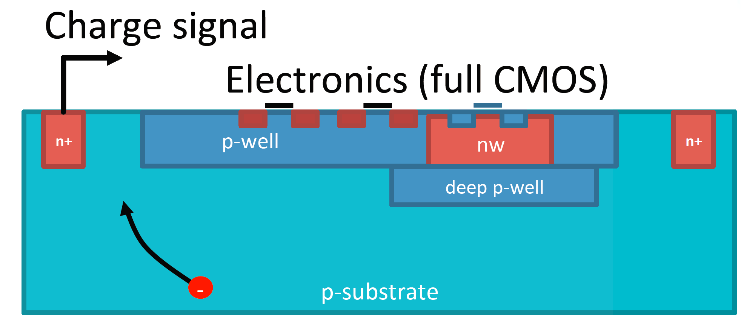
CMOS
CMOS Allows for monolithic detectors: sensor and readout on same die
CMOS: complimentary metal-oxide semiconductor
process of implementing NMOS* and PMOS* on a single integrated circuit
and also type of hardware logic design that uses them in a complimentary fashion.
** N- or P-type Metal-Oxide-Semiconductor (Field Effect Transistor): two types of transistors
Notes:
Cmos: complimantary metal-oxide semiconductor
Refers: technology and as well as chip design that uses them in complimentary fashion
Current pixel sensors: two chips, one sensing, one readout, bump bonding ($$$)
CMOS: can embedd readout electronics within the sensor itself
(thin, no bump bonding, smaller pixels etc)
Radiation hardness needs to be proven, and I am going to present measurements of our that that effect.
But first let me talk about features of the chronopixel

Slide 4
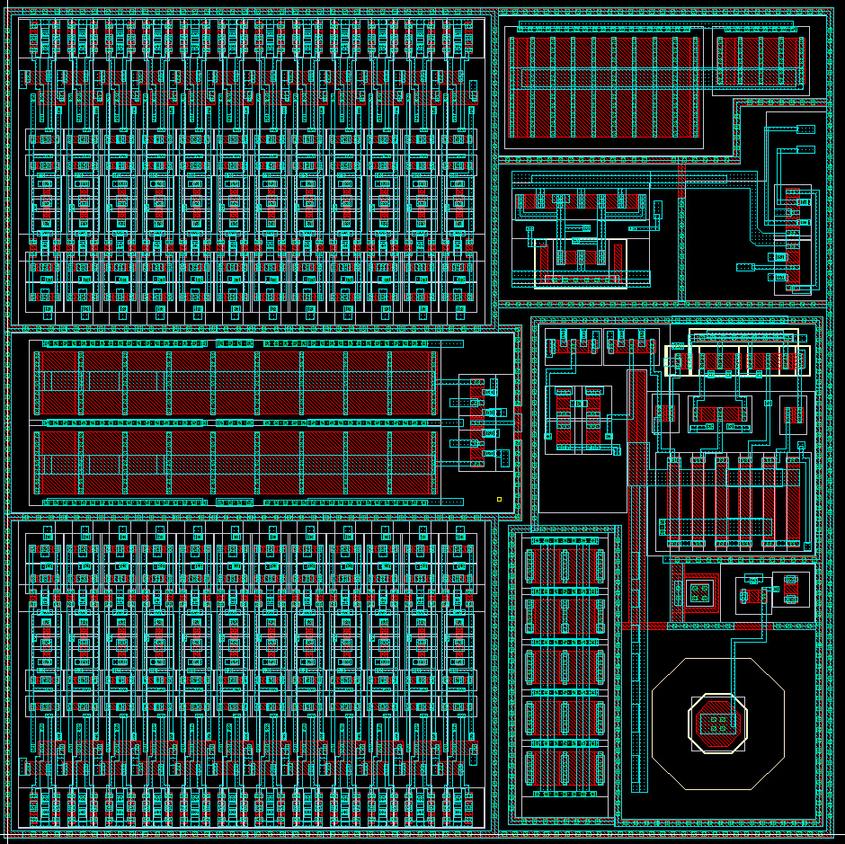
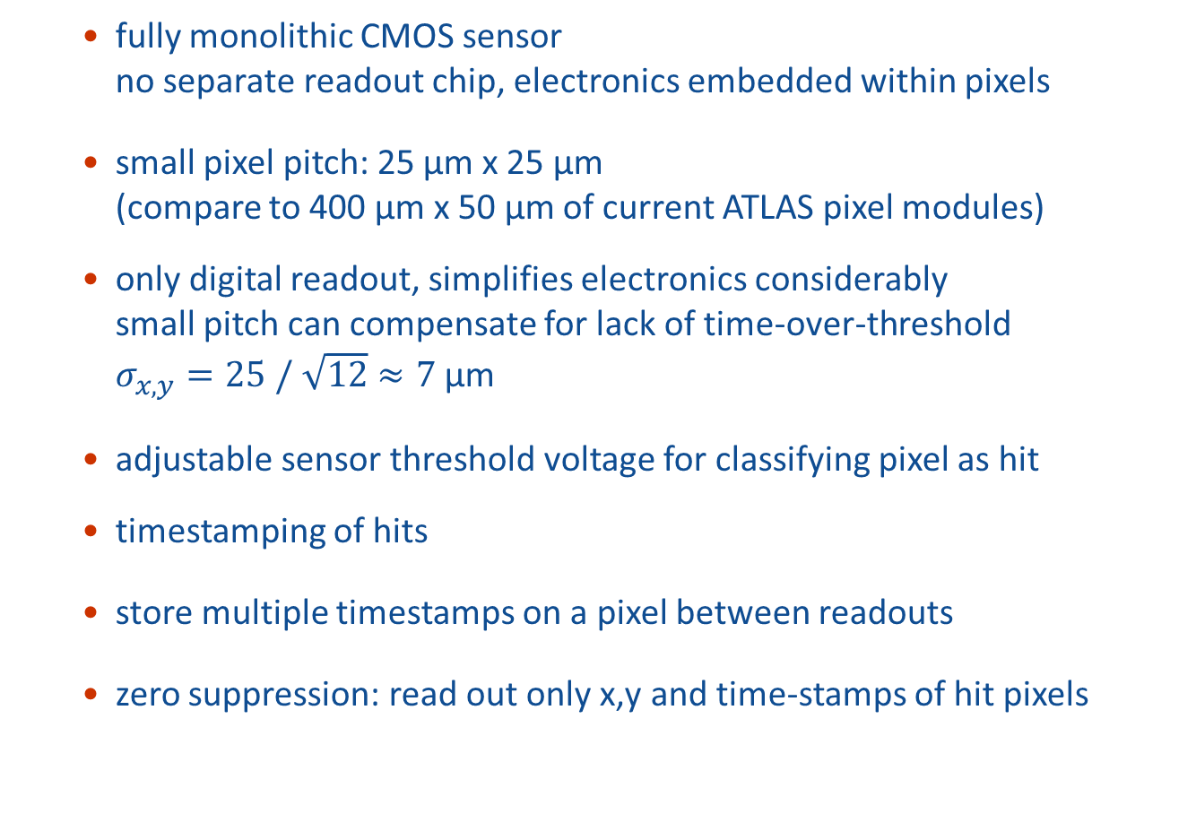
Chronopixel features
  fully monolithic CMOS sensor
  no separate readout chip, electronics embedded within pixels
  small pixel pitch: 25 µm x 25 µm
  (compare to 400 µm x 50 µm of current ATLAS pixel modules)
  only digital readout, simplifies electronics considerably
  small pitch can compensate for lack of time-over-threshold
  $σ_{x,y}=25 / \sqrt{12}≈7$ µm
  adjustable sensor threshold voltage for classifying pixel as hit
  timestamping of hits
  store multiple timestamps on a pixel between readouts
  zero suppression: read out only x,y and time-stamps of hit pixels
single pixel layout
25 µm
25 µm
Notes:
As mentioned, fully monolithic CMOS sensor, electronics in pixels
Small pixel pitch,
that can compensate the exclusively digitately readout, i.e. we have a binary hit/not hit classification for each pixel and not time over threshold
However, we can set adjust this threshold

Slide 5
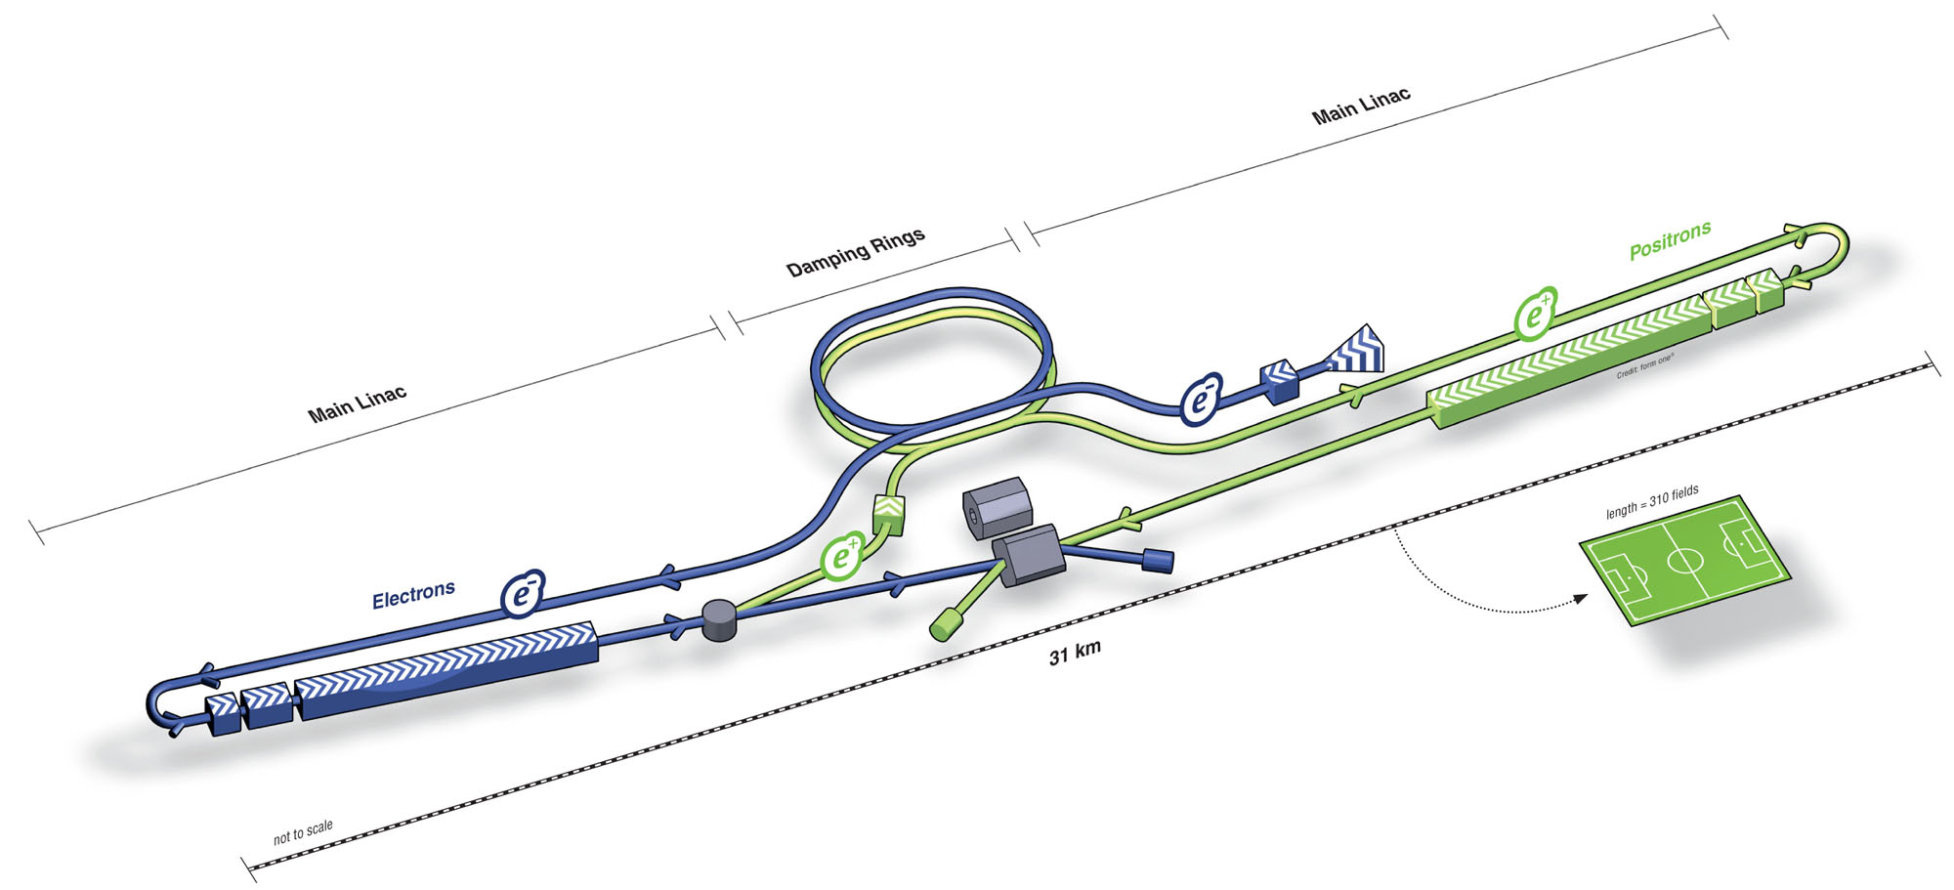
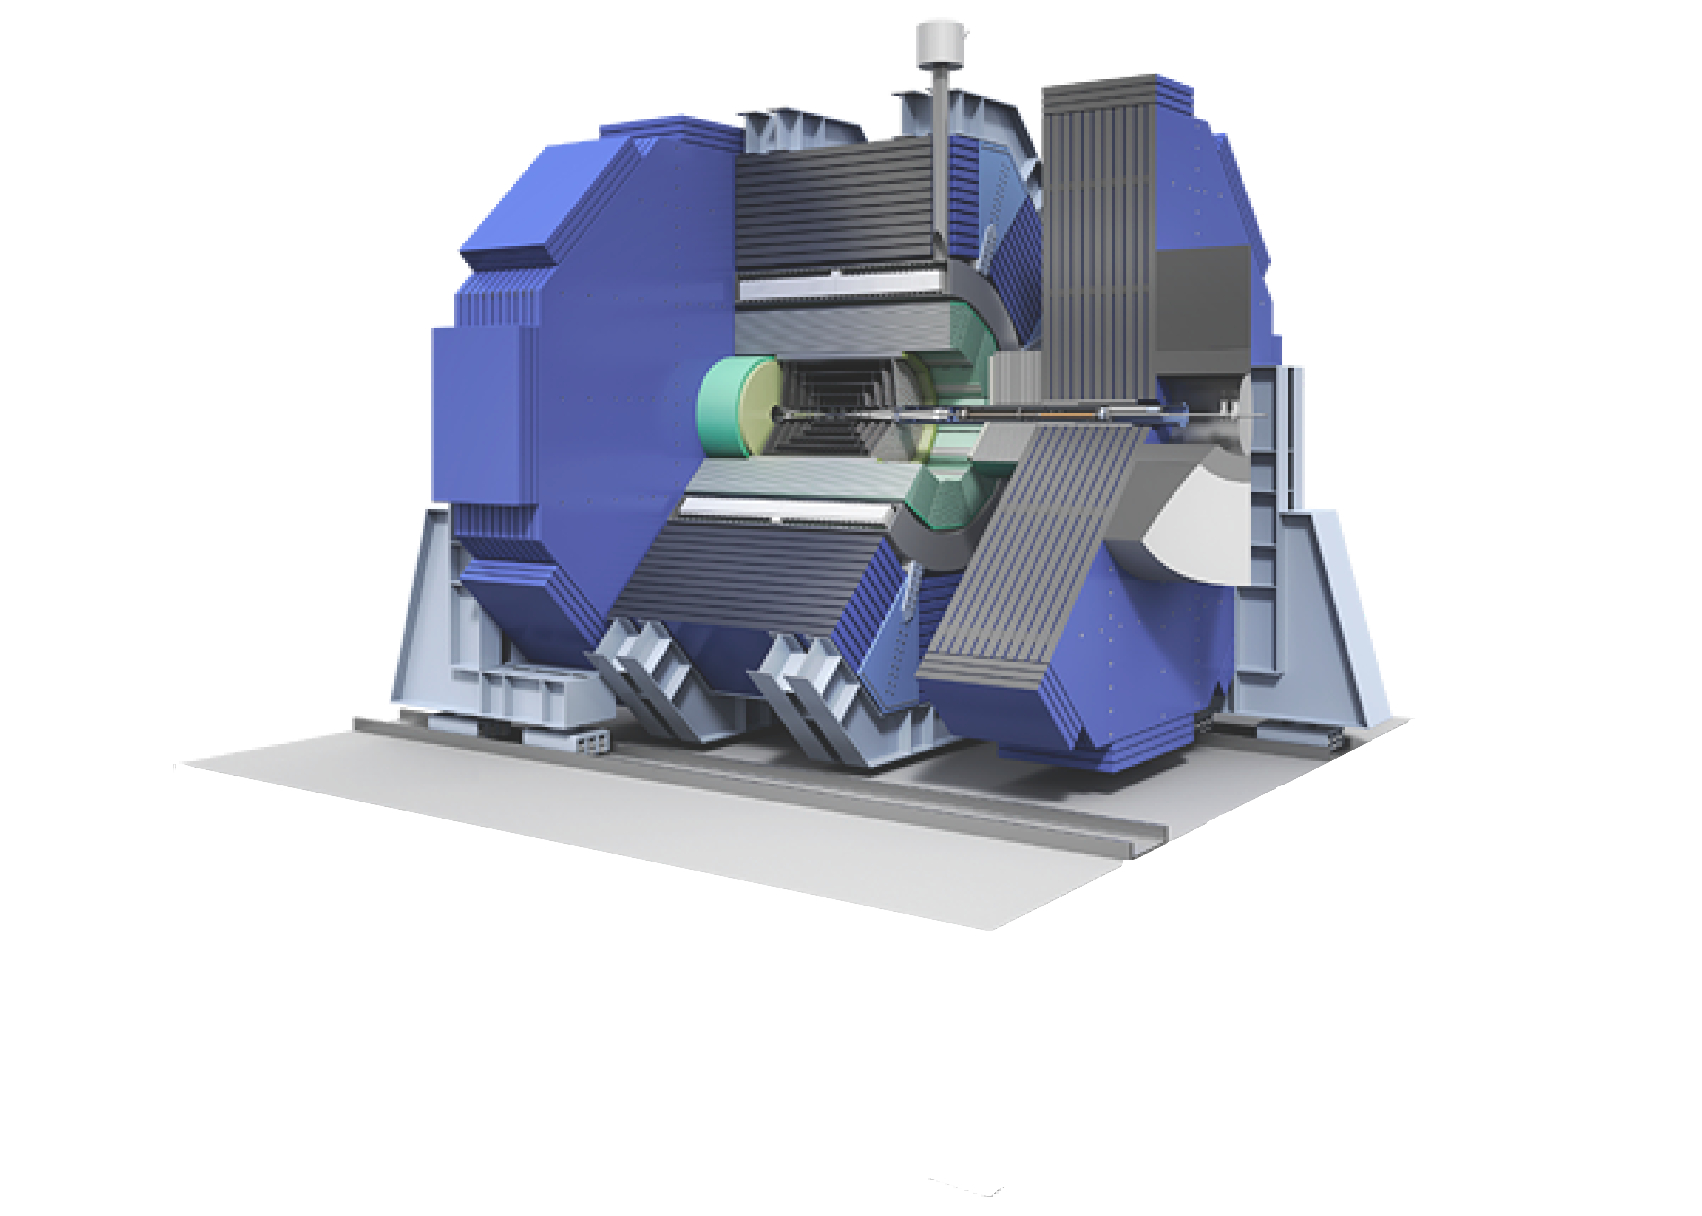
ILC
5 bunch trains every second
1312 bunches in a train, 554 ns apart
Silicon Detector (SiD)
convective cooling only
0.13 mW/mm² tracker power dissipation limit
Notes:
accommodate

Slide 6
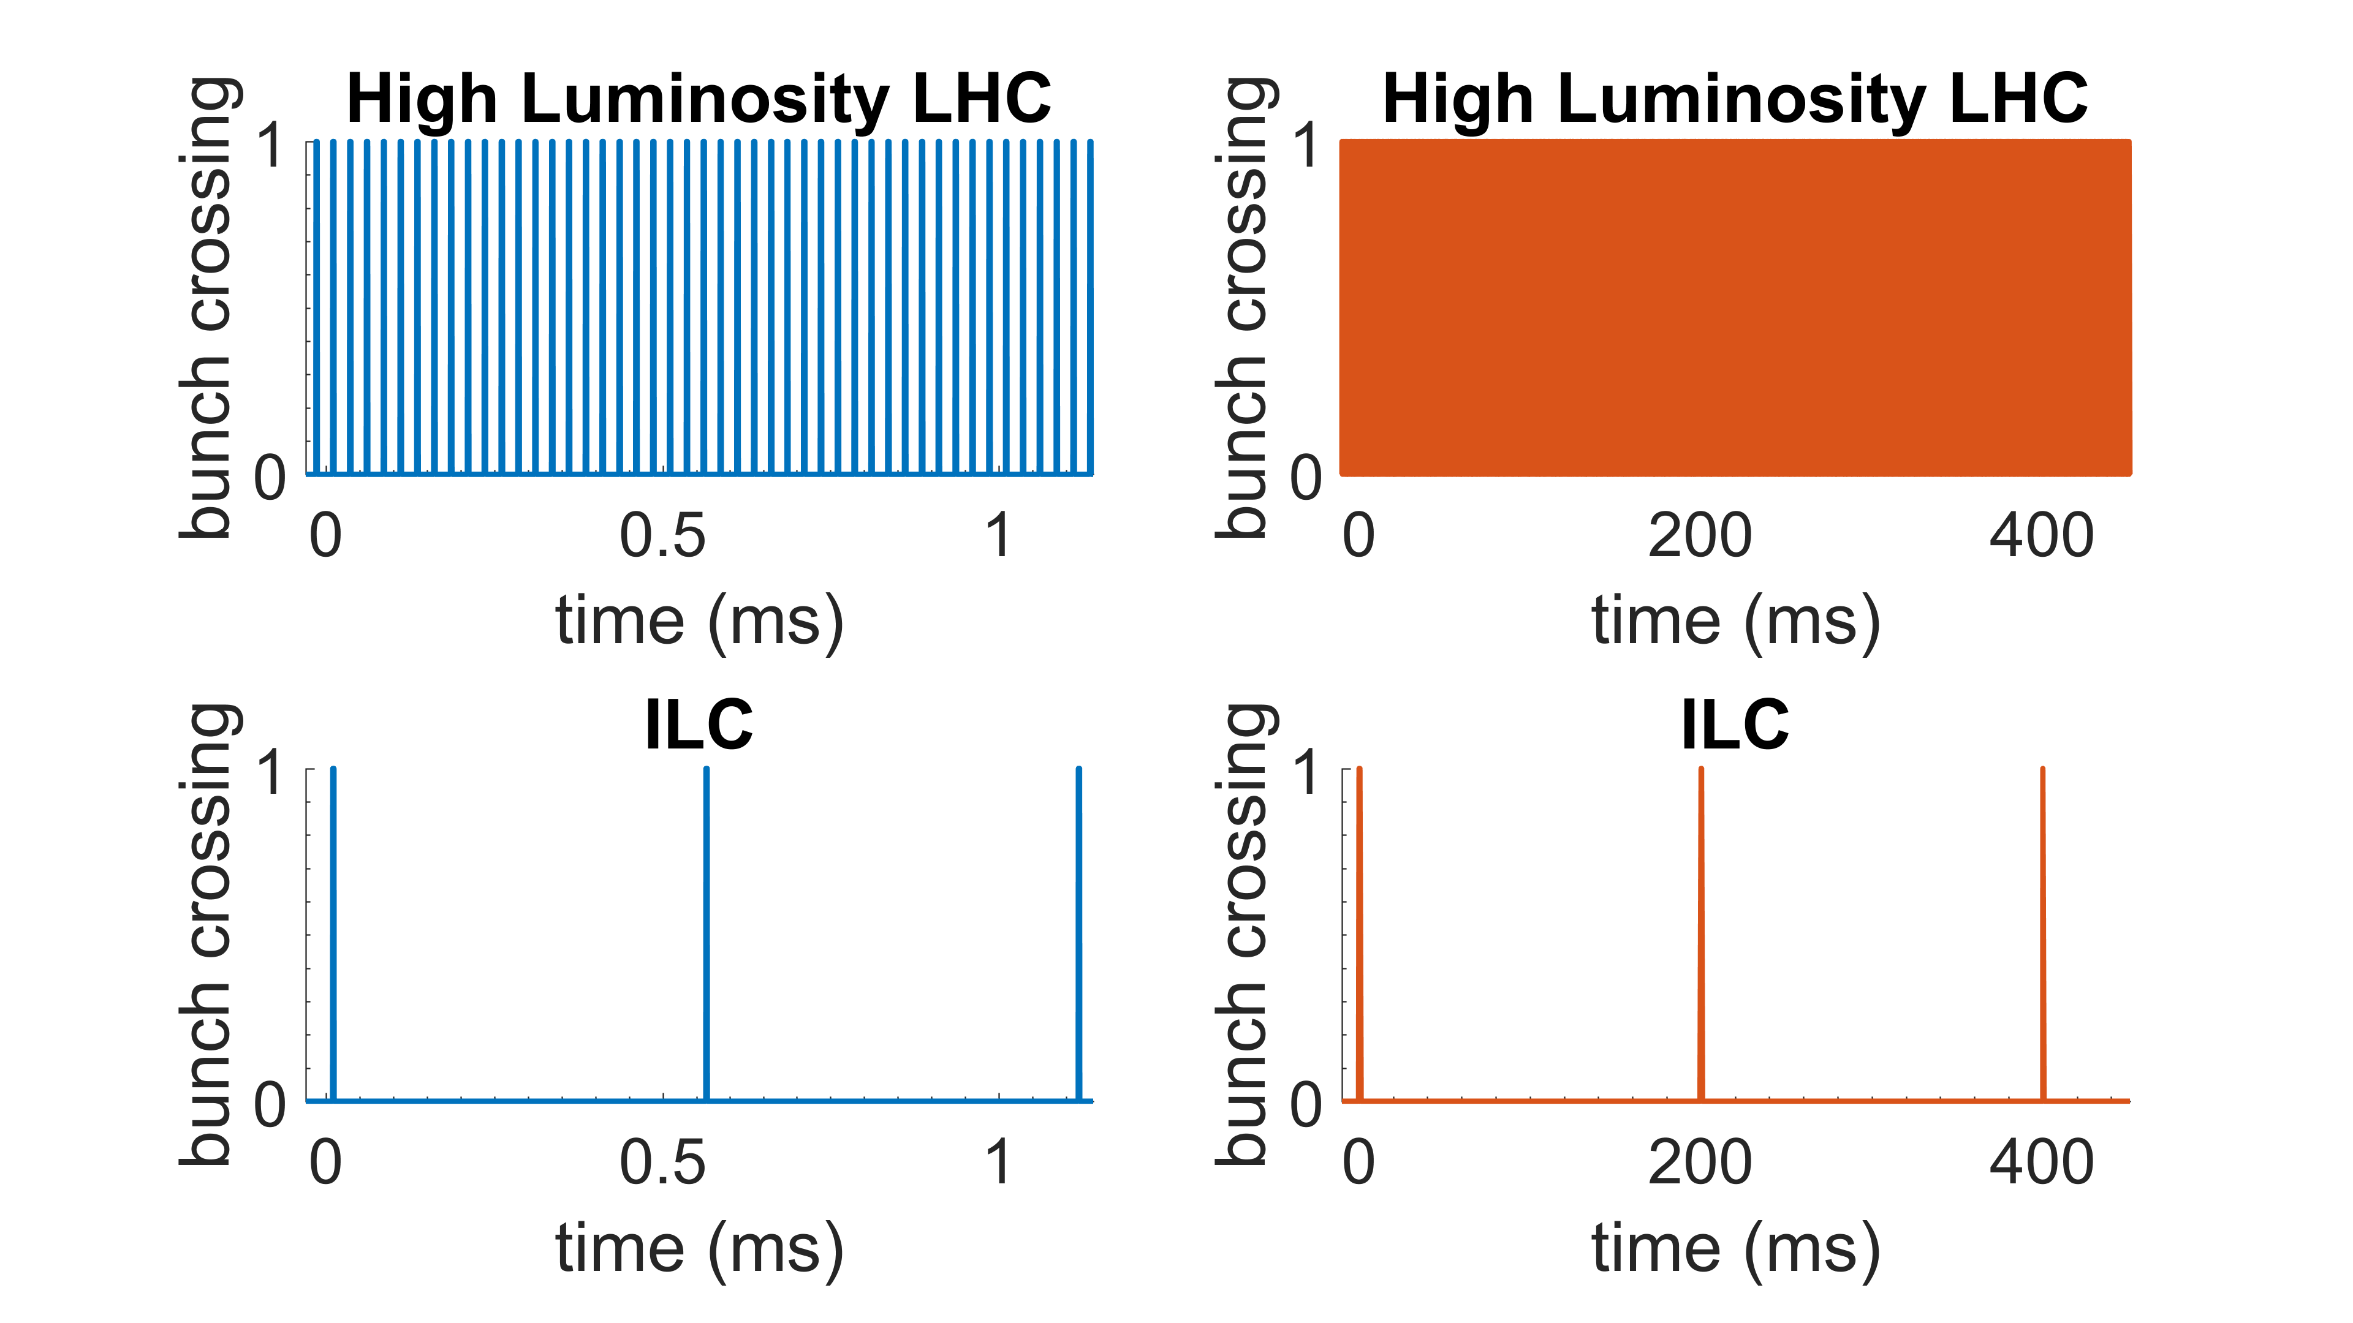
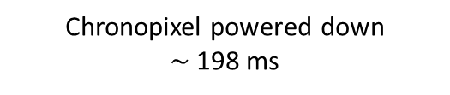

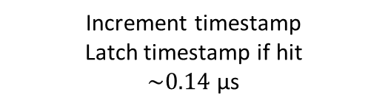

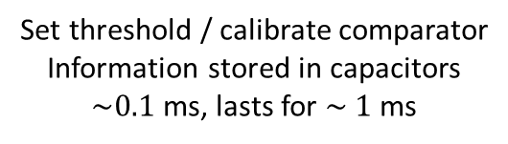
Chronopixel Operation
ILC bunch trains
Chronopixel powered down
$\sim$198 ms
200 ms
Set threshold / calibrate comparator
Information stored in capacitors
$\sim 0.1$ ms, lasts for $\sim 1$ ms
1312 bunches
0.7 ms
Clear memory
$few, O(1)$ μs
time (ms)
ILC bunches
Increment timestamp
Latch timestamp if hit
$\sim 0.14$ μs
554 ns
Read out pixels
$\sim 4$ μs per timestamp
time (μs)

Slide 7
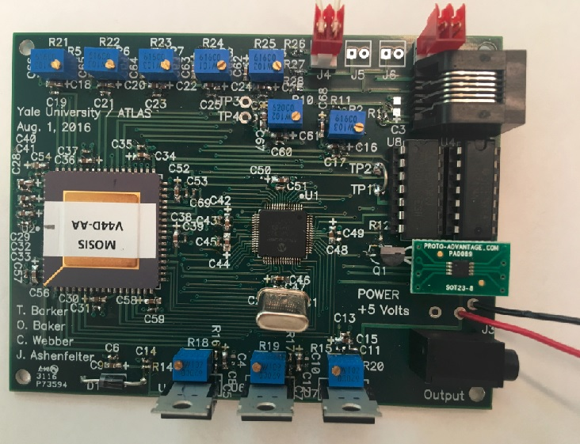
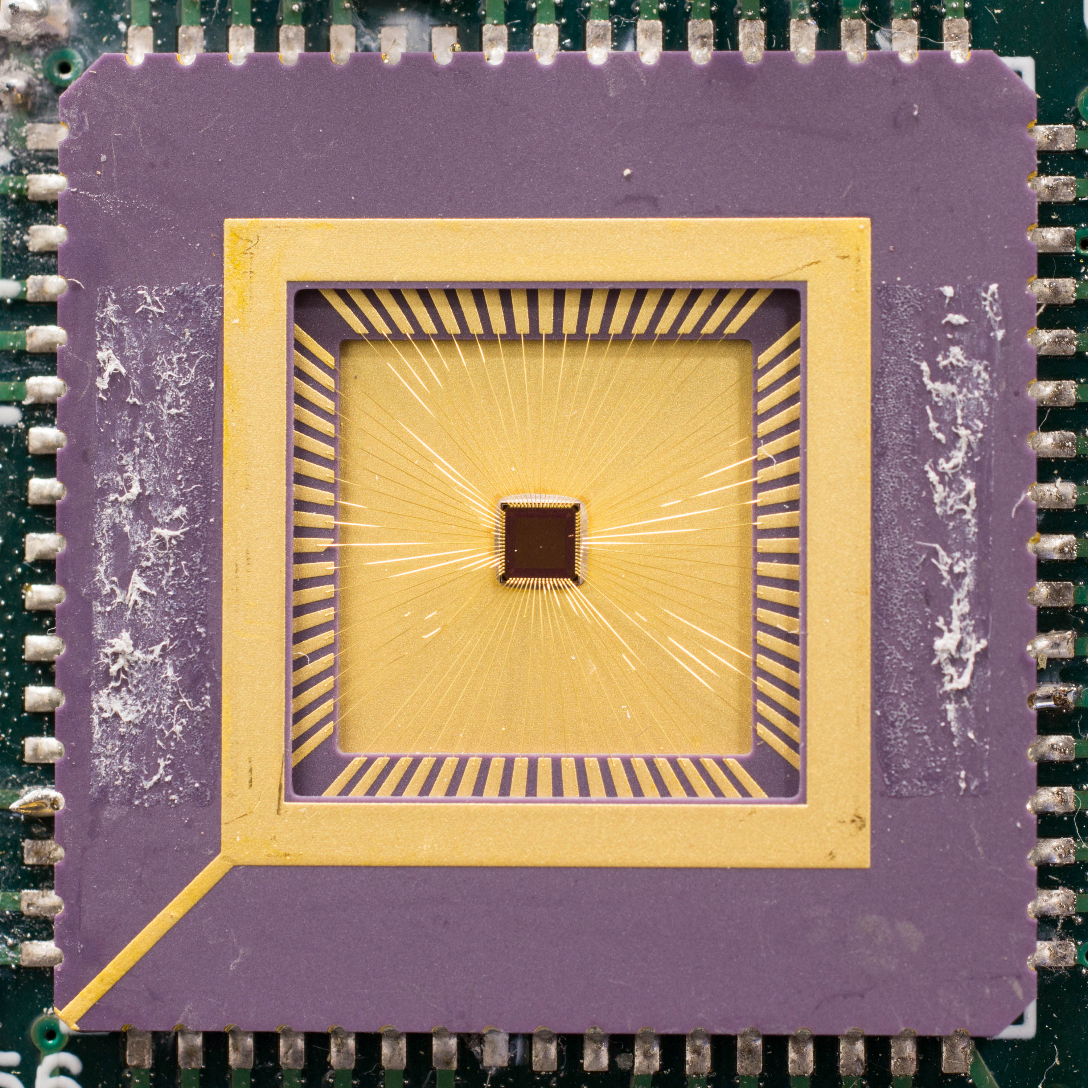
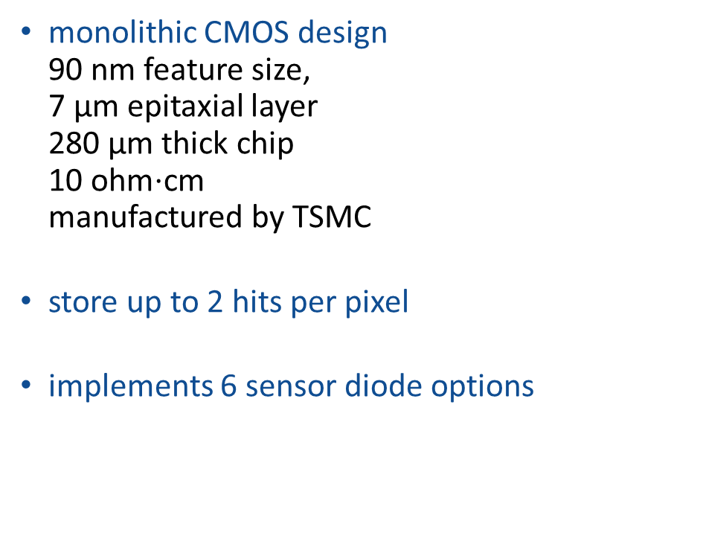
Chronopixel Prototype 3
monolithic CMOS design
90 nm feature size,
7 µm epitaxial layer
280 µm thick chip
10 ohm$⋅$cm
manufactured by TSMC
store up to 2 hits per pixel
implements 6 sensor diode options
Chronopixel
prototype 3
Chronopixel prototype 3 development board

Slide 8
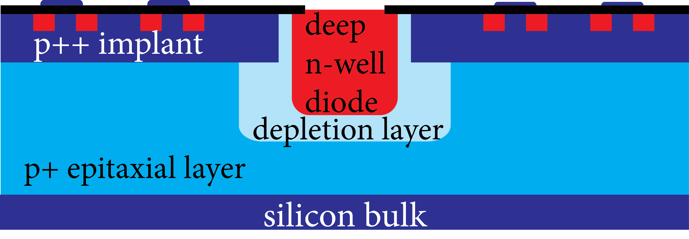
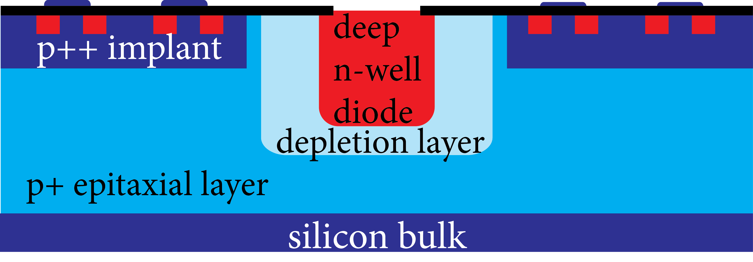
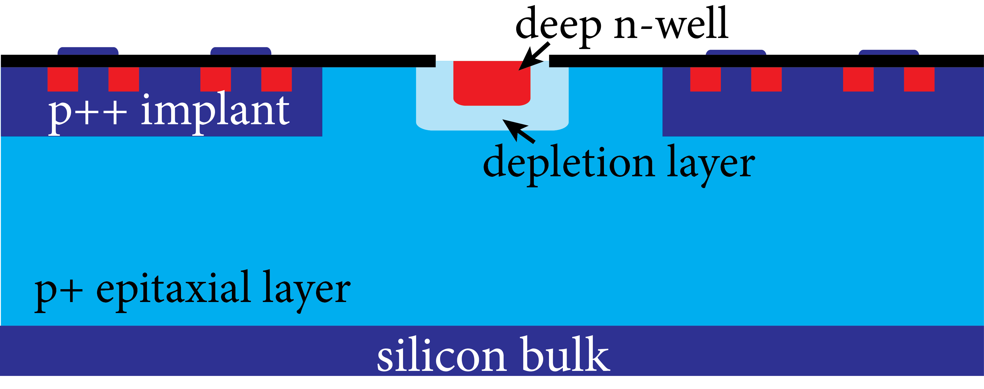
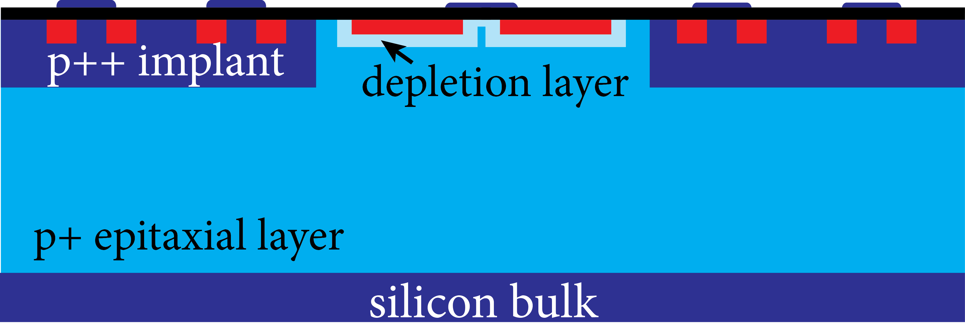
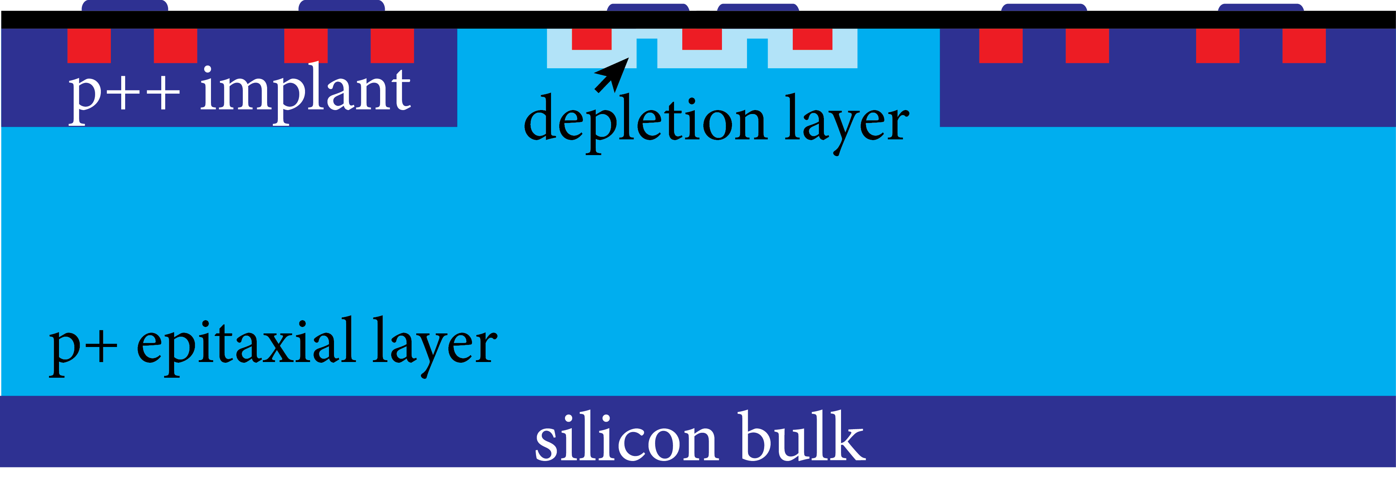
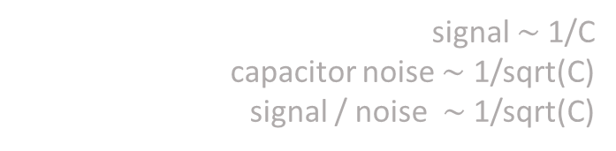
Sensor options in prototype 3
six different sensor options were implemented on the same chip – 8 columns for each option:
1
  same as in prototype 2 – for comparison similar capacitance to group 6
  deep NWELL diode in the window in P++ layer
  shallow NWELL diode, also in the window
  “Natural transistor” (NTN) in the P++ layer window
  transistor is formed directly on P+ epi layer
  large source and drain diffusion areas
  gate connected to both source and drain and form sensor output
  also NTN but with 2 fingers
  source and drain are narrow
  gate also connected to both, as in option 4
  same as 5, however gate is not connected to source and drain, but connected to external bias voltage
2
3
4
5&6
signal $\sim$1/C
capacitor noise $\sim$ 1/sqrt(C)
signal / noise $\sim$ 1/sqrt(C)

Slide 9

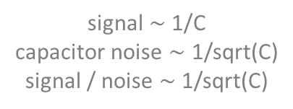
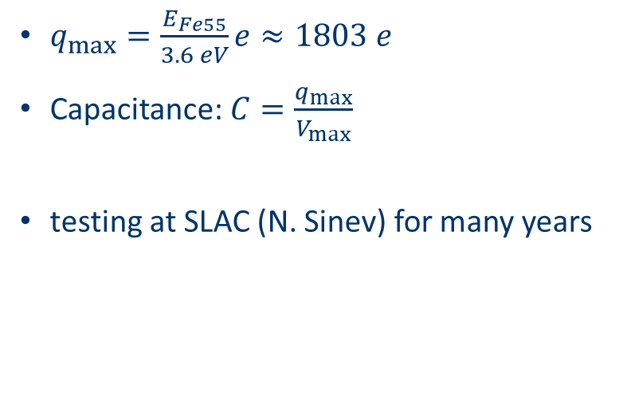
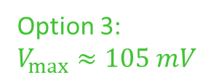
Capacitance measurements
$$E_{ Fe55}≈6.5 keV$$
$q_{max}=\frac{E_{Fe55}}{3.6 eV}e≈1803 e$
Capacitance: $C=\frac{q_{max}}{V_{max}}$
testing at SLAC (N. Sinev) for many years
diode option | Capacitance (fF) | μV/e
1 | 9.0 | 18
2 | 6.2 | 26
3 | 2.7 | 59
4 | 4.9 | 33
5 | 4.9 | 33
6 | 8.9 | 18
Option 3:
$V_{max}≈105 mV$
signal $\sim$1/C
capacitor noise $\sim$ 1/sqrt(C)
signal / noise $\sim$ 1/sqrt(C)

Slide 10
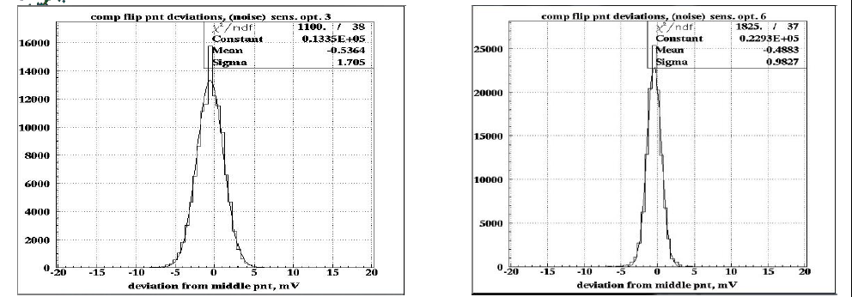
Noise measurements
Option # | Capacitance (fF) | Signal (μV/e) | Noise r.m.s (mV) | Noise r.m.s (# electrons)
1 | 9.0 | 18 | 1.12 | 63
2 | 6.2 | 26 | 1.08 | 42
3 | 2.7 | 59 | 1.7 | 29
4 | 4.9 | 33 | 1.21 | 37
5 | 4.9 | 33 | 1.23 | 38
6 | 8.9 | 18 | 0.98 | 54

Slide 11
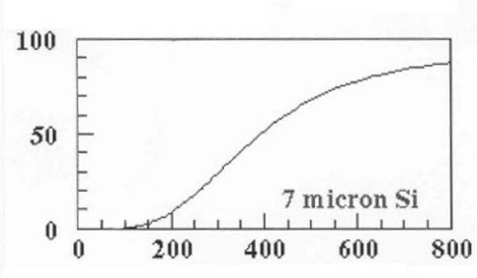
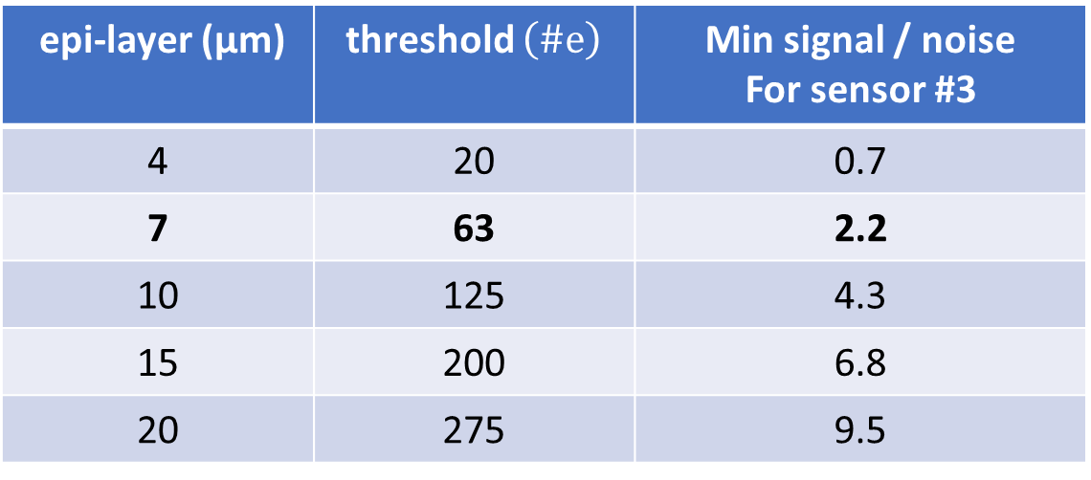
Noise and threshold considerations
1 GeV Pion, incident on Si, 7 µm
Number of electron-hole pairs in Silicon generated by minimum ionizing particle is a probability distribution
Set threshold at ½ of the 1st percentile of #electrons generated for 99% detection efficiency event if charge is shared between two pixels
cumulative probability
# conduction electrons produced
Sensor option 3:
signal 59mV/e
noise 29 e
epi-layer (μm) | threshold $\left(\#e\right)$ | Min signal / noise For sensor #3
4 | 20 | 0.7
7 | 63 | 2.2
10 | 125 | 4.3
15 | 200 | 6.8
20 | 275 | 9.5
prototype 3

Slide 12
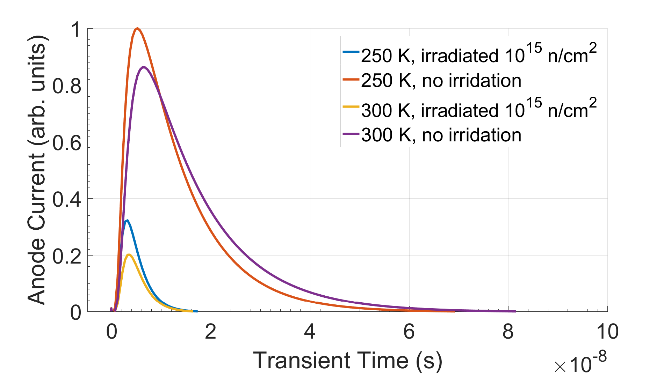
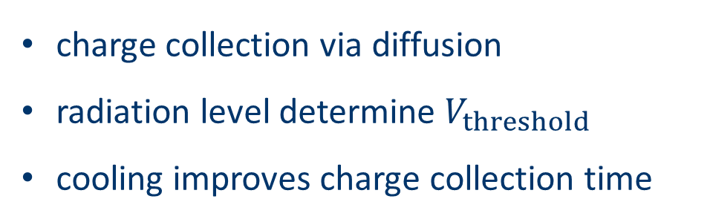
Charge collection speed simulations
Minimum ionizing particle at $t=0$, 1 V bias
charge collection via diffusion
radiation level determine $V_{threshold}$
cooling improves charge collection time
not irradiated
20 ns
`
irradiated to 10¹⁵ n_{eq}/cm²
Courtesy of G. Giacomini, BNL

Slide 13
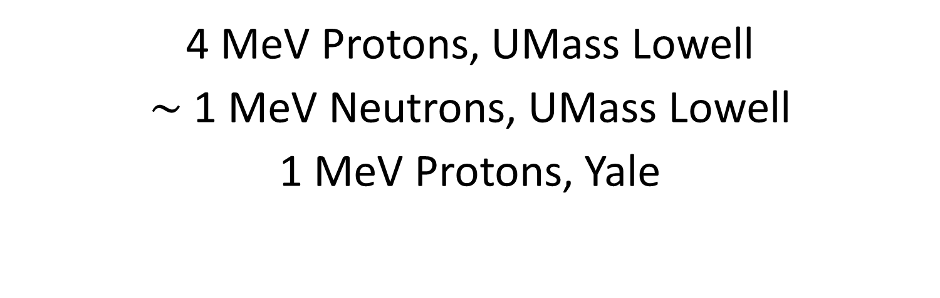
irradiation campaigns
4 MeV Protons, UMass Lowell
$\sim$ 1 MeV Neutrons, UMass Lowell
1 MeV Protons, Yale

Slide 14
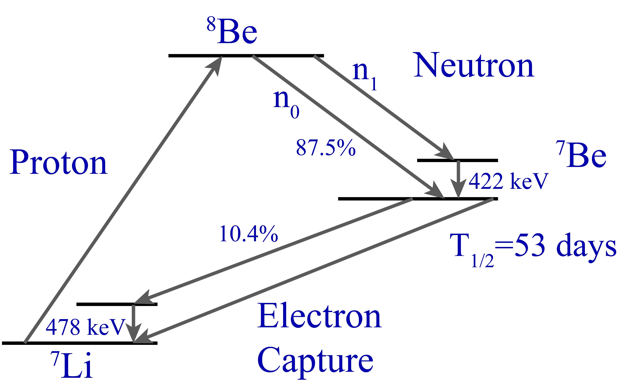
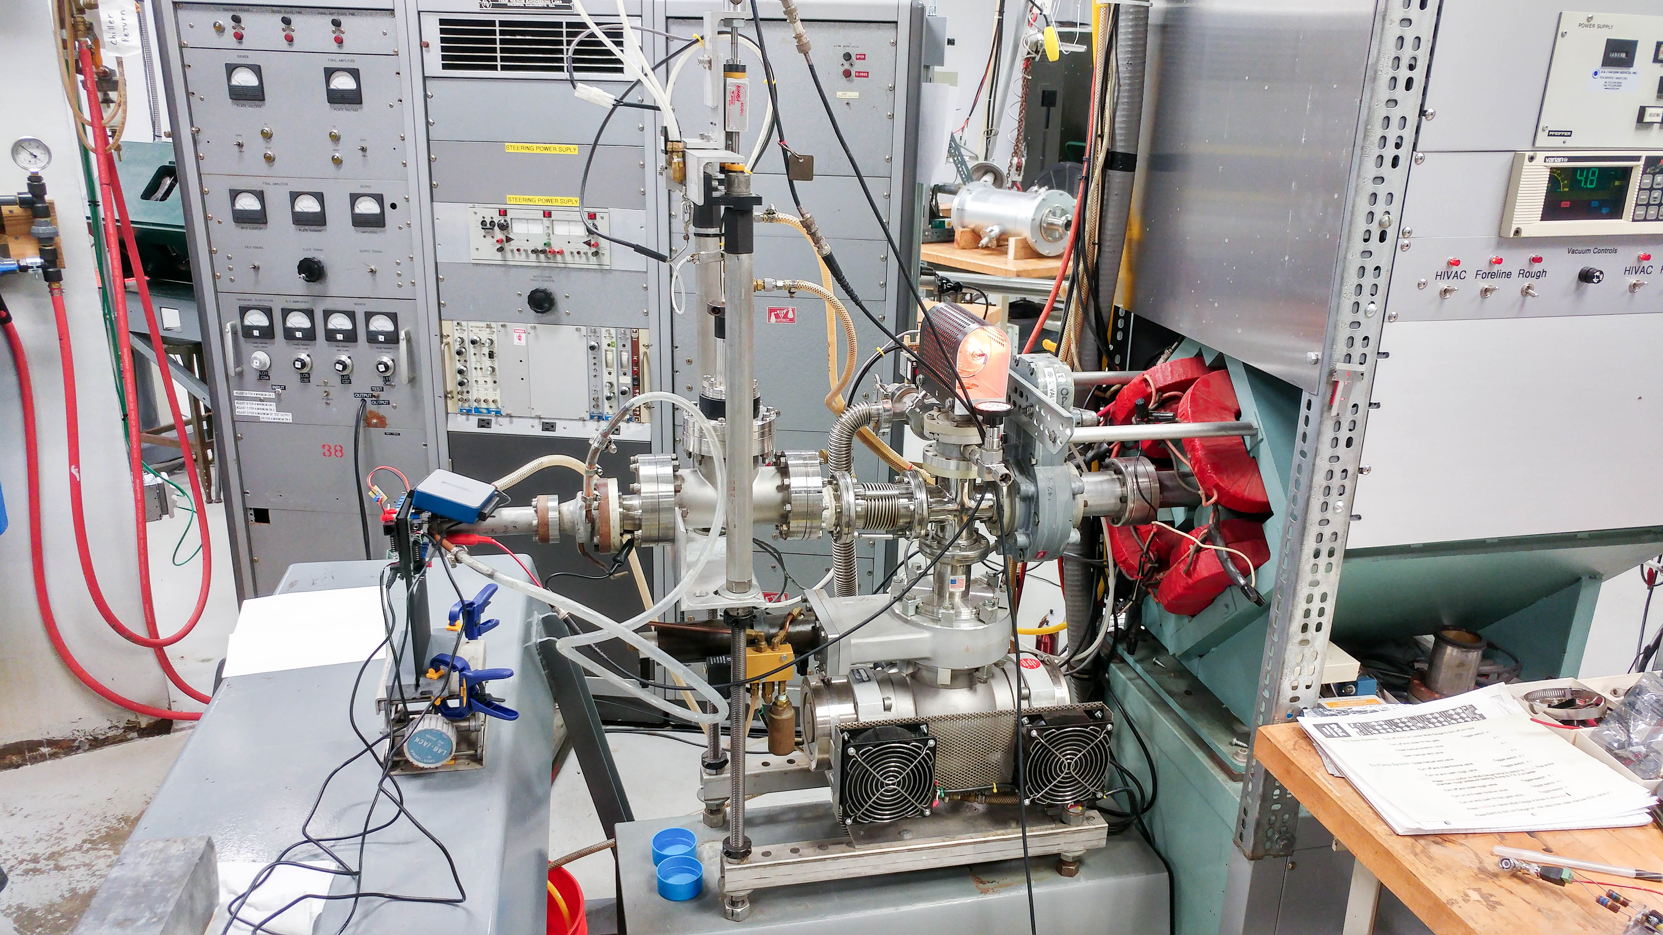
Neutron production
by bombarding ⁷Li with Protons
see G.H.R Kegel et al, IEEE TNS vol39, No6 (1992)
Neutrons
Protons, 4 MeV
Lithium target

Slide 15
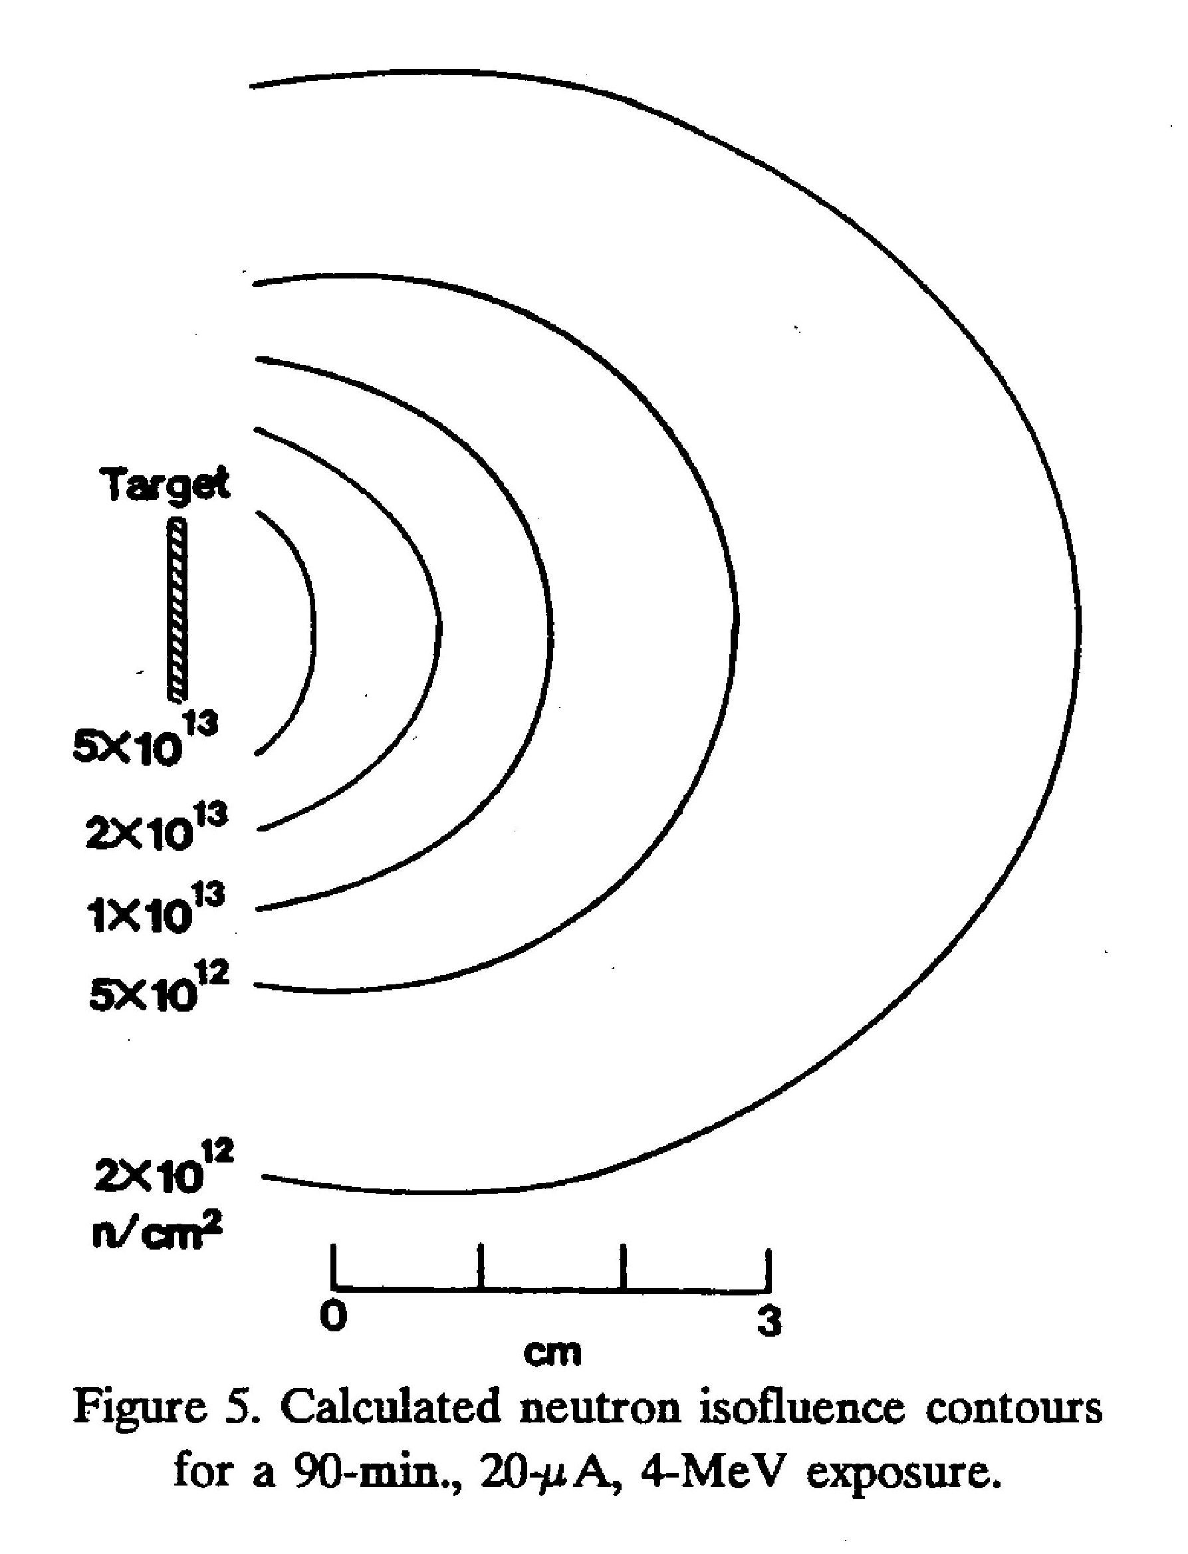
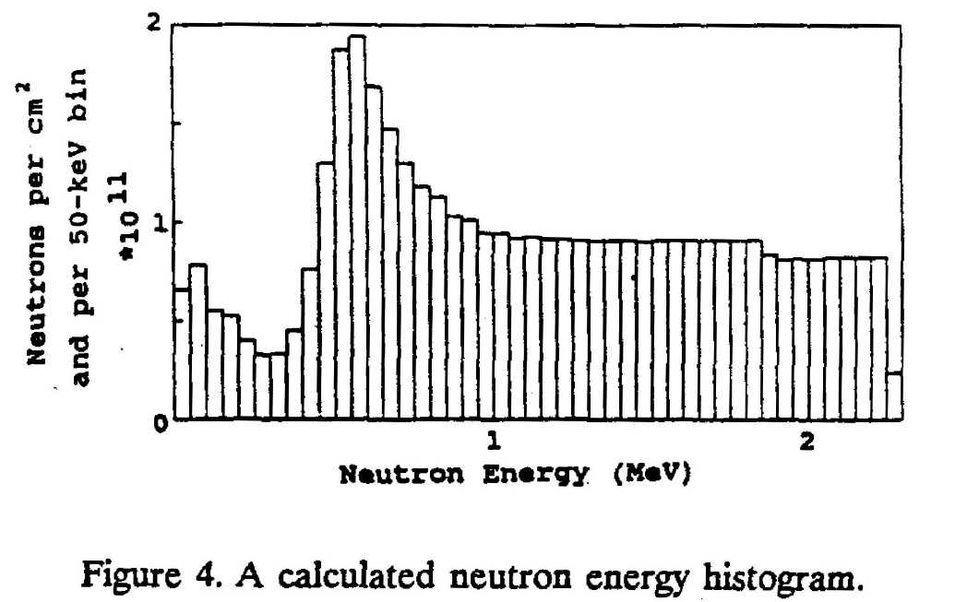
Neutron production
by bombarding ⁷Li with Protons
see G.H.R Kegel et al, IEEE TNS vol39, No6 (1992)
for 4 MeV protons

Slide 16
Neutron irradiation test
4 MeV proton incident on ⁷Li target to produce neutrons
proton beam current and neutron rate monitored during irradiation test
total number of neutrons created is eventually determined by radiation assay of target
Chronopixel still working after 10¹³ n_{eq}/cm²
see G.H.R Kegel et al, IEEE TNS vol39, No6 (1992)
Lithium target

Slide 17
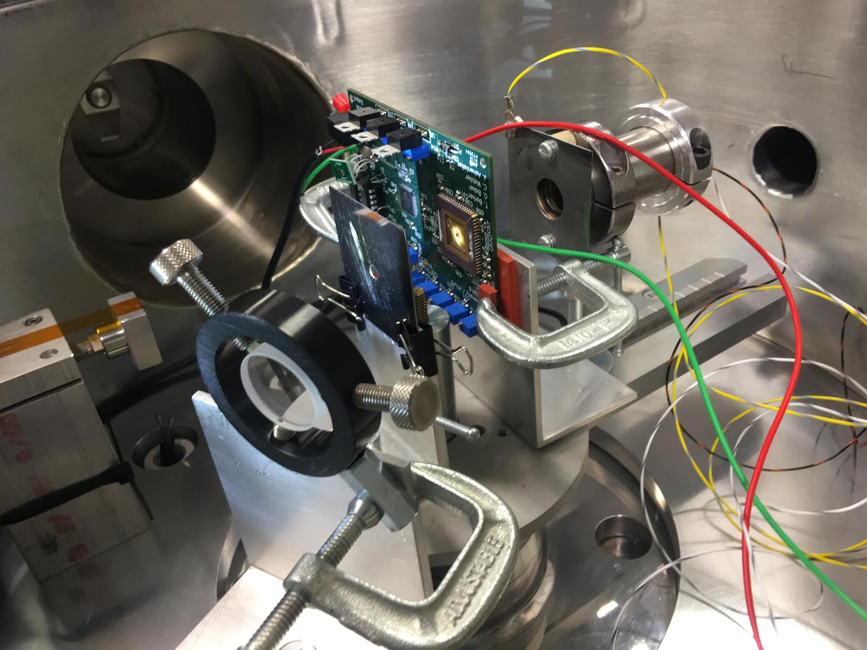
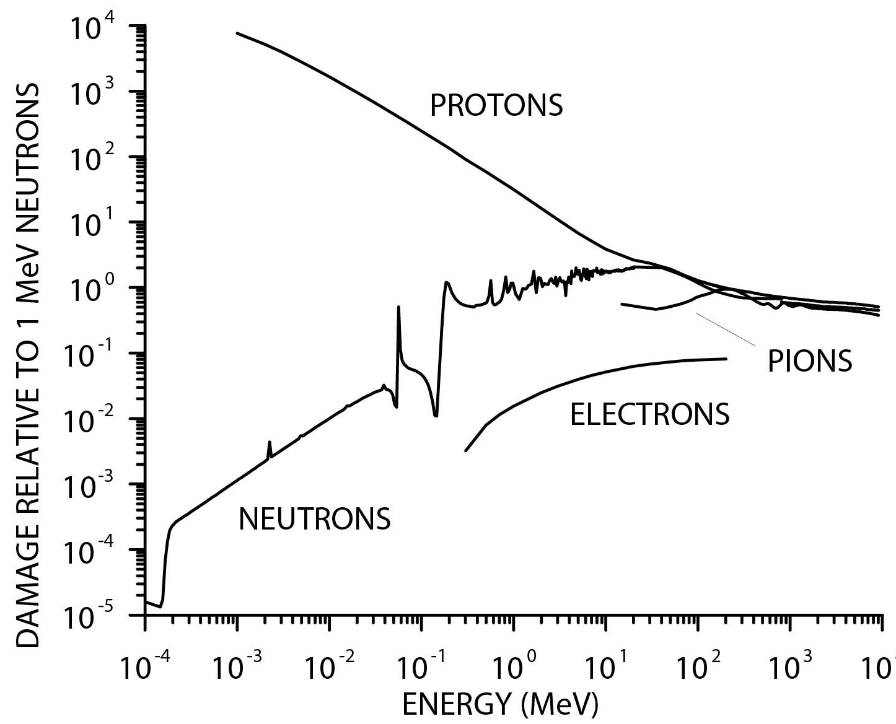
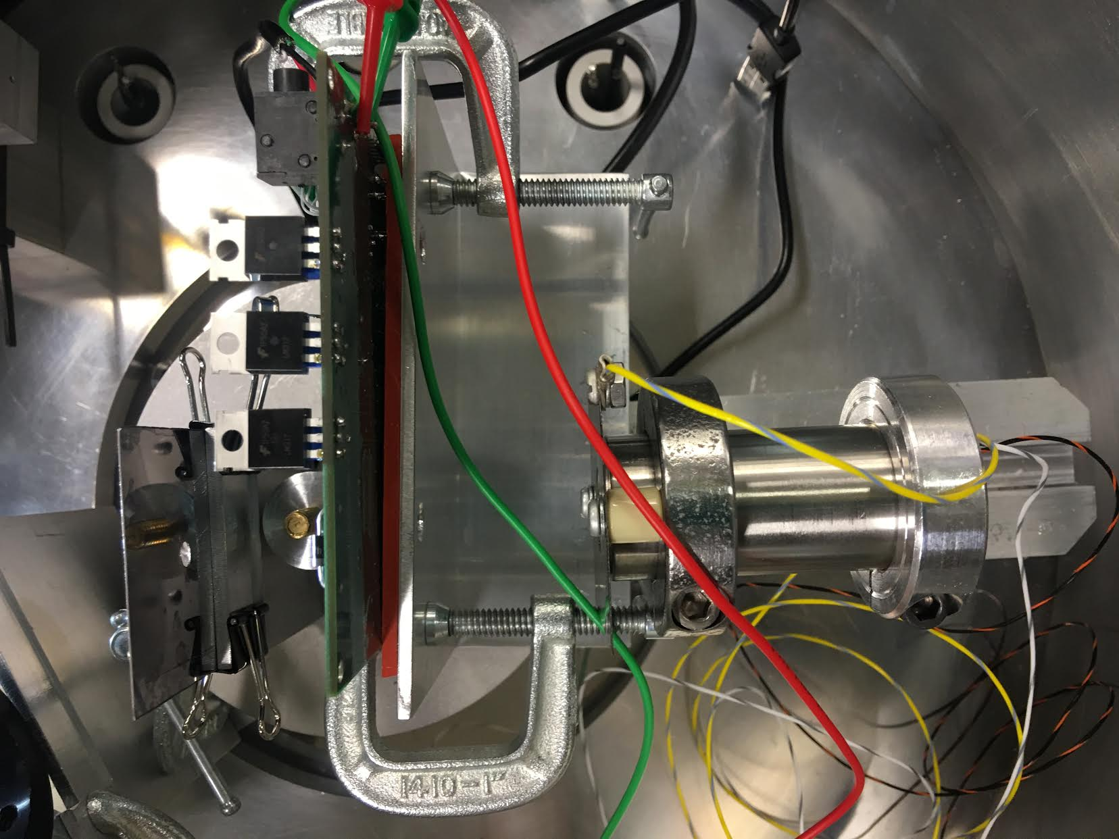
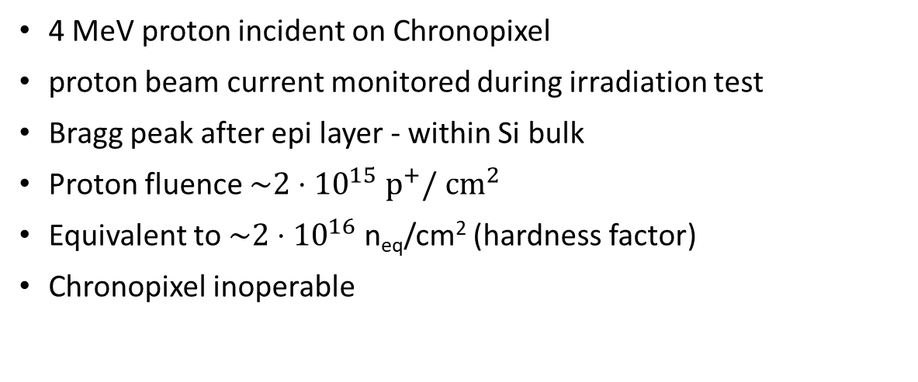
Proton irradiation test
4 MeV proton incident on Chronopixel
proton beam current monitored during irradiation test
Bragg peak after epi layer - within Si bulk
Proton fluence $\sim 2⋅{10}^{15} p^{+}/ {cm}^{2}$
Equivalent to $\sim 2⋅{10}^{16}$n_{eq}/cm² (hardness factor)
Chronopixel inoperable
‘hardness factor’
H. Spieler, Semiconductor Detector Systems Ch 7; Oxford University Press (2005)

Slide 18
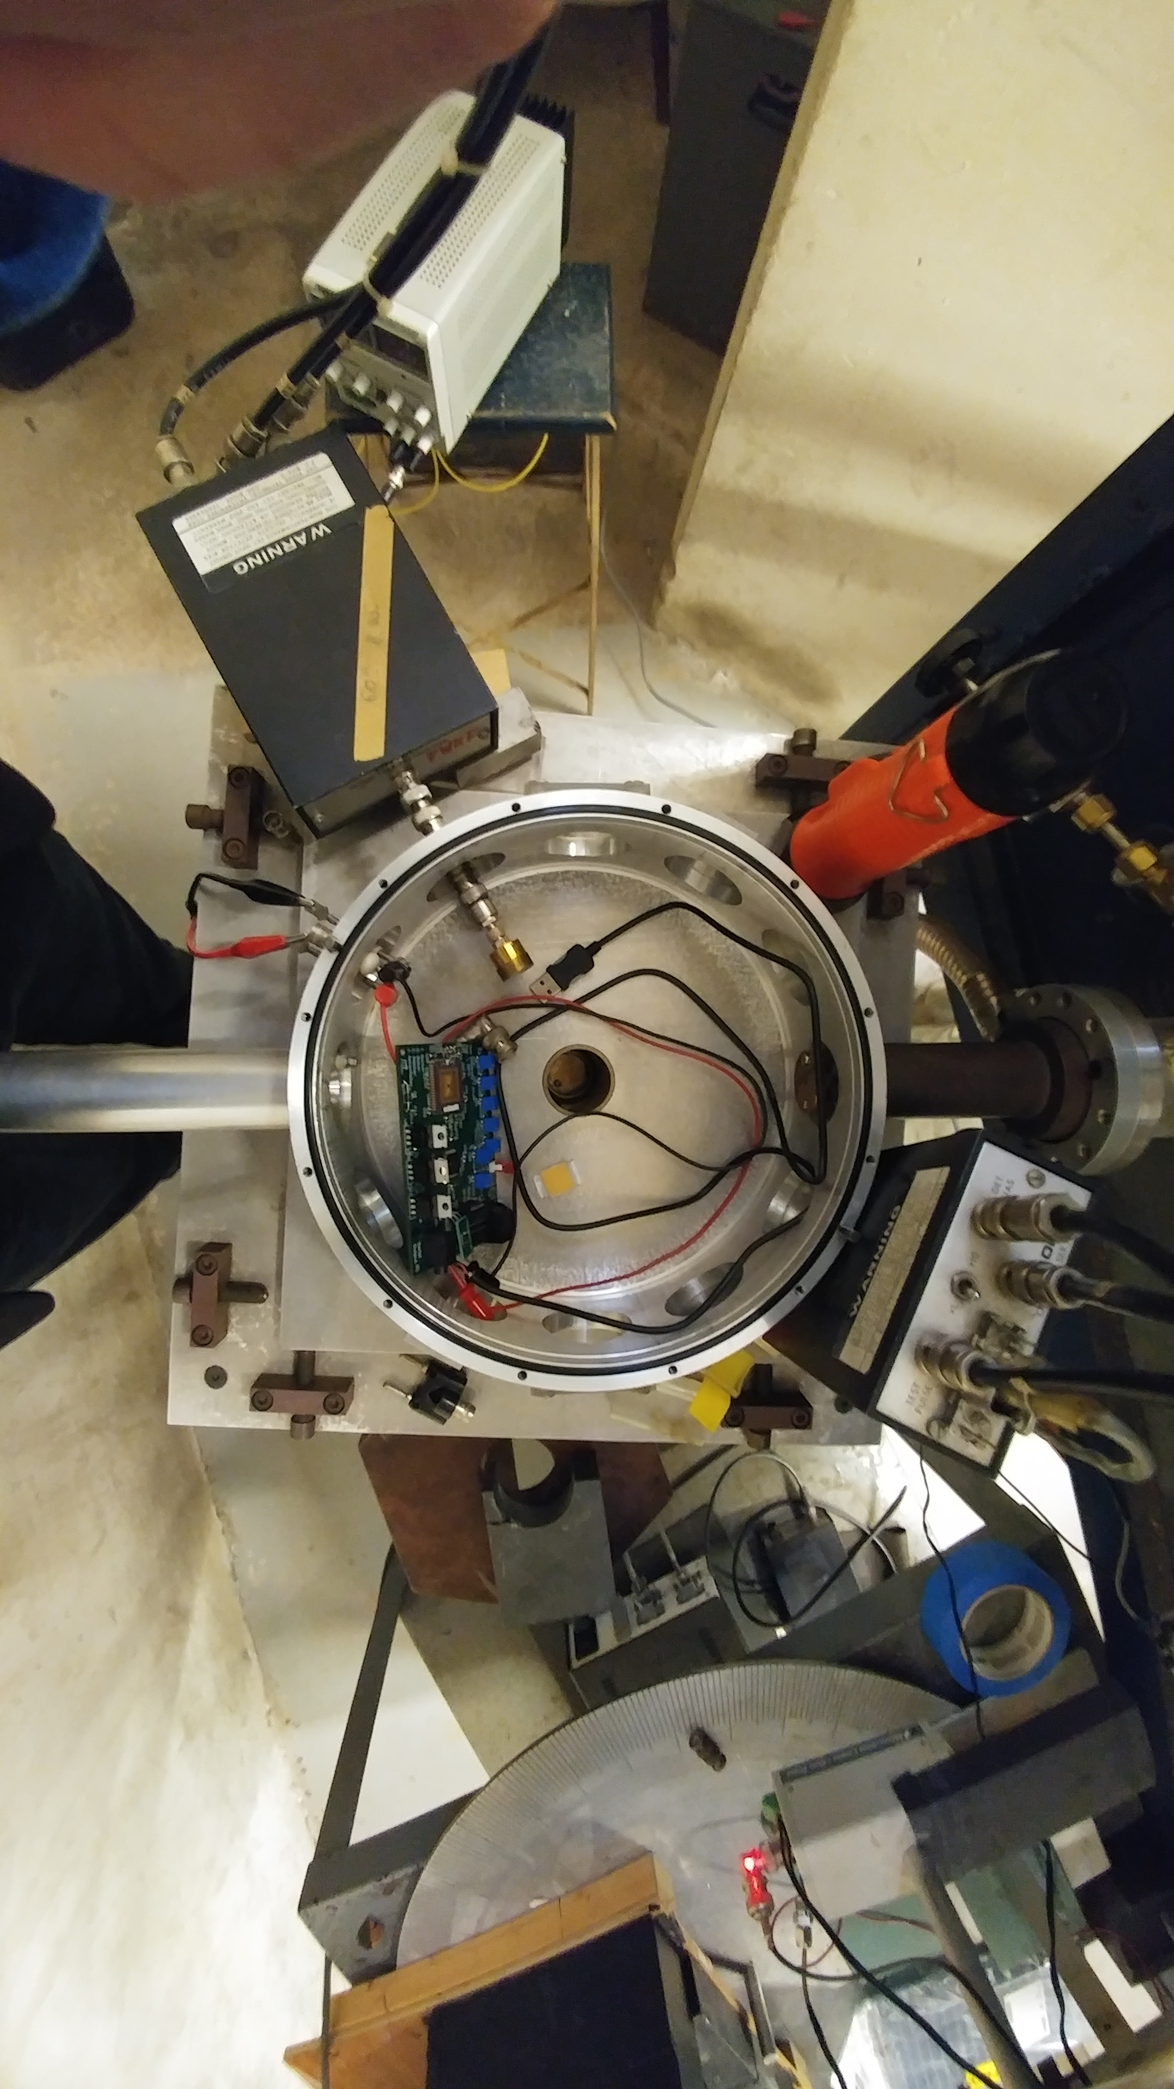
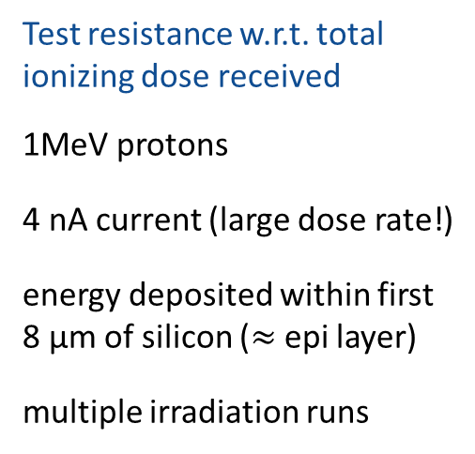
Total integrated dose test
Test resistance w.r.t. total ionizing dose received
1MeV protons
4 nA current (large dose rate!)
energy deposited within first 8 μm of silicon ($≈$ epi layer)
multiple irradiation runs
protons

Slide 19
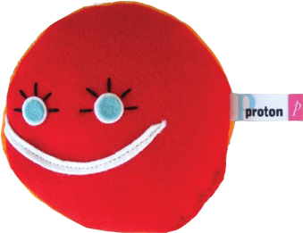
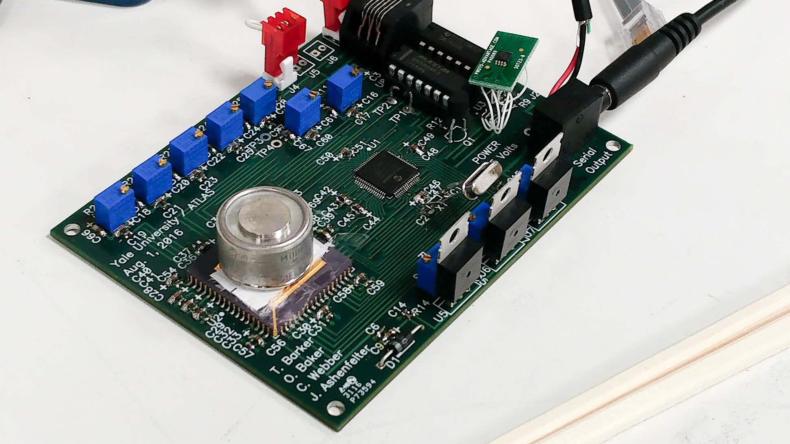
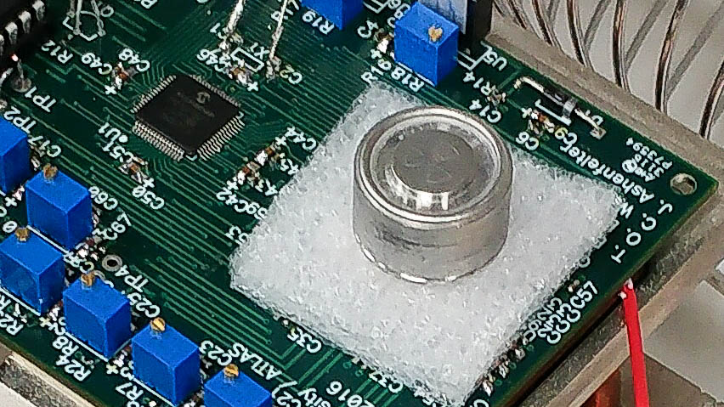
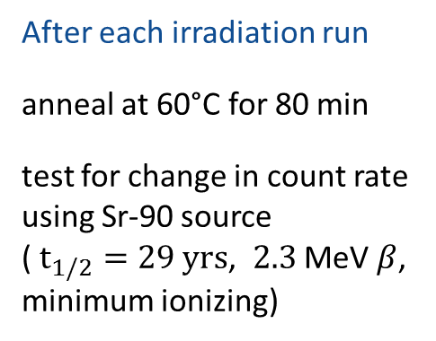
Total integrated dose test
Test resistance w.r.t. total ionizing dose received
1MeV protons
4 nA current (large dose rate!)
energy deposited within first 8 μm of silicon ($≈$ epi layer)
multiple irradiation runs
protons
After each irradiation run
anneal at 60°C for 80 min
test for change in count rate using Sr-90 source
( $t_{1/2}=29 yrs$, $2.3$ MeV $β$, minimum ionizing)

Slide 20
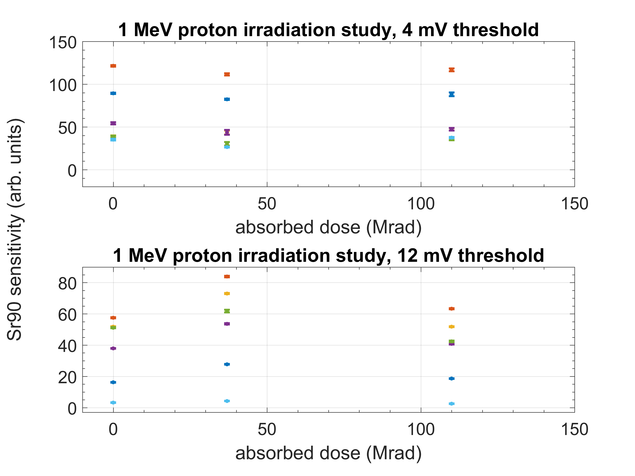
Irradiation results
sensor type 1 •
sensor type 2 •
sensor type 3 •
sensor type 4 •
sensor type 5 •
sensor type 6 •
ATLAS phase 2 pixel detector, outer layer
ATLAS phase 1 pixel detector, inner layer

Slide 21
ILC Chronopixel performance requirements
Parameter | ILC Requirement | Prototype Tests
Detector Sensitivity | 10 μV/electron | 59 μV/electron
Detector Noise | 25 electrons | 29 electrons
Comparator Accuracy | 0.2 mV RMS | 0.2 mV RMS
Sensor Capacitance | 10 fF | 2.7 fF
Clocking Speed | 3.3 MHz | 7.3 MHz
Charge collection time | 300 nsec | 20 nsec
Readout Rate | 25 Mbits/sec | 25 Mbits/sec
Power Consumption | 0.13 mW/mm² | OK by estimate
Radiation Hardness | 10¹¹ neutrons/cm²/yr | 10¹³neutrons/cm² or 110 Mrad

Slide 22
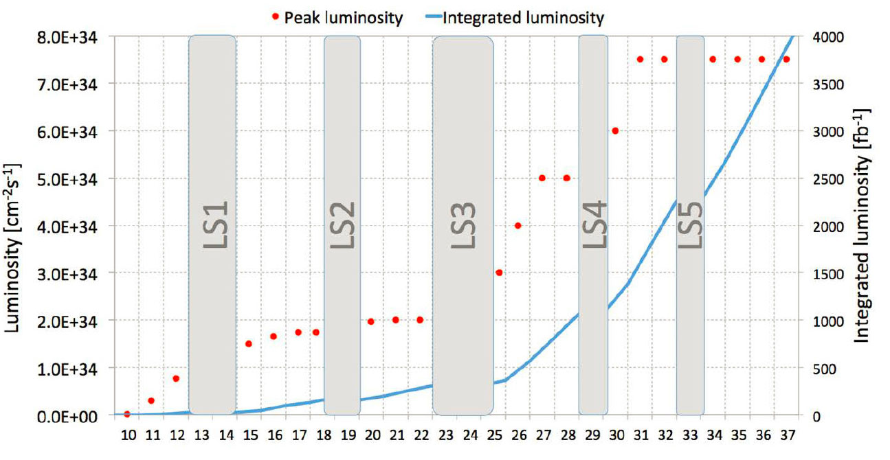
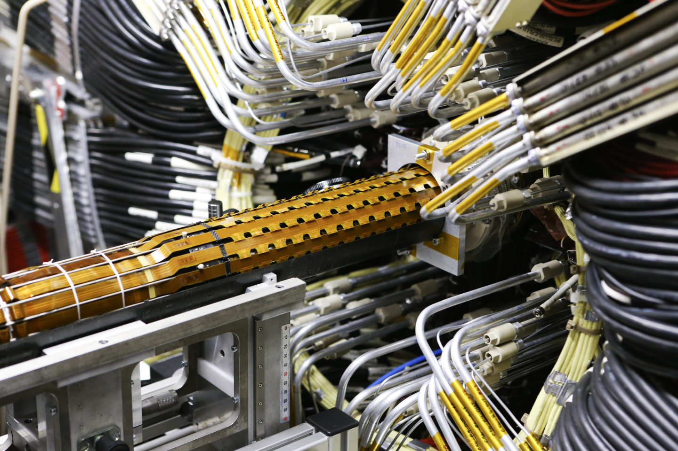
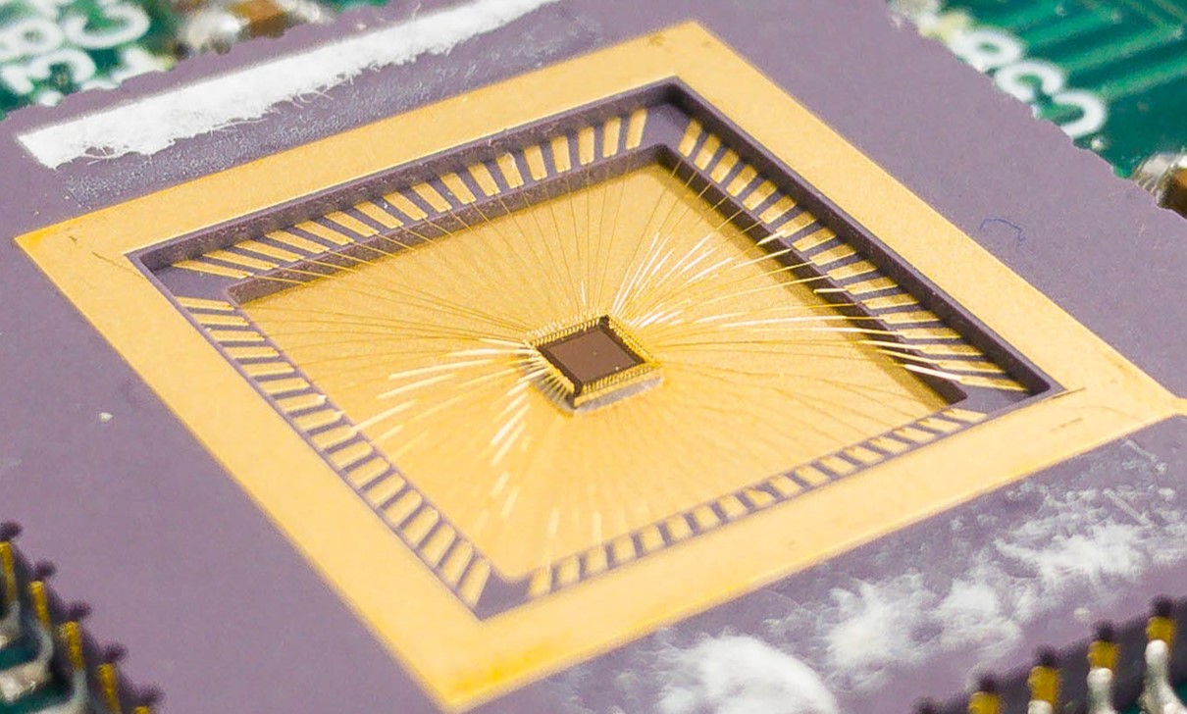
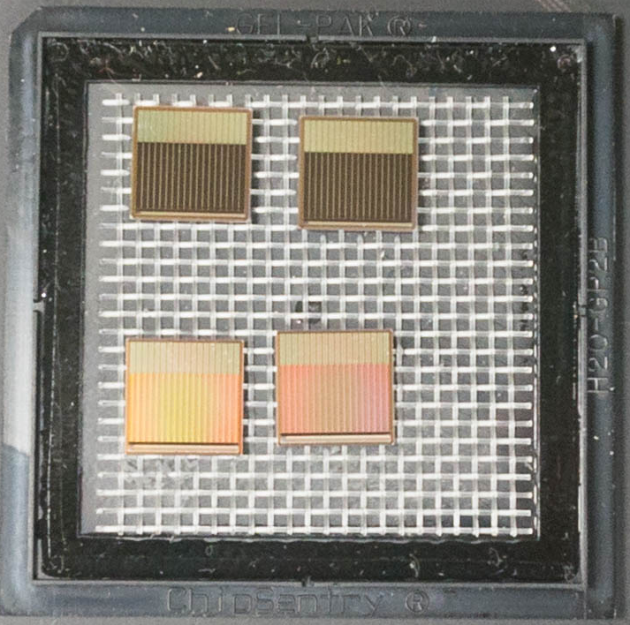
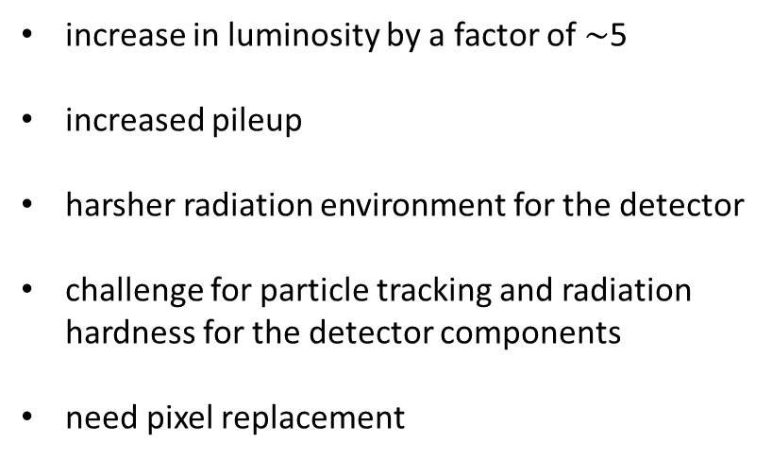
High-Luminosity LHC
increase in luminosity by a factor of $\sim$5
increased pileup
harsher radiation environment for the detector
challenge for particle tracking and radiation hardness for the detector components
need pixel replacement
HL-LHC
ATLAS phase 2
Options:
3D sensors
Planar sensors
CMOS
M. Lamont @ Recontre workshop, Vietnam
Insertable B-Layer
Chronopixel
LF CPIX

Slide 23





Timing: ILC, HL-LHC, and Chronopixel
ILC bunch trains
HL-LHC: continuous set of bunches
Chronopixel powered down
$\sim$198 ms
continuously operating
200 ms
Set threshold / calibrate comparator
Information stored in capacitors
$\sim 0.1$ ms, lasts for $\sim 1$ ms
1312 bunches
0.7 ms
Clear memory
$few, O(1)$ μs
time (ms)
time (ms)
HL-LHC bunches
ILC bunches
Increment timestamp
Latch timestamp if hit
$\sim 0.14$ μs
25 ns
554 ns
Read out pixels
$\sim 4$ μs per timestamp
time (μs)
time (μs)
+ Read out all data after each bunch train
+ Store data for 0.012 ms, read out only on ‘trigger’

Slide 24


Pixel bandwidth
ATLAS sensor module size 40.3 mm x 33.9 mm
@25µm pixel pitch: 1612 x 1356 pixels
(may stitch 4 smaller modules)
Want to keep up with at least 99.9% of events.
So need to transfer at least 9 hits out of column within 1 µs
9 hits each at
9 bit timestamp
11 bit column id
11 bit row id
Bandwidth: 9*31 bit / 1 µs $≈$ 280 Mbit / s per column
Similar for out of module bandwidth
On average 29 hits per module
Bandwidth: 29*31 bit / 1 µs $≈$ 900 Mbit / s per module

Slide 25


Radiation Hardness
Increase in luminosity at LHC will cause an increase in pile up from $\left\langle μ\right\rangle =\sim 40$ now to $\left\langle μ\right\rangle =\sim 200$.
Increased radiation hardness requirements for detector components
Radiation hardness requirements for pixel layers in ATLAS:
 | ATLAS LHC | ATLAS HL-LHC
 |  | Outer ($\text{r}>10$cm) | Inner ($\text{r}=3.3$cm)
NIEL (n_{eq} /cm²) | $$2⋅{10}^{15}$$ | $${10}^{15}$$ | $$2⋅{10}^{16}$$
Ionizing dose (Mrad) | $$80$$ | $$50$$ | $$>500$$
1 Gy = 100 rad
Notes:
Radiation hardness is under investigation
Present studies related to the hardness w.r.t. the total ionizing dose
But first let me talk about the properties of our Chronopixel

Slide 26
Chronopixel Performance Requirements
Parameter | ILC Requirement | HL-LHC Requirement | Prototype Tests
Detector Sensitivity | 10 μV/electron | 10 μV/electron | 59 μV/electron
Detector Noise | 25 electrons | 25 electrons | 29 electrons
Comparator Accuracy | 0.2 mV RMS | 0.2 mV RMS | 0.2 mV RMS
Sensor Capacitance | 10 fF | 10 fF | 2.7 fF
Clocking Speed | 3.3 MHz | >40 MHz | 7.3 MHz
Charge Collection Time | 300 nsec | 25 nsec | 20 nsec(simul)
Read Out Rate | 25 Mbits/sec | 1000 Mbits/sec | 25 Mbits/sec
Power Consumption | 13 mW/mm² * 1% duty cycle | ~10 mW/mm²* 100% duty cycle | OK by estimate
Radiation Hardness | 10¹¹ n/cm²/year | 10¹⁴n/cm²/year | 10¹³n/cm²
Readout Logic | All Hit Pixels | Hits w/t=t(trigger)
Notes:
I changed here the LHC readout rate requirement, added the LHC Power requirements, and changed the ILC requirement to make it comparable to the LHC one

Slide 27
Conclusion
working Monolithic Active Pixel Sensor
satisfies ILC requirements in general
Next up
beam tests to measure in time efficiency
Collaborators:
Jeff Ashenfelter – Yale (staff)
Keith Baker – Yale (faculty)
Charlie Baltay – Yale (faculty)
Tom Barker – Tomtronics (CEO) / Yale (staff)
Jim Brau – Oregon (faculty)
Nick Sinev – Oregon (staff)
David Strom – Oregon (faculty)
Christian Weber – Yale (grad student)

Slide 28

Backup

Slide 29




ATLAS (pixel) detector
ATLAS detector
Inner Tracker
Pixel Module
close to interaction point (radius Layer 0 : 5cm)
exposed to largest particle fluence and large radiation dose
accrues radiation damage over time
Pixel Detector
Notes:
ATLAS detector – number of sub systems
Among them: Inner tracker – aiding in track building
Innermost part: Pixel Detector
Made up of large number of pixel modules’
Accrue radiation damage over time -> finite lifespan at given luminosity, however Luminosity is set to increase

Slide 30


Charge collection speedup
Improve charge collection speed by increasing depletion region
  need high resistivity silicon (up to $\sim$10 kOhm cm)
Charge collection still partially by diffusion
Could improve resolution
  If charge spreads to adjacent pixels, not originating from below sensor diode
3D Simulations under way to study these effects (Nick Sinev)
y (µm)
x (µm)

Slide 31

electronics logic schematic
Each pixel has electronics to detect charged particle hit and to record the time (time stamp) of each hit.
electronics logic schematic – prototype 3

